Slide 1
TU 122 LAW IN EVERYDAY LIFE
Kongsatja Suwanapech

Slide 2
Criminal Offences

Slide 3
Types of Offences
Compoundable offences
Non-compoundable offences

Slide 4
1. Offences Relating to
Documents
Section 264 Any person, who is in a manner likely to cause injury to another person or the public, fabricates a false documents or part of a document, or adds to, takes from or otherwise alter a genuine document by any means whatsoever, or puts a false seal or signature to a document, if it is committed in order to make any person believe that it is a genuine document, then such a person is said to forge a document, and shall be sentenced to imprisonment for a term not exceeding 3 years or a fine not exceeding 60,000 baht, or both. (Falsification of Documents)

Slide 5
1. Offences Relating to
Documents
Section 264 Any person, who is in a manner likely to cause injury to another person or the public,
1.) fabricates a false documents or part of a document
2.) adds to, takes from or otherwise alter a genuine document by any means whatsoever
puts a false seal or signature to a document
if it is committed in order to make any person believe that it is a genuine document
such a person is said to forge a document,

Slide 6
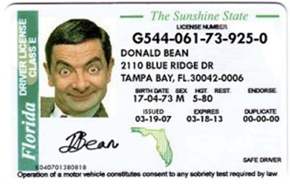
1. Offences Relating to
Documents

Slide 7
1. Offences Relating to
Documents
Example 1: Mr Bean’s driving license was expired. Mr Bean falsified a new driving license.
Example 2: Mr Bean altered his genuine license by changing ID photo from his to A’s photo.
Example 3: Mr Bean’s driving license was expired. Mr Bean falsified a new driving license by using a wooden card.

Slide 8
1. Offences Relating to
Documents
Example 4: B’s falsified A’s signature in an unsigned document written by A. The document authorises B to sell A’s car.
If A authorised B to sign “A’s signature”, would the answer be the same?

Slide 9
1. Offences Relating to
Documents
Section 267
Whoever, notifying the official doing oneself's duty to make any false entry in the public or official document for the aims to be used as evidence, shall be imprisoned not not exceeding three years or fined not exceeding sixty thousand baht, or both. (Giving Fault Information to the Official)

Slide 10
1. Offences Relating to
Documents
Section 267
Whoever,
notifying the official doing oneself's duty
to make any false entry in the public or official document for the aims to be used as evidence,
shall be imprisoned…

Slide 11
2. Offences Against
Property
Theft
Snatching
Robbery
Gang-robbery
Misappropriation or Embezzlement
Extortion
Blackmail

Slide 12
2. Offences Against
Property
Section 334 Whoever, dishonestly taking away the thing of other person or which another person co-owns is said to commit theft. He shall be imprisoned not exceeding three years and fined not exceeding sixty thousand baht. [Theft]

Slide 13
2. Offences Against
Property
Section 334
Whoever
dishonestly
taking away
the thing of other person or which another person co-owns
is said to commit theft…

Slide 14
2. Offences Against
Property
Example 1: A owned a pen. B took A’s pen from A’s bag without A’s permission.
Example 2: C owned a car. D took C’s car and drove around Bangkok. At the end, D returned the car to C.
Example 3: E, a friend of F, took a cigarette from F’s pocket.

Slide 15
2. Offences Against
Property
Section 336 Whoever, commits theft by snatching in presence is said to commit snatching, and shall be punished with imprisonment not exceeding five years and fined not exceeding one hundred thousand baht. [Snatching]

Slide 16
2. Offences Against
Property
Section 336
Whoever
commits theft by snatching in presence
is said to commit snatching

Slide 17

2. Offences Against
Property
Example: George entered an antique shop. He was pretending to look for goods. When the owner was turning back, George seized a chance and suddenly grabbed a teacup from the shop.

Slide 18
2. Offences Against
Property
Section 352 A person with possession of another’s property or property co-owned by another dishonestly takes that property. He shall be sentenced to jail not exceeding three years and/or fined not exceeding sixty thousand baht. [Misappropriation or Embezzlement]

Slide 19
2. Offences Against
Property
Section 352
A person
with possession of another’s property or property co-owned by another
dishonestly takes that property.
He shall be sentenced to jail…
[Misappropriation or Embezzlement]

Slide 20
2. Offences Against
Property
Difference between Theft and Misappropriation
Example 1: Songtham entered Thammasat Library and stole a book from the library’s shelf.
Example 2: Songtham entered Thammasat Library and borrowed a book from the library’s shelf. At the end, Songtham never returned that book and claim it for himself.

Slide 21
2. Offences Against
Property
Section 339 Whoever, commits theft by doing any act of violence or threatening to do any act of violence immediately in order:
(1) To facilitate the theft or taking away of the thing;
(2) To obtain delivery of the thing;
(3) To take hole of the thing;
(4) To conceal the commission of such offence; or
(5) To escape from arrest, is said to commit robbery, and shall be punished with imprisonment of five to ten years and fined of one hundred thousand to two hundred thousand baht. [Robbery]

Slide 22
2. Offences Against
Property
Example1: A took B’s necklace and pushed B to facilitate his robbery.
Example 2: A gave B tranquilizer and took B’s necklace while B was sleeping.
Example 3: A took B’s necklace. B was pursuing fro his property. A threatened to kill B unless B stops following.

Slide 23
2. Offences Against
Property
Section 337
Whoever compels a person to give or to agree to give him or another person a benefit in the nature of being a property by committing an act of violence or by a threat to commit violence against the life, body, liberty, reputation or property of the compelled person or a third person, so that the compelled person submits to the same is said to commit extortion, and shall be punished with imprisonment not exceeding five years and fined not exceeding one hundred thousand baht. [extortion]

Slide 24
2. Offences Against
Property
Section 337
Whoever
compels a person to give or to agree to give him or another person
by committing an act of violence or by a threat to commit violence against the life, body, liberty, reputation or property of the compelled person or a third person
a benefit in the nature of being a property, so that the compelled person submits to the same is said to commit extortion

Slide 25
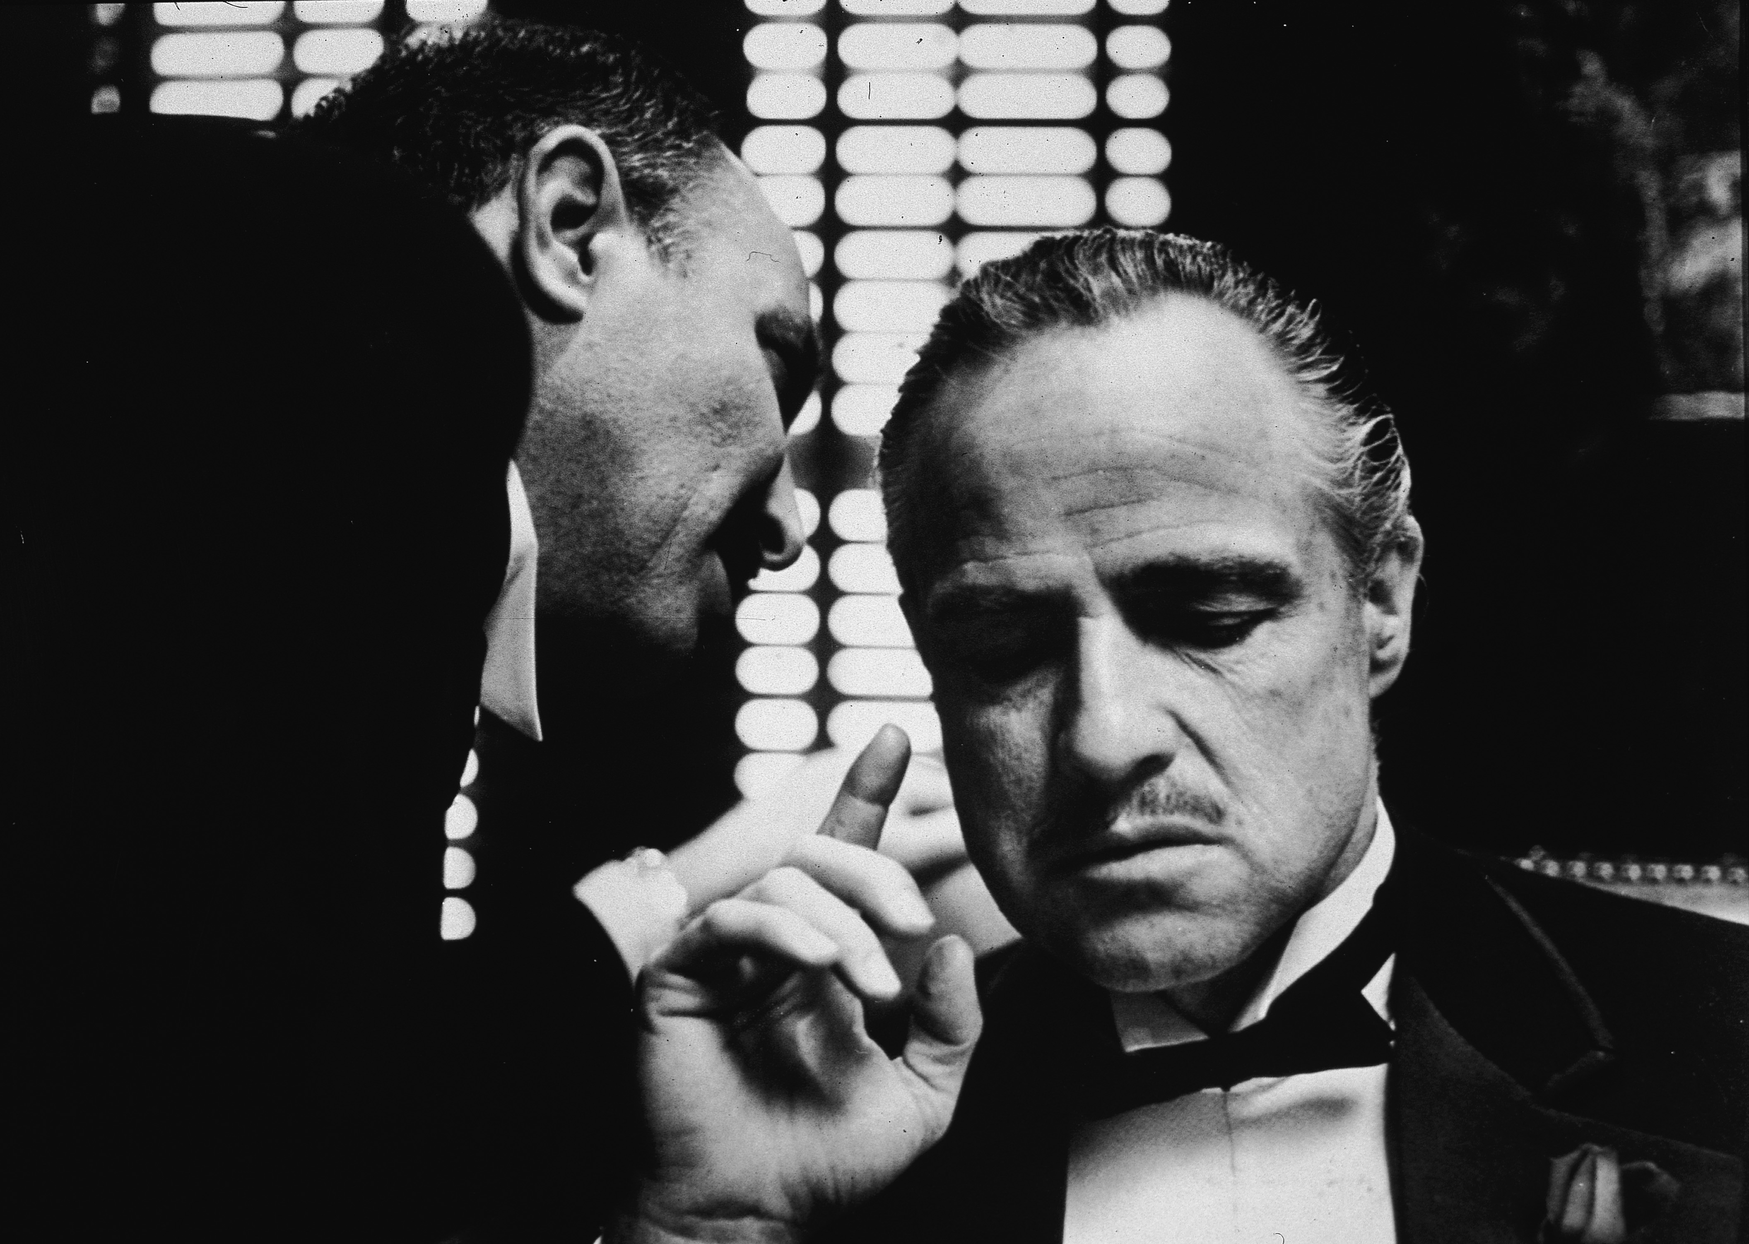
2. Offences Against
Property

Slide 26
2. Offences Against
Property
Example1: Michael compelled Frederick to sign a contract to give Frederick’s property to Michael’s Boss by threatening to burn Frederick’s house.
Example2: John compelled George to ‘dance’ by threatening to burn Frederick’s house.

Slide 27
2. Offences Against
Property
Section 338 Whoever, compelling the other person to give or to agree to give oneself or another person the benefit in the nature to be the property by threatening to disclose the secret, to cause injury to the compelled person or the third person, up to the compelled person submit to the same, such person to be said to commit blackmail, and shall be imprisoned as from one year to ten years and fined as from twenty thousand baht to two hundred thousand baht. [Blackmail]

Slide 28
2. Offences Against
Property
Section 338
Whoever
compelling the other person to give or to agree to give oneself or another person the benefit in the nature to be the property
by threatening to disclose the secret, to cause injury to the compelled person or the third person, up to the compelled person submit to the same, such person to be said to commit blackmail

Slide 29
2. Offences Against
Property
Section 338
Whoever
compelling the other person to give or to agree to give oneself or another person the benefit in the nature to be the property
by threatening to disclose the secret, to cause injury to the compelled person or the third person, up to the compelled person submit to the same, such person to be said to commit blackmail

Slide 30
2. Offences Against
Property
Difference between extortion and blackmail
Example1: Tod compelled Busaba to give Tod some money by exploiting her business reputation.
Example 2: Tod compelled Busaba to give Tod some money by disclosing Busaba’s commercial secret.

