Slide 1

MK 326 Group Assignment 10:
Chapter 8
Topic: Adaptation of International Products/services
Each group is to prepare a one slide presentation.
Successful products/services from your project country being adapted in Thailand ( 1) and another country (1)
Failures of products / services from your project country being adapted in Thailand (1) and another country (1)
Please explain the reasons of each success and failure
Please refer to the text of Chapter 8. Please be specific on the brand and rationale as possible. You may use graphs, visuals and examples to illustrate your point across to me.
Due next week , April 7 for discussion
Notes:
1

Slide 2
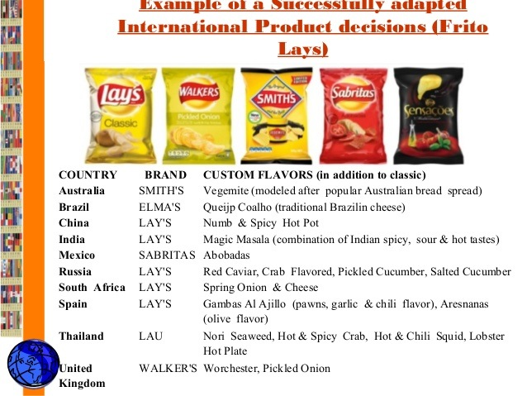

Slide 3
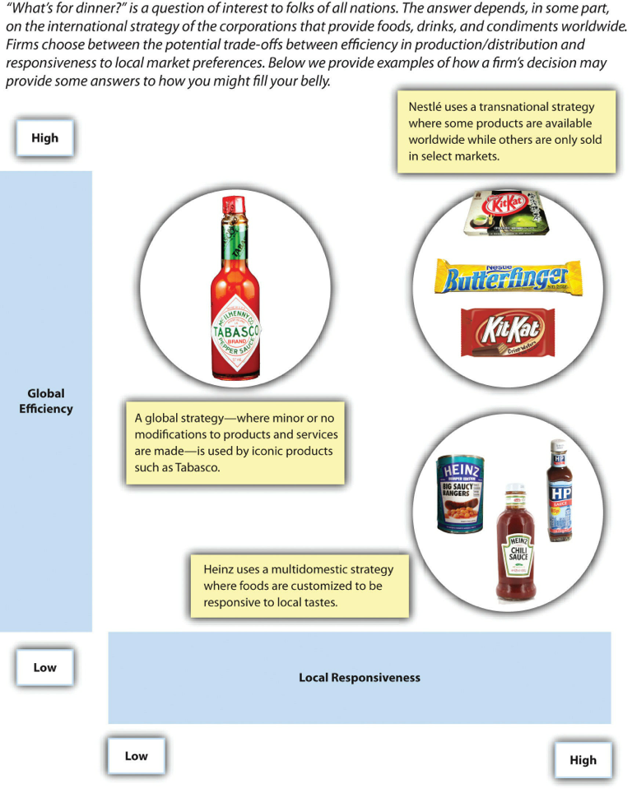

Slide 4

Think Global…Act Local

