Slide 1
Costs and
Cost Minimization

Slide 2
Explicit Costs and Implicit Costs
Explicit Costs:
Costs that involve a direct monetary outlay.
Implicit Costs:
Costs that do not involve outlays of cash.

Slide 3
Economic Costs and Accounting Costs
The relevant concept of cost is opportunity cost: the value of the next best forgone alternative.
Economic Costs: Sum of a firm’s explicit costs and implicit Costs, which is the same as “opportunity cost”
Accounting Costs: Total of a firm’s explicit costs

Slide 4
Opportunity Cost – Example
Suppose you own a business:
You pay $100,000/year to hire workers and $80,000/year to purchase supplies. You work X hrs/year.
Next Best Alternative:
You work X hrs in a company which pays $100,000 per year.
Opportunity Cost of continuing your own business
= Explicit Costs + Implicit Costs
= 180,000 + 100,000 = $280,000

Slide 5
Sunk Costs
Sunk Costs are costs that have been incurred and cannot be recovered. These costs are not part of opportunity costs.
Non-Sunk Costs are costs that are incurred only if a particular decision is made.
Example: Bowling Ball Factory
It costs $5M to build and has no alternative uses
$5M is not sunk cost for the decision of whether or not to build the factory
$5M is sunk cost for the decision of whether to operate or shut down the factory

Slide 6
Cost Minimization
Cost minimization problem: Finding the input combination that minimizes a firm’s total cost of producing a particular level of output.
Cost minimization firm: A firm that seeks to minimize the cost of producing a given amount of output.
Long run (LR): A period of time when the quantities of all of the firm’s input can vary.
Short run (SR): A period of time when at least one of its inputs’ quantities is fixed.

Slide 7
Long-Run Cost Minimization
In SR, a firm chooses ONE input, L, with K being fixed.
In LR, a firm chooses TWO inputs, K and L, to minimize its costs, subject to the firm producing a given output.
Cost to the Firm:
TC: Total Cost
w: Price of Labor (wage rate)
L: Quantity of Labor
r: Price of Capital (interest rate)
K: Quantity of Capital

Slide 8
Isocost Lines
Isocost Line: The set of combinations of labor and capital that yield the same total cost for the firm.
Isocost Equation:
TC = wL + rK
rK = TC – wL
K = TC/r – (w/r)L
Isocost Slope
= – (w/r)
Example
w = $10/hour
r = $20/hour
TC = $1M
1M = 10L + 20K
K = 1 mil/20 – (10/20)L

Slide 9
Isocost Lines
K
ISOCOST: Combinations of labor and capital that yields the same total cost for the firm.
L

Slide 10
Cost-Minimization Problem
Suppose that a firm wishes to minimize costs, subject to a given output. Let such output be Q₀.
Production Function: Q = f(L,K)
Cost Minimization Problem:
That is, we are looking for K and L on the lowest isocost, such that Q₀ can be produced.

Slide 11
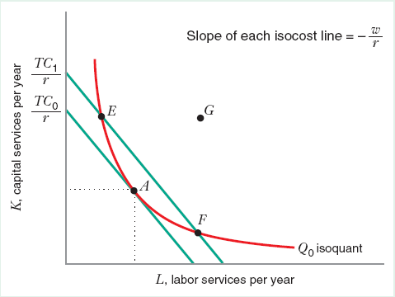
Cost-Minimizing Input Combination
Cost Minimization: looking for K and L on the lowest isocost, such that Q₀ can be produced.
G is Technically Inefficient because less inputs can be used to produce Q₀.
E & F are Technically Efficient because they can be used to produce Q₀; however, they do not minimize cost.

Slide 12
Cost-Minimizing Input Combination
Cost Minimization: looking for K and L on the lowest isocost, such that Q₀ can be produced.
K
L* and K* here solve the cost minimization problem.
(L*, K*) is the combination of inputs with the lowest cost.
(L*, K*) can be used to produced Q₀, as required.
K*
f(K,L) = Q₀
TC* = wL* + rK*
L
L*

Slide 13
Golden Rule of Cost Minimization
Solution to Cost Minimization
Slope of isoquant = Slope of isocost line
i.e. Ratio of marginal products = Ratio of input prices
This means “last dollar spent on K gives the same number of marginal products as last dollar spent on L”.

Slide 14
Golden Rule of Cost Minimization
At point E, Isoquant is steeper than Isocost:
One $ on L gives greater output than one $ on K.
The firm can save more by employing more L and less K.

Slide 15
Golden Rule of Cost Minimization
At point F, Isoquant is flatter than Isocost:
One $ on K gives greater output than one $ on L.
The firm can save more by employing more K and less L.

Slide 16
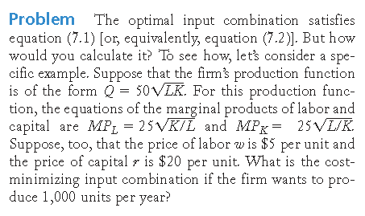
Finding an Interior Cost-Minimization Optimum

Slide 18
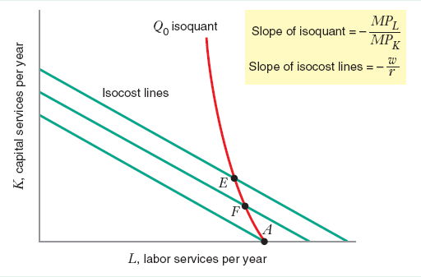
Corner Point Solutions
In some cases, using one input is cheaper than using both inputs, and doing so can still produce the required output.
In such cases, we will have a corner solution.

Slide 19
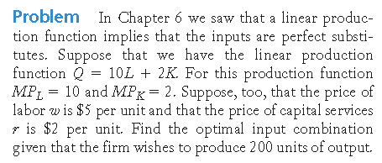
Finding a Corner Point Solution with Perfect Substitutes

Slide 20
Comparative Statics Analysis of Changes in Input Prices
A change in the relative price of inputs changes the slope of the isocost line.
Given a diminishing MRTS_{L,K} , an increase in the price of one input will cause the cost-minimizing quantity of that input to go down.
Given that both inputs are perfect complements, an increase in the price of one input will not change the cost-minimizing quantity of that input.

Slide 21
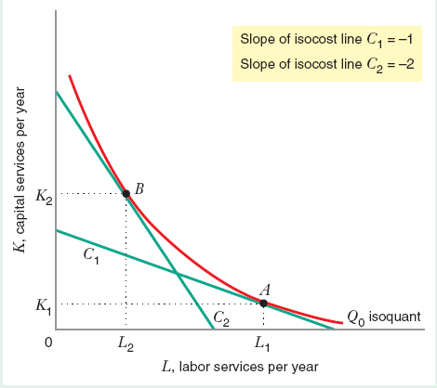
Comparative Statics Analysis of Changes in Input Prices

Slide 22
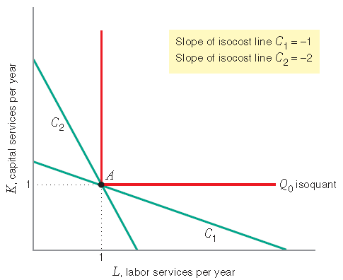
Comparative Statics Analysis of Changes in Input Prices

Slide 23
Comparative Statics Analysis of Changes in Output
An increase in Q₀ moves the isoquant Northeast.
Expansion Path: A line that connects the cost-minimizing input combinations as the quantity of output, Q, varies, holding input prices constant.
Normal Inputs: An input whose cost-minimizing quantity increases as the firm produces more output.
Inferior Input: An input whose cost-minimizing quantity decreases as the firm produces more output.

Slide 24
Comparative Statics Analysis of Changes in Output
As output increases, the cost minimization path moves from point A to B to C when both inputs are normal.

Slide 25
Comparative Statics Analysis of Changes in Output
As output increases, the cost minimization path moves from point A to B when labor is an inferior input.

Slide 26
The Input Demand Curves
Definition: A function that shows how the firm’s cost-minimizing quantity of input varies with the price of that input.
Labor demand curve: Shows how the firm’s cost-minimizing quantity of labor varies with the price of labor.
Capital demand curve: Shows how the firm’s cost-minimizing quantity of capital varies with the price of capital.

Slide 27
The Input Demand Curves

Slide 28
The Input Demand Curves

Slide 29
Price Elasticity of Demand for Inputs
Percentage change in the cost-minimizing quantity of labor with respect to a 1% change in the price of labor.
Percentage change in the cost-minimizing quantity of capital with respect to a 1% change in the price of capital.

Slide 30
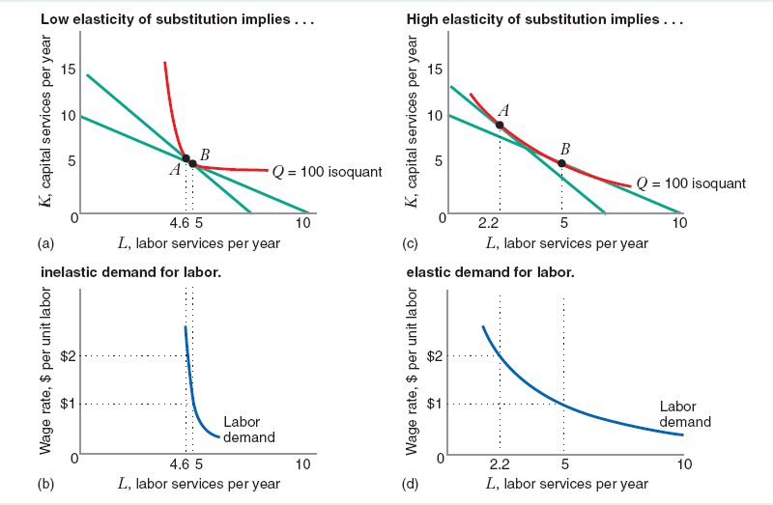
Price Elasticity of Demand for Inputs

Slide 31
Short-Run Cost Minimization
Total Variable Costs – the sum of total expenditures on variable inputs, such as labor and materials, at the short-run cost-minimizing input combination
Total Fixed Costs – the cost of fixed inputs; it does not vary with output
Sunk vs Non-Sunk – avoidable or not when Q = 0
Short-Run Costs can be classified as:
Variable and non-sunk (labor and materials)
Fixed and non-sunk (heating and lighting)
Fixed and sunk (factory)

Slide 32
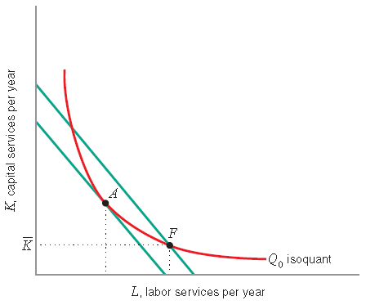
Short-Run Cost Minimization with One Fixed Input

Slide 33
Short-Run Cost Minimization – Input Demand
In short run, one input is fixed, e.g. capital .
Firm can vary the other input, labor.
The demand for labor will be independent of the price of labor or wage rate.
Short-run demand for labor will depend on quantity produced.
As quantity increased, labor used increases holding capital fixed.

Slide 34
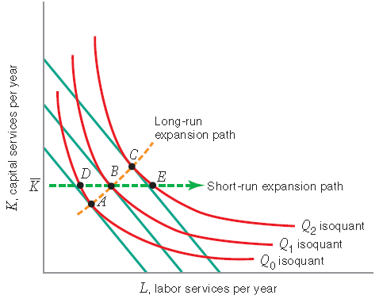
Short-Run Input Demand Vs. Long-Run Input Demand

Slide 35
Short-Run Cost Minimization with One Fixed Input

Slide 36
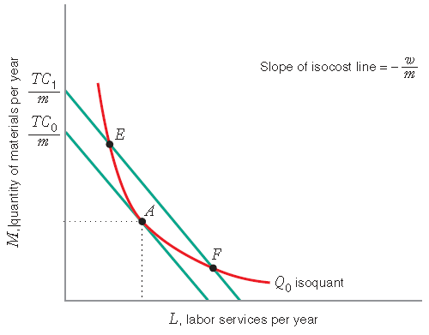
Short-Run Cost Minimization with Two Variable Inputs and One Fixed Input

Slide 37
Short-Run Cost Minimization with Two Variable Inputs

