Slide 1
FN 331: Financial Institutions Management
Class 5
Copyright © 2014 by the McGraw-Hill Companies, Inc. All rights reserved.
Notes:
1

Slide 2
Overview
This chapter discusses securities brokerage firms and investment banks
  Activities of securities firms and investment banks
  Size, structure, and composition
  Balance sheets and recent trends
  Regulation of securities firms and investment banks
  Global issues
Ch 4-2

Slide 3
Securities Firms & Investment Banks
Nature of business
  Underwrite securities – stocks, bonds and derivatives: full commitment or best efforts or private placement
  Market making – market makers, traders, dealers – trading for their own portfolios, earning from bid-offer spread
  Advising (example: M&A, restructurings) – fee based
Ch 4-3

Slide 4
Securities Firms & Investment Banks
Growth in domestic M&A:
  Less than $200 billion in 1990
  $1.83 trillion in 2000, mainly on dot com and finance & banking industries
  In US: bottomed out at $458 billion in 2002 ($1.2 trillion worldwide) – 2001 terrorist attack
  Topped $1.7 trillion 2007 ($4.5 trillion worldwide)
  Effects of financial crisis: fell to $687 billion in 2010 ($1.8 trillion worldwide)
    Worst financial crisis since 1930s, but M&A activity still greater than early 2000s
Ch 4-4

Slide 5
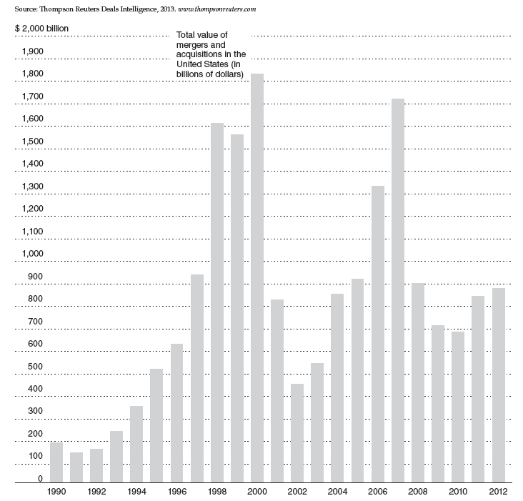
Mergers and Acquisitions, 1990-2012
Ch 4-5
Notes:
5

Slide 6
Structural Changes in Recent Years
Acquisition of Bear Stearns by J.P. Morgan Chase – March 2008
Bankruptcy of Lehman Brothers – September 2009 (balance sheet at the time of collapse was at $600 billion which was 5 times of Bank of Thailand’s international reserve)
Acquisition of Merrill Lynch by Bank of America – September 2008
Only two remaining major firms:
  Goldman Sachs and Morgan Stanley
    Converted to commercial bank holding companies in 2008 subject to the same stringent Basel Risk Management Accord
Ch 4-6

Slide 7
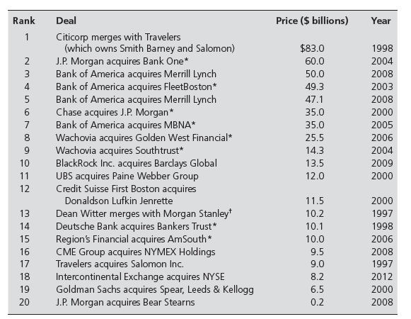
Largest M&A Transactions
Notes:
7

Slide 8
Size, Structure & Composition
Dramatic increase in number of firms from 1980 to 1987; Decline of 37% following the 1987 crash, to year 2006
Concentration of business among the largest firms
Ch 4-8

Slide 9
Size, Structure & Composition
Many recent inter-industry mergers (i.e., insurance companies and investment banks)
  Role of Financial Services Modernization Act, 1999
Lehman Brothers, Bear Stearns, Merrill Lynch, Goldman Sachs, and Morgan Stanley gone by end of 2008
Ch 4-9

Slide 10
Types & Relative Sizes of Firms
National full-line firms are largest
  BOA (via acquisition of Merrill Lynch); Morgan Stanley
National full-line firms specializing in corporate finance are second in size
  Goldman Sachs, Salomon Brothers/Smith Barney (Citigroup)
Ch 4-10

Slide 11
Types & Relative Sizes of Firms
Remainder of industry:
  Large investment banks (Lazard Ltd. And Greenhill & Co.)
  Regional securities firms (subdivided into large, medium, and small)
  Specialized discount brokers, electronic trading firms, venture capital firms, and other firms
Ch 4-11

Slide 12
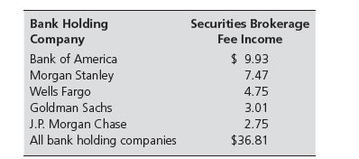
Top Bank Holding Companies 2011
(by brokerage fee income)
Ch 4-12
Notes:
12

Slide 13
Key Activities
Investing in the investable securities – MBS & CDOs are subject to mark-to-market to reflect the actual value of securities
Investment banking
  Activities related to underwriting and distributing new (IPOs) and secondary (seasoned) issues of debt and equity
    Public offerings & private placements
Venture Capital
Market making
  Increasing importance of online trading
    Technology risk
  Decimalization
Ch 4-13

Slide 14
Activities (continued)
Trading (proprietary trading)
  Position trading, pure arbitrage, risk arbitrage, program trading
Cash management – money market mutual fund sold by investment banks
Assisting with M&A, debt restructuring and earning fees based income
Back-office and service functions
Ch 4-14

Slide 15
Activities (continued)
Position Trading – involving buying large blocks of securities on the expectation of a favorable price move.
pure arbitrage – involving buying an asset in one market at one price and immediately sell in another market at higher price.
risk arbitrage – involving buying large blocks of securities in expectation of some information release, such as new investors like China Mobile will have a more than 20% stake in TRUE. M&A news, Federal Reserve or Central interest rate announcement.
program trading – simultaneous buying and selling a portfolio of at 15 different stocks valued more than $1 million, by using computer program to initiate such trades
Ch 4-15

Slide 16
Recent Trends
Decline in trading volume and brokerage commissions
  Particularly since crash of 1987, although some recovery since 1992; Record volumes 1995-2000
Declines in market values--and commission income 2001-2002
Resurgence in market values and commissions during mid-2000s
New lows in 2008
Ch 4-16

Slide 17
Trends (continued)
Pretax net income over $9 billion per year 1996-2000
Pretax profits soared to $31.6 billion in 2000
  Curtailed by economic slowdown and September 11 attacks 2001
Worries over securities law violations and investor confidence
Financial crisis, 2008
Profits recovered, 2009
Ch 4-17

Slide 18
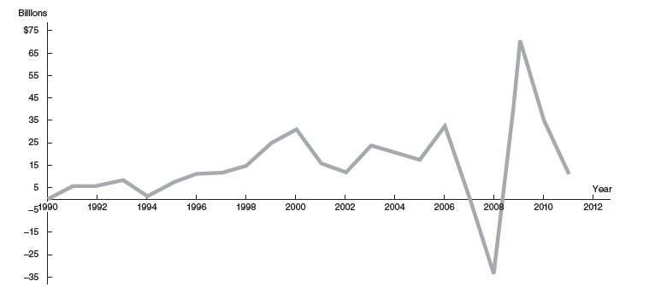
Securities Industry Pretax Profits, 1990-2012
Ch 4-18
Notes:
18

Slide 19
Balance Sheet
Key assets:
  Long positions (buying) in securities (MBS and CDOs and commodities (Gold, Silver, Oil)
  Reverse repurchase agreements
  Receivables from other broker-dealers
  Long positions in securities and commodities
Implications: Market, interest rate, & F/X risks
Ch 4-19

Slide 20
Balance Sheet
Key liabilities:
  Repurchase agreements are major source of funds
  Payables to customers
  Payables to other broker-dealers
  Securities and commodities sold short
Capital levels much lower than in banks – not subject to Basel Risk Management Bank Accord
Ch 4-20

Slide 21
Regulation
Primary regulator: SEC
Ch 4-21

Slide 22
Extension of Oversight
Additional oversight from US Congress
  Hearings focused on role of investment banks in the financial crisis
    Goldman Sachs bundling of toxic assets
    Goldman Sachs underwrite Credit Default Swap (CDS) to Greece Government, helped Greece Government to hide swap from the central balance sheet by using off-exchange rate to book the transactions
Ch 4-22

Slide 23
Global Issues
Global nature of securities firms
  Competition between US and European firms
  Foreign investors’ transactions in US securities and US investors’ transactions in foreign securities exchanges increased
  Global concern about capital, liquidity, and leverage following the financial crisis
    Implications for global competitiveness
      Strategic alliances
      Exits from foreign markets
Ch 4-23

