Slide 1
PY200/PY211 General Psychology
Motivation and Emotion

Slide 2
Major Approaches to Motivation
Instinct
Drive reduction
Arousal
Incentive
Cognitive
Hierarchy of needs

Slide 3
Explaining Motivation
Motivation: Factors that direct and energize the behavior of humans and other organisms
  Includes behavioral, cognitive, and social aspects
  Studied with a variety of approaches
    All approaches seek to explain the energy that guides behavior in specific directions

Slide 4
Instinct Approaches: Born to be Motivated
Instincts: Inborn patterns of behavior that are biologically determined rather than learned
Instinct approaches to motivation: The explanation of motivation that suggests people and animals are born preprogrammed with sets of behaviors essential to survival
  Weaknesses
    Lack of agreement on number of primary instincts
    Unable to explain why behaviors evolve in some species but not others
Notes:
Kohlberg, Freud, Reflexes

Slide 5
Drive-Reduction Approaches: Satisfying Our Needs (1)
Suggest that a lack of some basic biological need produces a drive to push an organism to satisfy that need
  Drive: Motivation tension, or arousal, that energizes behavior to fulfill a need
    Primary drives - Related to biological needs of the body or of the species as a whole
    Secondary drives - Related to behavior that fulfills no obvious biological need

Slide 6
Drive-Reduction Approaches: Satisfying Our Needs (2)
Homeostasis: Body’s tendency to maintain a steady internal state
  Underlies primary drives
  Uses feedback loops
  Operates the need for food, water, stable body temperature, and sleep
Notes:
Cannot explain curiosity

Slide 7
Arousal Approaches: Beyond Drive Reduction
Belief that people try to maintain a steady level of stimulation and activity
  Suggests that if stimulation and activity levels become too high, individuals tries to reduce them
    If stimulation and activity levels become too low, we seek out stimulation to increase them
  People vary in the optimal level of arousal they seek out; some look for especially high levels of arousal
    Daredevil sportsmen, high-stakes gamblers, and criminals

Slide 8
Incentive Approaches: Motivation’s Pull
Suggest that motivation stems from the desire to attain external rewards, known as incentives
  Fails to provide complete explanation of motivation as organisms sometimes seek to fulfill needs even with no apparent incentives
  Combination explanation of motivation
    Internal drives (proposed by drive-reduction theory) work in tandem with
    External incentives (proposed by incentive theory) to “push” and “pull” behavior

Slide 9
Cognitive Approaches: The Thoughts Behind Motivation
Suggest that motivation is a result of people’s thoughts, beliefs, expectations, and goals
  Draws distinction between:
    Intrinsic motivation - Causes individuals to participate in an activity for their own enjoyment rather than for any actual or concrete reward
    Extrinsic motivation - Causes individuals to do something for money, a grade, or some other actual, concrete reward

Slide 10
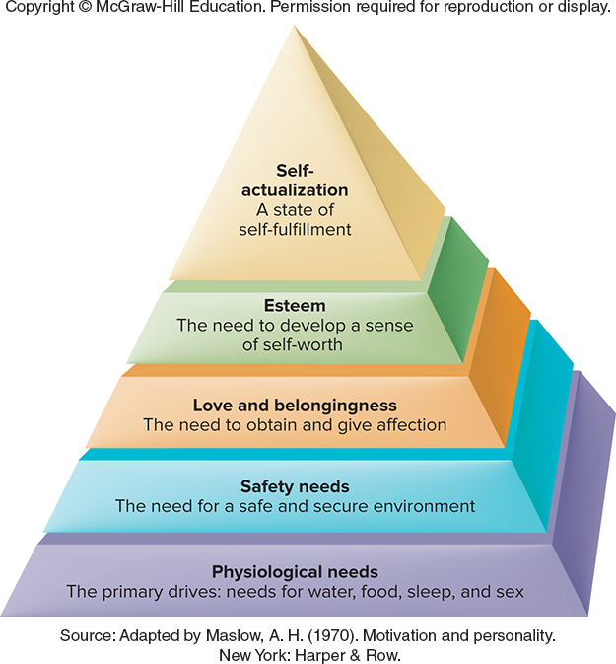
Maslow’s Hierarchy: Ordering Motivational Needs (1)
Places motivational needs in a hierarchy
Suggests that before meeting sophisticated, higher-order needs, certain primary needs must be satisfied
  Self-actualization: State of self-fulfillment in which people realize their highest potential in their own way

Slide 11
Maslow’s Hierarchy: Ordering Motivational Needs (2)
Maslow’s hierarchy of needs is important because it:
  Highlights complexity of human needs
  Emphasizes that until basic biological needs are met, people will be unconcerned about higher-order needs
  Spawned other approaches to motivation, including
    Self-determination theory: people have the three basic needs of competence, autonomy, and relatedness
  However, research has been unable to validate the specific order of Maslow’s hierarchy

Slide 12
Human Needs and Motivation: Eat, Drink, and Achievement
What biological and social factors underlie motivation?
How are needs relating to achievement, affiliation, and power motivation exhibited?

Slide 13
Biological Factors in the Regulation of Hunger (1)
Complex biological mechanisms tell organisms whether they require food or should stop eating
  Changes in the chemical composition of the blood
    Glucose levels
    Insulin
    Ghrelin

Slide 14
Biological Factors in the Regulation of Hunger (2)
Hypothalamus
  Monitors glucose levels
  Regulates food intake
  Injury affects the weight set point
    Weight set point: Particular level of weight that the body strives to maintain
Metabolism: Rate at which food is converted to energy and expended by the body

Slide 15
Social Factors in Eating
Societal rules
Cultural norms
Individual habits
Operant conditioning

Slide 16
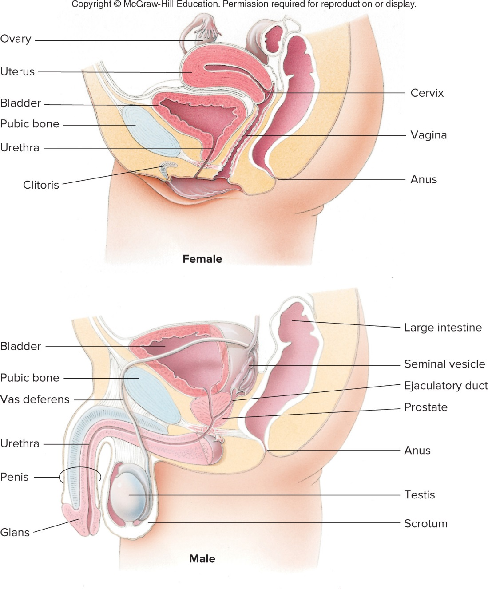
Sexual Motivation
Androgens: Male sex hormones secreted by the testes
Genitals: Male and female sex organs
Estrogens: Class of female sex hormones
Ovulation: Point at which an egg is released from the ovaries
Humans versatile sex-drive (compared to animals)
  Objects
  Sight
  Scent
  Sound

Slide 17
The Need for Achievement: Striving for Success (1)
Stable, learned characteristic in which a person obtains satisfaction by striving for and achieving challenging goals
  People with high need for achievement are selective in picking challenges
    Avoid situations with success coming too easily or unlikely to come
  People with low achievement motivation tend to be motivated primarily by a desire to avoid failure

Slide 18
The Need for Achievement: Striving for Success (2)
Measuring achievement motivation
  Thematic Apperception Tests (TAT)
Examiner shows a series of ambiguous pictures
Tells participants to write a story that describes what is happening
Researchers use a standard scoring system to determine the amount of achievement imagery in people’s stories
Notes:
What has led up to the event
What is happening in the event
What are the characters thinking and feeling
What was the outcome of the story?

Slide 19
Other Needs
The need for affiliation:
  Interest in establishing and maintaining relationships with other people
  TAT stories emphasize a desire to maintain or reinstate friendships and concern of rejection
  Gender is a great determinant of how much time is spent with friends
The need for power:
  Tendency to seek impact, control, or influence over others and to be seen as a powerful individual
  Significant gender differences exist in the display of need for power

Slide 20
Understanding Emotional Experiences
What are emotions, and how do we experience them?
What are the functions of emotions?
What are the explanations for emotions?

Slide 21
Understanding Emotional Experiences
Emotions: Feelings that generally have both physiological and cognitive elements and that influence behavior
Two system theories
  One system governs emotional response, another governs cognitive reactions to emotional response
    Some suggest: we first experience an emotional response, later try to make sense of it
    Others suggest: we develop cognitions about a situation, then react emotionally

Slide 22
The Functions of Emotions
Preparing us for action
Shaping our future behavior
Helping us interact more effectively with others

Slide 23
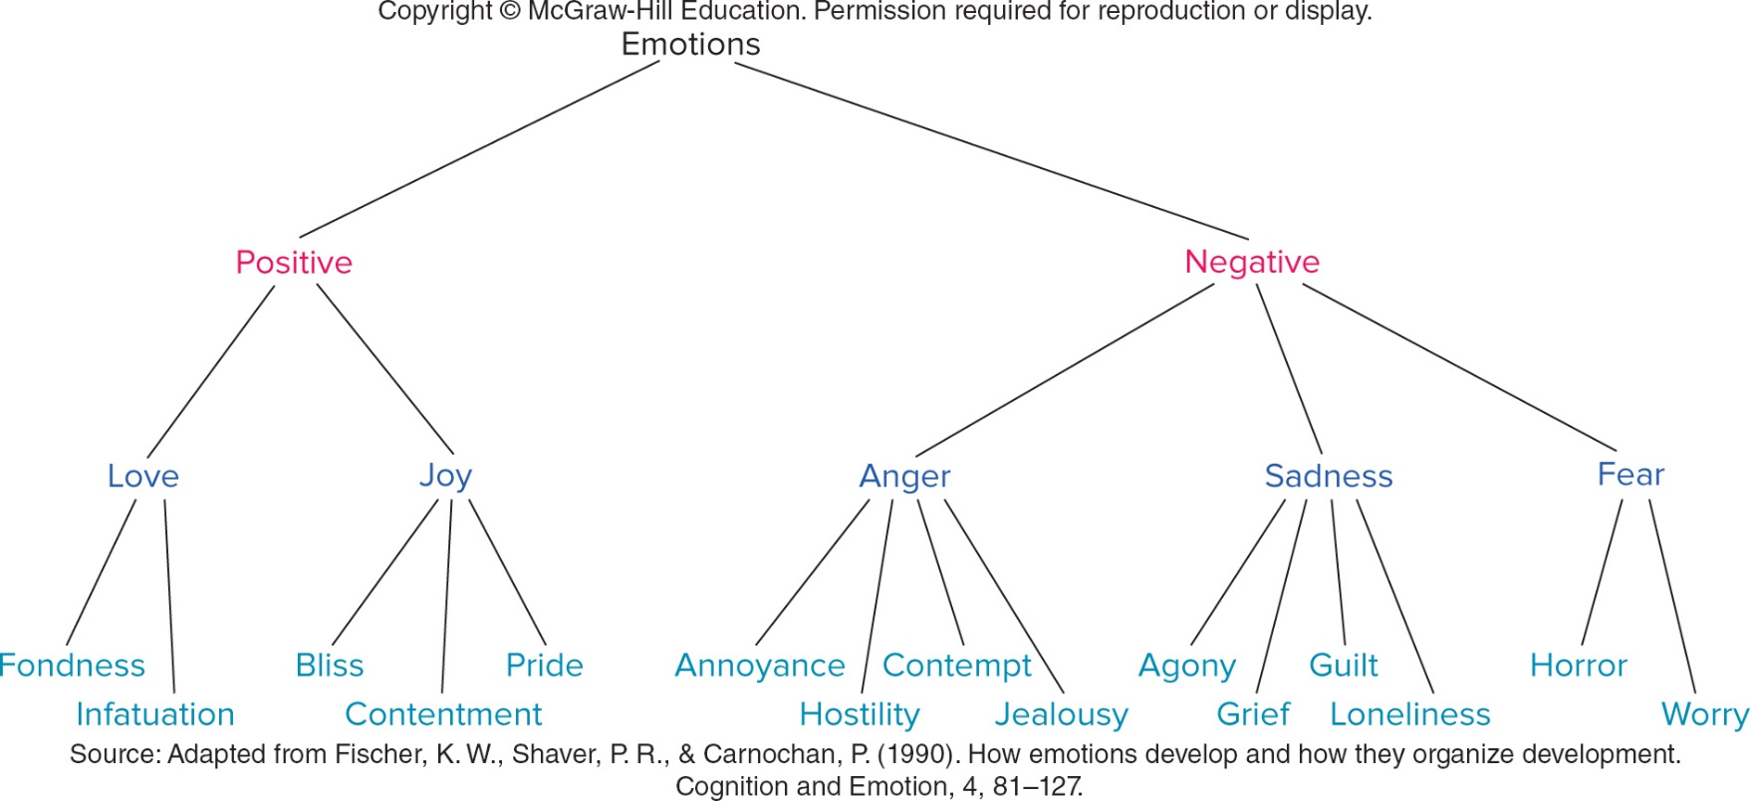
Determining the Range of Emotions: Labeling Our Feelings
Basic emotions
  Happiness
  Anger
  Fear
  Sadness
  Disgust
Broader list of emotions include:
  Surprise
  Contempt
  Guilt
  Joy

Slide 24
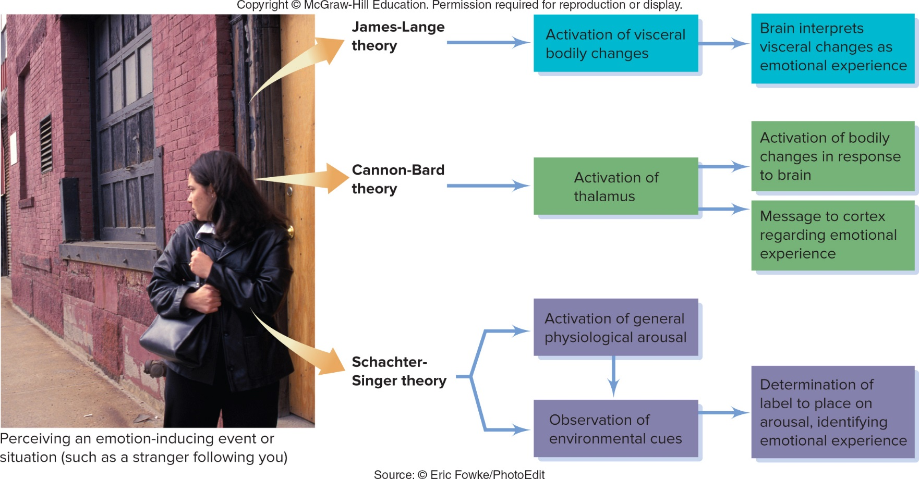
The Roots of Emotions (1)
The James-Lange theory

Slide 25
The Roots of Emotions (2)
The James-Lange theory
  Emotional experience is a reaction to bodily events occurring as a result of an external situation
    We experience emotions as a result of physiological changes that produce specific sensations, which the brain interprets as emotions
  Drawbacks
    Visceral changes would have to occur relatively quickly
    Physiological arousal does not invariably produce emotional experience
    Internal organs produce a relatively limited range of sensations

Slide 26
The Roots of Emotions (3)
The Cannon-Bard theory

Slide 27
The Roots of Emotions (5)
The Cannon-Bard theory
  Physiological arousal and emotional experience are produced simultaneously by the same nerve stimulus
    Rejects the view that physiological arousal alone leads to the perception of emotion
  After we perceive an emotion-producing stimulus, the thalamus is the initial site of the emotional response
    Thalamus sends responses to autonomic nervous system and the cortex
  Note. We now know that the hypothalamus other areas in the limbic system (rather than the thalamus) play important roles in emotion

Slide 28
The Roots of Emotions (6)
The Schachter-Singer theory

Slide 29
The Roots of Emotions (7)
The Schachter-Singer theory
  Emotions are determined jointly by a nonspecific kind of physiological arousal and its interpretation
    Based on environmental cues
    Supports a cognitive view of emotions

Slide 30
The Roots of Emotions (8)
  Schachter & Singer (1962)
    4 groups
      Adrenaline (epinephrine) informed
      Adrenaline misinformed
      Adrenaline ignorant
      No adrenaline
    Confederate in the room
      Euphoria
      Anger
    Adrenaline misinformed and ignorant participants reported emotion consistent with confederate actions
    Note. In the anger condition, there was no adrenaline misinformed group

Slide 31

The Roots of Emotions (9)
  E.g. Capilano Suspension Bridge Study (Dutton & Aron, 1974)

Slide 32
The Roots of Emotions (10)
Notes:
Attractive young woman meets guys on bridge and asks them to fill out a questionnaire for psych class, write a brief dramatic story on photograph.
Would love to explain in more detail but no time so call me later.
Same on safe bridge.
Scary bridge more likely to call her, write more romantic and sexual story

Slide 33
The Roots of Emotions (11)
  Later research has found that arousal is more specific than Schachter and Singer believed, research supports that we may look to our surrounding to determine the source of physiological arousal

Slide 34
The Roots of Emotions (12)

Slide 35
The Roots of Emotions (13)
Contemporary perspectives on the neuroscience of emotions
  Different emotions produce activation of different portions of the brain
  Amygdala plays an important role in the experience of emotions
    Provides a link between the perception of an emotion-producing stimulus and the recall of that stimulus later
  Neural pathways connect the amygdala, visual cortex, and hippocampus
    Indicates that emotion-related stimuli can be processed and responded to almost instantaneously

Slide 36
The Roots of Emotions (14)
Making sense of the multiple perspectives on emotion
  Emotions are complex phenomena, encompassing biological and cognitive aspects
  No single theory has been able to fully explain all the facets of emotional experience

Slide 37
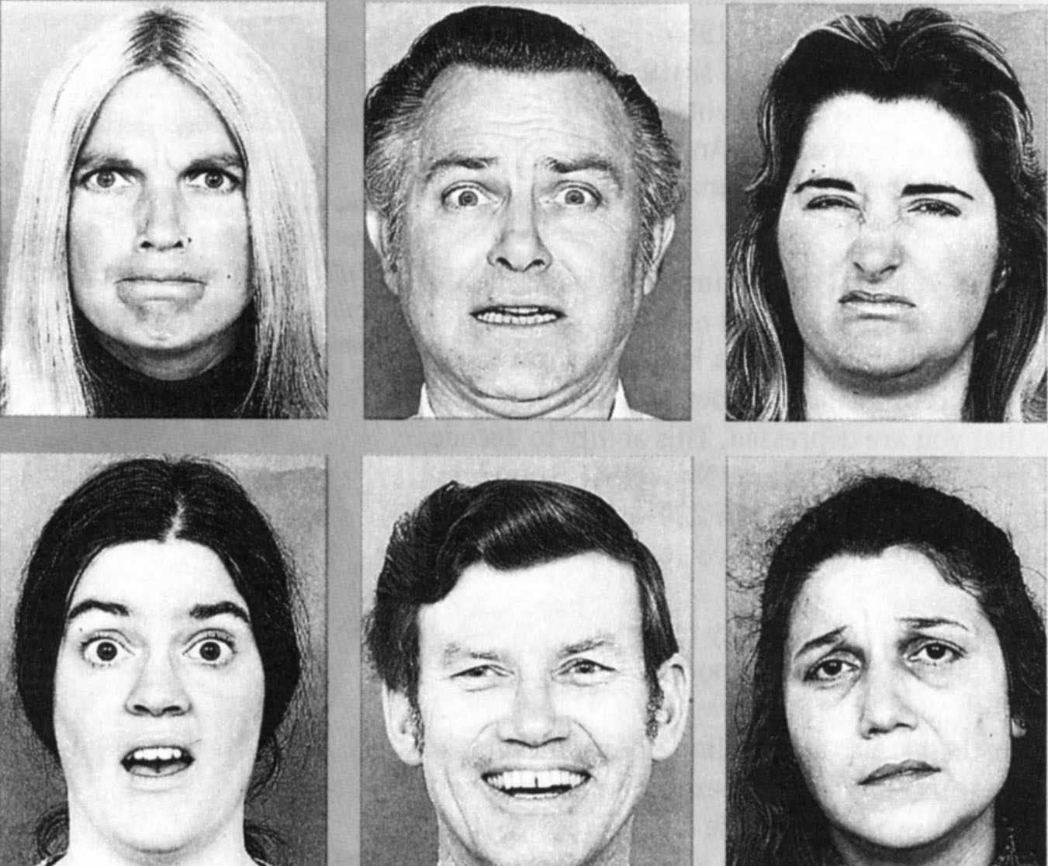
Do People in All Cultures Express Emotion Similarly? (1)

Slide 38
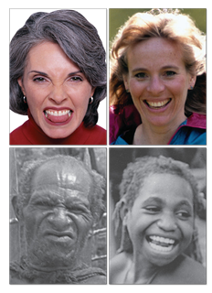
Do People in All Cultures Express Emotion Similarly? (2)
Expressions are rather universal across cultures
Display rules can vary

Slide 39
Do People in All Cultures Express Emotion Similarly? (3)
Universality Studies (Ekman, 1972)
  Photographs of emotion thought to portray universally recognizable emotions were shown to observers in different countries, who had to label each emotion
  High agreement for 6 basic emotions (happiness, anger, sadness, surprise, disgust, fear)
  Criticism: only literate, industrialized, modern cultures were included

Slide 40
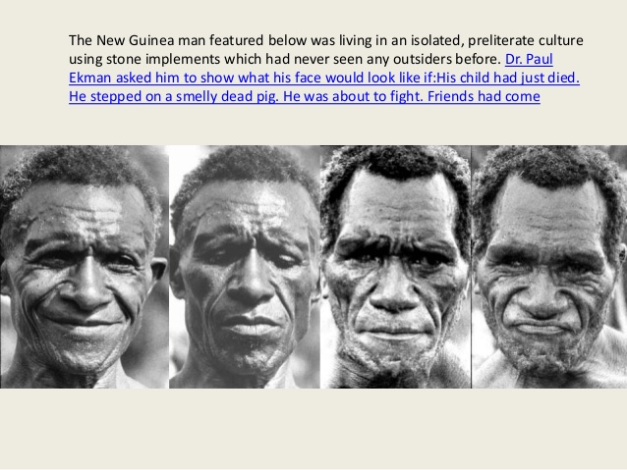
Do People in All Cultures Express Emotion Similarly? (4)
  Two preliterate tribes in New Guinea found similar results
  Participants asked to select a story that best described a facial expression
  Asked to produce facial expressions of different emotions
  Pictures taken of New Guinean facial expressions, shown to Americans who had never seen the tribe members
  Americans could accurately label emotions

Slide 41
Do People in All Cultures Express Emotion Similarly? (5)
Friesen (1972)
  Japanese and American participants viewed stressful stimulus alone
  High status experimenter
  Shows display rules are different
Condition | Americans | Japanese
Alone | Showed disgust | Showed disgust
With Experimenter | Showed disgust | Smiled

Slide 42
Do People in All Cultures Express Emotion Similarly? (6)
Why do people express emotions similarly across cultures?
Facial-affect program
  Activation of a set of nerve impulses that make the face display the appropriate expression

Slide 43
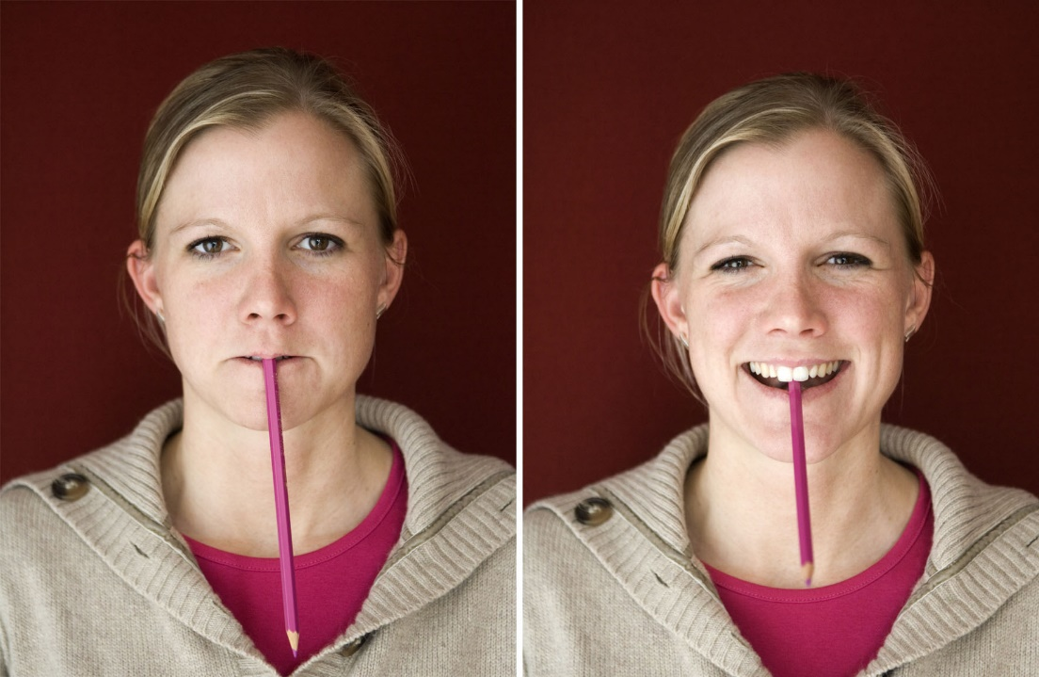
Importance of Facial Expressions
Not only reflect emotions, but also determine emotions
Facial-feedback hypothesis
  Hypothesis that facial expressions not only reflect emotional experience but also help determine how people experience and label emotions

