Slide 1
Chapter 11: Security Valuation Principles
Analysis of Investments &
Management of Portfolios
10TH EDITION
Reilly & Brown

Slide 2
Overview of the Valuation Process
Two General Approaches
  Top-down, three-step approach
  Bottom-up, stock valuation, stock picking approach
The difference between the two approaches is the perceived importance of economic and industry influence on individual firms and stocks
Both of these approaches can be implemented by either fundamentalists or technicians

Slide 3
Overview of the Valuation Process
The Three-Step Top-Down Process
  First examine the influence of the general economy on all firms and the security markets
  Then analyze the prospects for various global industries with the best outlooks in this economic environment
  Finally turn to the analysis of individual firms in the preferred industries and to the common stock of these firms.
  See Exhibit 11.1

Slide 4
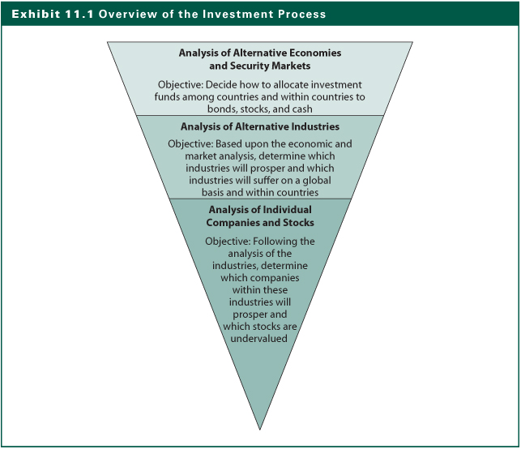
Exhibit 11.1

Slide 5
Three-Step Valuation Approach
General Economic Influences
  Fiscal policy initiatives, such as tax credits or tax cuts, can encourage spending
  Monetary policy though controlling money supply growth or interest rate therefore affects all segments of an economy and that economy’s relationship with other economies
  Inflation causes changes the spending and savings behavior of consumers and corporations
  Other events such as war, political upheavals in foreign countries, or international monetary devaluations exert strong effects on the economies

Slide 6
Three-Step Valuation Approach
Industry Influences
  Identify global industries that will prosper or suffer in the long run or during the expected near-term economic environment
  Different industries react to economic changes at different points in the business cycle
  Alternative industries have different responses to the business cycle
  Demographic factor and international exposure will also have different impacts on different types of industries

Slide 7
Three-Step Valuation Approach
Company Analysis
  The purpose of company analysis to identify the best companies in a promising industry
  This involves examining a firm’s past performance, but more important, its future prospects
  It needs to compare the estimated intrinsic value to the prevailing market price of the firm’s stock and decide whether its stock is a good investment
  The final goal is to select the best stock within a desirable industry and include it in your portfolio based on its relationship (correlation) with all other assets in your portfolio

Slide 8
Does the Three-Step Process Work?
Studies indicate that most changes in an individual firm’s earnings can be attributed to changes in aggregate corporate earnings and changes in the firm’s industry
Studies have also found a relationship between aggregate stock prices and various economic series such as employment, income, or production

Slide 9
Does the Three-Step Process Work?
An analysis of the relationship between rates of return for the aggregate stock market, alternative industries, and individual stocks showed that most of the changes in rates of return for individual stock could be explained by changes in the rates of return for the aggregate stock market and the stock’s industry

Slide 10
Theory of Valuation
The value of an asset is the present value of its expected returns
To convert this stream of returns to a value for the security, you must discount this stream at your required rate of return
This requires estimates of:
  The stream of expected returns, and
  The required rate of return on the investment

Slide 11
Theory of Valuation
Stream of Expected Returns
  Form of returns
    Earnings
    Cash flows
    Dividends
    Interest payments
    Capital gains (increases in value)
  Time pattern and growth rate of returns
    When the returns (Cash flows) occur
    At what rate will the return grow

Slide 12
Theory of Valuation
Required Rate of Return
  Reflect the uncertainty of return (cash flow)
  Determined by economy’s risk-free rate of return, plus
  Expected rate of inflation during the holding period, plus
  Risk premium determined by the uncertainty of returns
    business risk
    financial risk
    liquidity risk
    exchanger rate risk and country

Slide 13
Theory of Valuation
Investment Decision Process: A Comparison of Estimated Values and Market Prices
  You have to estimate the intrinsic value of the investment at your required rate of return and then compare this estimated intrinsic value to the prevailing market price
  If Estimated Value > Market Price, Buy
  If Estimated Value < Market Price, Don’t Buy

Slide 14
Valuation of Alternative Investments
Bond valuation
Preferred stock valuation
Common stock valuation
  Dividend Discount Models
  Present Value of Operating Free Cash Flows
  Present Value of Free Cash Flows to Equity

Slide 15
Valuation of Bonds
Valuation of Bonds is relatively easy because the size and time pattern of cash flows from the bond over its life are known:
  Interest payments are made usually every six months equal to one-half the coupon rate times the face value of the bond:
  The principal is repaid on the bond’s maturity date
The bond value is defined as the present value of its future interest and principle payments

Slide 16
Valuation of Bonds
Assume in 2012, a $10,000 par value bond due in 2027 with 10% coupon will pay $500 every six months for its 15-year life. What is the bond price if the required rate of return is 10%?
Present value of the interest payments
$500 x 15.3725 = $7,686
The present value of the principal
$10,000 x .2314 = $2,314
The bond value
  $7,686+$2,314=$10,000

Slide 17
Valuation of Bonds
The $10,000 valuation is the amount that an investor should be willing to pay for this bond, given the required rate on a bond of 10%
If the required rate of return changes, then bond value will change inversely.
What is the bond value if the return is 12%?
  $500 x 13.7648 = $6,882
  $10,000 x .1741 = 1,741
  Total value of bond at 12 percent = $8,623

Slide 18
Valuation of Preferred Stock
Owner of preferred stock receives a promise to pay a stated dividend, usually quarterly, for perpetuity
Since payments are only made after the firm meets its bond interest payments, there is more uncertainty of returns
Tax treatment of dividends paid to corporations (80% tax-exempt) offsets the risk premium

Slide 19
Valuation of Preferred Stock
The value is simply the stated annual dividend divided by the required rate of return on preferred stock (k_{p})
Assume a preferred stock has a $100 par value and a dividend of $8 a year and a required rate of return of 9 percent

Slide 20
Valuation of Preferred Stock
Given a market price, you can derive its promised yield
At a market price of $85, this preferred stock yield would be

Slide 21
Valuation of Common Stock
Two General Approaches
  Discounted Cash-Flow Techniques
    Present value of some measure of cash flow, including dividends, operating cash flow, and free cash flow
  Relative Valuation Techniques
    Value estimated based on its price relative to significant variables, such as earnings, cash flow, book value, or sales
  See Exhibit 11.2

Slide 22
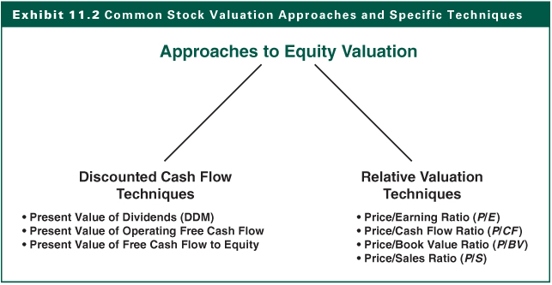
Exhibit 11.2

Slide 23
Valuation of Common Stock
Both of these approaches and all of these valuation techniques have several common factors:
  All of them are significantly affected by investor’s required rate of return on the stock because this rate becomes the discount rate or is a major component of the discount rate;
  All valuation approaches are affected by the estimated growth rate of the variable used in the valuation technique

Slide 24
Why Discounted Cash Flow Approach
These techniques are obvious choices for valuation because they are the epitome of how we describe value—that is, the present value of expected cash flows
  Dividends: Cost of equity as the discount rate
  Operating cash flow: Weighted Average Cost of Capital (WACC)
  Free cash flow to equity: Cost of equity as the discount rate
Dependent on growth rates and discount rate

Slide 25
Why Relative Valuation Techniques
Provides information about how the market is currently valuing stocks
  aggregate market
  alternative industries
  individual stocks within industries
No guidance as to whether valuations are appropriate
  best used when have comparable entities
  aggregate market and company’s industry are not at a valuation extreme

Slide 26
Discounted Cash Flow
Valuation Techniques
The General Formula
Where:
V_{j} = value of stock j
n = life of the asset
CF_{t} = cash flow in period t
k = the discount rate that is equal to the investor’s
required rate of return for asset j,

Slide 27
The Dividend Discount Model (DDM)
The value of a share of common stock is the present value of all future dividends
where:
V_{j} = value of common stock j
D_{t} = dividend during time period t
k = required rate of return on stock j

Slide 28
The Dividend Discount Model (DDM)
The N-Period Model
  If the stock is held for only N period, e.g. 2 years, and a sale at the end of year 2 would imply:
  The expected selling price, SP_{j2}, of stock j at the end of Year 2 is crucial, which is in fact the present value of future expected dividends

Slide 29
The Dividend Discount Model (DDM)
Infinite Period Model (Constant Growth Model)
  Assumes a constant growth rate for estimating all of future dividends
where:
V_{j} = value of stock j
D₀ = dividend payment in the current period
g = the constant growth rate of dividends
k = required rate of return on stock j
n = the number of periods, which we assume to be infinite

Slide 30
The Dividend Discount Model (DDM)
Given the constant growth rate, the earlier formula can be reduced to:
Assumptions of DDM:
  Dividends grow at a constant rate
  The constant growth rate will continue for an infinite period
  The required rate of return (k) is greater than the infinite growth rate (g)

Slide 31
Infinite Period DDM and Growth Companies
Growth companies have opportunities to earn return on investments greater than their required rates of return
To exploit these opportunities, these firms generally retain a high percentage of earnings for reinvestment, and their earnings grow faster than those of a typical firm
During the high growth periods where g>k, this is inconsistent with the constant growth DDM assumptions

Slide 32
Valuation with Temporary Supernormal Growth
First evaluate the years of supernormal growth and then use the DDM to compute the remaining years at a sustainable rate
Suppose a 14% required rate of return with the following dividend growth pattern
Dividend
Year Growth Rate
1-3 25%
4-6 20%
7-9 15%
10 on 9%

Slide 33
Valuation with Temporary Supernormal Growth
The Value of the Stock (See Exhibit 11.3)

Slide 34
Present Value of
Operating Free Cash Flows
Derive the value of the total firm by discounting the total operating cash flows prior to the payment of interest to the debt-holders
Then subtract the value of debt to arrive at an estimate of the value of the equity
Similar to the DDM, we can have
  We have use a constant rate forever
  We can assume several different rates of growth for OCF, like the supernormal dividend growth model

Slide 35

Present Value of
Operating Free Cash Flows

Slide 36
Present Value of
Free Cash Flows to Equity
“Free” cash flows to equity are derived after operating cash flows have been adjusted for debt payments (interest and principle)
These cash flows precede dividend payments to the common stockholder
The discount rate used is the firm’s cost of equity (k) rather than WACC

Slide 37
Present Value of
Free Cash Flows to Equity
The Formula
  where:
  V_{j} = Value of the stock of firm j
  n = number of periods assumed to be infinite
  FCFE_{t} = the firm’s free cash flow in period t
  K _{j} = the cost of equity

Slide 38
Relative Valuation Techniques
Value can be determined by comparing to similar stocks based on relative ratios
Relevant variables include earnings, cash flow, book value, and sales
Relative valuation ratios include price/earning; price/cash flow; price/book value and price/sales
The most popular relative valuation technique is based on price to earnings

Slide 39
Earnings Multiplier Model
P/E Ratio: This values the stock based on expected annual earnings
Price/Earnings Ratio= Earnings Multiplier

Slide 40
Earnings Multiplier Model
Combining the Constant DDM with the P/E ratio approach by dividing earnings on both sides of DDM formula to obtain
Thus, the P/E ratio is determined by
  Expected dividend payout ratio
  Required rate of return on the stock (k)
  Expected growth rate of dividends (g)

Slide 41
Earnings Multiplier Model
Assume the following information for AGE stock (1) Dividend payout = 50% (2) Required return = 12% (3) Expected growth = 8% (4) D/E = .50 and the growth rate, g=.08. What is the stock’s P/E ratio?
What if the required rate of return is 13%
What if the growth rate is 9%

Slide 42
Earnings Multiplier Model
In the previous example, suppose the current earnings of $2.00 and the growth rate of 9%. What would be the estimated stock price?
Given D/E =0.50; k=0.12; g=0.09
P/E = 16.7
You would expect E₁ to be $2.18
V = 16.7 x $2.18 = $36.41
Compare this estimated value to market price to decide if you should invest in it

Slide 43
The Price-Cash Flow Ratio
Why Price/CF Ratio
  Companies can manipulate earnings but Cash-flow is less prone to manipulation
  Cash-flow is important for fundamental valuation and in credit analysis
The Formula
where:
P/CF_{j} = the price/cash flow ratio for firm j
P_{t} = the price of the stock in period t
CF_{t+1} = expected cash low per share for firm j

Slide 44
The Price-Book Value Ratio
Widely used to measure bank values
Fama and French (1992) study indicated inverse relationship between P/BV ratios and excess return for a cross section of stocks
The Formula
where:
P/BV_{j} = the price/book value for firm j
P_{t} = the end of year stock price for firm j
BV_{t+1} = the estimated end of year book value per share for firm j

Slide 45
The Price-Sales Ratio
Sales is subject to less manipulation than other financial data
This ratio varies dramatically by industry
Relative comparisons using P/S ratio should be between firms in similar industries
The Formula
where: P/S_{j} = the price to sales ratio for Firm j
P_{t} = the price of the stock in Period t
S_{t+1} = the expected sales per share for Firm j

Slide 46
Implementing the Relative Valuation Technique
First Step: Compare the valuation ratio for a company to the comparable ratio for the market, for stock’s industry and to other stocks in the industry
  Is it similar to these other P/Es
  Is it consistently at a premium or discount
Second Step: Explain the relationship
  Understand what factors determine the specific valuation ratio for the stock being valued
  Compare these factors versus the same factors for the market, industry, and other stocks

Slide 47
Estimating the Inputs: k and g
Valuation procedure is the same for securities around the world
The two most important input variables are :
  The required rate of return (k)
  The expected growth rate of earnings and other valuation variables (g) such as book value, cash flow, and dividends
These two input variables differ among countries in the world
The quality of these estimates are key

Slide 48
Required Rate of Return (k)
The investor’s required rate of return must be estimated regardless of the approach selected or technique applied
This will be used as the discount rate and also affects relative-valuation
Three factors influence an investor’s required rate of return:
  The economy’s real risk-free rate (RRFR)
  The expected rate of inflation (I)
  A risk premium (RP)

Slide 49
Required Rate of Return (k)
The Economy’s Real Risk-Free Rate
  Minimum rate an investor should require
  Depends on the real growth rate of the economy
    (Capital invested should grow as fast as the economy)
  Rate is affected for short periods by tightness or ease of credit markets

Slide 50
Required Rate of Return (k)
The Expected Rate of Inflation
  Investors are interested in real rates of return that will allow them to increase their rate of consumption
  The investor’s required nominal risk-free rate of return (NRFR) should be increased to reflect any expected inflation:
where:
E(I) = expected rate of inflation

Slide 51
Required Rate of Return (k)
The Risk Premium
  Causes differences in required rates of return on alternative investments
  Explains the difference in expected returns among securities
  Changes over time, both in yield spread and ratios of yields

Slide 52
Estimating the Required Return for Foreign Securities
Foreign Real RFR
  Should be determined by the real growth rate within the particular economy
  Can vary substantially among countries
Inflation Rate
  Estimate the expected rate of inflation, and adjust the NRFR for this expectation
NRFR=(1+Real Growth)x(1+Expected Inflation)-1
See Exhibit 11.6

Slide 53
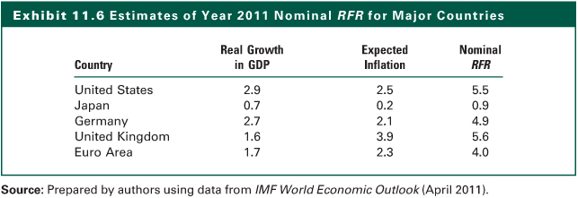
Exhibit 11.6

Slide 54
Estimating the Required Return for Foreign Securities
Risk Premium
  Must be derived for each investment in each country
  The five risk components vary between countries
    Business risk
    Financial risk
    Liquidity risk
    Exchange rate risk
    Country risk

Slide 55
Expected Growth Rate
Estimating Growth From Fundamentals
  Determined by
    the growth of earnings
    the proportion of earnings paid in dividends
  In the short run, dividends can grow at a different rate than earnings if the firm changes its dividend payout ratio
  Earnings growth is also affected by earnings retention and equity return
  g = (Retention Rate) x (Return on Equity)
  = RR x ROE

Slide 56
Expected Growth Rate
Breakdown of ROE
ROE=
Net
Income
Sales
Total
Assets
=
×
×
Sales
Total
Assets
Common
Equity
Profit Total Asset Financial
Margin Turnover Leverage
=
x
x

Slide 57
Expected Growth Rate
The first operating ratio, net profit margin, indicates the firm’s profitability on sales
The second component, total asset turnover is the indicator of operating efficiency and reflect the asset and capital requirements of business.
The final component measure financial leverage. It indicates how management has decided to finance the firm

Slide 58
Expected Growth Rate
Estimating Growth Based on History
  Historical growth rates of sales, earnings, cash flow, and dividends
  Three techniques
    Arithmetic or geometric average of annual percentage changes
    Linear regression models
    Log-linear regression models
  All three use time-series plot of data

Slide 59
Estimating Dividend Growth for Foreign Stocks
The underlying factors that determine the growth rates for foreign stocks are similar to those for U.S. stocks
The value of the equation’s components may differ substantially due to differences in accounting practices in different countries
  Retention Rate
  Net Profit Margin
  Total Asset Turnover
  Total Asset/Equity Ratio

Slide 60
The Internet Investments Online
http://www.leadfusion.com
http://www.lamesko.com/FinCalc
http://www.numeraire.com
http://www.moneychimp.com

