Slide 1


MK 312 Brand Management
Business Model Canvas
By Ajarn Suwalya K.
Lesson 1

Slide 2

Business Model Canvas
"The Business Model Canvas helps visualize what is important and forces users to address key areas. It can also be used by a team (employees and/or advisors) to understand relationships and reach agreements."

Slide 3
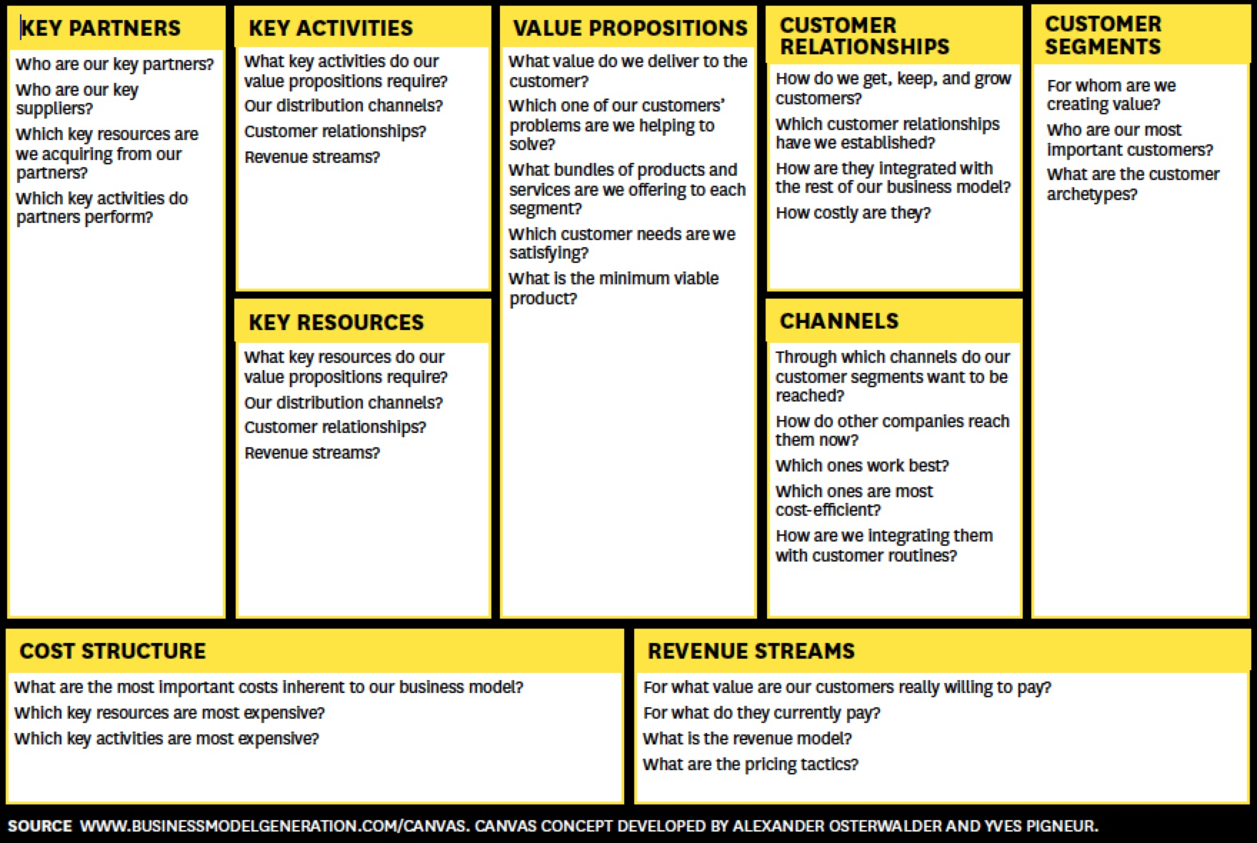
Business Model Canvas
A value proposition refers to the value a company promises to deliver to customers should they choose to buy their product. ... A value proposition can be presented as a business or marketing statement that a company uses to summarize why a consumer should buy a product or use a service.

Slide 4
Areas of Focus
The Business Model Canvas has nine different areas of focus that make up building blocks in a visual representation of your business.
Key Partners—Who are the buyers and suppliers you need to form relationships with? What other alliances will help you accomplish core business activities and fulfill your value proposition to customers?
Key Activities—What are the most important activities you must engage in to fulfill your value propositions, to secure distribution channels, to strengthen customer relationships, to optimize revenue streams, etc.?
Key Resources—What resources do you need to create value for your customers and sustain your business?
Value Propositions—What products and services will you offer to meet the needs of your customers? How will your business be different from your competition? What challenges will you solve for your customers?
Customer Relationships—What types of relationships will you forge with your customer segments? What are the relationship expectations of each customer segment? How are they entwined with the rest of your business model?
Customer Segments—What sets of customers will you serve? Which are most important to your business?
Channels—Through what means will you reach your targeted customers and deliver your products and services to them? Which are most cost effective? How are the channels integrated?
Cost Structure—What are the key costs your business will face? Which resources will cost the most? Which activities will cost the most?
Revenue Streams—How much will you charge for your products and services? What are customers willing to pay for? How will customers pay? How much will each revenue stream contribute to your overall revenue?

Slide 5
The 7 Elements of a Strong Business Model
Identify your specific audience. ...
Establish business processes. ...
Record key business resources. ...
Develop a strong value proposition. ...
Determine key business partners. ...
Create a demand generation strategy. ...
Leave room for innovation.

Slide 6
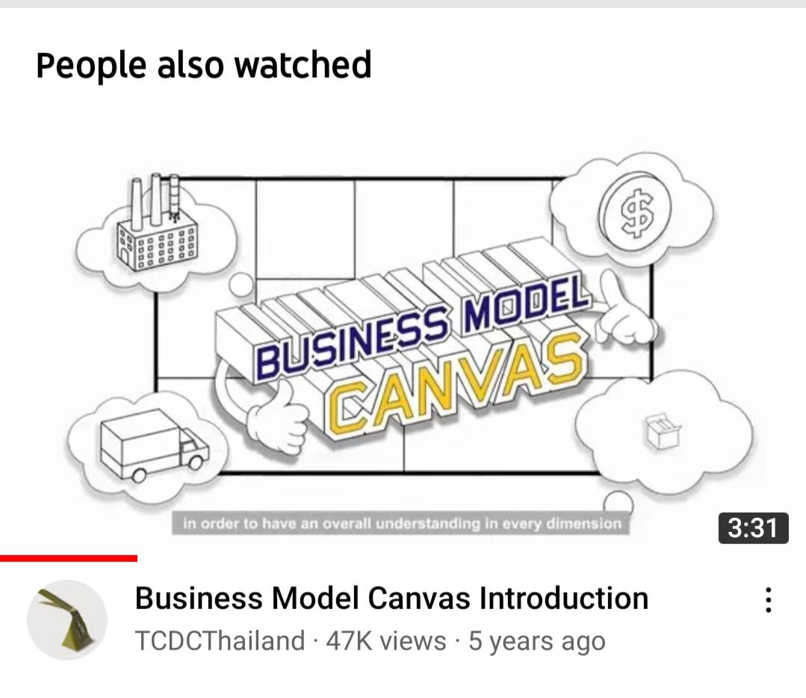

Business Model Canvas

Slide 7
How To Fill In A Business Model Canvas
Step 1: Naming the purpose of the business. ...
Step 2: Customers and Value Propositions. ...
Step 3: Channels and Customer Relationships. ...
Step 4: Key Resources, Key Activities and Key Partners. ...
Step 5: Cost Structure and Revenue Streams. ...
Step 6: Linking The Boxes +Tidying Up.

Slide 8
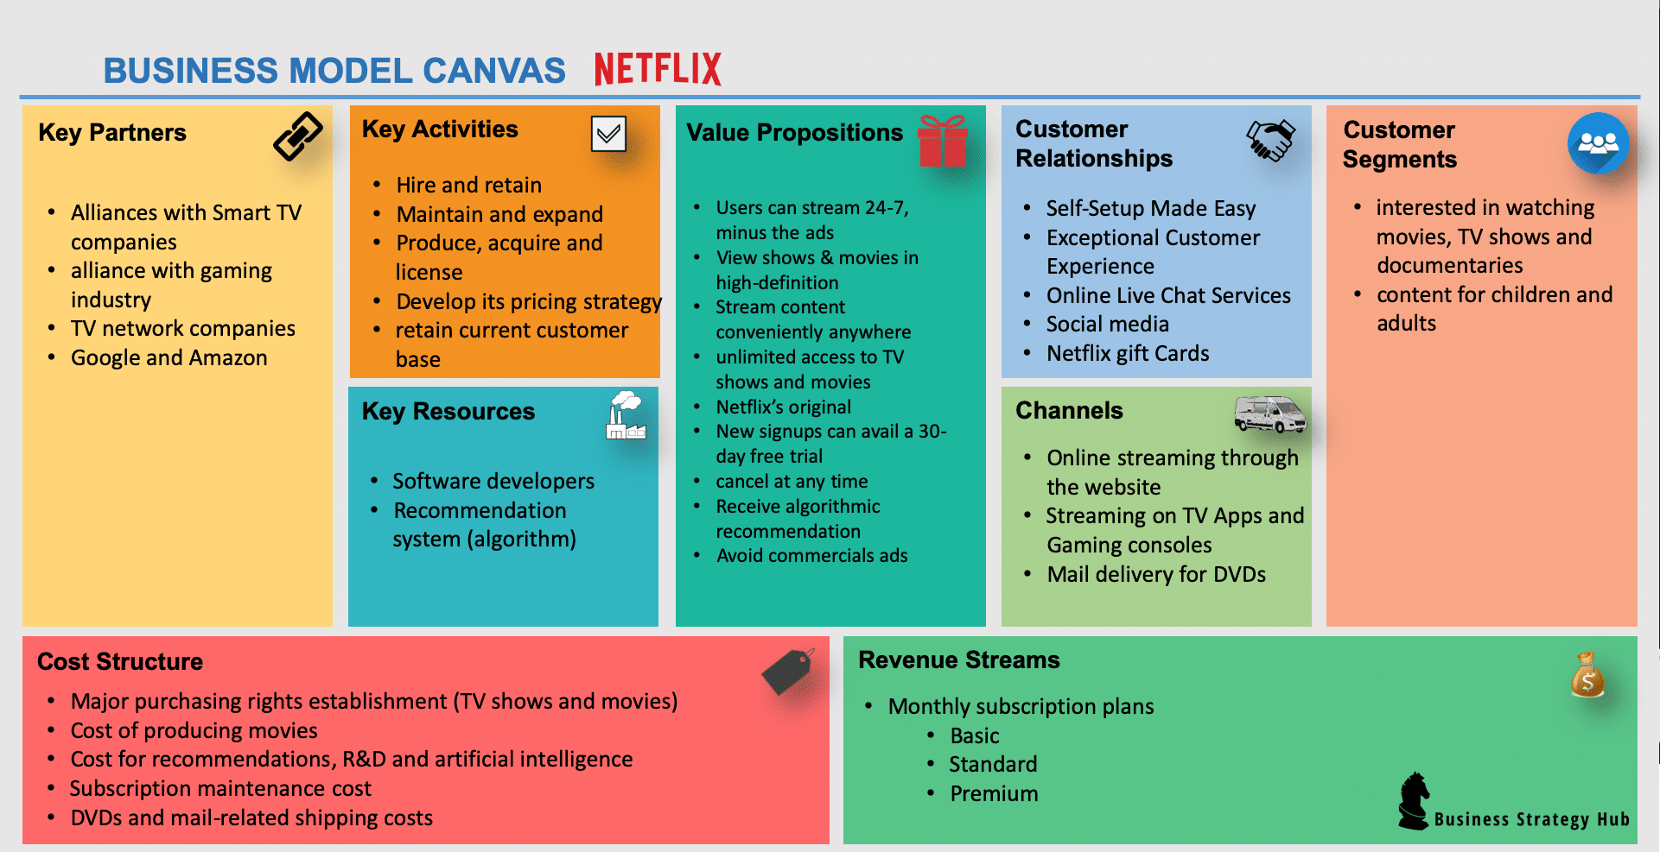
Business Model Canvas

Slide 9
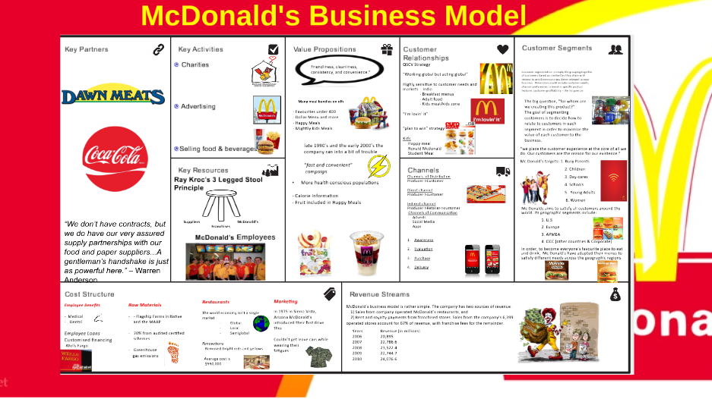

Source :McDonald's Business Model by Hannah Keogh

Slide 10
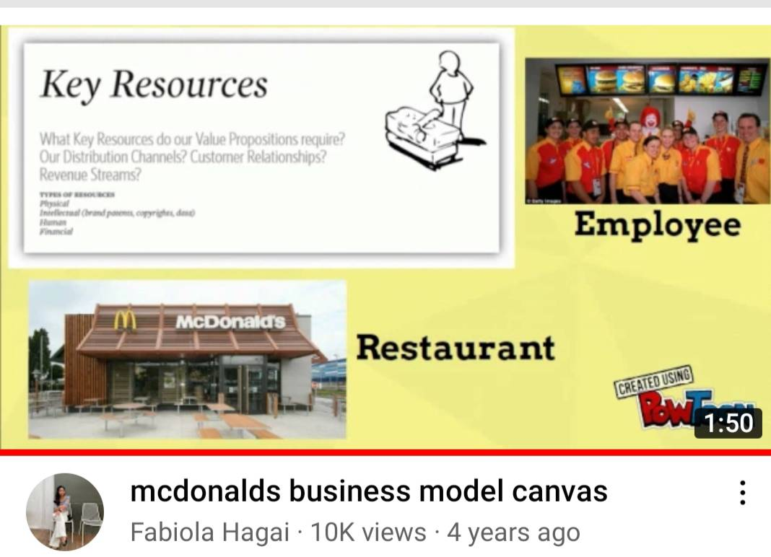

Slide 11
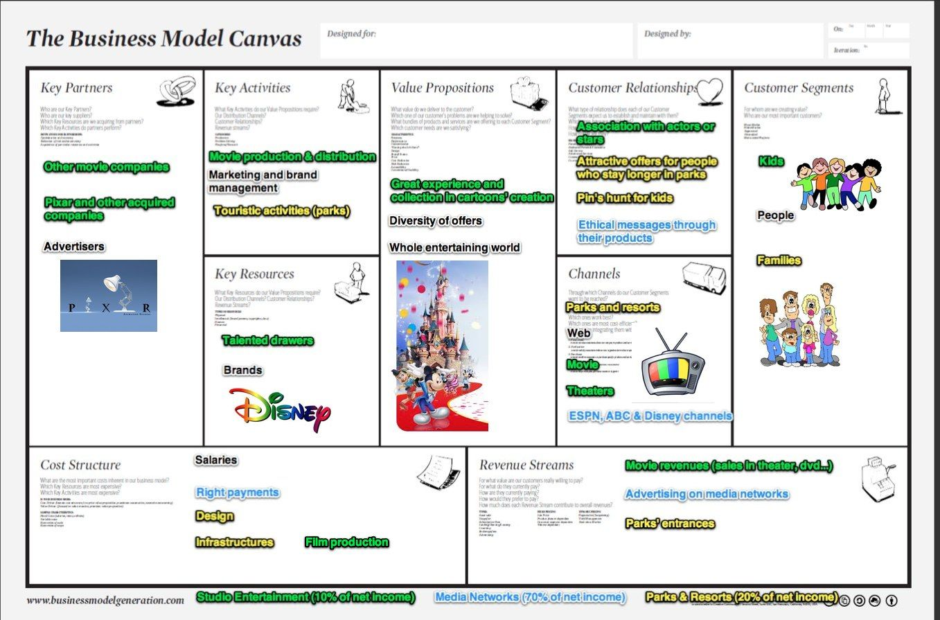

Slide 12
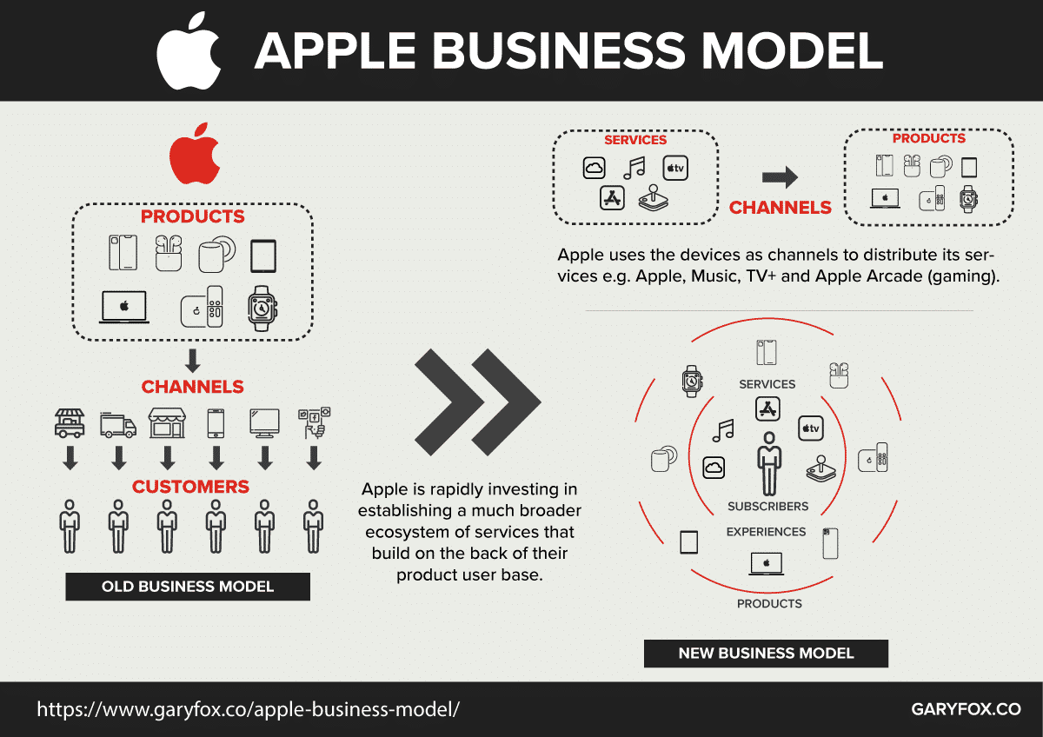

Slide 13
Business Model Canvas

Slide 14

Group Assignment
You are to create a one page ppt slide on the Business Canvas Model of After You
Please use information from vdo clip and more research if necessarily.
Be creative in your canvas
Also answer the following questions and put in bottom of slide
What are your key learnings from creating the canvas
How can After You utilize this canvas to grow its business
Due next week: One page ppt slide of After You Business Model Canvas
Have Fun ☺

Slide 15
Business Model Canvas

Slide 16


