Slide 1
Macroeconomics:
The Measurement of Economic Indicators (1): Measuring GDP
Thorn Pitidol
Faculty of Economics, Thammasat University
EE212, Semester 2/2017

Slide 2
Agendas
Measurement of macroeconomic indicators
GDP and its measurement
  Production Side
  Expenditure Side
  Income Side
Nominal/real GDP, GDP growth, and GDP per capita

Slide 3
Questions
If you are the government, what information do you need to make decisions on macro-economic policies?
  What indicators?
  What do the indicators reflect?
  How useful are the indicators?

Slide 4
Measurement of Macroeconomic Indicators
The measurement of macroeconomic indicators is geared toward measuring the “aggregate behaviours” of economic agents
  For example; households, firms, government
In the Thai context, measurements are carried out by different government units
  For example: BOT, NESDB, NSO, and MOF
  Note that the detailed calculation techniques constantly evolves.
In macroeconomics, the big 3 indicators are “GDP, inflation, and unemployment”

Slide 5
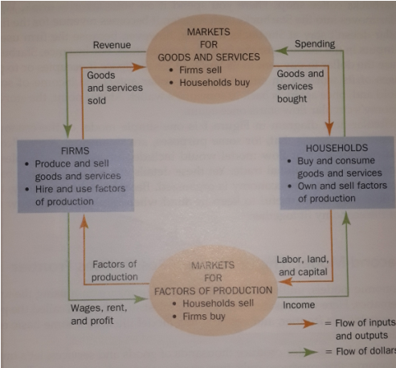
The circular flow of macro-economy
The “circular flow” model captures the important aspects of “aggregate behaviours” in the economy
Basic circular flow diagram (without the government,
financial institutions, and the foreign sector)

Slide 6
GDP and its measurement
GDP = a measure of the total value of final goods and services newly produced in a country over a period of time (usually one year)
  Final goods and services =
  Question

Slide 7
GDP and its measurement
GDP = a measure of the total value of “final goods and services newly produced” in a country over a period of time
What are not included in the GDP!
Measuring the GDP, how?
  The circular-flow shows the way!

Slide 8
GDP and its measurement
Three approaches to GDP measurement
  What did you learn from the circular flow diagram?
    The relationship between aggregate production, aggregate expenditure, and aggregate income within an economic system
  In a simple economy (as reflected by the circular flow diagram)
  GDP, therefore, can be measured from three sides:

Slide 9
GDP and its measurement
GDP measurement: production side
  This is the most direct method
    Summing up the value of all “final” goods and services produced in each sector
      Sector = each type of product.
        For example, farming, mining, manufacturing etc.
  GDP =

Slide 10
GDP and its measurement
GDP measurement: production side
  The presence of ____________________represent a major problem for calculating GDP from the production side.
    If we count the value of an intermediate goods, its value will be counted more than once, as the value is also included in the final product.
    We can avoid this problem by using ___________________in finding the value of production for each final goods.

Slide 11
GDP and its measurement
GDP measurement: production side
  Value added method:
    Value for each of the good can be calculated through summing up
  For example:
The value of production for grilled meatballs =

Slide 12
Calculating GDP Production Side
Value-added method
Example: Finding the value of pork-meatball noodle using the value added method
 | Pork | Noodle | Pork-meatballs | Pork-meatball Noodle
Input Costs | 0 | 0 | Pork | Noodle & Pork-meatballs
Value of output | 20 | 30 | 40 | 200

Slide 13
GDP of Thailand (Production Side) (Unit: Million Baht)

Slide 14
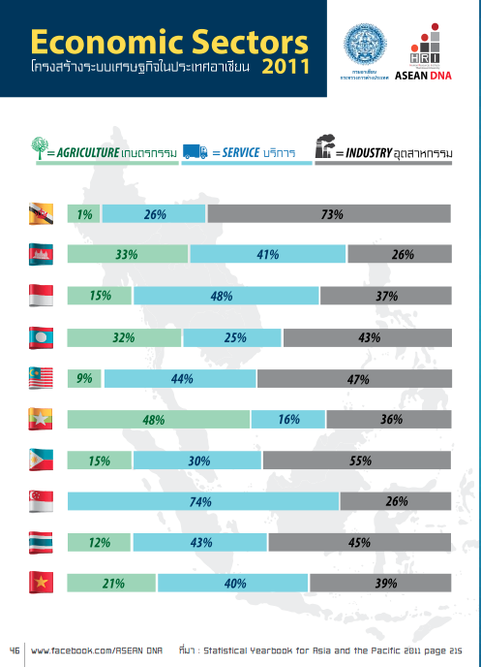

Slide 15
GDP and its measurement
GDP measurement: expenditure side
  Total value of all categories of expenditure on “final” goods and services
    Categories are divided according to types of spender
      Each type of spender designates “who” spends
    GDP = household consumption spending + business spending + government spending + net foreign sector spending
      Or simply GDP =

Slide 16
GDP and its measurement
GDP measurement: expenditure side
  More details on C + I + G + (X-M)
Component | Meaning
Private Consumption Expenditure (C) | Total value of spending on final consumption of goods and services, as spent by households or non-profit seeking organisations.
Government Consumption Expenditure (G) | Total government spending on final goods and services

Slide 17
2.3.3 Expenditure Approach
Component of GDP | Meaning
Gross Capital Formation (I)
Gross Fixed Capital Formation | Investments in constructions and equipments that are used in the production process and last longer than 1 year.
Change in Inventories | Difference between demand and supply of goods within one accounting year. ***A convenient way to think of this is to think of goods that have been produced but have not yet been sold.

Slide 18
2.3.3 Expenditure Approach
Component of GDP | Meaning
Exports and Imports of Goods and Services (X-M) | Export of goods: values of final goods exported to foreign countries. Export of services: value of services in transportation and tourism, and other services such as communication services, insurance services, sold to foreign countries. Import of goods: values of final goods imported from foreign countries Import of services: values of services bought from foreign countries.

Slide 19
GDP of Thailand (Expenditure Side)

Slide 20
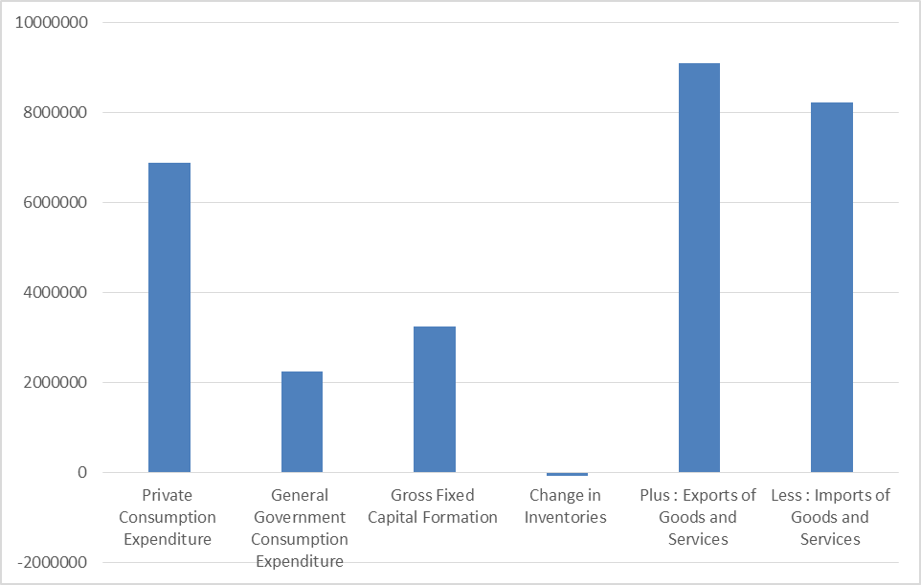
GDP of Thailand (Expenditure Side) 2014 (Unit: Million Baht)
Source: NESDB, Thailand

Slide 21
Exercise: Calculating GDP Expenditure Side
Example:
 | 2009
Private Consumption Expenditure | 5,000,000
General Government Consumption Expenditure | 1,500,000
Gross Fixed Capital Formation | 2,200,000
Change in Inventories | -200,000
Plus : Exports of Goods and Services | 6,000,000
Exports of Goods | 5,000,000
Exports of Services | 1,000,000
Less : Imports of Goods and Services | 5,000,000
Imports of Goods | 4,000,000
Imports of Services | 1,000,000
Expenditure on Gross Domestic Product
Plus : Statistical Discrepancy | 0
Gross Domestic Product, (GDP)

Slide 22
GDP and its measurement
GDP measurement: income side
  Summing up the production related income earned by all people and organisations
  But in order to get to the number of GDP, the calculation needs further steps
    Within GDP, there are components of income not earned by people within a country.
    And even from GNP, there are income not earned by factors of production, due to depreciation.

Slide 23
GDP and its measurement
GDP vs GNP
  GDP measures the total value of goods and services newly produced within the “___________________” of a nation
  GNP measures the same thing, but within the boundary of a nationality of economic agents.
    Can you imagine the case in which the two measurements for the same nation can be largely different?
  GNP = GDP +
    Net Income Payment from Abroad = Receipts of Income from Abroad – Payments of Income to Abroad

Slide 24
Japan GDP and GNP (Unit: Billion Yen)
 | 2012 | 2013 | 2014
Gross domestic product | 474,403.7 | 482,430.4 | 489,623.4
Net primary income from the rest of the world | 15,396.2 | 17,937.5 | 21,047.0
Gross national product | 489,799.8 | 500,367.8 | 510,670.4
Thailand's GDP and GNP (Unit: Million Baht)
 | 2012 | 2013 | 2014
Gross domestic product | 12,349,021 | 12,901,490 | 13,132,241
Net primary income from the rest of the world | -529,547 | -799,242 | -651,195
Gross national product | 11,819,474 | 12,102,248 | 12,481,046
Sources: Statistics Bureau of Japan and NESDB of Thailand

Slide 25
GDP and its measurement
Additional measures (in relation to GDP & GNP)
  Net National Product (NNP): GNP less depreciation
  National Income (NI): Total income earned by factors of production
    **In case statistical discrepancy is zero, NNP equals NI
  Personal Income (PI): Total income accrued to households
  Disposable Personal Income: Total income available for household to spend
  How to get from GDP to other measurements?

Slide 26
GDP and its measurement
GDP measurement: additional measures (in relation to GDP)
    GDP
      Plus: Receipts of factor income from the rest of the world
      Less: Payments of factor income from the rest of the world
    Equals:
      Less: Depreciation
    Equals:
      Less: Statistical Discrepency
    Equals:

Slide 27
GDP and its measurement
GDP measurement: additional measures (in relation to GDP)
    National income
      Less: Amount of national income not going to households
    Equals:
      Less: Personal Income Taxes
    Equals: Disposable personal income
      Less: Personal consumption expenditures, personal interest payments, and transfer payments made by households
    Equals: Personal saving

Slide 28
Calculating GDP Income Side
Example:
 | 2009
Gross Domestic Product, (GDP) | 9,000,000
Net Income Payment from Abroad | -500,000
Gross National Product (GNP)
Depreciation | 1,500,000
NNP (Net National Product)
Statistical Discrepancy | 0
NI (National Income)
 | 2009
Compensation to employees | 3,000,000
Household mixed income/operating surplus | 2,500,000
Household property income (rent + interest) | 500,000
Government property income (rent + interest) | -10,000
Corporate profit | 1,010,000
NI (Net Income)
Statistical Discrepancy | 0
NNP (Net National Product)
Depreciation | 1,500,000
Gross National Product (GNP)
Net Income Payment from Abroad | -500,000
Gross Domestic Product, (GDP)
 | 2009
NI (National Income) | 7,000,000
Income not going to household | 2,000,000
PI (Personal Income)
Personal income taxes | 1,000,000
Disposable personal income

Slide 29
GDP of Thailand (Income Side) 2009-2011 (Unit: Million Baht)

Slide 30
GDP and its measurement
Calculate GDP expenditure side and income side from the following information
  Consumption Expenditure = 10
  Government Expenditure = 15
  Savings = 5
  Depreciation = 2
  Fixed Capital Formation = 3
  Change in Inventory = 2
  Import = 2
  Export = 4
  Net income payment from abroad = -2
  Statistical Discrepancy = 0

Slide 31
GDP growth, Nominal/Real GDP, and GDP per capita
Measuring the GDP growth
  Can we simply compare the value of GDP from each year?
    Complications arise as prices keep on changing every year.
    Thus, the distinction has to made between nominal VS real GDP before the reliable measurement of growth in GDP can be obtained
      Nominal GDP =
      Real GDP =

Slide 32
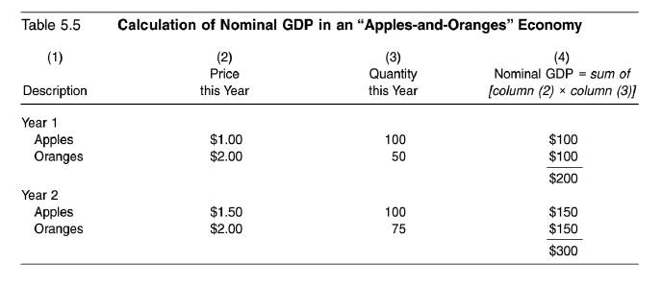
GDP growth, Nominal/Real GDP, and GDP per capita
Nominal GDP = GDP at current price

Slide 33
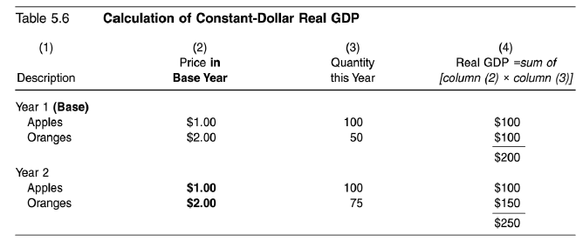
GDP growth, Nominal/Real GDP, and GDP per capita
Real GDP = GDP at base year price

Slide 34
GDP growth, Nominal/Real GDP, and GDP per capita
GDP Deflator
GDP Growth
GDP per capita

Slide 35
Nominal/Real GDP
GDP Deflator
  Indicator of the level of prices of all new, domestically produced, final goods and services in an economy.
  GDP deflator is calculated to indicate how the overall price level has changed through a period of time (i.e. from the base year until the current year).

Slide 36
Nominal/Real GDP
GDP Deflator
  Example
    In 2014, Thailand’s Nominal GDP is 5 billions, the GDP deflator (base year 2013) is 125. In 2013, Thailand’s Nominal GDP is 4 billions, with the GDP deflator of 100. Calculate the growth in real GDP.

Slide 37
GDP growth, Nominal/Real GDP, and GDP per capita
Exercise: calculate real GDP growth and GDP Deflator
 | Quantity |  | Price |  | Nominal GDP₁ | Nominal GDP₂ | Real GDP₁ (Base Year = Y1) | Real GDP₂ (Base Year = Y1
 | Year 1 (Q₁) | Year 2 (Q₂) | Year 1 (P₁) | Year 2 (P₂) | Q₁ x P₁ | Q₂ x P₂ | Q₁ x P₁ | Q₂ x P₁
Goods A | 6 | 6 | 5 | 6
Goods B | 7 | 7 | 3 | 5
Goods C | 10 | 12 | 7 | 9

Slide 38
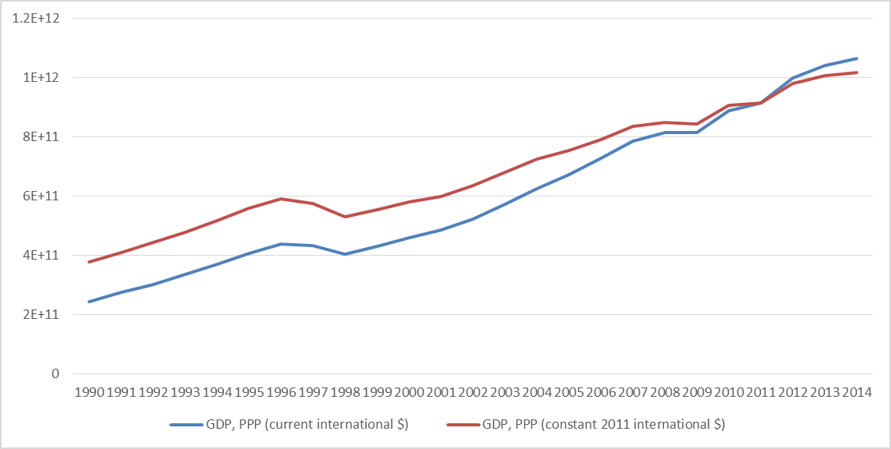
Thailand Real and Nominal GDP (US Dollars), 1990-2014

Slide 39
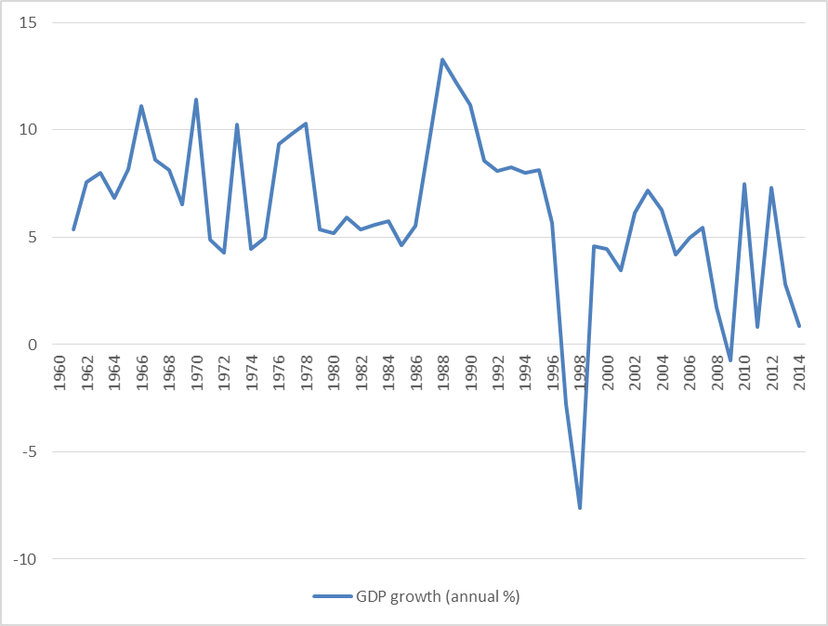
Thailand GDP growth 1960-2014
Source: World Bank

