Slide 1
Rice farmers and New Merchants in the Time of Revolution
Thai Economic History
Thorn Pitidol
1/2016

Slide 2
Topics
The persistent poverty of rice farmers
The rise of new merchants
  Rice barons
  Urban entrepreneurs

Slide 3
The persistent poverty of rice farmers
The cultivating regime expanded by the peasants had one particular problem "low yield"
  Factors
    Limited capitals and technology
    The natural condition (clay, weather) also did not help.
    Paddy varieties.
The yield of Thai peasants was very low by international comparison.
  The yield increased a little in the latter half of 19th century. But the change was not immense.

Slide 4
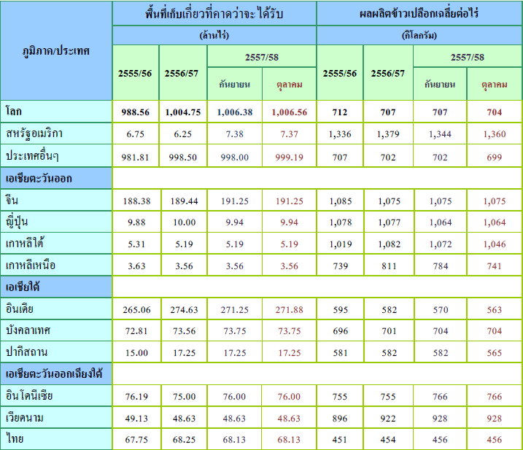

Slide 5
The question over low yields
Investment and extractive pressure could push for change
  Pressure can come from government, landlords, and merchants.
  Peasants’ differentiation and proletarianization.
Such pressure missing in Siam for a long time, Why?

Slide 6
Government Exploitations of Peasants
Government exploited the rice economy through the universal poll taxes and land taxes.
  Poll-taxes produced large revenue, and land tax were hiked many times (1900, 1905, and 1909)
  Tax collection applied strictly, with harsh penalty
  Farmers resented the taxes, and petitioned for more supports from the government
    Situation worsened in 1929

Slide 7
Government Exploitations of Peasants
Despite the exploitation, government did not provide infrastructure and credits to peasants.
  Van Der Heide plan for large scale irrigation could led to a more stable yield.
  But the project was not chosen
  Support limited to drainage works and seeds distributions

Slide 8
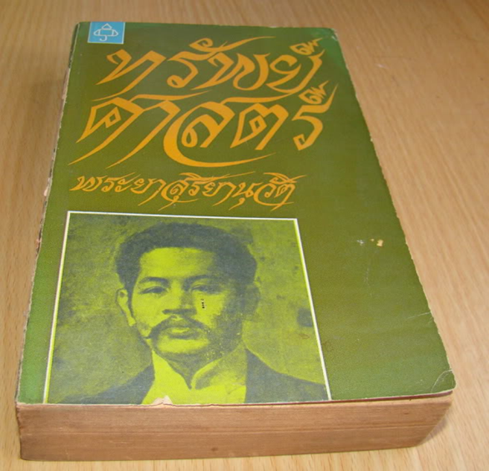
พระยาสุริยานุวัตร
  ความเจริญของกรุงสยาม ซึ่งต้องอาศัยการทำนาเป็นใหญ่กว่าอย่างอื่นดังทุกวันนี้ จะเจริญเร็วและช้าก็ต้องสุดแล้วแต่ผลประโยชน์ที่ชาวนาจะได้มากและน้อยเป็นสำคัญ แต่จะทำประการใดจึงจะมีทุนให้ชาวนาพอใช้ได้โดยไม่ต้องเสียดอกเบี้ยเรี่ยวแรงนัก และจะทำประการใดจึงจะให้ชาวนามีกำไรยิ่งขึ้น
รัชกาลที่ 6
  ชาวนาเป็นอิสระ สุขสบาย และกอปรไปด้วยความจงรักภักดี ภาพวาดชาวนาว่าทุกข์ยากขาดหลักฐานสนับสนุน
  ไม่ควรแบ่งคนไทยเป็นชนชั้น เพราะสร้างความแตกแยก
  “ความพอใจในสี่งที่ตนมีอยู่แล้วนั่นล่ะเป็นทรัพย์อันประเสริฐยิ่ง”

Slide 9
Merchant Exploitations of Peasants
Merchants exploitation had more influence. But could only produced limited pressure.
  Merchants involved were mostly small with limited capital.
    Did not invest but focused on trading activities.
  They travelled ups and downs lands and rivers. Purchased and transported rice. Selling some imported and locally made products.

Slide 10
Merchant Exploitations of Peasants
Merchants as lenders
  By 1910s, it was estimated that most cultivating peasants were indebted
  Could the debts break down the peasant society, causing the peasants to lose their land?
    Even in 1930s, land losses and destruction of peasantry did not occurred. Debt continued to rise, and peasants dealt with recession by retreating into subsistence.

Slide 11
Merchant Exploitations of Peasants
Why limited impact on peasants?
  Limited extent of lending due to the lack of land deed
  The merchants also small-scale operators with limited capital.
Up until WWII, Siam peasants only had limited differentiation.
  Small peasants dominated
  Production remained labour intensive with low yield

Slide 12
Merchant Exploitations of Peasants
Other factors sustaining Siam’s peasant society from differentiation
  Large supply of land
  Unclear property rights over land
  Low yield caused limited chance for accumulation.

Slide 13
The new groups of businesses
From 1920s to 1950s, 80-90 percent of Thailand's export consist of rice, teak, tin, and rubber
In the 1920s, two new merchant groups
  The rice baron
  The urban entrepreneurs
Both of them had similar development and faced similar challenges

Slide 14
Rice barons
The accumulation from rice trade was difficult.
  Lack of land titles and the fluctuation in price
  Global economic recession from 1919-1929.
In 1930s, a new group of Chinese families dominated rice trade, and became major corporate dynasties of modern Thailand.
  5 big Chinese families: Wanglee, Lamsam, Bulasuk, Bulakun, and Iamsuri.

Slide 15
Rice barons
The new group differed from the past.
  Most were not related to tax-collectors
They carved their own successes with limited gov’t help
  Colonial firms dominated shipping, banking, and insurance. The government tended to give priority to the Western businesses
The new group applied different strategy
  They expanded and integrated the range of their business to reduce risk and gain more profits
    Started from lower-level trading activities, moved into rice milling, and expanded to rice exports.

Slide 16
Rice barons
Wanglee
  Began with junk trade and textile imports.
  Set up banks, insurance, shipping firms to serve their own rice trade.
  By 1938, their rice mills handled 1/5 of industry
Bulakun
  Cantonese engineer specialised in rice mill machinery
  Set up own rice mill and later expanded to shipping, insurance, and foreign exchange dealing

Slide 17
Rice barons
The new group of rice entrepreneurs relied on the network built on Chinese communities.
  A large scale Chinese business associations were founded through supports by big Chinese families
  Teochiu Association, Hakka Association, Cantonese Assocation.
  The families also intermarried to forged alliances.

Slide 18
Urban Entrepreneurs
Another new group of merchants developed their business in the urban areas.
  Responded to rise in urban-based demand
    European trading agencies imported products such as textiles, beer, wine, soaps
They tried to compete with the import products.
  Produced products such as ice, soap, drinks, beer, textile, and cooking oils.
Their path to success similar to the rice barons.

Slide 19
Urban Entrepreneurs
Nai Lert
  Imported cars, manufactured ice, and set up bus service
Nai Boonrawd
  Worked for Kim Seng Lee. Traded timber and set up ferry service. Eventually produced beer.
Mangkorn Samsen
  Rice mills, cononut oil plants, and a sugar factory
Koson Huntrakul
  Ice and carbonated-water factory

Slide 20
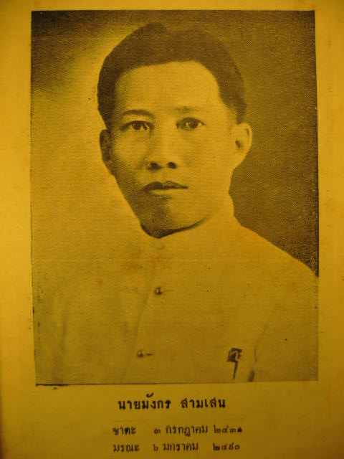
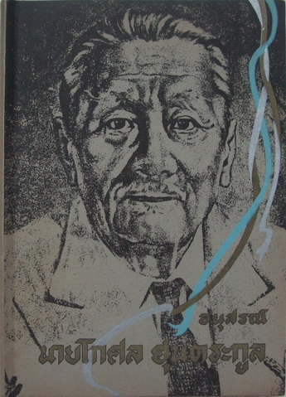
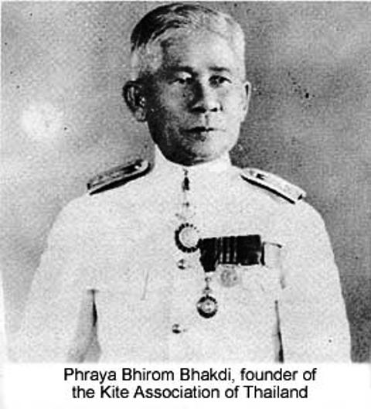
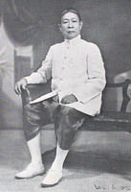
Urban Entrepreneurs
Boonrawd
Kosol
Lert
Mangkorn

Slide 21
Urban Entrepreneurs
The urban entrepreneurs also faced the unfavorable context.
  With low tariff, colonial imports gained advantages over them.
  They sought more protection and asked for loans.
    But their petitions for government supports failed.

Slide 22
Pressuring the government
From 1910s, business associations were formed to put pressure on the government.
Government supports asked based on grounds of nationalism and sound economics.
  Privileges of the West caused lack of development and contrasted with the modern and independent nation.
  The source was the Bowring Treaty, signed by the monarchy.
Absolutism as “bias and incompetent”

Slide 23
Urban entrepreneur and 1932 revolution
Although they played no direct part in the 1932 revolution, the merchants welcomed the result.
  The revolution seemed to favour economic nationalism.
  The merchants tried to participate in the drafting a new national economic plan.
But Pridi’s economic plan overlooked the urban entrepreneurs.
  The plan gave priority to the well-being of the masses, most of whom are the poor.

Slide 24

Pridi’s lost ambition
Pridi's 1933 economic plan involves the creation of the state/cooperative system that employ every Thais who are willing to work
Primary goal: promote the well-being of "all Thais“.
But his plan failed after facing resistance.

Slide 25
Urban entrepreneur and 1932 revolution
The failure of Pridi’s plan led to an alternative plan. But the focus remained the peasants.
  Siam seen as a society of peasants organised by bureaucrats.
  Domestic (Chinese) entrepreneurs neglected or even considered the threat by the revolutionaries
    The middlemen and Chinese seen as causing hardship to peasants.
    State ownership favoured over private capitals.

