Slide 1
Macroeconomics:
An Introduction (2)
Thorn Pitidol
Faculty of Economics, Thammasat University
EE212, Semester 1/2016

Slide 2
Topics
Tools for understanding macroeconomic issues
Tradeoff between macroeconomic objectives
Basic concepts in understanding economic activities

Slide 3
Tools for understanding macroeconomic issues
Basic tools for investigating macroeconomic phenomena
  Empirical tools
  Theoretical tools
  Historical tools

Slide 4
Tools for understanding macroeconomic issues
Empirical tools
  Empirical = observation and recording of specific happenings in the world
  In economics, most empirical analysis are done quantitatively (through analysis of numbers)
    Recording of how quantitative value of a variable change through time (= time series)
    Also, recording of relationships between variables (regression)
      This is about finding correlation between variables
      But needs to be careful that correlation does not imply causation

Slide 5
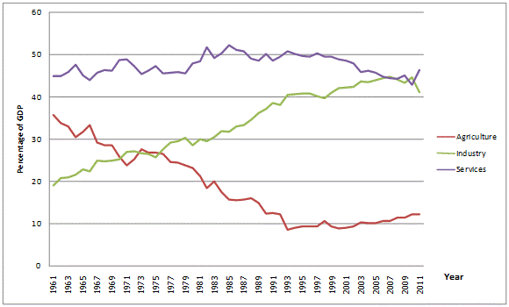
Tools for understanding macroeconomic issues
Empirical tools (time-series)
Share of GDP in Thailand (Percentage) from 1961-2011
Data Source: The World Bank 2013 (http://data.worldbank.org/country/thailand)

Slide 6
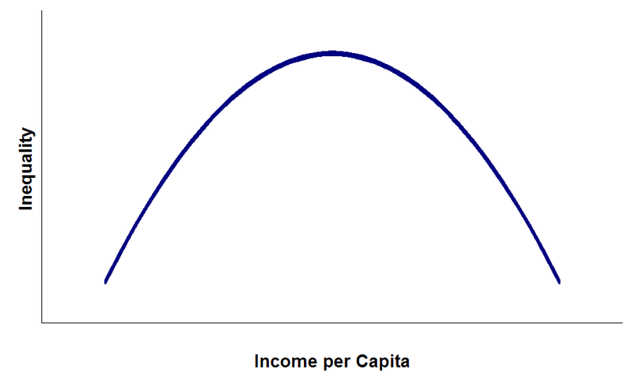
Tools for understanding macroeconomic issues
Empirical tools (regression)
Kuznet Curve

Slide 7
Tools for understanding macroeconomic issues
Theoretical tools
  Quantitative analysis may not produce enough insights on “how things work”
  Economists construct “economic models” to do such a task
    A model, proposing the nature of relationships between variables, is based on thought-experiments.
    Assumptions are outlined, and through careful reasoning, a mathematical explanation is built.

Slide 8
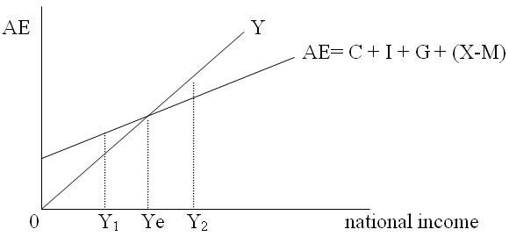
Tools for understanding macroeconomic issues
Theoretical tools
  Economic Model
  Keynesian model of income determination

Slide 9
Tools for understanding macroeconomic issues
Historical tools
  In addition, knowledge of historical events also forms another route in which economic knowledge can be developed.
  This route can be indispensable in giving broader insight on economic phenomena. This is because it can provide a connection between economic, social, and political factors.

Slide 10
Tools for understanding macroeconomic issues
Historical tools
  Example: “Kicking Away the Ladder” (Ha Joon Chang, 2002)
    Historically, the Western developed nations had used trade protections and subsidies to support the growth of their industries. Such policies, in place throughout 18-19th century, contributed to its powerful economic position in the present. It seems, therefore, contradictory that these are the nations that ask developing countries to develop through “trade-liberalisation.

Slide 11
Tradeoff between macroeconomic objectives
The concept of trade-off is central to economics
  Remember the Production Possibility Frontier (PPF)?
What about the trade-off in macroeconomics?
  Employment and inflation
  Energy and environment
  Efficiency and equality

Slide 12
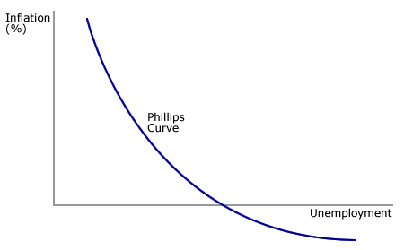
Tradeoff between macroeconomic objectives
Trade off in employment and inflation
  Phillips Curve

Slide 13
Tradeoff between macroeconomic objectives
Trade off in efficiency and equity
  Programs to promote equality comes at the expense of distorting incentives to work and, thus, reduce efficiency in the economy.
    For example: unemployment benefits
But we have to keep in mind that several notions of “trade-off” are contestable.

Slide 14
Basic concepts in understanding economic activities
4 essential macroeconomic activities:
  Resource maintenance
  Production
  Distribution
  Consumption

Slide 15
4 essential macroeconomic activities
Resource maintenance activities help to keep up the quantity and quality of important capital stocks.
  Capital stocks = a quantity of any resource that is valued for its potential economic contributions

Slide 16

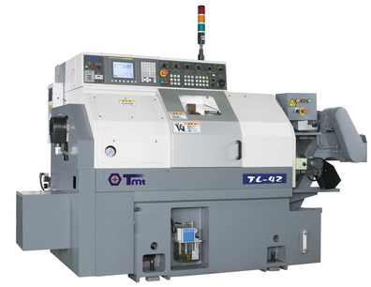



4 essential macroeconomic activities
Types of capital
  Natural capital
  Manufactured capital
  Human capital
  Social capital
  Financial capital

Slide 17
Important concepts on resource maintenance
Stock VS Flow Variables
  Stocks = something whose quantity can be measured at a point in time
  Flow = something whose quantity can be measured over a period of time
Flows change the level of stocks
Most macroeconomic variables can be categorised into stock or flow variables

Slide 18

Important concepts on resource maintenance
Stock VS Flow
Examples
Income = flow variable
Wealth = stock variable
Investment = flow variable
Capital = stock variable

Slide 19
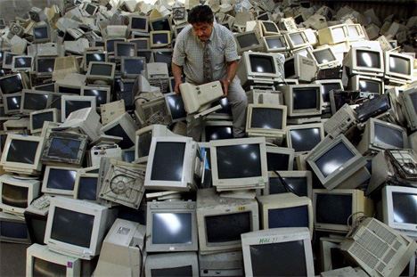
Important concepts on resource maintenance
Investment VS Depreciation
  Investment is primarily the activity of resource maintenance
  Depreciation occurs when a capital stock decline in quantity or quality
    Manufactured assets, for example, wear out and lost their usefulness overtime.

Slide 20
4 essential macroeconomic activities
Consumption
  The final use of a good or service
  Consumption is frequently contrasted with investment, which refers to resource maintenance activities.

Slide 21
4 essential macroeconomic activities
Production = conversion of resources into goods and services.
Production converts "inputs" into "outputs"
  Inputs include materials that become part of the produced good, supplies that are used up in the production process, and labour time.
  But there are flow of services, arising out of capital stocks, that will not be used up. These include human and social capitals.

Slide 22
Important concepts on production
“Nominal VS. Real” Value
  In economics, “nominal” value refers to the value expressed in monetary terms, i.e. in the units of a currency.
  “Real” is a value that is adjusted from the “nominal” value to remove the effect of a change in price over a period of time.
  For example, the “nominal” value of outputs produced by firm A may increase from the previous year. But if the rise in value is caused solely by the change in price level. The real value of the outputs remains the same.

Slide 23
4 essential macroeconomic activities
Distribution
  the allocation of products and resources among people
Macroeconomists are usually particularly interested in who receives the income generated by production, and the roles the government plays in re-adjusting distribution.

Slide 24
Important concepts on distribution
Who receives income? Labour VS Capital
  Labour income is compensation received by workers in the form of wages, salaries, and fringe benefits
  Capital income include rents, profits, and interest
Questions usually arise “whether a distribution between these types of income is justified”

Slide 25

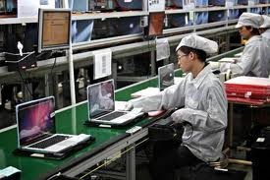
Important concepts on distribution
Tim Cook (Apple CEO) VS A Chinese labour (who produces apple products)
The Apple CEO's pay was $4.2 million in 2012 (Forbes)
A salary for an entry level worker in Foxconn factory is approximately $ 3600 per annual in 2013 (Dailymail, UK)
The difference is just 1,166 times

Slide 26
Important concepts on distribution
Measurement of income distribution
  20:20 Ratio (income of the richest 20% divided by that of the poorest 20%)
  Lorenz curve = a line used to portray an income distribution, drawn on a graph with percentiles of household on the horizontal axis and the cumulative percentage of income on the vertical axis.
  Gini ratio = a ratio of the area between Lorenz curve and the diagonal line to the total area under the diagonal line.

Slide 27
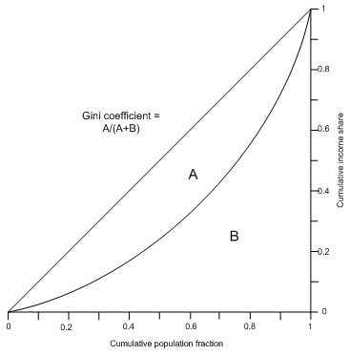
Lorenz Curve
Gini ratio (or coefficient) = a/a+b
If the gini is higher, the economy is more unequal
Thailand Gini Coefficient (world bank)
1990 = 45.27
1996 = 42.9
2000 = 42.84
2006 = 42.35
2009 = 40.0
Other countries
Cambodia 2009 = 36.0
South Korea 2007= 31.3

Slide 28
Thailand’s fallen poverty VS persistent inequality
Despite being very successful with the effort to reduce absolute poverty, Thailand has achieve very little success in reducing inequality.
Why do you think this has happened to us?

Slide 29
Large income improvement and poverty reduction
Real GDP per capita increased 3.7% per year for the past decade
Poverty headcount ratio reduced to only 3.4%.
Source: data from the World Bank.

Slide 30
Income inequality has been persistently high
Thailand
Malaysia
Philippines
Vietnam
Lao PDR
Cambodia
Indonesia
Source: smoothed estimate using data from the World Bank.

Slide 31
Important concepts on distribution
Wealth inequality -- the distribution of wealth, i.e. what people own in assets or debt
  This tends to be much more unequal than distribution of income.
Example:
  http://business.time.com/2014/01/20/worlds-85-wealthiest-people-as-rich-as-3-5-billion-poorest/
  http://www.theguardian.com/business/2015/jan/19/global-wealth-oxfam-inequality-davos-economic-summit-switzerland

Slide 32
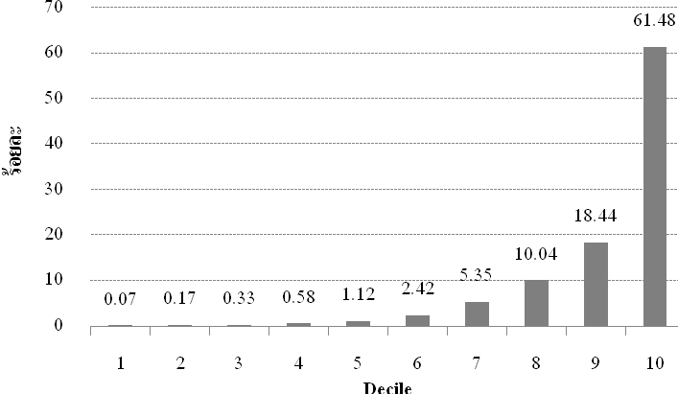
Landholdings (with Chanod) distribution: personal and corperate
2014
Source: Land Department, and Duangmanee’s calculation

Slide 33
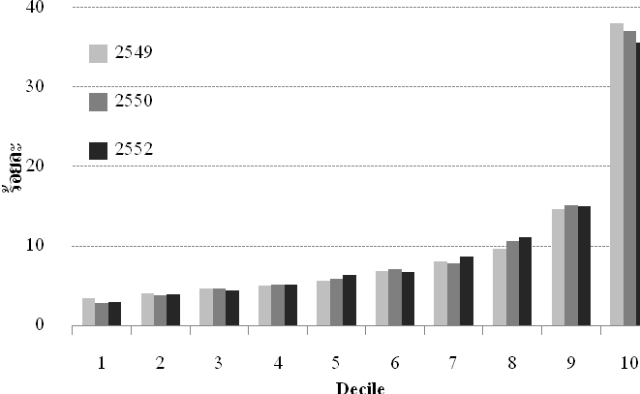
Wealth distribution
2014
Source: SES

Slide 34
The 3 spheres of economic activities
Economic activity take place in three major sphere:
  Households: make decisions on consumption and savings, supply of labour, investment in education.
  Firms: makes decisions in production and investment.
    Main motive is assumed to be profit-making.
  Government: makes decisions related to the provision of public goods, and regulation of markets.
    But is generally seen by economists as inefficient.

