Slide 1

Group Assignment 2
Retail Entrepreneurial Opportunities

Slide 2

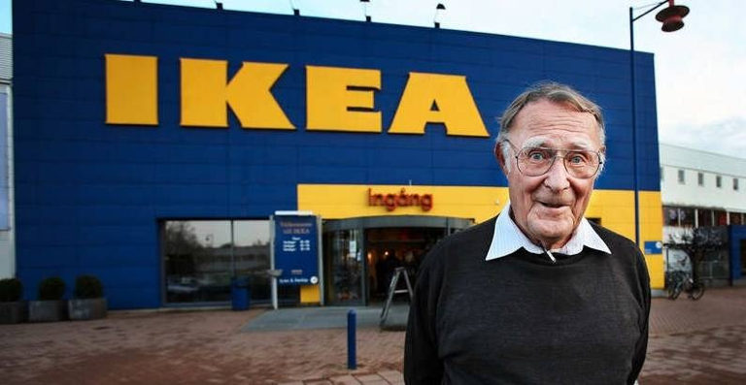
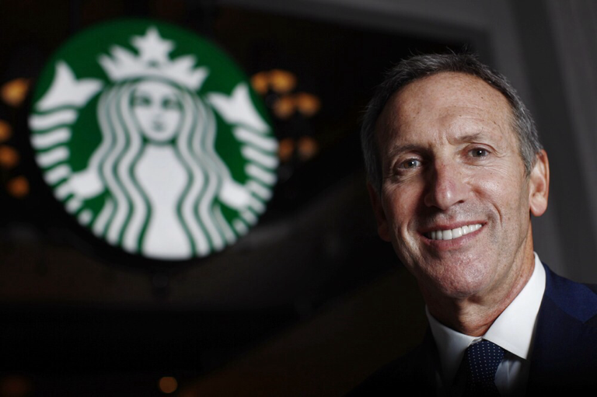
Entrepreneurial opportunities
Group Assignment:
What do they have in common?
What differences do they have?
What vision did each one have?
What makes their retail businesses so successful?
Please create one page ppt. slide to be due next Tuesday Feb.9th. Please design the one page by using graphs, charts, visuals to make one page interesting ka.
Notes:
1

Slide 3
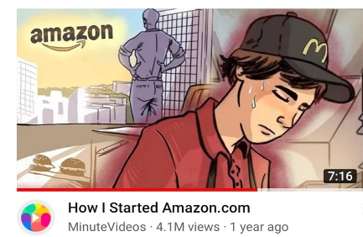

Entrepreneurial opportunities
Jeff Bezos – Amazon.com
Notes:
1

Slide 4
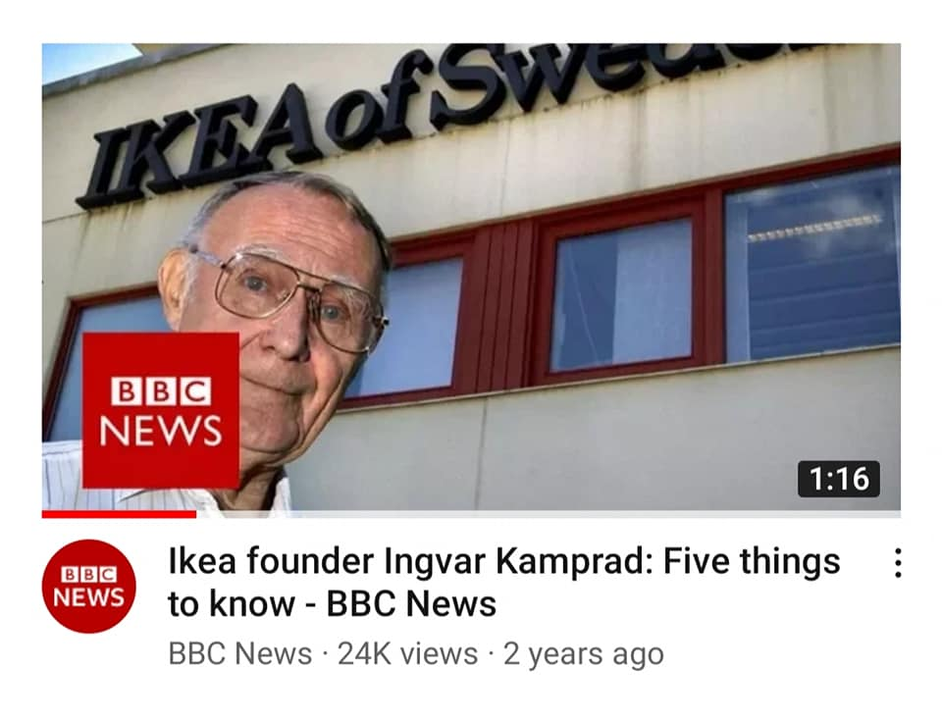
Entrepreneurial opportunities
Ingvar Kampred - IKEA
Notes:
1

Slide 5

Entrepreneurial opportunities
Howard Schulz - Starbucks
Notes:
1

