Slide 1
FN 281: Personal Finance
Thanachote Rungsitivat, CFA, FRM

Slide 2
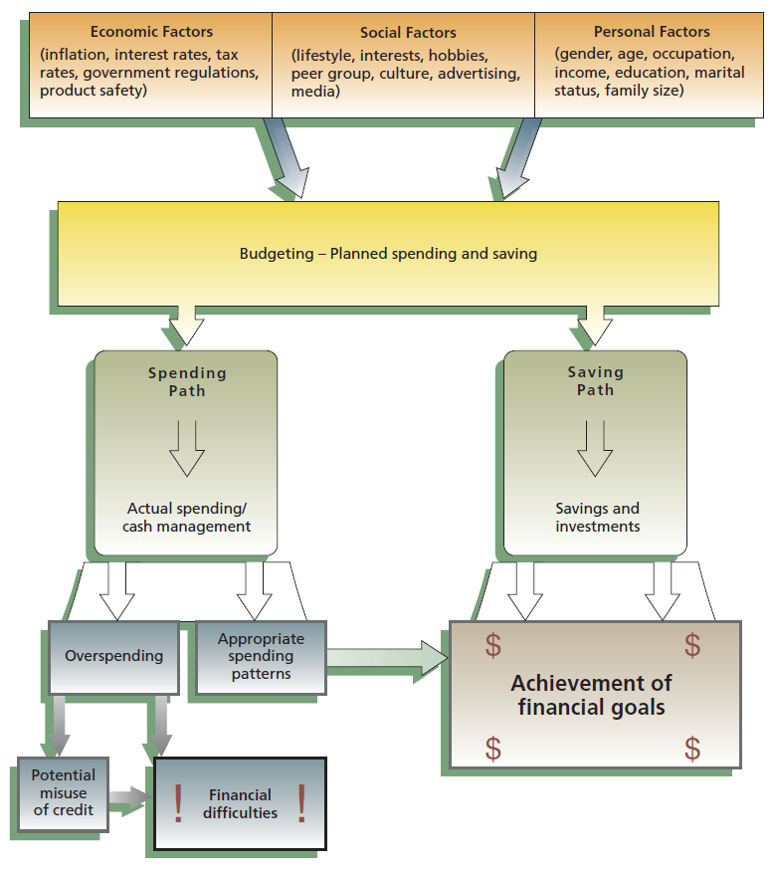
Purchase Decisions
Financial Implications of Consumer Decisions

Slide 3

Financial Implications of
Purchasing Decisions
Commonly overlooked trade-offs when buying include…
  Selecting brands that may be difficult to service or repair.
  Ordering by mail or online to save time and money, but return or repair may be difficult.
  Taking time and effort to comparison shop.

Slide 4
Factors of Consumer Purchases
Economic Factors
Social Factors
Consumer prices
Interest rates
Supply/demand
Brand name
Warranty
Product Quality
Tax rates
Govt. regs.
Lifestyle
Culture
Attitudes
Ads
Media/Internet
Hobbies
Peer group
Consumer
Buying
Influences
Personal Factors
Sex and age
Marital status
Occupation
Income
Education
Family size
Housing type
Ethnic group
Religion

Slide 5
Financial Implications of Consumer Decisions
Nok has a tendency to make impulse purchases. This has caused her to get into some financial difficulty. She would like to make better purchases in the future and has found several practical purchasing strategies that she thinks will help her avoid making poor decisions in the future.

Slide 6
Practical Purchasing Strategies
Timing Purchases
Store Selection
  Location, convenience vs Price (Cash and Carry)
Brand Comparison
  Starbucks?
Price Comparison
  Unit pricing

Slide 7
Timing Purchases
  Certain items go on sale at the same time each year
  Weather reports might give information about prices of certain food products
  News reports may be important
    Changing economic conditions
    Political difficulties around the world
Nok has always shopped when clothes first appear in the store. She realizes that by waiting just a few months she might be able to get much better prices on the same clothes. She has never paid much attention but realizes that changing economic conditions might change the interest rate she would have to pay on a loan or that political turmoil in China might raise the prices of goods imported from there.

Slide 8
Store Selection
Specialty Shops
Superstores
Online Stores
Cooperatives
Nok knows that there are many different places she can make purchases these days, and this increased competition combined with new technology gave given her greater choices and often lower prices.

Slide 9
Brand Comparison
Nok knows that there are many different brands available and that there can be important differences in price and quality for the different brands. She knows that national brands include Tylenol, Sony, Kellogg’s, Levi and many others which are household names. They often have higher prices that other brands but have gotten to be nationally known brands because of their consistent quality. i-Mobile, on the other hand, sells its own brand of phones while Big C sells its own brand of various durable goods. These products are often produced by same companies that produces the national brand. The quality is often similar to national brands, but the prices can often be lower.

Slide 10
Price Comparison
More store convenience (location, hours, sales staff) generally means higher prices
Ready-to-use products have higher prices.
Large packages are usually the best buy. However, unit pricing allows the comparison of prices of packages of different sizes.
A ‘sale’ might not always mean saving money.
Consider promotional offers.

Slide 11
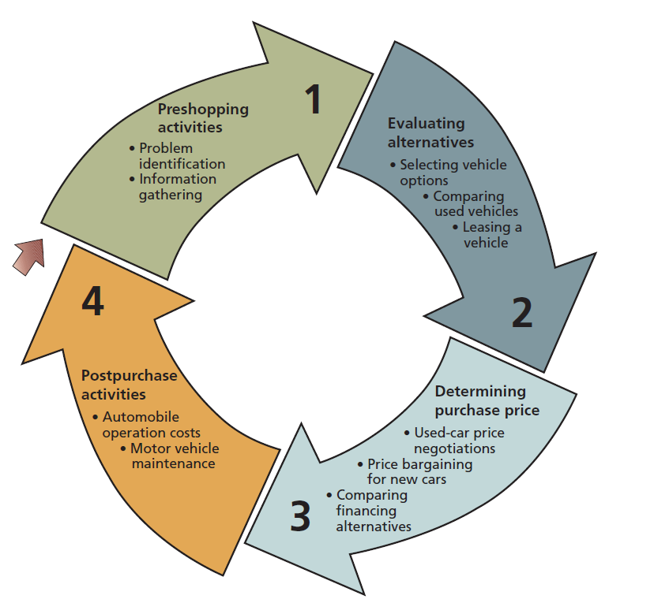
Purchasing a Car

Slide 12
Leasing a Motor Vehicle
Advantages
  Only a small security deposit might be necessary up front
  Monthly lease payments are often smaller than financing payments
  Detailed records for business purposes
  Can often obtain a more expensive car than otherwise
Disadvantages
  No ownership interest in the vehicle
  Qualifying credit requirements the same as financing a purchase
  Additional costs may be incurred for extra mileage, repairs, turning car in early, or moving to another province

Slide 13
The True Cost of a Lease
Capitalized Cost – the price of the vehicle in the leasing agreement
Money Factor – the interest rate being paid on the capitalized cost
The monthly payment and number of payments
The residual value – the expected value of the car at the end of the lease

Slide 14
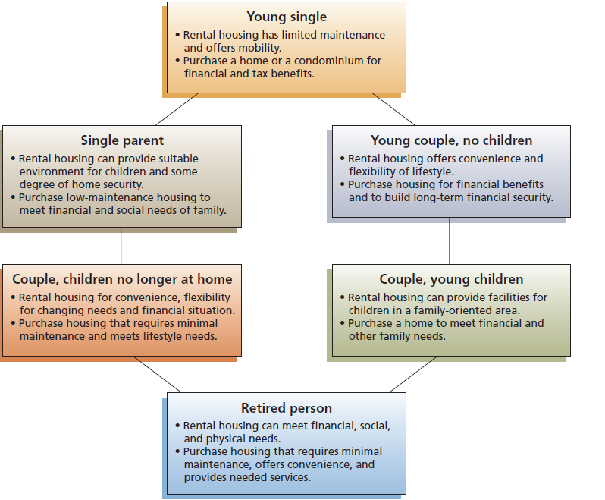
The Housing Decision

Slide 15
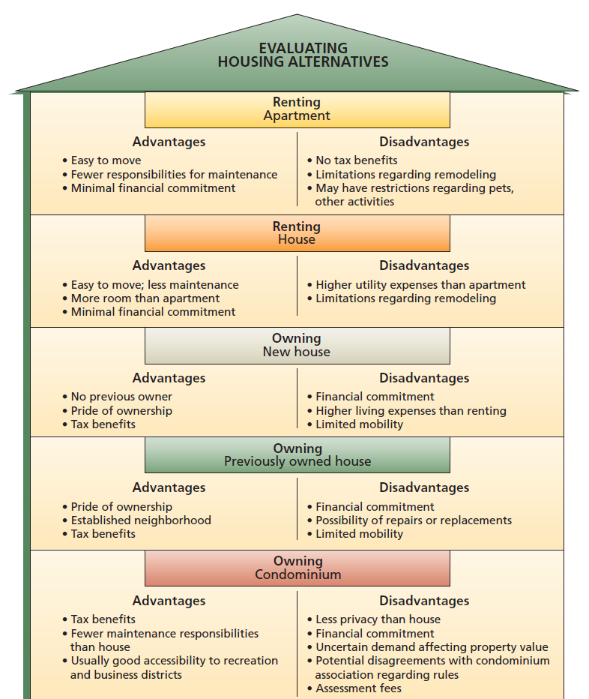
Evaluating Housing Alternatives

Slide 16
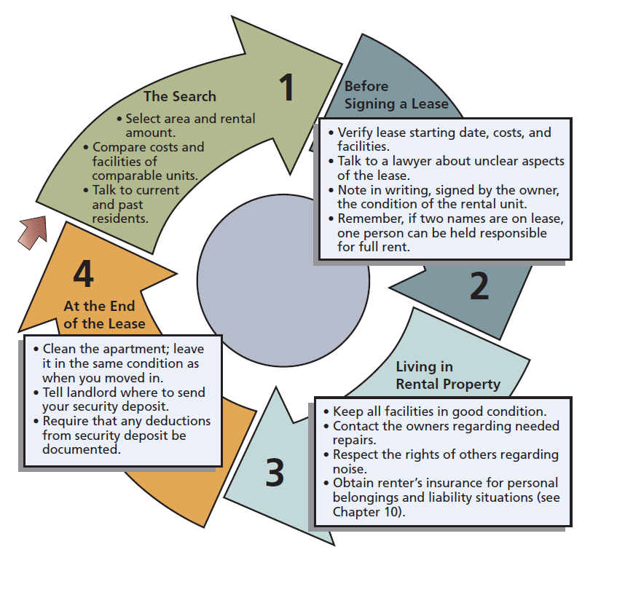
Selecting a Rental Unit

Slide 17
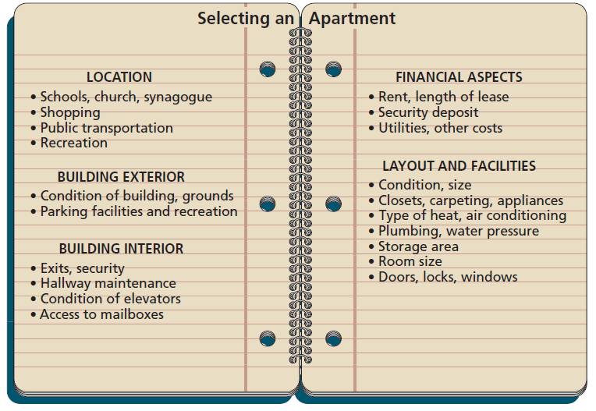
Advantages on Renting
Mobility
Fewer Responsibilities
Lower Initial Costs

Slide 18
Disadvantages of Renting
Few Financial Benefits – tax deduction, increased in value of property, subject to rent increase
Restricted Lifestyle – limited activities, noise, etc.
Legal Details

Slide 19
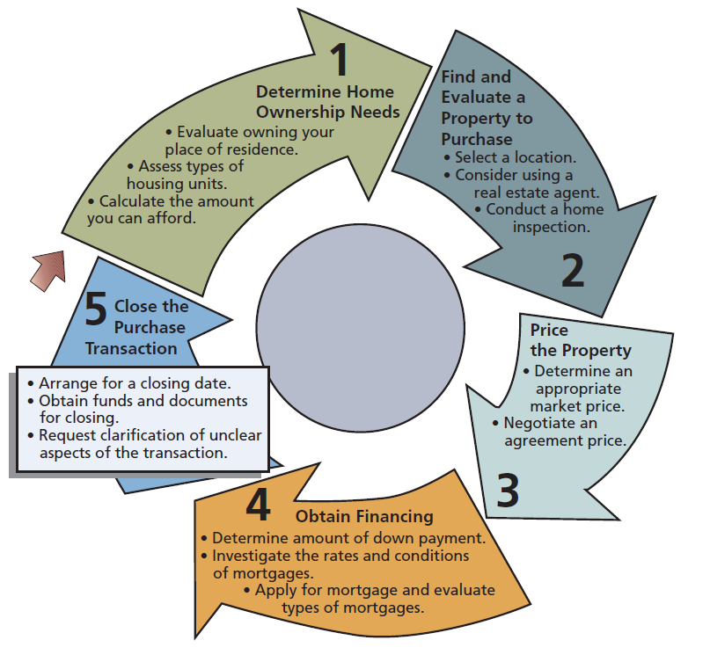
Home Buying Process

Slide 20
The Situation
Todd Cummings is single and has just graduated from college and gotten his first job.
Currently, he is working 60 hours a week
He dose not have much in savings yet and is not sure he will stay in Stillwater, Oklahoma for much longer
He needs to find a new place to live. He is trying to decide whether to rent or to buy

Slide 21
Advantages and Disadvantages of Renting
Advantages
  Mobility
  Fewer responsibilities
  Lower initial costs
Disadvantages
  Few financial benefits
  Restricted lifestyle
  Legal details

Slide 22
Todd’s Decision
Todd realizes that at this time, he is not ready for home ownership.
There are too many uncertainties in his life and he is working too many hours to take care of a house or a pet
He decides to rent right now and save money for a down payment on house in the future when he is more ready

Slide 23
Step 1 of Rent Activities:
Todd’s Search
Todd looks for an apartment near where he works
He visits several apartment complexes to see the cost of each as well as the condition and layout of the apartments.
He talks to current residents about responsiveness of management to problems, utility costs, and other issues

Slide 24
Step 2 of Rent Activities:
Before Signing a Lease
Todd verifies that the rent will be $575 per month and that he has a year’s lease staring on June 1
He consults with a lawyer to make sure he understands his right completely.
He inspects the property with the landlord and notes in writing any stains on the carpet and other defects.
He makes sure he understands the conditions under which he would forfeit his security deposit.

Slide 25
Legal Details of Todd’s Lease
A description of the property
Name and address of landlord
Name of tenant
Effective date of the lease
Length of the lease
Amount of the security deposit
Amount and due date of the monthly rent
Location where rent must be paid
Date and charges for late rental payments
List of utilities, appliances, and furniture included in rental amount
Restrictions on activities
Tenant’s right to sublet
Conditions under which landlord may enter apartment
Charges for damages

Slide 26
Step 3 of Rent Activities:
Living in Rental Property
Todd is careful with his new apartment. He cleans it regularly and makes sure not to spill anything on the being carpet.
Right after Todd moves in, the hot water heater stops working. He calls the landlord immediately to fix it.
Todd makes sure to respect the rights of his neighbors by not making much noise.
Todd gets renter’s insurance for his personal property.

Slide 27
Step 4 of Rent Activities:
At the End of the Lease
Todd cleans the apartment and leaves it in the same condition he found it.
Todd provides information in writing as to his forwarding address for his security deposit.
Todd makes sure his landlord will document any deductions from his security deposit.

Slide 28
The Situation
Amanda Walker has been living in an apartment for several years and is a little tired of it.
She constantly has to ask her neighbors to be quite and cannot have a pet where she lives.
She has significant savings to use for adown payment and does not plan on changing jobs or cities in the new future.

Slide 29
Advantages and Disadvantages of Owning a Home
Advantages
  Pride of Ownerships
  Financial Benefits
  Lifestyle Flexibility
Disadvantages
  Financial Uncertainty
  Limited Mobility
  Higher Living Costs

Slide 30
Determine Home Ownership Needs
The first thing that Amanda realizes is that there are many more housing options available than what she thought. She knows she needs to look carefully at all of the choices, so she can make sure she knows what fits her needs best

Slide 31
Condominium Option
Amanda learns that if she bought a condominium, then she would own her individual living unit within a building that has several units in it. She would have to pay a monthly fee to cover the maintenance and repairs of common areas, insurance for the building, and recreation facilities

Slide 32
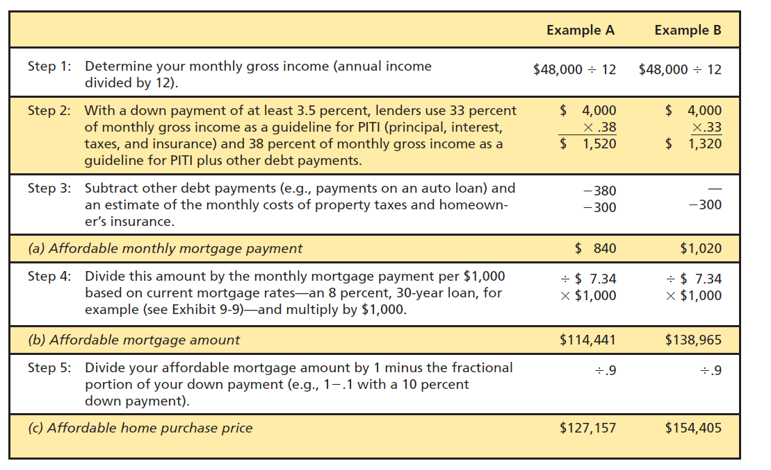
Financing Ability

Slide 33
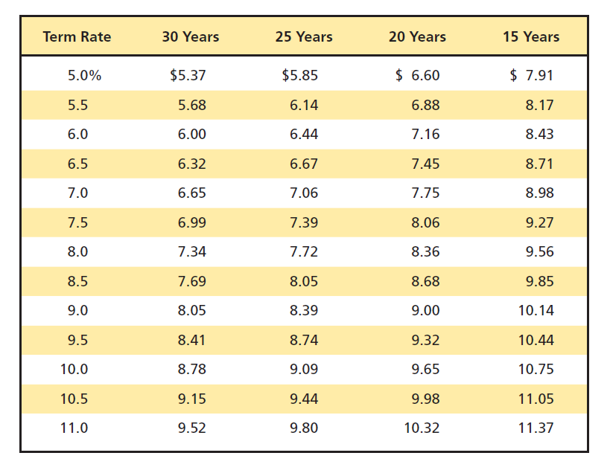
Financing Ability

Slide 34
Financing Terms
Variable Floating Rate
Interest Rate Cap
Refinancing
Fixed Rate

Slide 35
How much can you afford?
Amanda earns $40,000 per year.
She has no other debts and has saved enough to make a 20% down payment on the house.
From talking to other home owners, she thinks her property taxes and homeowner’s insurance will cost her about $300 per month.
She thinks she can get a 30-year mortgage at 7% interest.

Slide 36
Determining Amanda’s Affordable Housing Price
1. Determine Monthly Gross Income:
    $40,000/12 = $3,333
2. Percentage of Monthly Gross Income to Use for Monthly Mortgage Payments:
    $ 3,333 x 33% =$ 1,100
3. Subtract estimated property taxes and homeowners insurance as well as other debts
    $ 1,100 - $300 = $800

Slide 37
Determining Amanda’s Affordable Housing Price(continued)
4. Divided Affordable Monthly Mortgage Payment by Mortgage Payment Factor:
    800/6.65 = 120.3
5. Multiply by $1,000 to arrive at Affordable Mortgage Amount:
    120.3 x 1,000 = $120,300
6. Divide by (1- % down payment) to arrive at Affordable Home Purchase Price:
    $120,300 / 0.8 = $150,400

Slide 38
Property and Motor Vehicle Insurance
Insurance is protection against possible financial loss. Although many types of insurance exist, they all have one thing in common: They give you the peace of mind that comes from knowing that money will be available to meet the needs of your survivors, pay medical expenses, protect your home and belongings, and cover personal or property damage caused by you when driving.
Life insurance replaces income that would be lost if the policyholder died. Health insurance helps meet medical expenses when the policyholder becomes ill.
Automobile insurance helps cover property and personal damage caused by the policyholder’s car.
Home insurance covers the policyholder’s place of residence and its associated financial risks, such as damage to personal property and injuries to others.

Slide 39
Insurance
Insurance is based on the principle of pooling risks, in which thousands of policyholders pay a small sum of money ( premium ) into a central pool. The pool is then large enough to meet the expenses of the small number of people who actually suffer a loss.
An insurance company , or insurer , is a risk-sharing firm that agrees to assume financial responsibility for losses that may result from an insured risk. A person joins the risk-sharing group (the insurance company) by purchasing a policy (a contract).
Under the policy, the insurance company agrees to assume the risk for a fee (the premium) that the person (the insured or the policyholder ) pays periodically.

Slide 40
The Situation
Melinda Smith has graduated form college and is getting ready to move into her first home. She has a car but it has occurred to her that she does not understand much about insurance. She needs homeowner’s insurance and wants to review her car insurance at the same time. However, she wants to start by reviewing that insurance is and what it can do for her.

Slide 41
What is Insurance?
Insurance is protection against possible financial loss. Melinda can purchase an insurance contract (policy) for a fee (premium). Insurance is based on the principal of pooling risks. A large group of policyholders pay a premium into a central pool.
This pool is than large enough to meet the expenses of the small number of people who actually suffer a loss.

Slide 42
Basic Insurance Terms
Risk – Uncertainty or lack of predictability. In this case, it refers to the uncertainty as to loss that a person might face to themselves or their property.
Peril – is the cause of possible loss. Fires, windstorms, explosions, robber, accidents, and premature death are all perils that can cause loss.
Hazard - is something that increases the likelihood of loss through some peril.
Pure Risk – consists of personal, property, and liability risks that are insurable ( accidental and unintentional risks).
Speculative Risk – risks that carry a chance of gain or loss: most are uninsurable (gambling, staring a business)

Slide 43
Risk Management Methods
Risk Avoidance – Some risks can be avoided by not taking certain actions.
Risk Reduction – Some risks can be reduced by taking certain actions.
Risk Assumption – Financial responsibility is taken for some risks.
Risk Shifting – Some risks can be transferred to other parties.

Slide 44
Planning an Insurance Program
Step 1: Set Insurance Goals
Step 2: Develop a Plan to Reach Your Goals
Step 3: Put Your Plan into Action
Step 4 : Check Your Result

Slide 45
Property and Liability Insurance
Property Losses – losses that deal with physical damage to property or loss of use of property. This applies to homes, automobiles, furniture, clothing, and other personal property.
Liability – is legal responsibility for the financial cost of another person’s losses or injuries.

Slide 46
Home and Property Insurance
House and Other Structures
Additional Living Expenses
Personal Property
Personal Liability and Related Coverage
Specialized Coverage

Slide 47
House and Other Structures
Damage to House or Attached Structures
Damage to Detached Structures
  Garage
  Gazebo
  Toolshed
Damage to Trees, Shrubs, and Plants

Slide 48
Additional Living Expenses
If damage to your house is severe enough to prevent the use of it, this part of your insurance policy pays for the cost of living in a temporary location while the house is being repaired.

Slide 49
Personal Property
Household belongings such as furniture, appliances, and clothing are insured up to a percentage of the insured value of the home
Personal property floater
  Home computers
  Jewelry
  Firearms
  Silverware
  Other high value items
Actual Cash Value versus Replacement Value

Slide 50
Personal Liability
Covers the risk of financial loss due to injuries to other or damage to property for which you are responsible.
An umbrella policy (also called a personal catastrophe policy) can supplement basic liability coverage.
Medical payments coverage covers minor accidental injuries on your property and minor injuries caused by you, family members, or pets.

Slide 51
Specialized Coverage
Homeowner’s insurance does not usually cover losses from floods or earthquakes.
If you live in a flood or earthquake zone, then you will need special insurance.

Slide 52
Factors That Affect Home Insurance Costs
Location of Home
Type of Structure
Coverage Amount and Policy Type
Home Insurance Discounts
Company Differences

Slide 53
Auto mobile Insurance Coverage
Bodily Injury Coverage
  Bodily Injury Liability
  Medical Payments
  Uninsured Motorist’s Protection
Property Damage Coverage
  Property Damage Liability
  Collision
  Comprehensive Physical Damage

Slide 54
Bodily Injury Liability
Covers the risk of financial loss due to legal expenses, medical costs, lost wages and other expenses caused by an auto mobile accident for which you are responsible.
Covers individuals who are not in your car at the time of the accident.

Slide 55
Medical Payments
Medical payments coverage pays for the costs of injuries to anyone riding in your can at the time of awn accident.
It would also pay if you were hit by a car or injured while riding in another person’s vehicle.

Slide 56
Uninsured Motorist’s Protection
Uninsured motorist’s protection covers the costs of injury to you and your family if you were in an accident caused by a motorist without automobile insurance.
It also provides protection in hit – and – run accidents, and if the other driver had insufficient to cover the cost of your injuries.

Slide 57
Property Damage Liability
Property damage liability covers the cost of financial loss when you damage the property of others.
It applies mainly to other vehicles but also includes damage to street signs, lampposts, buildings , and other property.

Slide 58
Collision
Collision insurance covers the cost of damage to your vehicle if you are involved in an accident regardless of fault.
Your insurance company may seek reimbursement from the other driver’s insurance if the other driver is at fault (subrogation).

Slide 59
Comprehensive Physical Damage
Comprehensive physical damage covers damage to a vehicle caused by something other than a collision.
It includes damage to your vehicle from fire, theft, glass breakage falling objects, vandalism, wind, hail, flood, tornado, lightning, earthquake avalanche, or damage caused by hitting an animal.

Slide 60
Automobile Insurance Costs
Amount of Coverage
  Legal concerns
  Property values
Automobile Type
Rating Territory
Driver Classification

Slide 61
Reducing Automobile Insurance Premiums
Comparing Companies
Premium Discounts
  Safe Driving Records
  Avoid Accidents and Traffic Violations
  Driver education for drivers under 25
  Security devices to reduce theft
  Two or more cars under one policy
  Increase the amount of deductibles

Slide 62
Thank you

