Slide 1

International Payment Methods
Group 7

Slide 2



The world before SWIFT
SWIFT’s Presence
and other international transfer methods
SWIFT in practice
Content
Pros and Cons
SWIFT’s outlook

Slide 3




The world before SWIFT
Notes:
I think almost everyone in this class has been in another country for a couple of weeks. During this time, you will need a lot of money.
It is nearly impossible to carry all this money in your purse every day. So international money transfers are the perfect and effective alternative for this problem.

Slide 4



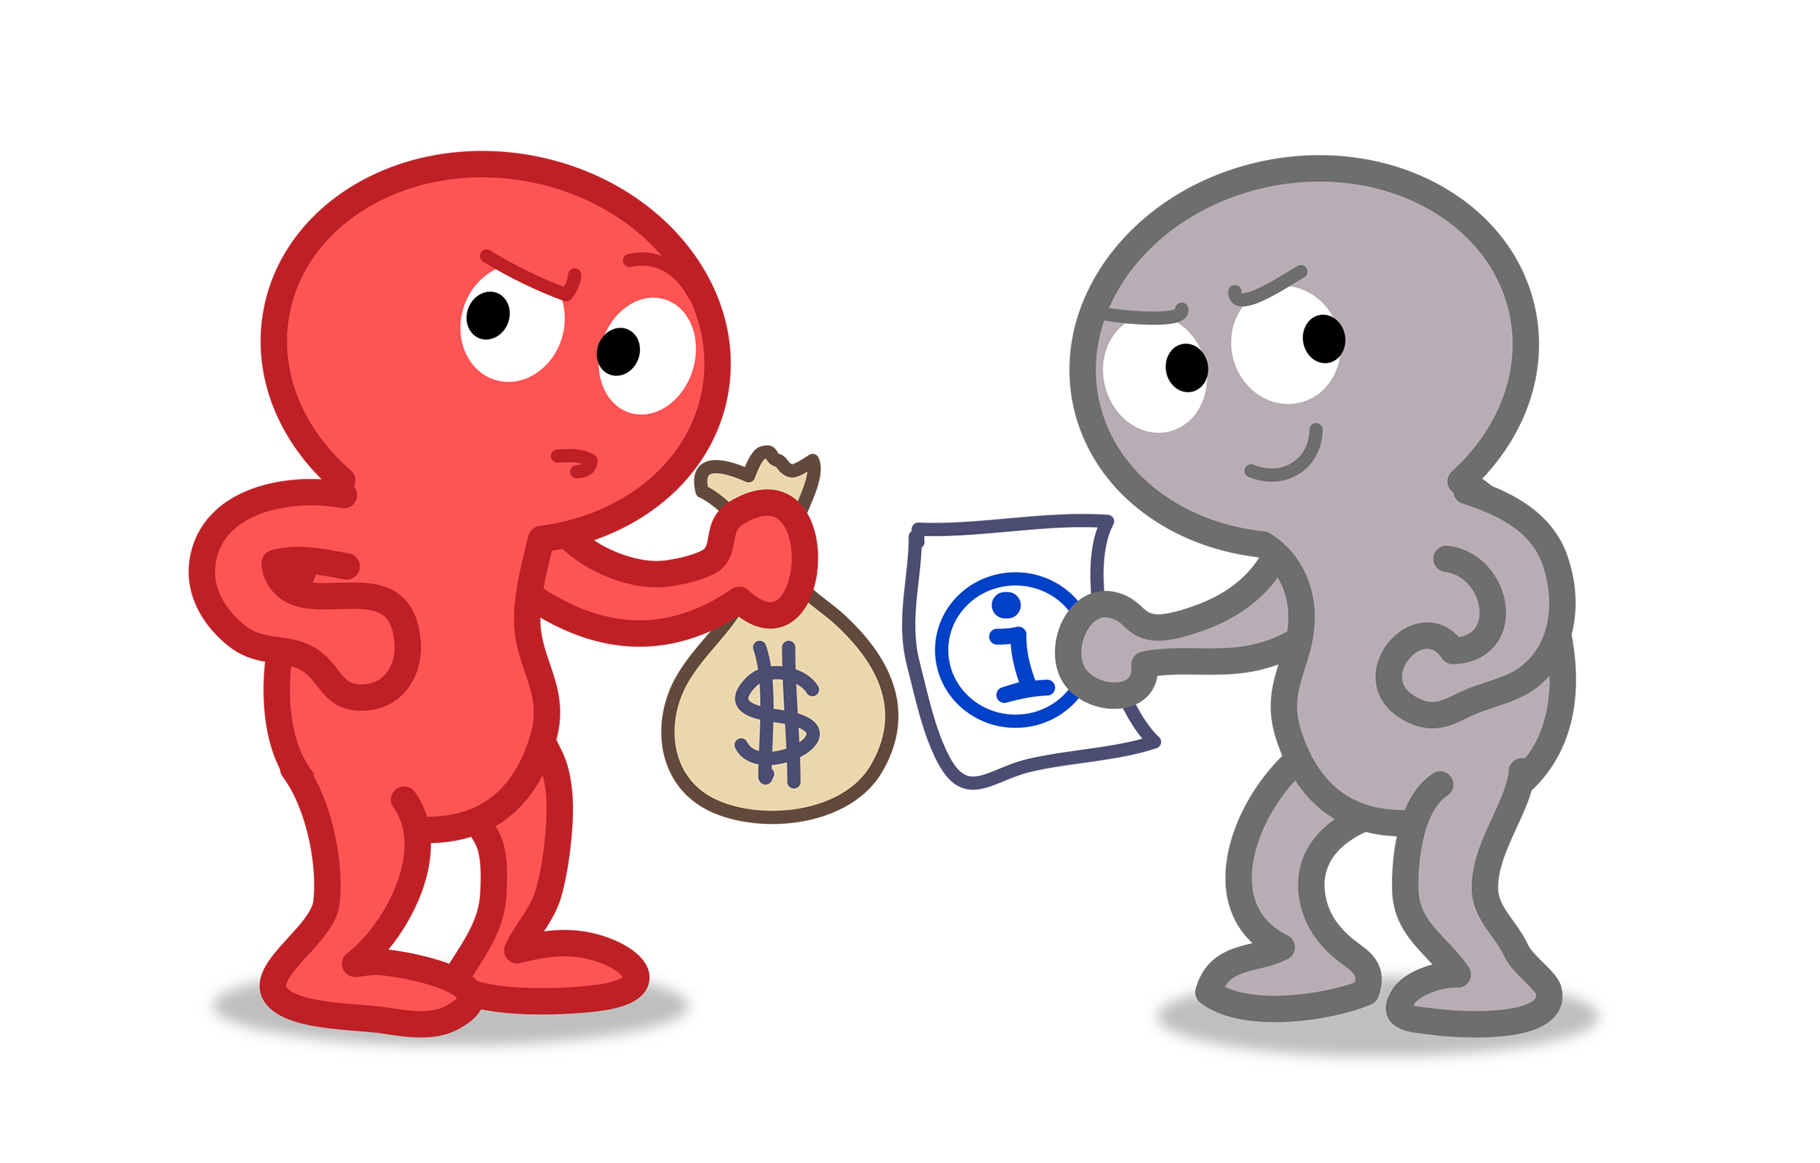
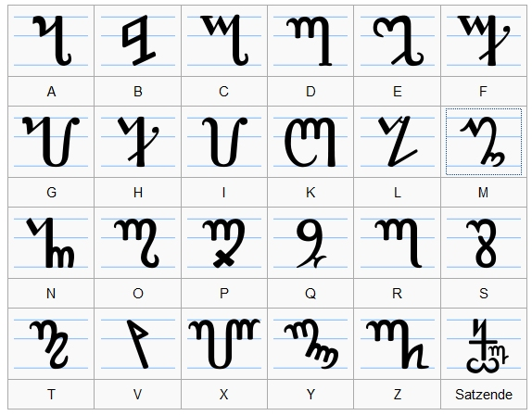
Telegraphic Transfers (TT)
Telex mostly used for oversea transactions
Very high transfer costs (200-400 baht)
A lot of information needed
Transactions have to be send in specific sentences
This process leads to a lot of human errors
Notes:
The Telex method was mostly used for oversea transactions. The transfer costs were very high. For example, for one transaction you had to pay between 200 and 400 Baht. You had to know a lot of information about the receiver and the financial institution. Therefore, Telex senders had to describe every transaction in sentences, then then the descriptions had to be interpreted and executed for the receiver. This process has led to a lot of human errors.

Slide 5

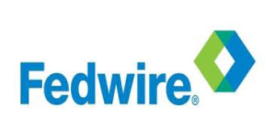
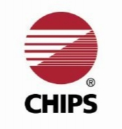
Other international payment methods
Receiver is able to get the money immediately.
He needs no account just the tracking number and an ID card.
Electronic transfers among all the members.
Mostly used for for large-value, time-critical payments.
Is the primary clearing house in the U.S for large banking transactions.
It is cheaper than Fedwire but not as fast. The average transaction is 3 Mio.
Is working as a netting engine.
Are working in two steps: clearing and settlement
Fedwire and CHIPS are responsible for 96% of all large-volume payments in US dollars.
Notes:
Western Union
It is a really fast transaction method, because ones the transaction is made, the receiver is able to get the money immediately.
The person who receives the money has to go to an WU agent location and has to bring two things: an ID-card and the tracking number from the sender.
Fedwire enables financial institutions to electronically transfer funds among all the Fedwire members.
It is generally used to make large-value, time-critical payments.
HOW CHIPS works:
There are two steps to processing funds transfers: clearing and settlement. Clearing is the transfer and confirmation of information between the payer and payee. Settlement is the actual transfer of funds between the payer's financial institution and the payee's financial institution. CHIPS acts as a netting engine, where payments between parties are netted against each other instead of the full dollar value of both trades being sent.
In summary, Fedwire and CHIPS are responsible for 96% of all large-volume payments in US dollars.

Slide 6
SWIFT’s Presence

Slide 7






SWIFT’s Presence
What is SWIFT?
What is SWIFT?
“Society for Worldwide Interbank Financial Telecommunications”
A member-owned
cooperative
Provides a network that enables financial institutions worldwide to send/ receive financial transactions’ information in a secure, standardized, and reliable environment
Sends payment orders rather than facilitating funds transfer for financial institutions

Slide 8


SWIFT’s Presence
Products/ Services
Products
Services
SWIFTNet Link (SNL)
Alliance Gateway (SAG)
Alliance WebStation (SAB)
Alliance Access (SAA)
Alliance Messaging Hub (AMH)
The Alliance Workstation (SAW)
Alliance Web Platform (SWP)
Alliance Lite2
Securities
Cash Management
SWIFTNet Fix
SWIFTNet Data Distribution
SWIFTNet Funds
SWIFTNet Bulk Payments
SWIFTNet Cash Reporting
SWIFTNet Exceptions and Investigations
Treasury & Derivatives
SWIFTNet Affirmations
SWIFTNet CLS Third Party Service
Trade Services
SWIFTNet Trade Services Utility
Notes:
SWIFTNet Link (SNL) software which is installed on the SWIFT customer's site and opens a connection to SWIFTNet. Other applications can only communicate with SWIFTNet through the SNL.
Alliance Gateway (SAG) software with interfaces (e.g., RAHA = Remote Access Host Adapter), allowing other software products to use the SNL to connect to SWIFTNet
SWIFTNet Funds - Funds service supports the automation of investment funds distribution, alternative funds and pension funds.
SWIFTNet Bulk Payments - The Bulk Payments solution enables banks to exchange files of low-value payments according to agreed operational and business rules.
SWIFTNet Trade Services Utility a matching system for trade documents which is designed to allow banks to provide funding at various stages throughout the physical supply chain.

Slide 9

SWIFT in Practice

Slide 10






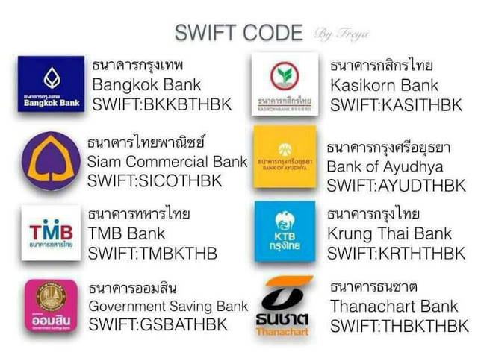
SWIFT in practice
Name
Supplier’s account
Currency to
Amount
Supplier’s SWIFT code
+US$100,000
Supplier
Customer
Confirmation
-US$100,000
Bank identifier code (BIC) is one of the most common forms of bank code used to identify individual banks.
Country code
Branch code
XXXX XX XX XXX
Bank code
Location code

Slide 11

SWIFT in practice
Looking in details of the platform
PAG
PAG
DMC
Components of model
Domestic Messaging Channel (DMC) – which uses local network access points to switch payments between the participating banks.
Efficient addressing - short name or email address link to customer’s bank account.
Payment gateway (PAG) – support exchange of pre-clearing and pre-settlement messages including value-added services.
Standard (ISO 20022) - an international messaging development standard that is designed to simplify global financial communication.
Notes:
Components of model
1. Domestic Messaging Channel (DMC) – low latency and high message volumes to connect all participants. facilitate b/w creditor and debittor
2. Efficient addressing - Short name, email address link to customer’s bank account. Customer account details to address database >> identify
3. Payment gateway (PAG) – support exchange of pre-clearing and pre-settlement messages including value-added services. Exchange directly to the banks i.e., Skim specification, transaction screen, improve attractive by value-added to the ended customers. Payment Gateway, a SWIFT interface deployed to each NPP participant, that will orchestrate clearing and settlement flows between the participating banks and the RBA, and potentially additional flows such as payment initiations that are entered into the system by directly connected value added services (known as overlay services i.e., mobileto-mobile payments, bill payments and property settlement services. ).
4. Standard – LT interoperability support all currency. Messaging Standards ISO 20022 will be utilised to provide XML-based messaging standards across the solution. ISO 20022 is an international messaging development standard that is designed to simplify global financial communication. ISO 20022 messages allow flexibility and extensibility and can carry additional remittance information with the payment. SWIFT built many of the ISO20022 standards and is the Registration Authority for the standard.

Slide 12

Pros & Cons of SWIFT

Slide 13

Benefits
-Transparency can track the transaction, understand the cost and time period
-Traceability provides clear and recognised proof of payment
-Consistency easy to decode regardless of country or language barriers
-Safe and reliable way several security checks must be performed.
-Issue money transfer allowing to issue money transfers in all major foreign currencies
Notes:
-Transparency. SWIFT payments clearly detail the amounts involved in the transaction, the route it takes between banks, the details of all charges and the nature of the payment. This information allows all parties involved to track the transaction and to understand the costs and time period involved.
-Traceability. Because SWIFT details the route of the transaction between banks and the amount of money involved, it provides clear and recognised proof of payment.
-Consistency. Due to the consistency of how messages are structured, payment information is easy to decode regardless of country or language barriers.
-Safe and reliable way to send and receive money worldwide.
There are several security checks which must be performed when a SWIFT payment is initiated.
-->The bank conducts checks to ensure fraud is not being committed by the sender (“Know Your Client” rules)
and Anti Money Laundering (AML) checks as well.
-You are allowed to issue money transfers in all major foreign currencies.

Slide 14

Limitations
-Comparatively expensive way of sending funds.
-Risk of an exchange rate fluctuation
-The duration is slower than what people expected.
-Time difference
-Currencies involved in the transaction
-Payment method
-Day in the sending and receiving countries
-Identify confirmation processes
Notes:
-SWIFT messages are a comparatively expensive way of sending funds. Since the money passes through its infrastructure, any intermediary bank which comes into contact with the payment is able to take a fee without the consent of either sender or recipient.
-there is a risk of an exchange rate fluctuation. When the exchange rate changes, it will absolutely affect clients who transfer money internationality in the foreign currencies.
- SWIFT payments usually take 1-3 working days to reach their destination, however it is possible that they can take longer due to circumstances such as
· Time differences between the sending and receiving country
· Currencies involved in the transaction
· Payment method for the transfer
· Day of the week in the sending and receiving countries ( Since, bank holidays and weekends might extend the transaction duration)
· Identity confirmation processes which varies across the countries and may very occasionally affect the speed of transfer

Slide 15
Prior to SWIFT
SWIFT’s
Presence
SWIFT in
practice
Pros & Cons
of SWIFT

Slide 16

SWIFT’s outlooks

Slide 17



SWIFT’s outlooks
7.1
Billion total FIN messages
200+
Countries and Territories
28.1+
Million in average
daily message
11,000+
8.4 %
FIN growth
Institutions connected to SWIFT
Source: SWIFT annual review
Source: SWIFT annual review
With growth rate consistency, SWIFT has provided products and services to financial related institutions globally

Slide 18
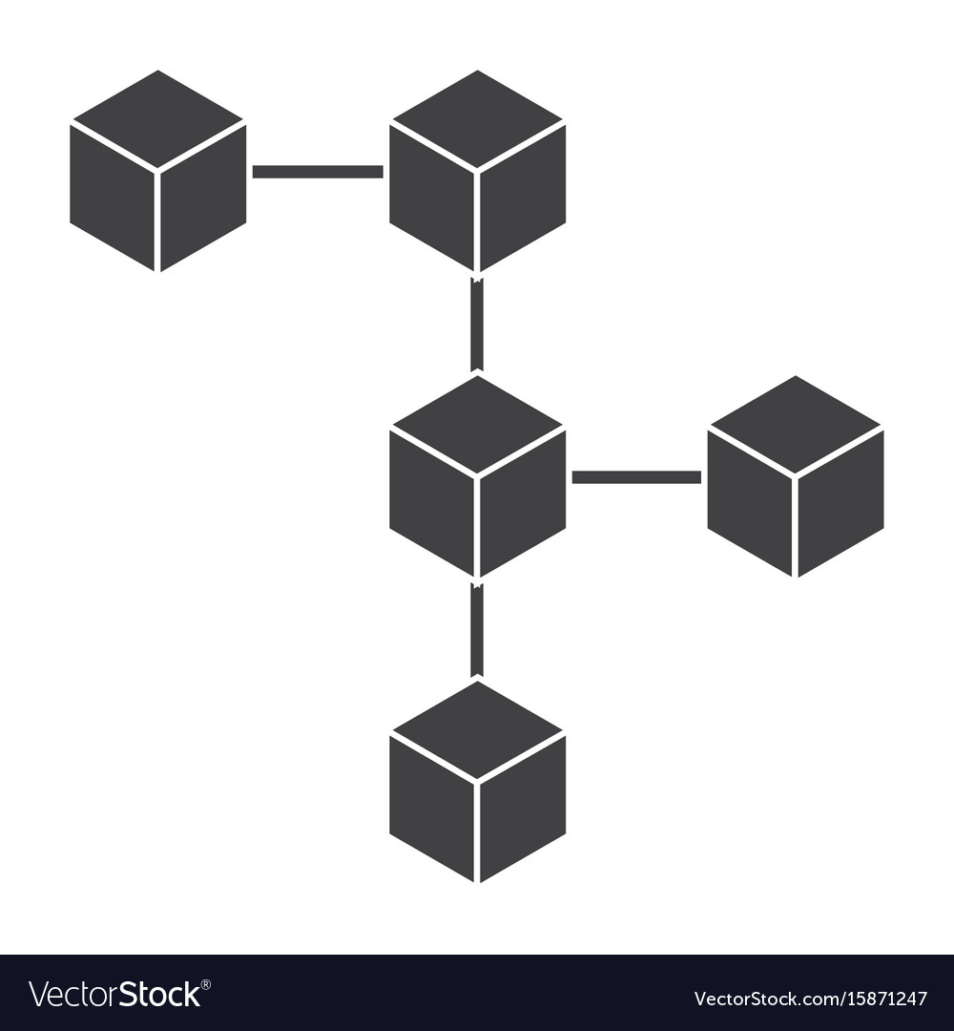

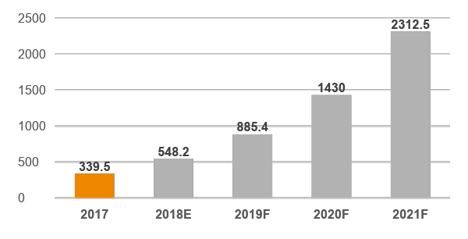
SWIFT’s outlooks
Intermediary
Blockchain
Core competency, SWIFT
Size of the Blockchain technology market worldwide
In million USD
SWIFT offers the most SECURE, uncompromising approach to information security, COST-EFFECTIVE and RELIABLE way of transmitting messages relating to financial activities
CAGR 61.55%
Core competency, Blockchain
Actual
Blockchain was created by combining pre-existing computer networking and cryptography technologies that anyone can access but no single person can control
Forecast
The global Blockchain market is predicted to grow substantially consistent with the precedent trend
Immutable
Transparent
Secure
Cost reduction
Source: SWIFT
Source: Statista and team analysis
With substitutable qualities and heavily funding secured, Blockchain could potentially replace current international transfer method

Slide 19





SWIFT’s outlooks
Name
Supplier’s account
Currency to
Amount
Supplier’s SWIFT code
+US$100,000
Supplier
Customer
Confirmation
-US$100,000
Coming up
Potential obstacles
Complexity of the concept
Blockchain would allow financial institutions to transfer money internationally without SWIFT as an intermediary. More secure, transparent and cost reduction by eliminating non-value added activities from the processes
Network approach requires a sufficient number of member
Legal and governance
Source: Team analysis
Source: Infosys
If we can overcome potential obstacles, Blockchain can eliminate the need of trusted third party creating significant benefits

Slide 20
Q&A

Slide 21
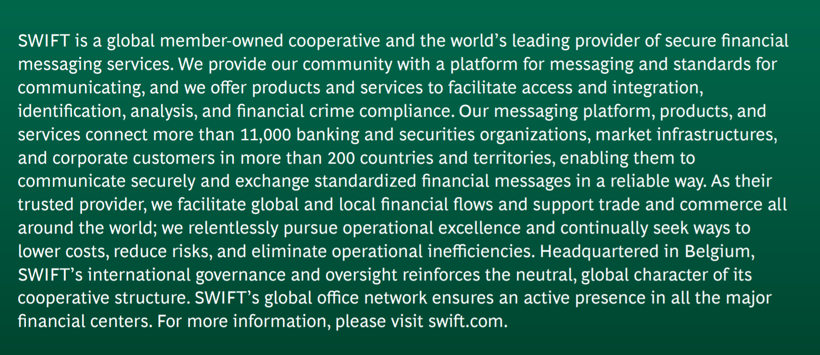
Process of Western Union
Source: BCG

Slide 22





Process of Western Union
1. Select the way to send money
2. Select your receiver and location
3. Choose how will you pay (online, in person)
4.Send money
5.Money arrive at WU
6.Customer cash out at WU retail stores

Slide 23
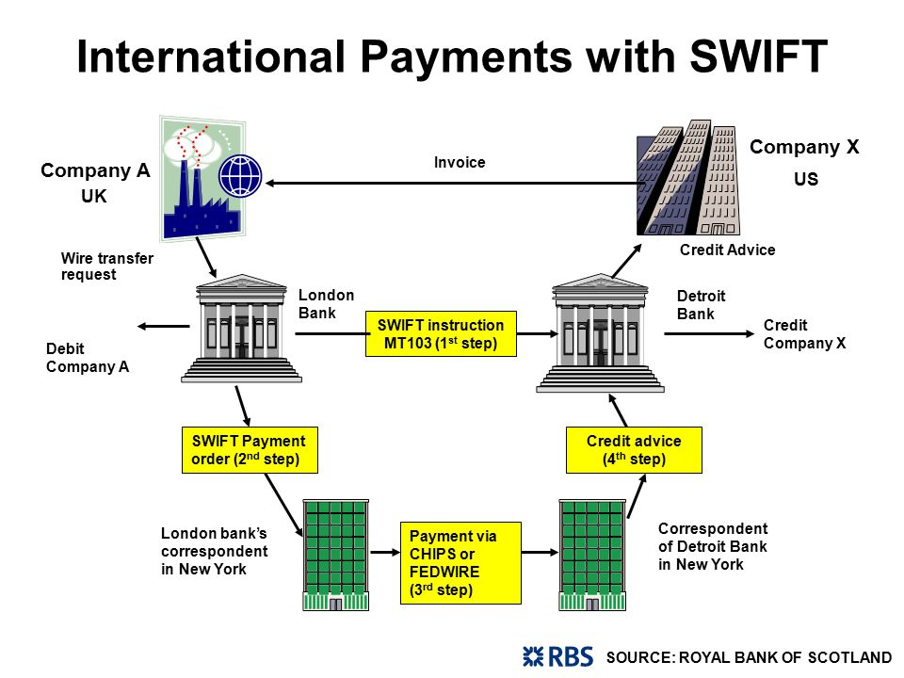
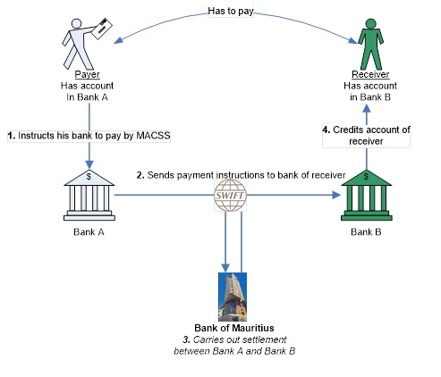
SWIFT in practice
How does international money transfer actually work?
Notes:
SWIFT does not facilitate funds transfer: rather, it sends payment orders, which must be
settled by correspondent accounts that the institutions have with each other.
Each financial institution, to exchange banking transactions, must have a banking relationship
by either being a bank or affiliating itself with one (or more) so as to enjoy those particular
business features
https://www.bom.mu/payment-systems/macss/mauritius-automated-clearing-and-settlement-system
https://blog.revolut.com/swift-sepa-how-international-money-transfers-actually-work/

Slide 24
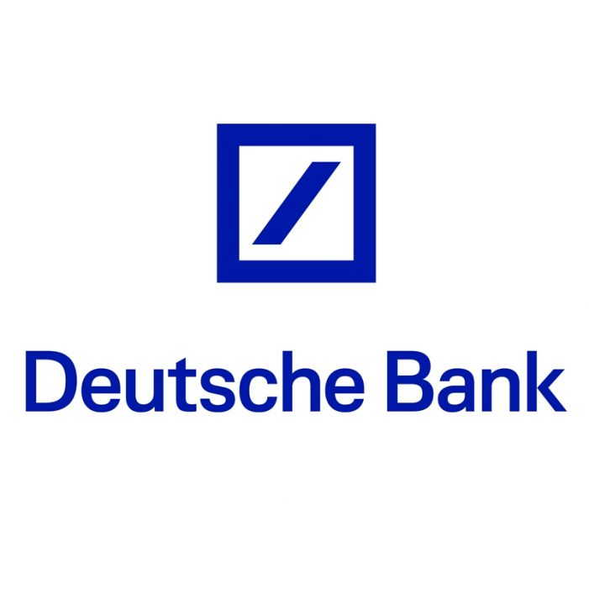


Back up
Deutsche Bank: is currently exploring various use cases of blockchain in areas like payments and settlement of fiat currencies, asset registries, enforcement and clearing derivative contracts
Frankfurt, Germany
Nasdaq: Nasdaq Linq is a digital ledger technology that leverages a blockchain to facilitate the issuance, cataloging and recording of privately held company’s shares on the Nasdaq Private Market
New York, USA
JP Morgan: has lunched a new interbank payment platform based on a private blockchain for Ethereum, a form of cryptocurrency
New York, USA
Source: Apiumhub and CNBC

Slide 25


Back up
BNP Paribas: is experimenting with making transactions by using Blockchain
Paris, France
US Federal Reserve: is working with IBM on developing a new digital payment system tied to Blockchain
Washington D.C., USA
Source: Apiumhub and CNBC

Slide 26
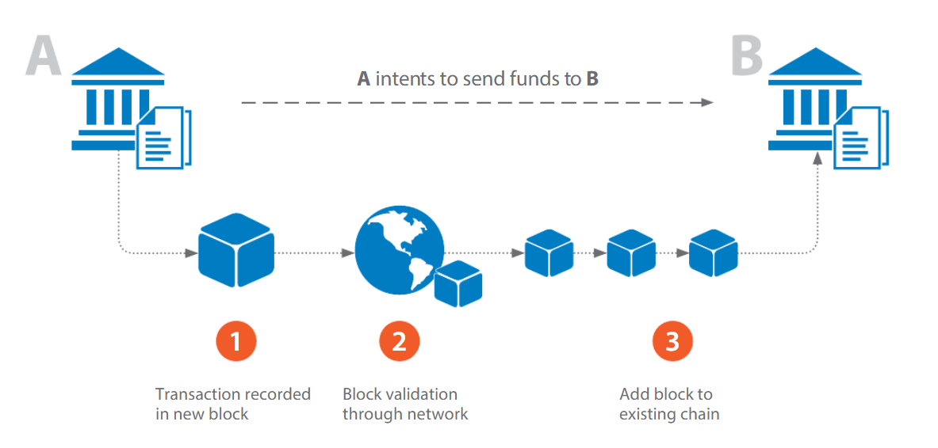
Back up
Source: Infosys

Slide 27
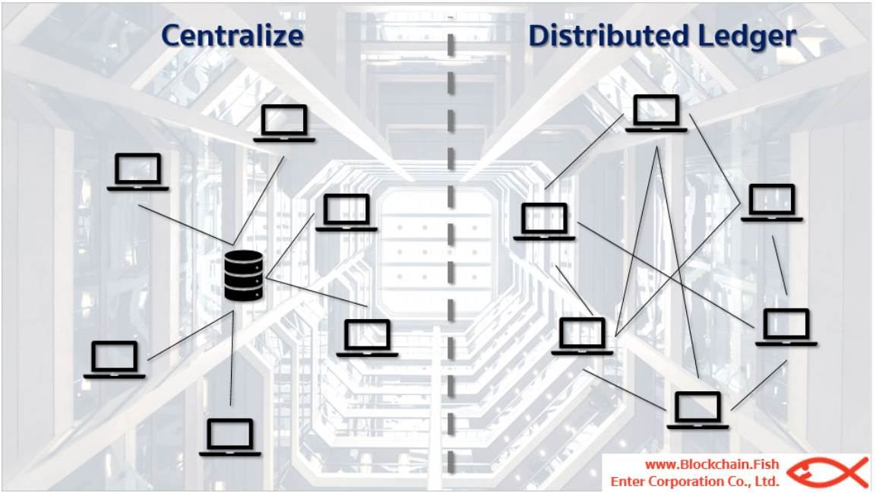
Back up
Supporting by Distributed Ledger Technology (DLT), information is decentralized and everyone can access to the identical information making fraud become much more difficult
Source: Blockchain.fish

Slide 28
International payment methods
How can we improve the system?

