Slide 1
V. Poverty & Inequality
An introduction
EE406: Contemporary Economic Issues
Semester 1/2020
Faculty of Economics, Thammasat University

Slide 2
Measuring poverty

Slide 3
Conceptual issues: defining the poverty line
A poverty line is a critical threshold of income, consumption, or access to goods and services below which individuals are declared to be poor.
A poverty line represents a minimum level of ‘acceptable’ economic participation in a given society at a given point in time.
A poverty line is an approximation to a threshold that is, in fact, a deeper and less quantifiable concept

Slide 4
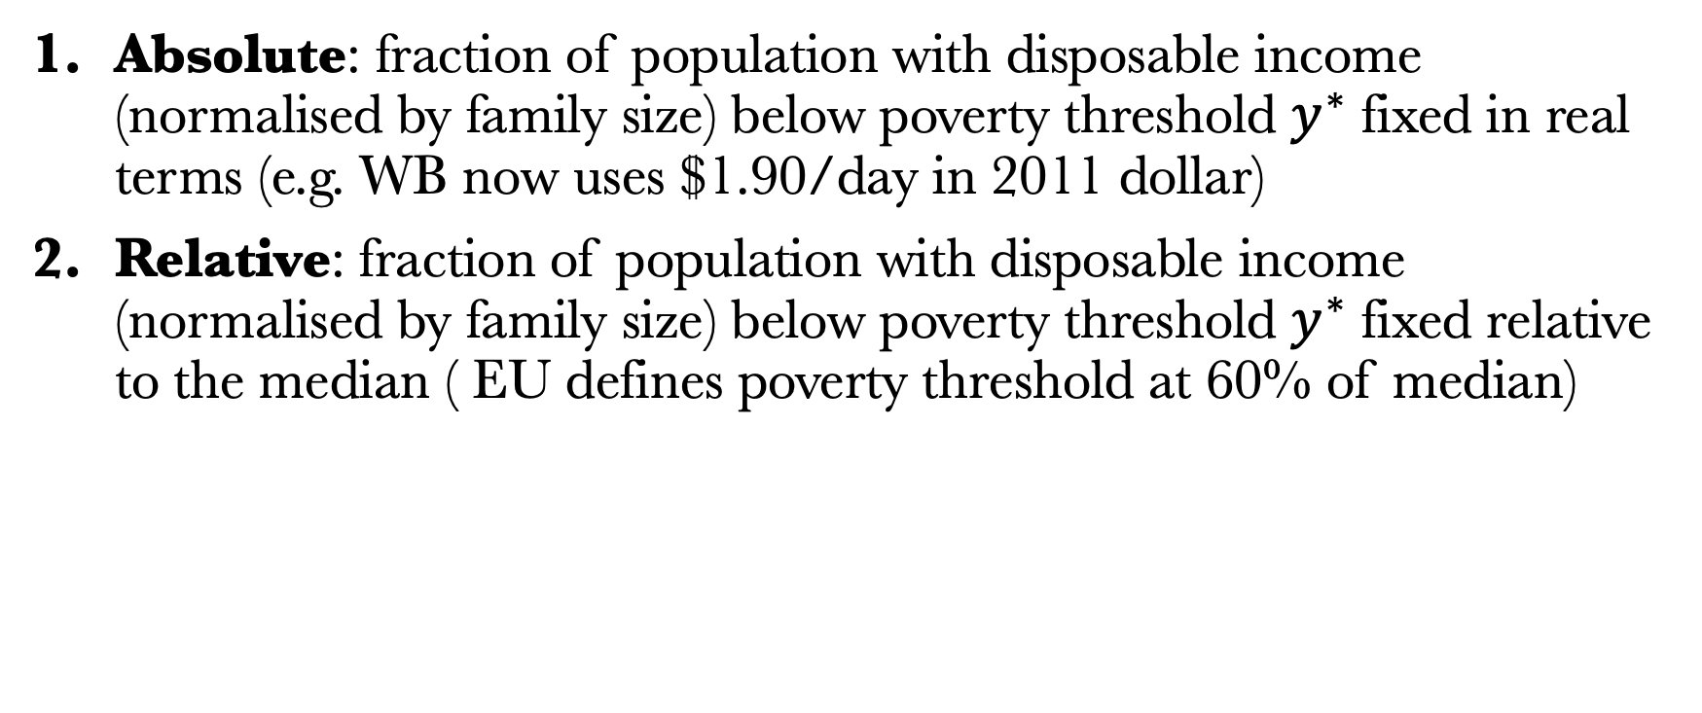
Poverty rate definitions
Absolute: fraction of population with disposable income (normalised by family size) below poverty threshold $y^{∗}$ fixed in real terms (e.g. WB now uses $1.90/day in 2011 dollar)
Relative: fraction of population with disposable income (normalised by family size) below poverty threshold $y^{∗}$ fixed relative to the median ( EU defines poverty threshold at 60% of median)

Slide 5
Poverty rate definitions
Absolute poverty falls in the long run with economic growth (nobody in the US is WB poor) but relative poverty does not
Absolute poverty captures both growth & inequality effects while relative poverty captures only inequality effects
The fact that inequality stays in the debate in spite of huge growth since 1800 shows that relative income matters (see e.g. Luttmer 2005 for empirical study)

Slide 6
Conceptual issues: the length of poverty
People in a state of poverty often experience significant fluctuations in their income and consumption.
‘Temporary poverty’ occurs when people temporarily enter a poverty state because of bad economic shocks.
‘Chronic poverty’ is when they constantly stay in a poverty state for a long time.
Policies to deal with problems are also different.
  e.g. safety net or occupation change

Slide 7
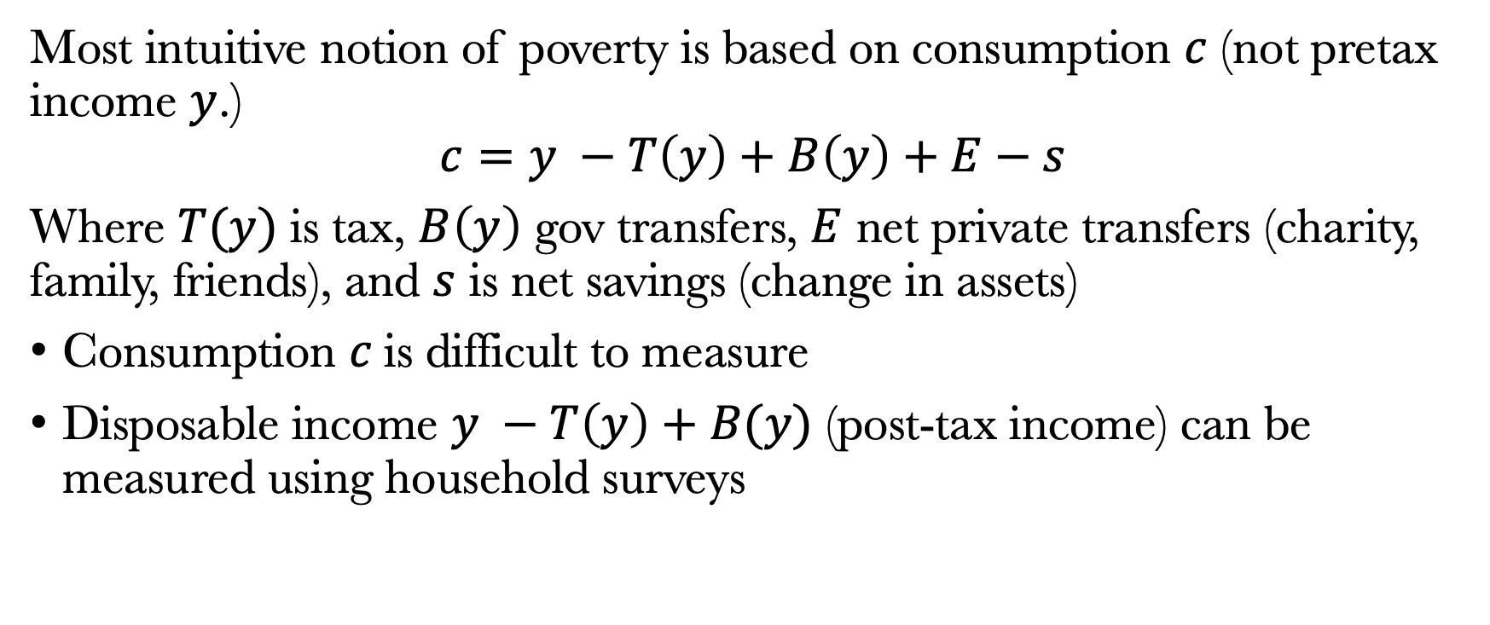
Poverty rate disposable income definition
Most intuitive notion of poverty is based on consumption $c$ (not pretax income $y$.)
$$c=y −T\left(y\right)+B\left(y\right)+E−s$$
Where $T(y)$ is tax, $B\left(y\right)$ gov transfers, $E$ net private transfers (charity, family, friends), and $s$ is net savings (change in assets)
Consumption $c$is difficult to measure
Disposable income $y −T\left(y\right)+B(y)$ (post-tax income) can be measured using household surveys

Slide 8
Family scale
Ideally, poverty should be defined at the individual level based on individual consumption [e.g., kids better off when mother or grandmother controls income instead of father, Duflo (2003)
However, many consumption goods are shared within the family [e.g., housing, joint meals, etc.] and it is difficult to measure consumption at individual level
Measured poverty is therefore based on consumption or disposable income at the family level [or unit sharing resources] and everybody within the family has same poverty status
Bigger families need more resources but economies of scale in consumption: scale disposable income by family size

Slide 9
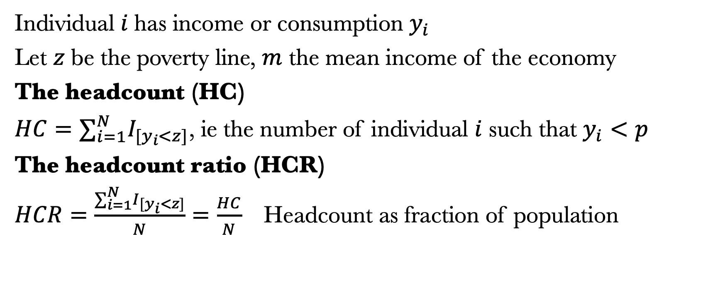
Measuring poverty: Headcount and HCR
Individual $i$has income or consumption $y_{i}$
Let $z$ be the poverty line, $m$ the mean income of the economy
The headcount (HC)
$HC=∑_{i=1}^{N }I_{[y_{i}<z]}$, ie the number of individual $i$ such that $y_{i}<p$
The headcount ratio (HCR)
$HCR=\frac{∑_{i=1}^{N }I_{[y_{i}<z]}}{N}=\frac{HC}{N}$ Headcount as fraction of population

Slide 10
HC & HCR drawbacks
fail to capture the extent to which individual income falls below the poverty line, i.e. fail to capture the extent of poverty
lead to biased policy decisions toward individuals who are very close to the poverty line
Ignore ‘relative deprivation’ among the poor (inequality among the poor), i.e. Some poor people are poorer than other poor people whose incomes are closer to the poverty line.

Slide 11
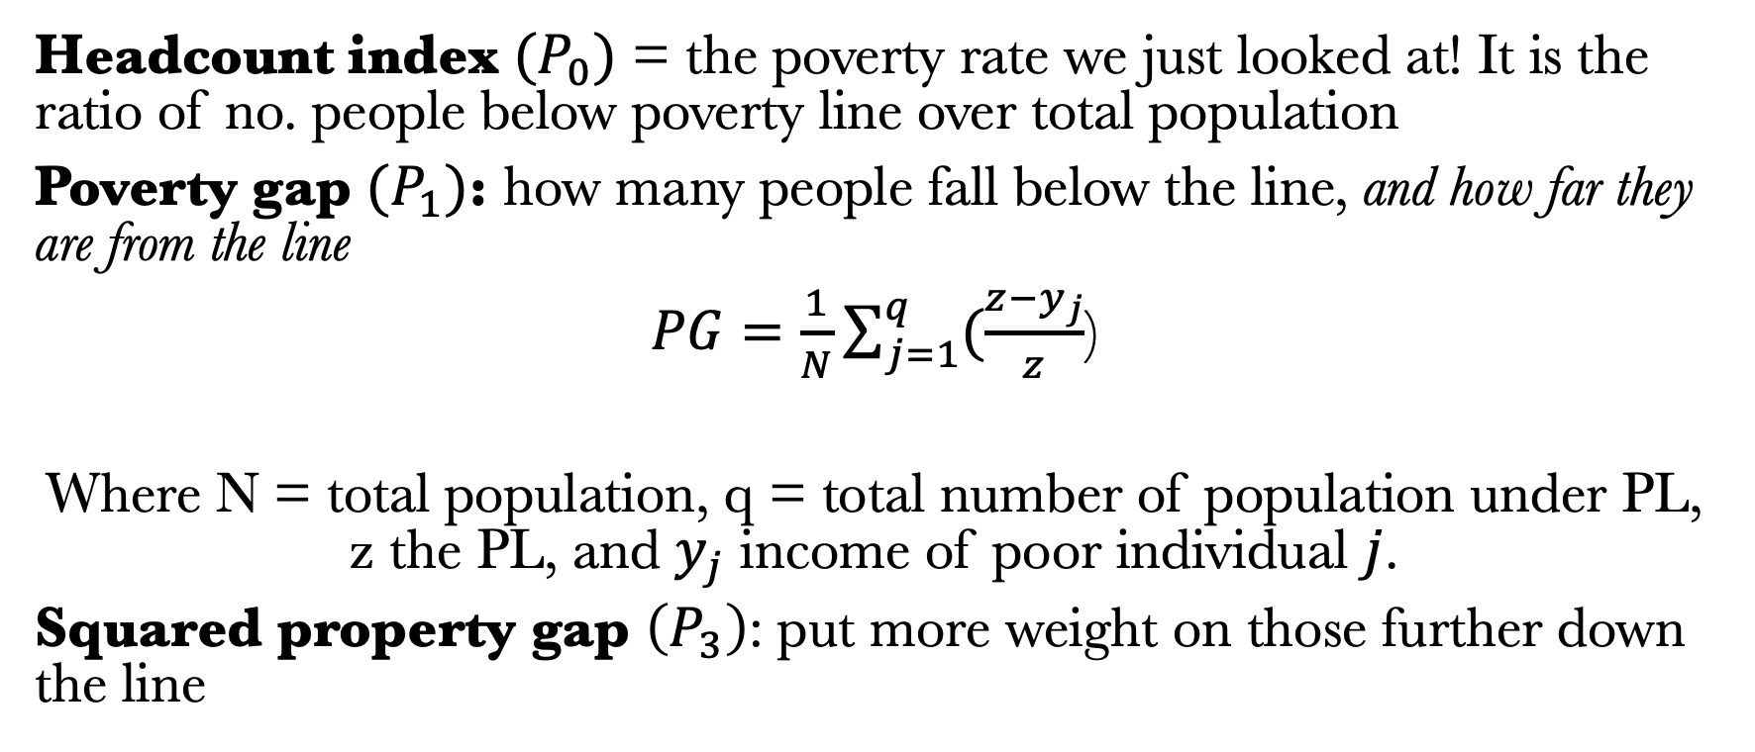
Other measures of poverty
Headcount index ${(P}_{0})$ = the poverty rate we just looked at! It is the ratio of no. people below poverty line over total population
Poverty gap $(P_{1})$: how many people fall below the line, and how far they are from the line
$PG=\frac{1}{N}\sum_{j=1}^{q}{(\frac{z−y_{j}}{z}}$)
Where N = total population, q = total number of population under PL, z the PL, and $y_{j}$ income of poor individual $j$.
Squared property gap $\left(P_{3}\right)$: put more weight on those further down the line

Slide 12
Poverty line in practice
World Bank’s extreme poverty line is cited as “the International Poverty Line (IPL)”, and expressed in each country in terms of its local currency. The IPL is at $1.90 a day in 2011 PPPs.
LMICs line is US$3.20 per person per day expressed in 2011 PPP U.S. dollars, UMICs line is at. US$5.50.

Slide 13
Poverty line in practice
For many countries, the social relevance of the IPL has lessened over time as their economies have grow.
World Bank’s Societal poverty line is based on a poverty line that is adjusted for the median level of wellbeing in each country.
The new measure considers that individuals are suffering from societal poverty if they are living on less than US$1.00 a day plus half of the value of median consumption (or income) per day in that country.
If US$1.00 plus half the median consumption is less than the IPL, then the SPL is equal to the IPL. In many countries, this value is greater than US$1.90, and this greater value then becomes the SPL.

Slide 14
What does the current situation look like?
Ans: Between 1990 to 2015, a billion people were lifted out of poverty.

Slide 15
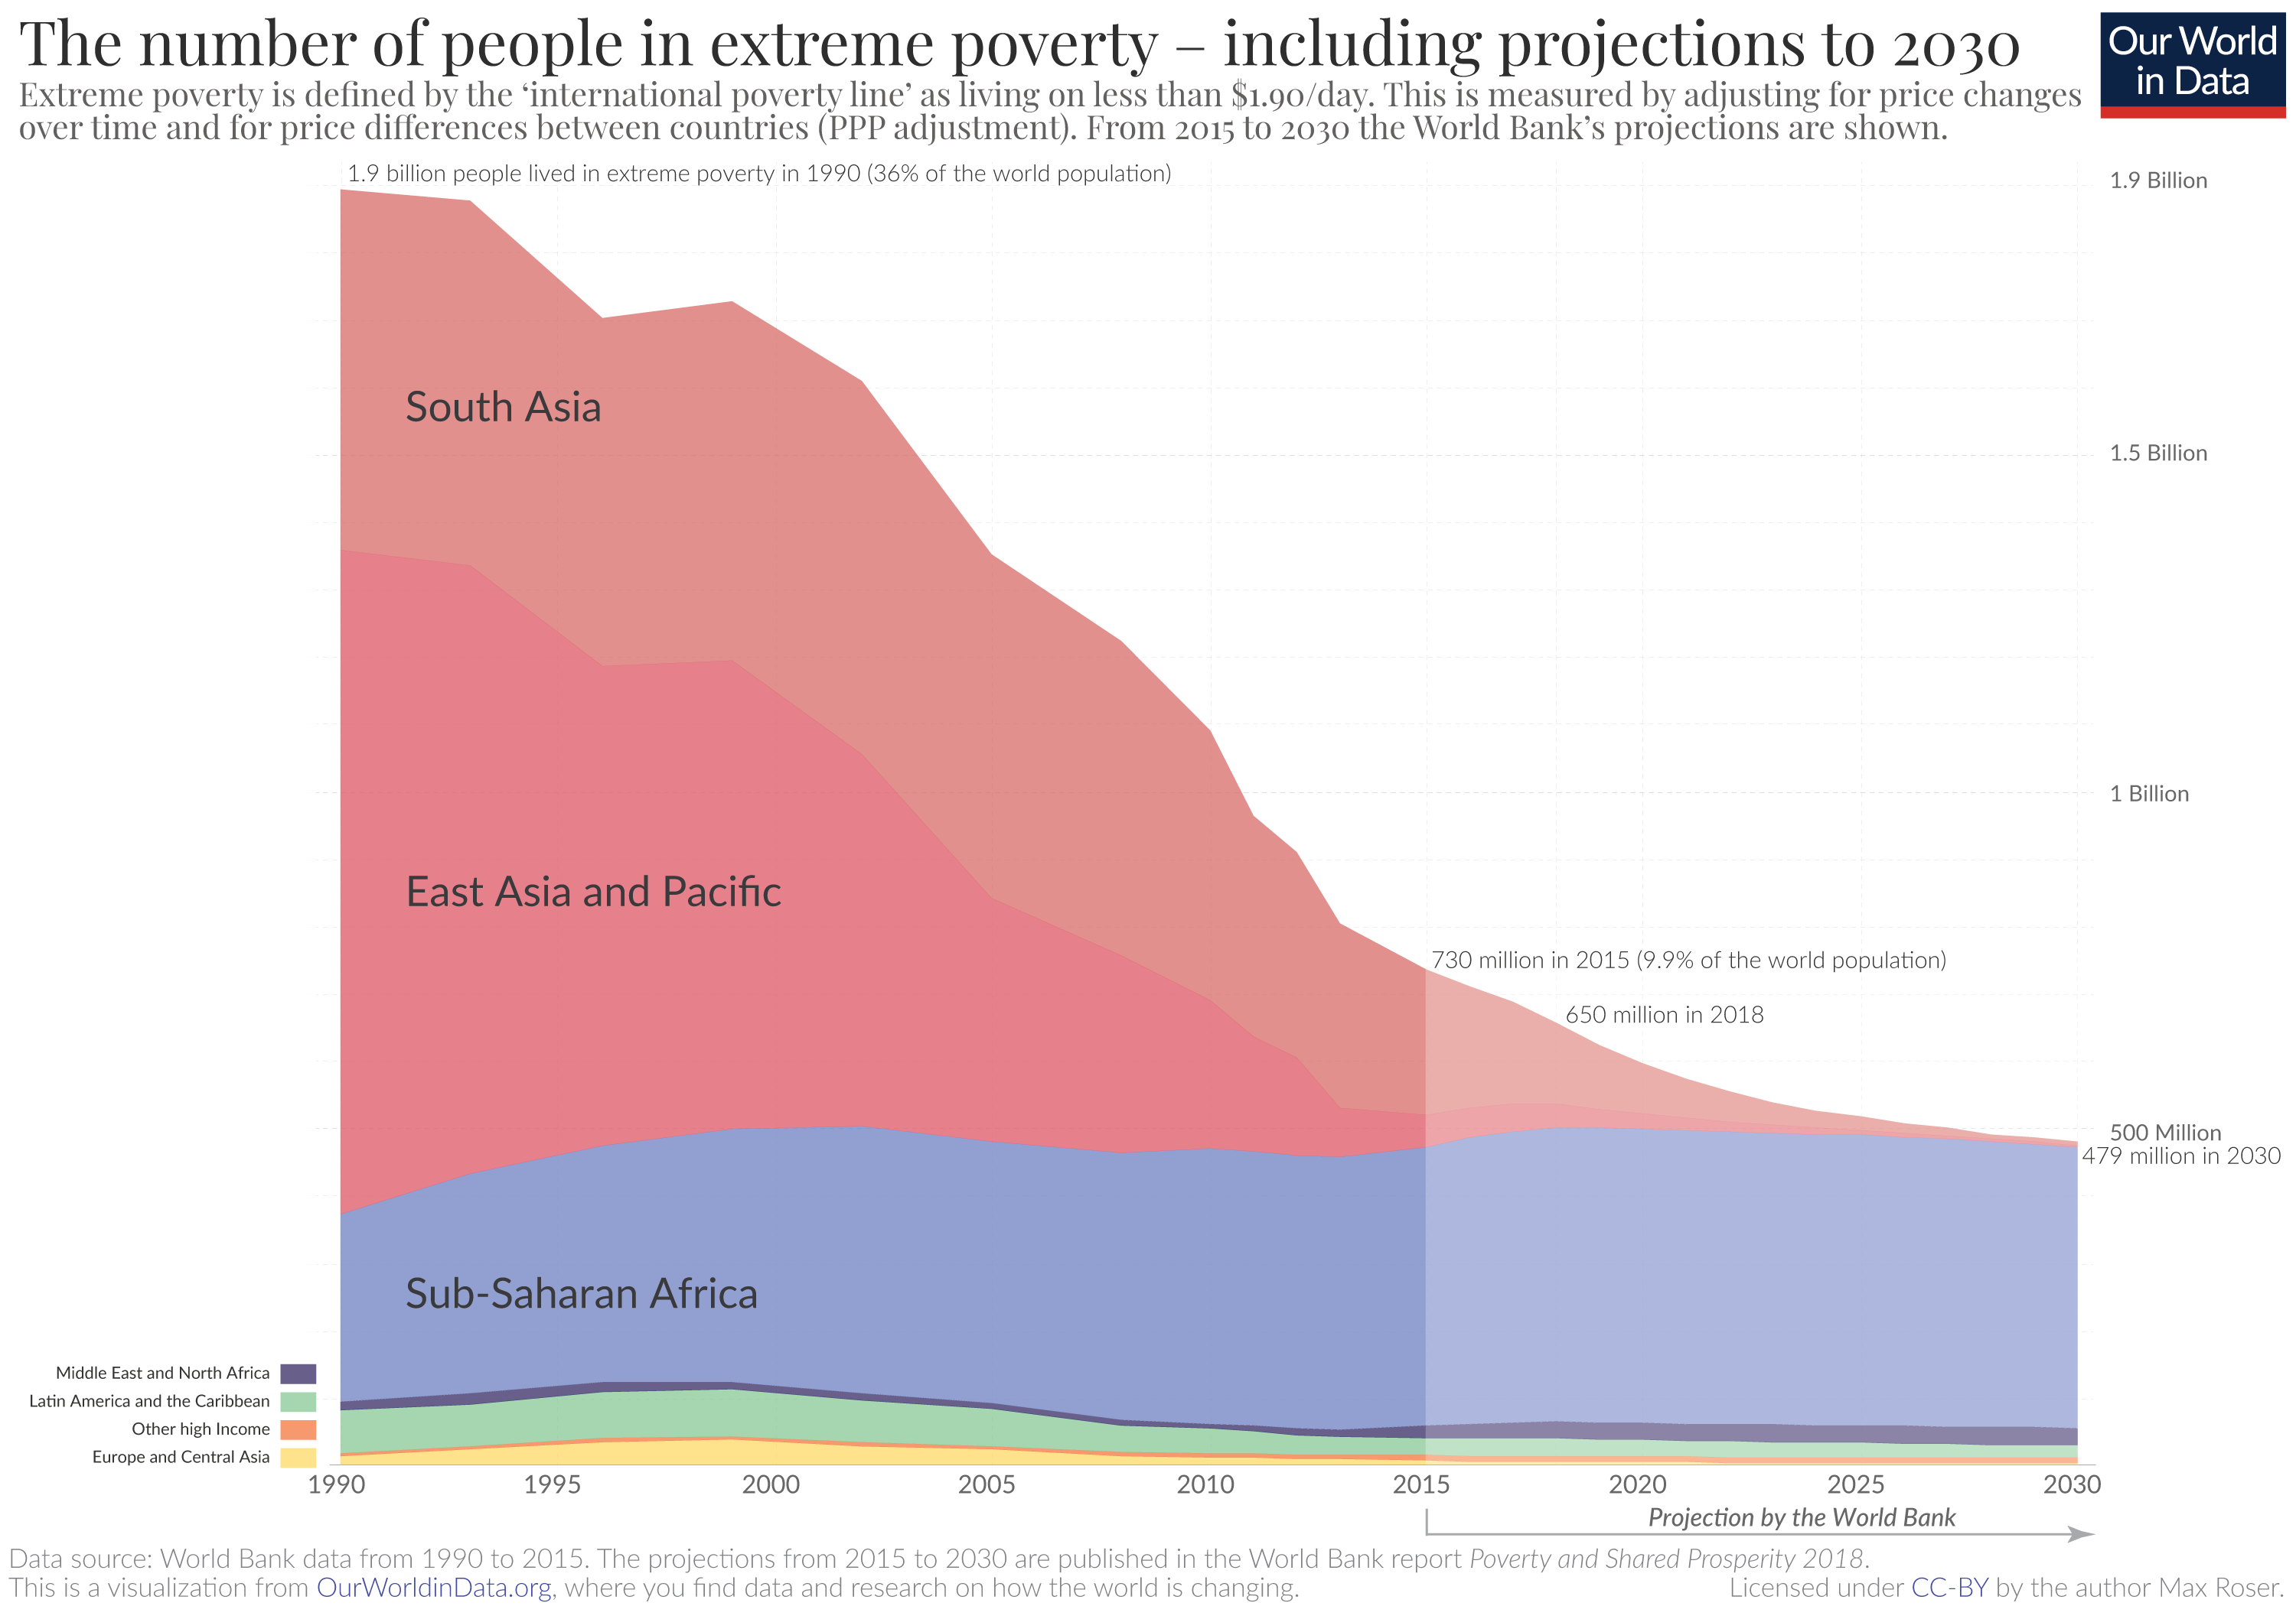

Slide 16
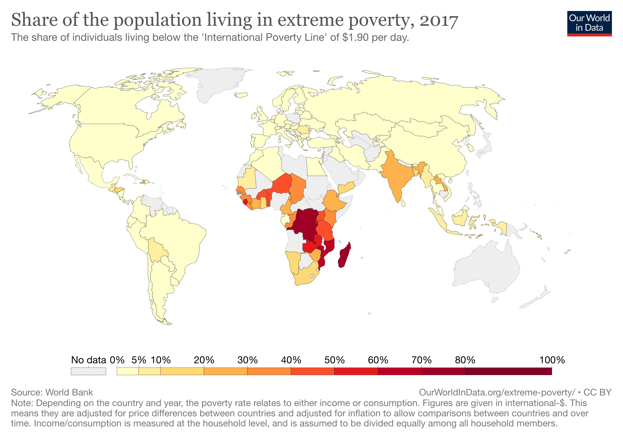

Slide 17
Example: US poverty rate definition
Based on money income = market income before taxes + cash govt transfers + cash private transfers
In-kind market income and transfers (employer health insurance, Medicaid, nutrition, public housing) do NOT count
Income and employee payroll taxes are NOT deducted, Income tax credits (EITC, Child Tax Credit) are NOT added
Threshold depends on household size/structure: e.g., $20K/year for single parent with 2 kids
Thresholds adjusted annually using the official CPI

Slide 18
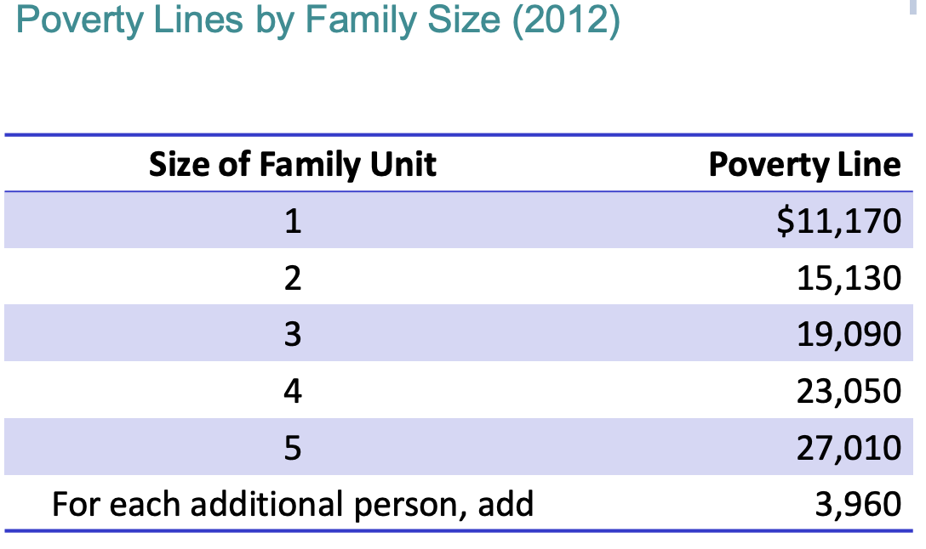

Slide 19
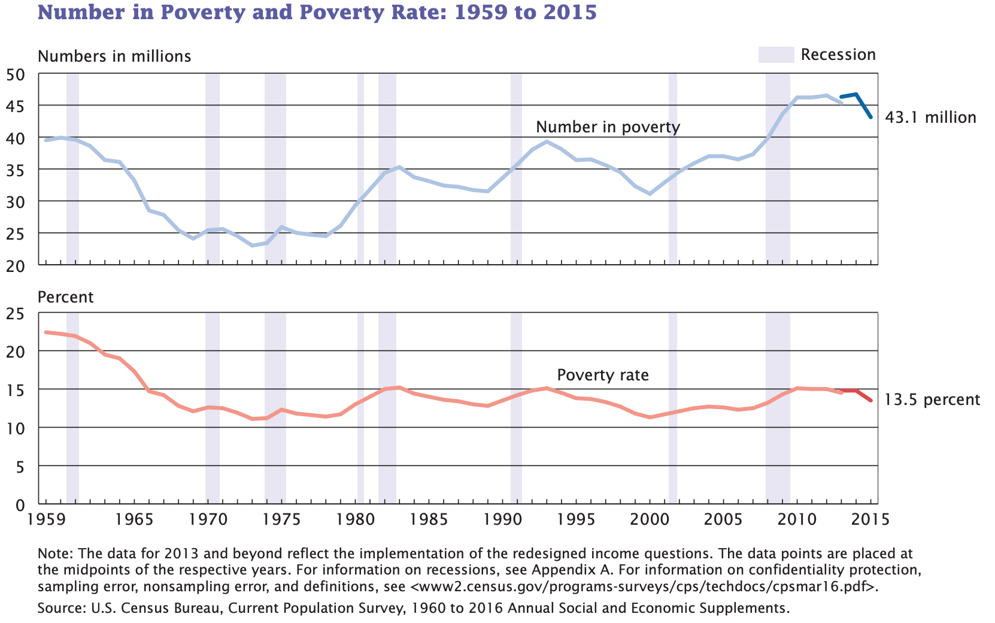

Slide 20
Factors Explaining Evolution of Poverty Based on Hoynes, Page, and Stevens (2006)
Increasing pre-tax inequality: stagnant bottom wages in spite of economic growth per capita [large effect]
Changes in family structure: single parent families ↑ from 7% in 1967 to 14.4% in 2003 ⇒ Increases poverty rate by 4 pts [large effect]
Increase in female labor force participation ⇒ Reduces poverty rate [significant effect only since 1980]
Immigration: accounts for about 0.7 points in the poverty rate increase from 1969 to 1999 [small effect]
Means-tested transfers [medium effect because they are concentrated below poverty line]

Slide 21
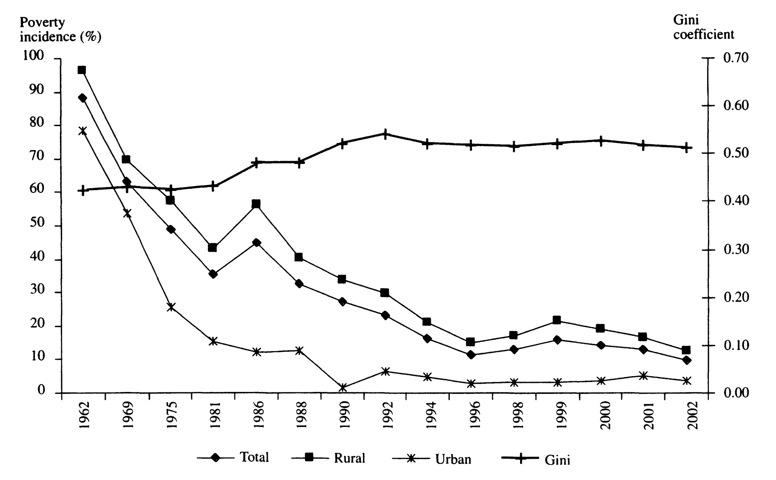
The case of Thailand
Source: reprinted from Warr (2004)

Slide 22
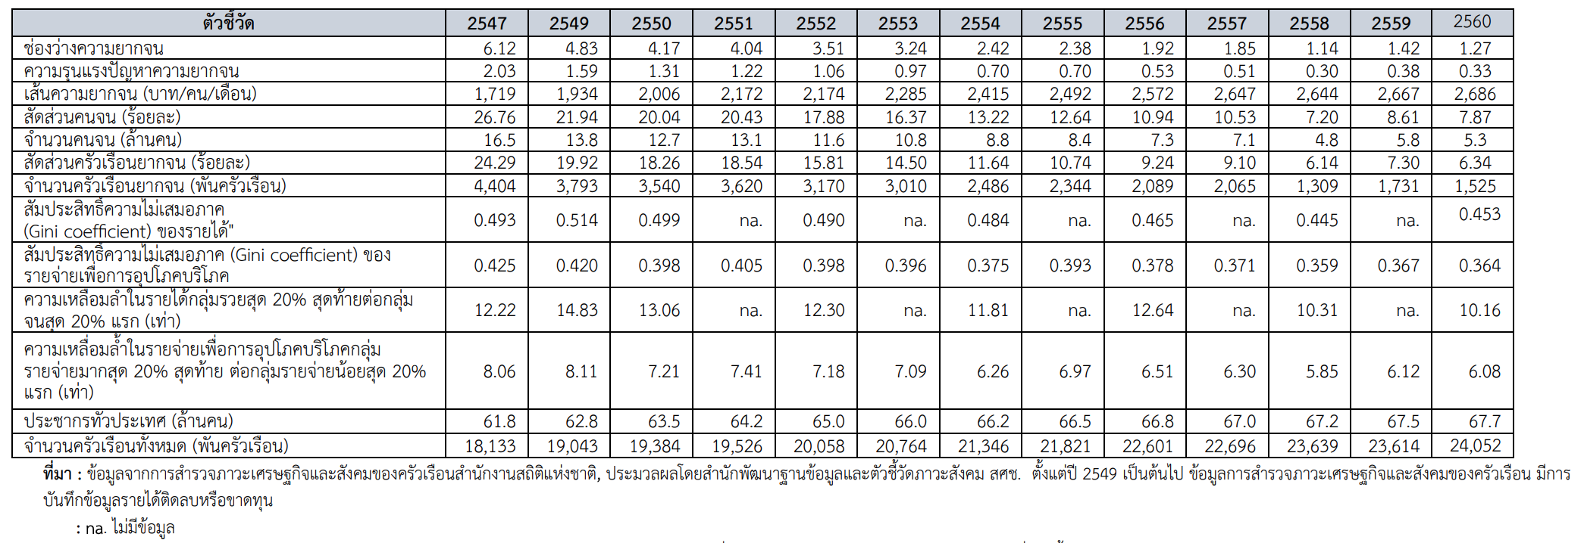

Slide 23
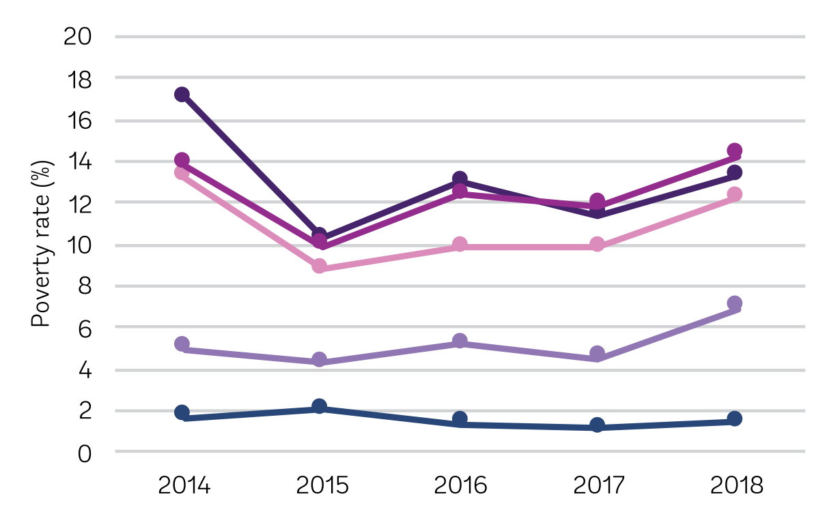
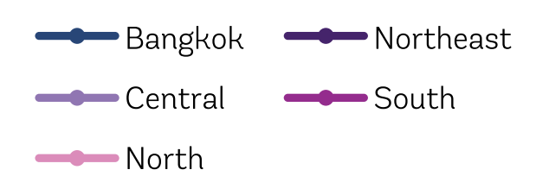
Official poverty rate by region

Slide 24
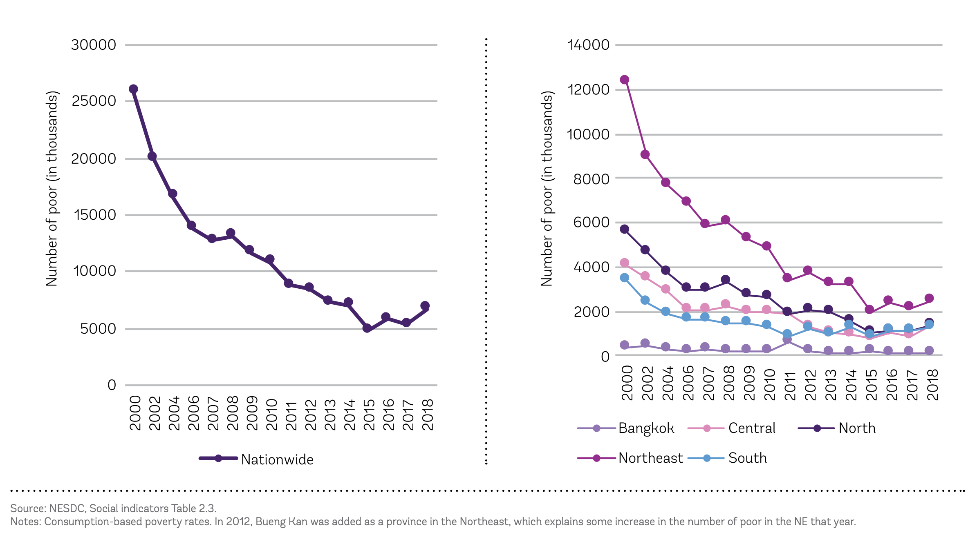

Slide 25
Current situation in Thailand
Nationally, there were 6.7 million poor people in Thailand in 2018.
The number of poor in 2018 is much lower than in previous decades, but was higher than in any year in the period 2015–17
In 2018, there was almost 2.5 million poor in the Northeast region.
The number of poor in the Central region increased by almost half a million people, as its regional poverty rate increased from 4.5 percent in 2017 to 6.9 percent in 2018.

Slide 26
Current situation in Thailand
Across regions in Thailand, there have been large variations in the success of poverty reduction over the medium term. With Bangkok enjoying the biggest success in reducing poverty (12% per year btw 1988-2013)
However, in recent years, the pace of poverty reduction has slowed down and even reversed in some regions.
  For 2014–18, poverty increased in the urban and rural areas of the Central region, as well as the Southern urban regions
An increase in poverty was seen across most provinces – compared with provincial poverty rates in 2014.

Slide 27
References
Luttmer, E. (2005). Neighbors as Negatives: Relative Earnings and Well-being. The Quarterly Journal of Economics, Volume 120, Issue 3, Pages 963-1002. https://doi.org/10.1093/qje/120.3.963
Warr, P. (2004). Globalization, Growth, and Poverty Reduction in Thailand. ASEAN Economic Bulletin, 21(1), 1-18. Retrieved October 6, 2020, from http://www.jstor.org/stable/25773799

