Slide 1
Economics of Litigation:
Disputes, Settlements, and Legal Processes

Slide 2
Dispute
Violations
  Of right (property right + tort)
  Of agreement (contract)
  Of public order (tort + criminal law)
Notice the role of public prosecutor
  On public offences
    US – DA: district attorney
    Thailand – ?

Slide 3
Pursuit to reclaim loss
Those violation caused a loss to one party or to the public
Recuperation of that loss
Rights to do so
The process of legal process to reclaim that loss is in the area of procedural law

Slide 4
Objective of Legal Process
Minimising the social cost
Who knows best?
Who is called to involve?
  What they have to do?
What is the consequence?
What is the best possible solution?
What if the best solution cannot be attained?

Slide 5
Alternative to Legal Process
That process is not compulsory
It is optional
Whether to use it or not?
Under what condition?
Private Negotiation is the cheapest
  No formal lawsuit/procedure
  Possible Coase Theorem solution
  Low cost
  US/UK: Plea Bargaining (just before the trial)
  Thai: Compromise at various stage

Slide 6
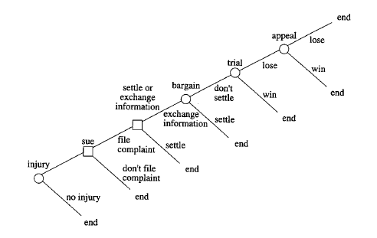
Stages of Legal Process

Slide 7
Sue
Suing or filing a lawsuit against someone does not entirely imply the intention to proceed with the legal process
Doing so can be considered as creating a threat to achieve pre-trial settlement
Commitment device
You have to pay some fees (to the court and to the lawyer)

Slide 8
Sue
Most fees are proportional to the value of the dispute
If your expected outcomes from each stage of legal processes is less than corresponding costs, you will not initiate the case
Or you will continue up to the stages where your expected outcomes are positive.

Slide 9
Sue
Most fees are proportional to the value of the dispute
If your expected outcomes from each stage of legal processes is less than corresponding costs, you will not initiate the case
Or you will continue up to the stages where your expected outcomes are positive.
Using backward induction

Slide 10
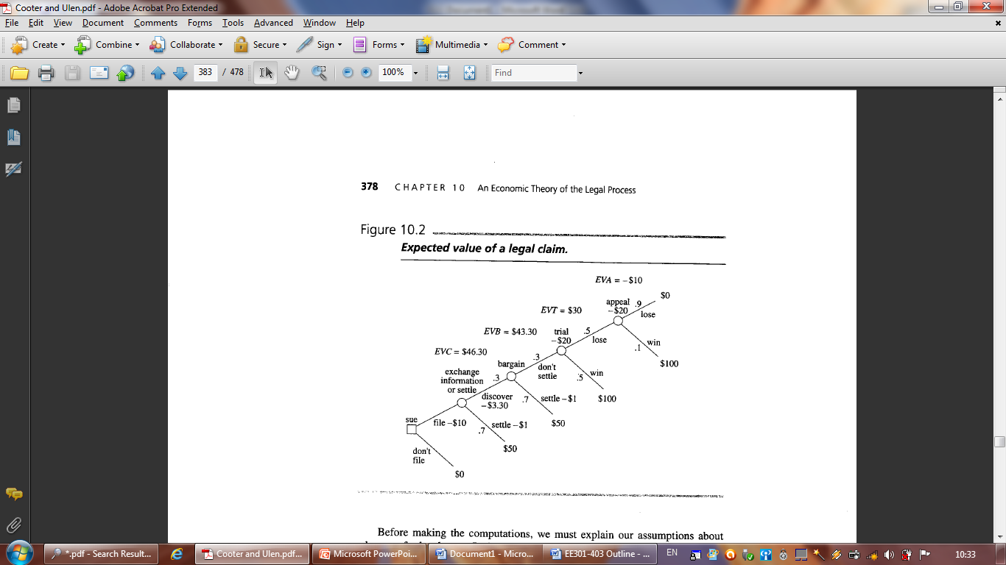
Backward Induction of Expected Outcomes/Value of the Claim by the Plaintiff

Slide 11
Who pays for the legal cost?
US: Disputing parties are responsible for their own costs
UK/European + Thailand: the loser pays all
Different cost structure
  Ex ante effect on the disputing parties’ behaviour
  Why US lawyers are very active
  If the chance of winning the case is relatively low, the possible loser (regardless of being the defendant or the plaintiff) is more willing to settle outside the court.

Slide 12
To sue or not to sue?
Comparing Filing Cost and Expected Value of Claim
Filing Cost includes
  Lawyers
  Court Fees
  And other opportunity costs
Factors
  Probability in each stage
  Outcome in each stage
  Cost in each stage

Slide 13
Why should a legal process expensive?
Extracting information
Screening device for the court
Commitment device for the disputing parties
The legal process shall be designed in such a way that the cost is increasing
  Why?

Slide 14
Court Error
Court can make mistake
Type I Error
  Rejecting H₀ whereby H₀ shall be accepted = ?
Type II Error
  NOT rejecting H₀ whereby H₀ shall be rejected = ?
Positive impact for the society?

