Slide 1

C H A P T E R 3
Consumer Behavior
CHAPTER OUTLINE
3.1 Consumer Preferences
3.2 Budget Constraints
3.3 Consumer Choice
3.4 Revealed Preference
3.5 Marginal Utility and Consumer Choice
3.6 Cost-of-Living Indexes
Prepared by:
Fernando Quijano, Illustrator

Slide 2
Consumer Behavior
● theory of consumer behavior Description of how consumers
allocate incomes among different goods and services to maximize their well-being.
Consumer behavior is best understood in three distinct steps:
Consumer Preferences
Budget Constraints
Consumer Choices
WHAT DO CONSUMERS DO?
Recent models of consumer behavior incorporate more realistic assumptions about rationality and decision making.
A basic “workhorse” of economics, our model makes simplifying assumptions to explain much of what we actually observe regarding consumer choice and the characteristics of consumer demand.

Slide 3
Consumer Preferences
3.1
Market Baskets
● market basket (or bundle) List with specific quantities of one or more goods.
TABLE 3.1 | ALTERNATIVE MARKET BASKETS
A |  | 20 | 30
B |  | 10 | 50
D |  | 40 | 20
E |  | 30 | 40
G |  | 10 | 20
H |  | 10 | 40
MARKET BASKET
UNITS OF FOOD
UNITS OF CLOTHING
To explain the theory of consumer behavior, we will ask whether consumers prefer one market basket to another.

Slide 4
Some Basic Assumptions about Preferences
Completeness: Preferences are assumed to be complete. In other words, consumers can compare and rank all possible baskets. Thus, for any two market baskets A and B, a consumer will prefer A to B, will prefer B to A, or will be indifferent between the two. By indifferent we mean that a person will be equally satisfied with either basket.
  Note that these preferences ignore costs. A consumer might prefer steak to hamburger but buy hamburger because it is cheaper.

Slide 5
  Transitivity: Preferences are transitive. Transitivity means that if a consumer prefers basket A to basket B and basket B to basket C, then the consumer also prefers A to C. Transitivity is normally regarded as necessary for consumer consistency.
  More is better than less: Goods are assumed to be desirable—i.e., to be good. Consequently, consumers always prefer more of any good to less. In addition, consumers are never satisfied or satiated; more is always better, even if just a little better.
Notes:
The assumption that more is better than less is made for pedagogic reasons; namely, it simplifies the graphical analysis. Of course, some goods, such as air pollution, may be undesirable, and consumers will always prefer less. We ignore these “bads” in the context of our immediate discussion of consumer choice because most consumers would not choose to purchase them.

Slide 6



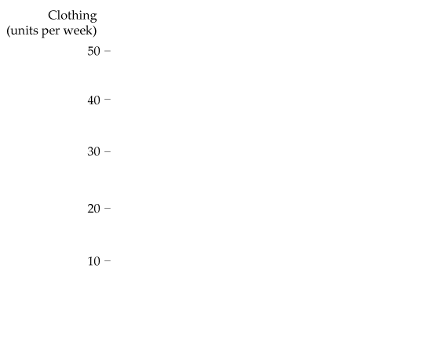
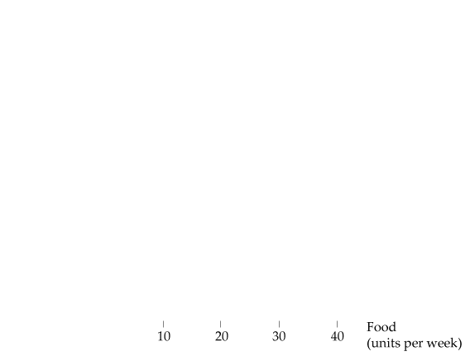






Indifference Curves
FIGURE 3.1
DESCRIBING INDIVIDUAL PREFERENCES
Because more of each good is preferred to less, we can compare market baskets in the shaded areas.
Basket A is clearly preferred to basket G, while E is clearly preferred to A.
However, A cannot be compared with B, D, or H without additional information.
● indifference curve Curve representing all combinations of market baskets that provide a consumer with the same level of satisfaction.

Slide 7
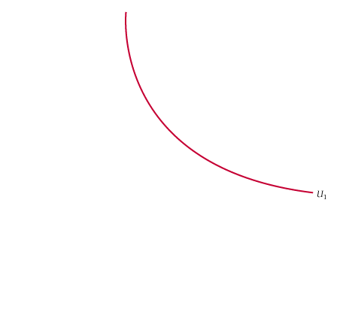

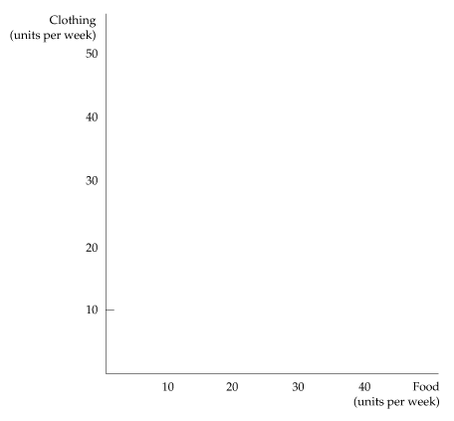

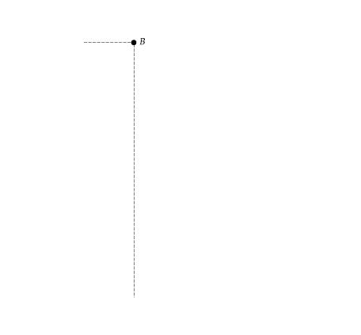
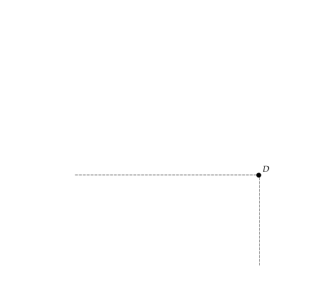
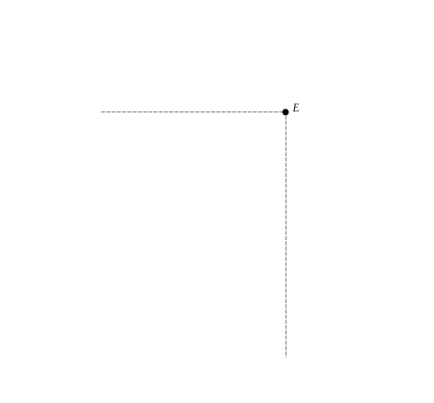


FIGURE 3.2
AN INDIFFERENCE CURVE
The indifference curve U₁ that passes through market basket A shows all baskets that give the consumer the same level of satisfaction as does market basket A; these include baskets B and D.
Our consumer prefers basket E, which lies above U₁, to A, but prefers A to H or G, which lie below U₁.

Slide 8
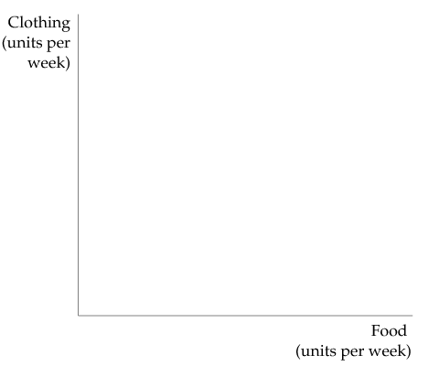
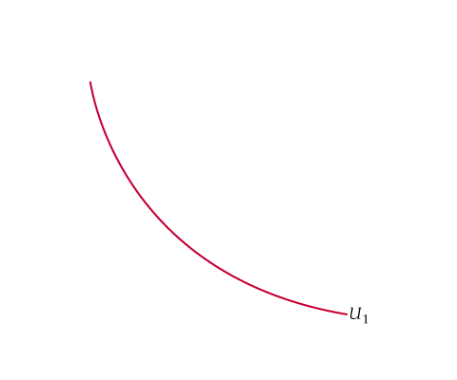
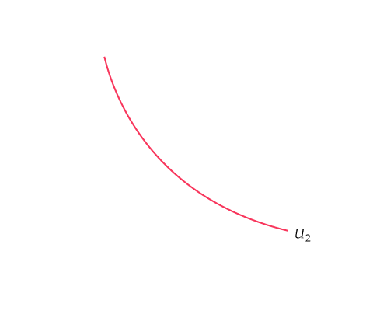


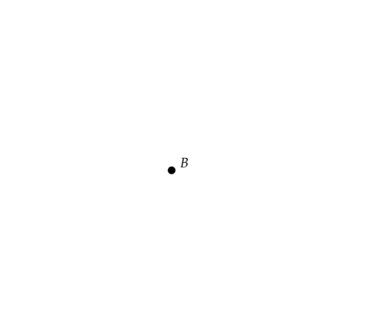

Indifference Maps
● indifference map Graph containing a set of indifference curves
showing the market baskets among which a consumer is indifferent.
FIGURE 3.3
AN INDIFFERENCE MAP
An indifference map is a set of indifference curves that describes a person's preferences.
Any market basket on indifference curve U₃, such as basket A, is preferred to any basket on curve U₂ (e.g., basket B), which in turn is preferred to any basket on U₁, such as D.

Slide 9
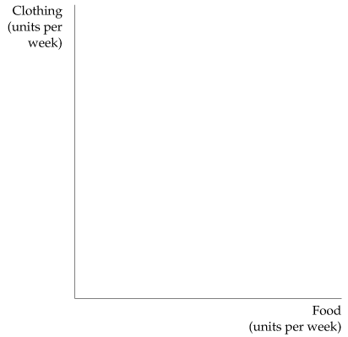
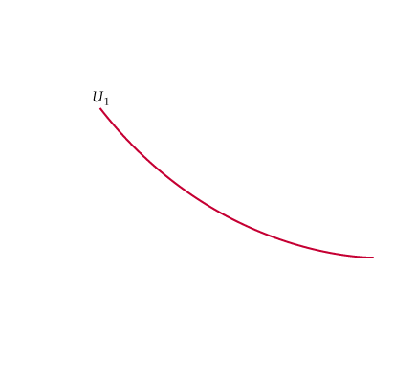
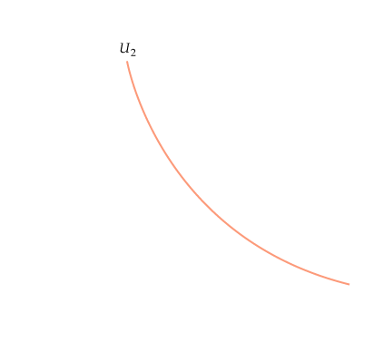

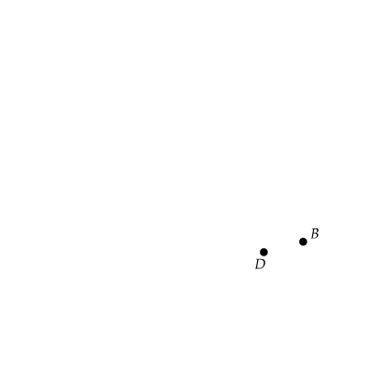
FIGURE 3.4
INDIFFERENCE CURVES CANNOT INTERSECT
If indifference curves U₁ and U₂ intersect, one of the assumptions of consumer theory is violated.
According to this diagram, the consumer should be indifferent among market baskets A, B, and D. Yet B should be preferred to D because B has more of both goods.

Slide 10
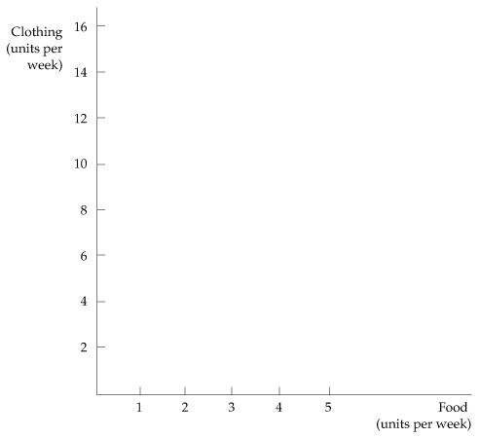

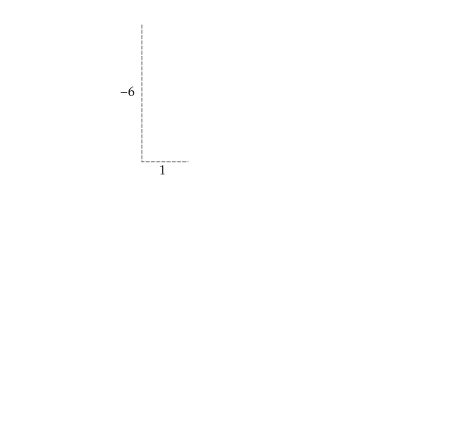

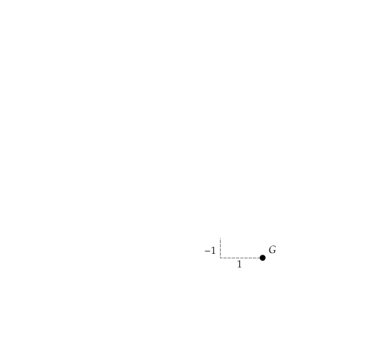
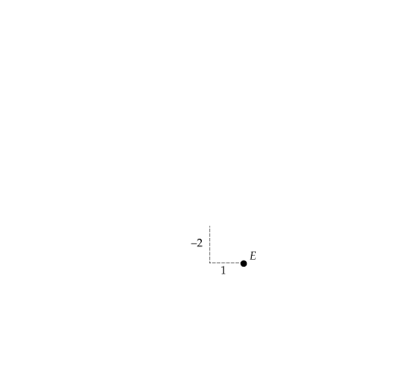
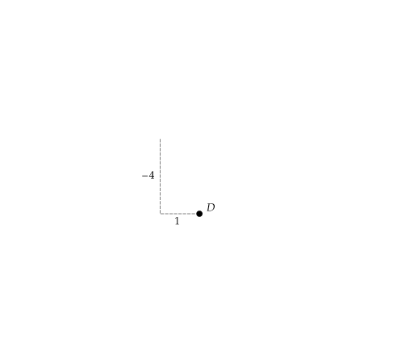
The Shape of Indifference Curves
FIGURE 3.5
THE MARGINAL RATE OF SUBSTITUTION
The magnitude of the slope of an indifference curve measures the consumer’s marginal rate of substitution (MRS) between two goods.
In this figure, the MRS between clothing (C) and food (F) falls from 6 (between A and B) to 4 (between B and D) to 2 (between D and E) to 1 (between E and G).

Slide 11
The Marginal Rate of Substitution
● marginal rate of substitution (MRS) Maximum amount of a good
that a consumer is willing to give up in order to obtain one additional unit of another good.
CONVEXITY
Observe that the MRS falls as we move down the indifference curve. The decline in the MRS reflects our fourth assumption regarding consumer preferences: a diminishing marginal rate of substitution. When the MRS diminishes along an indifference curve, the curve is convex.

Slide 12
Perfect Substitutes and Perfect Complements
● perfect substitutes Two goods for which the marginal rate of substitution of one for the other is a constant.
● perfect complements Two goods for which the MRS is zero or infinite; the indifference curves are shaped as right angles.
BADS
● bad Good for which less is preferred rather than more.

Slide 13

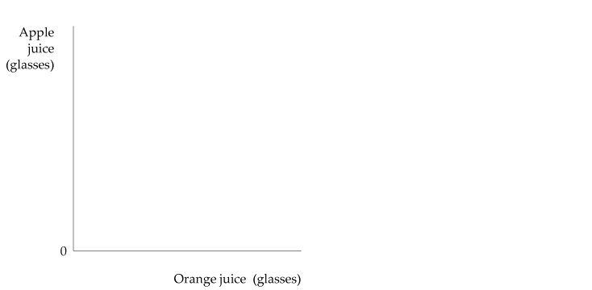



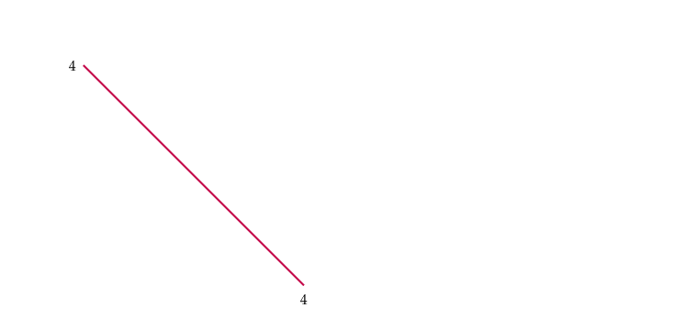

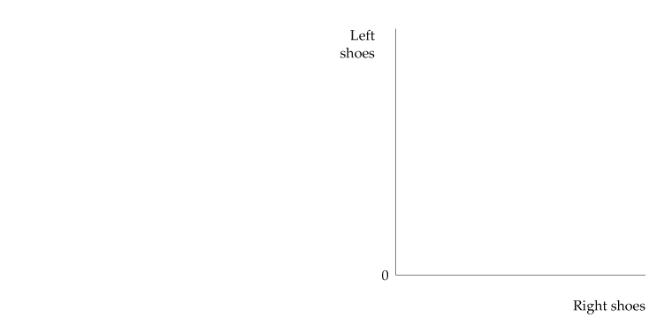




FIGURE 3.6
PERFECT SUBSTITUTES AND PERFECT COMPLEMENTS
In (a), Bob views orange juice and apple juice as perfect substitutes: He is always indifferent between a glass of one and a glass of the other.
In (b), Jane views left shoes and right shoes as perfect complements: An additional left shoe gives her no extra satisfaction unless she also obtains the matching right shoe.

Slide 14


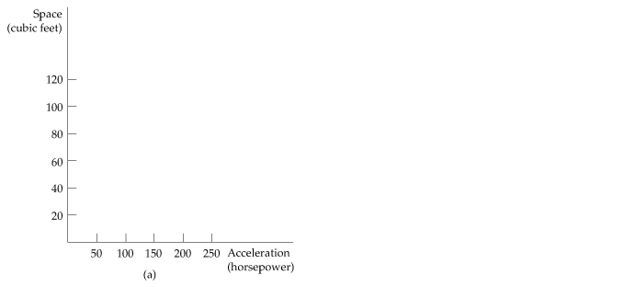



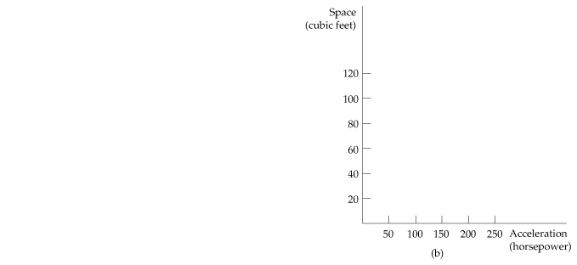


EXAMPLE 3.1
DESIGNING NEW AUTOMOBILES (I)
Preferences for automobile attributes can be described by indifference curves. Each curve shows the combination of acceleration and interior space that give the same satisfaction.
FIGURE 3.7
PREFERENCES FOR AUTOMOBILE ATTRIBUTES
Owners of Ford Mustang coupes (a) are willing to give up considerable interior space for additional acceleration.
The opposite is true for owners of Ford Explorers. They prefer interior space to acceleration (b).

Slide 15
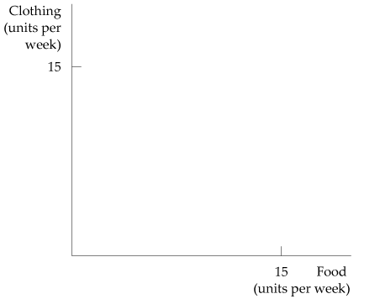
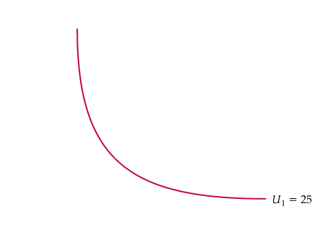
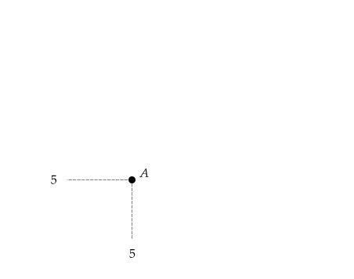
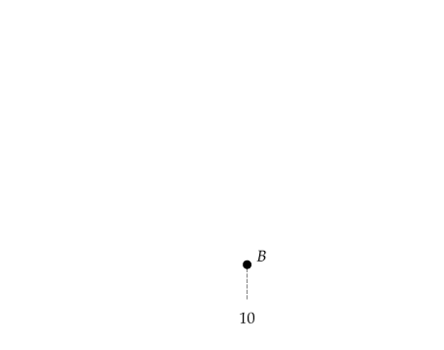
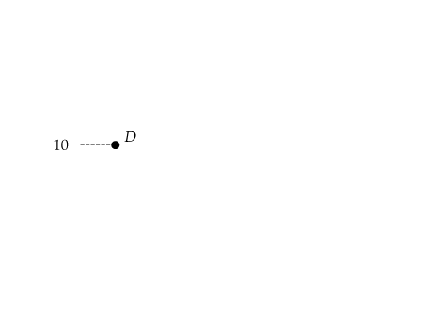
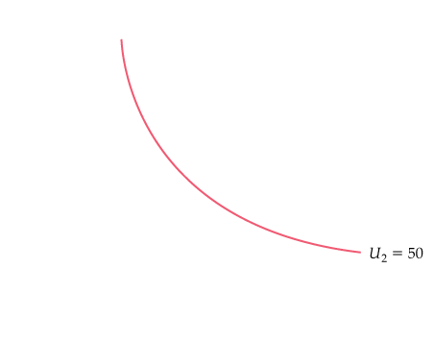
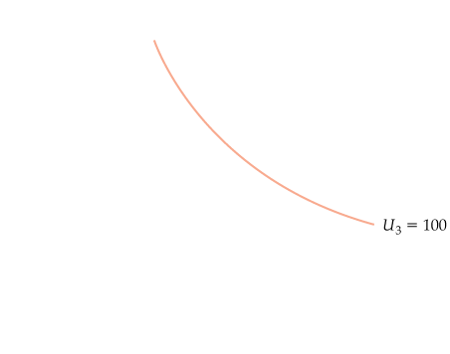
UTILITY AND UTILITY FUNCTIONS
● utility Numerical score representing the satisfaction that a
consumer gets from a given market basket.
● utility function Formula that assigns a level of utility to individual
market baskets.
FIGURE 3.8
UTILITY FUNCTIONS AND INDIFFERENCE CURVES
A utility function can be represented by a set of indifference curves, each with a numerical indicator.
This figure shows three indifference curves (with utility levels of 25, 50, and 100, respectively) associated with the utility function:
u (F,C ) = FC

Slide 16
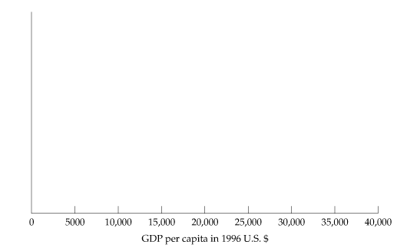


ORDINAL VERSUS CARDINAL UTILITY
● ordinal utility function Utility function that generates a ranking of
market baskets in order of most to least preferred.
● cardinal utility function Utility function describing by how much one market basket is preferred to another.
EXAMPLE 3.2
CAN MONEY BUY HAPPINESS?
FIGURE 3.9
INCOME AND HAPPINESS
A cross-country comparison shows that individuals living in countries with higher GDP per capita are on average happier than those living in countries with lower per-capita GDP.

Slide 17
Budget Constraints
3.2
● budget constraints Constraints that consumers face as a result
of limited incomes.
The Budget Line
● budget line All combinations of goods for which the total amount of money spent is equal to income.
(3.1)
TABLE 3.2 | MARKET BASKETS AND THE BUDGET LINE
MARKET BASKET |  | FOOD (F) | CLOTHING (C) | TOTAL SPENDING
A |  | 0 | 40 | $80
B |  | 20 | 30 | $80
D |  | 40 | 20 | $80
E |  | 60 | 10 | $80
G |  | 80 | 0 | $80
Market baskets associated with the budget line F + 2C = $80

Slide 18
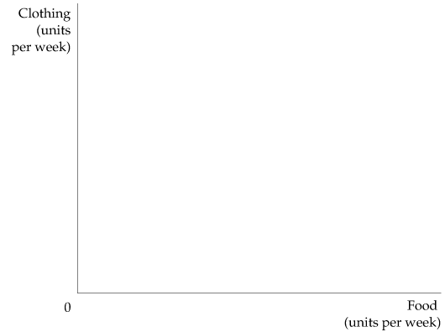

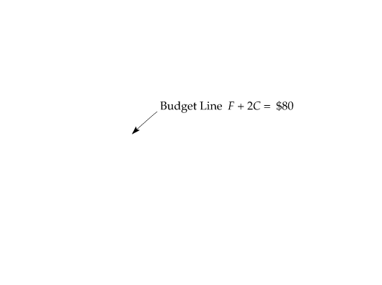

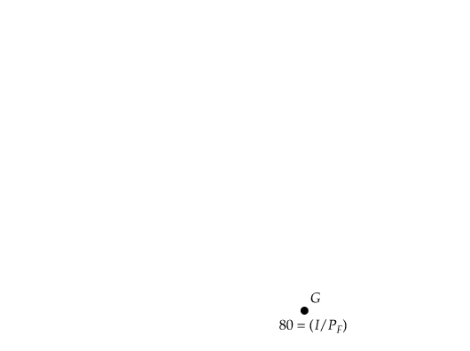
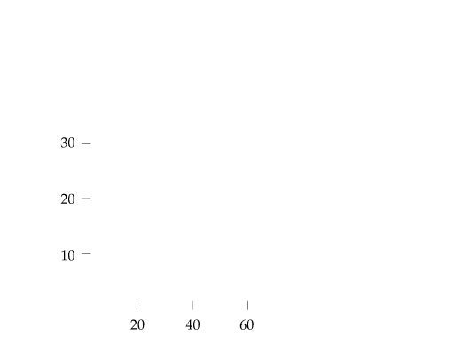
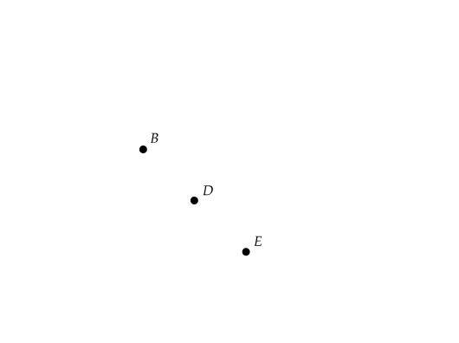
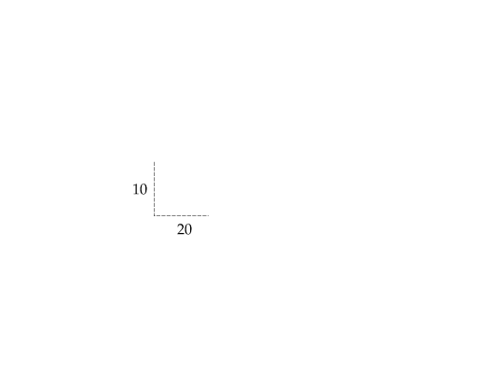
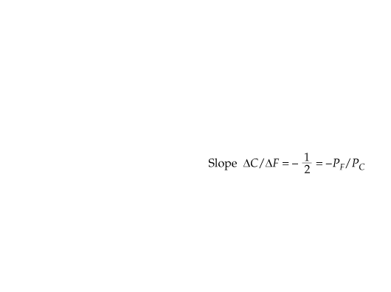
FIGURE 3.10
A BUDGET LINE
A budget line describes the combinations of goods that can be purchased given the consumer’s income and the prices of the goods.
Line AG (which passes through points B, D, and E) shows the budget associated with an income of $80, a price of food of P_{F} = $1 per unit, and a price of clothing of P_{C} = $2 per unit.
The slope of the budget line (measured between points B and D) is −P_{F}/P_{C} = −10/20 = −1/2.
(3.2)

Slide 19
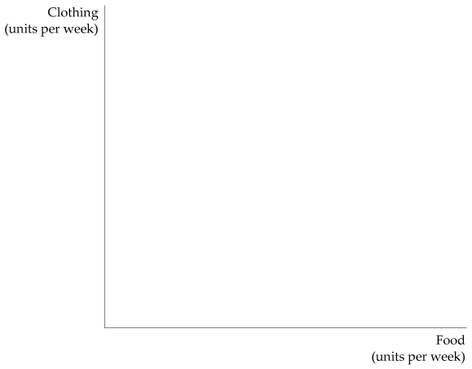
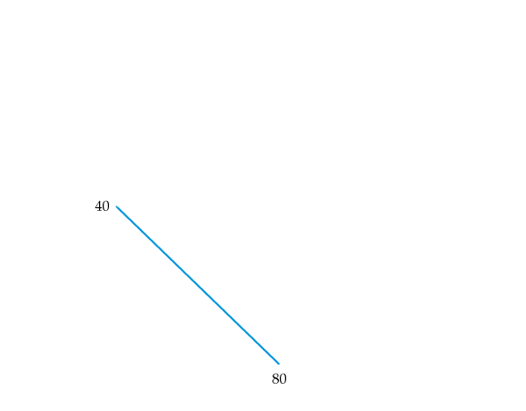
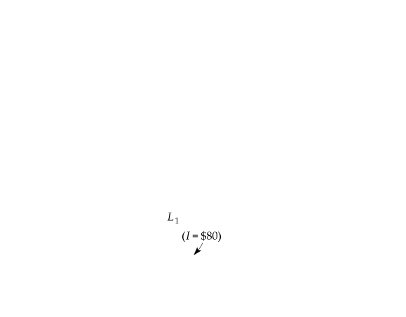

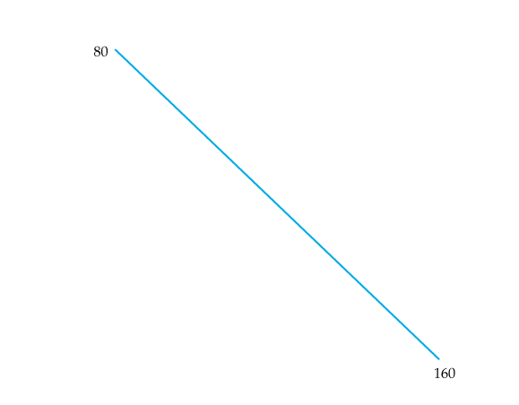
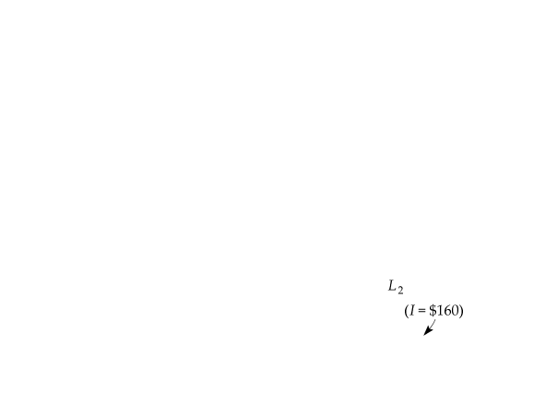
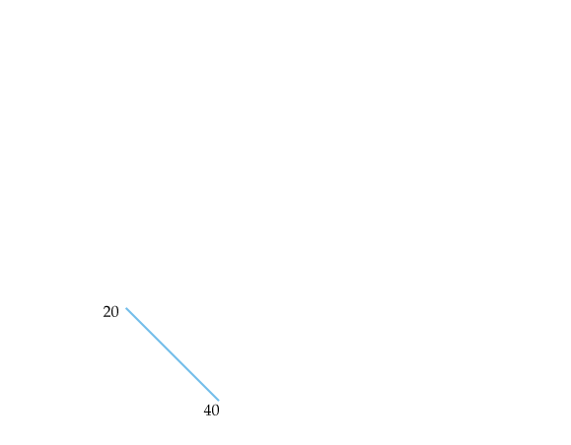
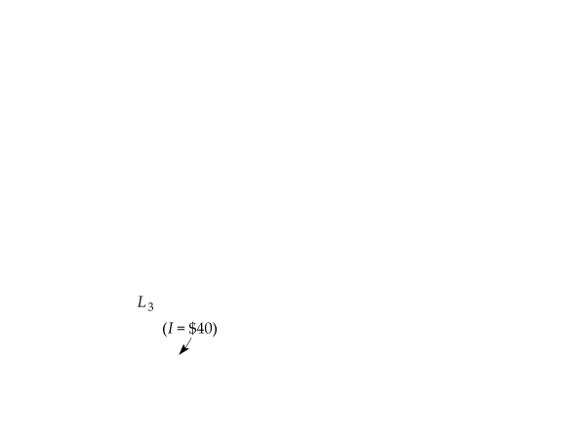
The Effects of Changes in Income and Prices
FIGURE 3.11
EFFECTS OF A CHANGE IN INCOME ON THE BUDGET LINE
INCOME CHANGES
A change in income (with prices unchanged) causes the budget line to shift parallel to the original line (L₁).
When the income of $80 (on L₁) is increased to $160, the budget line shifts outward to L₂.
If the income falls to $40, the line shifts inward to L₃.

Slide 20
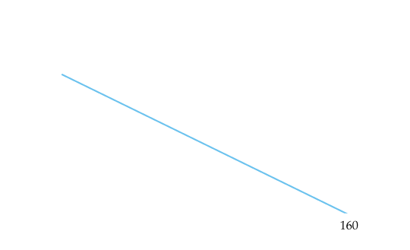
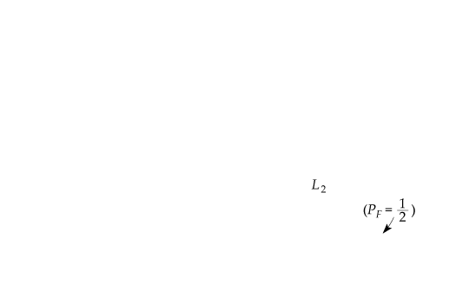

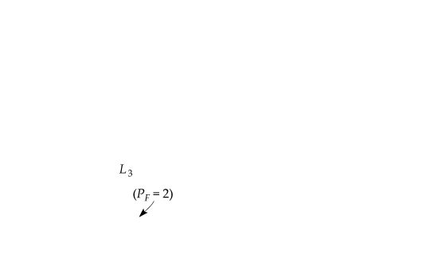




FIGURE 3.12
EFFECTS OF A CHANGE IN PRICE ON THE BUDGET LINE
PRICE CHANGES
A change in the price of one good (with income unchanged) causes the budget line to rotate about one intercept.
When the price of food falls from $1.00 to $0.50, the budget line rotates outward from L₁ to L₂.
However, when the price increases from $1.00 to $2.00, the line rotates inward from L₁ to L₃.

Slide 21
Consumer Choice
3.3
The maximizing market basket must satisfy two conditions:
  It must be located on the budget line.
  It must give the consumer the most preferred combination of goods and services.

Slide 22











FIGURE 3.13
MAXIMIZING CONSUMER SATISFACTION
A consumer maximizes satisfaction by choosing market basket A. At this point, the budget line and indifference curve U₂ are tangent.
No higher level of satisfaction (e.g., market basket D) can be attained.
At A, the point of maximization, the MRS between the two goods equals the price ratio. At B, however, because the MRS [− (−10/10) = 1] is greater than the price ratio (1/2), satisfaction is not maximized.

Slide 23
Satisfaction is maximized (given the budget constraint) at the point where
          MRS = P_{F}/P_{C}
(3.3)
● marginal benefit Benefit from the consumption of one additional unit
of a good.
● marginal cost Cost of one additional unit of a good.
So, we can then say that satisfaction is maximized when the marginal benefit—the benefit associated with the consumption of one additional unit of food—is equal to the marginal cost—the cost of the additional unit of food. The marginal benefit is measured by the MRS.

Slide 24








EXAMPLE 3.3
DESIGNING NEW AUTOMOBILES (II)
Different preferences of consumer groups for automobiles can affect their purchasing decisions. Following up on Example 3.1, we consider two groups of consumers planning to buy new cars.
FIGURE 3.14
CONSUMER CHOICE OF AUTOMOBILE ATTRIBUTES
The consumers in (a) are willing to trade off a considerable amount of interior space for some additional acceleration.
Given a budget constraint, they will choose a car that emphasizes acceleration.
The opposite is true for consumers in (b).

Slide 25





Corner Solutions
● corner solution Situation in which the marginal rate of substitution
for one good in a chosen market basket is not equal to the slope of the budget line.
FIGURE 3.15
A CORNER SOLUTION
When a corner solution arises, the consumer maximizes satisfaction by consuming only one of the two goods.
Given budget line AB, the highest level of satisfaction is achieved at B on indifference curve U₁, where the MRS (of ice cream for frozen yogurt) is greater than the ratio of the price of ice cream to the price of frozen yogurt.

Slide 26














EXAMPLE 3.4
CONSUMER CHOICE OF HEALTH CARE
FIGURE 3.16
CONSUMER PREFERENCES FOR HEALTH CARE VERSUS OTHER GOODS
These indifference curves show the trade-off between consumption of health care (H) versus other goods (O). Curve U₁ applies to a consumer with low income; given the consumer’s budget constraint, satisfaction is maximized at point A.
As income increases the budget line shifts to the right, and curve U₂ becomes feasible. The consumer moves to point B, with greater consumption of both health care and other goods.
Curve U₃ applies to a high-income consumer, and implies less willingness to give up health care for other goods. Moving from point B to point C, the consumer’s consumption of health care increases considerably (from H₂ to H₃), while her consumption of other goods increases only modestly (from O₂ to O₃).

Slide 27










EXAMPLE 3.5
A COLLEGE TRUST FUND
FIGURE 3.17
A COLLEGE TRUST FUND
When given a college trust fund that must be spent on education, the student moves from A to B, a corner solution.
If, however, the trust fund could be spent on other consumption as well as education, the student would be better off at C.

Slide 28








Revealed Preference
3.4
If a consumer chooses one market basket over another, and if the chosen market basket is more expensive than the alternative, then the consumer must prefer the chosen market basket.
FIGURE 3.18
REVEALED PREFERENCE:
TWO BUDGET LINES
If an individual facing budget line l₁ chose market basket A rather than market basket B, A is revealed to be preferred to B.
Likewise, the individual facing budget line l₂ chooses market basket B, which is then revealed to be preferred to market basket D.
Whereas A is preferred to all market baskets in the green-shaded area, all baskets in the pink-shaded area are preferred to A.

Slide 29














FIGURE 3.19
REVEALED PREFERENCE:
FOUR BUDGET LINES
Facing budget line l₃, the individual chooses E, which is revealed to be preferred to A (because A could have been chosen).
Likewise, facing line l₄, the individual chooses G, which is also revealed to be preferred to A.
Whereas A is preferred to all market baskets in the green-shaded area, all market baskets in the pink-shaded area are preferred to A.

Slide 30








EXAMPLE 3.6
REVEALED PREFERENCE FOR RECREATION
FIGURE 3.20
REVEALED PREFERENCE FOR RECREATION
When facing budget line l₁, an individual chooses to use a health club for 10 hours per week at point A.
When the fees are altered, she faces budget line l₂.
She is then made better off because market basket A can still be purchased, as can market basket B, which lies on a higher indifference curve.

Slide 31
Marginal Utility and Consumer Choice
3.5
● marginal utility (MU) Additional satisfaction obtained from
consuming one additional unit of a good.
● diminishing marginal utility Principle that as more of a good is consumed, the consumption of additional amounts will yield smaller additions to utility.
(3.5)
(3.6)
or
(3.7)
● equal marginal principle Principle that utility is maximized when the consumer has equalized the marginal utility per dollar of expenditure across all goods.

Slide 32





EXAMPLE 3.7
MARGINAL UTILITY AND HAPPINESS
What, if anything, does research on consumer satisfaction tell us about the relationship between happiness and the concepts of utility and marginal utility?
FIGURE 3.21
MARGINAL UTILITY AND HAPPINESS
A comparison of mean levels of satisfaction with life across income classes in the United States shows that happiness increases with income, but at a diminishing rate.

Slide 33









Rationing
FIGURE 3.22
INEFFICIENCY OF GASOLINE RATIONING
When a good is rationed, less is available than consumers would like to buy. Consumers may be worse off.
Without gasoline rationing, up to 20,000 gallons of gasoline are available for consumption (at point B).
The consumer chooses point C on indifference curve U₂, consuming 5000 gallons of gasoline.
However, with a limit of 2000 gallons of gasoline under rationing, the consumer moves to D on the lower indifference curve U₁.

Slide 34








FIGURE 3.23
COMPARING GASOLINE RATIONING TO THE FREE MARKET
Some consumers will be worse off, but others may be better off with rationing. With rationing and a gasoline price of $1.00, she buys the maximum allowable 2000 gallons per year, putting her on indifference curve U₁.
Had the competitive market price been $2.00 per gallon with no rationing, she would have chosen point F, which lies below indifference curve U₁.
However, had the price of gasoline been only $1.33 per gallon, she would have chosen point G, which lies above indifference curve U₁.

Slide 35
Cost-of-Living Indexes
3.6
● cost-of-living index Ratio of the present cost of a typical bundle of consumer goods and services compared with the cost during a base period.
Ideal Cost-of-Living Index
● ideal cost-of-living index Cost of attaining a given level of utility at current prices relative to the cost of attaining the same utility at base-year prices.

Slide 36







FIGURE 3.24 (1 of 2)
TABLE 3.3 | IDEAL COST-OF-LIVING INDEX
Price of books |  | $20/book | $100/bk
Number of books |  | 15 | 6
Price of food |  | $2.00/lb. | $2.20/lb.
Pounds of food |  | 100 | 300
Expenditure |  | $500 | $1260
COST-OF-LIVING INDEXES
2000 (SARAH)
2010 (RACHEL)
The initial budget constraint facing Sarah in 2000 is given by line l₁; her utility-maximizing combination of food and books is at point A on indifference curve U₁.
Rachel requires a budget sufficient to purchase the food-book consumption bundle given by point B on line l₂ (and tangent to indifference curve U₁).

Slide 37

FIGURE 3.24 (2 of 2)
TABLE 3.3 | IDEAL COST-OF-LIVING INDEX
Price of books |  | $20/book | $100/bk
Number of books |  | 15 | 6
Price of food |  | $2.00/lb. | $2.20/lb.
Pounds of food |  | 100 | 300
Expenditure |  | $500 | $1260
COST-OF-LIVING INDEXES
2000 (SARAH)
2010 (RACHEL)
A price index, which represents the cost of buying bundle A at current prices relative to the cost of bundle A at base-year prices, overstates the ideal cost-of-living index.

Slide 38
Laspeyres Index
● Laspeyres price index Amount of money at current year prices that an individual requires to purchase a bundle of goods and services chosen in a base year divided by the cost of purchasing the same bundle at base-year prices.
COMPARING IDEAL COST-OF-LIVING AND LASPEYRES INDEXES
The Laspeyres index overcompensates Rachel for the higher cost of living, and the Laspeyres cost-of-living index is, therefore, greater than the ideal cost-of-living index.

Slide 39
Paasche Index
● Paasche index Amount of money at current-year prices that an individual requires to purchase a current bundle of goods and services divided by the cost of purchasing the same bundle in a base year.
COMPARING THE LASPEYRES AND PAASCHE INDEXES
Just as the Laspeyres index will overstate the ideal cost of living, the Paasche will understate it because it assumes that the individual will buy the current year bundle in the base period.

Slide 40
● fixed-weight index Cost-of-living index in which the quantities of
goods and services remain unchanged.
Price Indexes in the United States: Chain Weighting
● chain-weighted price index Cost-of-living index that accounts for changes in quantities of goods and services.
EXAMPLE 3.8
THE BIAS IN THE CPI
A commission chaired by Stanford University professor Michael Boskin concluded that the CPI overstated inflation by approximately 1.1 percentage points—a significant amount given the relatively low rate of inflation in the United States in recent years.
Approximately 0.4 percentage points of the 1.1-percentage-point bias was due to the failure of the Laspeyres price index to account for changes in the current year mix of consumption of the products in the base-year bundle.

