Slide 1
Chapter 6: Efficient Capital Markets
Analysis of Investments &
Management of Portfolios
10TH EDITION
Reilly & Brown

Slide 2
Why Should the Markets Be Efficient?
Premises of An Efficient Market
  A large number of competing profit-maximizing participants analyze and value securities, each independently of the others
  New information regarding securities comes to the market in a random fashion
  Profit-maximizing investors cause security prices to adjust rapidly to reflect the effect of new information

Slide 3
Why Should the Markets Be Efficient?
The Results
  Security price changes should be independent and random
  The security prices that prevail at any time should be an unbiased reflection of all currently available information
  In an efficient market, the expected returns implicit in the current price of a stock should be consistent with the perceived risk of the stock

Slide 4
Efficient Market Hypotheses (EMH)
Random Walk Hypothesis
  – Changes in security prices occur randomly
Fair Game Model
  Current market price reflect all available information about a security and the expected return based upon this price is consistent with its risk
Efficient Market Hypothesis (EMH)
  Divided into three sub-hypotheses depending on the information set involved

Slide 5
Efficient Market Hypotheses (EMH)
Weak-Form EMH
  Current prices reflect all security-market historical information, including the historical sequence of prices, rates of return, trading volume data, and other market-generated information
  This implies that past rates of return and other market data should have no relationship with future rates of return
  In short, prices reflect all historical information

Slide 6
Efficient Market Hypotheses (EMH)
Semistrong-Form EMH
  Current security prices reflect all public information, including market and non-market information
  This implies that decisions made on new information after it is public should not lead to above-average risk-adjusted profits from those transactions
  In short, prices reflect all public information

Slide 7
Efficient Market Hypotheses (EMH)
Strong-Form EMH
  Stock prices fully reflect all information from public and private sources
  This implies that no group of investors should be able to consistently derive above-average risk-adjusted rates of return
  This assumes perfect markets in which all information is cost-free and available to everyone at the same time
  In short, prices reflect all public and private information

Slide 8
Tests and Weak-Form EMH
Statistical Tests of Independence
  Autocorrelation tests
  Runs tests
Tests of Trading Rules
  Testing constraints
    Use only publicly available data
    Include all transactions costs
    Adjust the results for risk
  Only better-known technical trading rules have been examined
    Too much subjective interpretation of data
    Almost infinite number of trading rules

Slide 9
Tests of Weak-Form EMH
Simulations of Specific Trading Rules
  Trades a stock when the price change exceeds a filter value
  Studies of this trading rule have used a range of filters from 0.5 percent to 50 percent
  When the pre-2000 trading costs were considered, all the trading profits turned to losses. The recent lower trading costs could have a different result.
Testing results generally support the weak-form EMH, but results are not unanimous

Slide 10
Tests of Semistrong Form EMH
Two Sets of Studies
  Time series analysis of returns or the cross-section distribution of returns for individual stocks. If the market is efficient, individual stock returns shouldn’t be predicted with past returns or other public information.
  Event studies that examine how fast stock prices adjust to specific significant economic events. If the market is efficient, it would not be possible for investors to experience superior risk-adjusted returns by investing after the public announcement and paying normal transaction costs

Slide 11
Tests of Semistrong Form EMH
Adjustment for Market Effects
  Test results should adjust a security’s rate of return for the rate of return of the overall market during the period considered
  Abnormal rate of return
    AR_{it} = R_{it} - R_{mt}
    where:
    AR_{it} = abnormal rate of return on security i during period t
    R_{it} = rate of return on security i during period t
    R_{mt} =rate of return on a market index during period t

Slide 12
Tests of Semistrong Form EMH
Return Prediction Studies
  Predict the time series of future rates of return for individual stocks or the aggregate market using public information
Predict Cross-Sectional Returns
  Look for public information regarding individual stocks that will help predict the cross-sectional distribution of future risk-adjusted rates of return
  These tests involve a joint hypothesis and are dependent both on market efficiency and the asset pricing model used

Slide 13
Return Prediction Studies
Time Series Tests for Abnormal Return
  Short-horizon returns have limited results
  Long-horizon returns analysis has been quite successful based on
    dividend yield (D/P)
    default spread
    term structure spread
  Quarterly earnings reports may yield abnormal returns due to
    unanticipated earnings change

Slide 14
Return Prediction Studies
Quarterly Earnings Reports
  Large Standardized Unexpected Earnings (SUEs) result in abnormal stock price changes, with over 50% of the change happening after the announcement
  Unexpected earnings can explain up to 80% of stock drift over a time period
  These results suggest that the earnings surprise is not instantaneously reflected in security prices

Slide 15
Return Prediction Studies
The January Anomaly
  Stocks with negative returns during the prior year had higher returns right after the first of the year
  Tax selling toward the end of the year has been mentioned as the reason for this phenomenon
  Such a seasonal pattern is inconsistent with the EMH
  Several studies in foreign markets found abnormal returns in January, but the results could not be explained by tax laws.

Slide 16
Return Prediction Studies
Other Calendar Effects
  All the market’s cumulative advance occurs during the first half of trading months
  Monday/weekend returns were significantly negative
  For large firms, the negative Monday effect occurred before the market opened (it was a weekend effect), whereas for smaller firms, most of the negative Monday effect occurred during the day on Monday (it was a Monday trading effect)

Slide 17
Predicting Cross-Sectional Returns
Price-Earnings Ratios
  Low P/E stocks experienced superior risk-adjusted results relative to the market, whereas high P/E stocks had significantly inferior risk-adjusted results
  Publicly available P/E ratios possess valuable information regarding future returns
  This is inconsistent with semistrong efficiency

Slide 18
Predicting Cross-Sectional Returns
Price-Earnings/Growth Rate (PEG) Ratios
  Studies have hypothesized an inverse relationship between the PEG ratio and subsequent rates of return. This is inconsistent with the EMH
  The results are mixed
    Several studies using either monthly or quarterly rebalancing indicate an anomaly
    In contrast, a study with more realistic annual rebalancing indicated that no consistent relationship exists between the PEG ratio and subsequent rates of return.

Slide 19
Predicting Cross-Sectional Returns
The Size Effect
  Several studies have examined the impact of size on the risk-adjusted rates of return
  The studies indicate that risk-adjusted returns for extended periods indicate that the small firms consistently experienced significantly larger risk-adjusted returns than large firms
  Firm size is a major efficient market anomaly
  The small-firm effect is not stable from year to year

Slide 20
Predicting Cross-Sectional Returns
Neglected Firms and Trading Activity
  Firms divided by number of analysts following a stock
  Small-firm effect was confirmed
  Neglected firm effect caused by lack of information and limited institutional interest
  Neglected firm concept applied across size classes
  Size effect was confirmed, but no significant difference was found between the mean returns of the highest and lowest trading activity portfolios

Slide 21
Predicting Cross-Sectional Returns
Book Value to Market Value Ratio
  Significant positive relationship found between current values for this ratio and future stock returns
  Results inconsistent with the EMH
  Size and BV/MV dominate other ratios such as E/P ratio or leverage
  This combination only works during expansive monetary policy
  See Exhibit 6.1

Slide 22
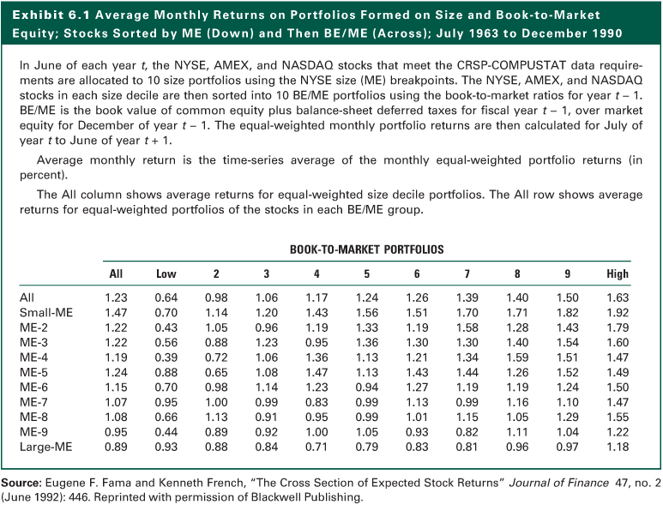
Exhibit 6.1

Slide 23
Predicting Cross-Sectional Returns
Summary
  Firm size has emerged as a major predictor of future returns
  This is an anomaly in the efficient markets literature
  Attempts to explain the size anomaly in terms of superior risk measurements, transactions costs, analysts attention, trading activity, and differential information have not succeeded

Slide 24
Event Studies
Stock split studies show that splits do not result in abnormal gains after the split announcement, but before
Initial public offerings seems to be underpriced by almost 18%, but that varies over time, and the price is adjusted within one day after the offering
Listing of a stock on an national exchange such as the NYSE may offer some short term profit opportunities for investors

Slide 25
Event Studies
Stock prices quickly adjust to unexpected world events and economic news and hence do not provide opportunities for abnormal profits
Announcements of accounting changes are quickly adjusted for and do not seem to provide opportunities
Stock prices rapidly adjust to corporate events such as mergers and offerings

Slide 26
Event Studies
Strong support from numerous event studies with the exception of exchange listing studies
In contrast
  Studies on predicting rates of return for a cross-section of stocks indicates markets are not semistrong efficient
    Dividend yields, risk premiums, calendar patterns, and earnings surprises
  This also included cross-sectional predictors such as size, the BV/MV ratio (when there is expansive monetary policy), E/P ratios, and neglected firms.

Slide 27
Tests of Strong-Form EMH
Strong-form EMH contends that stock prices fully reflect both public and private
This implies that no group of investors with private information will consistently earn above-average profits
Testing Groups of Investors
  Corporate insiders
  Security analysts
  Professional money managers

Slide 28
Corporate Insider Trading
Corporate insiders include major corporate officers, directors, and owners of 10% or more of any equity class of securities
Insiders must report to the SEC each month on their transactions in the stock of the firm for which they are insiders
These insider trades are made public about six weeks later and allowed to be studied
Corporate insiders generally experience above-average profits especially on purchase transactions

Slide 29
Corporate Insider Trading
This implies that many insiders had private information from which they derived above-average returns on their company stock
Public Investors
  After transaction costs, following insider trading will not be generally profitable for public investors according to the pre-2006 studies
  However, one can increase returns from using insider trading information by combining it with key financial ratios and the type of insiders

Slide 30
Security Analysts
Tests have considered whether it is possible to identify a set of analysts who have the ability to select undervalued stocks
The analysis involves determining whether, after a stock selection by an analyst is made known, a significant abnormal return is available to those who follow their recommendations

Slide 31
Security Analysts
The Value Line Enigma
  Value Line (VL) publishes financial information on about 1,700 stocks
  The report includes a timing rank from 1 down to 5
  Firms ranked 1 substantially outperform the market
  Firms ranked 5 substantially underperform the market
  Changes in rankings result in a fast price adjustment
  Some contend that the Value Line effect is merely the unexpected earnings anomaly due to changes in rankings from unexpected earnings

Slide 32
Security Analysts
Analysts Recommendations
  There is evidence in favor of existence of superior analysts who apparently possess private information
  Analysts appear to have both market timing and stock-picking ability
  Consensus recommendations do not contain incremental information, but changes in consensus recommendations are useful.
  The most useful information consisted of upward earning revision

Slide 33
Professional Money Managers
Money Managers
  Trained professionals, working full time at investment management
  If any investor can achieve above-average returns, it should be this group
  If any non-insider can obtain inside information, it would be this group due to the extensive management interviews that they conduct

Slide 34
Professional Money Managers
The Performance
  Most tests examine mutual funds
  New tests also examine trust departments, insurance companies, and investment advisors
  While it is difficult to do a specific comparison between “universes” and the benchmarks, the overall results from Exhibit 6.3 seem to indicate, at best, some weak support for the strong-form EMH
  See Exhibit 6.3

Slide 35
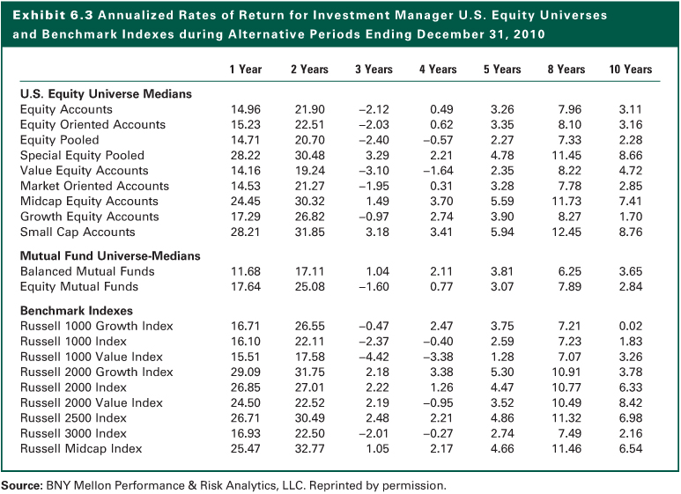
Exhibit 6.3

Slide 36
Behavioral Finance
It is concerned with the analysis of various psychological traits of individuals and how these traits affect the manner in which they act as investors, analysts, and portfolio managers
The emphasis has been on identifying portfolio anomalies that can be explained by various psychological traits
Three “Tributaries”
  Psychology
  Social psychology
  Neurofinance

Slide 37
Behavioral Finance
Explaining Biases
  Prospect Theory
    Contends that utility depends on deviations from moving reference point rather than absolute wealth
  Overconfidence (confirmation bias)
    Look for information that supports their prior opinions and decision
  Noise Traders
    Influenced strongly by sentiment, they tend to move together, which increases the prices and the volatility
  Escalation Bias
    Put more money into a bad investment

Slide 38
Behavioral Finance
Fusion Investing
  The integration of two elements of investment valuation-fundamental value and investor sentiment
  During some periods, investor sentiment is rather muted and noise traders are inactive, so that fundamental valuation dominates market returns
  In other periods, when investor sentiment is strong, noise traders are very active and market returns are more heavily impacted by investor sentiments

Slide 39
Implications of Efficient Capital Markets
Overall, the results of many studies indicate the capital markets are efficient as related to numerous sets of information
On the other hand, there are substantial instances where the market fails to rapidly adjust to public information
What are the implications for investors in light of these mixed evidence?
  Technical Analysis
  Fundamental Analysis
  Portfolio Management

Slide 40
EMH and Technical Analysis
Assumptions of technical analysis directly oppose the notion of efficient markets
Technicians believe that new information is not immediately available to everyone, but disseminated from the informed professional first to the aggressive investing public and then to the masses
Technicians also believe that investors do not analyze information and act immediately

Slide 41
EMH and Technical Analysis
Stock prices move to a new equilibrium after the release of new information in a gradual manner, causing trends in stock price movements that persist for periods of time
Technical analysts develop systems to detect movement to a new equilibrium (breakout) and trade based on that
If the capital market is weak-form efficient, a trading system that depends on past trading data has little value given higher trading costs

Slide 42
EMH and Fundamental Analysis
Fundamental analysts believe that there is a basic intrinsic value for the aggregate stock market, various industries, or individual securities and these values depend on underlying economic factors
Investors should determine the intrinsic value of an investment at a point in time and compare it to the market price

Slide 43
EMH and Fundamental Analysis
If you can do a superior job of estimating intrinsic value, you can make superior market timing decisions and generate above-average returns
Intrinsic value analysis involves:
  Aggregate market analysis
  Industry and company analysis

Slide 44
Aggregate Market Analysis
EMH implies that examining only past economic events is not likely to lead to outperforming a buy-and-hold policy because the market adjusts rapidly to known economic events
Merely using historical data to estimate future values is not sufficient
You must estimate the relevant variables that cause long-run movements

Slide 45
Industry and Company Analysis
Wide distribution of returns from different industries and companies justifies industry and company analysis
Must understand the variables that effect rates of return and
Do a superior job of estimating future values of these relevant valuation variables, not just look at past data

Slide 46
Industry and Company Analysis
Important relationship between expected earnings and actual earnings
Accurately predicting earnings surprises
Strong-form EMH indicates likely existence of superior analysts
Studies indicate that fundamental analysis based on E/P ratios, size, and the BV/MV ratios can lead to differentiating future return patterns

Slide 47
Fundamental Analysis Conclusion
Estimating the relevant variables is as much an art and a product of hard work as it is a science
Successful investor must understand what variables are relevant to the valuation process and have the ability and work ethic to do a superior job of estimating these important valuation variables

Slide 48
EMH and Portfolio Management
Portfolio Managers with Superior Analysts
  Concentrate efforts in mid-cap stocks that do not receive the attention given by institutional portfolio managers to the top-tier stocks
  The market for these neglected stocks may be less efficient than the market for large well-known stocks

Slide 49
EMH and Portfolio Management
Portfolio Managers without Superior Analysts
  Determine and quantify your client's risk preferences
  Construct the appropriate portfolio
  Diversify completely on a global basis to eliminate all unsystematic risk
  Maintain the desired risk level by rebalancing the portfolio whenever necessary
  Minimize total transaction costs

Slide 50
EMH and Portfolio Management
The Rationale and Use of Index Funds and Exchange-Traded Funds
  Efficient capital markets and a lack of superior analysts imply that many portfolios should be managed passively (so their performance matches the aggregate market, minimizes the costs of research and trading)
  Institutions created market (index) funds which duplicate the composition and performance of a selected index series

Slide 51
EMH and Portfolio Management
Insights from Behavioral Finance
  Growth companies will usually not be growth stocks due to the overconfidence of analysts regarding future growth rates and valuations
  Notion of “herd mentality” of analysts in stock recommendations or quarterly earnings estimates is confirmed

Slide 52
The Internet Investments Online
http://www.bloomberg.com
http://news.ft.com
http://www.online.wsj.com
http://finance.yahoo.com
http://money.cnn.com
http://www.cnbc.com
http://www.abcnews.com
http://www.nbcnews.com
http://www.msnbc.msn.com

