Slide 1
PY200/PY211 General Psychology
Neuroscience and behavior

Slide 2
The Structure of the Neuron (1)
Neurons: Nerve cells; the basic elements of the nervous system
  Consist of a cell body that contains a nucleus
  Physically held in place by glial cells which:
    Provide nourishment to neurons
    Insulate neurons
    Help repair damage
    Support neural functioning

Slide 3
The Structure of the Neuron (2)
Distinctive feature of neurons
  Ability to communicate with other cells
  Transmission of information across relatively long distances

Slide 4
The Structure of the Neuron (3)
Dendrite
  Cluster of fibers at one end of a neuron that receives messages from other neurons
Axon
  Part of the neuron that carries messages destined for other neurons
Terminal buttons
  Small bulges at the end of axons that send messages to other neurons
Myelin sheath
  Protective coat of fat and protein that wraps around the axon

Slide 5
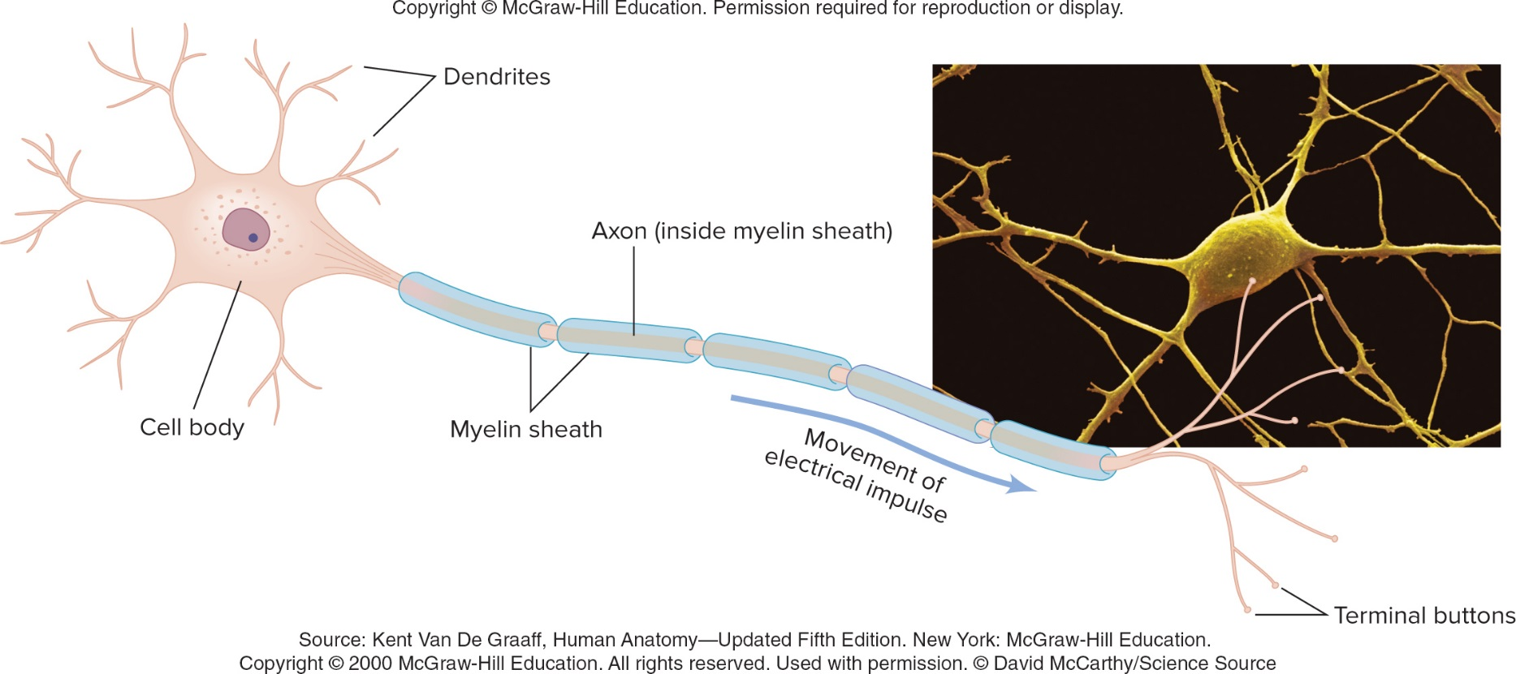
The Structure of the Neuron (4)

Slide 6
How Neurons Fire
Neurons follow an all-or-none law
  Rule that neurons are either on or off
Resting state: State in which there is a negative electrical charge of about -70 millivolts within a neuron
  Before a neuron is triggered
Action potential: Electric nerve impulse that travels through a neuron’s axon when it is set off by a “trigger”
  Positive electrical charge of about +40 millivolts within a neuron

Slide 7
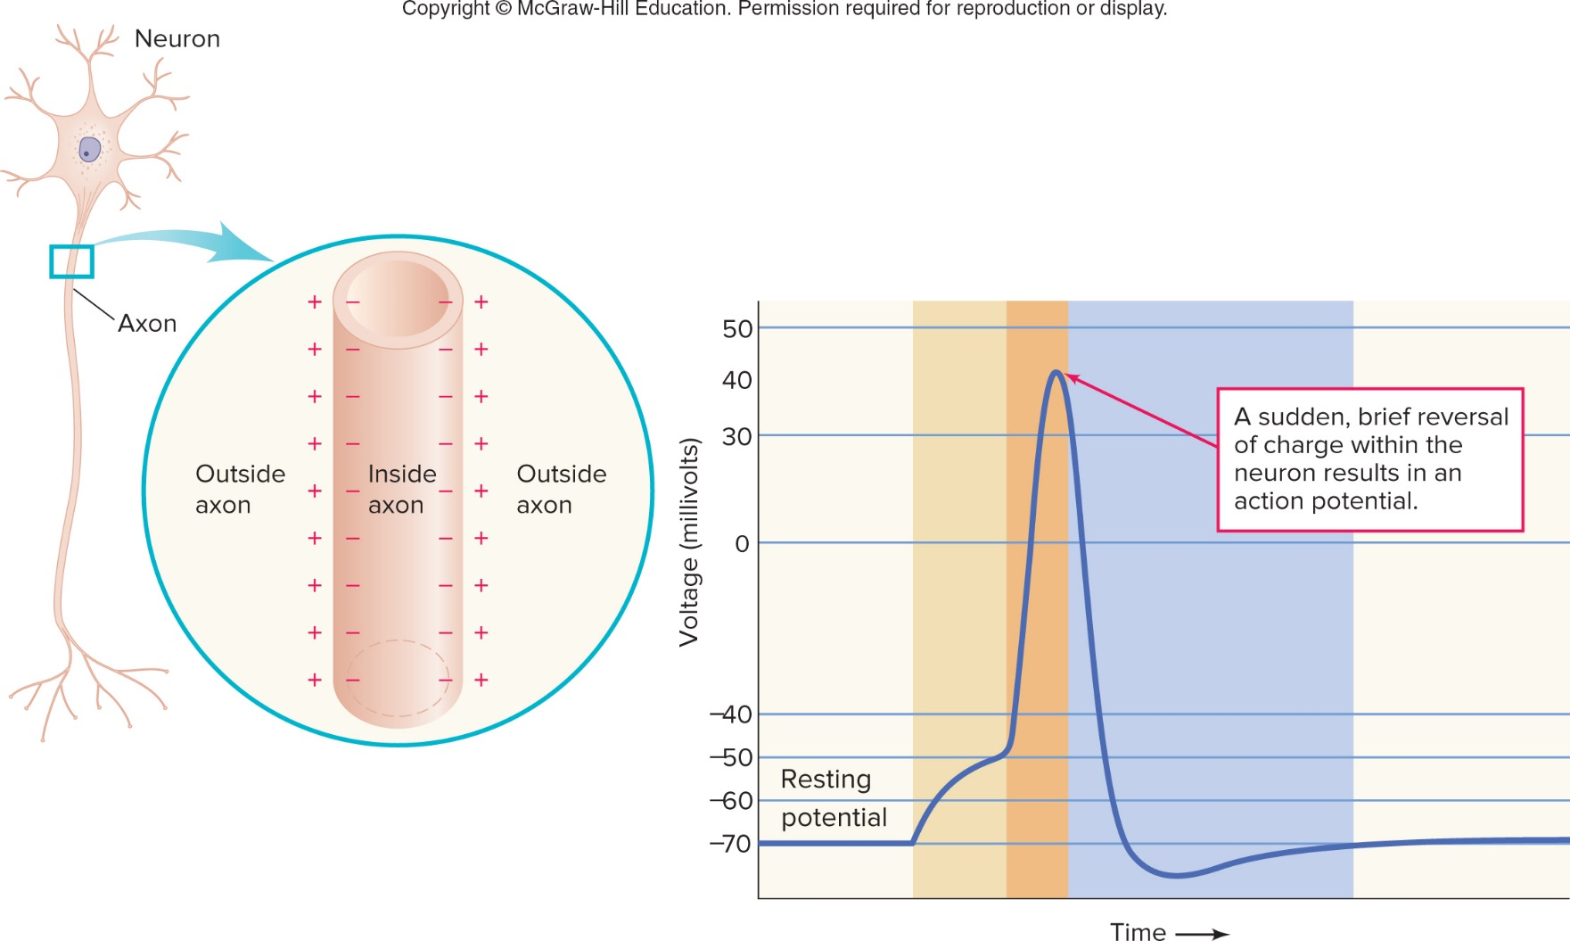
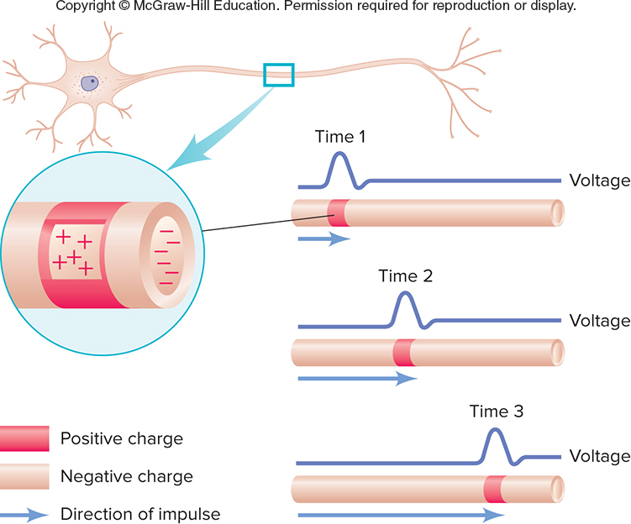
How Neurons Fire

Slide 8
Speed of Transmission
Speed at which an action potential travels along an axon is determined by the:
  Axon’s size
  Thickness of the myelin sheath
Neurons differ in terms of:
  Quickness of an impulse moving along the axon
  Potential rate of firing
Intensity of a stimulus determines how much of a neuron’s potential firing rate is reached

Slide 9
Where Neurons Meet: Bridging the Gap (1)
Synapse: Space between two neurons where the axon of a sending neuron communicates with the dendrites of a receiving neuron by using chemical messages
Neurotransmitters: Chemicals that carry messages across the synapse to the dendrite (and sometimes the cell body) of a receiving neuron

Slide 10
Where Neurons Meet: Bridging the Gap (2)
Every neuron is not capable of receiving the chemical message carried by a particular neurotransmitter
  Successful chemical communication is possible only when a neurotransmitter fits precisely into a receptor site

Slide 11
Where Neurons Meet: Bridging the Gap (3)
Types of chemical message delivered by neurotransmitters:
  Excitatory message: Makes it more likely that a receiving neuron will fire and an action potential will travel down its axon
  Inhibitory message: Prevents or decreases the likelihood that a receiving neuron will fire

Slide 12
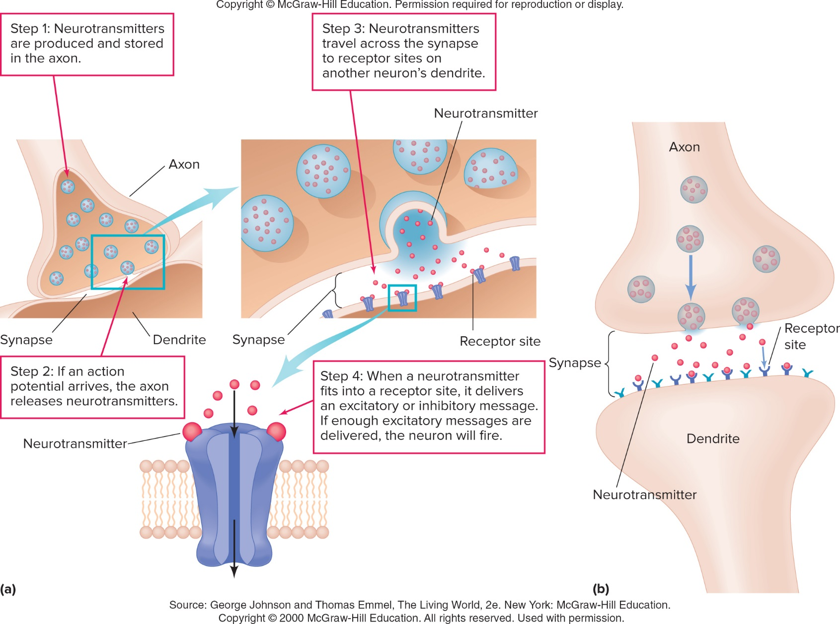
Where Neurons Meet: Bridging the Gap (4)

Slide 13
Where Neurons Meet: Bridging the Gap (5)
Neurotransmitters remaining at the site of the synapse lead to:
  Receiving neurons awash, in a continual chemical bath
  Producing constant stimulation or constant inhibition of the receiving neurons
  Effective communication across the synapse will no longer be possible

Slide 14
Where Neurons Meet: Bridging the Gap (6)
Reuptake: Reabsorption of neurotransmitters by a terminal button
  Understanding of reuptake has led to the development of certain drugs that treat psychological disorders
    SSRIs (selective serotonin reuptake inhibitors): permit certain neurotransmitters to remain in synapses for a longer period of time
      Reduces the symptoms of depression

Slide 15
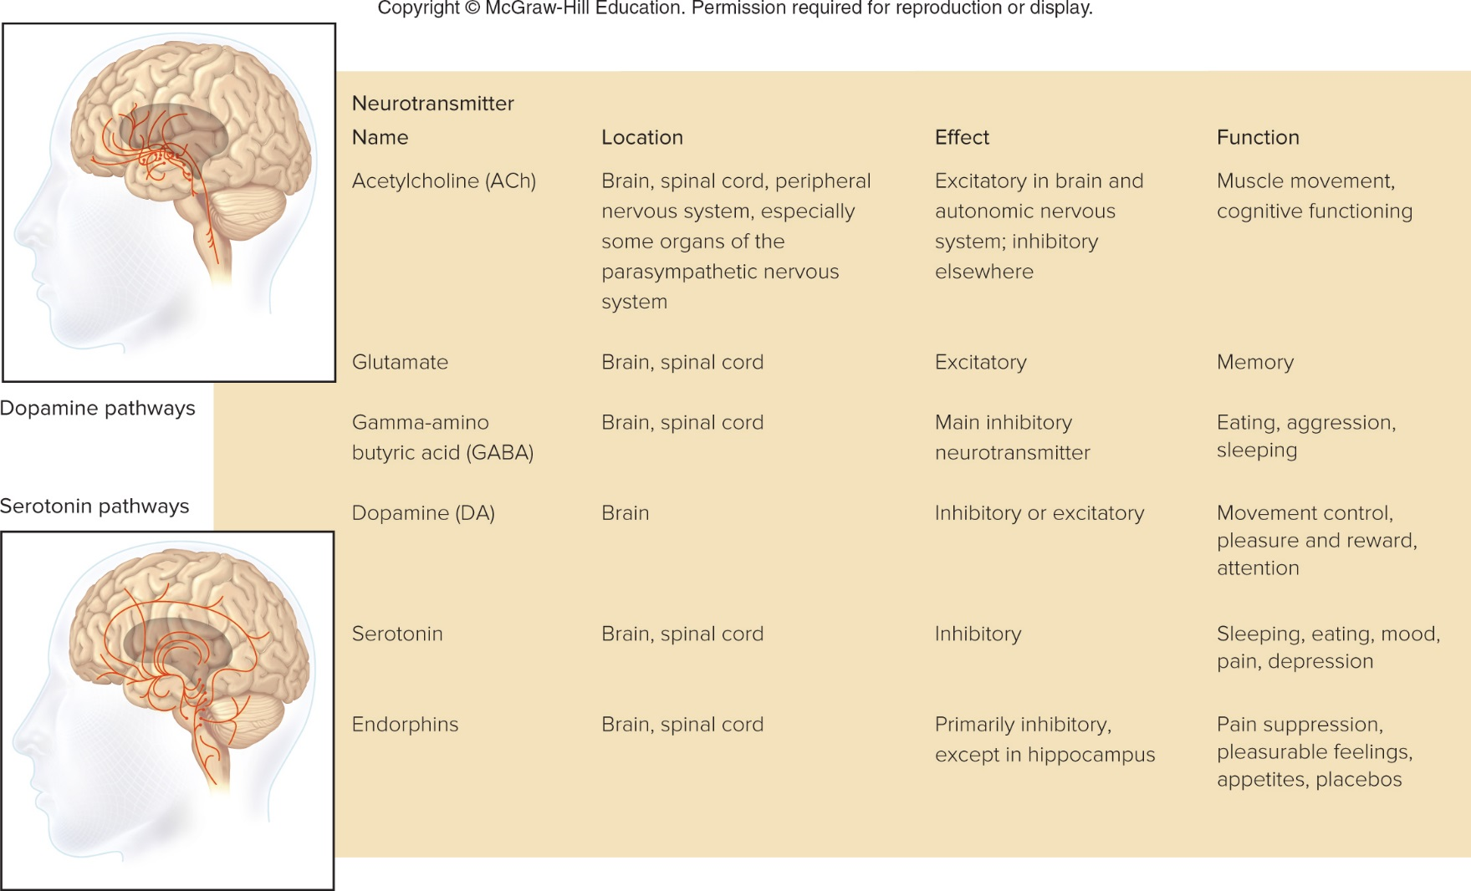
Major Neurotransmitters

Slide 16
Central and Peripheral Nervous Systems (1)
Central nervous system (CNS): Part of the nervous system that includes the brain and spinal cord
  Spinal cord: Bundle of neurons that leaves the brain and runs down the length of the back
    Main means for transmitting messages between the brain and the body
    Controls simple behaviors on its own, without any help from the brain

Slide 17
Central and Peripheral Nervous Systems (2)
Reflex: Automatic, involuntary response to an incoming stimulus
Kinds of neurons involved in reflexes:
  Sensory (afferent) neurons: Transmit information from the perimeter of the body to the central nervous system
  Motor (efferent) neurons: Communicate information from the nervous system to muscles and glands

Slide 18
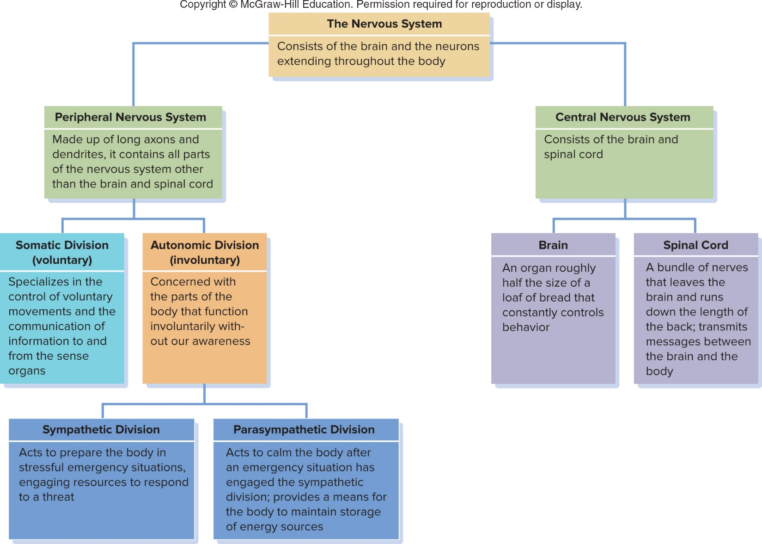
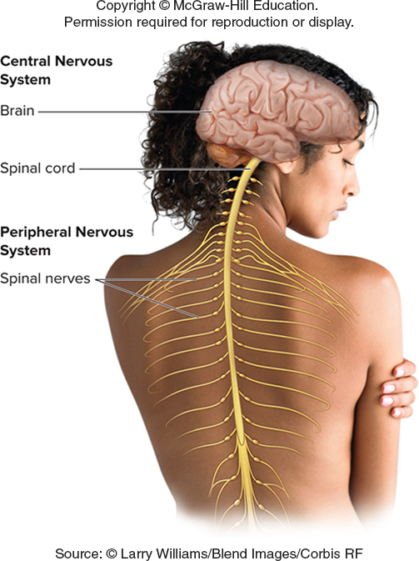
Central and Peripheral Nervous Systems (3)

Slide 19
Central and Peripheral Nervous Systems (4)
Peripheral nervous system: Made up of neurons with long axons and dendrites, it branches out from the spinal cord and brain and reaches the extremities of the body
Includes
  Somatic division: Specializes in the control of voluntary movements and the communication of information to and from the sense organs
  Autonomic division: Controls involuntary movement of the heart, glands, lungs, and other organs

Slide 20
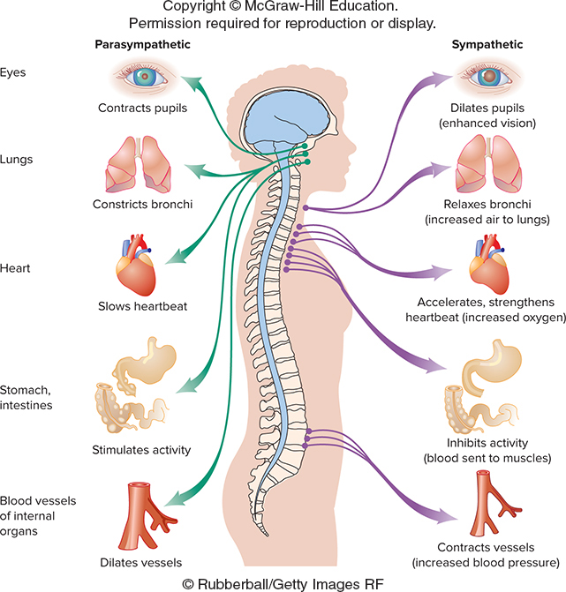
Activating the Divisions of the Autonomic Nervous System
Autonomic nervous system consists of:
  Sympathetic division: Acts to prepare the body for action in stressful situations, engaging all the organism’s resources to respond to a threat
  Parasympathetic division: Acts to calm the body after an emergency has ended

Slide 21
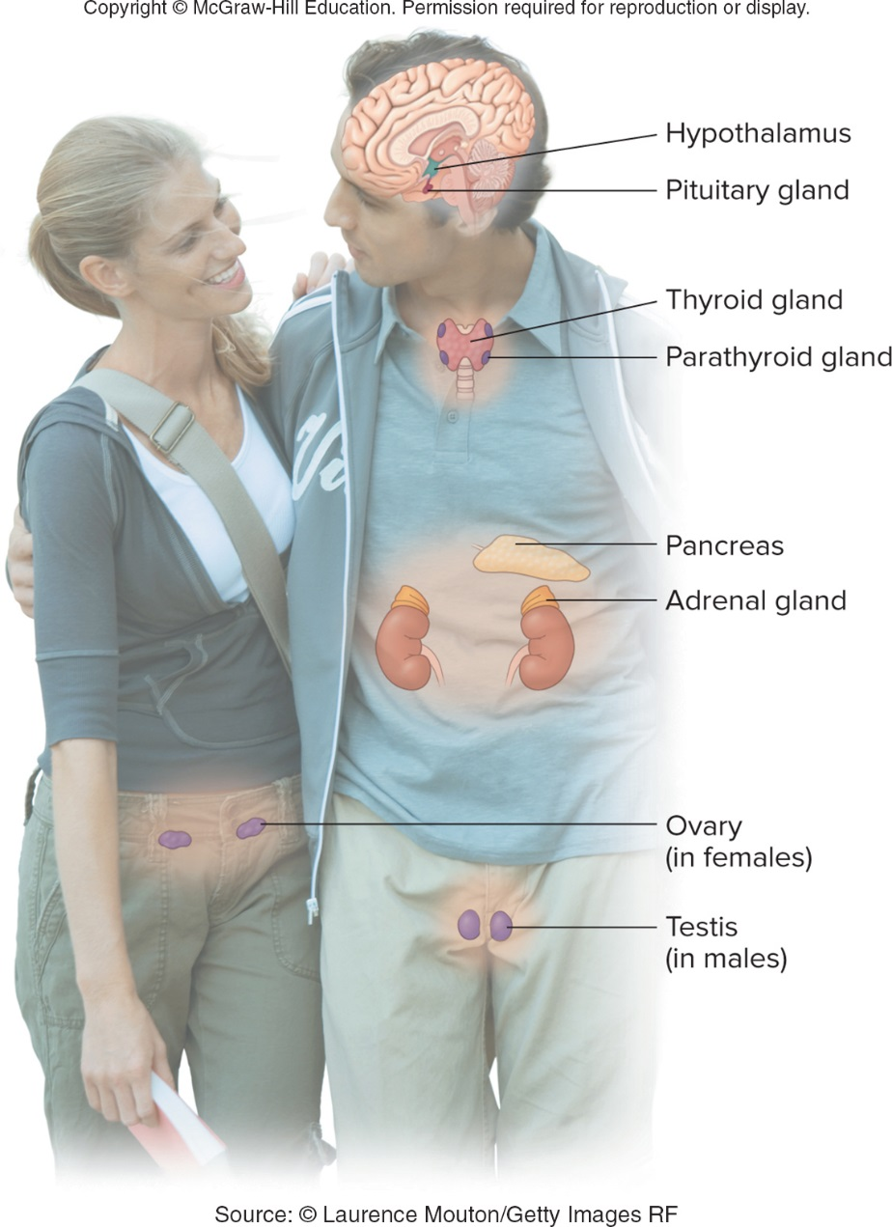
The Endocrine System: Of Chemicals and Glands
Endocrine system: A chemical communication network that sends messages throughout the body via the bloodstream
Hormones: Chemicals that circulate through the blood and regulate the functioning or growth of the body
Pituitary gland: Major component of the endocrine system, or the “master gland”
  Secretes hormones that control growth and other parts of the endocrine system

Slide 22
Studying the Brain’s Structure and Functions: Spying on the Brain (1)
Electroencephalogram (EEG)
  Records electrical activity in the brain through electrodes placed on the outside of the skull
Functional magnetic resonance imaging (fMRI)
  Provides a detailed, three dimensional computer-generated image of brain structures and activity by aiming a powerful magnetic field at the body

Slide 23
Studying the Brain’s Structure and Functions: Spying on the Brain (2)
Positron emission tomography (PET)
  Shows biochemical activity within the brain at a given moment
    Requires radioactive tracer injection
Transcranial magnetic stimulation (TMS)
  Causes a momentary interruption of electrical activity by exposing a tiny region of the brain to a strong magnetic field

Slide 24
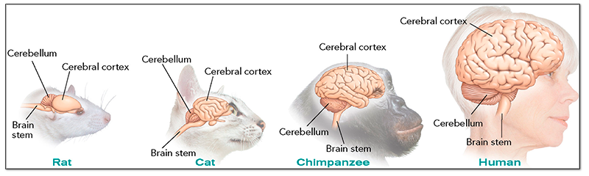
The Central Core: Our “Old Brain” (1)

Slide 25
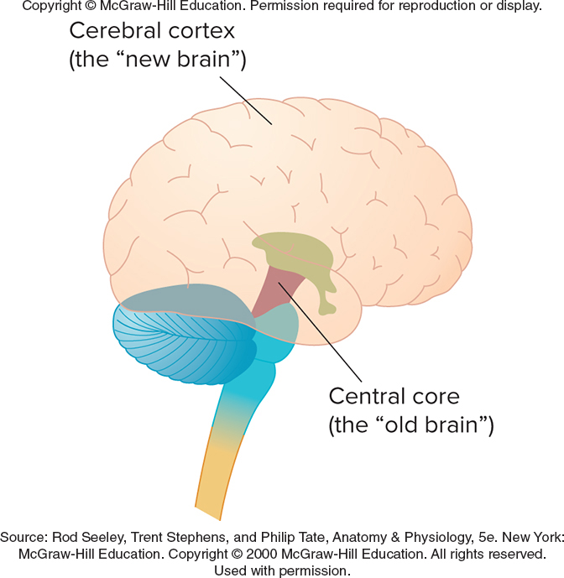
The Central Core: Our “Old Brain” (2)
Central core: “Old brain”
  Controls basic functions such as eating and sleeping and is common to all vertebrates
Hindbrain contains:
  Medulla: Controls a critical body functions, such as breathing and heartbeat
  Pons: Bridge in the hindbrain
    Acts as a transmitter of motor information
    Involved in regulating sleep
  Cerebellum: Part of the brain that controls bodily balance

Slide 26
The Central Core: Our “Old Brain” (3)
Reticular formation: Extends from the medulla through the pons, passing through the midbrain and the forebrain
  Produces general arousal of the body
Thalamus: Part of the brain located in the middle of the central core that acts primarily to relay information about the senses

Slide 27
The Central Core: Our “Old Brain” (4)
Hypothalamus: Tiny part of the brain, located below the thalamus
  Maintains homeostasis
  Produces and regulates behavior that is critical to the basic survival of the species
    Eating, self-protection, sex

Slide 28
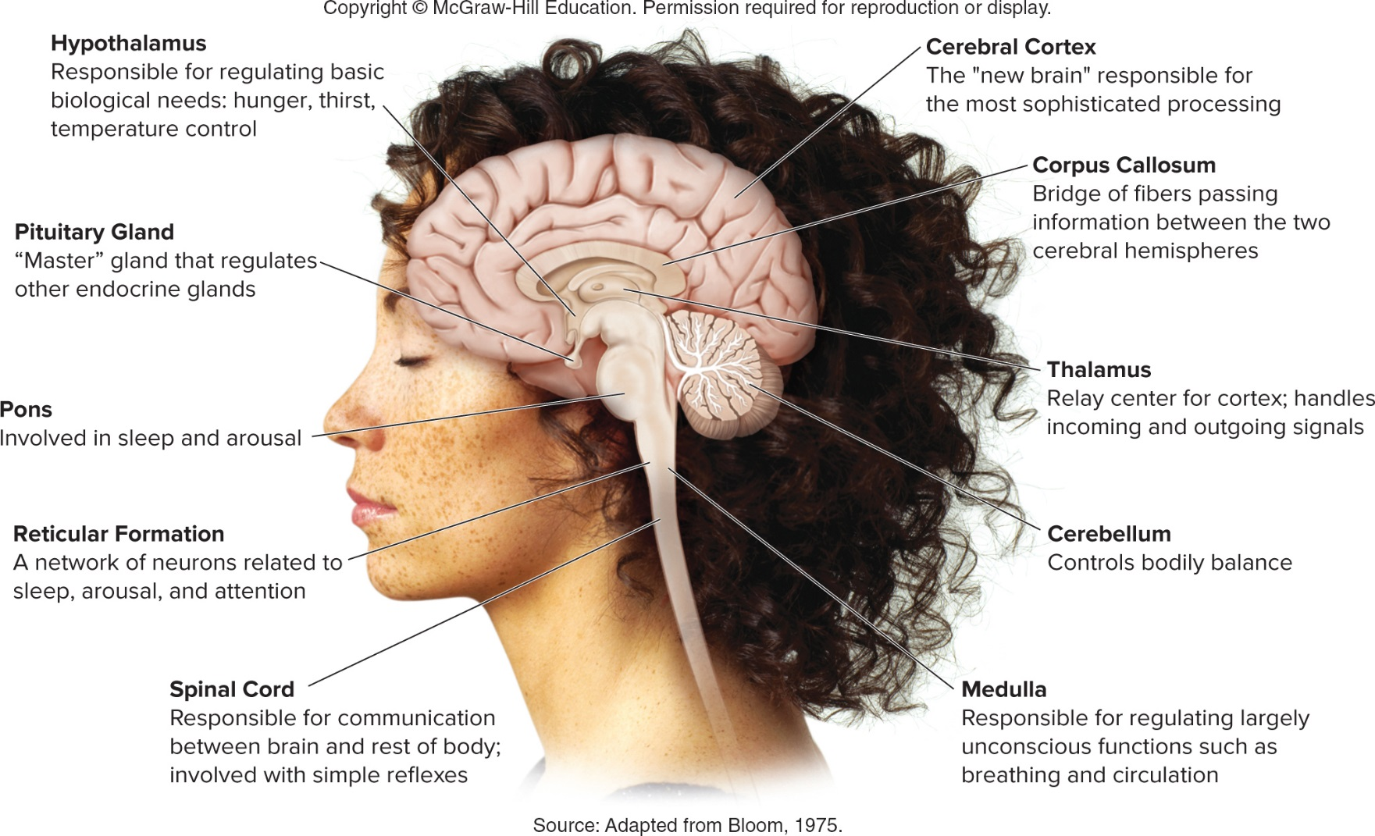
Major Structures of the Brain

Slide 29
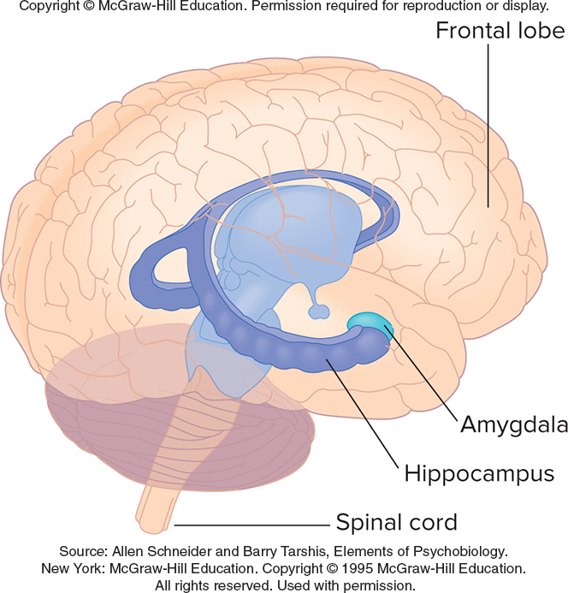
The Limbic System: Beyond the Central Core
Limbic system: Part of the brain that controls eating, aggression, and reproduction
  Includes the amygdala and hippocampus
  Plays an important role in emotion, learning, and memory, along with hippocampus
Otherwise referred as “animal brain,” due to similarities in structures and functions to those of other mammals

Slide 30
The Cerebral Cortex: Our “New Brain”
Responsible for the most sophisticated information processing in the brain
Lobes: Four major sections of the cerebral cortex
  Frontal
  Parietal
  Temporal
  Occipital
Sulci: deep grooves in the cortex that physically divide the four sets of lobes

Slide 31
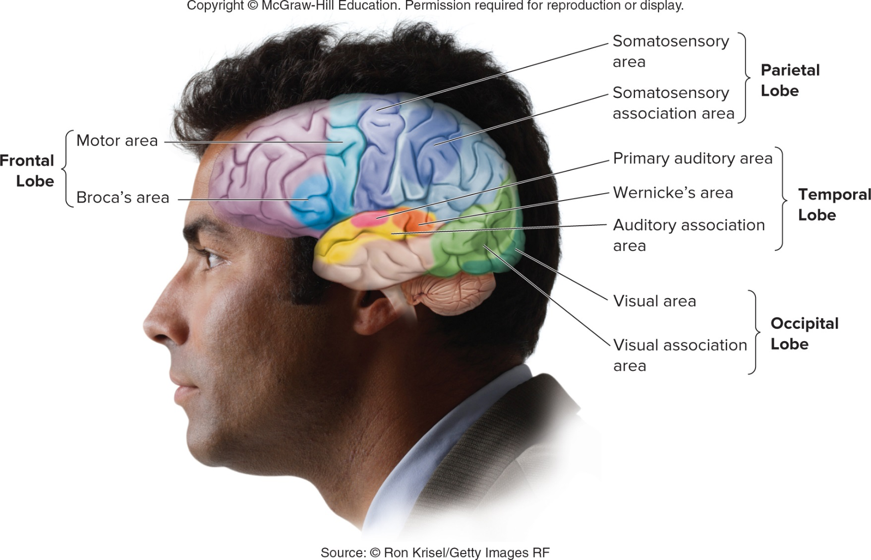
The Cerebral Cortex

Slide 32
The Motor Area of the Cortex
Motor area: Responsible for the body’s voluntary movement
  Well mapped: researchers have identified the amount and relative location of cortical tissue used to produce movement in specific parts of the body
Sensory area: Site in the brain of the tissue that corresponds to each of the senses, with the degree of sensitivity related to the amount of tissue
  Example: somatosensory area - in the parietal lobe; specific locations associated with the ability to perceive touch and pressure in a particular location on the body
  Auditory area in temporal lobe
  Visual area in occipital lobe

Slide 33
The Association Areas of the Cortex
Association areas: Site of the higher mental processes
  Thought, language, memory, and speech
  Executive function: planning, goal setting, judgment, impulse control
Example: Phineas Gage, railroad worker accident
  Damage to the association area
Aphasia: result from injuries to the association areas of the brain, and create problems with language
  Broca’s aphasia
  Wenicke’s aphasia

Slide 34
Neuroplasticity and the Brain
Neuroplasticity
  Changes in the brain that occur throughout the life span relating to the addition of new neurons
  New interconnections between neurons
  Reorganization of information-processing areas
Neurogenesis - Creation of new neurons in certain areas of the brain during adulthood

Slide 35
The Specialization of the Hemispheres: Two Brains or One?
Brain is divided into two roughly mirror-image halves
Hemispheres: Symmetrical left and right halves of the brain that control the side of the body opposite to their location
Lateralization: Dominance of one hemisphere of the brain in specific functions
  Language

