Slide 1
Comparative Statics and the Concept of Derivative
Pawin Siriprapanukul
CW Ch.6 - 7

Slide 2
Outline
The Nature of Comparative Statics
Rate of Change and the Derivative
The Derivative and the Slope of a Curve
Rules of Differentiation for a Function of One Variable
Rules of Differentiation Involving Two or More Functions of the Same Variable
Rules of Differentiation Involving Functions of Different Variables*
Partial Differentiation*
Applications to Comparative-Static Analysis*
Note on Jacobian Determinants*

Slide 3
The Nature of Comparative Statics
Comparative statics is concerned with the comparison of different equilibrium states that are associated with different sets of values of parameters and exogenous variables.
It should be noted that in comparative statics we still disregard the process of adjustment of the variables: we merely compare the initial (prechange) equilibrium state with the final (postchange) equilibrium state.
A comparative-static analysis can be either qualitative or quantitative in nature.
Here, the problem under consideration is essentially one of finding a rate of change: the rate of change of the equilibrium value of an endogenous variable with respect to the change in a particular parameter or exogenous variable.

Slide 4
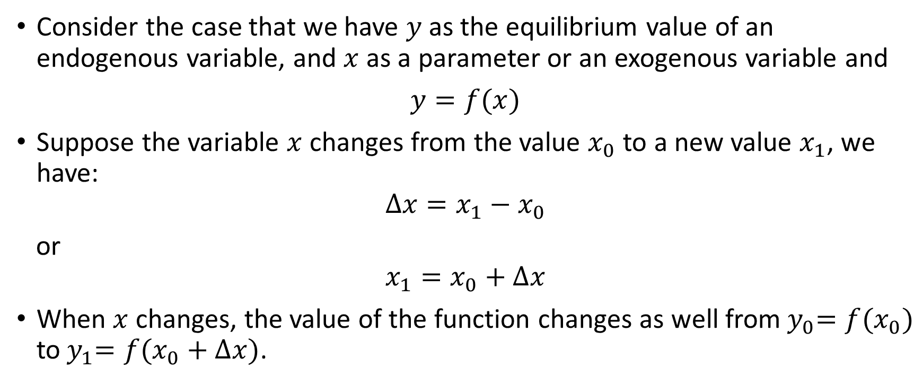
Rate of Change and the Derivative
Consider the case that we have $y$ as the equilibrium value of an endogenous variable, and $x$ as a parameter or an exogenous variable and
$y=f(x)$
Suppose the variable $x$ changes from the value $x_{0}$ to a new value $x_{1}$, we have:
$$∆x=x_{1}−x_{0}$$
or
$$x_{1}=x_{0}+∆x$$
When $x$ changes, the value of the function changes as well from${ y}_{0}=f(x_{0})$ to${ y}_{1}=f(x_{0}+∆x)$.

Slide 5
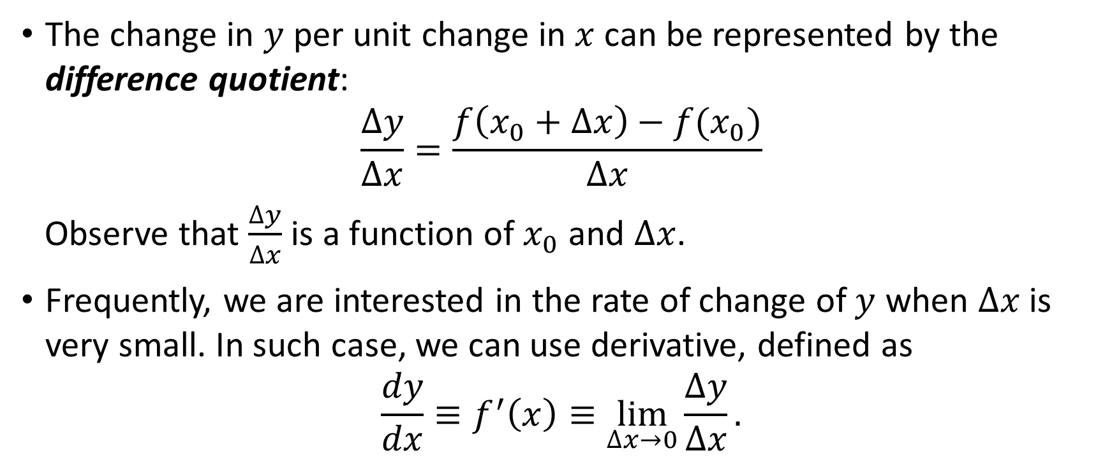
The Difference Quotient and The Derivative
The change in $y$ per unit change in $x$ can be represented by the difference quotient:
$$\frac{∆y}{∆x}=\frac{f\left(x_{0}+∆x\right)−f(x_{0})}{∆x}$$
Observe that $\frac{∆y}{∆x}$ is a function of $x_{0}$ and $∆x$.
Frequently, we are interested in the rate of change of $y$ when $∆x$ is very small. In such case, we can use derivative, defined as
$$\frac{dy}{dx}≡f^{′}\left(x\right)≡\lim_{∆x→0}{\frac{∆y}{∆x}}.$$

Slide 6
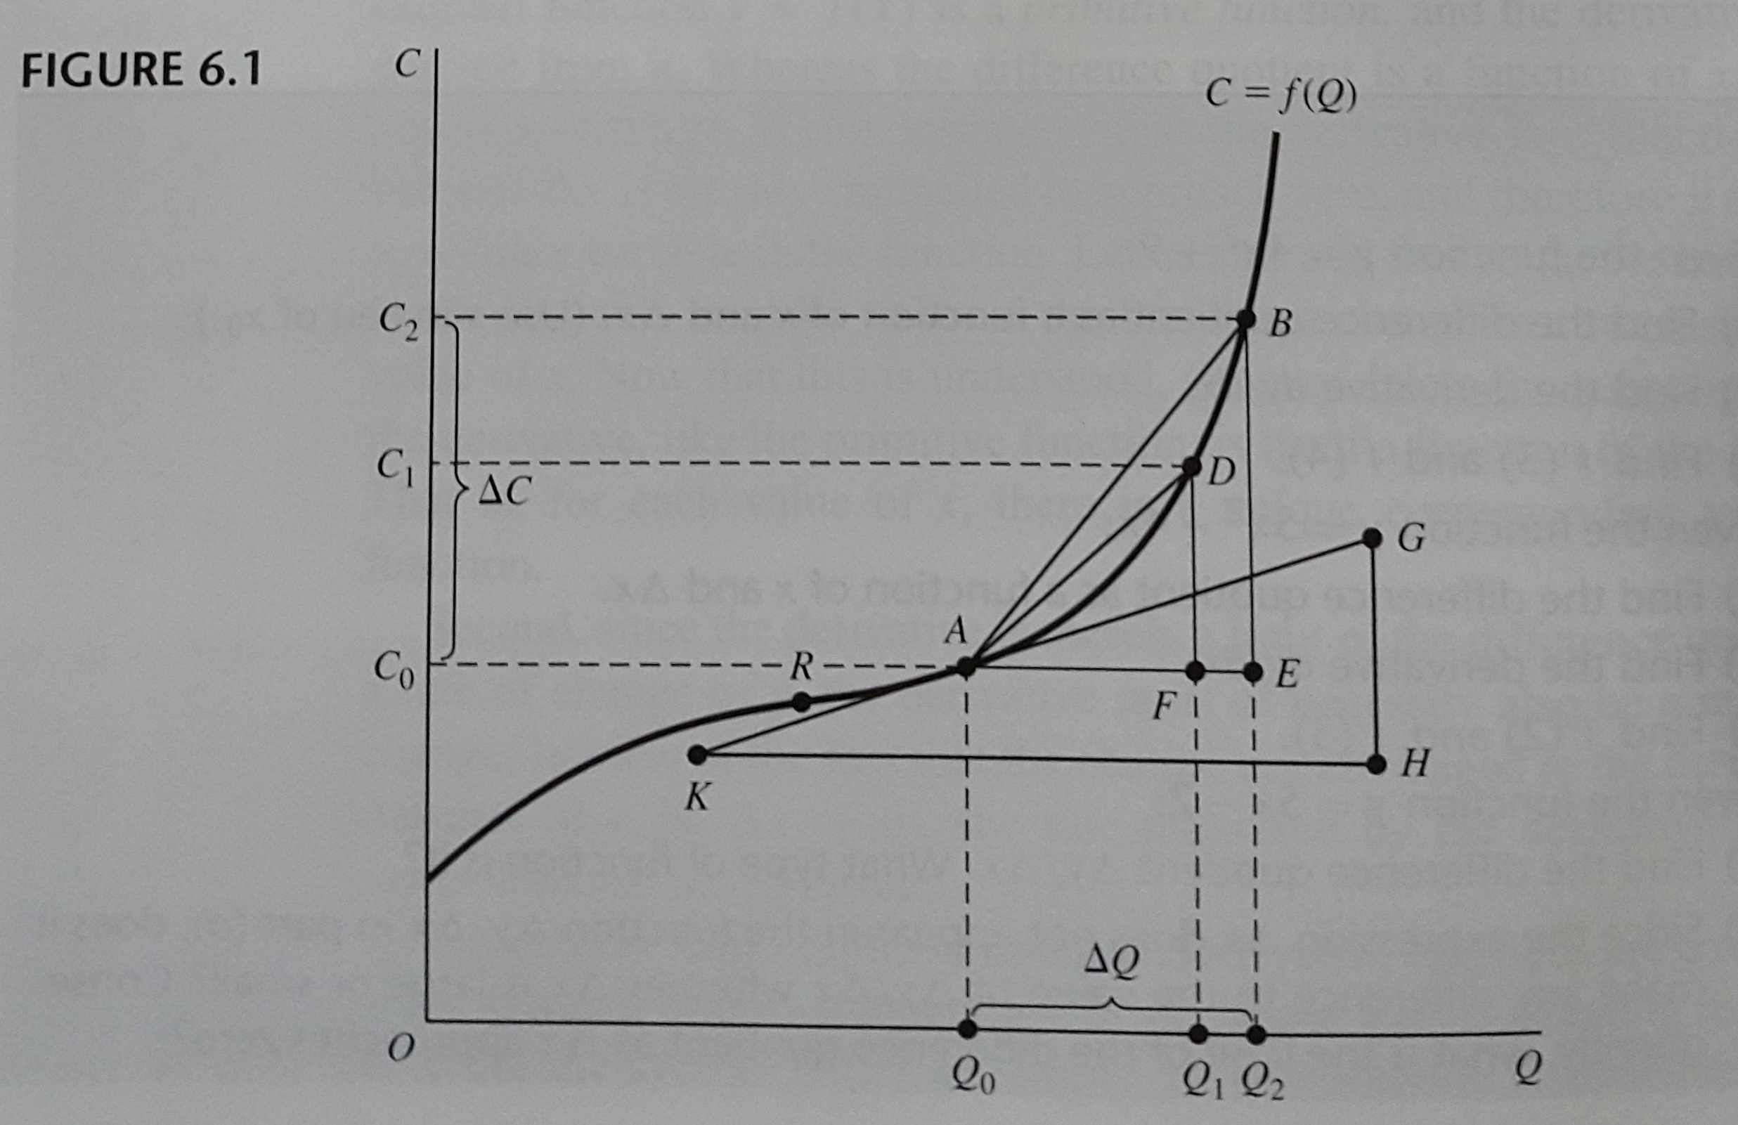
The Derivative and the Slope of a Curve

Slide 7
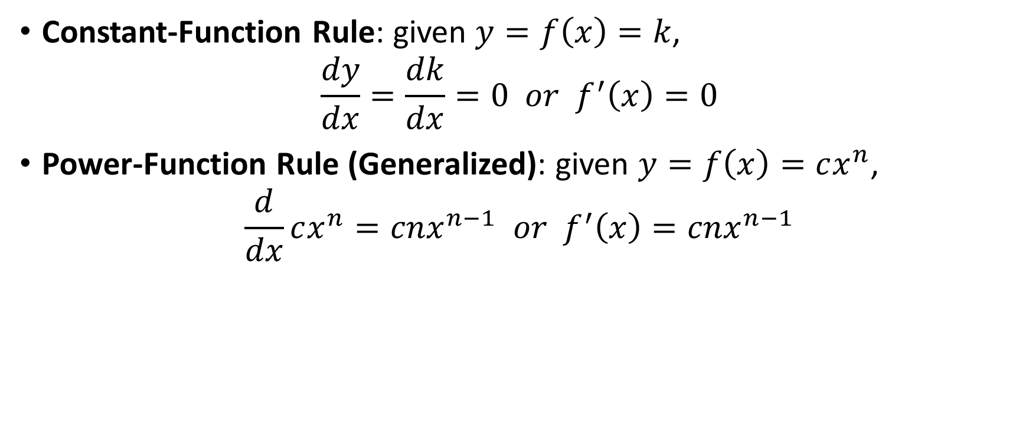
Rules of Differentiation for a Function of One Variable
Constant-Function Rule: given $y=f\left(x\right)=k$,
$$\frac{dy}{dx}=\frac{dk}{dx}=0 or f^{′}\left(x\right)=0$$
Power-Function Rule (Generalized): given $y=f\left(x\right)=cx^{n}$,
$$\frac{d}{dx}cx^{n}=cnx^{n−1} or f^{′}\left(x\right)=cnx^{n−1}$$

Slide 8
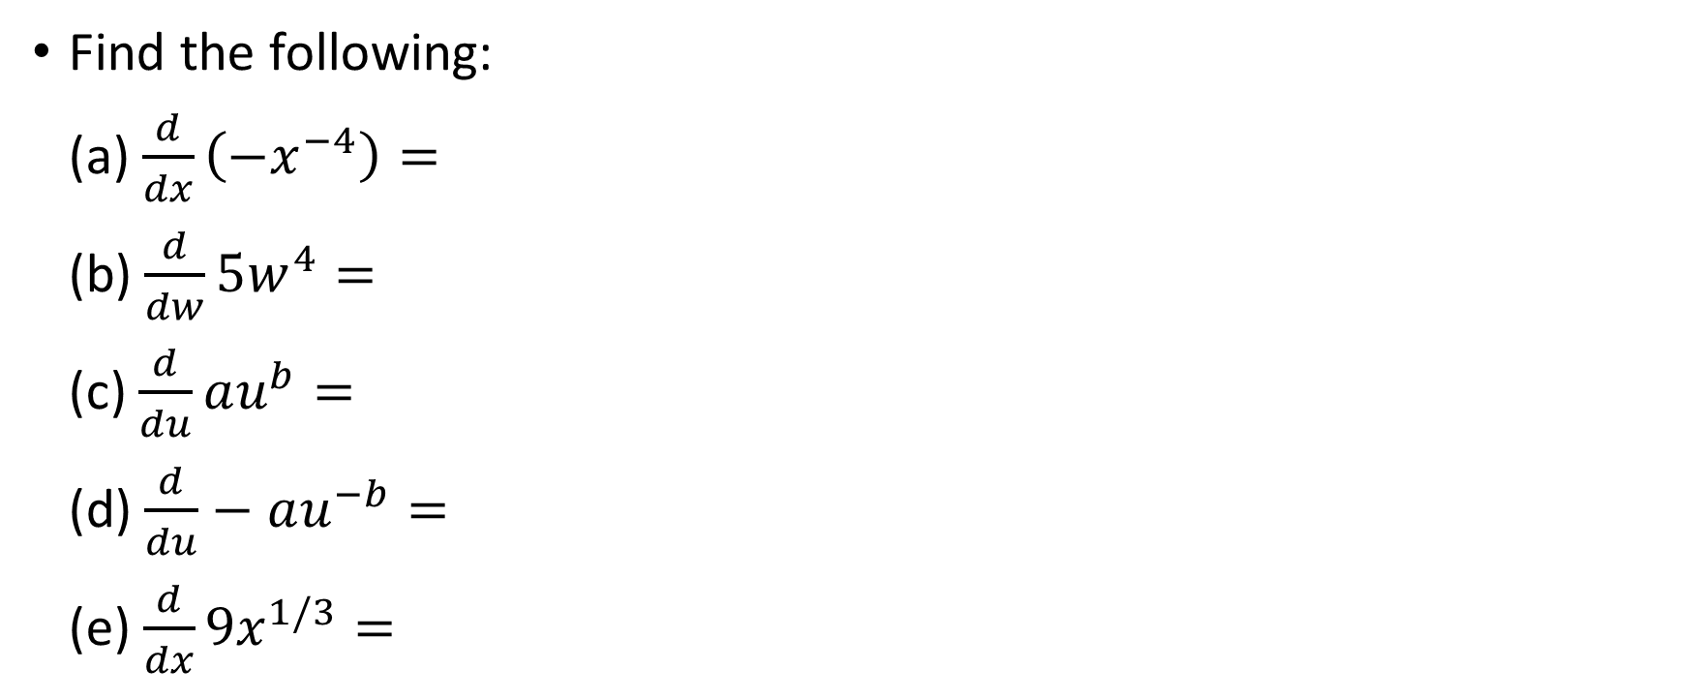
Examples
Find the following:
(a) $\frac{d}{dx}\left(−x^{−4}\right)=$
(b) $\frac{d}{dw}5w^{4}=$
(c) $\frac{d}{du}au^{b}=$
(d) $\frac{d}{du}−au^{−b}=$
(e) $\frac{d}{dx}9x^{1/3}=$

Slide 9
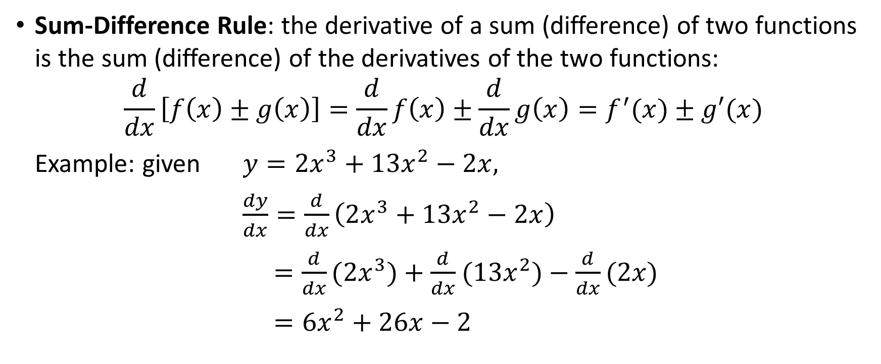
Rules of Differentiation Involving Two or More Functions of the Same Variable
Sum-Difference Rule: the derivative of a sum (difference) of two functions is the sum (difference) of the derivatives of the two functions:
$$\frac{d}{dx}\left[f\left(x\right)±g\left(x\right)\right]=\frac{d}{dx}f\left(x\right)±\frac{d}{dx}g\left(x\right)=f^{′}(x)±g′(x)$$
Example: given $y=2x^{3}+13x^{2}−2x,$
$\frac{dy}{dx}=\frac{d}{dx}\left(2x^{3}+13x^{2}−2x\right)$
$=\frac{d}{dx}(2x^{3})+\frac{d}{dx}$ $(13x^{2})−\frac{d}{dx}(2x)$
$=6x^{2}+26x−2$

Slide 10
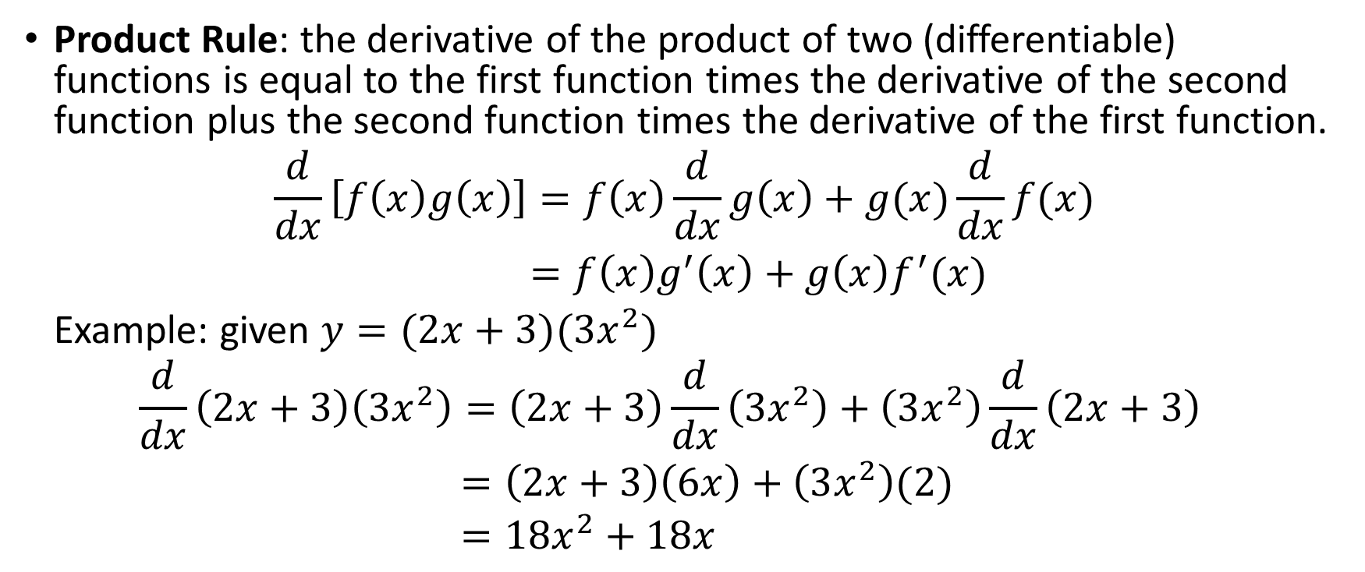
Rules of Differentiation Involving Two or More Functions of the Same Variable
Product Rule: the derivative of the product of two (differentiable) functions is equal to the first function times the derivative of the second function plus the second function times the derivative of the first function.
$$\frac{d}{dx}\left[f\left(x\right)g\left(x\right)\right]=f\left(x\right)\frac{d}{dx}g\left(x\right)+g(x)\frac{d}{dx}f(x)$$
$=f\left(x\right)g^{′}\left(x\right)+g\left(x\right)f^{′}(x)$
Example: given $y=(2x+3)(3x^{2})$
$$\frac{d}{dx}\left(2x+3\right)\left(3x^{2}\right)=\left(2x+3\right)\frac{d}{dx}\left(3x^{2}\right)+\left(3x^{2}\right)\frac{d}{dx}\left(2x+3\right)$$
$=\left(2x+3\right)\left(6x\right)+\left(3x^{2}\right)(2)$
$=18x^{2}+18x$

Slide 11
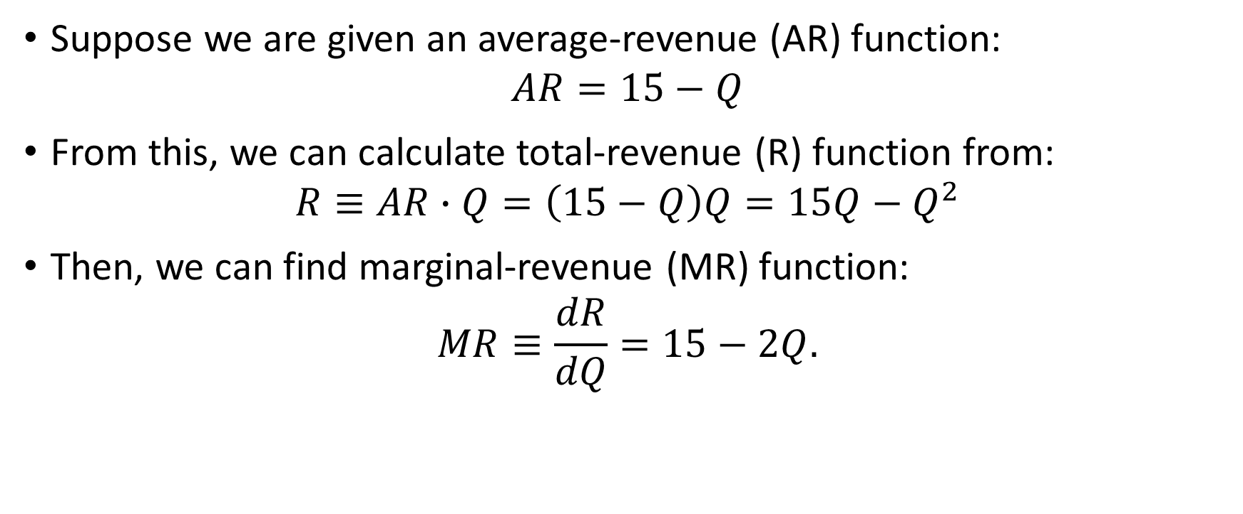
Finding Marginal-Revenue Function from Average-Revenue Function
Suppose we are given an average-revenue (AR) function:
$$AR=15−Q$$
From this, we can calculate total-revenue (R) function from:
$$R≡AR∙Q=\left(15−Q\right)Q=15Q−Q^{2}$$
Then, we can find marginal-revenue (MR) function:
$$MR≡\frac{dR}{dQ}=15−2Q.$$

Slide 12
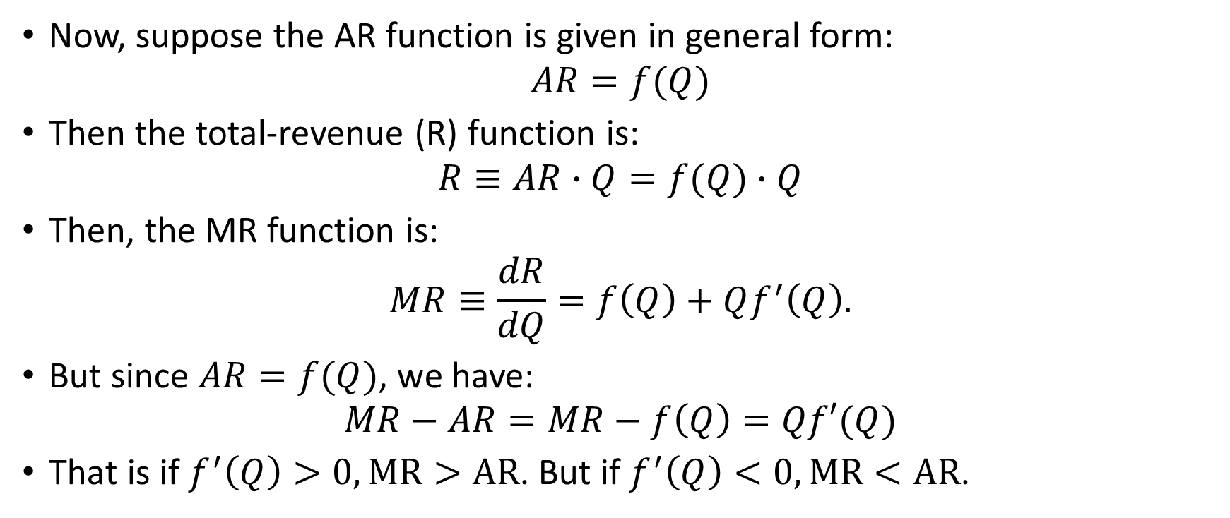
Finding Marginal-Revenue Function from Average-Revenue Function
Now, suppose the AR function is given in general form:
$$AR=f(Q)$$
Then the total-revenue (R) function is:
$$R≡AR∙Q=f(Q)∙Q$$
Then, the MR function is:
$$MR≡\frac{dR}{dQ}=f\left(Q\right)+Qf^{′}\left(Q\right).$$
But since $AR=f(Q)$, we have:
$$MR−AR=MR−f\left(Q\right)=Qf′(Q)$$
That is if $f^{′}\left(Q\right)>0, MR>AR$. But if $f^{′}\left(Q\right)<0, MR<AR$.

Slide 13
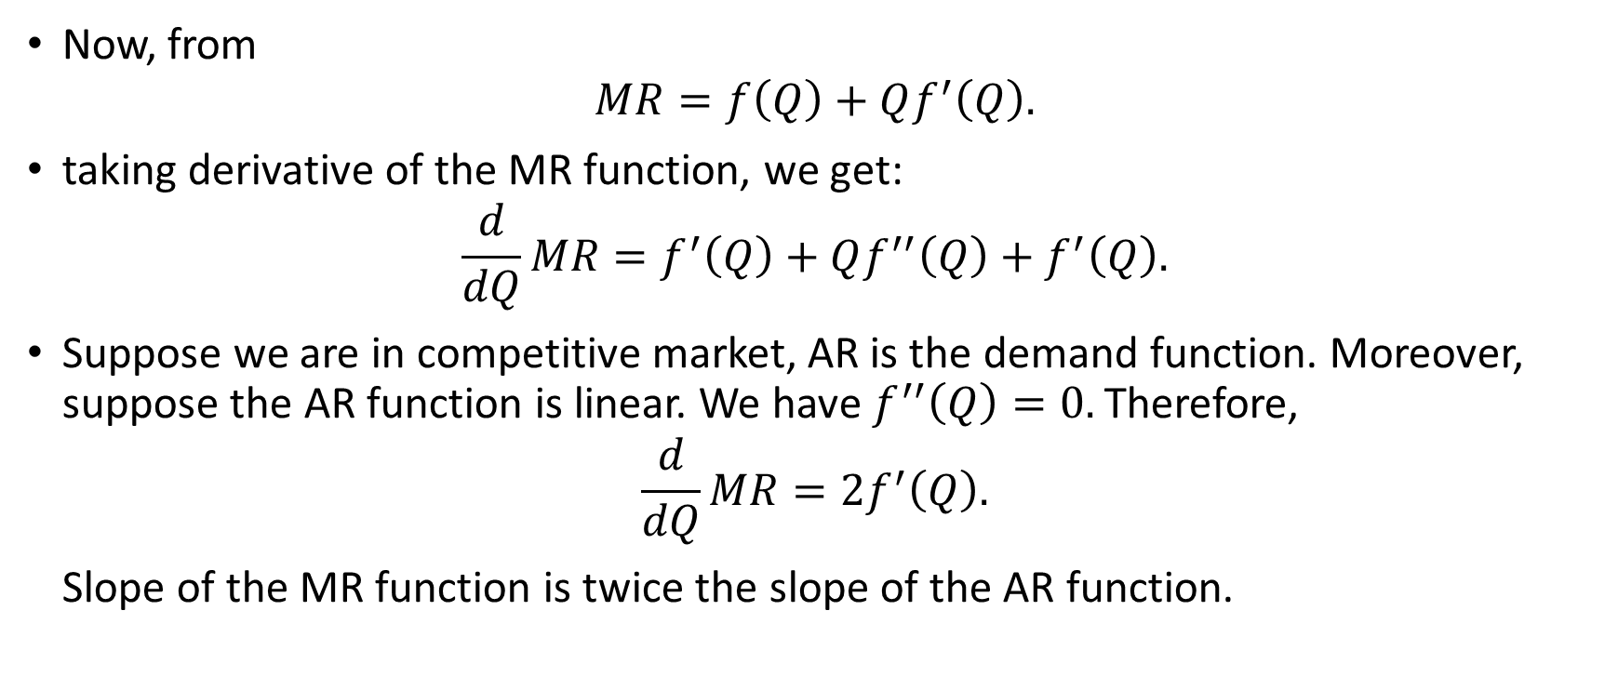
Finding Marginal-Revenue Function from Average-Revenue Function
Now, from
$$MR=f\left(Q\right)+Qf^{′}\left(Q\right).$$
taking derivative of the MR function, we get:
$$\frac{d}{dQ}MR=f^{′}\left(Q\right)+Qf^{′′}\left(Q\right)+f^{′}\left(Q\right).$$
Suppose we are in competitive market, AR is the demand function. Moreover, suppose the AR function is linear. We have $f^{′′}\left(Q\right)=0.$ Therefore,
$$\frac{d}{dQ}MR=2f^{′}\left(Q\right).$$
Slope of the MR function is twice the slope of the AR function.

Slide 14
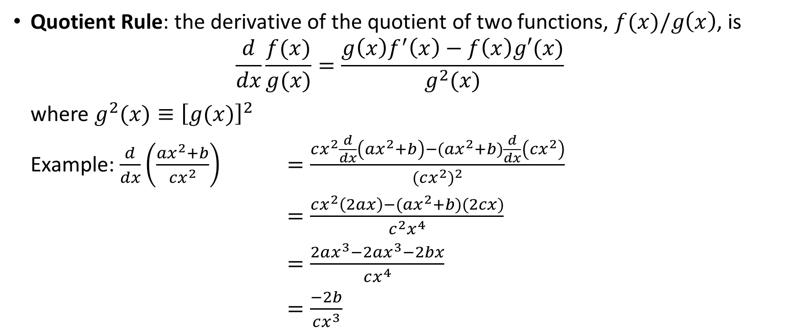
Rules of Differentiation Involving Two or More Functions of the Same Variable
Quotient Rule: the derivative of the quotient of two functions, $f(x)/g\left(x\right)$, is
$$\frac{d}{dx}\frac{f(x)}{g(x)}=\frac{g\left(x\right)f^{′}\left(x\right)−f\left(x\right)g′(x)}{g^{2}(x)}$$
where $g^{2}(x)≡{\left[g(x)\right]}^{2}$
Example: $\frac{d}{dx}\left(\frac{ax^{2}+b}{cx^{2}}\right)$ $=\frac{cx^{2}\frac{d}{dx}\left(ax^{2}+b\right)−(ax^{2}+b)\frac{d}{dx}\left(cx^{2}\right)}{{(cx^{2})}^{2}}$
$=\frac{cx^{2}\left(2ax\right)−(ax^{2}+b)(2cx)}{c^{2}x^{4}}$
$=\frac{2ax^{3}−2ax^{3}−2bx}{cx^{4}}$
$=\frac{−2b}{cx^{3}}$

Slide 15
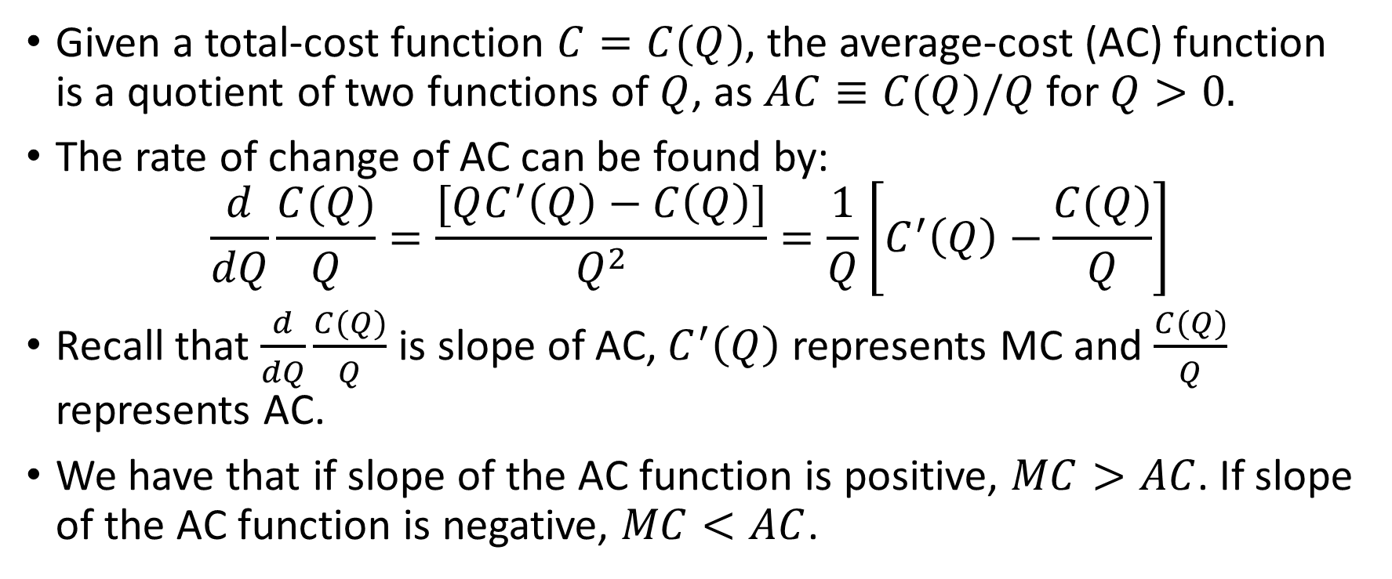
Relationship Between Marginal-Cost and Average-Cost Functions
Given a total-cost function $C=C(Q)$, the average-cost (AC) function is a quotient of two functions of $Q$, as $AC≡C(Q)/Q$ for $Q>0.$
The rate of change of AC can be found by:
$$\frac{d}{dQ}\frac{C(Q)}{Q}=\frac{[QC^{′}\left(Q\right)−C\left(Q\right)]}{Q^{2}}=\frac{1}{Q}\left[C^{′}\left(Q\right)−\frac{C(Q)}{Q}\right]$$
Recall that $\frac{d}{dQ}\frac{C(Q)}{Q}$ is slope of AC, $C^{′}\left(Q\right)$ represents MC and $\frac{C(Q)}{Q}$ represents AC.
We have that if slope of the AC function is positive, $MC>AC$. If slope of the AC function is negative, $MC<AC$.

