Slide 1
TU 122 LAW IN EVERYDAY LIFE
Basic Principles of Tort
Nadnaphas Leakpech

Slide 2
Basic Principles of Tort
OUTLINE
Tort liability arising from one’s own act (Primary Liability)
Tort liability arising from someone else’s act (Vicarious Liability)
Liability for damage arising from things
Scope of damages

Slide 3
I. Primary Liability
(1) General Tort
Section 420 TCCC “A person who, wilfully or negligently, unlawfully injures the life, body, health, liberty, property or any right of another person, is said to commit a wrongful act and is bound to make compensation therefore.”
Section 421 TCCC “The exercise of a right which can only have the purpose of causing injury to another person is unlawful.”

Slide 4
I. Primary Liability
General Tort
Elements of General Tort:
A person willfully or negligently acts or fails to act;
(2) The act is unlawful;
(3) Damage occurs; and
(4) Damage is caused by an unlawful act.

Slide 5
I. Primary Liability
(2) Defamation
Section 423 “A person who, contrary to the truth, asserts or circulates as a fact that which injurious to the reputation or the credit of another or his earnings or prosperity in any other manner, shall compensate the other for any damage arising therefrom, even if he does not know of its untruth, provided he ought to know it.
A person who makes a communication the untruth of which is unknown to him, does not thereby render himself liable to make compensation, if he or the receiver of the communication has a rightful interest in it.”

Slide 6
I. Primary Liability
Defamation
Elements of Defamation:
(1) A person asserts or circulates;
(2) Statement that is contrary to the truth;
(3) Injuring the reputation or the credit of another or his earnings or prosperity in any other manner;
(4) Even if he does not know of its untruth, provided he ought to know it; and
(5) Exceptions

Slide 7
II. Vicarious Liability
(1) Employer - Employee (hire of service)
Section 425 “An employer is jointly liable with his employee for the consequences of a wrongful act committed by such an employee in the course of his employment.”
Section 426 “The employer who has made compensation to a third person for a wrongful act committed by his employee is entitled to reimbursement from such employee.”

Slide 8
II. Vicarious Liability
(2) Principal - Agent
Section 427 “The two foregoing sections shall apply mutatis mutandis to principal and agent.”
(3) Employer – Contractor (hire of work)
Section 428 “An employer is not liable for damage done by the contractor to a third person in the course of the work, unless the employer was at fault in regard to the work ordered or to his instructions or to the selection of the contractor.”

Slide 9
II. Vicarious Liability
(4)Incapacitated Person – Parents/Guardian
Section 429 “A person, even though incapacitated, on account of minority or unsoundness of mind is liable for the consequences of his wrongful act. The parents of such person are, or his guardian is, jointly liable with him, unless they or he can prove that proper care in performing their or his duty of supervision has been exercised.”

Slide 10
II. Vicarious Liability
(5) Incapacitated Person - Caretaker
Section 430 “A teacher, employer or other person who undertakes the supervision of an incapacitated person either permanently or temporarily, is jointly liable with such person for any wrongful act committed by the latter whilst under his supervision, provided that it can be proved that he has not exercised proper care.”

Slide 11
III. Liability for damage
arising from things
(1) Liability of animal caretakers
Section 433 “If damage is caused by an animal, the owner, or the person who undertakes to keep the animal on behalf of the owner, is bound to compensate the injured party for any damage arising therefrom, unless he can prove that he has exercised proper care in keeping it according to its species and nature or other circumstances, or that the damage would have been occasioned notwithstanding the exercise of such care.
The person responsible under the foregoing paragraph may exercise a right of recourse against the person who has wrongfully excited or provoked the animal or against the owner of another animal which has caused the excitement or provocation.”

Slide 12
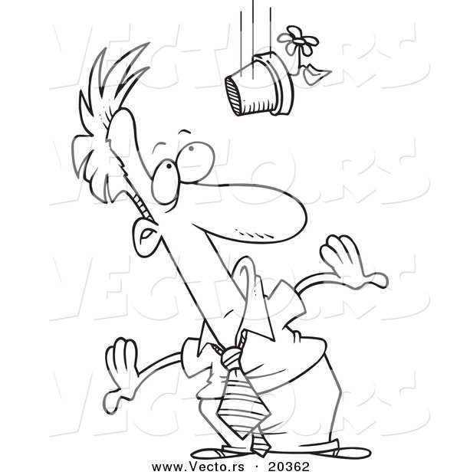
III. Liability for damage
arising from things
(2) Liability of building occupier
Section 436 “An occupier of a building is responsible for damage arising from things which fall from it or are thrown into an improper place.”

Slide 13
III. Liability for damage
arising from things
(3) Liability arising from vehicles or machines
Section 437 “A person is responsible for injury caused by any conveyance propelled by mechanism which is in his possession or control, unless he proves that the injury results from force majeure or fault of the injured person.
The same applies to the person who has in his possession things dangerous by nature of destination or on account of their mechanical action.”

Slide 14
IV. Scope of Damage
Section 438 “The Court shall determine the manner and the extent of the compensation according to the circumstances and the gravity of the wrongful act.
Compensation may include restitution of the property of which the injured person has been wrongfully deprived or its value as well as damages for any injury caused.”

