Slide 1

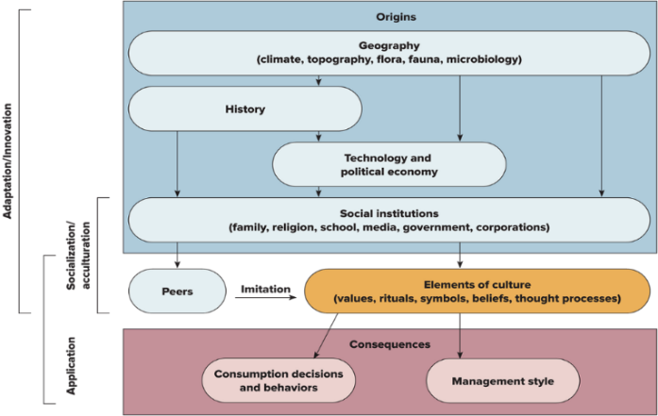
MK 326 Group Assignment 5:
Chapter 3 & 4
Topic : Origins, Elements, and Consequences of Culture
Please analysis your project country on all the elements in the chart below. (1 overview slide + 3 break up slides)
Please analyze “Thailand” on all the elements in the chart below (1 overview slide + 3 break up slides)
Please be as detail and specific as possible, but screen/select main information for the slide. Other supporting information could be included in appendix.
Altogether, your ppt presentation slides maximum 8 slides plus an unlimited number of Appendix slides ( if needed)
Please design the one page by using graphs, charts, visuals to make one page interesting ka.
Due in 2 weeks: Feb.25th
TBC - 5 mins brief presentation of your
Project country culture only by addressing-
“ How origins, elements influence the
Consequences of culture”
Notes:
1

Slide 2
MK 326 Group Assignment 5:
Chapter 3 & 4
Topic : Origins, Elements, and Consequences of Culture
Due in 2 weeks: Feb.25th
5 mins presentation of your
Project country culture only by addressing-
“ How origins, elements influence the
Consequences of culture”
Notes:
1

Slide 3
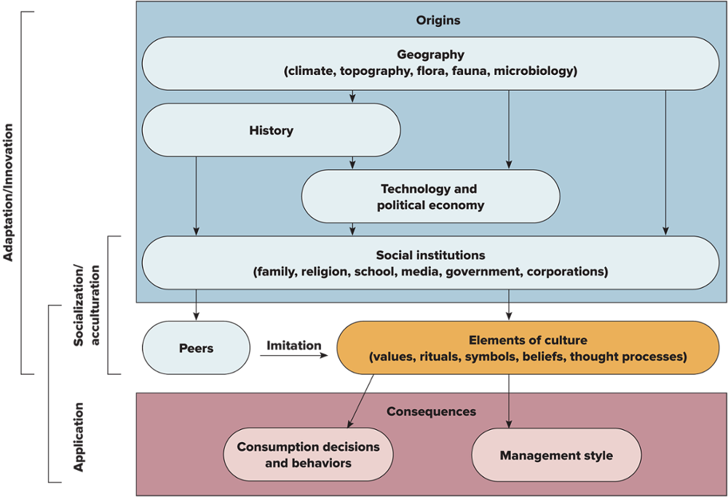
Exhibit 4.4 Origins, Elements, and Consequences of Culture
Jump to long description.

