Slide 1
Agricultural Sector
Chanin Mephokee
EE460

Slide 2
Background
Over almost four decades, from 1968 to 2005, Thailand’s economic output grew in the real terms at an average annual rate of 6.5 percent.
The boom decade (1986-1996) which preceded the Asian crisis of 1997-1999, Thailand growth rate was 9.5 percent that was the fastest in the world.
However, the agricultural output grew more slowly than GDP, implying a declining share of agriculture in aggregate output.
.

Slide 3
Declining Sector
The agricultural sector accounted for 32 percent of GDP in 1965. By 2004 this share had declined to 10 percent. Over the same period the GDP share of industry rose from 23 to 43 and the share of services grew from 45 to 47 percent.
There was a change in distribution of expenditure as income increased. The expenditure on rice, maize, and cassava declines as a share of total expenditures. But the shares of fruits, poultry, cattle and rubber increased

Slide 4
Real Growth of GDP, Thailand
 | Pre-boom 1968-1986 | Boom 1987-1996 | Crisis 1997-1999 | Recovery 2000-2005 | 1986-2005
Total GDP | 6.7 | 9.5 | -2.5 | 5.1 | 6.5
Agriculture | 4.5 | 2.6 | 0.1 | 3.6 | 3.5
Industry | 8.5 | 12.8 | -1.7 | 6.3 | 8.5
Services | 6.8 | 9.0 | -3.6 | 4.2 | 6.2

Slide 5
Industry share of agricultural value-added
Source: NESDB
 | 1975 | 1985 | 1995 | 2000
Paddy | 38.0 | 34.7 | 26.9 | 26.1
Maize | 6.4 | 4.2 | 3.7 | 3.4
Cassava | 4.2 | 5.5 | 5.2 | 0.2
Sugar cane | 5.9 | 3.2 | 5.2 | 5.3
Palm nut and oil palm | 0.0 | 0.6 | 1.2 | 1.4
Rubber | 2.2 | 8.4 | 17.5 | 12.4
Coconut | 1.4 | 1.8 | 0.9 | 0.7
Swine | 3.2 | 1.6 | 1.7 | 1.5
Poultry | 1.1 | 4.0 | 3.9 | 6.6

Slide 6
Intermediate Input
The share of intermediate input use in the value of total output increased significantly over the two and a half decades since 1975. In paddy production, the share increased from 14 to 30 percent. For the entire agricultural sector, this cost share rose from 21 to 37 percent over the same period. Most intermediate goods used in Thai agriculture are domestically produced, but the share of imports in total intermediate input use increased from 10 to 17 percent.

Slide 7
They have been substantial changes in the pattern of sales of agricultural products. In 1975, sales of agricultural products in intermediate users (millers and processors) accounted for 57% of total sales, but by 2000, these sales had increased to 70%. Almost all paddy is milled into edible rice commercially, rather than on farm. Paddy is neither exported nor imported, but milled rice has been an important export item

Slide 8
Cassava is exported in the form of processed animal feeds.
Rubber exports has become increasingly significant since the 1990s.
Soybeans has become an important net import and is used for processed foods and for animal feed.

Slide 9
Sales to intermediate users as a share of industry total sales
 | 1975 | 1985 | 1995 | 2000
Paddy | 94.0 | 99.0 | 97.6 | 100
Maize | 16.5 | 97.6 | 61.7 | 93.6
Cassava | 97.9 | 97.7 | 95.9 | 98.1
Sugar cane | 96.9 | 99.9 | 100 | 100
Coconut | 14.9 | 37.2 | 57.8 | 68.5
Swine | 100 | 100 | 99.4 | 99.3
Poultry | 64.2 | 82.5 | 87.1 | 97.1
Total agri. | 57.3 | 71.0 | 68.8 | 70.0

Slide 10
Industry sales to export users as a share of industry total sales
 | 1975 | 1985 | 1995 | 2000
Paddy | 0.0 | 0.0 | 0.0 | 0.0
Rice Milling | 15.1 | 32.6 | 39.8 | 51.7
Sugar cane | 0.0 | 0.0 | 0.0 | 0.0
Refined sugar | 56.5 | 36.3 | 48.3 | 39.1
Maize | 77.6 | 0.0 | 2.8 | 1.7

Slide 11
Thailand is a major net agricultural exporter.
The list of agricultural exports includes many of the most important agricultural products produced and consumed within the country, including the staple food.
Rice exports account for between 30-50% of its total output.
The list of imported agricultural commodities is much thinner: maize, soybeans, palm oil.

Slide 12
Dependence on Imported Fertilizers million ton
2009 | 2010 | 2011 | 2012 | 2013
3.833 | 5.172 | 5.579 | 5.583 | 5.638

Slide 13
Use of chemicals herbicide, insecticide and fungicide herbicide, insecticide and fungicide million ton
2009 | 2010 | 2011 | 2012 | 2013
0.138 | 0.117 | 0.164 | 0.134 | na

Slide 14
Policies
Policies for the various agriculture commodities were determined individually, in response to political circumstances which varied among the commodities concerned, rather than as apart of a single, integrated agricultural policy strategy.
Government imposed distortions that create a gap between domestic prices and what they would be under free markets.

Slide 15
Policy
Policies on food security and raising agricultural productivity to reduce import dependence were not a significant concern.
Policy on stabilizing food prices for consumers has been recurrent theme of agricultural pricing policy.

Slide 16
Paddy Pledging Program
Thailand Paddy Pledging Program affected economic outcomes. While the program has helped raise incomes of participating farmers, it has been very expensive. The program is estimated to cost almost 2% of GDP each harvesting year since 2012. Many countries, including the EU, that have implemented large agricultural subsidy programs have found them to be costly and that they have reduced competitiveness of the agricultural sector, while the most successful programs that supported and strengthened the agricultural sector had focused on raising agricultural productivity and helping then poor.

Slide 17
Siamwalla, Setboonsarng, and Patamasiriwat
(1993)
Until the 1980s, agricultural exports were viewed as a source of revenue for the central government.
Because the price elasticity of supply for most agricultural products was very low, it was perceived that their production could be taxed heavily without producing contraction of output.
Most agricultural producers were impoverished, poorly educated and politically unorganized, so taxing agriculture, especially rice, was politically attractive and rice exports were indeed taxed until 1986.

Slide 18
Democratic Effects Since 1973
With the move to more democratic political institutions, policy shifted away from taxing agriculture to the more neutral set of trade policies.
It is necessary to find ways to attract the support of the huge rural electorate.
The policies switched from taxing agriculture to the direction of subsidizing. It was not the direction of the efficiency-based policy.
The subsidizing policy has been the major reason of agricultural problems nowadays.
There are so many important agricultural commodities that are net exports under subsidizing program in order to compete with imports.

Slide 19
Thailand is an active member of the Cairns Group of agricultural-exporting countries within the WTO membership.
Thailand provides import-protection measures to several main products such as soybeans, palm oil, rubber, rice, and sugar.
Protective measures employed include non-tariff instruments which permits a high degree of discretion on the part of government officials.
The set of import controls includes import prohibitions, strict licensing agreements, local content rules and requirement for special case-by-case approval of imports.
The commodities for which these restrictions are applied include 5 products above and onions, garlic, potatoes, pepper, tea, raw silk, maize, coconut products and coffee.

Slide 20
Thailand’s general exclusion list which applies tom the ASEAN Free Trade Area (AFTA) agreements, includes several agricultural products, among them are rice, sugar, and palm oil(both crude and refined).
The problem of Thai agricultural exports main concerned with the environmental and sanitary and phyto-sanitary (SPS) issues. These problems have included the well-known dispute with the US. regarding shrimp (environmental issue) and with Australia regarding Thailand exports of frozen, cooked chicken (SPS issue).

Slide 21
Populist Policy
Since the economic crisis of 1997-1998 and during the government of Prim Minister Thaksin (2001-2006), a wide range of income support programs, cash grants to villages, and subsidized credit schemes have been introduced.
Support for these schemes was a significant component of the populist economic policy agenda of the Thaksin government.

Slide 22
Pricing Policies
According to Siamwalla and Setboonsarng (1989 and 1991), Thai pricing policies for various agricultural commodities were determined individually, in response to political circumstances which varied among the commodities concerned, rather than as a part of a single, integrated agricultural policy strategy.
According to Anderson et al. (2008), the government-imposed distortion that create a gap between domestic prices and what they would be under free markets.

Slide 23
Rice
From the end of WW II to 1986, Thailand taxed its export of rice. Siamwalla and Setboonsarng estimates the rate of export taxation of around 40 percent from the late 1950s to the early 1970s. The rate increased to around 60 percent during the commodity price boom of 1972 to 1974.. It was around 40 percent during the Second Oil Shock in 1997 to 1980. Since 1986, rice exports have remained untaxed.

Slide 24
Table Normal Prices of Paddy
Year | Domestic Prices (baht/ton) | Export Prices (baht/ton)
1968 | 1,231 | 3,034
1971 | 1.011 | 1,784
1972 | 1,168 | 2,068
1974 | 2,348 | 6,517
1977 | 2,309 | 3,582
1980 | 3,405 | 5,071
1985 | 2,757 | 3,622
1986 | 2,438 | 2,615
1987 | 3,027 | 3,570

Slide 25
Cassava
Thailand cassava exports developed for the supply of animal feed to European and some Asian markets, including Taiwan.
The quota restrictions of the EU led to rents attached to export quotas from Thailand, which in turn led to corruption in the allocation of these quotas.
The rents associated with the quotas resulting in the export price exceeding the domestic price by the amounts averaging around 10 percent. (Warr and Kohpaiboon, 2007)

Slide 26
Price comparisons for cassava, Thailand nominal price of cassava pellet basis(baht/ton)
Year | Domestic Price | Export Price | Farm Price
1970 | 762 | 859 | 390
1980 | 2,524 | 2,731 | 750
1985 | 1,520 | 1,965 | 430
1990 | 2,373 | 2,713 | 710
1995 | 3,115 | 3,168 | 1,160
1998 | 3,173 | 3,410 | 1,300
2000 | 2,045 | 2,367 | 610
2002 | 2721 | 2688 | 1040
2004 | 2,720 | 2,888 | 800

Slide 27
Sugar
Sugar was an imported item until the late 1950s, but since has been a net export item.
The sugar milling industry required large mills and precise scheduling of sugar deliveries to these mills. The mills were large and few in number.
Sugar milling is a highly capital intensive business and during the sugar processing season it is essential that the processing plants be fully utilized. Growers and millers have bickered over prices but they have been able to combine their efforts to lobby the government for intervention on their behalf.
In Thailand, sugar growers and millers are highly organized.

Slide 28
Home Price Scheme
It receives protection in the form of a home price scheme. This type of scheme involves taxing consumers and using the proceeds to subsidize exports. A home price scheme drives up the domestic consumer and producer prices of the product, subsidizing the producer at the expense of the consumer.
To make the scheme work, leakage from the export market to the more profitable domestic market has to be prevented.
Re-importing for domestic consumption must also be restricted.

Slide 29
Consumer prices have been stabilized by the scheme, relative to the export price.
Consumer and producer prices have been well above export prices.
Even though it is exported, sugar is by far the most heavily protected of Thailand agricultural industries.

Slide 30
Price comparisons for sugar, Thailand nominal price of raw sugar basis (baht/ton)
Year | Export Price | Grower Price | Miller Price | Consumer Price
1962 | 1161 | 3413 | 3450 | 3810
1970 | 1708 | 2115 | 2730 | 2880
1975 | 10676 | 4721 | 6597 | 4470
1980 | 6499 | 6315 | 8631 | 10110
1985 | 3330 | 6069 | 6452 | 10970
1990 | 7293 | 10221 | 11360 | 10988
1997 | 7090 | 11162 | 11556 | 10997
2000 | 5863 | 11849 | 8632 | 11415
2005 | 8,560 | 11,994 | 11,637 | 11,750

Slide 31
Rubber
Rubber is a net export item for Thailand and the Thai rubber industry was for a long time subject to an export tax.
The government collected two types of taxes on rubber: duty general revenue and a small levy to finance a rubber-replanting program.
There was no export quota and required no licensing.
With the low rubber price, the government has implemented the price support program for the producers.

Slide 32
Price comparisons for rubber, Thailand nominal price for raw rubber sheet basis (baht/ton)
Year | Domestic Price | Export Price | Farm Price
1967 | 5851 | 6555 | 5100
1970 | 6580 | 7197 | 5720
1975 | 8310 | 9589 | 6420
1980 | 18940 | 26377 | 16350
1985 | 15820 | 18716 | 14820
1990 | 18326 | 19661 | 17150
1999 | 19800 | 21869 | 18050
2000 | 23200 | 24799 | 21520
2005 | 55180 | 57130 | 53570

Slide 33
Thailand palm oil industry fluctuated between being a net exporter and a net importer. Although the industry has been a net exporter since 1998, a system of import quotas remains in place.

Slide 34
Import Quota for Palm oil, Thailand
 | Quota tariff rate (%) | Non-quota tariff rate (%) | Import quota (ton)
2000 | 20 | 147.8 | 4757
2001 | 20 | 146.2 | 4809
2002 | 20 | 144.6 | 4834
2003 | 20 | 143.0 | 4860
2004 | 20 | 143.0 | 4860
2005 | 20 | 143.0 | 4860

Slide 35
soybean
Soybean was a net export item for Thailand from 1960 until 1988, before becoming a net import item from 1992 onwards.
During the export period, export was taxed, but from 1995 onwards the trade regime shifted to one of tariff quotas.
Within the quota volume of imports, soybean could be imported at low or zero tariffs. Beyond the quota the applied tariff was set at the maximum amount permitted by Thailand’s WTO obligations which varied between 80 to 90 percent.

Slide 36
Price comparisons for soybeans, Thailand nominal price for mixed grade soybean grain basis (baht/ton)
 | Import Price | Export Price | Farm Price | Domestic Price
1991 | 23785 | 11410 | 7440 | 9496 | X
1992 | 6311 | 11672 | 7600 | 9407 | M
1995 | 7417 | 14882 | 7650 | 9855 | M
1997 | 9908 | 18094 | 8250 | 10975 | M
2000 | 8690 | 17099 | 9190 | 13115 | M
2005 | 11591 | 31071 | 10720 | 14680 | M

Slide 37
Future Reform
Over time, the direct taxation of agricultural exports has been gradually eliminated. This has been important in the case of rice (1986), rubber (1990).
Cassava exports have continued to be taxed to a minor extent by the system of export quotas.
Maize exports have been consistently untaxed, as have chicken exports.
Sugar is an export commodity but the domestic sugar industry is protected by a system which taxes domestic consumers and transfer the revenue to producers.

Slide 38
Government interventions on behalf of rural people have been important, but they have generally not taken the form of intervening in agricultural commodity markets. Cash transfers to village organizations, subsidized loan schemes not linked to agricultural production, and a generally good system of public infrastructure have been the main instruments. The prospect for further trade liberalization are not encouraging, unless this occurs through bilateral preferential trading arrangements such as the scheme proposed with the United States.

Slide 39
Agricultural Economy in 2014
The growth rate of Thai agricultural economy in 2014 slightly increased by 1.2 percent compared with 2013.
The sectors which lead to the expansion are crops, livestock and forestry sector by 1.5, 1.9, and 2.8 percent, respectively.
The fishery sector decreased by 1.8 percent.

Slide 40
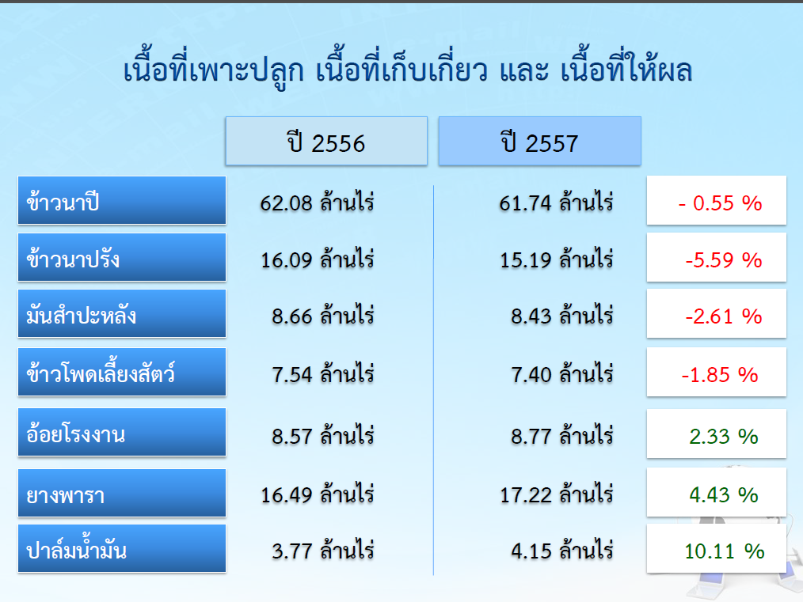

Slide 41
Determinants of the Expansion
Favorable weather condition in the plantation of major economic crops, such as cassava, maize, oil palm and fruits.

Slide 42
Negative factors
Drought during the end of 2013 up to the first quarter of 2014.
Flood in September 2014
Disease of the Early Mortality Syndrome (EMS) on shrimp production in 2013-14.

Slide 43
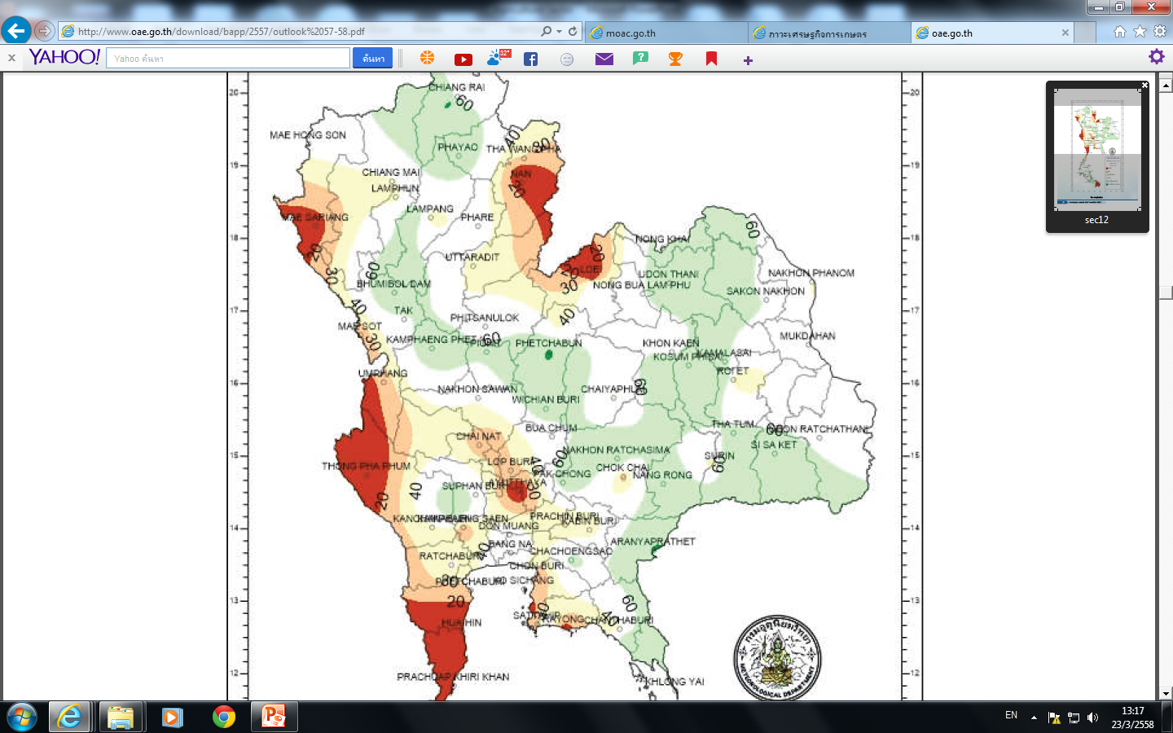

Slide 44
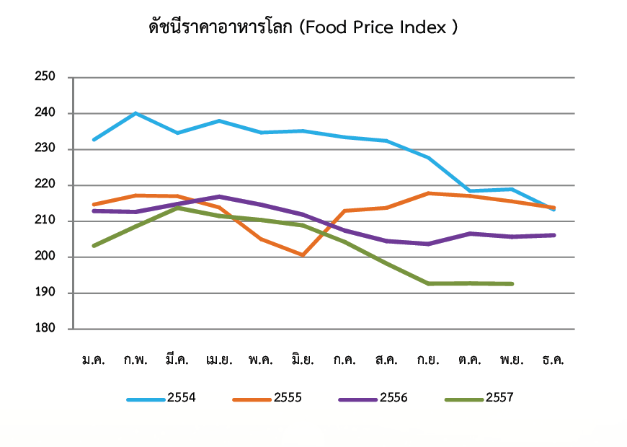

Slide 45
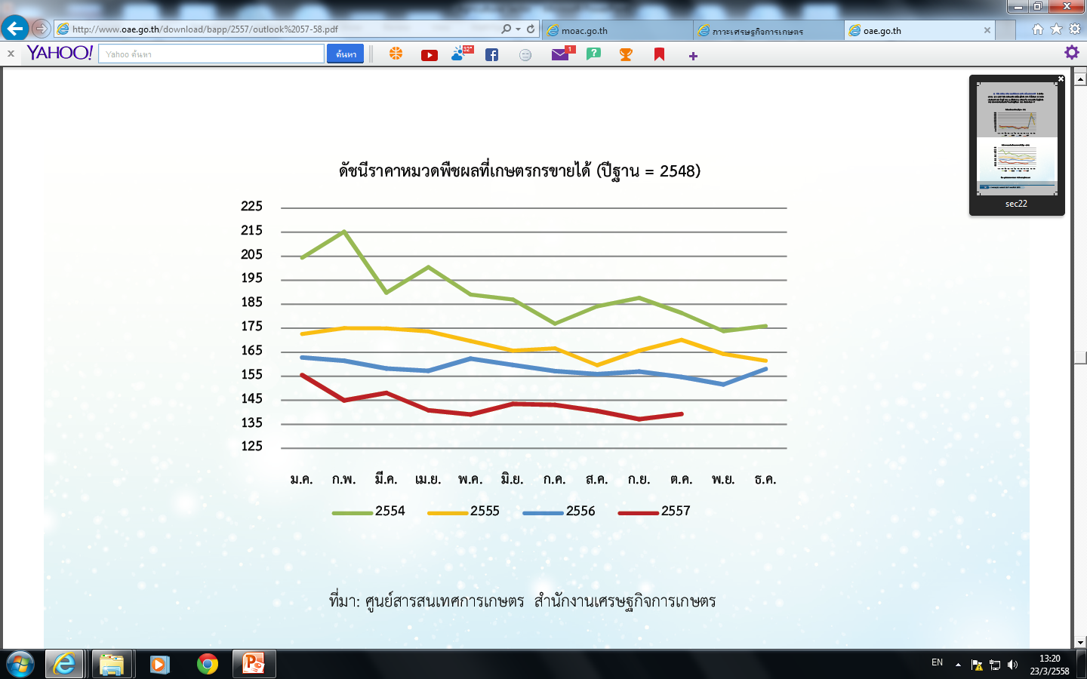

Slide 46
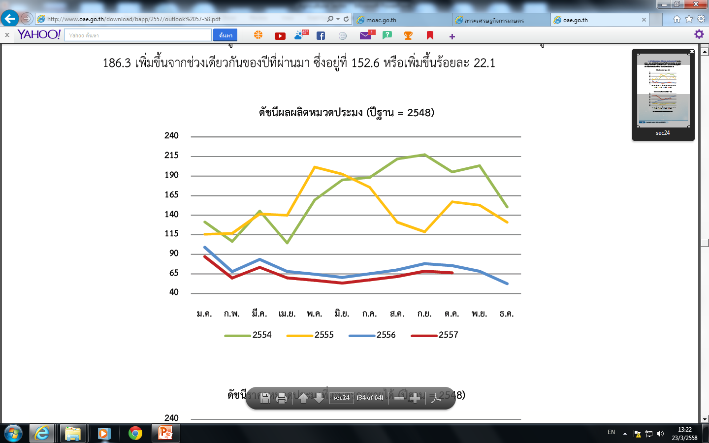

Slide 47
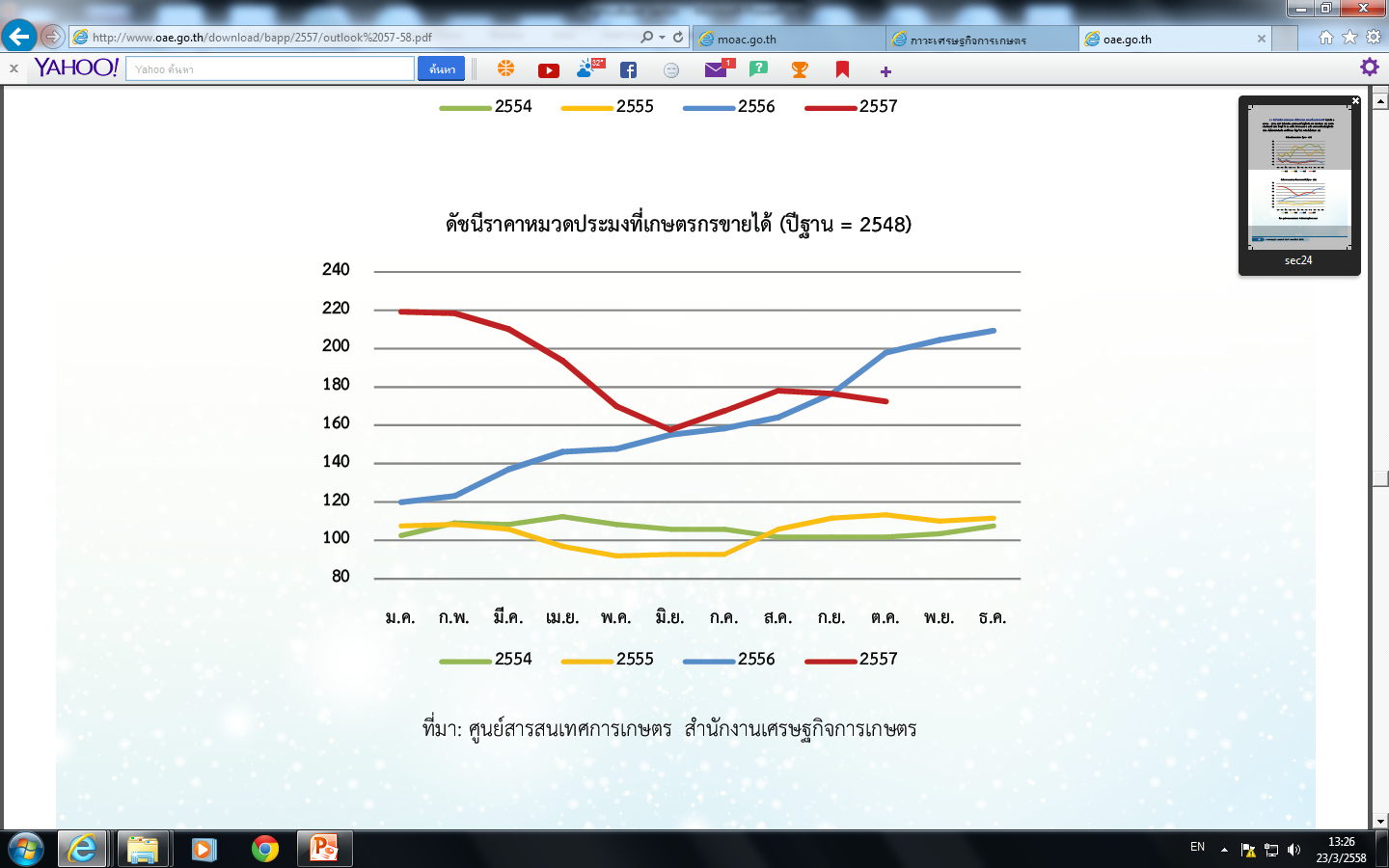

Slide 48
Outlook in 2015
Office of Agricultural Economics
sectors | 2014 | 2015
Agriculture | 1.2 | 2.0-3.0
crops | 1.5 | 2.2-3.2
livestock | 1.9 | 1.5-2.5
fishery | -1.8 | 1.0-2.0
Agricultural services | -0.5 | -3.0
forestry | 2.8 | 2.5-3.5

Slide 49
Risks
Drought that has been starting since late of 2014. The shortage of water in main reservoirs will affect on rice production during the second crop.

Slide 50
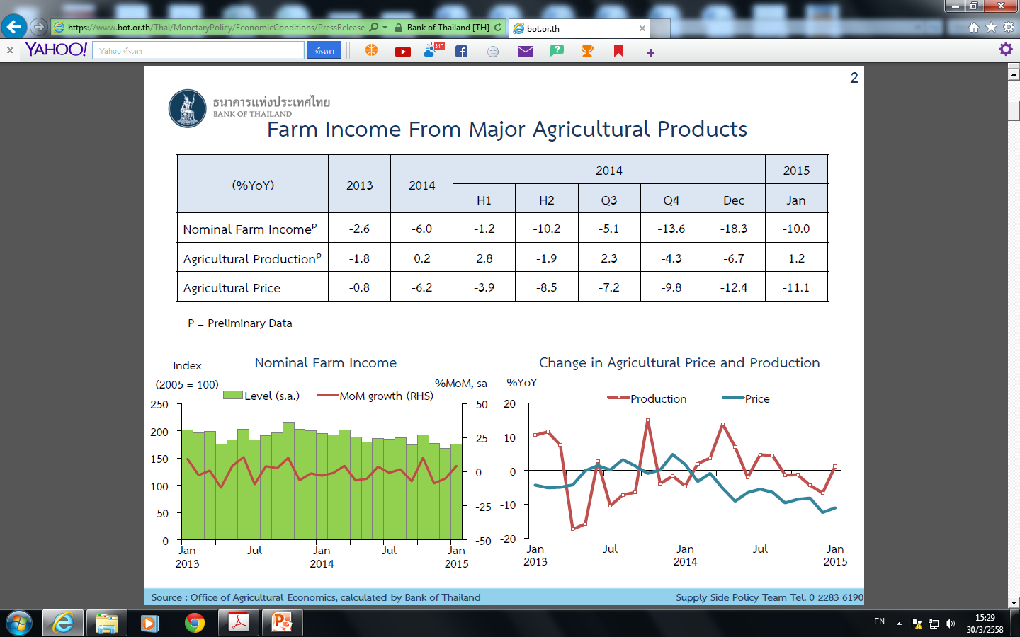

Slide 51
Reading Lists
Singhapreecha, Charuk,” Agricultural Policy Development in Thailand”, Faculty of Economics, Chiangmai University, 2014.
Warr, Peter and Archanun Kohpaiboon, “Distortions to Agricultural Incentives in Thailand”, Agricultural Distortions Working Paper 25, the World Bank, December 2007

Slide 52
Question
Explain why for the past five decades, Thailand agricultural sector has been unable to be modernized or increase in productivity. Is it the policy-making problem or economic structural problem? Provide evidence to support your statement.

