Slide 1
Revision Slide 3
Equilibrium in free market and mixed economy

Slide 2
Outline
Equilibrium in Free Market
Equilibrium in Mixed Economy: Government Intervention
  Price Control
  Tax
  Subsidy

Slide 3
Free market Equilibrium
Equilibrium: a state of balance between opposing forces
In microeconomics, equilibrium refers to a situation where demand and supply are balanced.
Free Market Equilibrium is achieved through the Price Mechanism.
That is, price will adjust to equate demand and supply.
Equilibrium Price (P*): price that equates demand and supply
Market Price (Pmkt): price at which the market operates.
Note that Mkt Price may differ from Eqbm Price.

Slide 4
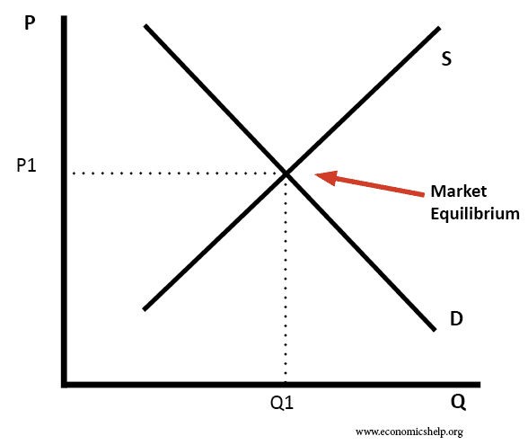
Free market Equilibrium

Slide 5
Surplus and Shortage
When…
Pmkt > P*, there is a surplus (excess supply).
Because at a high price, quantity supplied exceeds quantity demanded.
Pmkt < P*, there is a shortage (excess demand).
Because at a low price, quantity demanded exceeds quantity supplied.
In free market, Pmkt will eventually adjust towards P*, thus clearing any surplus or shortage.

Slide 6
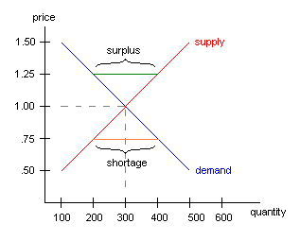
Surplus and Shortage
At P = 1.25, there is a surplus of 200 units.
At P = 0.75, there is a shortage of 200 units.

Slide 7
Mixed economy
Mixed Economy: an economic system with elements from both free market and command economy.
In the mixed economy, the government may intervene the market.
Forms of Government Interventions:
Price Control
Tax
Subsidy

Slide 8
Price control
The government may set a specific price in a market.
Minimum Price / Price Floor (Pmin):
A limit on how low a price can be charged for a product.
Pmin must be set above P* in order to be effective.
Maximum Price / Price Ceiling (Pmax):
A limit on how high a price can be charged for a product.
Pmax must be set below P* in order to be effective.

Slide 9
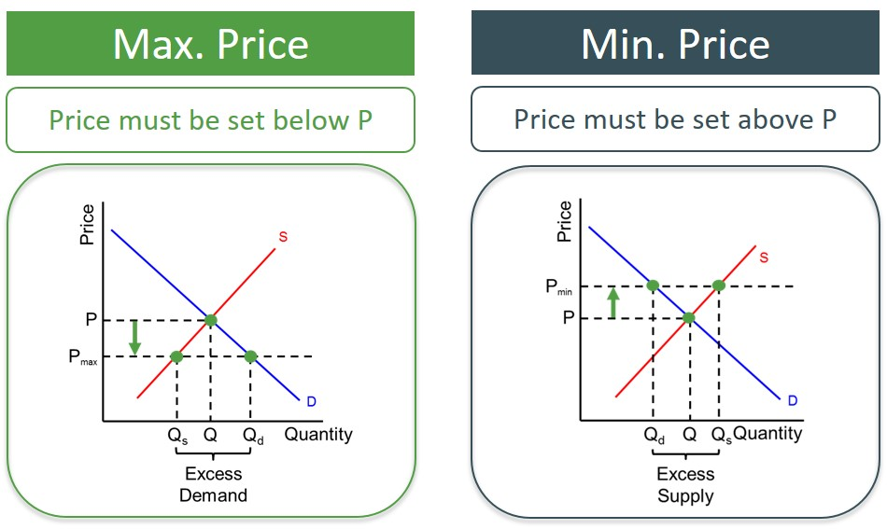

Slide 10
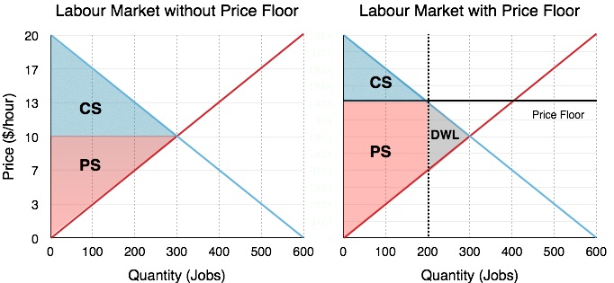
Min. Price / price floor
Under price floor, there are only 200 jobs bought and sold, although there could have been 300 jobs traded in a free market.

Slide 11
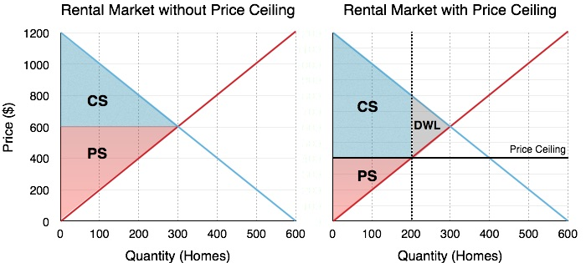
Max. Price / price ceiling
Under price ceiling, there are only 200 homes bought and sold, although there could have been 300 homes traded in a free market.

Slide 12
Price control
Both price floor and price ceiling generate Deadweight Loss (DWL).
DWL is a loss in welfare, represented by a loss in consumer surplus and/or producer surplus.
DWL illustrates INEFFICIENCY and arises when there is underallocation or overallocation of resources.
In the case of price controls, there is underallocation of resources as there are unexploited gains from trade since less quantity of a product is bought and sold.

Slide 13
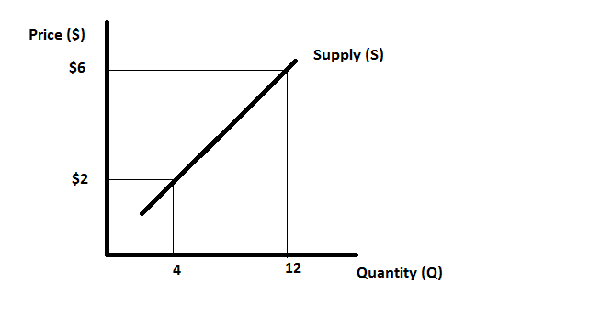
Tax
There are many types of taxes, but we will consider “Specific Tax”.
Specific Tax or Per-Unit Tax: a fixed amount of tax for each unit of a good or service sold
Effect of Tax on Supply Curve

Slide 14
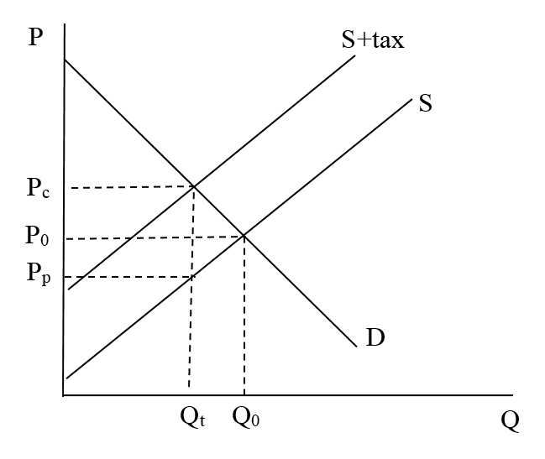
Equilibrium with Tax

Slide 15
Tax and welfare
Before Tax After Tax

Slide 16
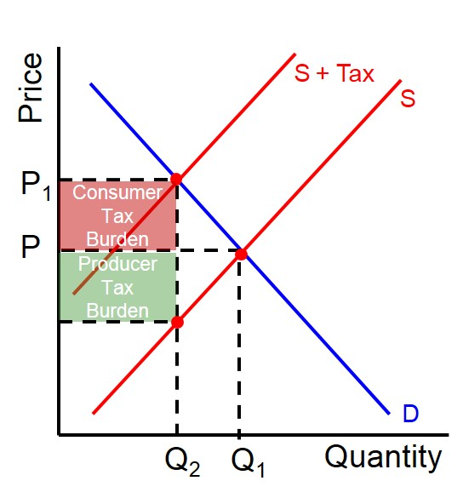
Tax Incidence

Slide 17
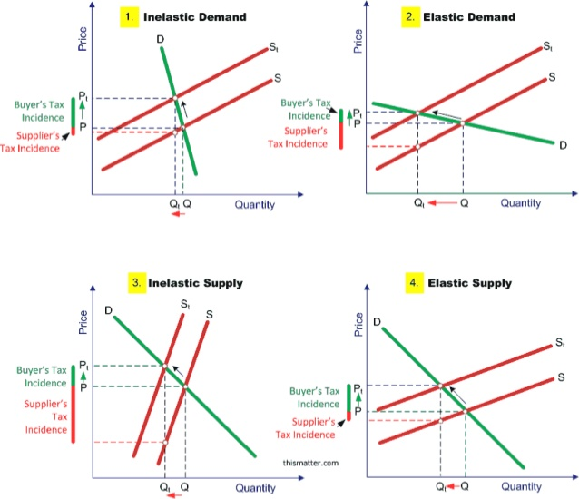
PED & PES on tax incidence

Slide 18
Subsidy
There are many types of subsidies, but we will consider “Unit Subsidy”.
Unit Subsidy: a fixed amount of subsidy for each unit of a good or service sold, paid by the government to producers
Effect of Subsidy on Supply Curve

Slide 19
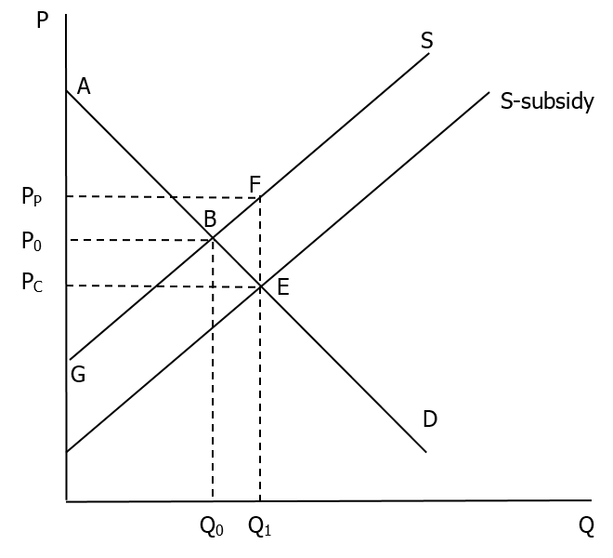
Equilibrium with Subsidy

Slide 20
Subsidy and welfare

Slide 21
Subsidy and welfare

Slide 22
Tax & subsidy on welfare
Both tax and subsidy generate DWL.
Tax reduces the quantity bought and sold, leading to underallocation of resources: there are unexploited gains from trade, as the additional cost of producing the extra units is lower than the additional benefit from consuming them.
Subsidy raises the quantity bought and sold, leading to overallocation of resources: the additional cost of producing the extra units is higher than the additional benefit from consuming them.

