Slide 1




Marketing Planning 312
Chapter 1
By Ajarn Suwalya K.

Slide 2
Chapter 1
Marketing in Today’s Economy

Slide 3
Chapter Outline
Introduction
The challenges and opportunities of marketing in today’s economy
Basic marketing concepts
Major marketing activities and decisions
Taking on the challenges of marketing strategy

Slide 4
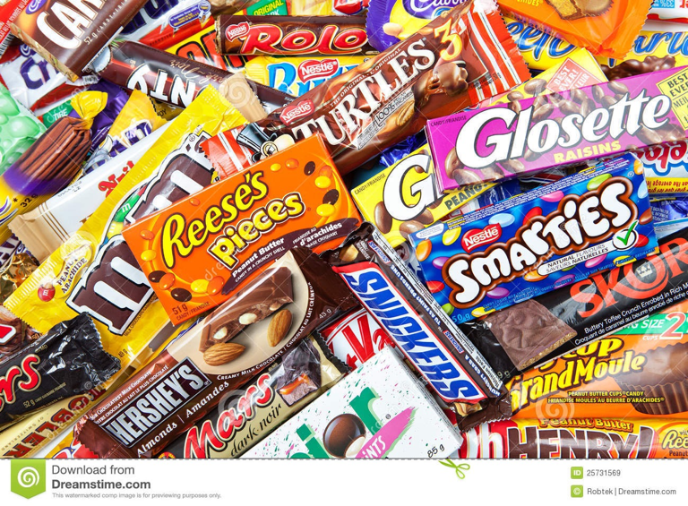
Introduction
Commoditization
  Consequence of mature industries where slowing innovation, extensive product assortment, excess supply, and frugal consumers force margins to the floor

Slide 5

Introduction
All organizations require effective planning and a sound marketing strategy to achieve their goals and objectives

Slide 6

Introduction
Today’s economy is characterized by rapid technological change, economic/financial anxiety, and increasing consumer skepticism

Slide 7
Challenges and Opportunities of Marketing in Today’s Economy
Power shift to customers
Massive increase in product selection
Audience and media fragmentation
Changing value propositions
Shift in demand patterns
Privacy, security, and ethical concerns
Unclear legal jurisdiction

Slide 8

Challenges and Opportunities of Marketing in Today’s Economy
Power shift to customers

Slide 9

Challenges and Opportunities of Marketing in Today’s Economy
Massive increase in product selection

Slide 10
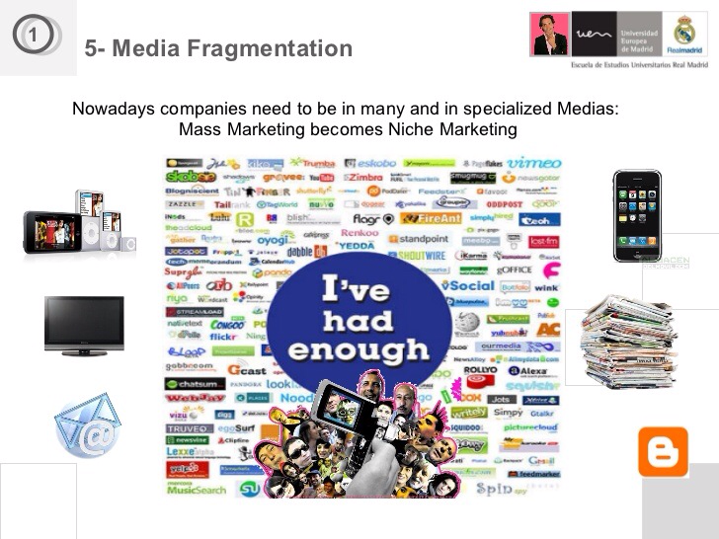
Challenges and Opportunities of Marketing in Today’s Economy
Audience and media fragmentation

Slide 11

Challenges and Opportunities of Marketing in Today’s Economy
Changing value propositions

Slide 12
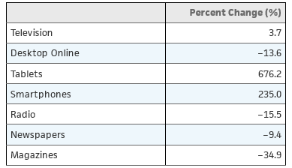
Exhibit 1.1 - Change in Daily Media Usage by U.S. Adults, 2010-2014
Source: “Average Daily Media Use in the United States from 2010 to 2014,” Statista (http://www.statista.com/statistics/270781/average-daily-media-use-in-the-us/), accessed February 18, 2015.

Slide 13
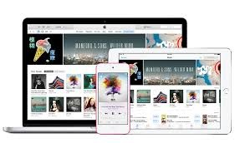
Challenges and Opportunities of Marketing in Today’s Economy
Shift in demand patterns

Slide 14

Challenges and Opportunities of Marketing in Today’s Economy
Privacy, security, and ethical concerns

Slide 15
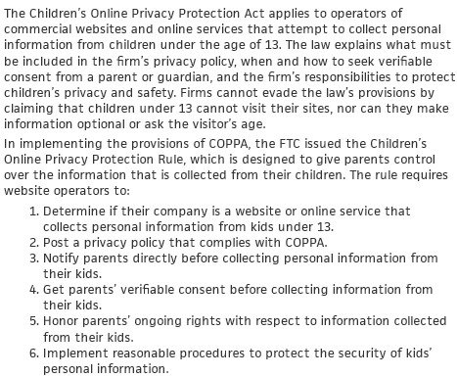
Exhibit 1.2 - The Children’s Online Privacy Protection Act
Source: United States Federal Trade Commission, Bureau of Consumer Protection (http://www.ftc.gov/tips-advice/business-center/guidance/childrens-online-privacy-protection-rule-six-step-compliance), accessed February 18, 2015.

Slide 16

Challenges and Opportunities of Marketing in Today’s Economy
Unclear legal jurisdiction

Slide 17
Challenges and Opportunities of Marketing in Today’s Economy
Power shift to customers
Massive increase in product selection
Audience and media fragmentation
Changing value propositions
Shift in demand patterns
Privacy, security, and ethical concerns
Unclear legal jurisdiction

Slide 18
Basic Marketing Concepts: Marketing Defined
Marketing (2005 AMA definition)
  “… organizational function and a set of processes for creating, communicating, and delivering value to customers and for managing customer relationships in ways that benefit the organization and its stakeholders”
Marketing (2007 AMA definition)
  “… activity, set of institutions, and processes for creating, communicating, delivering, and exchanging offerings that have value for customers, clients, partners, and society at large”

Slide 19
Basic Marketing Concepts: Market
Group of individuals or institutions with similar needs that can be met by a specific product
Marketspace
  Electronic marketplaces unbound by time or space
Metamarket
  Cluster of closely related goods and services that center around a specific consumption activity

Slide 20

Basic Marketing Concepts: Market (Continued)
Metamediary
  Provides a single access point where buyers can locate and contact many different sellers in the metamarket

Slide 21
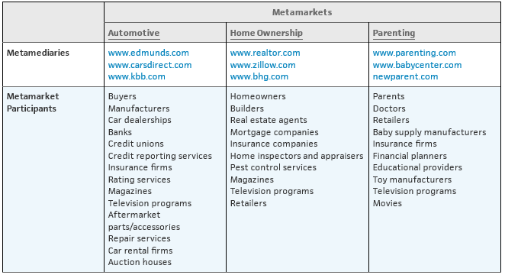
Exhibit 1.3 - Common Metamarkets and Participants

Slide 22
Basic Marketing Concepts: Exchange
Process of obtaining something of value by offering something in return
Conditions of exchange
  There must be at least two parties for the exchange
  Each party should have something that the other party values
  Each party must be capable of communication and delivery

Slide 23

Basic Marketing Concepts: Exchange (Continued)
  Each party must be free to accept or reject exchange
  Each party must believe it is desirable to exchange with the other party

Slide 24
Basic Marketing Concepts: Product
Something acquired through an exchange to satisfy a need or want
Examples
  Goods
  Services
  Ideas
  Information
  Digital products
  People
  Places
  Experiences
  Real or financial property
  Organizations

Slide 25
Basic Marketing Concepts: Utility
Ability of a product to satisfy a customer’s need or want
Types
  Form utility - Product contains distinguishing attributes
  Time utility - Product is available when customer wants it
  Place utility - Product is available where customers want it

Slide 26
Basic Marketing Concepts: Utility (Continued)
  Possession utility - Deals with easy transfer of ownership or title
  Psychological utility - Product provides positive experiential attributes that customers find satisfying

Slide 27

Basic Marketing Concepts: Utility
  Form utility - Product contains distinguishing attributes

Slide 28
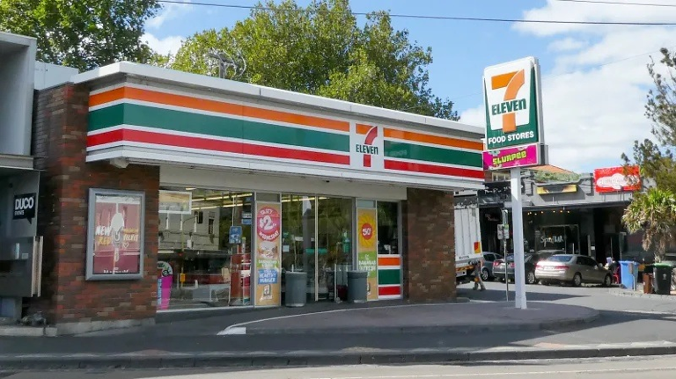
Basic Marketing Concepts: Utility
  Time utility - Product is available when customer wants it

Slide 29

Basic Marketing Concepts: Utility
  Place utility - Product is available where customers want it

Slide 30

Basic Marketing Concepts: Utility (Continued)
  Possession utility - Deals with easy transfer of ownership or title

Slide 31
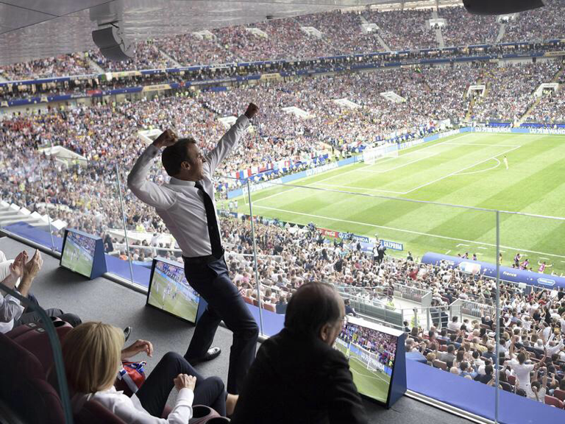
Basic Marketing Concepts: Utility (Continued)
  Psychological utility - Product provides positive experiential attributes that customers find satisfying

Slide 32

Figure 1.1: The stages of building a
marketing plan

Slide 33
Marketing Activities and Decisions
Strategic planning
  Strategy - Firm’s game plan for success
  Tactical planning - Focusing on specific markets or market segments and the marketing programs that meet their needs
  Marketing plan - Outlining the marketing program

Slide 34
Marketing Activities and Decisions (Continued 1)
Research and analysis
  Internal analysis - Analyzing the firm’s current and future performance and sustainability strategies
  Competitive intelligence - Analyzing competing businesses
  Environmental scanning - Analyzing the external environment
  Situation analysis - Collecting and interpreting internal, competitive, and environmental information

Slide 35
Discussion Question 2
Discussion Questions
How concerned are you about privacy and security in today’s economy? Why do so many people, particularly younger people, seem to be unconcerned about privacy? Will these issues still be important in ten years? Explain.

Slide 36
Marketing Activities and Decisions (Continued 2)
Developing competitive advantage
  Competitive advantage - Advantage a firm has over competitors
  Serves as an edge to serve customer needs and maintain relationships with important stakeholders
  Helps set a strategic focus to the entire marketing program

Slide 37
Marketing Activities and Decisions (Continued 3)
Marketing strategy decisions
  Market segmentation and target marketing
  Marketing program decisions
    Creating a link between product benefits and customer needs
    Pricing decisions
    Distribution and supply chain management

Slide 38
Marketing Activities and Decisions (Continued 4)
    Integrated marketing communication (IMC) or promotion
  Branding and positioning
    Product positioning - Establishing a mental image of the product in the minds of target buyers

Slide 39
Marketing Activities and Decisions (Continued 5)
Social responsibility and ethics
  Social responsibility - Firm's obligation to maximize positive impact on society while minimizing negative impact
  Marketing ethics - Principles and standards that define acceptable conduct in marketing activities

Slide 40
Marketing Activities and Decisions (Continued 6)
Implementation and control
  Marketing implementation - Process of executing the marketing plan
    Should be controlled to ensure that the strategy stays on course
Developing and maintaining customer relationships
  Involves shifting from transactional marketing to relationship marketing

Slide 41
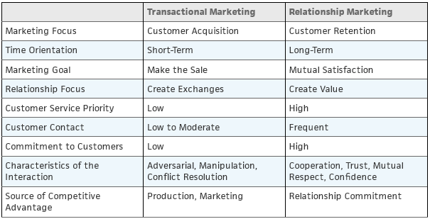
Exhibit 1.4 - Major Characteristics of Transactional and Relationship Marketing

Slide 42
Challenges of Marketing Strategy
Constant change
People-driven nature of marketing
Lack of rules for choosing marketing activities
Societal evolution of marketing and business practices
Increasing customer expectations
Declining customer satisfaction and brand loyalty
Increasing price sensitivity

Slide 43
Challenges of Marketing Strategy (Continued)
Change in customer attitudes toward business and marketing activities
Competition in mature markets
Increase in expansion into foreign markets
Aggressive cost-cutting measures

Slide 44
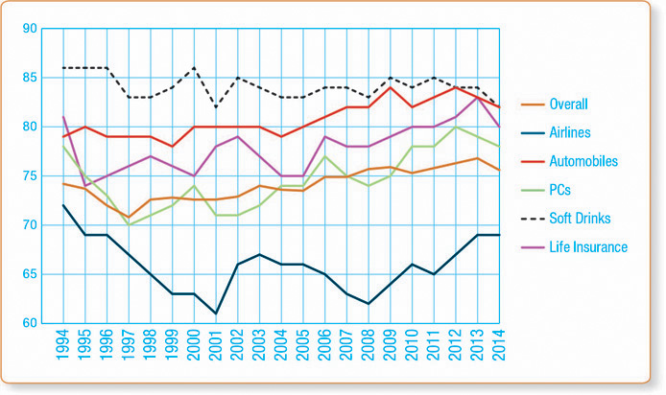
Exhibit 1.5 - American Customer Satisfaction Index

Slide 45
Discussion Question 3
Discussion Questions
The text argues that marketing possesses very few rules for choosing appropriate marketing activities. Can you describe any universal rule of marketing that can be applied to most products, markets, customers, and situations?

Slide 46
Figure 1.1: The stages of building a
marketing plan

Slide 47
Discussion Question 1
Individual Assignment –due next class
Increasing customer power is a continuous challenge to marketers in today’s economy
  Have you experienced this shift in power, either as a customer or a business person, and in what ways have you experienced it? Is this shift in power uniform across industries and markets? How is it so?
  Please note: no more than one A4 page, please feel free to include charts, graphs or illustrations

Slide 48


