Slide 1

Chapter 1
Chapter 8
Marketing Mix Decisions II: Pricing
Introduction
MK 312 Marketing Management
By
Suwalya Khemvaraporn

Slide 2
Ch. 8 - Learning objectives
After studying this chapter you should be able to:
■ discuss the importance of pricing decisions to the individual firm
■ explain the major steps in pricing decisions
■ demonstrate how external factors influence pricing decisions
■ explain how the product life cycle can affect the price decision
■ understand the advantages of using a differentiated price strategy across segments
■ discuss the special problems in international pricing.

Slide 3

Pricing
Based on environmental factors (customers, competitors, and publics) and general marketing strategy, the major components of pricing decision-making are:
  Pricing objectives (long term)
  Pricing strategies (long term)
  Pricing tactics (short term)

Slide 4
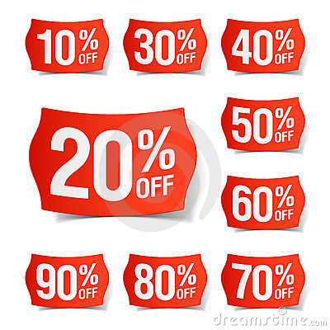
Importance of pricing
Pricing is one of the most important marketing mix decisions, price being the only marketing mix variable that generates revenues.
Pricing strategy is of great importance because it affects both revenue and buyer behaviour.

Slide 5
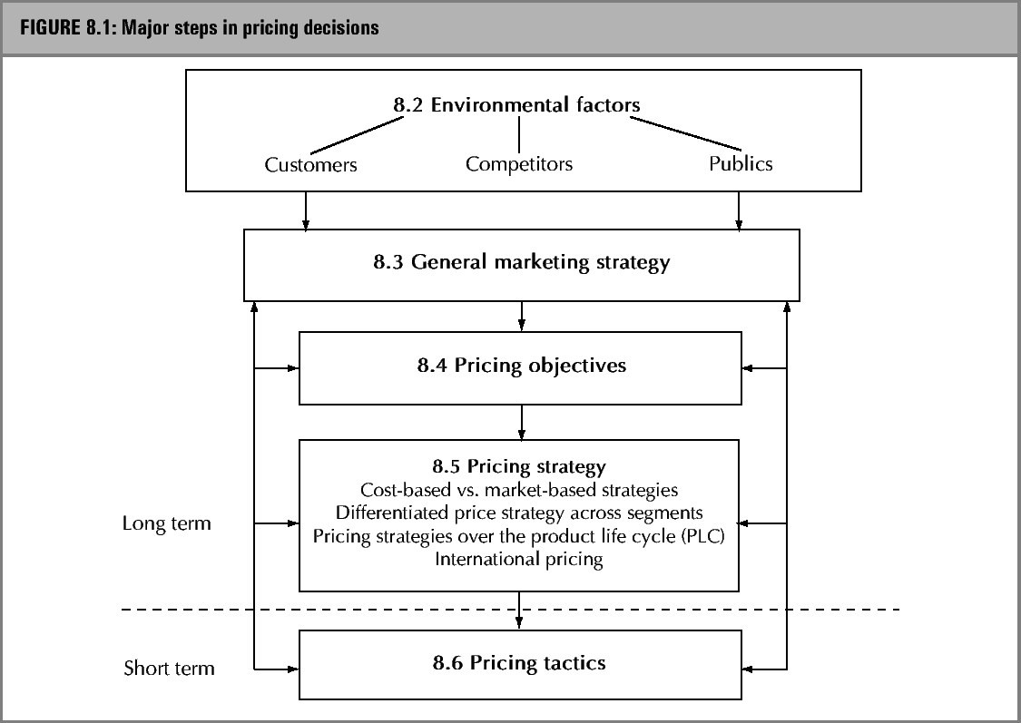
Pricing decision process

Slide 6

Environmental Factors
Customers: A key parameter affecting pricing decisions is essentially customer based. The upper limit to price to be charged is set by the market – unless, of course, the customer must purchase the product and we are the sole supplier. Effectively, then, at least in competitor markets, demand (ie. price which customers are both willing and able to pay) is a major consideration in the selection of pricing strategies and levels.

Slide 7
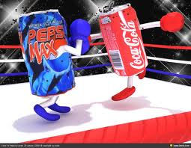
Environmental Factors
Competitor: The results of the pricing strategy will non only depend on consumer response, but also on the reaction of competitors. Competitive behavior varies considerably with market structure, intensity of competition and the existence and nature of significant competitive advantage.
Competitive prices are therefore more decisive for own pricing decisions in markets with many undifferentiated competitors. Market structure and intensity of competition change over the product life cycle (PLC) as new competitors enter the market and products become more homogeneous.

Slide 8

Environmental Factors
Publics: In addition to customers and competitors, a number of other publics influence pricing decisions. The most important of these is government (legal; constraints.) Other individuals, groups, or institutions may also have an impact on the pricing decision (eg. Financial institutions, workforce).
A number of government laws set legal constraints on competitive pricing behavior, consumer pricing, international pricing and (the control over) retailer pricing.

Slide 9

Analysis of competitor pricing
The most important considerations with regard to competitor pricing include:
■ competitors’ prices, including discounts, credit terms and terms of trade
■ competitors’ resources, especially financial
■ competitors’ costs and profit margins
■ likely competitor responses to a firm’s pricing strategies and decisions
■ likely potential competitors and barriers to market industry entry
■ substitutes from other industries
■ competitor marketing strategies, especially targeting, positioning and product differentiation.

Slide 10
Pricing objectives
Many pricing objectives can be pursued and these can be classified as follows:
■ profit-orientated objectives (e.g. profit maximization, profit satisfaction, target return on investment)
■ cost-orientated objectives (e.g. recover investment costs over a particular time period, generate volume so as to drive down costs)
■ demand/sales-orientated objectives (e.g. sales growth or maintenance, market share growth or maintenance, use price of one product to sell other products in the line, build traffic), or
■ competition-orientated objectives (e.g. be the price leader, discourage entry by new competitors, discourage others from lowering prices).

Slide 11

Pricing strategy
Many different pricing strategies have been put forward by marketing academics and practitioners. Which of these are feasible in a given problem situation depends on three main factors:
  1. The characteristics of the environment
  2. The general marketing strategy of the company
  3. The pricing objectives of the company

Slide 12
Two main pricing strategies
Cost-based pricing
  Cost-plus pricing involves a company calculating average cost per unit and then allocating a specified mark-up, which may be related to rate of profit required by the company, to arrive at the selling price.
Market-based pricing
  Market-based pricing concentrates on what the price should be, seen in a combination of two perspectives:
    What are competitors’ prices for similar products?
    What is the perceived value of the product to customers?

Slide 13

Differentiated price strategy across segments
At one price, even if it has been developed on the basis of market date in conjunction with overall marketing strategy, risks leaving a huge amount of money on the table. Because each customer- or, more realistically, each customer segment – make value/price judgment, developing on ‘average’ price at some midpoint along the spectrum of perceived value runs counter to the concept of aligning price and value. The result of this single ‘average’ price approach, represented in Fig.9.2 is that the company ends up charging almost everyone the wrong price (Simon and Butscher, 2001)

Slide 14
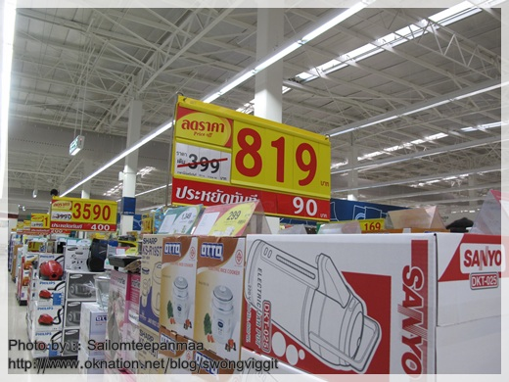
Differentiated price strategy across segments
Ideal pricing strategy, then should follow the natural segmentation of the market based on perceived value. By setting prices at or just below the value realized by each customer segment, a company will maximize revenue and profit. The role of marketing in this process is to identify the customer value segments and set prices accordingly. The role of sales is to maintain the differentiated pricing structure by selling on value, rather than just one price.

Slide 15
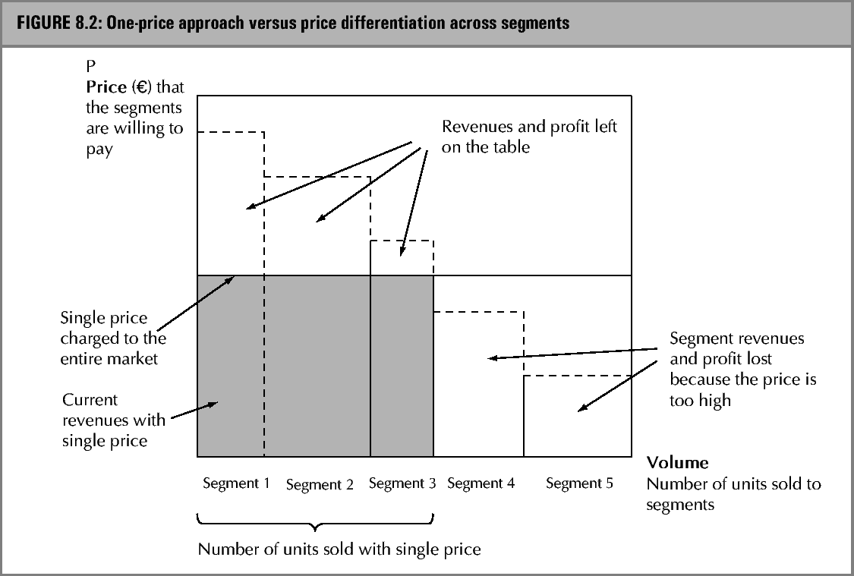
Price differentiation

Slide 16
Two pricing strategies at the introduction stage of the PLC
With an innovatory product its developers can expect to have a competitive edge, at least for a period of time. With innovatory new products, a company can elect to choose between two extreme pricing strategies. (Lancaster and Massinghan 2001):
1. price skimming – introducing new products at a high price level
2. price penetration – introducing new products at a low price level.

Slide 17
Price skimming
When a company adopts this price skimming strategy to ‘milk’ the market and achieve maximum profits available in the shortest period of time. the following variables are usually present:
■ demand for the product is high
■ the high price will not attract early competition
■ the high price gives the impression to the buyer of purchasing a high-quality product from a superior firm.
This strategy involves the company estimating the highest price the customer is willing or able to pay, which involves assessing the benefits of the product to the potential customer

Slide 18
Price penetration
When a company adopts this price penetration strategy to capture a large market chare in the quickest period of period possible, the following variables are usually present:
■ demand for the product is price sensitive
■ a low price will tend to discourage competitors from entering the market
■ potential economies of scale and/or significant experience curve effects.

Slide 19


Exhibit 8.1 Pricing research in the early stage of pharmaceutical product development

Slide 20
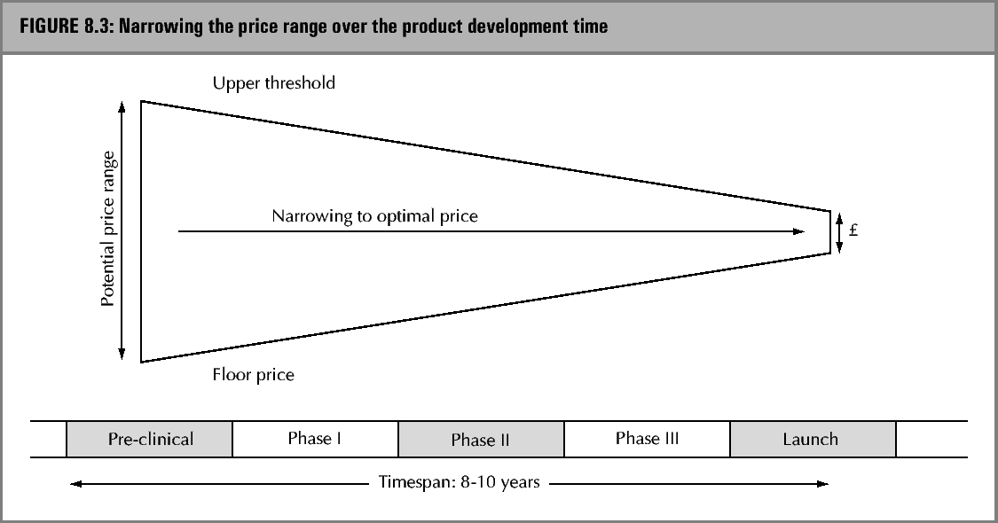
Narrowing the price range in the pharmaceutical industry

Slide 21
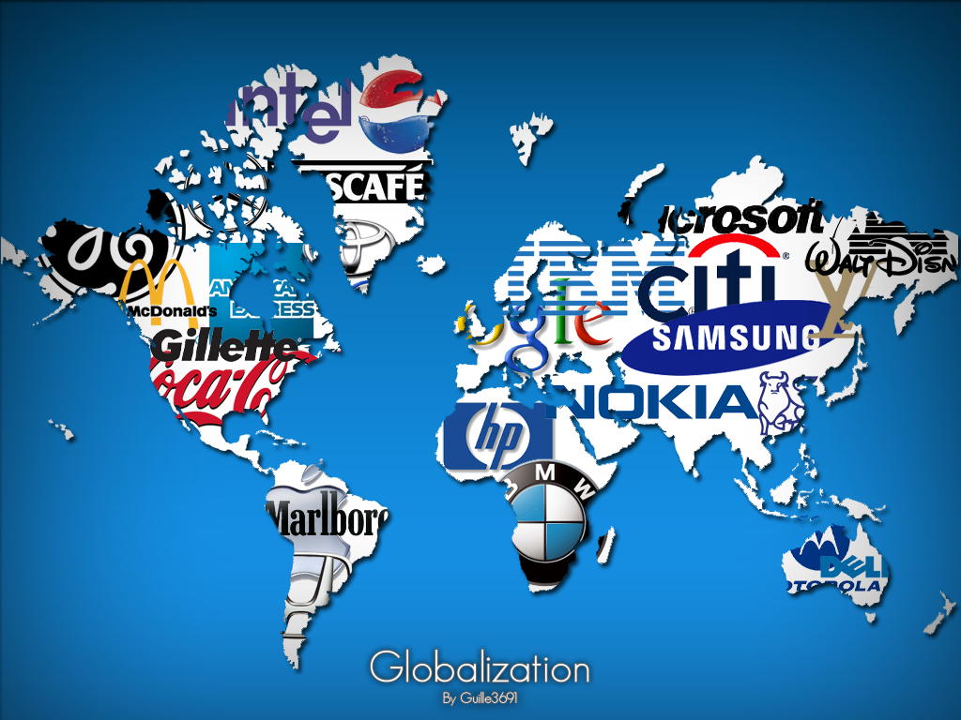
International pricing: Geographic pricing
  Multinationals tend to make pricing decisions close to each market’s prevailing conditions, but the relationship is symbiotic: co-ordination and strategic direction come from headquarters, yet short-term pricing decisions should be made locally.

Slide 22
International pricing: Price escalation
In preparing a quotation, the international marketer must be careful to include unique export-related costs as well as normal costs shared with the domestic side of the business, such as:
  ■ the cost of modifying the product for foreign markets
  ■ operational costs of the export operation (e.g. subsidiary costs) – personnel, market research, additional shipping and insurance costs, communications costs with foreign customers, and overseas promotional costs
  ■ foreign market entry costs – tariffs and taxes, commercial credit and political risks associated with a buyer in a different market, and foreign exchange risks.

Slide 23
Price escalation
The combined effect of clear-cut and hidden costs causes export prices to accelerate. Price escalation can result in different-sized price increased across markets.
Customers who shop around for lower prices, or distributors unhappy about their margins in certain markets, might force a marketer to abandon a market altogether.
International markers combat price escalation through accurate information and creative strategies such as the following methods, which emphasize cutting costs.

Slide 24
Price escalation
Reorganize the channel of distribution: eliminate some distribution levels, However, shortening the value chain might incur other new costs such as new intermediaries’ demands for better discounts.
Adapt the product: use less expensive ingredients or unbundle costly features, remaining features, such as packaging, can also be cheapened. If price escalation causes differentials between markets that customers might discover, alter the product by changing styling and packaging , for example.

Slide 25
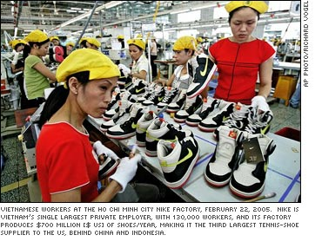
Price escalation
Emphasize non-price benefits: quality, after-sales service, warranties,etc. ( not necessarily price concessions) can add to the value the customer receives, or at least perceives, from your offer.
Assemble or produce the product overseas: through foreign sourcing, the exporter may receive an additional benefit to lower cost-duty drawbacks.

Slide 26
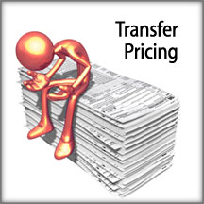
International pricing: Transfer Pricing
  Transfer (intra-corporate) pricing is the pricing of sales to members of the multinational corporate family.
  Transfer pricing must be managed in a world of varying tax rates, foreign exchange rates, governmental regulations, and other economic and social challenges.

Slide 27


Exhibit 8.2 Barbie clothing: a case of brand stretching at high-end prices

Slide 28
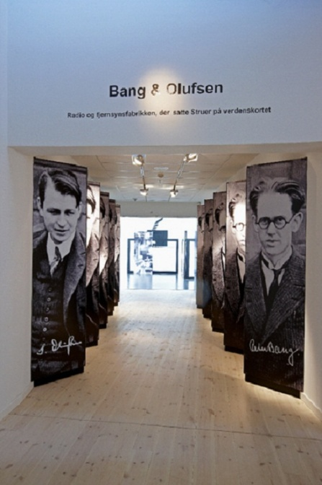
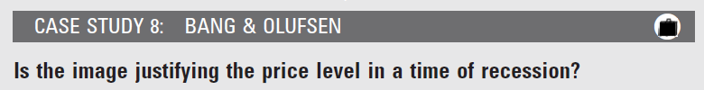
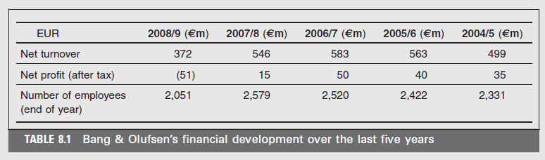

Slide 29



