Slide 1


MK 333/326 International Marketing
ASEAN Trading
By Ajarn Suwalya K.

Slide 2


MK 333/326 Group Assignment 3:
ASEAN
Topic: BEST ASEAN Trade Partner
1. Please research what country in ASEAN will be a successful trading partner with THAILAND. ( 1 slide)
2. Please research what country in ASEAN will be a successful trading partner with your PROJECT COUNTRY ( 1 slide)
3. Please create a total 2 page powerpoint slide explaining your findings why it could be beneficial for both countries. It could be due to many reasons.
4.Assignment Due next week February 11, 2021
Notes:
1

Slide 3
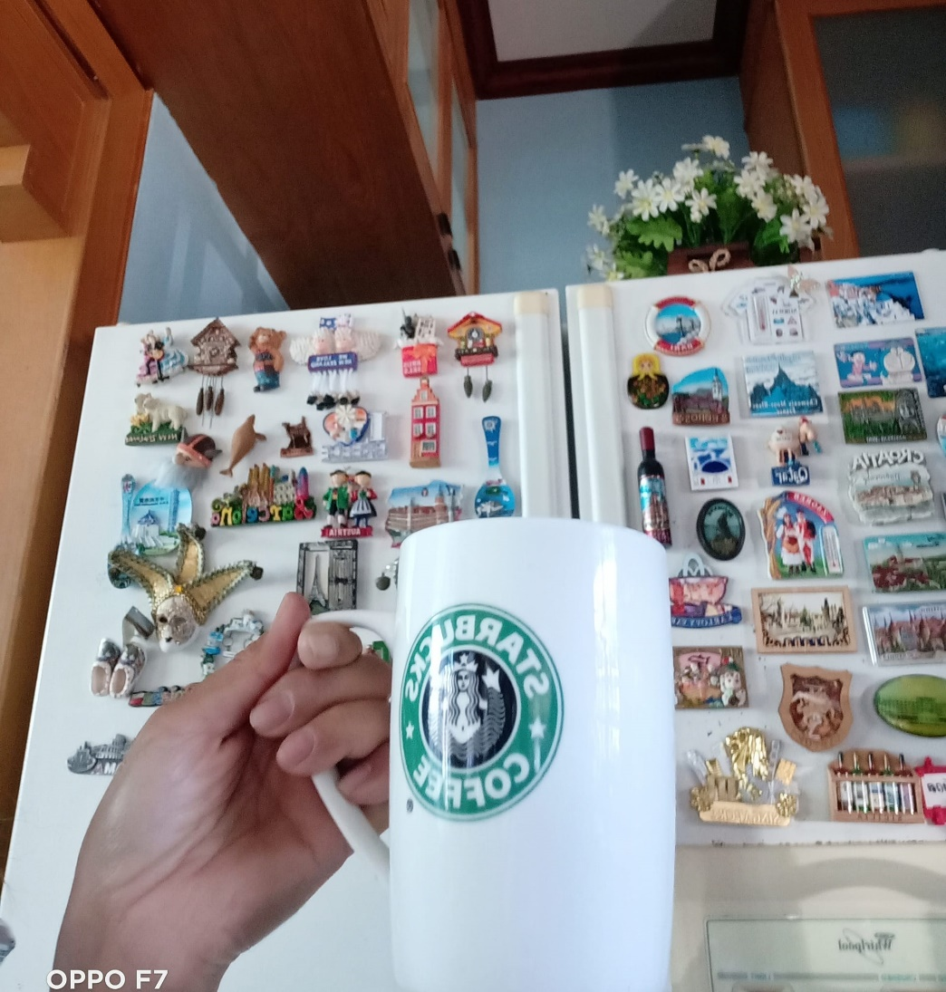
11 Countries for MK 333/326
Sequence
1.Germany
2.India
3.New Zealand
4.Switzerland
5.Spain
6.France
7.Sweden
8.Russia
9.Italy
10.Portugal
11.Canada

Slide 4
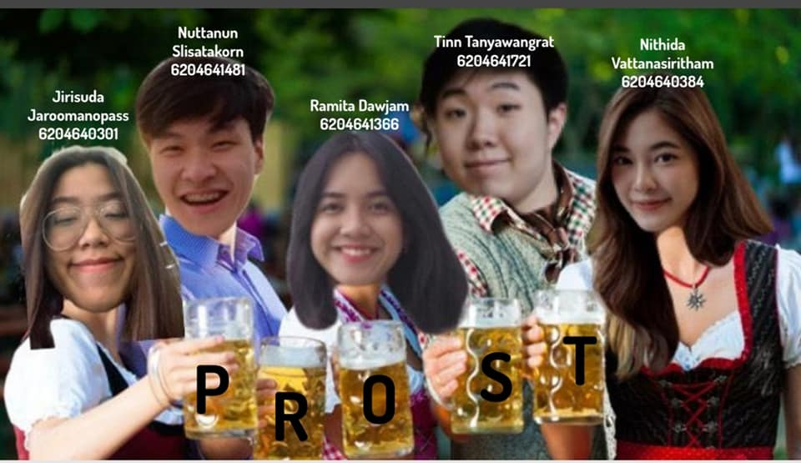
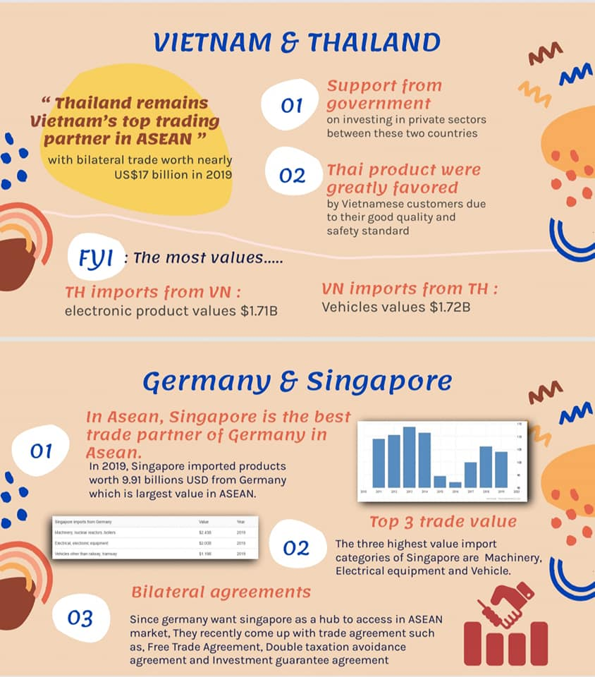
Germany

Slide 5

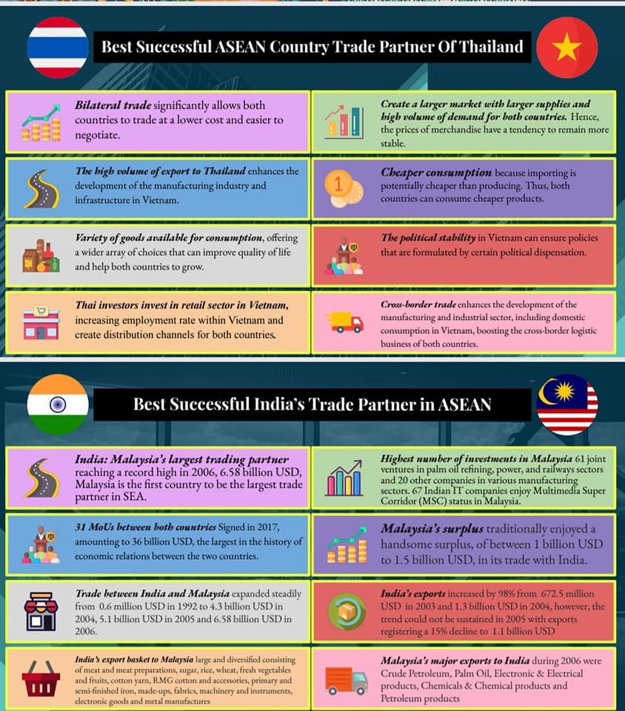
India

Slide 6

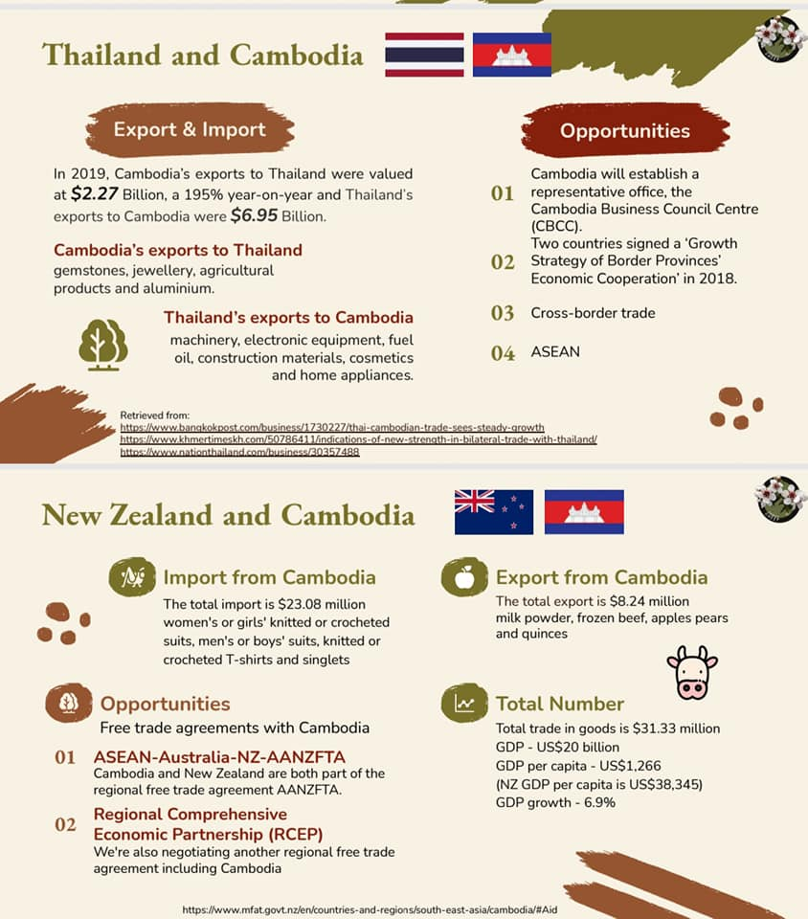
New Zealand

Slide 7

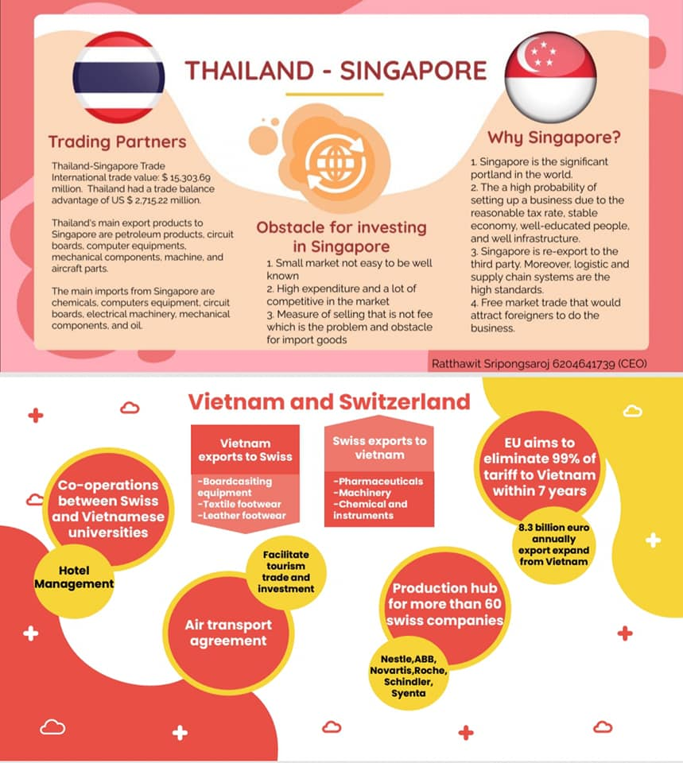
Switzerland

Slide 8
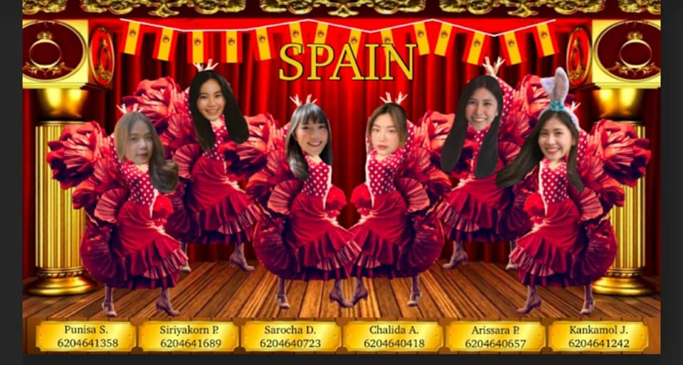
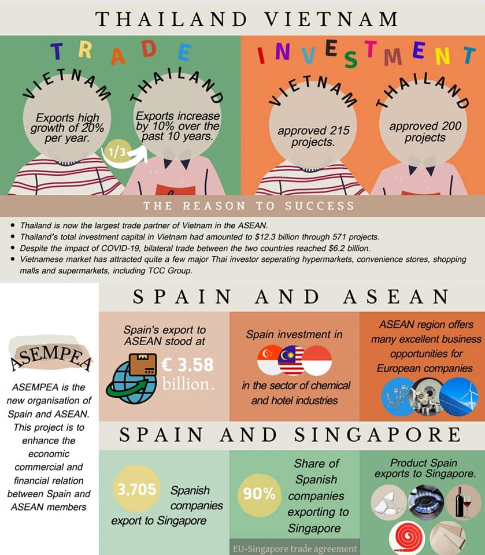
Spain

Slide 9

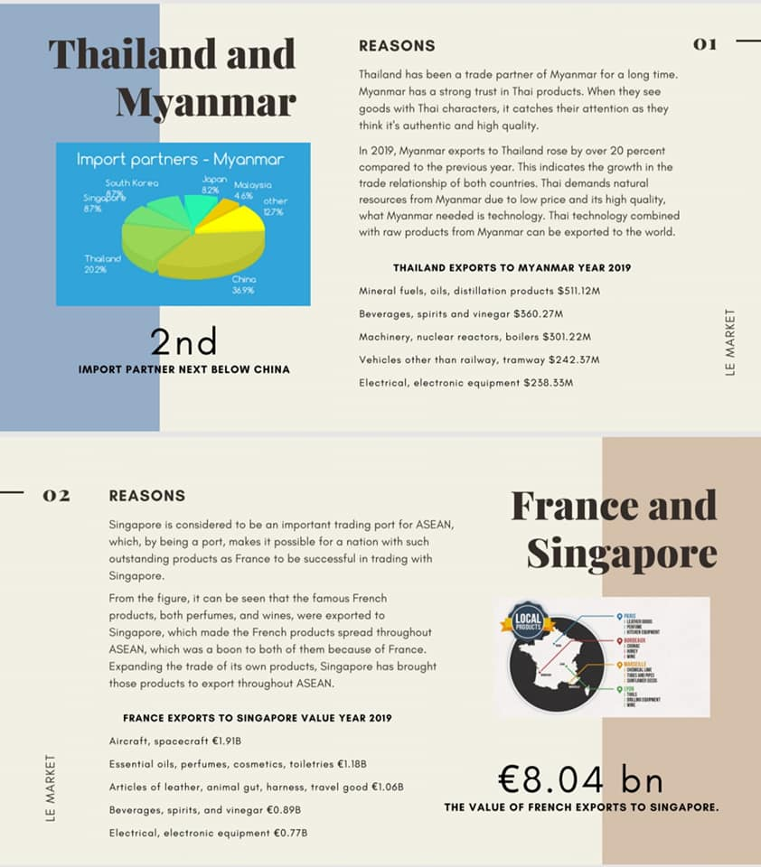
France

Slide 10
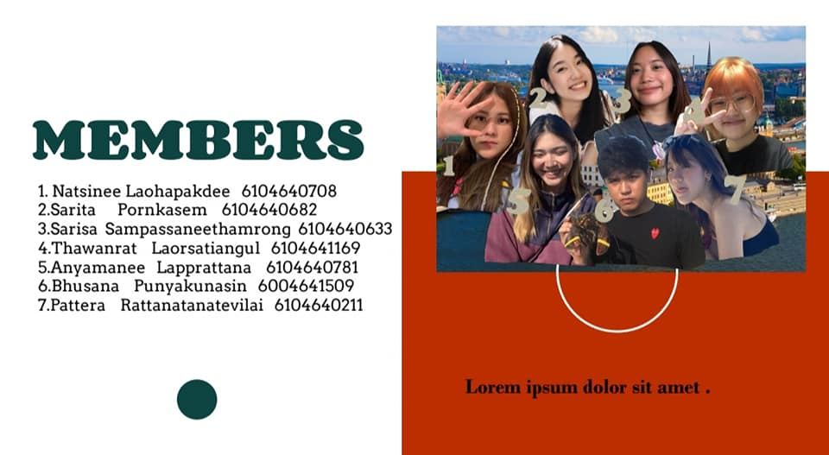
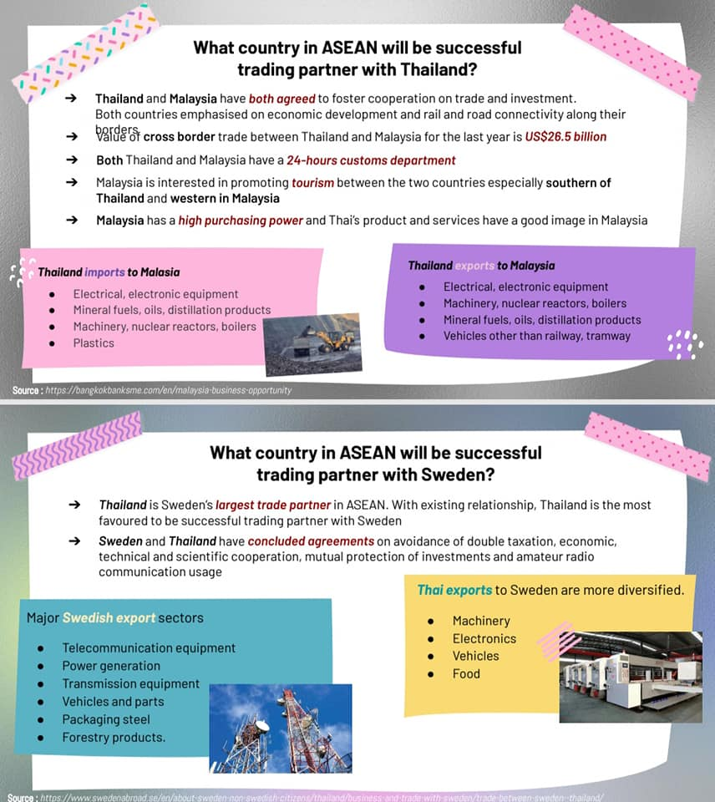
Sweden

Slide 11

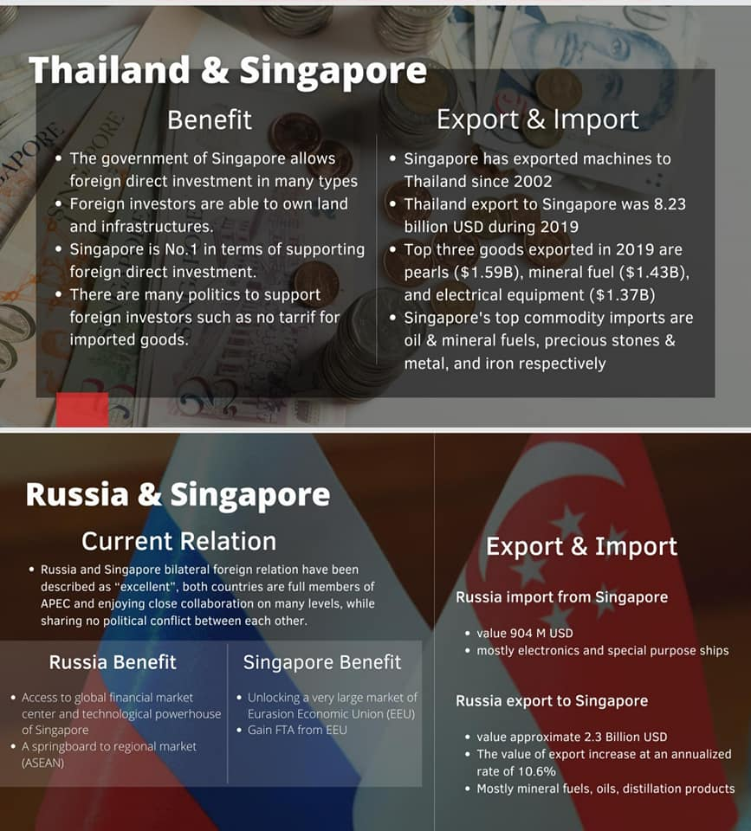
Russia

Slide 12
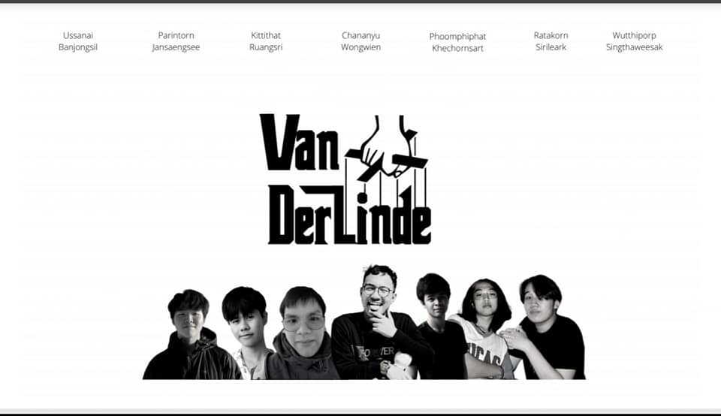
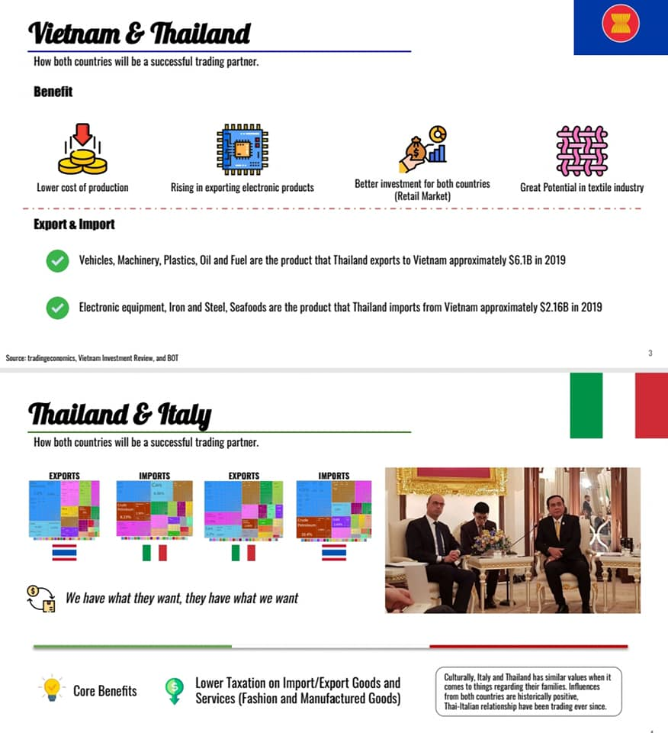
Italy

Slide 13

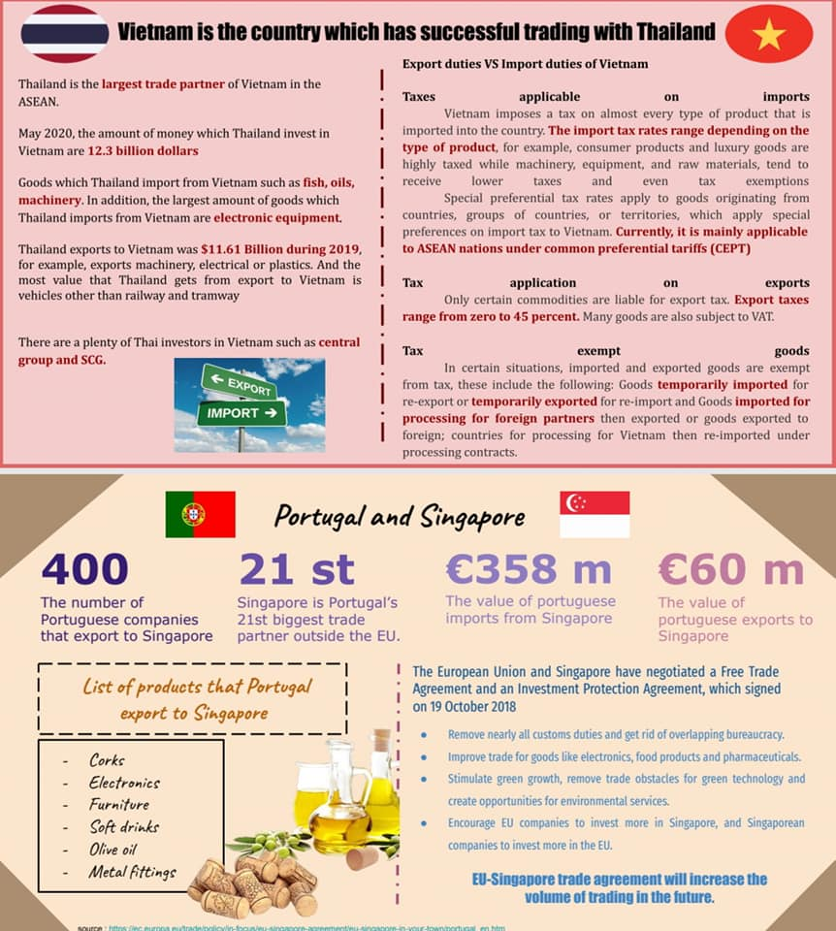
Portugal

Slide 14

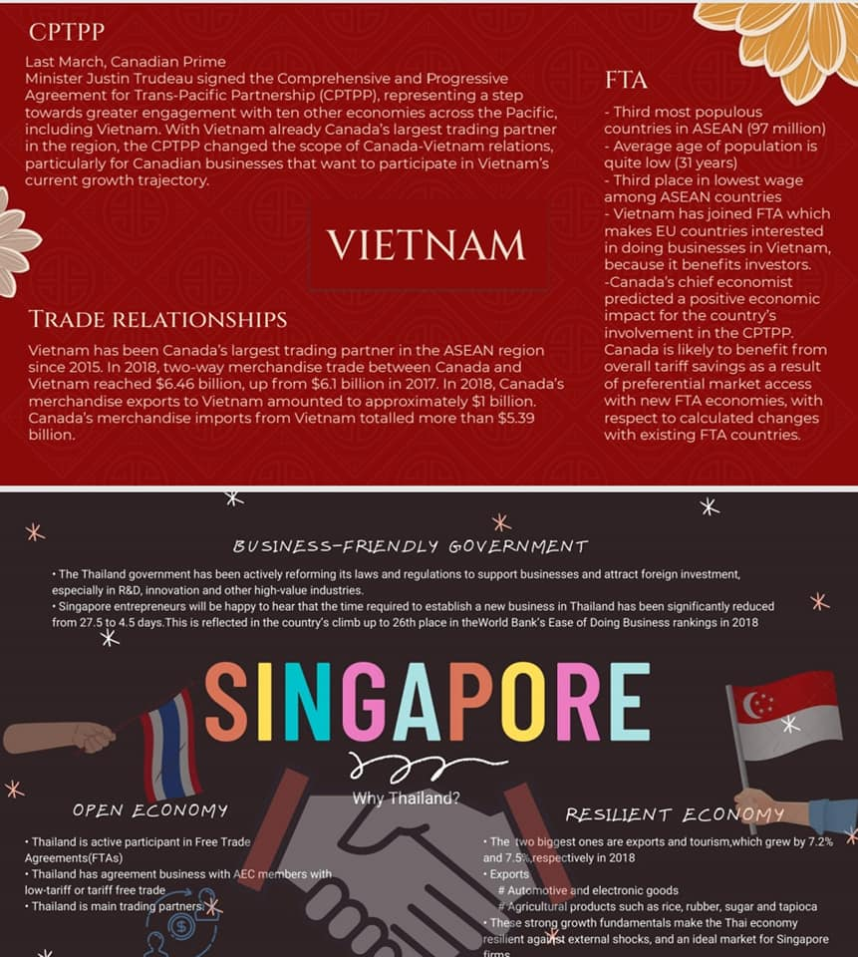
Canada

Slide 15


