Slide 1



BENEFITS
FEATURES
EXAMPLES
CAPITAL MARKET PRODUCTS

Slide 2
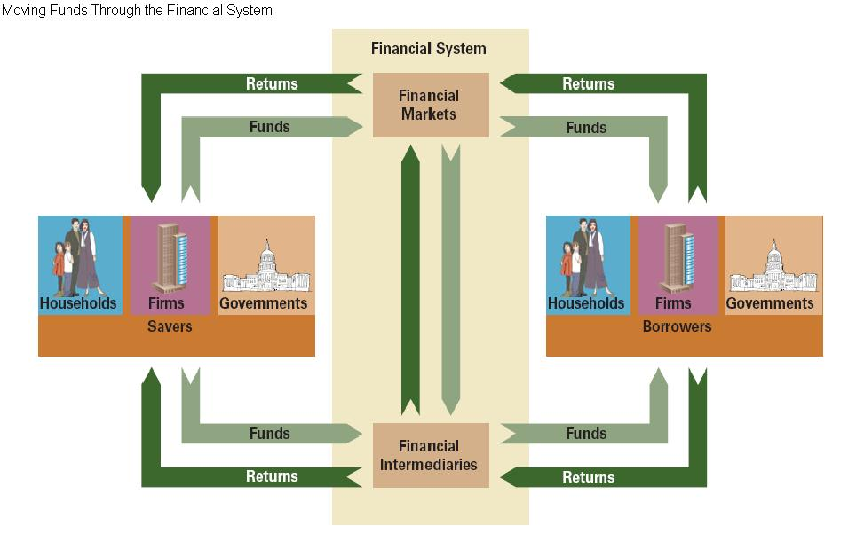
Feature
Feature

Slide 3
Difference between Capital Market and Money Market
 | Capital market | Money market
Duration | Long-term financing typically more than 1 year | Short-term financing typically less than 1 year
Nature of fund | Supplies fund for big project, fixed capital requirement i.e. long term investment | Supplies fund for working capital requirement, day- to day operation
Size of fund | Large | Small
Risk | High | Low
Example | Bond, Equity, Syndicated loan | T-Bill, money, certificated of deposit
Feature
Notes:
ขอจัด layout แบบนี้นะ คิดว่าอ่านง่ายกว่า ไม่ต้องเปลืองสไลด์คุมเวลาได้ดีกว่า

Slide 4
Main Services and Instruments in Capital Market
Investment Banking
Advisory service
Assist client on corporate strategy need Bank provides advisory services based on its wide-ranging financial products and those within its Group on debt restructuring, funding sources, credit rating and planning suitable for industrial competition, interest trend, foreign exchange, internal and external economic conditions
Underwriting
Raise investment capital from investors on behalf of corporations that are issuing either equity or debt securities.
Syndicated Loan Arranging
Syndicated loans can use in case of mega project requires large amount of loan for a single lender or when a project needs a specialized lender with expertise in a specific asset class.
Feature
Notes:
ขอตัด retail ออหเพราะรู้สึกไม่ค่อย relavant และเวลา

Slide 5
Key Difference between Each Instrument
Type | Bond | Equity | Syndication
Characteristic | Loan | Share of company (ownership) | Loan
What lender get | Interest payment and principal at maturity | Dividend payment and Capital gain | Fees Interest
What Borrower get | Capital
Feature
Notes:
อันสุดท้าย capital pk; myh’lk,vyog]pot

Slide 6

Benefits of Investing in Capital Market Product
Borrower’s point of view
Investor’s point of view
Benefit

Slide 7

Borrower’s point of view
No Dilution of Control
No Dilution in Share of Profits
Forecasted interest principal and interest rate obligations
Tax deductible
Less complication
Lower interest rate on large amount
Underwriting
Benefit

Slide 8


Investor’s point of view
Fixed and Stable return
Priority claim
Risk diversification
Providing alternatives
Encourage investor to accumulate savings
Source of income
Capital gain
Collateral
Benefit

Slide 9
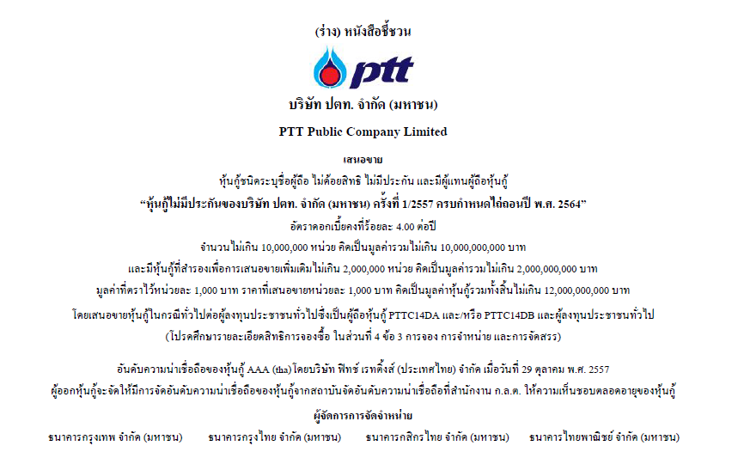
Example: Bank provided corporate bond underwriting services
Registered Bond
Unsubordinated Bond
Unsecured Bond
Maturity in 7 years
Provided by Bangkok Bank, Krungthai Bank, Kasikorn Bank, and Siam commercial Bank
Example

Slide 10

Example
Registered Bond
Unsubordinated Bond
Unsecured Bond
Callable Bond
Maturity in 4 years
Provided by Bangkok Bank, Krungthai Bank, and Siam commercial Bank
Example

Slide 11
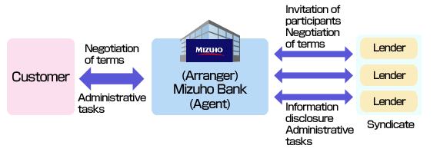
Example: Syndication Loan
Example
Example

Slide 12




Example: Syndication Loan
BlueScope Steel (Thailand) Limited
The Hongkong and Shanghai Banking Corporation Limited, Bangkok Bank Public Company Limited, The Bank of Tokyo, and Mitsubishi UFJ Limited
2,500,000,000 Baht (July 2010)
Example
Example

Slide 13

Bussabawan Sirinupong 5604640176
Nattanont Arunyakananda 5604640705
Itthiched Kriengyuttapoom 5604640358
Anuthida Vattanasiri 5704640076
Nawamin Siritantitham 5604640770
Nutchanun Piyasuwan 5604640887
Tanat Wigromlert 5604641752
Q&A
Notes:
Nattanont

