Slide 1
MEMORY
PY200/ PY211 General Psychology

Slide 2
LOOK AT SOME PICTURES ON THE SCREEN FOR ABOUT 60 SECONDS, WITHOUT ANY DISTRACTIONS. WITH THE INTENTION OF REMEMBERING AS MANY AS YOU CAN.
Notes:
Butterfly, House, Chair, Pencil, Ice-cream, Rainbow, clock, telephone, kite, lock, scissor, computer, guitar, light bulb, airplane, apple, earth, pot plant, hammer, cake

Slide 3
Agenda
Information-Processing Model & Types of Memory
Sensory Register (Sensory Memory)
Short Term Memory (STM) = Working Memory
Long Term Memory (LTM)
Implicit = Non-declarative
Explicit = Declarative
Semantic Memory
Procedural Memory

Slide 4
Memory Processes
Memory: Active system that receives, stores, organizes, alters, and recovers (retrieves) information
Encoding--transforming information into a form that can be entered and retained in the memory system
Storage--retaining information in memory so that it can be used at a later time
Retrieval--recovering information stored in memory so that we are consciously aware of it
Information-processing model describes how information is encoded, organized, and stored in memory, and how it is retrieved from memory.
Notes:
Memory: Process by which we encode, store, and retrieve information
Three system approach to memory
Encoding
Storage
Retrieval

Slide 5
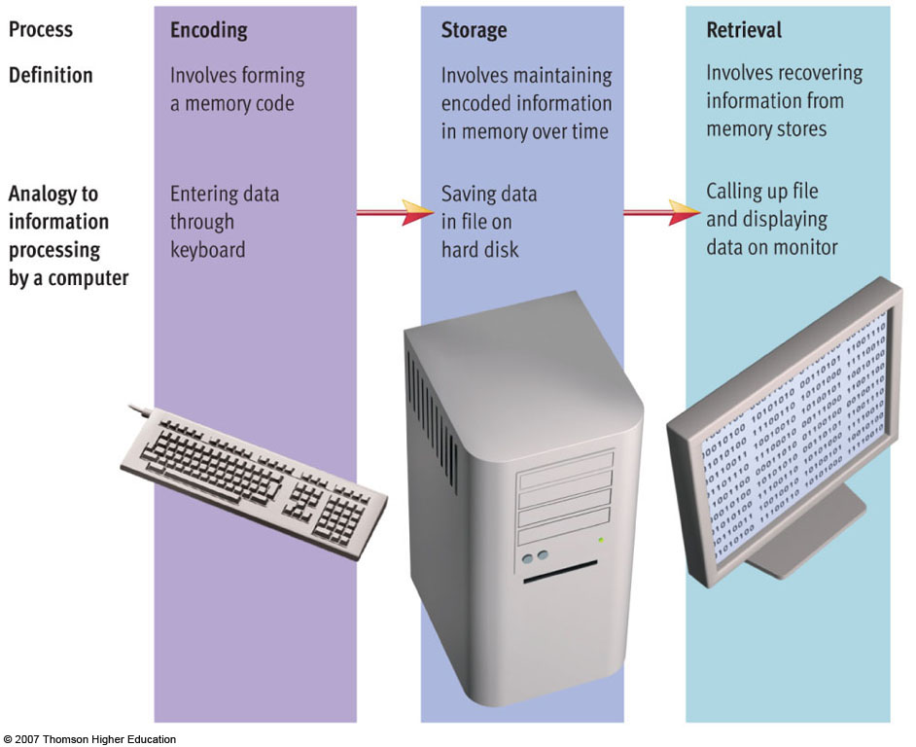

Slide 6
Information-Processing Model
Three memory stores that differ in function, capacity and duration
Maintenance Rehearsal
Sensory
Memory
Working or
Short-term
Memory
Encoding
Long-term
memory
Sensory
Input
Attention
Retrieval
Notes:
Hockenbury slides (Schulman)
Key words: modal model of the mind; stage model of memory; sensory memory; short-term memory; working memory; long-term memory; attention; encoding; maintenance rehearsal; retrieval

Slide 7
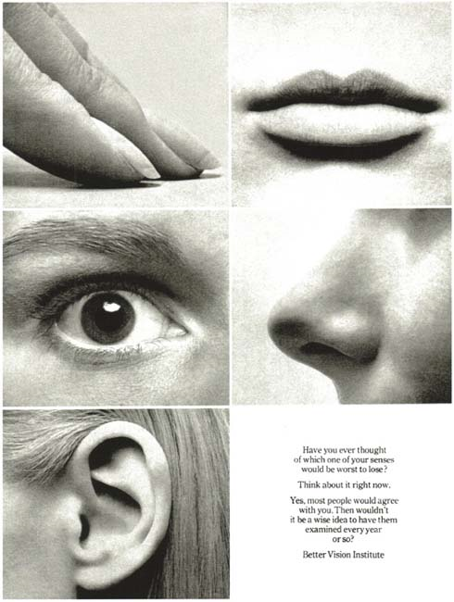
THE SENSORY REGISTERS
the entry points for raw information from all the senses.
If we do not process this information further, it disappears.
Sensory
Memory
Sensory
Input

Slide 8

Visual Registers
As new visual information enters the eyes, information, or visual image is "masked" almost immediately and disappears (0.3 second)
Iconic Memory

Slide 9
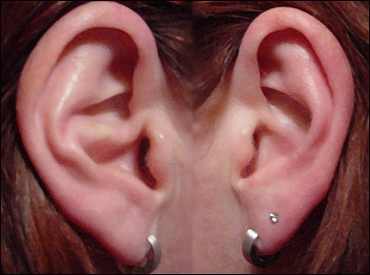
Auditory Registers
Auditory information fades more slowly; the echo may last for several seconds.
Echoic Memory

Slide 10
Initial Processing
From the mass of incoming information, we select elements and hold them for further processing.
In this process, called attention, we also give meaning to the information.
Sensory
Memory
Working or
Short-term
Memory
Sensory
Input
Attention

Slide 11
Short-term memory/ working memory
A memory system that holds information temporarily while actively manipulating and rehearsing that information

Slide 12
Working MEMORY
Information that we attend to enters short-term memory (STM)
STM contains everything that we are consciously aware of at any instant.
Capacity—limited (holds 7+/-2 items)
STM only briefly stores information (about 30 seconds)
Mental or verbal repetition of information allows information to remain in working memory longer than the usual 30 seconds
Maintenance Rehearsal
Sensory
Memory
Working or
Short-term
Memory
Sensory
Input
Attention

Slide 13
Capacity of WM
STM has limits.
Researches have found that STM can hold only as much information as can be repeated or rehearsed in 1.5 to 2 seconds, which is usually 5 to 10 separate bits of information.
We can process more information by grouping it into larger meaningful units, a process called chunking.

Slide 14
Retention and Retrieval in WM
Material in STM disappears in 15 to 30 seconds unless it is rehearsed or practiced.
Memory loss from STM is permanent.
This prevents us from becoming overwhelmed with a mass of irrelevant, trivial, or unrelated data.

Slide 15
Chunking
Try and remember the following string of letters (in order):
XCI AFB IVC RDN AIB MQZ

Slide 16
Chunking
Grouping small bits of information into larger units of information
  expands working memory load
Which is easier to remember?
  4 8 3 7 9 2 5 1 6
  483 792 516
Notes:
Key words: modal model of the mind; stage model of memory; short-term memory; working memory; chunking

Slide 17
Working Memory
A memory system that holds information temporarily while actively manipulating and rehearsing that information
  WM is thought to contain a Central executive processor - Involved in reasoning and decision making
  Coordinates 3 distinct storage-and-rehearsal system
    Visual store
    Verbal store
    Episodic buffer
  Uses a significant amount of cognitive resources during its operation
  Stress can reduce its effectiveness

Slide 18
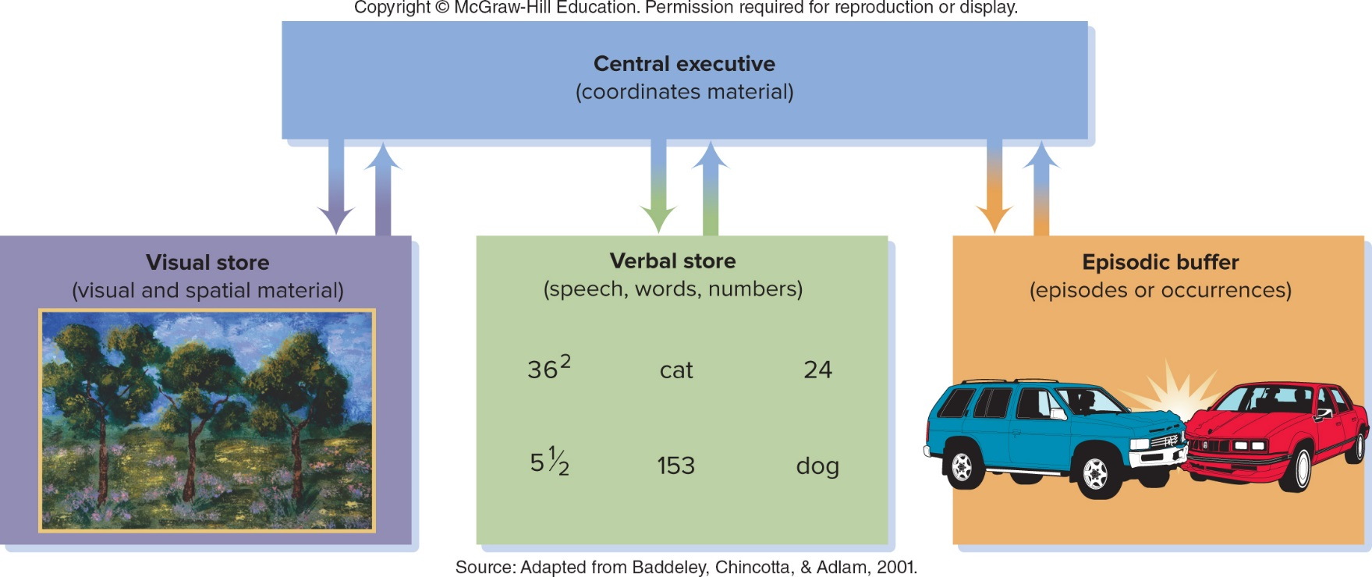

Slide 19
Long-Term Memory
Once information passes from sensory to working memory, it can be encoded into long-term memory
Function—organizes and stores information
Unlimited capacity
Duration—thought by some to be permanent
Maintenance Rehearsal
Sensory
Memory
Working or
Short-term
Memory
Encoding
Long-term
memory
Sensory
Input
Attention
Retrieval
Notes:
Hockenbury slides (Schulman)
Key words: modal model of the mind; stage model of memory; long-term memory; working memory; short-term memory; encoding; retrieval

Slide 20
Long-Term Memory
Encoding—process that controls movement from working to long-term memory store
Retrieval—process that controls flow of information from long-term to working memory store
Maintenance Rehearsal
Elaborative Rehearsal
Sensory
Memory
Working or
Short-term
Memory
Encoding
Long-term
memory
Sensory
Input
Attention
Retrieval
Notes:
Hockenbury slides (Schulman)
Key words: modal model of the mind; stage model of memory; long-term memory; working memory; short-term memory; encoding; retrieval

Slide 21
WM → LTM
Rote Rehearsal (Maintenance Rehearsal)
  we retain information in STM for a minute or two by repeating it over and over again.
  However, rote memorization does not promote long-term memory.
Elaborative Rehearsal
  Is the linking of new information in STM to familiar material stored in long-term memory.
  This enables us to keep information for a longer time in STM.
  Elaborative rehearsal processes new data in a deeper and more meaningful way than through simple rote repetition.
Notes:
Encoding: prior knowledge help/ Depth of knowledge

Slide 22
Mnemonics
Mnemonics are formal strategies and tricks for encoding, storing, and retaining information.
Mnemonics aim to translate information into a form that the human brain can retain better than its original form.
Mnemonics can be helpful by:
  Reducing the amount of information via chunking.
  Making material easier to store by making it more meaningful.
  Making facts more "memorable."
    Example: weaving the parts of the digestive system into a story.
Mnemonics are not especially useful for ordinary tasks.
  Easier to write your grocery list than try to memorize it.

Slide 23
Mnemonics
Acronyms – first letter method.
  Openness, Consciensciousness, Extraversion, Agreeableness, Neuroticism: OCEAN
  Red, Orange, Yellow, Green, Blue, Indigo, Violet: Roy G. Biv
Ohel is the Hebrew word for tent →"Oh hell, there's a bear in my tent"

Slide 24
Serial Position
Primacy Effect
Recall %
Serial Position of word
Notes:
Serial position effect is the tendency of a person to recall the first and last items in a series best, and the middle items worst.^{[1]} The term was coined by Hermann Ebbinghaus through studies he performed on himself, refers to the finding that recall accuracy varies as a function of an item's position within a study list.^{[2]} When asked to recall a list of items in any order (free recall), people tend to begin recall with the end of the list, recalling those items best (the recency effect). Among earlier list items, the first few items are recalled more frequently than the middle items (the primacy effect).^{[3][4]}
One suggested reason for the primacy effect is that the initial items presented are most effectively stored in long-term memorybecause of the greater amount of processing devoted to them. (The first list item can be rehearsed by itself; the second must be rehearsed along with the first, the third along with the first and second, and so on.) The primacy effect is reduced when items are presented quickly and is enhanced when presented slowly (factors that reduce and enhance processing of each item and thus permanent storage). Longer presentation lists have been found to reduce the primacy effect

Slide 25
Serial Position
Recency Effect
Recall %
Serial Position of word
Notes:
One theorized reason for the recency effect is that these items are still present in working memory when recall is solicited. Items that benefit from neither (the middle items) are recalled most poorly. An additional explanation for the recency effect is related to temporal context: if tested immediately after rehearsal, the current temporal context can serve as a retrieval cue, which would predict more recent items to have a higher likelihood of recall than items that were studied in a different temporal context (earlier in the list).^{[5]} The recency effect is reduced when an interfering task is given. Intervening tasks involve working memory, as the distractor activity, if exceeding 15 to 30 seconds in duration, can cancel out the recency effect.^{[6]} Additionally, if recall comes immediately after test, the recency effect is consistent regardless of the length of the studied list,^{[4]} or presentation rate.^{[7]}
Amnesiacs with poor ability to form permanent long-term memories do not show a primacy effect, but do show a recency effect if recall comes immediately after study.^{[8]} People with Alzheimer's Disease exhibit a reduced primacy effect but do not produce a recency effect in recall.

Slide 26
False Memory
psychologists have found that our recollection of everyday events may not be as dependable as we would believe.
Moreover, even once information has been committed to memory, it can be altered.
Our recollection of memories can be manipulated and even entire sets of events can be created

Slide 27
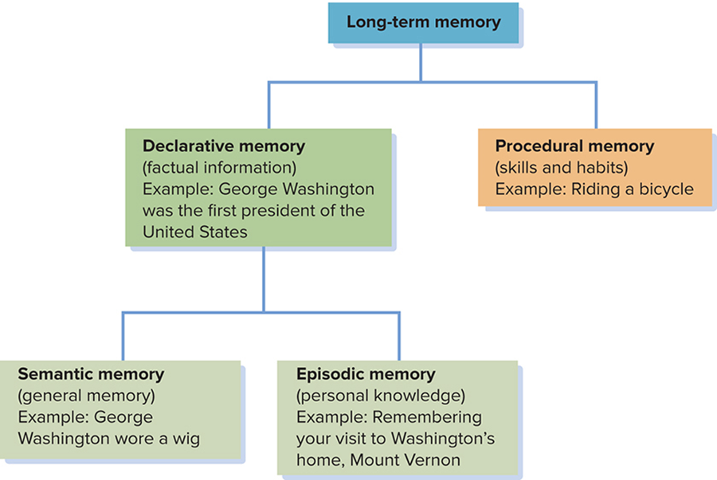
LONG-TERM MEMORY
Long-term memory (LTM) is permanent and stores everything we "know."

Slide 28
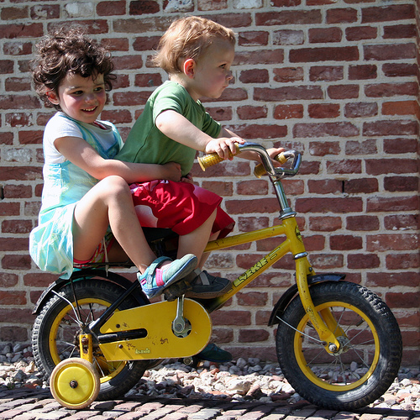
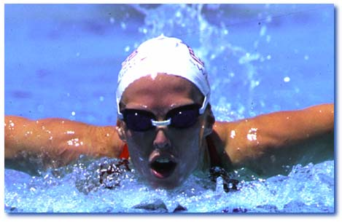
LONG-TERM MEMORY
Implicit Memory refers to memories for information that either was not intentionally committed to LTM or is retrieved unintentionally from LTM.
Procedural Memory
Notes:
Implicit 1) difficult to convey to others 2) may be acquired without awareness 3) require several repetitions
Explicit – 1) easy to communicate 2) learned in a single experience 3) consciously accessible

Slide 29
Long term memory
By contrast, explicit memory allows us to recall information that is intentionally committed to LTM and retrieved from LTM.
Declarative memory
It is divided into
  semantic memory and
  episodic memory

Slide 30
Long Term Memory
Semantic memory is the portion of LTM that stores general facts and information in dictionary or encyclopedia form.
  What is the capitol of Laos?
  How many tires on a car?
  What is a cloud?
  What color is a banana?
Episodic memory, stores information rich with personal meaning.
  Your first kiss; A fight you had; a car accident.

Slide 31
Semantic Networks
Why can we recall detailed information from LTM
The associations we build between different pieces of information
Knowledge is stored in ‘semantic networks’ – mental representations of clusters of interconnected information.
Activating one memory triggers the activation of related memories in a process known as spreading activation.

Slide 32
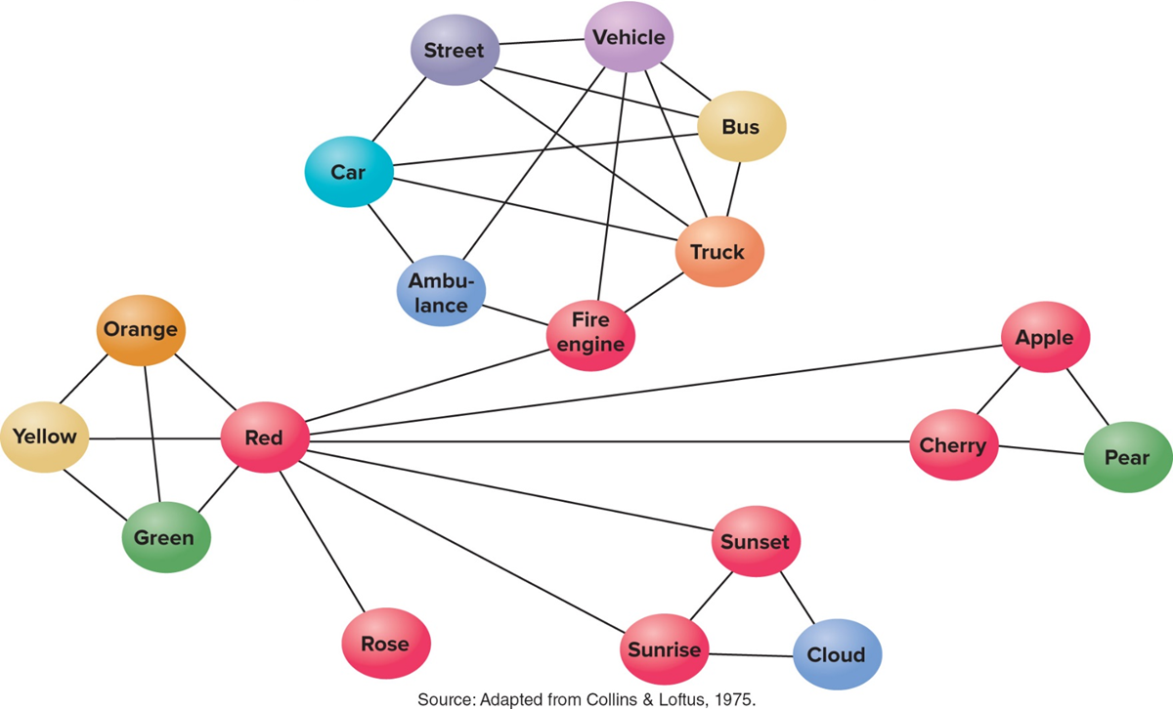
Semantic Networks

Slide 33
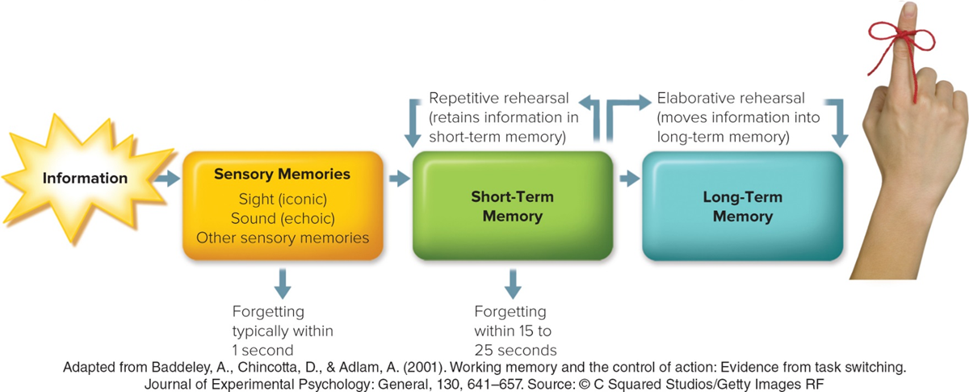

Slide 34
TYPES OF MEMORY
Sensory
Memory
Short-term
(Secondary,
Working)
Long-term
(Primary)
Explicit or
Declarative
(knowing what)
Implicit or Procedural
(knowing how)
Episodic
Semantic
Notes:
Declarative: memories that you are consciously aware of and can communicate flexiblt, can be learned quickly
Nondeclarative – memories for habits skills and procedures not flexible and often unconscious requires sunstantial practice
Episodic – autobiographical memories of yur own life
Semantic memories of facts and general knowledge

Slide 35
The Neuroscience of Memory
The hippocampus, a part of the brain’s limbic system, helps to consolidate memories, stabilizing them after they are initially acquired. That information is subsequently passed along to the cerebral cortex of the brain, where it is actually stored.
The amygdala, another part of the limbic system, also plays an important role in memory. The amygdala is especially involved with memories involving emotion

Slide 36
The Neuroscience of Memory
Long-term potentiation shows that certain neural pathways become easily excited while a new response is being learned.
At the same time, the number of synapses between neurons increases as the dendrites branch out to receive messages.
These changes reflect a process called consolidation, in which memories become fixed and stable in long-term memory.
Long-term memories take some time to stabilize; this explains why events and other stimuli are not suddenly fixed in memory.
Consolidation may continue for days and even years.
Memory traces are distributed throughout the brain.

Slide 37
Recalling
Long-term Memory

Slide 38
Retrieval of Memory
A retrieval cue: a stimulus that allows us to recall more easily information that is in long-term memory. It may be a word, an emotion, or a sound; whatever the specific cue, a memory will suddenly come to mind when the retrieval cue is present
Recall: Specific piece of information must be retrieved
Recognition: Occurs when one is presented with a stimulus and asked whether he/she has been exposed to it previously, or is asked to identify it from a list of alternatives

Slide 39
Godden & Beddely, 1975
Participants learned 2 lists of 40 words
  One list learned on land
  One list learned underwater (during scuba)
Tested
  Same context land list tested on land/ scuba list on scuba
  Different context: land listed on scuba/ scuba list on land
Results
Same context group performed significantly better
Retrieval works best when conditions are similar to encoding conditions.

Slide 40
Retrieval of Memory
Context-dependent memory – we retrieve info better in the context in which it was encoded. Cues from the environment enhance recall: *especially odors. E.g. police go to the scene of the crime with the witness. Swimmer experiment
The surrounding environment can be used as a cue for memory
State-dependent memory – we retrieve info better when we are in the same mood. Happy/sad. Drunk/sober. Excited/calm.
Notes:
Forgetting/ interference/ misattribution/ false memory

Slide 41
Retrieval of Memory
In which way the material is first perceived
Level-of-processing theory
The degree to which new information is mentally analysed
The amount of information processing that occurs when material is initially encountered is central in determining how much the information is ultimately remembered
the depth of information processing during exposure to material – the greater the intensity of its initial processing – the more likely we are to remember it

Slide 42
Level-of-processing theory
At shallow levels, information is processed merely in terms of its physical and sensory aspects
At the deepest level of processing, information is analysed in terms of its meaning

Slide 43
Why do we Forget information

Slide 44
Forgetting
Memory failure is also essential to remembering important information.
The ability to forget inconsequential details about experiences, people, and objects helps us avoid being burdened and distracted by trivial stores of meaningless data.
Forgetting helps keep unwanted and unnecessary information from interfering with retrieving information that is wanted and necessary.
Forgetting also permits us to form general impressions and recollections

Slide 45
Why We forget
Failure of encoding
  Did not pay attention to material
Failures of memory
  Decay: Loss of information through nonuse. Fade or disintegration of memory traces
Interference
  Information in memory disrupts the recall of other information
Cue-dependent forgetting
  Occurs when there are insufficient retrieval cues to rekindle information that is in memory

Slide 46
Retrieval of Memory
Retroactive Interference
  New replaces old
  Material that was learned later disrupts the retrieval of information that was learned earlier
Proactive Interference
  Old replaces new
  Information learned earlier disrupts the recall of newer material
Notes:
1. I have trouble recalling my old phone number, because I get it mixed up with my new number.
2. A student understood a concept last week but can no longer discuss the concept correctly, because he confuses it with other concepts studied since that time.
Psychology → sociology
Call your ex name
carpark

Slide 47
Memory Dysfunctions
Alzheimer’s disease
a progressive brain disorder that leads to a gradual and irreversible decline in cognitive abilities.
In the beginning, Alzheimer’s symptoms appear as simple forgetfulness of things such as appointments and birthdays.
As the disease progresses, memory loss becomes more profound, and even the simplest tasks—such as using a telephone—are forgotten.

Slide 48
Memory Dysfunctions
Amnesia
  Memory loss that occurs without other mental difficulties
Retrograde amnesia
  memory is lost for occurrences prior to a certain event, but not for new events
Anterograde amnesia
  memory is lost for events that follow an injury

Slide 49


