Slide 1

Vision
MK 341: Special Topics in Marketing 1
Marketing Leadership Development and Cross-cultural Management
By Ajarn Suwalya K.

Slide 2
What we plan to achieve?
Self- Awareness- Who am I?
Activities
Mission
Vision
Vision Statement Analysis
How to create a winning vision
Motivation
Individual Assignment
Project Update 2

Slide 3
Self –Awareness- Who am I?
Realistic Assessment of your own abilities
What you are good at
Your deficiencies
Your success
Your mistakes
Your motivations
Your preferences
Your attitudes
Your effect on others
The learning gaps you need to fill

Slide 4

Self –Awareness- Who am I?
Iceberg Model

Slide 5
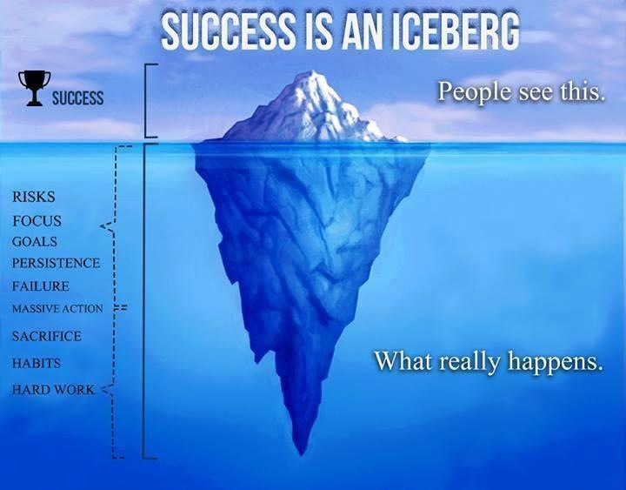
Self –Awareness- Who am I?
Iceberg Model

Slide 6
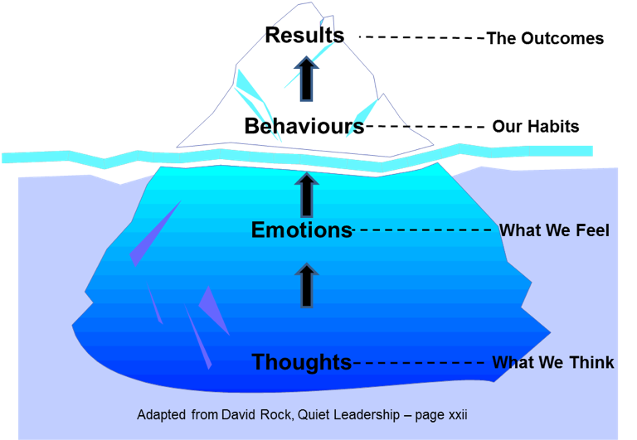
Self –Awareness- Who am I?
Iceberg Model

Slide 7



Exercise 1: Self Awareness
Photo Swap

Slide 8
What is a Mission Statement?

Slide 9
Definition of Mission Statement
A mission statement is a short statement of an organization's purpose, identifying the goal of its operations: what kind of product or service it provides, its primary customers or market, and its geographical region of operation.

Slide 10

Mission Statement Example

Slide 11


Mission Statement Example

Slide 12

Mission Statement Example

Slide 13

TV advertising has vast reach.Microsoft's inspiring Super Bowl XLVIII ad, "Empowering" – about how technology improves our lives- Drew 100+ million TV viewers and triggered millions of online views and shares.

Slide 14
What is a Vision?

Slide 15
Definition of Vision
vision definition: 1. an idea or mental image of something: 2. an experience in which you see things that do not exist physically, when your mind is affected powerfully by something such as deep religious ...

Slide 16
Definition of Vision Statement
"A vision statement is "An aspirational description of what an organisation would like to achieve or accomplish in the mid-term or long-term future. It is intended to serve as a clear guide for choosing current and future courses of action." ... clear: defines a prime goal.

Slide 17
Definition of Vision Statement
Some leaders find it helps to establish a vision statement or even a visual representation to describe their ultimate end-state desire.
The best vision statements for organizations are short, snappy, and 'Twitter friendly'- they condense a lot of information into an inspiring, memorable and clear declaration that can be quickly understood by most people.

Slide 18

Vision Statement Examples
To be Earth's most customer centric company; to build a place where people can come to find and discover anything they might want to buy online

Slide 19


Slide 20

Vision Statement Examples
At IKEA our vision is to create better everyday life for many people

Slide 21


Slide 22
Exercise 2: Find Vision Statements
Starbucks
Apple
Samsung
Alibaba
AIS
Thai Life Insurance

Slide 23
Exercise 2: Vision Statements Analysis
Vision Statements for
Discuss
How are the visions aligned with their business?
How are they driving growth for the company?
What happens if the visions change, exemplify?
Starbucks
Apple
Samsung
Alibaba
AIS
Thai Life Insurance

Slide 24
Difference between a vision statement and a mission statement
A mission statement answers questions like:
Why does my/our business exist?
What is my/our work?
While a vision statement answers the questions:
Where do I see my business going?
What do I/we intend to do?

Slide 25
Motivation: the 'motive' to act
Inspiration and Motivation are not the same.
Your inspiration is the internal pull that keeps you in line with the future you want
Motivation is the everyday push to psych yourself up and do what's needed to be done to make tantalizing dream happen.

Slide 26
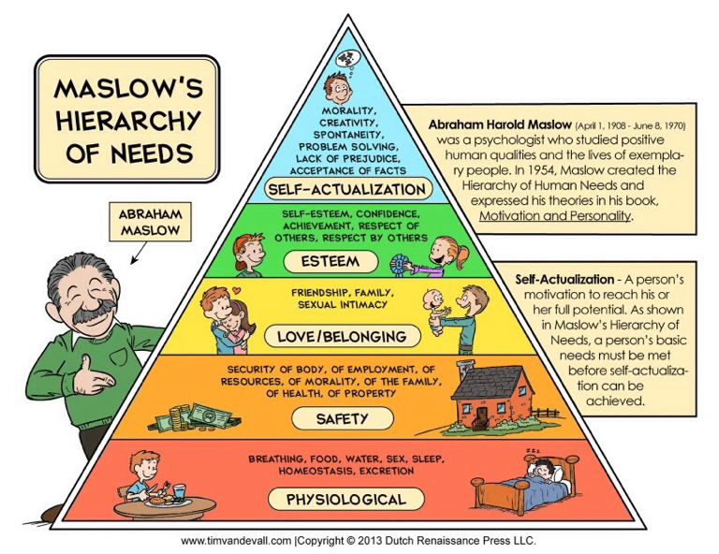
Climbing up Maslow's Pyramid

Slide 27
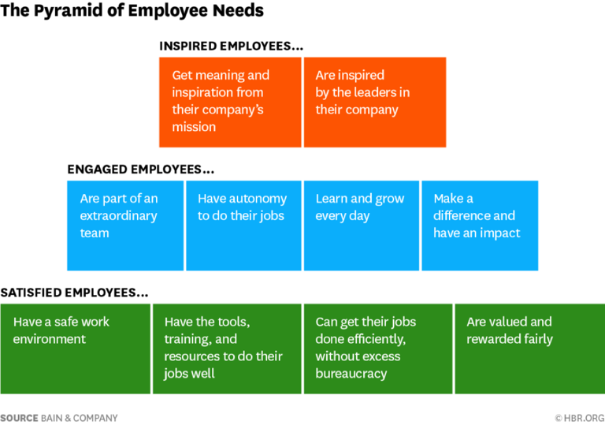

Slide 28
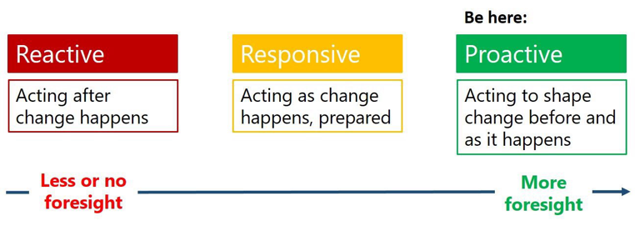
Proactive vs. Reactive Leadership

Slide 29
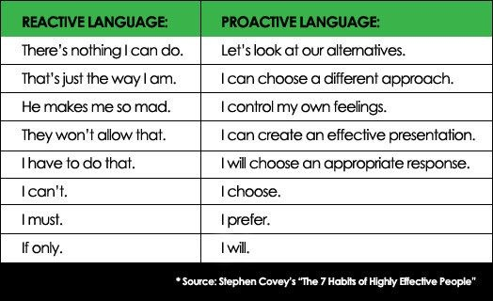
Proactive vs. Reactive Leadership

Slide 30

The Rose by Ajarn Suwalya

Slide 31
Individual Assignment
Dear Diary…
Each student is required to submit the following by writing all the below in your diary:
Mission Statement
Vision Statement
Proactive and Reactive: analysis from your chosen marketing leader (from report)
Four worksheets in next slides
Sharing in next Session

Slide 32
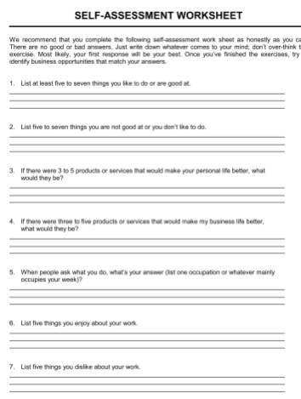
Individual Assignment
Dear Diary…

Slide 33
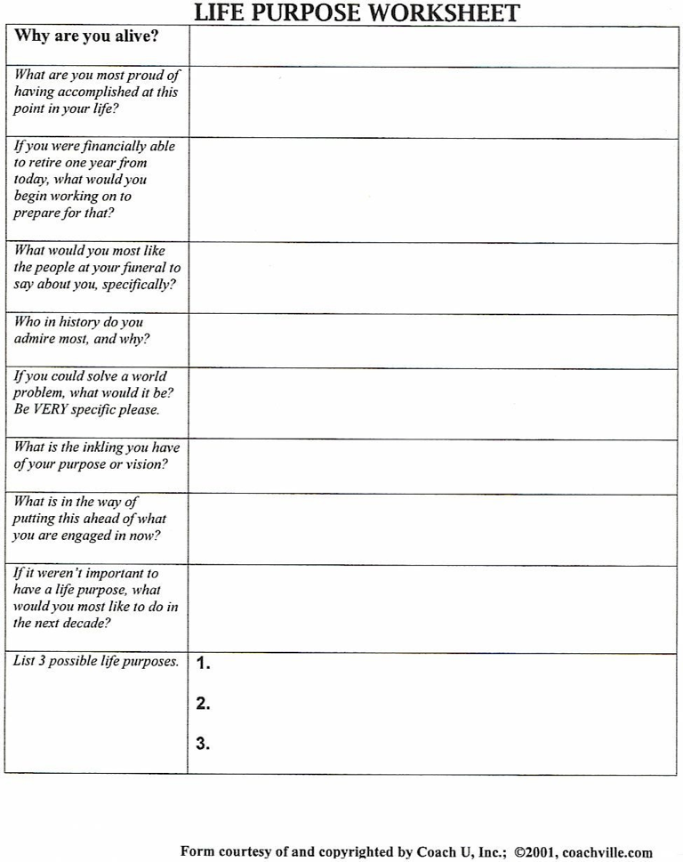
Individual Assignment
Dear Diary…

Slide 34
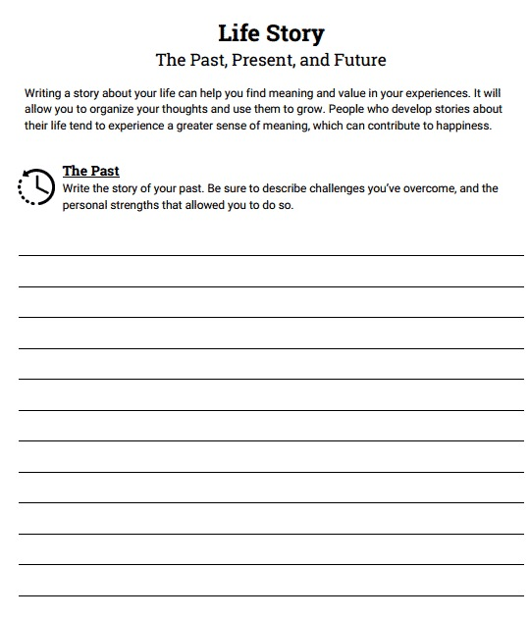
Individual Assignment
Dear Diary…

Slide 35
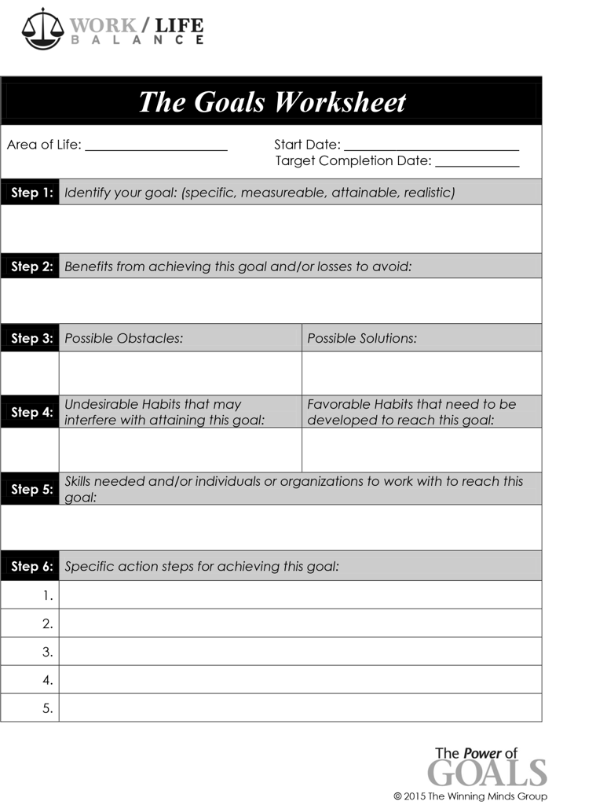
Individual Assignment
Dear Diary…

Slide 36

Exercise 1: Self Awareness
Diary

Slide 37

Project Update 2
Progress Update
Share any concerns/help
Direction
Feedback

Slide 38
What we accomplished
Self- Awareness- Who am I?
Activities
Mission
Vision
Vision Statement Analysis
How to create a winning vision
Motivation
Individual Assignment
Project Update 2

Slide 39


