Slide 1
HEALTHCARE INDUSTRY
Pawin Siriprapanukul

Slide 2

The world around us
Section 1:

Slide 3
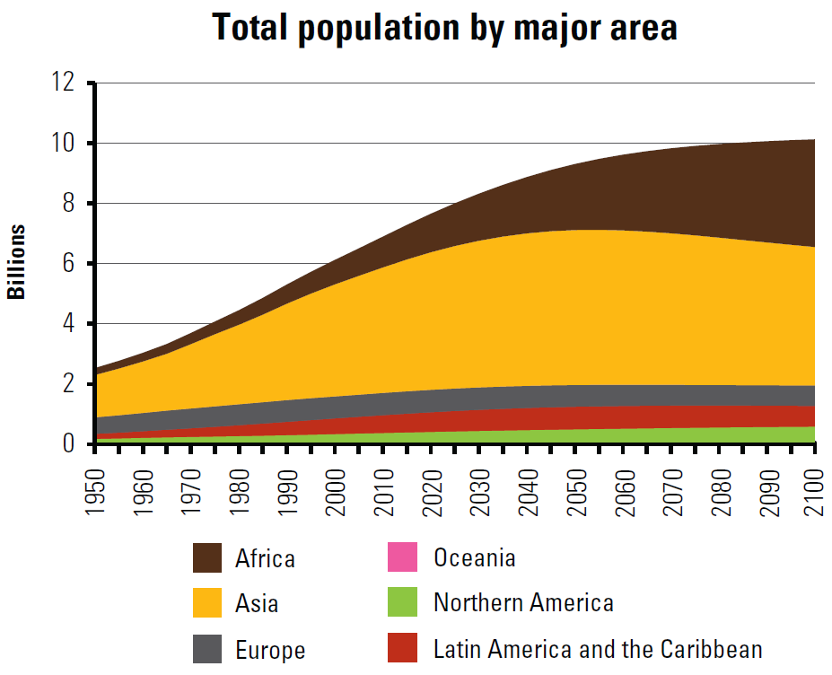
World Population Prospects 2010
Source: United Nations, Department of Economic and Social Affairs, Population Division (2011): World Population Prospects, the 2010 Revision. New York

Slide 4
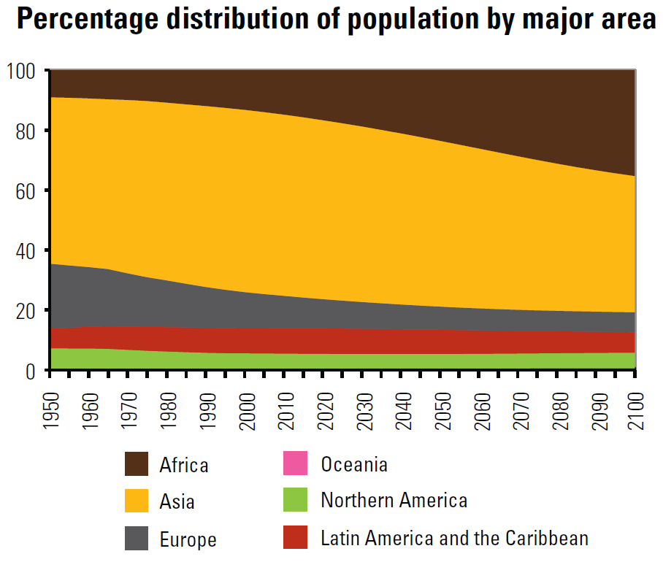
Source: United Nations, Department of Economic and Social Affairs, Population Division (2011): World Population Prospects, the 2010 Revision. New York

Slide 5
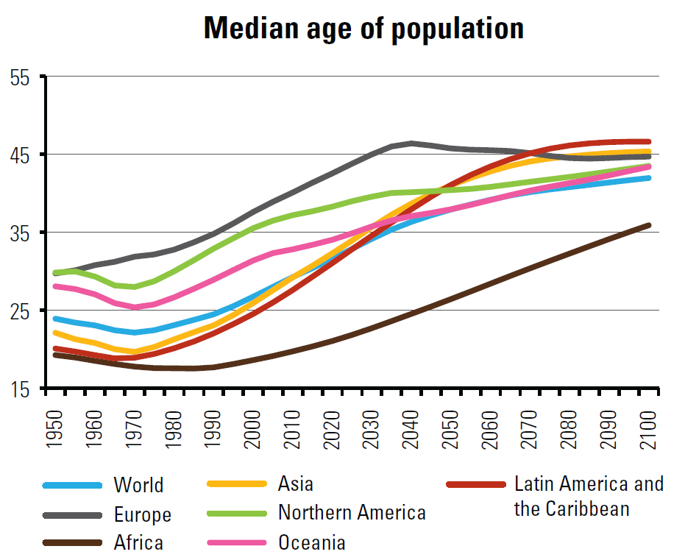
An Ageing World
Source: United Nations, Department of Economic and Social Affairs, Population Division (2011): World Population Prospects, the 2010 Revision. New York

Slide 6
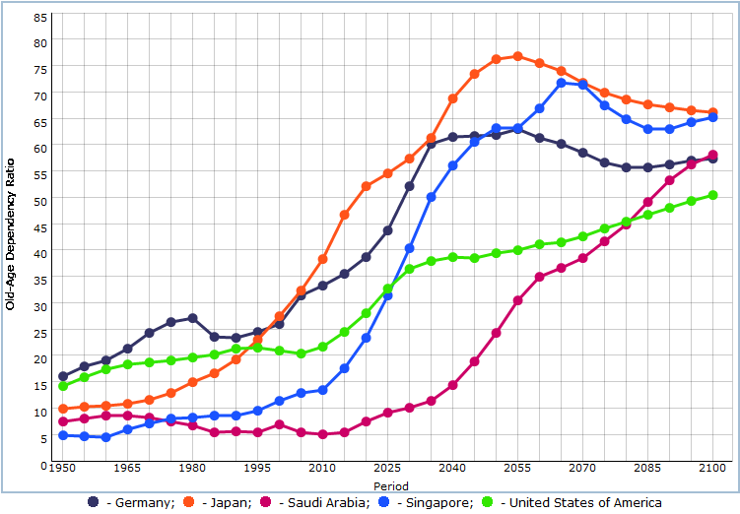
Old-Age Dependency Ratios
Note: The old-age dependency ratio is the ratio of the population aged 65 years or over to the population aged 20-64. All ratios are presented as number of dependants per 100 persons of working age (20-64).
Source: http://esa.un.org/wpp/JS-Charts/aging-old-dep-ratio_0.htm

Slide 7
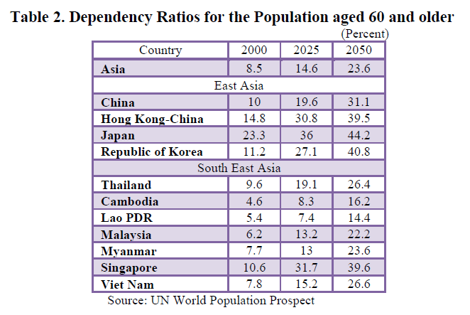
An Ageing Thailand
Note: The dependency ratio of the elderly population is the ratio of the population aged 60 or over to the population aged 15-59 (working age).
Source: Thailand Economic Monitor April 2011, the World Bank.

Slide 8
Expenditure on Health
Source: WHO National Health Accounts (NHA). Country health information. Geneva, World Health Organization, February 2010

Slide 9
Expenditure on Health:
Some Selected Countries
Source: WHO National Health Accounts (NHA). Country health information. Geneva, World Health Organization, February 2010

Slide 10
WHO: The World Health Report
■■ Improving health is critical to human welfare and essential to sustained economic and social development. Reaching the “highest attainable standard of health,” as stated in the WHO Constitution, requires a new or continued drive towards universal coverage in many countries, and strong actions to protect the gains that have been achieved in others.
■■ To achieve universal health coverage, countries need financing systems that enable people to use all types of health services – promotion, prevention, treatment and rehabilitation – without incurring financial hardship.
■■ Today, millions of people cannot use health services because they have to pay for them at the time they receive them. And many of those who do use services suffer financial hardship, or are even impoverished, because they have to pay.
■■ Globally, we are a long way from achieving universal health coverage. But countries at all income levels have recently made important progress towards that goal by raising more funds for health, pooling them more effectively to spread financial risks, and becoming more efficient.

Slide 11

World trade in services
Section 2

Slide 12
The General Agreement on Trade in Services (GATS)
The General Agreement on Trade in Services (GATS) is a relatively new agreement.
It entered into force in January 1995 as a result of the Uruguay Round negotiations to provide for the extension of the multilateral trading system to services.
Services have recently become the most dynamic segment of international trade. Since 1980, world services trade has grown faster, albeit from a relatively modest basis, than merchandise flows.

Slide 13
Scope of GATS
151 countries (all WTO members)
Any sector (160) in any service except:
- Services supplied in the exercise of governmental authority (fire, police, …)
- Traffic air regulations

Slide 14
Mode of Service Trade
MODE | MEANING | EXAMPLE
Mode 1 Cross-border trade | Trade takes place from the territory of country A into that of B | - Telehealth - Passing of information by means of fax or email
Mode 2 Consumption abroad | Services consumed by nationals of country A in territory of country B | - Tourism - Consumers who cross borders to obtain medical treatment
Mode 3 Commercial presence | A service supplier of country A crosses the border to establish and provide a service in country B | - Establishment of a private hospital by a European company in Ecuador
Mode 4 Movement of natural persons | Temporary movement from country A to B to supply a service | - Doctors moving to another country to temporarily provide their services

Slide 15
Health Related Sectors and Sub-sectors
1. Business services
A. Professional services
h. Medical and dental services
j. Midwives, nurses, physiotherapists, paramedical services
7. Financial services
A. All insurance and insurance-related services
a. Life, accident and health insurance services
8. Health related and social services
A. Hospital services
B. Other human health services

Slide 16
GATS and Domestic Regulation
“GATS does not remove a government´s right to regulate services in its country”
Government regulation of a service should be “not more burdensome than necessary to ensure the quality of the service” (possibility of necessity test)

Slide 17
GATS and Healthcare Industry
Modes of trade Health services
1. Cross border supply Telemedicine
2. Consumption abroad Patients seeking health care in foreign countries
Medical/health educational services provided to foreign students

Slide 18
GATS and Healthcare Industry
Modes of trade Health services
3. Commercial presence Foreign commercial presence:
- in the hospital operation/ management sector
- in the health insurance / education sector
4. Presence of natural persons Temporary movement of medical/health professionals to provide services abroad

Slide 19
Opportunities and Risks
Modes | Opportunities | Risks
1 | Increase care to remote and under-served areas | Diversion of resources from other health services
2 | Generates foreign exchange earnings for health services of importing country | Crowding out of local population and diversion of resources to service foreign nationals
3 | Creates opportunities for new employment and access to new technologies | Development of two-tiered health system, with an internal brain drain
4 | Economic gains from remittances of health care personnel working overseas | Permanent outflow of health personnel, with loss of investment in educating and training such personnel

Slide 20
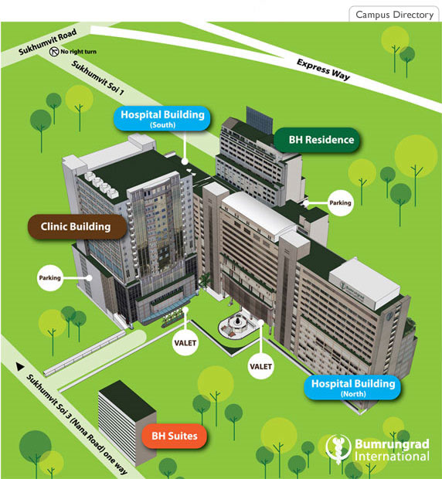
A case study:
Bumrungrad Hospital, pcL.
Section 3

Slide 21
Overview
Founded in 1980, in the heart of Bangkok.
International accredited. (See: http://www.bumrungrad.com/en/about-us/bumrungrad-hospital-accreditation-jci-others )
Bumrungrad serves over a million patients annually. Over 400,000 are internationals.
They include thousands of expatriates who live in Bangkok and nearby countries, plus visitors from 190 countries around the world who come here for treatment.

Slide 22
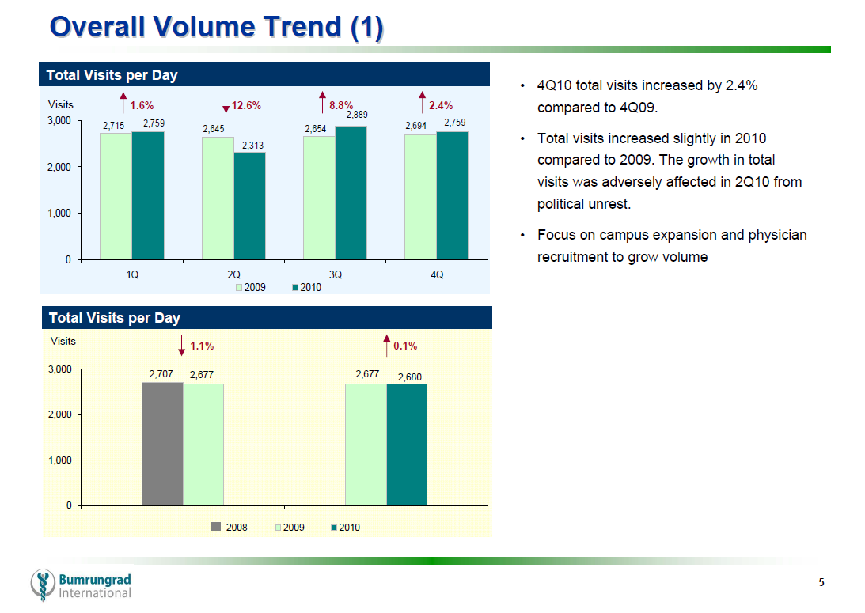

Slide 23
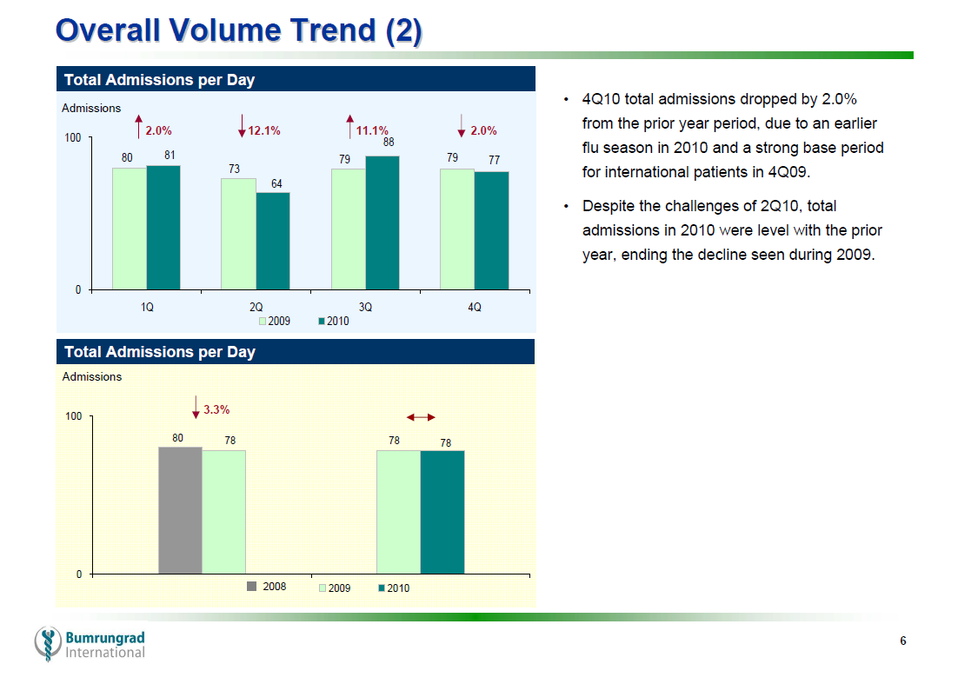

Slide 24
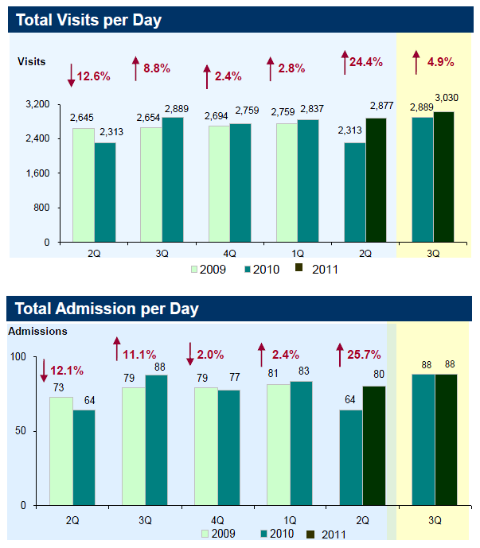


Slide 25
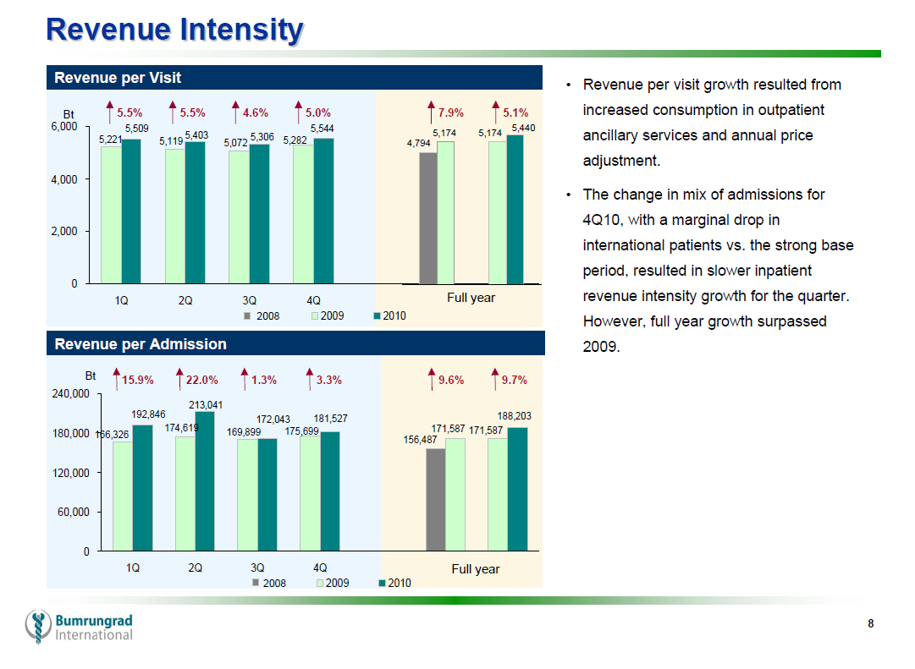

Slide 26
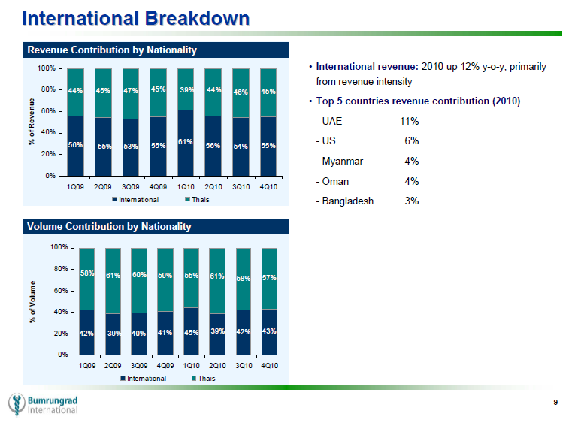

Slide 27
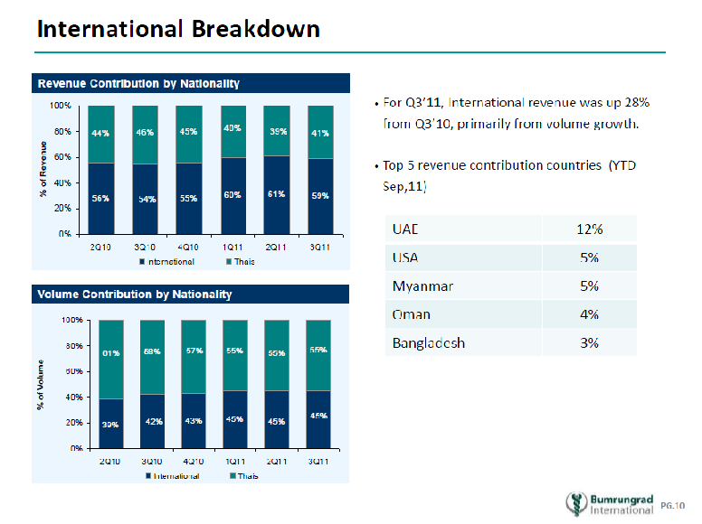

Slide 28
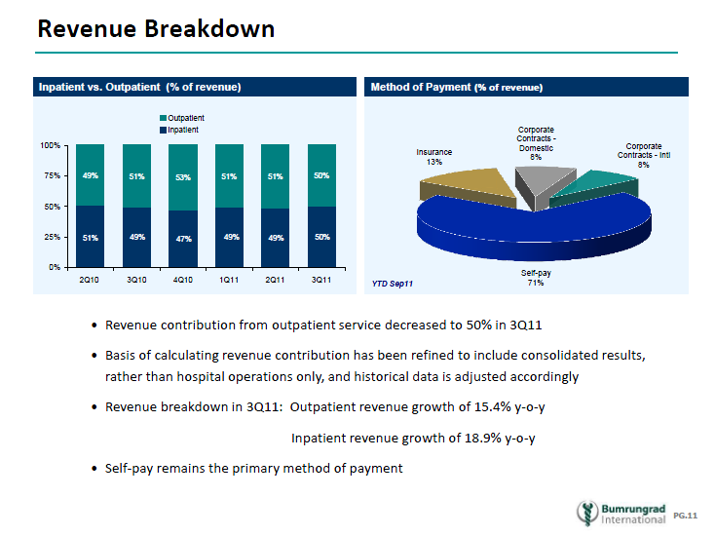

Slide 29
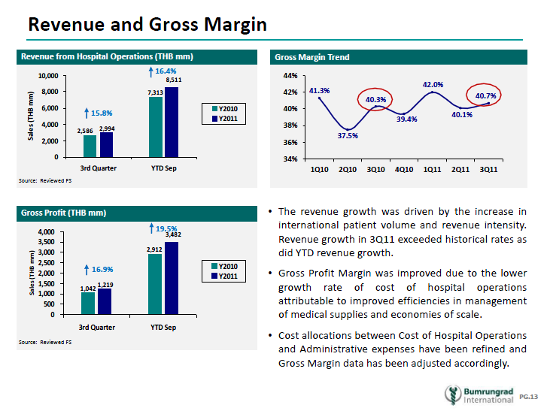

Slide 30
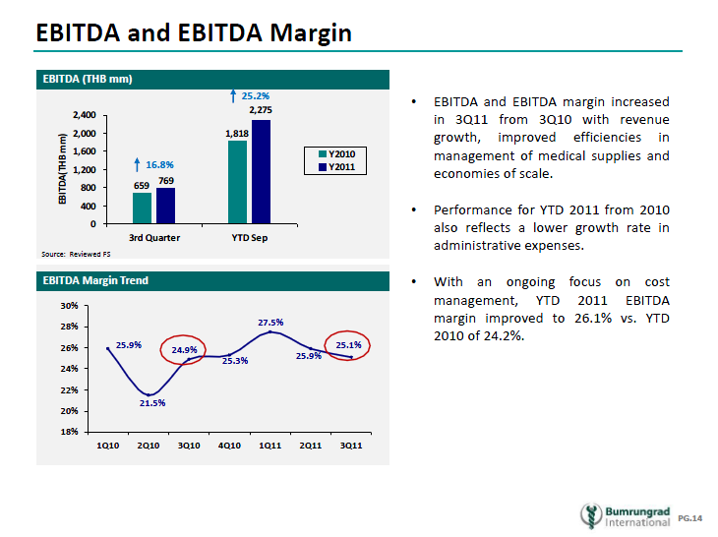

Slide 31
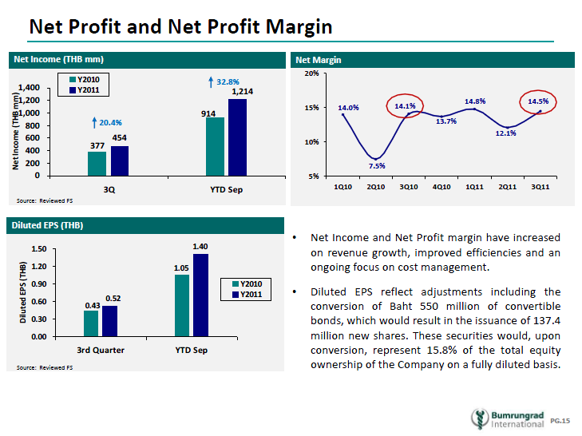

Slide 32
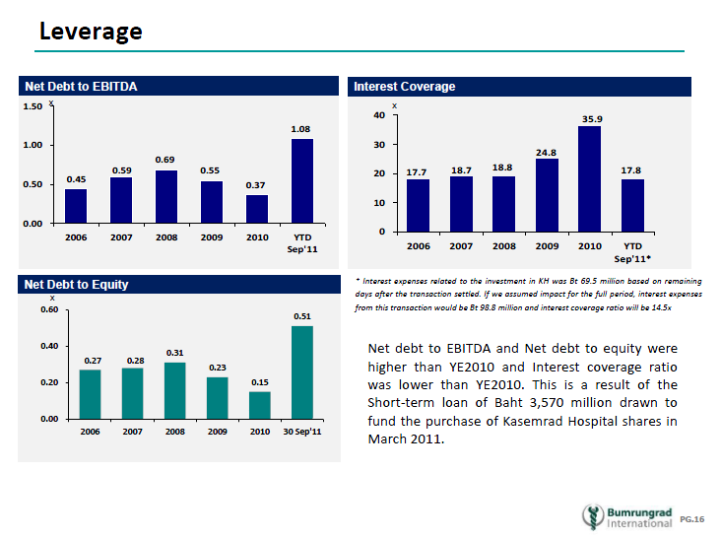

Slide 33
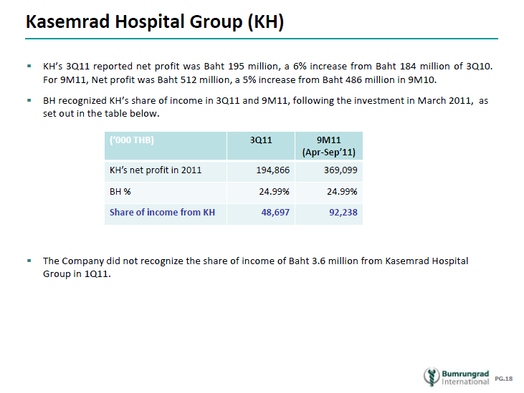

Slide 34
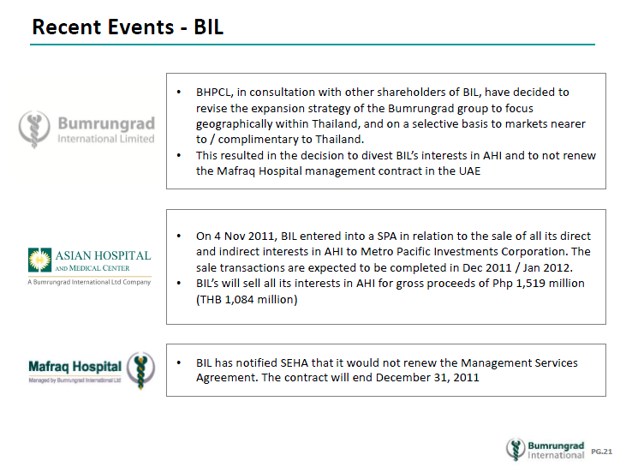

Slide 35
Personels
As of 31 December 2010, BH has totally 3,418 personels, divided into:
  Nurses 1,596 people
  Physicians 1,222 people
  Supporting Staffs 600 people
Source: Form 56-1 and Annual Report 2010, BH

Slide 36
Industry and Competition
(From BH Annual Report 2010)
In general, the demand for healthcare correlates with the growth of GDP and the aging of the population. ... With supply of private healthcare facilities in Thailand* in excess of domestic demand, the competition for Thai patients remains intense.
*According to the latest available data provided by publications, there were 344 private hospitals totaling 35,806 beds in Thailand as at 2006, of which 102 hospitals totaling 15,500 beds are in Bangkok

Slide 37
Industry and Competition
(From BH Annual Report 2010)
While the global medical tourism industry is expected to see continued growth, the Company believes that most international demand will arise from patients living within an 8 hour flight of Bangkok.
Thailand’s regional competitors are hospitals in countries such as Singapore, Malaysia and India. Private hospitals in Thailand have a competitive advantage compared to many other countries, as Thailand has a unique combination of high quality healthcare, accessibility and affordability, coupled with Thailand being a popular tourist destination with a good supporting infrastructure.
Within Thailand itself, there are a limited number of private hospitals that have the broad range of specialties and subspecialties, technology and quality of patient care on a single campus, as offered by the Company.

Slide 38
Industry and Competition
(From BH Annual Report 2010)
The Company’s strategy is to continue building on this advantage in clinical expertise, service capability and patient satisfaction which results in a differentiated product based on quality superiority. Pricing is targeted within the top tier of Thai hospitals, while remaining price competitive in the region, to offer a compelling value proposition.
In appealing to international patients, the Company operates in conjunction with 18 overseas referral offices in its major markets and has an International Patient Center to accommodate the needs of international patients, including language and cultural support. The Company is also a tertiary referral center for both domestic and international hospitals.

Slide 39

OTHER Interesting information
Section 4

Slide 40
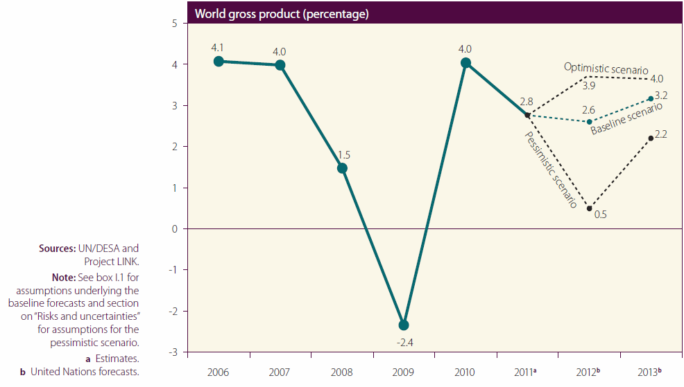
World Gross Product Forecasting
Source: UN, World Economic Situation and Prospects, 2012

Slide 41
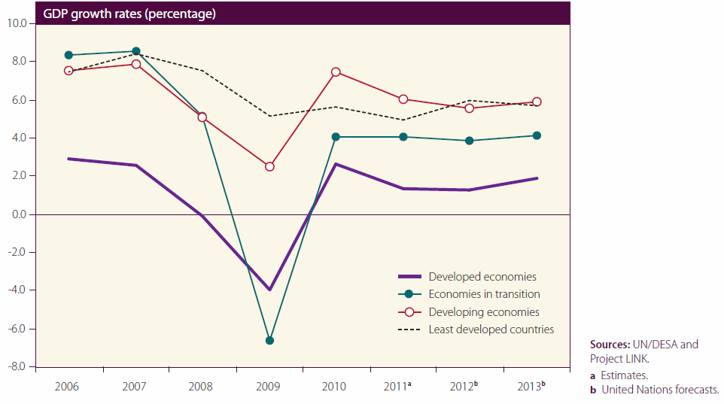
World Gross Product Forecasting
Source: UN, World Economic Situation and Prospects, 2012

Slide 42
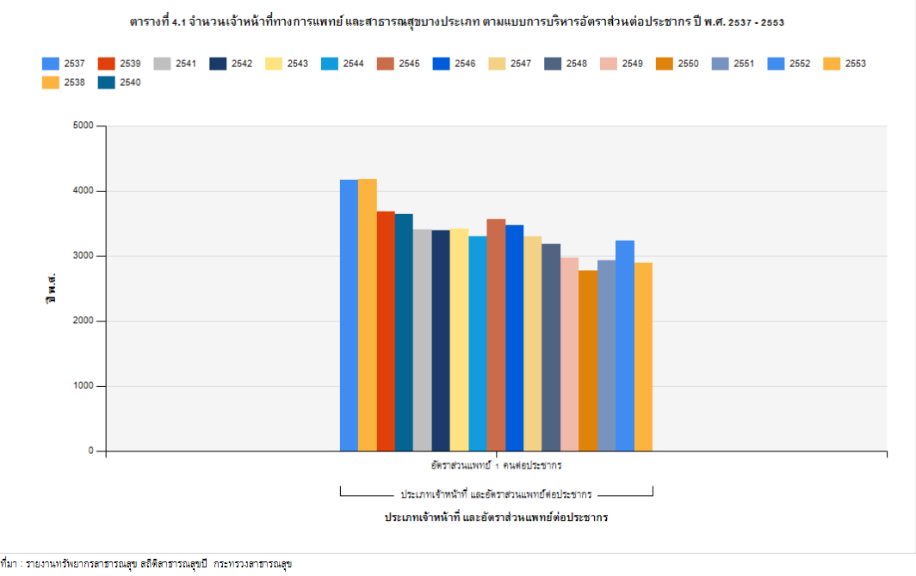
Number of Thai population per 1 physician, 1994 - 2010

Slide 43
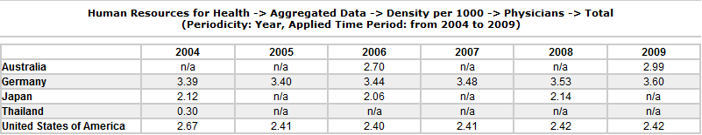
Total number of physicians per 1000 population, 2004 - 2009
Source: Global Atlas of the Health Workforce, WHO

Slide 44
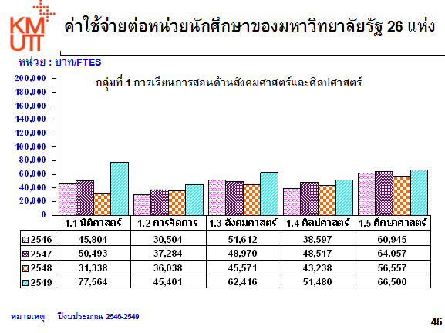
ที่มา โครงการศึกษาค่าใช้จ่ายต่อหน่วยนักศึกษา มหาวิทยาลัยเทคโนโลยีพระจอมเกล้าธนบุรี

Slide 45
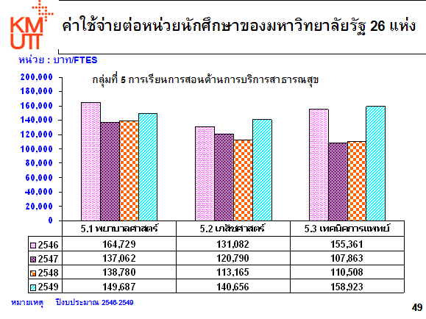
ที่มา โครงการศึกษาค่าใช้จ่ายต่อหน่วยนักศึกษา มหาวิทยาลัยเทคโนโลยีพระจอมเกล้าธนบุรี

Slide 46
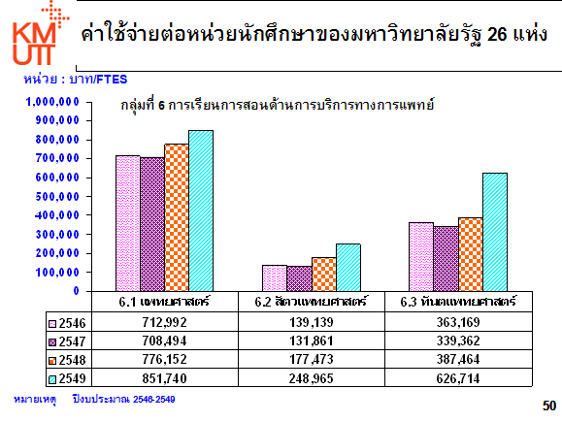
ที่มา โครงการศึกษาค่าใช้จ่ายต่อหน่วยนักศึกษา มหาวิทยาลัยเทคโนโลยีพระจอมเกล้าธนบุรี

Slide 47
Assignment

Slide 48
Answer the following questions
For every group:
1. List opportunities and risks of the hospital industry in Thailand.
2. Analyze hospital industry in Thailand. Do we have a higher competition capacity than other countries? What should be the position of Thailand in this industry?

Slide 49
Answer the following questions
For private hospitals:
3. What do you expect the government to do in this industry?
4. What are first priorities for your hospitals to do in the near future?
For the government authorities:
3. What do you expect private hospitals to do in the near future?
4. What are the necessary regulations for Thailand in healthcare industry?

