Slide 1

The Greater Mekong Subregion (GMS) Programme
Building Connectivity, Connectiveness and
Community

Slide 2
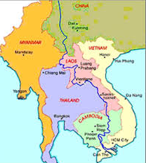
Key features
Established in 1992 by six countries with to enhance economic relations
Comprises Cambodia, PR China (Yunnan Province and Guangxi), Lao PDR, Myanmar, Thailand, and Viet Nam
Bounded together by the Mekong River, with an area of 2.6 million km² and 334 million people
The GMS Program: identifies and implements high-priority subregional projects in a wide range of sectors

Slide 3


Development strategy
• Increase connectivity through sustainable development of physical infrastructure and the transformation of transport corridors into transnational economic corridors
• Improve competitiveness through efficient facilitation of cross-border movement of people and goods and the integration of markets, production processes, and value chains; and
• Build a greater sense of community through projects and programs that address shared social and environmental concerns

Slide 4

vision
Mekong subregion that is more prosperous, integrated, and harmonious.
PURPOSE
Create an enabling policy environment develop infrastructure to:
  facilitate cross-border trade, investment, tourism, and economic cooperation
  develop human resources and skills competencies
  ensure sustainable, environment and social development

Slide 5
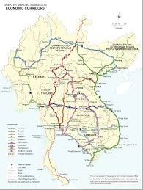
Economic corridors
Economic corridor development has catalyzed development of special economic zones, particularly border economic zones
Coordination across multiple sectors is essential
Maximizing the benefits of economic corridors required multisector projects that involve public and private sector investments and that include both hardware and software interventions

Slide 6
Key sectors and areas of cooperation

Slide 7
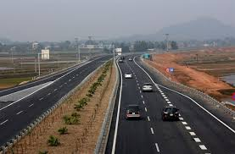
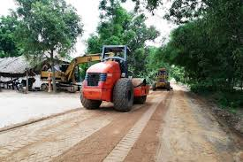
transport
Develop priority transport corridors that that link urban centers, agricultural production, markets, tourist destinations, and other areas of economic activity
Promote trade, tourism, investment, and access to social and other services
The main transport corridors the North–South, East–West, and Southern economic corridors

Slide 8
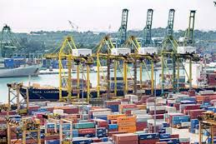
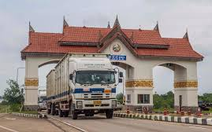
Trade facilitation
Focuses on nonphysical or “software” measures to enhance connectivity and linkages among member countries
Provide a framework for trade facilitation, efficient cross-border movement of goods, vehicles, and people; and investment
GMS Cross-Border Transport Facilitation Agreement signed by GMS countries in 1999 (Lao PDR, Thailand, Viet Nam), 2001 (Cambodia), PR China (2002) and Myanmar (2003)

Slide 9


energy
Establish a competitive and integrated regional power market that will develop, in a sustainable manner, the rich energy resources of the GMS
Improve the subregion’s energy security and the people’s access to modern and affordable energy supplies

Slide 10
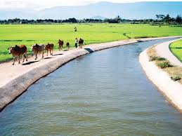

agriculture
Improve agricultural productivity in GMS countries
Faciltate production of safe food using climate-friendly agricultural practices and integrated into global markets
Implement the GMS Core Agriculture Support Program Phase II (2011–2020)

Slide 11

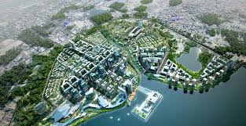
Urban development
Invest in priority urban infrastructure and services in small and medium-sized cities
Contribute to the transformation of transport corridors into economic corridors
Assist in preparing strategies for sustainable, competitive and livable cities
Provide rural areas with greater access to jobs and markets

Slide 12


tourism
Develop and promotes the GMS as a single destination, offering a diversity of good quality and high-yielding subregional products that distribute the benefits of tourism
Minimize adverse impacts of tourism
Invest in infrastructure that supports tourism, combined with capacity building and training and community-based tourism development to reduce poverty, generate employment generation, and ensure sustainable development

Slide 13


Information
technology
Improve telecommunications linkages, promote information and communications technology applications
Facilitate increased access to information and communications to lower transaction costs and enhance the competitiveness of the GMS.

Slide 14


Human development
Promote cooperation in health, education, labor and migration, and social development
Support communicable diseases control and HIV/AIDS prevention,
Provide training on technical and vocational training, and higher education and research

Slide 15
conclusion
GMS Program has achieved success in fostering regional cooperation. At the inception of the program, the region was just emerging from a period of prolonged regional conflict.
As of December 2018, the Program had implemented 95 investment projects totaling $22 billion, involving subregional roads, airport and railway improvements, agricultural production, electricity generation and transmission, cross-border trade facilitation, tourism infrastructure development, vocational and educational training and communicable disease control.
The GMS Program is flexible yet results-oriented, delivering projecs to promote regional cooperation and thereby contributing to growth and poverty reduction as well as addressing regional public goods

Slide 16
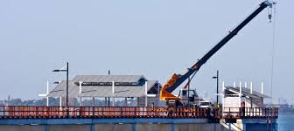

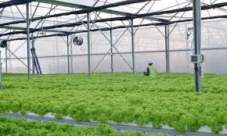

Thank you!

