Slide 1

BA 291 – Human resource management
By Aj. Parichat Jantori

Slide 2
„Your organization can create a new product, and it is easily copied. Lower your prices and your competitor will follow. Go after a lucrative market and someone is there right after you, careful to avoid making your initial mistakes. But replicating a high quality, highly engaged workforce is nearly impossible. The ability to effectively hire, retain, deploy and engage talents at all levels – is really the only true competitive advantage an organization possesses“
(Wellins, R. & Smith A.B., 2009)

Slide 3

Human Capital
Human Capital: The economic value of the knowledge, experience, skills, and capabilities of employees
Building Human Capital:
Develop strategies to find the best talent
Enhance their skills and knowledge
Opportunities for personal and professional development
Providing compensation and benefits

Slide 4

Intellectual Capital
The value of a company or organization's employee knowledge, business training and any proprietary information that may provide the company with a competitive advantage. It is an organization’s combined human capability for solving business problems.
Human & Intellectual capital is inherent in people and cannot be owned by an organization. Therefore, human capital can leave an organization when people leave.

Slide 5

Human Resource Management (HRM)
The design and application of formal systems in an organization to ensure the effective and efficient use of human talent to accomplish organizational goals
HRM includes activities undertaken to attract, develop and maintain an effective workforce within an organization

Slide 6
Functions of HRM
Attract an Effective Workforce
(find the right people)
HRM planning
Develop and Effective Workforce
(manage talent)
Training
Maintain an Effective Workforce
Wage
Job analysis
Forecasting
Recruiting
Selecting
Developing
Appraisal
Benefits
Labor Relations
Terminations

Slide 7

Objectives of HRM
  Providing qualified, well-trained employees for the organization.
  Maximizing employee effectiveness in the organization.
  Satisfying individual employee needs through monetary compensation, benefits, opportunities to advance, and job satisfaction.
Happy cows give more milk, so satisfied workers give more work

Slide 8
Challenge of HRM
Demographic change
- aging society
- lack of skilled workforce
- gen Y workforce
Globalization and diversity
- labor mobility
Information technology

Slide 9

Human Resource Planning
Human Resource Planning: The assessing and forecasting of human resource needs and the projected matching of individuals with expected vacancies
What new technologies are emerging and how will these affect the work system?
What is the volume of the business likely to be in the next 5-10 years?
What is the turnover rate, and how much, if any, is avoidable?

Slide 10
Human Resource Planning
Tools:
Workforce profile: Number of employee, level, family, service years, age distribution, gender, education
Workforce efficiency analysis, Gap Analysis – Labor shortage?
Movement
HR proactive program: creating talent pool, career path, succession planning
HR reactive program: placement, recruitment

Slide 11
Job forecasting
- Demand Forecasting
Determining the number of employees that the organization will need at some point in the future as well as the knowledge, skills, and abilities that these employees must posses
- Supply Forecasting
Determining what human resources will be available, both inside and outside the organization

Slide 12
Human Resource Planning
A job analysis refers to the systematic process of gathering and interpreting information about the essential duties, tasks and responsibilities of a job
Specify job description (Task, Duty, Responsibility)
Determine job specification (Knowledge, Skill, Ability, Other characteristics)

Slide 13
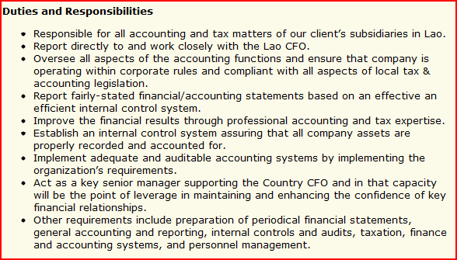
Example – Job description
Notes:
auditor

Slide 14
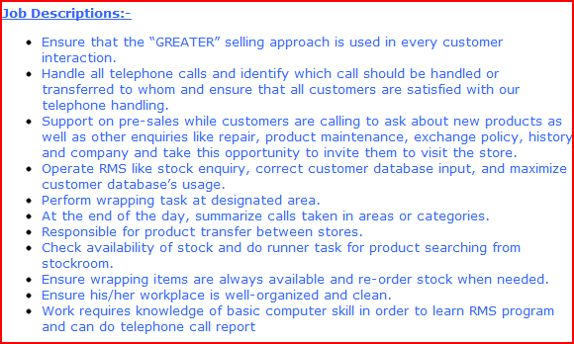
Example job description
Notes:
Sales person

Slide 15
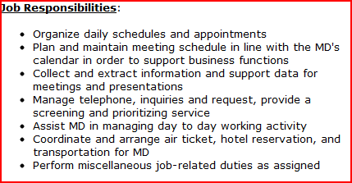
Example job description

Slide 16
Recruitment
Internal recruitment: Identify candidates from inside the organization and encouraging them to apply for jobs that are vacant
External recruitment: Advertising for and soliciting applications from outside the organization
The process of finding and attracting job candidates who are qualified to fill job vacancies
Notes:
http://www.thaiwebsites.com/recruitment.asp

Slide 17
Internal and external recruitment
Advantages | Disadvantages

Slide 18
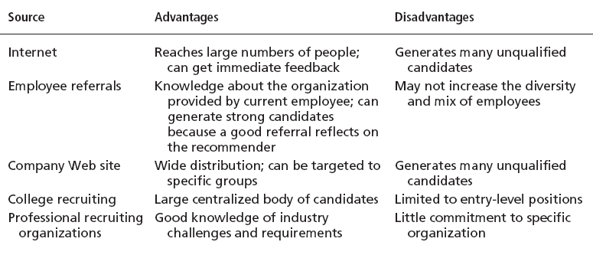
Major Sources of Potential Job Candidates

Slide 19
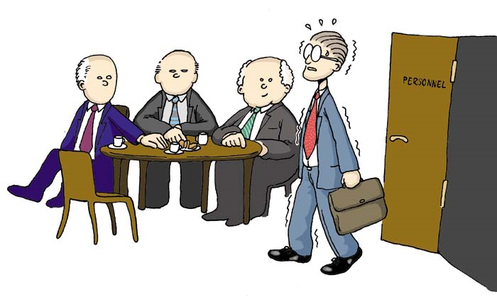
Selection
The process of evaluating and choosing the best qualified candidate from the pool of applicants recruited for the position
Predict which applicants will be successful if hired
Predict which applicants will generate a high volume of sales
Predict which applicants will suit the corporate culture

Slide 20
Selection Methods
Selection: The process of collecting information about applicants and using that information to make hiring decision
The application & resumé (CV, cover letter)
Online application, questionare and a problem solving test
Interview
Test & check References
Select a Candidate & Negotiate and offer

Slide 21
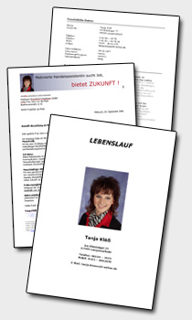
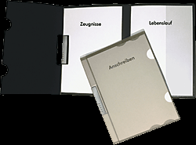
Application and résumé
First stage of the selection process
A resume is a written compilation
of your education, work experience, credentials,
and accomplishments and is used to apply for jobs
  Resume needs to impress the hiring manager enough to get the interview
Notes:
http://www.eures.is/files/cvdae_1324827930.bmp
http://www.resume-guide.info/wp-content/uploads/english-teacher-resume-1.jpg
http://www.coverletterhelp.org/wp-content/uploads/2009/06/cover_letter_example_PE_teacher.gif
http://www.resume-guide.info/wp-content/uploads/examples-of-a-good-cover-letter-1.jpg

Slide 22
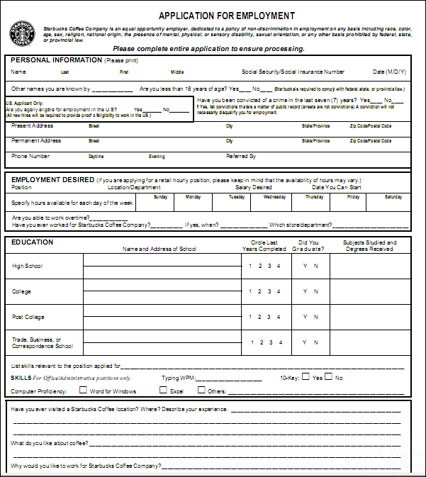

Slide 23

Interview
2nd phase of selection
Detailed information on candidate (applicant)
Attitudes toward job
  Do employees seen to get along and work well in teams?
  Are employees happy, tense or overworked?
  Are employees enthusiastic and excited about their work?
  Are employees suite to organizational culture?

Slide 24
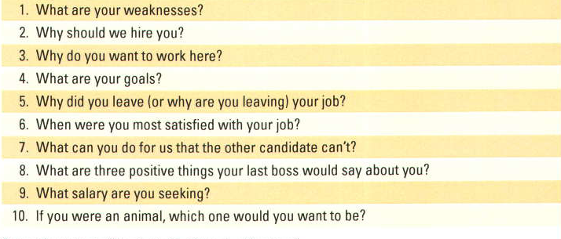
Top 10 Interview Questions
Notes:
http://jobsearch.about.com/od/interviewquestionsanswers/a/toughquest.htm
http://jobsearch.about.com/od/interviewquestionsanswers/a/interviewquest.htm
http://jobsearch.about.com/od/interviewquestionsanswers/a/interviewquest.htm
http://jobsearch.about.com/od/interviewquestionsanswers/a/interviewquest.htm
http://www.datsi.fi.upm.es/~frosal/docs/25mdq.html

Slide 25
Interview Brainteasers
  How would you answer the following questions in a job interview?
  How would you weight a jet plane without using scales?
  Why are manhole coves round?
  How many golf balls can fit inside a standard school bus?
  How many times heavier than a mouse is an elephant?.
  How many Christmas’s gift a Santa clause has to give on Christmas Day?
  How many shoes have you had in your life?

Slide 26
Top 10 Mistakes Made in Interviewing
1. Not taking the interview seriously
2. Not dressing appropriately (dressing down)
3. Not appropriately discussing experience and education
4. Being too modest about one’s accomplishments
5. Talking too much
6. Too much concern about compensation
7. Speaking negatively of a former employer
8. Not asking enough or appropriate questions
9. Not showing the proper enthusiasm level
10. Not engaging in appropriate follow-up to interview

Slide 27

Employment Tests
  Test help pick the best candidate for the position
  Written tests
  Performance tests (work sampling, assessment center)
  Personality or personal test

Slide 28
Background Investigation and Physical Examination
Background Investigations
  Verification of application data
    looking up and compiling criminal records, commercial records and financial records of an individual
    Results of a background check typically include past employment verification, credit score, and criminal history
  Reference checks:
    Lack validity because self-selection of references ensures only positive outcomes.
Physical Examinations
  Useful for physical requirements and for insurance purposes related to pre-existing conditions.

Slide 29
Online background check
  Seeing what people has to say about him or herself on social networking sites such as Facebook, Hi5, StudiVZ (in Germany) or MySpace, LinkedIn etc.
  Companies today are not only interested in a candidates‘ educational and work qualifications, but also in personal characteristic and values that fit with the organization‘s culture

Slide 30
Training and development
  Training: teaching lower-level employees how to perform their present job
  Developing: teaching managers and professional employees broad skills needed for their present and future jobs
  Type of training:
  General training: Communication skills, computer system application and programming, customer service, executive development, management skills and development, supervisory skills, technological skills and knowledge
  Specific training: Basic life-work skills, creativity, customer education, diversity/ cultural awareness, managing change, leadership, public speaking, presentation skills, team building etc.

Slide 31
Training Methods
  On-the-job: Employee learn how to do tasks simply by performing them, usually after an initial introduction to the task
  Job rotation: Employees work at different jobs in a particular area, getting exposure to a variety of tasks
  Mentoring and Coaching: Employees work with an experience worker who provides information, support and encouragement
  Experimental Exercise: Employee participate in role playing, simulations or other face to face types of training
  Workbooks/ Manuals: Employees refer to training workbooks or manuals for information
  Classroom lectures/ Corporate University: Employees attend lectures designed to convey specific information

Slide 32
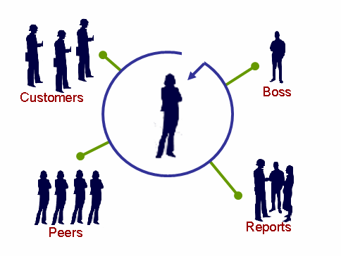
Performance Appraisal
  The process of observing and evaluating an employee‘s performance, recording the assessment, identifying strengths or weakness of employees, providing feedback and determining ways to improve performance
360-degree feedback:
A process that use multiple sources to gain comprehensive perspective of one‘s performance and guide development

Slide 33
Appraisal Methods
Rating scale
Critical incidents - With a critical incident appraisal, the manager records examples of the employee’s effective and ineffective behavior during the time period between evaluations
Ranking - The manager will have a list of all employees and will first choose the most valuable employee and put that name at the top. Then he or she will choose the least valuable employee and put that name at the bottom of the list
Behaviorally Anchored Rating Scales (BARs) - there is a specific narrative outlining what exemplifies a “good” and “poor” behavior for each category.
Notes:
http://2012books.lardbucket.org/books/beginning-management-of-human-resources/s15-02-appraisal-methods.html#portolesedias_1.0-ch11_s02_s01_f01

Slide 34
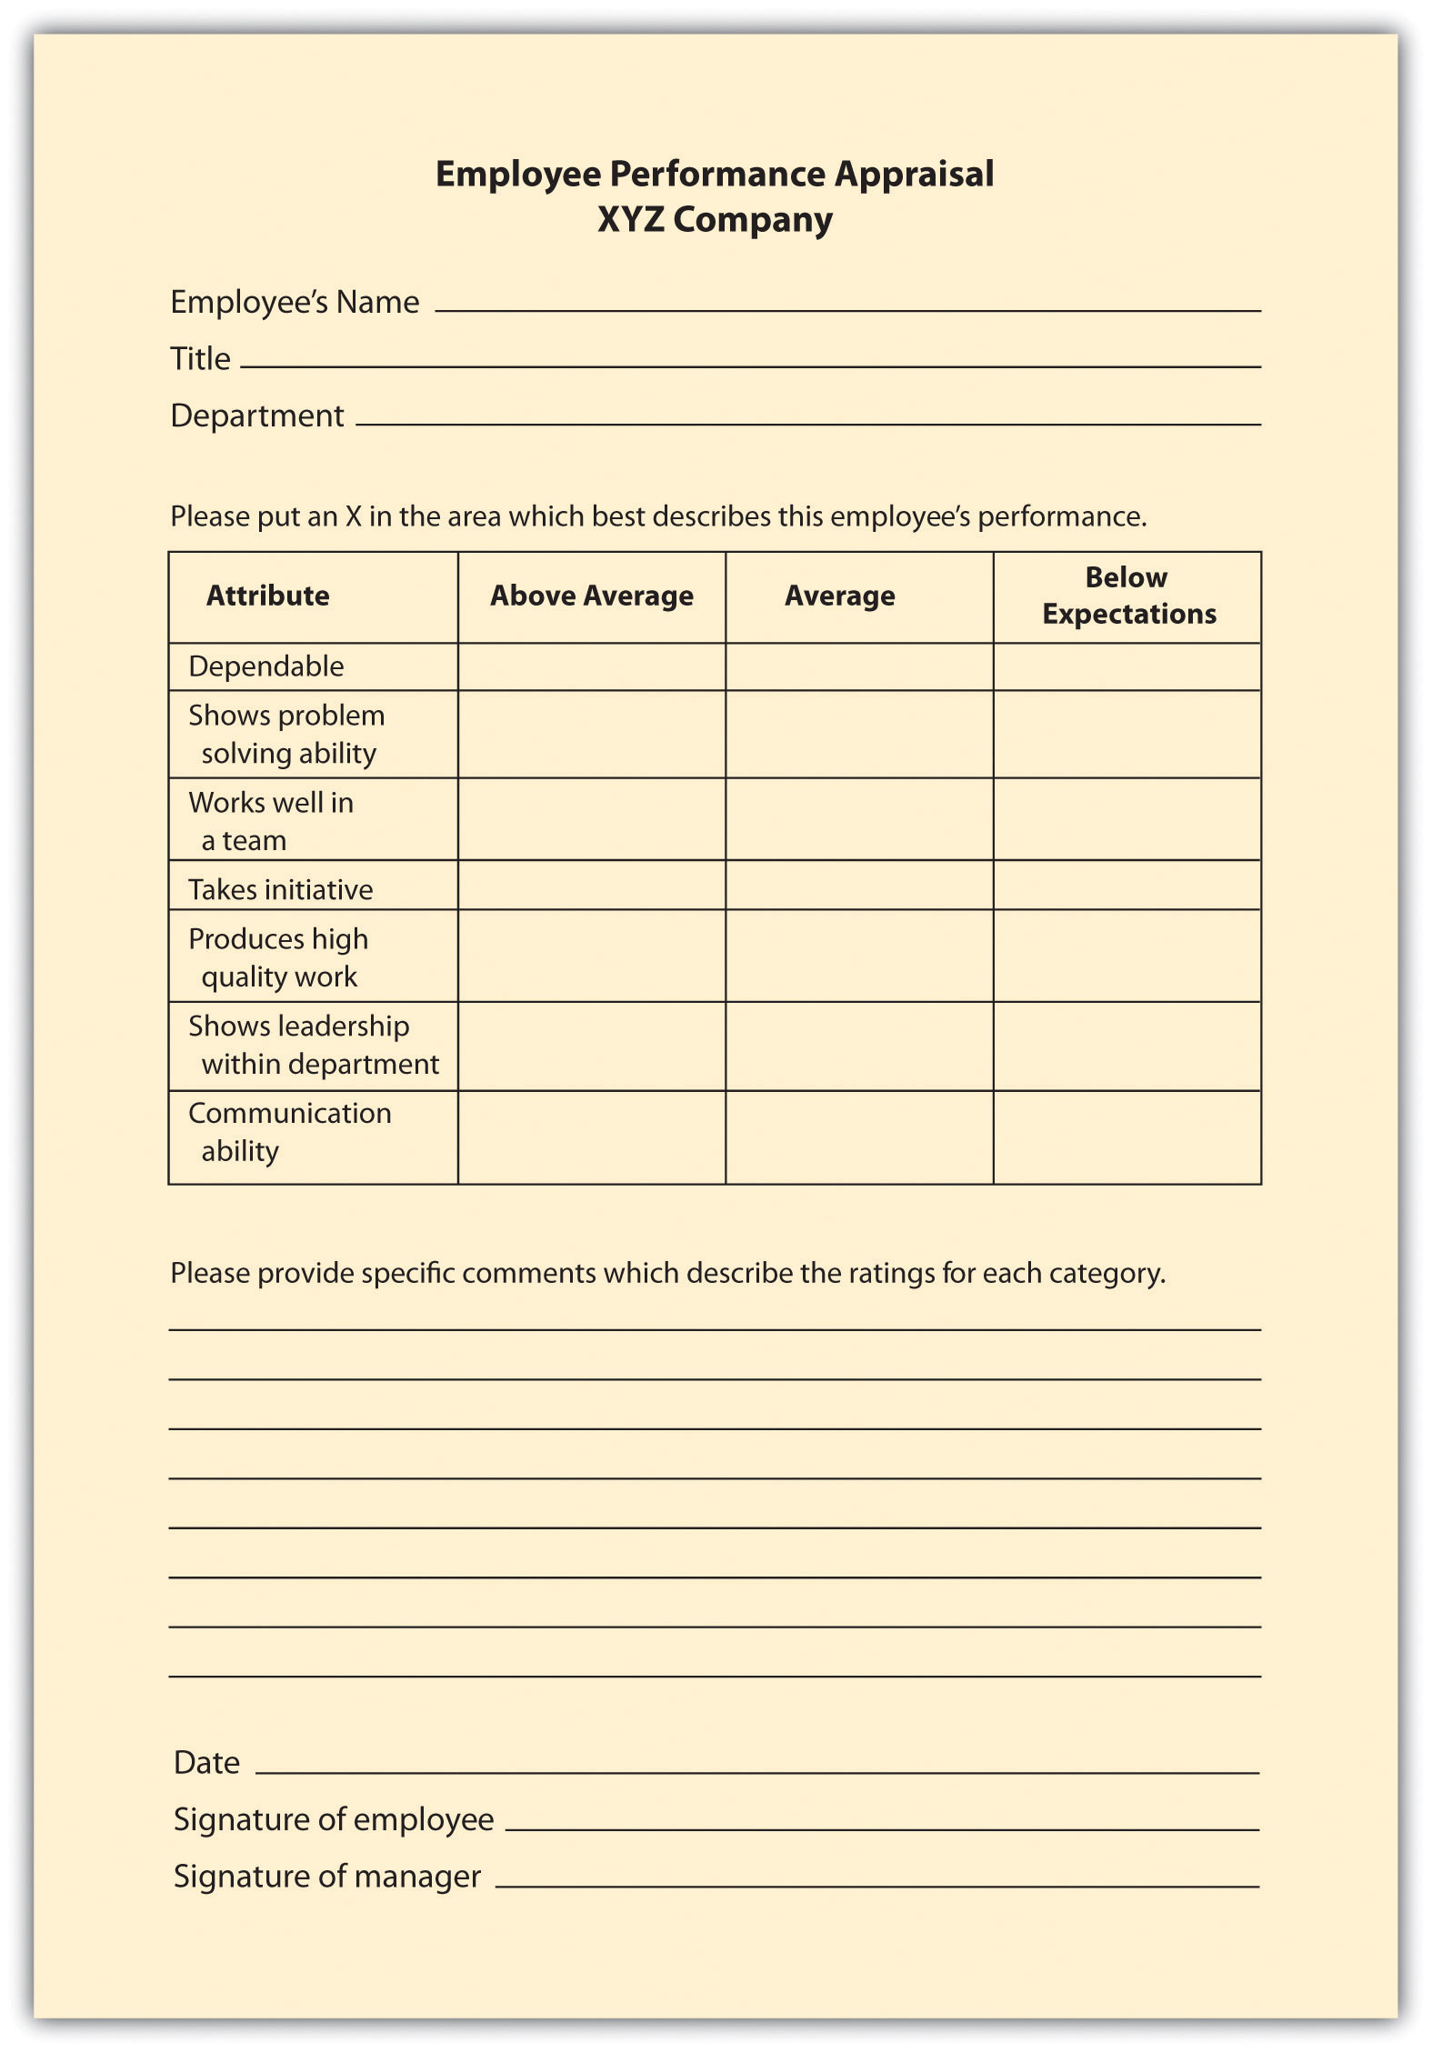

Slide 35
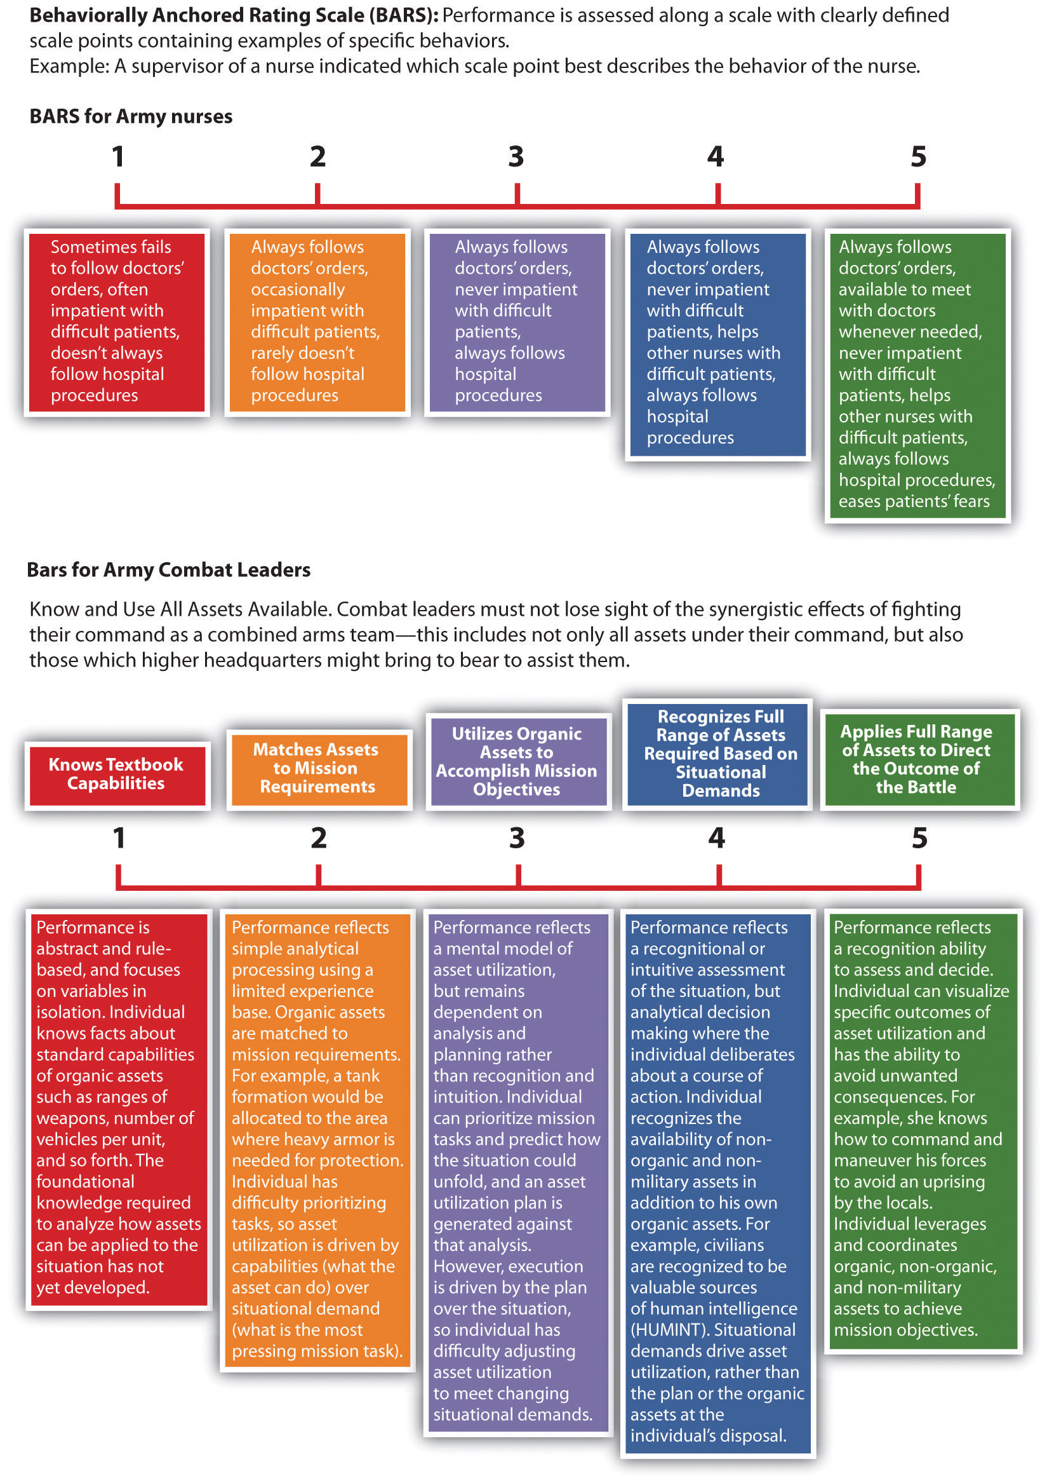

Slide 36
Maintaining effective workforce
Reasons Employees Stay in Their Current Jobs
Interesting job responsibilities | 41%
Long-term potential | 31%
Loyalty to the company | 18%
Compensation | 6%
Loyalty to manager | 4%
Source: Ferrell/Hirt/Ferell, 2009, P. 334)

Slide 37
Maintaining effective workforce
Direct Compensation
Wage and salary system
Refers to wages and salaries employees receive in exchange for performing their job
Incentives
Compensation beyond wage and salary used to attract, retain and motivate employee
Bonus, commissions, profit-sharing plans, stock options.
Indirect Compensation
Benefit
Rewards employees receives as part of their employment relationship with the organization
Require and voluntary security
Retirement
Time-off
Insurance and financial
Social and recreational

Slide 38
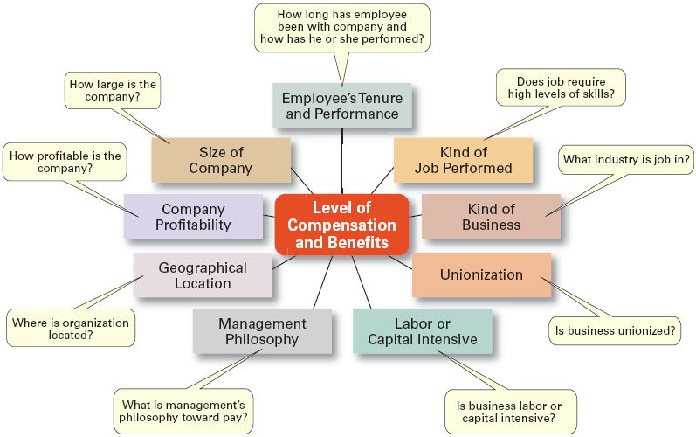
Factors that influence compensations and benefits

Slide 39
Designing Equitable Reward System
  Compensation designers are concern with 3 sources of fairness expectation:
  External Fairness
  Is the pay for the job fair in one organization relative to the pay for the same job in other organization?
  Internal Fairness
  Is the pay for the job within the organization fair relative to the pay of other jobs in the same organization?
  Employee Fairness
  Is the pay fair relative to what coworkers are making on the same job?
Notes:
Fairness?
Motivation Theory: perceive fairness

Slide 40
Designing Equitable Reward System
  Job-based pay: linking compensation to the specific tasks an employee performs.
  Skill-based pay: linking compensation to the skill required by a specific task. It will encourage employees to develop their skills and competencies
  Pay-for-performance (Incentive pay): trying at least part of compensation to employee effort and performance e.g. bonuses, team incentives, profit sharing plan

Slide 41

Termination
  When companies experience downsizing (elimination of jobs in an organization)
  Dismiss poor performer
Exit Interview:
An interview conducted with departing employees to determined the reasons for their termination. It should be use in a positive way.
QUIT

