Slide 1
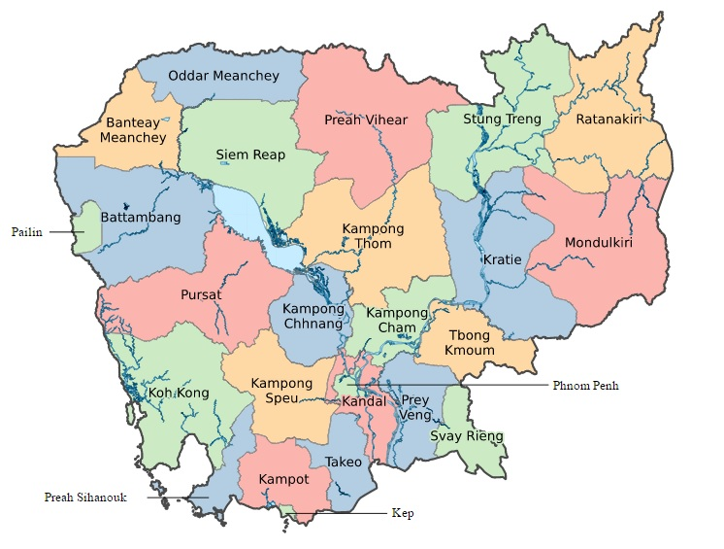
Cambodia

Slide 2
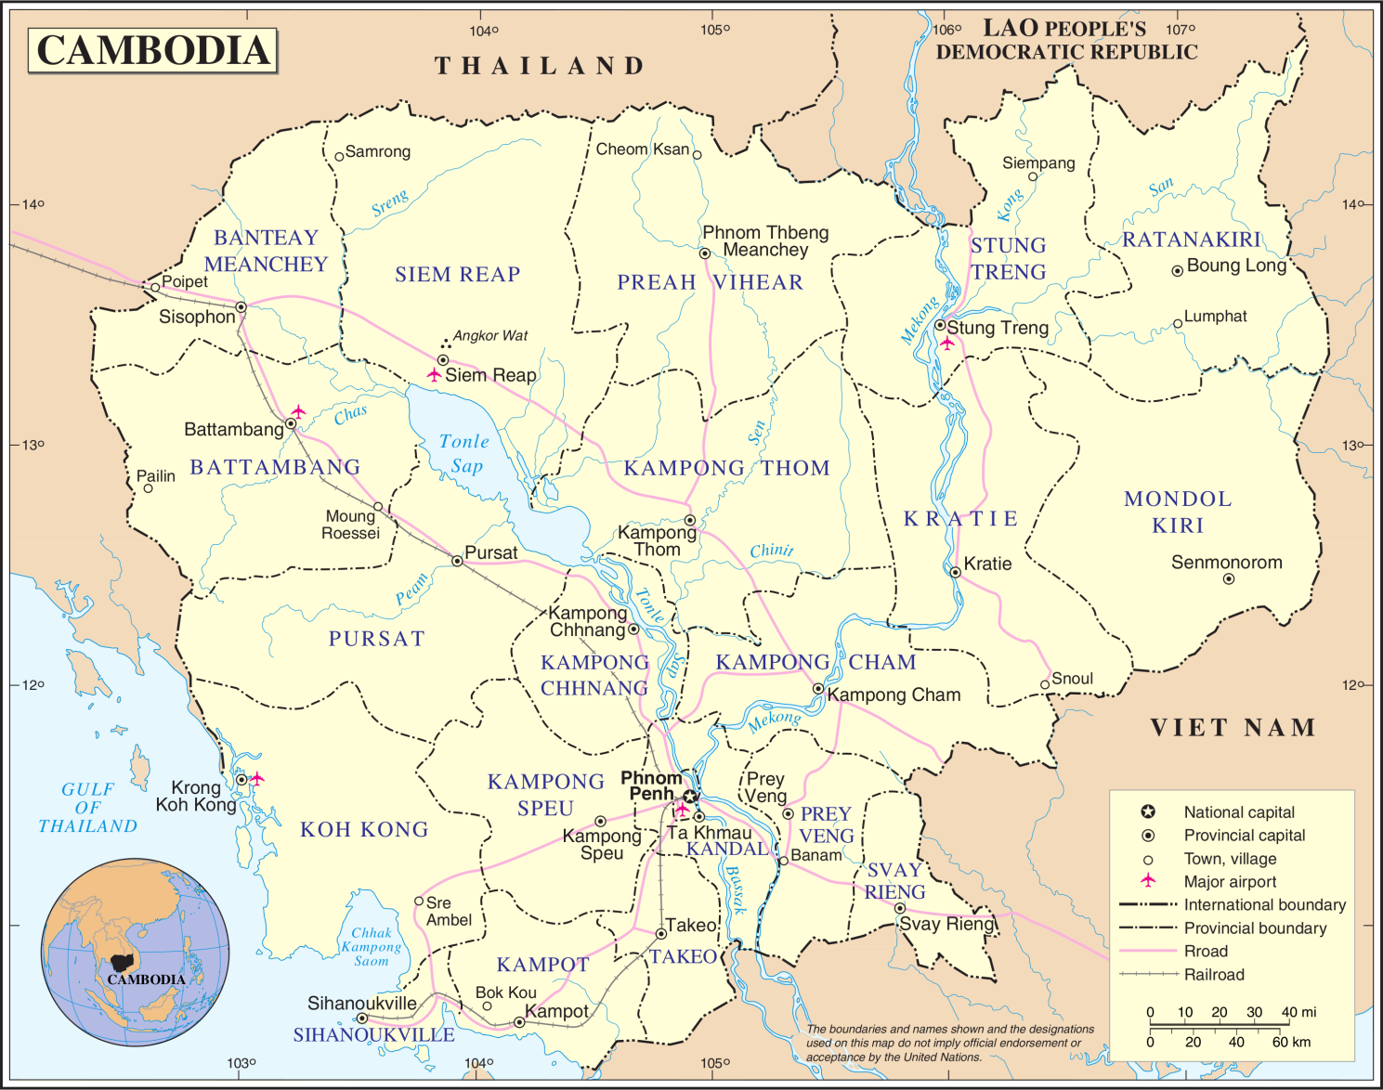
Cambodia in SEA, next to Thailand, Lao and Vietnam

Slide 3
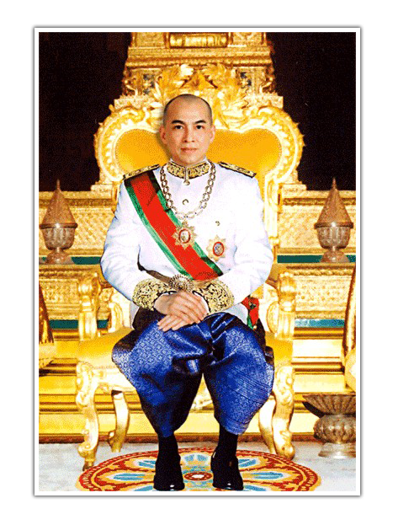
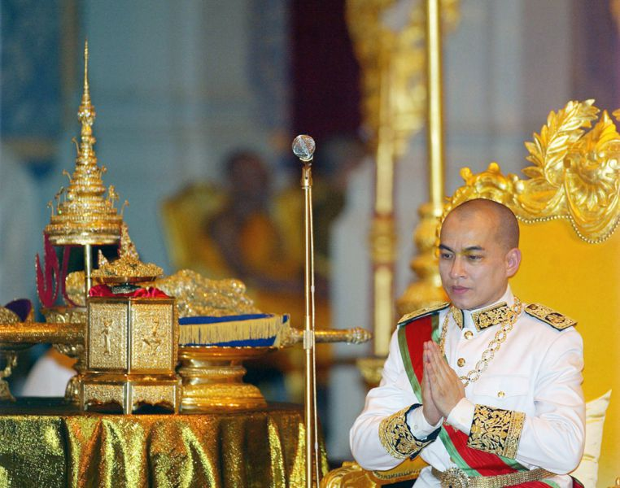
Preah Bat Samdech Preah Boromneath NORODOM SIHAMONI, King of Cambodia
2004 – present

Slide 4
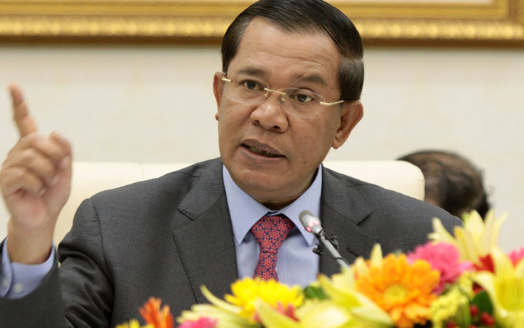
Samdech Akka Moha Sen Padei Techo HUN SEN, Prime Minister
1985 - present

Slide 5
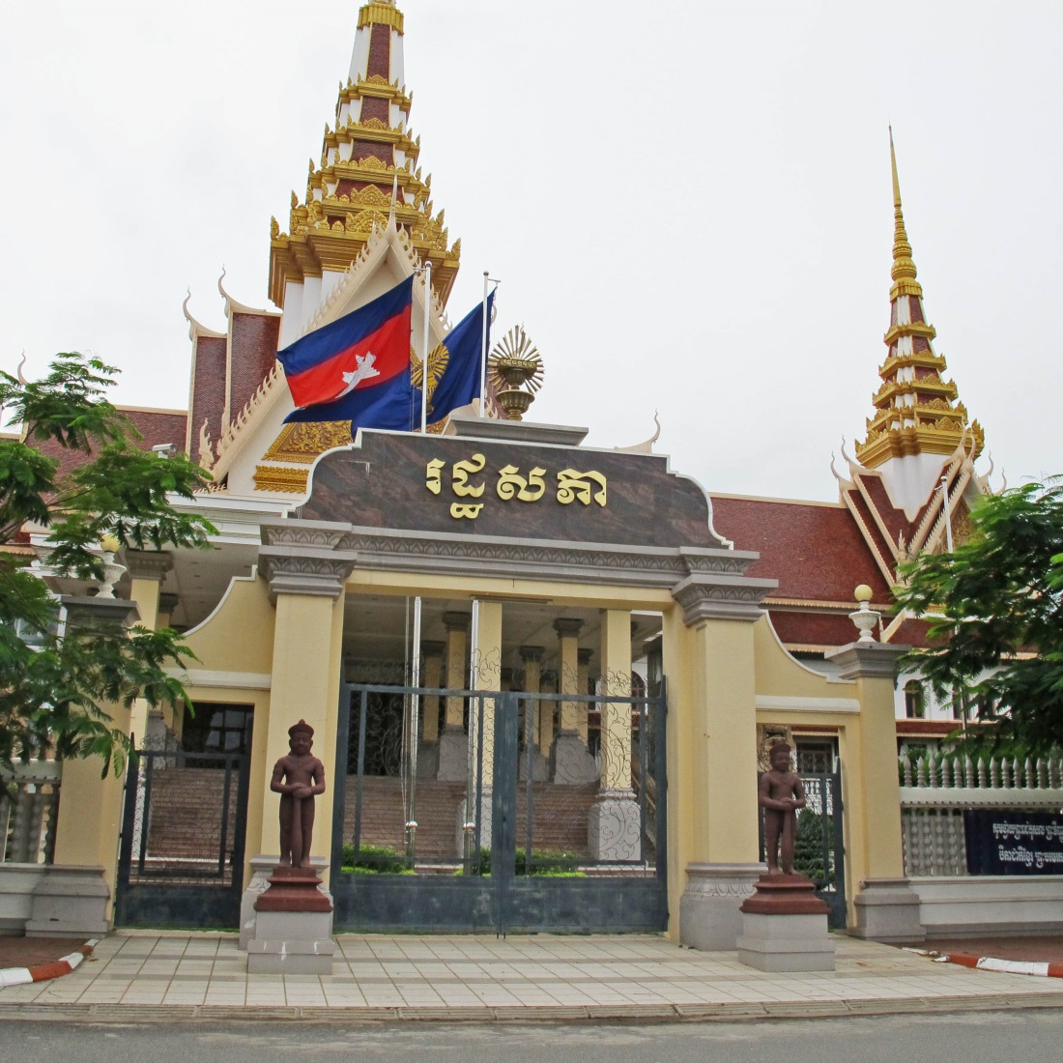
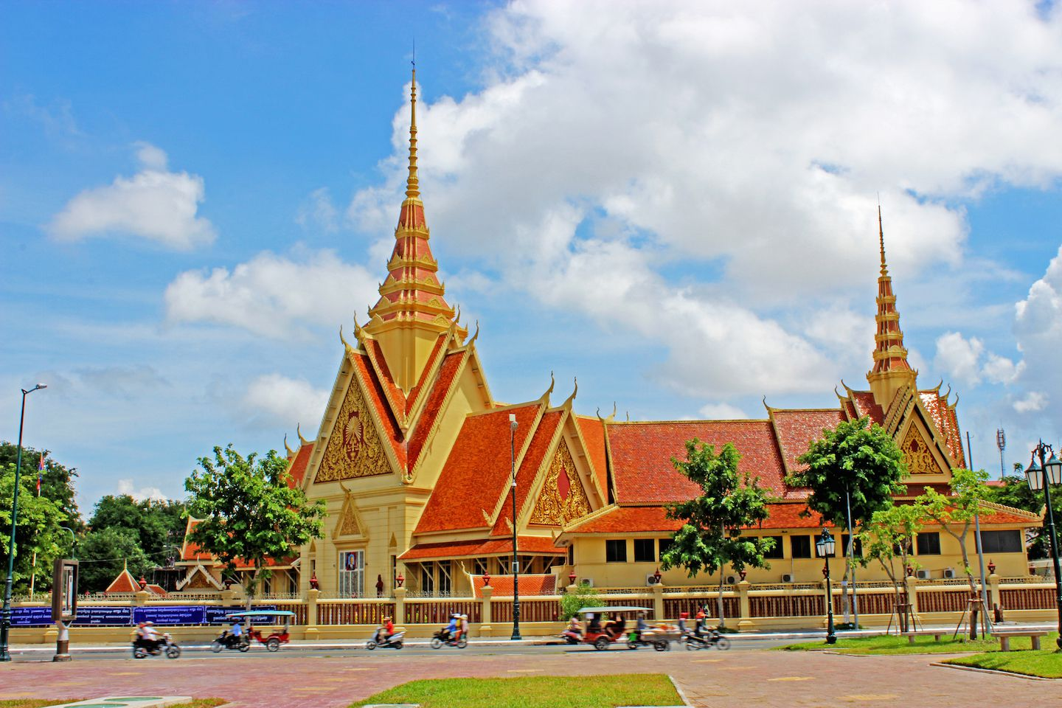
National Assembly and the Supreme Court

Slide 6
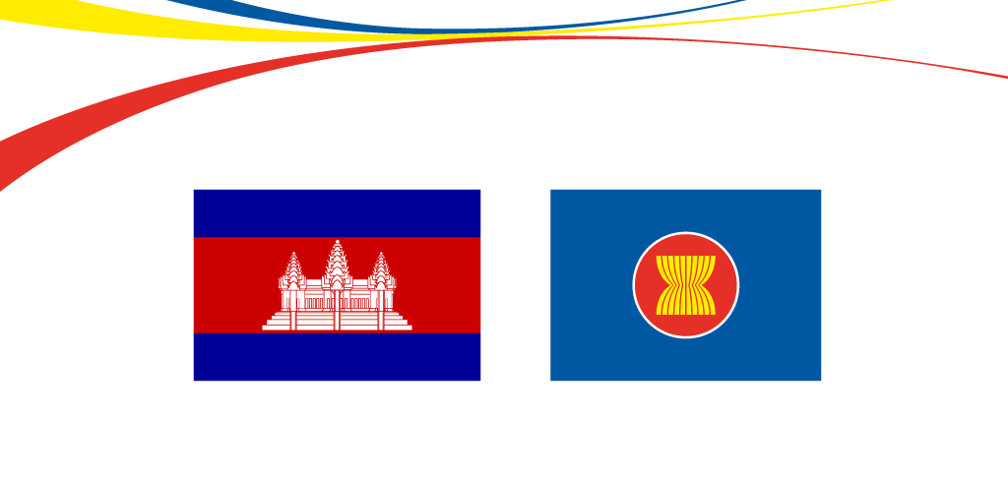
ASEAN and CAMBODIA

Slide 7
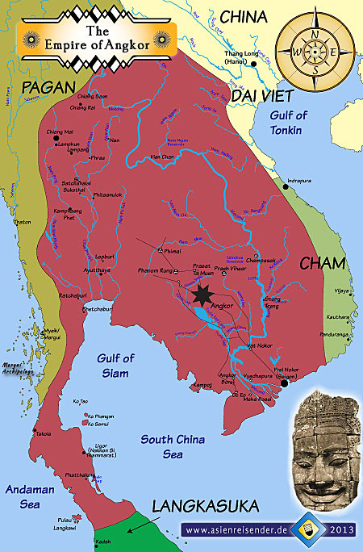
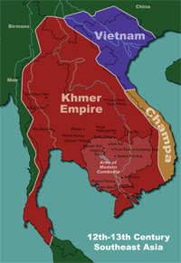
Khmer Kingdom 12th – 13th Century

Slide 8
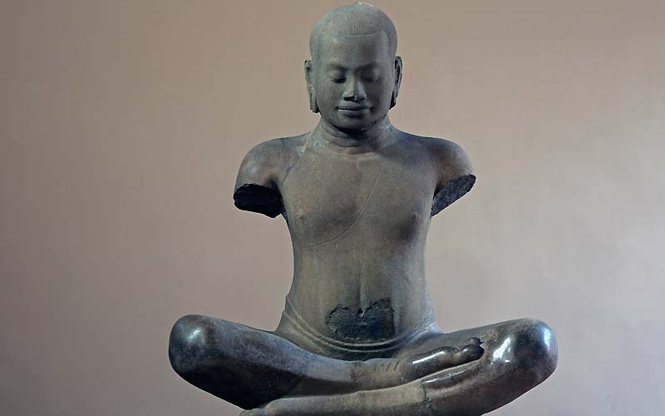
KING JAYAVARMAN VII

Slide 9
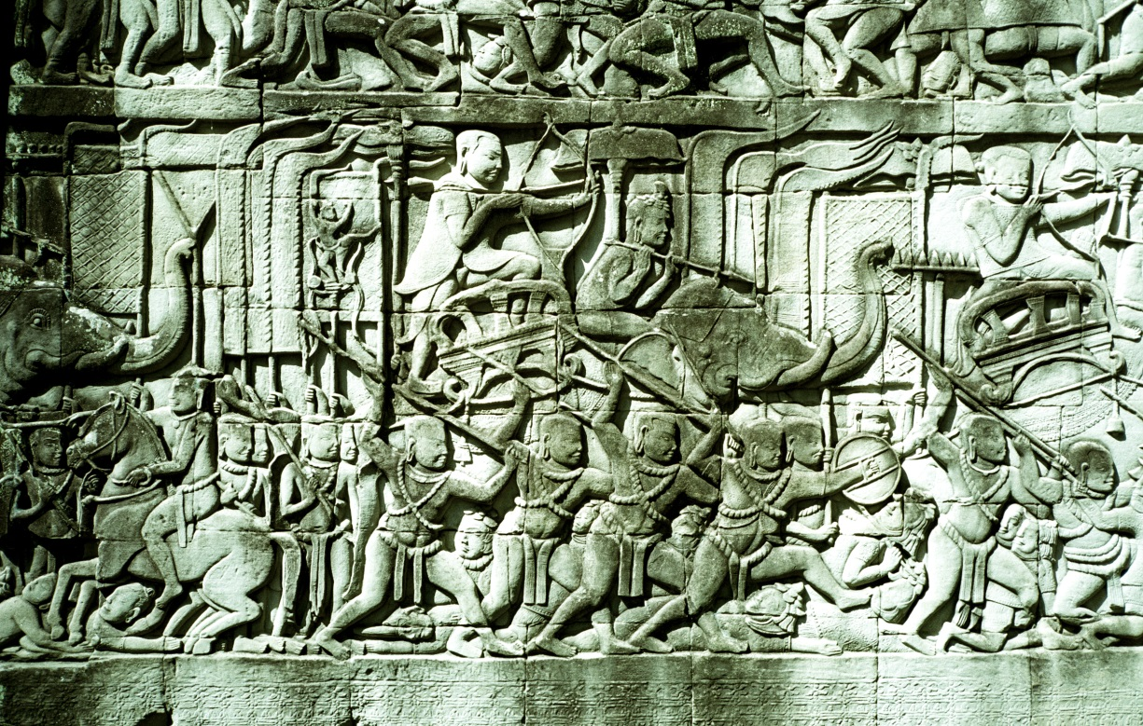
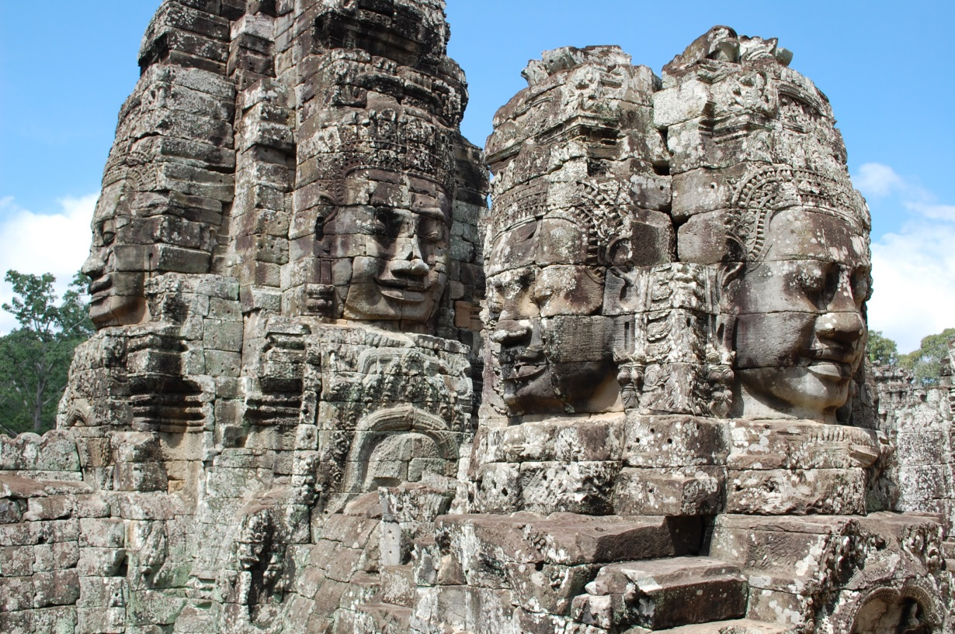
KING JAYAVARMAN VII

Slide 10
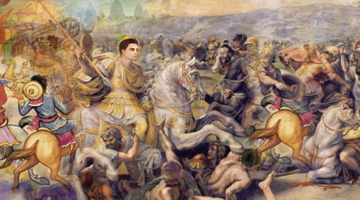
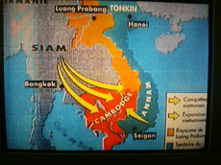
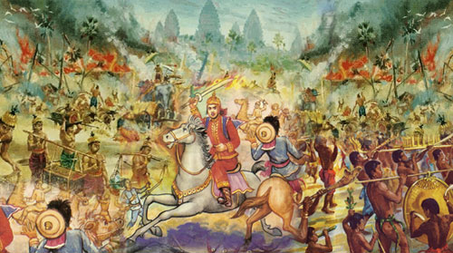
Cambodia 15th – 17th Century

Slide 11

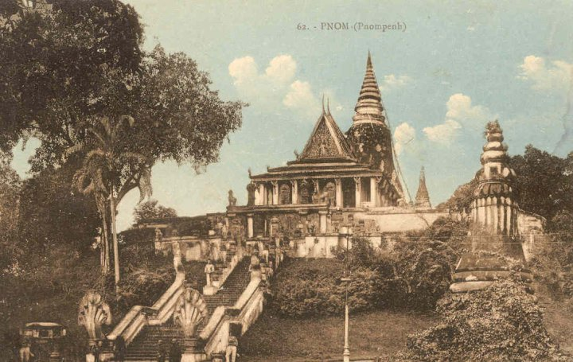
Cambodia 15th – 17th Century
Udong period/Chaktomuk period

Slide 12
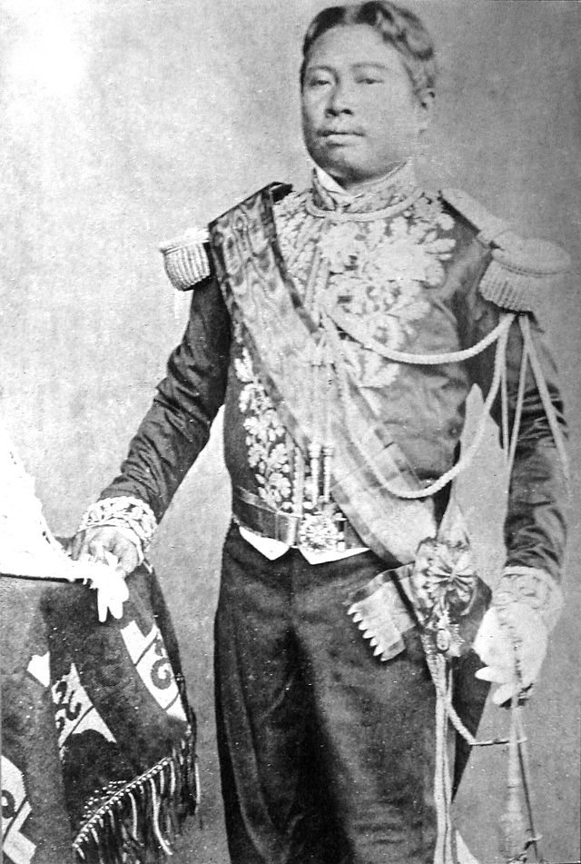
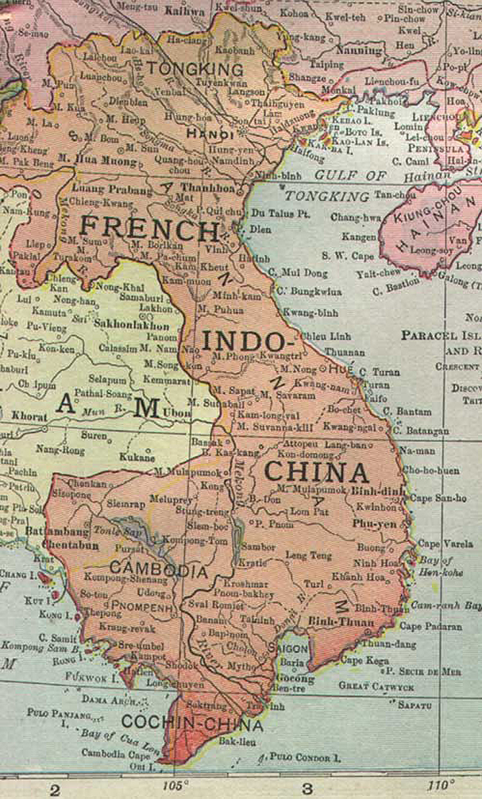
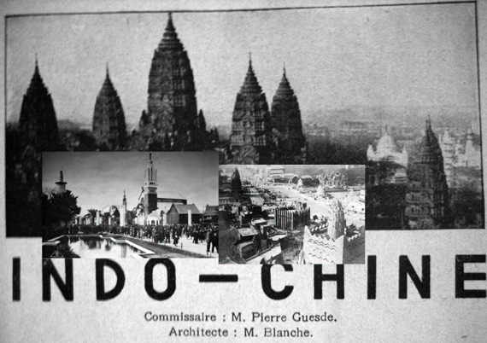
French Protectorate
King Norodom

Slide 13
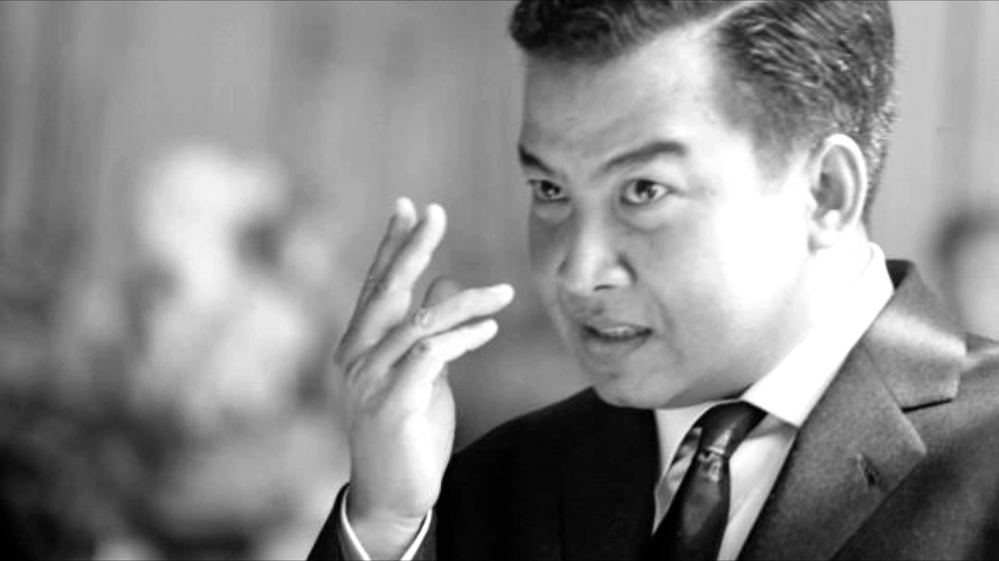
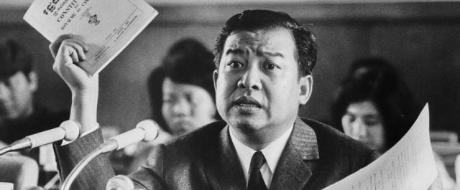
Struggle for independence
King Sihanouk

Slide 14
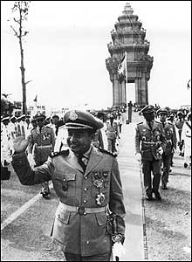
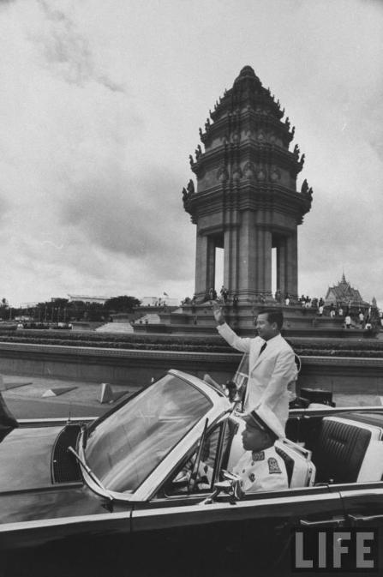
Independence 1953

Slide 15
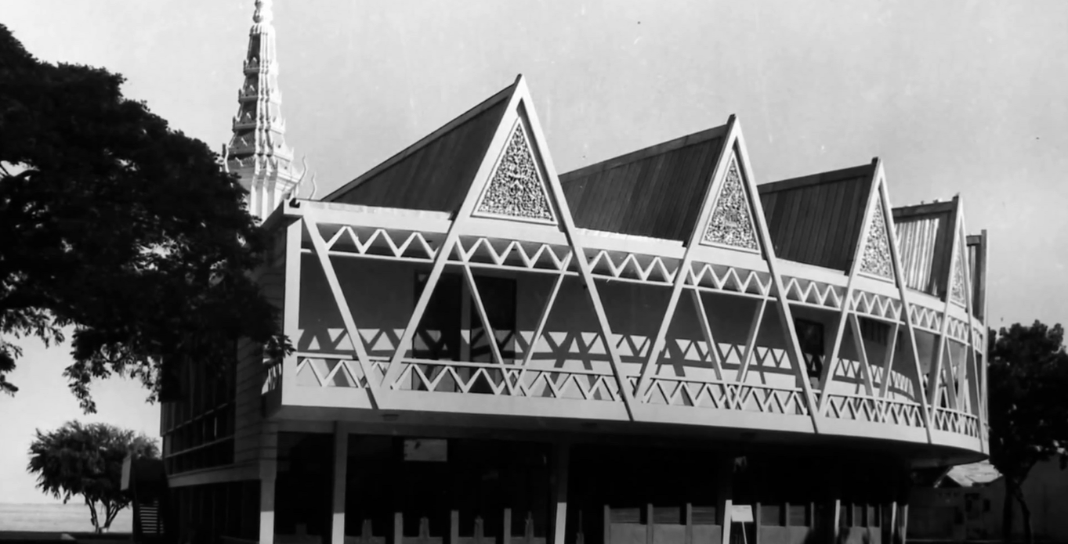
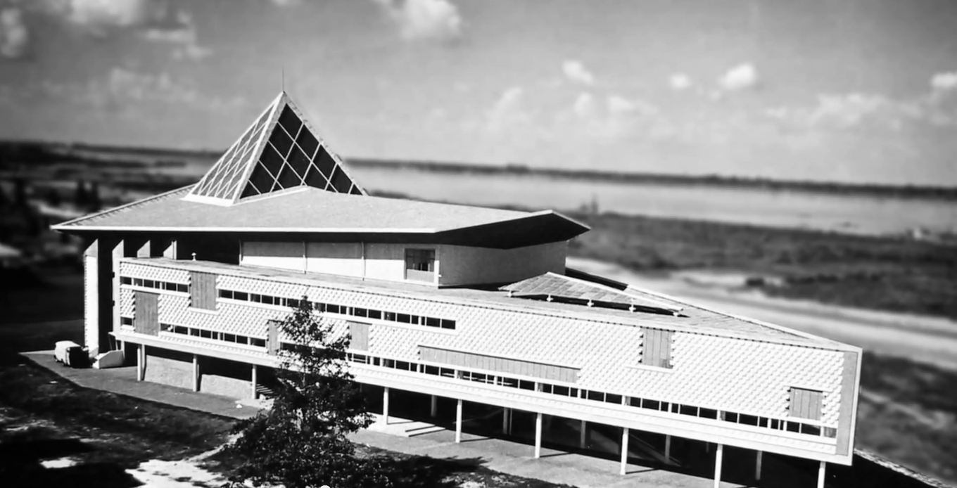
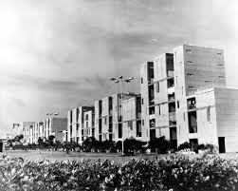
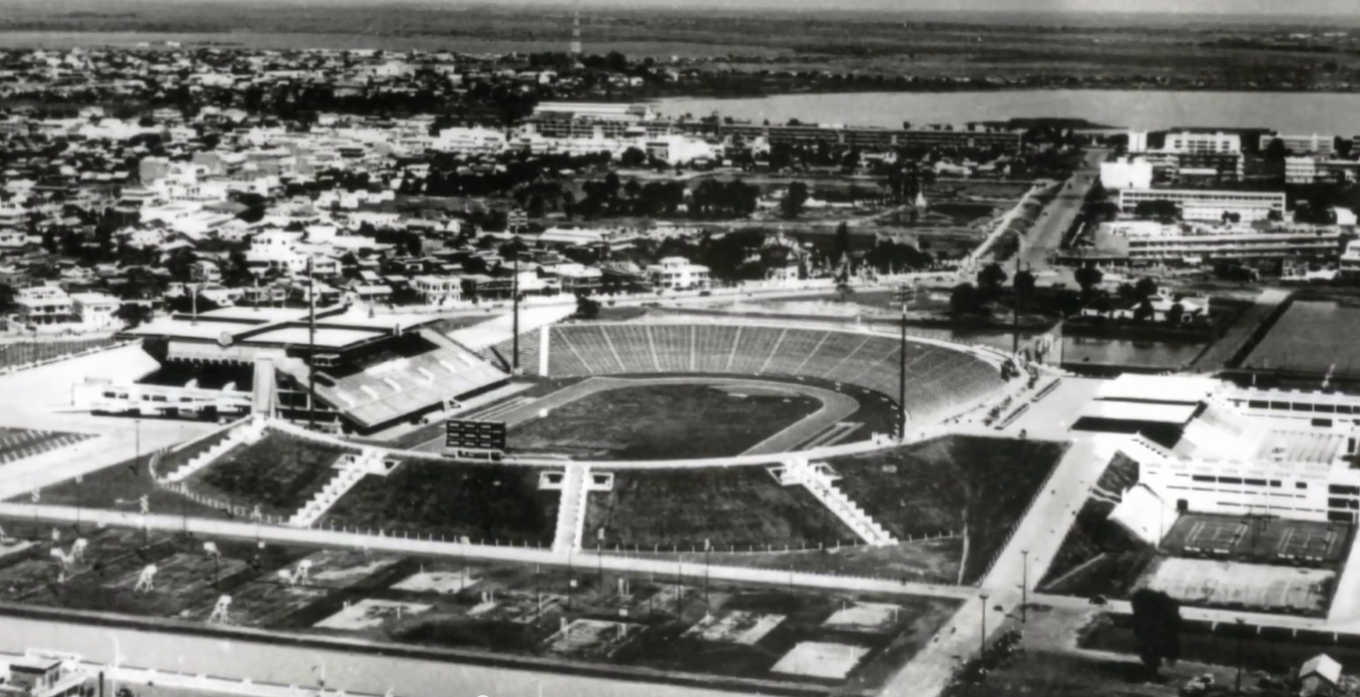
1960s – Sangkum Reastr Niyum

Slide 16
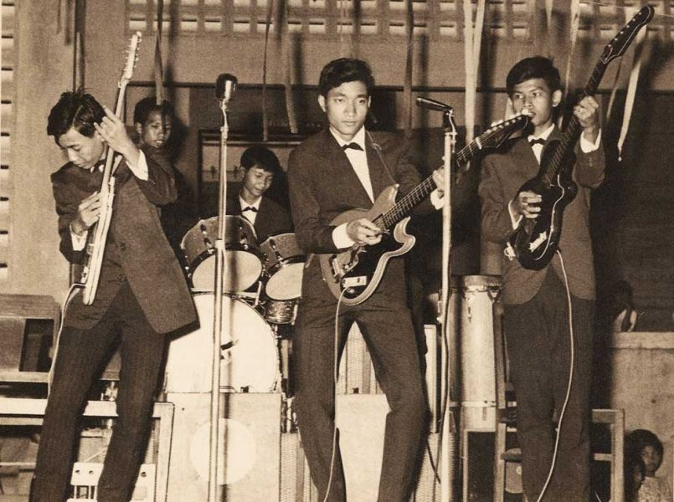
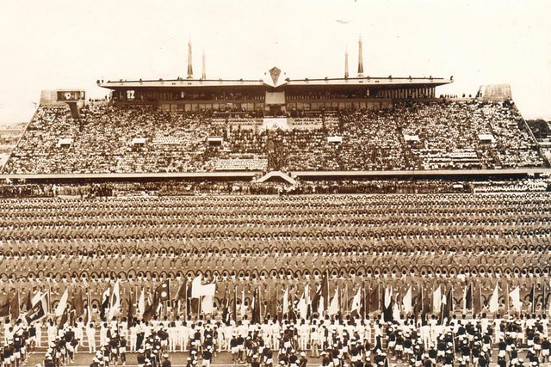
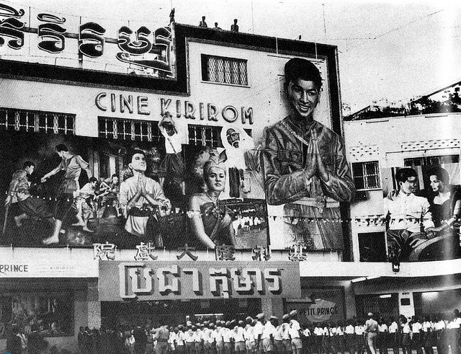
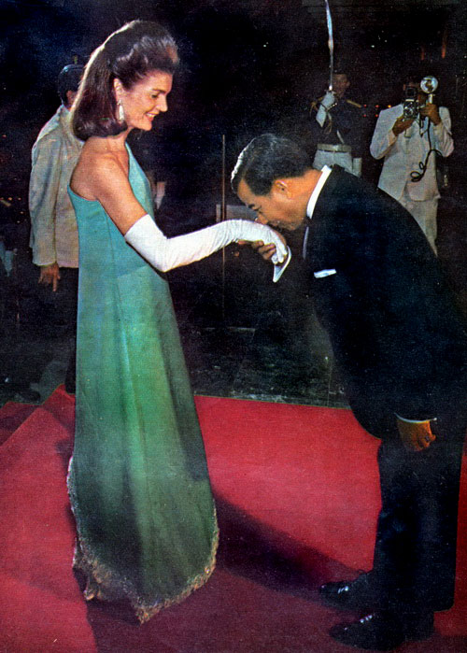
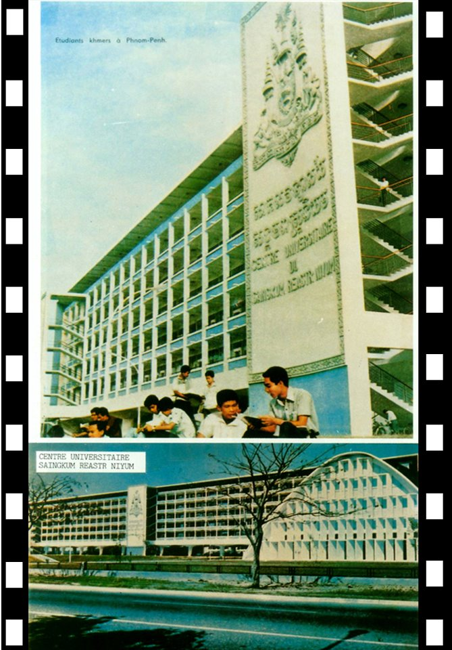
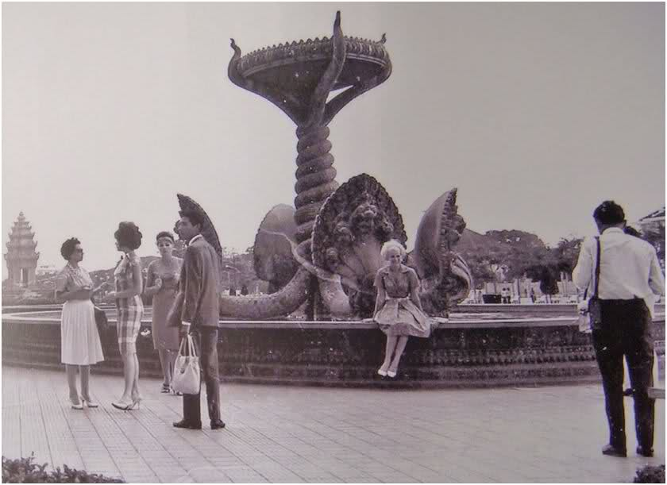
1960s – Sangkum Reastr Niyum

Slide 17
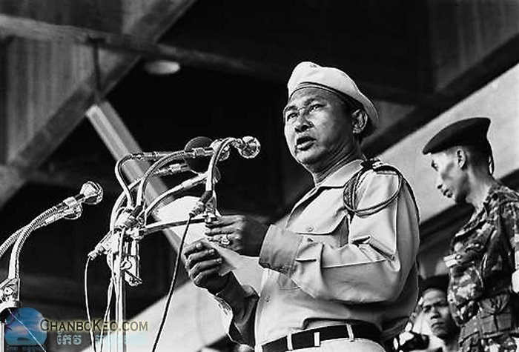
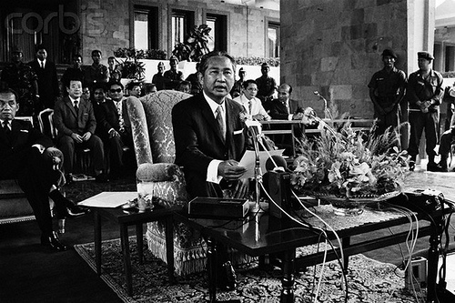
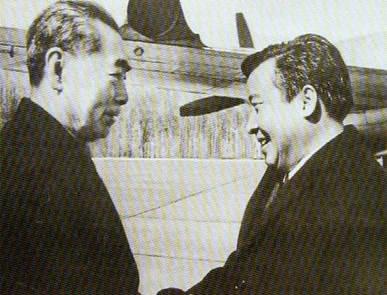
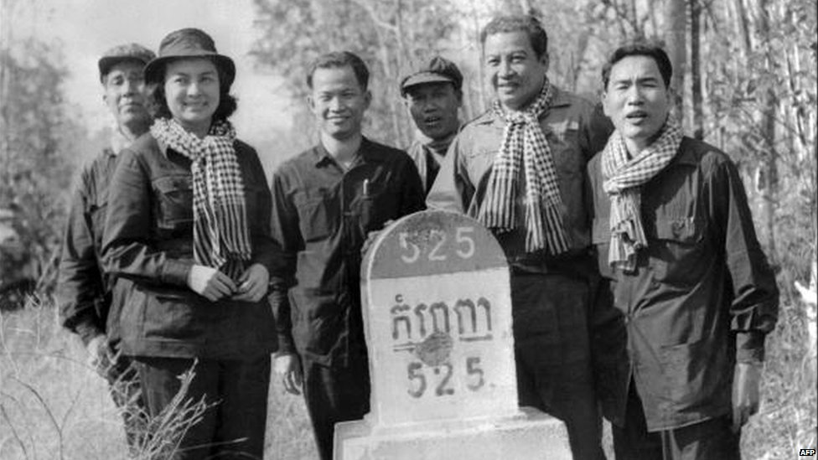
early 1970s –coup and the cold war

Slide 18
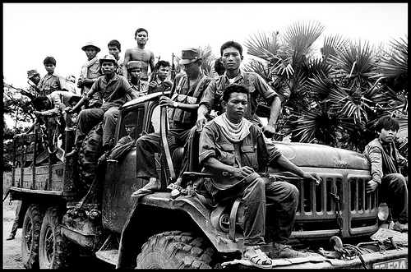

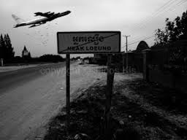
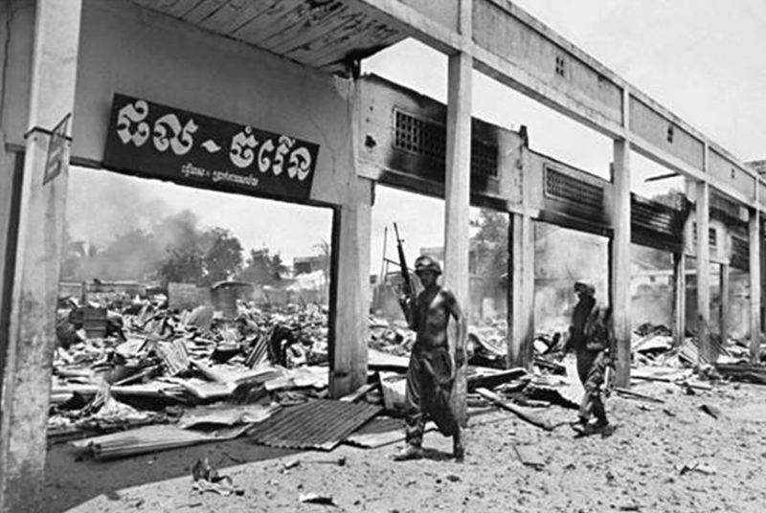
early 1970s – civil war

Slide 19
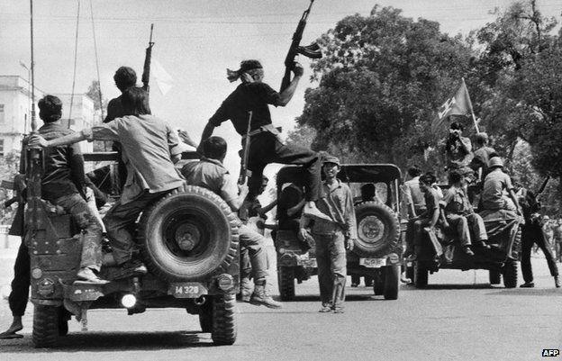
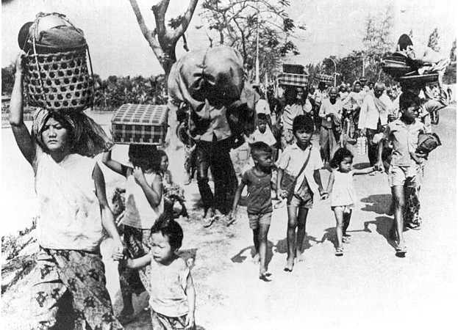
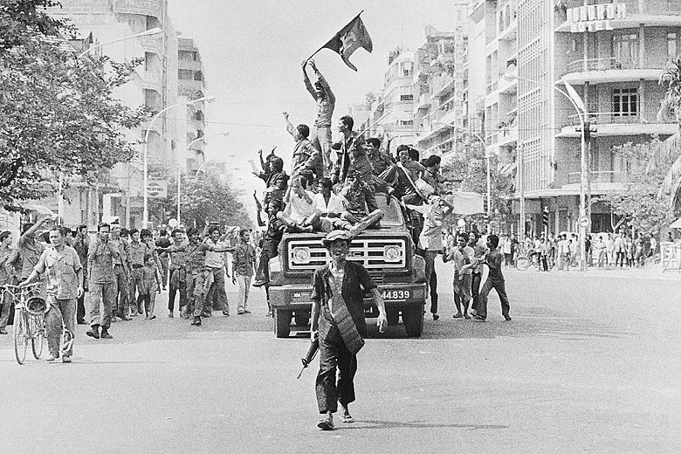
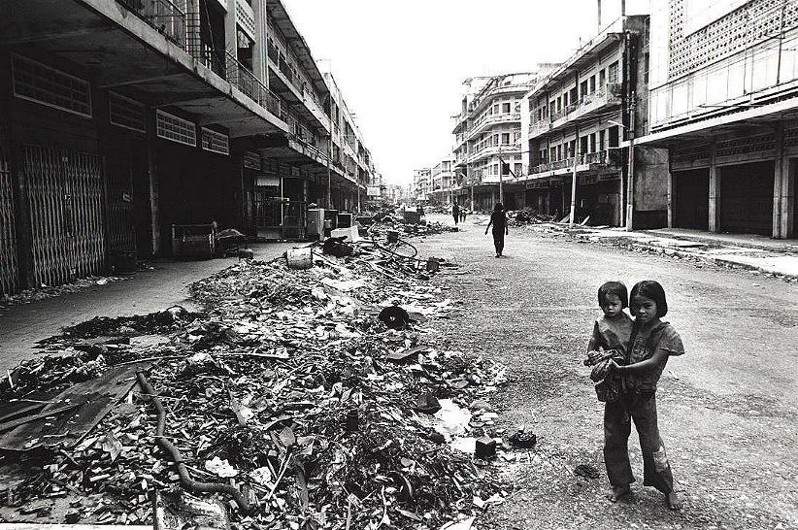
17 APRIL 1975 – year ZERO

Slide 20
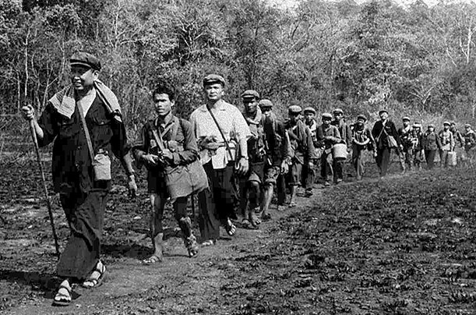
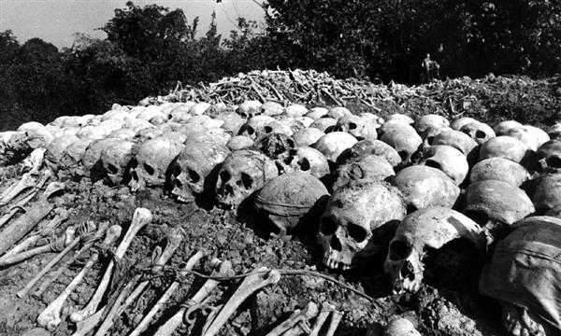

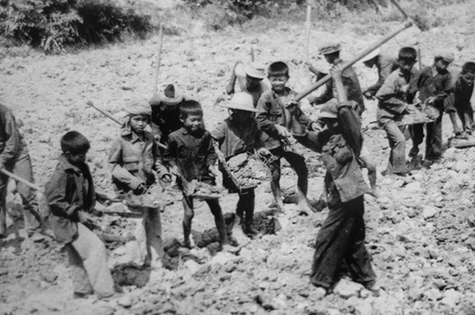
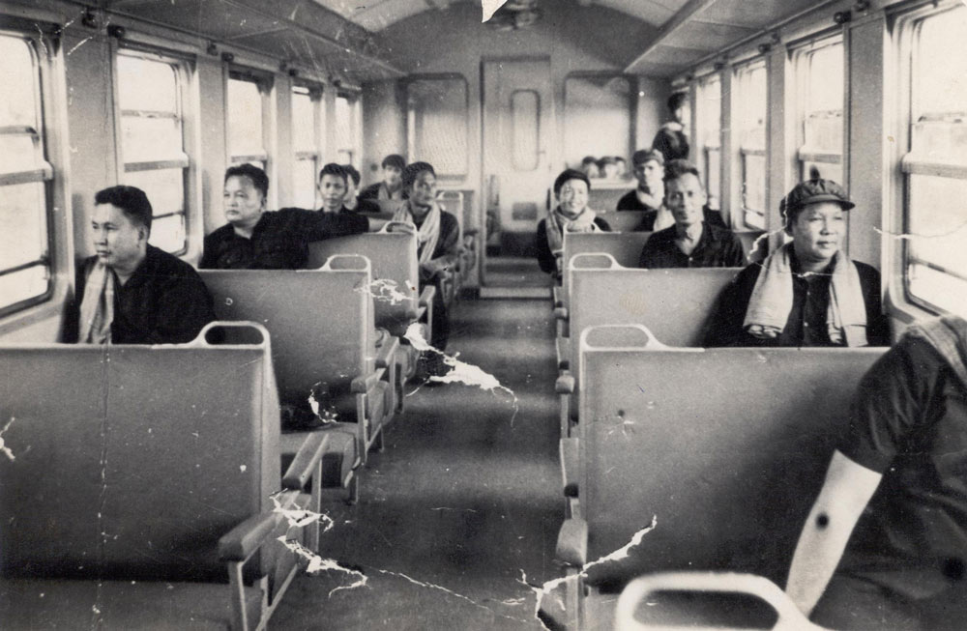
1975 – 1979 Democratic Kampuchea

Slide 21

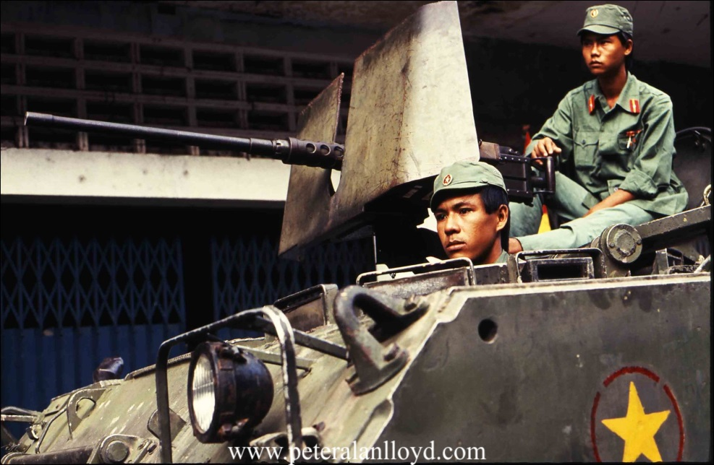


1979 – 1989 People’s Republic of Kampuchea (Vietnam Domination)

Slide 22




1991 - Peace Agreement

Slide 23




1992 - 1993 : UNTAC - 1st General Election

Slide 24



1997 – coup

Slide 25


1998 – 2015 HUN SEN as Prime Minister

Slide 26




2013 General Election

Slide 27




Post - 2013 Election : 1 year in protest

Slide 28


22 July 2014 – present : reconciliation and reform

Slide 29


22 July 2014 – present : culture of dialogue

Slide 30

Looking forward to 6th General Election
Demographic Change

Slide 31


Looking forward to 6th General Election
Election reform

Slide 32


Looking forward to 6th General Election
Tendency of Populism

