Slide 1
Introductory to Thai Economy
  Julius Everke5

Slide 2
Hyperinflation
Germany 1923
Three-year period in the Weimar Republic between June 1921 and January
Caused by
  Internal political instability
  Weak Economy
  Treaty of Versailles
    War reparations of $6.6 billion
    Occupation of the Ruhr by foreign troops due to inability to pay
    Labor strikes

Slide 3
Terminology
Inflation occurs when money loses its value, so you need more money to pay for the same thing
Hyperinflation occurs when inflation is very high and out of control; prices increase so fast and by enormous amounts

Slide 4
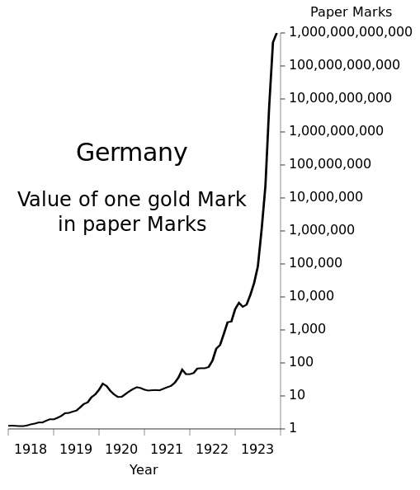
Germany bought foreign currency at any price in August 1921
The lower the value of the mark, the more mark required to buy foreign currency
By fall 1922, the mark was worthless
Germany paid war reparations in terms of goods, e.g. coal
Printed more money after Ruhr occupation

Slide 5
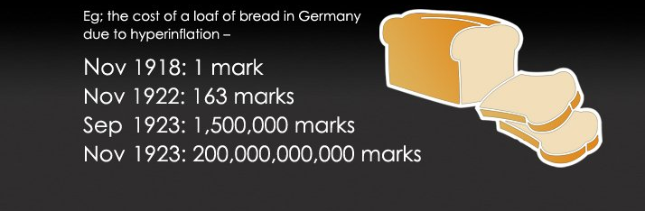
It was cheaper to burn marks than use them to buy firewood
People collected their wages in waggons or suitcases
Unattended suitcases were stolen, however the money left behind
Wages were negotiated on a daily basis

Slide 6
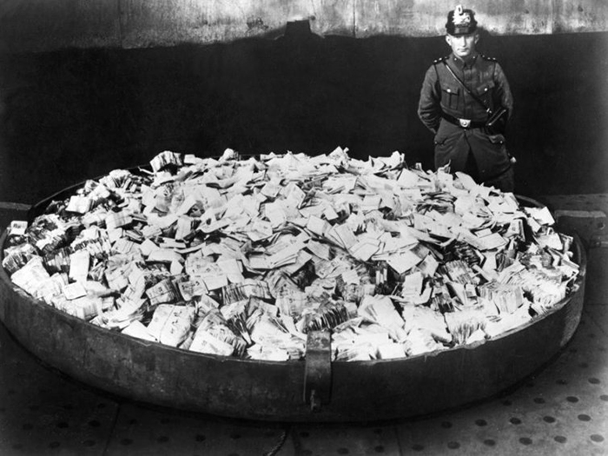

Slide 7
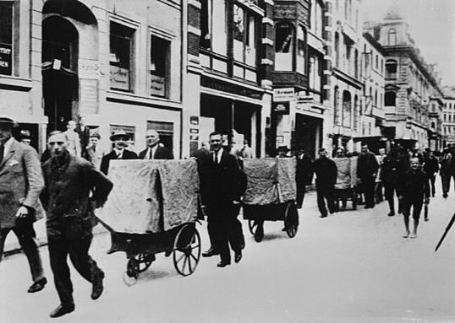
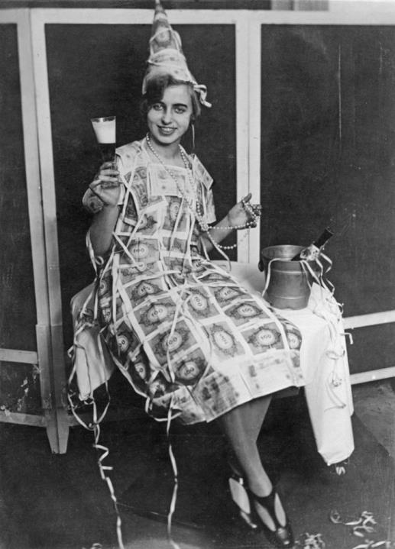
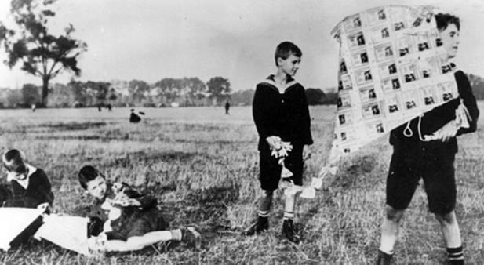

Slide 8
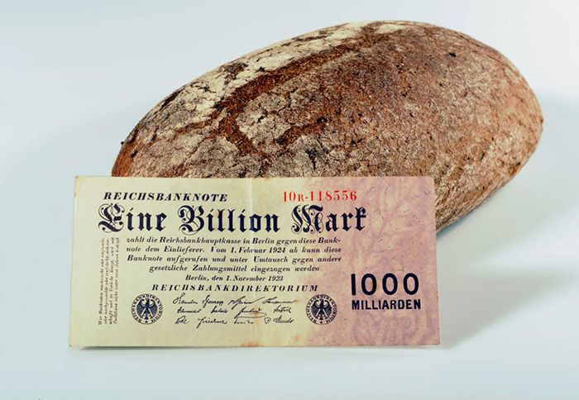

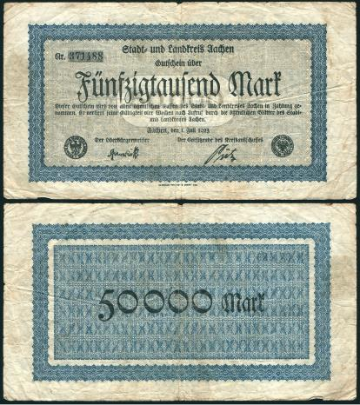
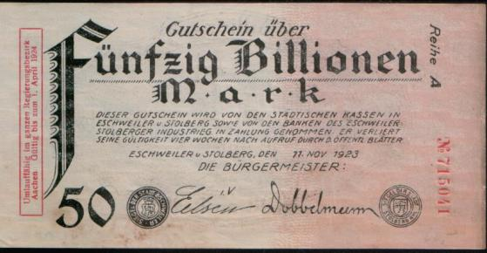

Slide 9
Aftermath
Gustav Stresemann September 1923
  Ordered workers in the Ruhr to go back to work
  Strong leadership
Rentenmark → Reichsmark
Dawes Plan
  Realistic reparation payments of $50 million instead of $2 billion
  American loan of $200 million
Golden Age of Weimar 1924-1929

