Slide 1
Rules of Tort Liability
No liability
Strict liability
Negligence
Contributory Negligence
Comparative Negligence

Slide 2
Behaviour under
Different Liability Rules
No liability
  Victim bears all cost
    Victim, thus, is the one who shall invest in precaution
    Overinvestment in precaution
  Wrongdoer bears nothing
    Wrongdoer, thus, does not invest in precaution
    Underinvestment in precaution
Strict liability
  Reversed

Slide 3
Section 437 – Strict Liability
A person is responsible for injury caused by any conveyance propelled by mechansim which is in his possession or control, unless he proves that the injury results from force majeure or fault of the injured person.
The same applies to the person who has in his possession things dangerous by nature of destination or on account of their mechanical action

Slide 4
Negligence
Definition of Negligence
  Negligence is a lack of ‘due care’ whereby one may exert a certain level of care to prevent ‘accident’ but fail to do so.
  i.e. Standard of care is not achieved.
Negligence vs Reckless

Slide 5
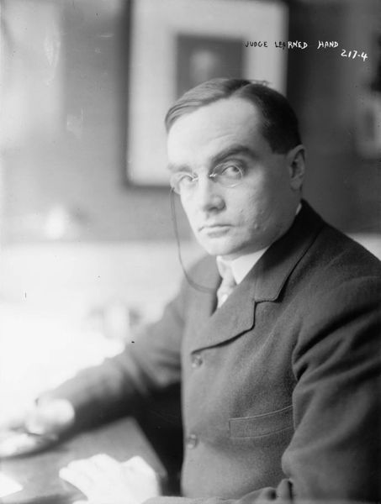
Judge Billings Learned HAND

Slide 6
Hand’s Rule
Calculus of Negligence
From the case that US government appealed the towing company whereby the judgement was made in favour of the company (United States v. Carroll Towing Co)
Judge Hand suggested that
Accident is contributed by factors:
    Probability of accident (p)
    Level of injury (L)
    Cost of preventing such injury (B)
Therefore, the tort liability is determined if and only if
  B < pL
    If B > pL, the defendant is not negligent

Slide 7
Behavioural Aspects of Hand’s Rule
Optimal Precaution
  Equating ‘cost of preventing injury’ and ‘expected cost of injury’
  Cost of preventing < Cost of injury: precaution should be invested
  Cost of preventing > Cost of injury: precaution is too expensive (wasting too much resource to prevent relatively small injury)
Calculation of precaution level
  Total Cost = Cost of preventing + Cost of expected injury

Slide 8
Behaviour under
Negligence
Negligence (or simple negligence) concerns ONLY on wrongdoer’s negligence
If the wrongdoer does not exert sufficient precaution = the wrongdoer is negligent  the wrongdoer is liable for wrongful act
If the wrongdoer does already have due care (=sufficient precaution) = the wrongdoer is not negligent  the wrongdoer is not liable  the victim responsible for own injury

Slide 9
Behaviour under
Contributory Negligence
Bilateral Precaution: not only wrongdoer should take precaution since precaution is ex ante. Everyone should take precaution
If the wrongdoer does not exert sufficient precaution (=negligent) AND the victim is not negligent
  ☞ The wrongdoer is liable
If the wrongdoer is not negligent (take due care) OR the victim is negligent
  ☞ The wrongdoer is not liable
How about the rest? Both are negligent/not negligent

Slide 10
Behaviour under
Comparative Negligence
Comparative ability of both parties to take precaution
If the wrongdoer does not exert sufficient precaution (=negligent) AND the victim is not negligent  The wrongdoer is liable
If the wrongdoer is not negligent (take due care) AND the victim is negligent  The wrongdoer is not liable
If both are negligent, both share the injury weighted by the level of their negligence

Slide 11
Section 442+223 - Comparative Negligence
442: If any fault of the injured party has contributed in causing the injury, the provision of Section 223 apply mutatis mutandis
223: If any fault of the injured party has contributed in causing the injury, the obligation to compensate the injured party and the extent of the compensation to be made depends upon the circumstances, especially upon how far the injury has been caused chiefly by the one or the other party.
This applies also even if the fault of the injured party consisted only in an omission to call the attention of the debtor to the danger of an usually serious injury which the debtor neither knew or ought to have known, or in an omission to avert or mitigate the injury.

Slide 12
Vicarious Liability
Precaution of ‘supervisor’
Inducing optimal monitoring for supervising
Optimal monitoring would induce optimal precaution for the wrongdoer
  Employer/employee
  Teacher/student
  Parent/children

Slide 13
Punitive Damages
Excessive compensation
Treble Damages
Objectives?
Behaviour?
Who take risk? Who is responsible for precaution?

Slide 14
Compensation for Non-pecuniary Injury
Non-material damage
Feeling + Hurt + Suffering: mental impact of injury
Different from contract law whereby non-pecuniary injury cannot be claimed.

