Slide 1

BA 291 – Business ethics and social responsibility
By Aj. Parichat Jantori

Slide 2
Ethics
Ethics is concerned with what is good for individuals and society and is also described as moral philosophy
Ethics covers the following dilemmas:
how to live a good life
our rights and responsibilities
the language of right and wrong
moral decisions - what is good and bad?
The concepts of ethics have been derived from religions, philosophies and cultures

Slide 3

Law
Law refers to a system of rules and guidelines, usually enforced through a set of institutions.
Laws are the forcible means by which a government achieves its goals. Laws contain sanctions for those who do not obey. Subsidies, fines, and imprisonment are examples of mechanisms that may be used as the forcible sanction of a law

Slide 4
Different between law and ethics
Ethics are rules of conduct. Laws are rules developed by governments in order to provide balance in society and protection to its citizens
Ethics comes from people’s awareness of what is right and wrong. Laws are enforced by governments to its people
A law is something you must obey. Ethics is how society expects you to behave
Laws carry with them a punishment for violations , ethics does not
Ethics comes from within a person’s moral sense and desire to preserve his self respect, laws does not
People obey the laws in order to avoid the consequences, people behave ethically because they believe, it is a good way to do so.

Slide 5

Many people believe that if you are not breaking the law, then you are behaving in an ethical manner.
Are they right?

Slide 6
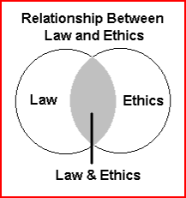
In some instances, law and ethics overlap and what is perceived as unethical is also illegal. In other situations, they do not overlap.

Slide 7

“Managers face a variety of difficult situations”
Many time they stuck in the ethical dilemma….
An ethical dilemma is a situation that arises when all alternative choices or behaviors are deemed undesirable because of potentially negative consequences, making it difficult to distinguish right from wrong.

Slide 8
Decision making process
Identifying and diagnosing the problem
Generating alternative solution
Evaluating alternative
and making the choice
Implementation
Evaluating the decision

Slide 9
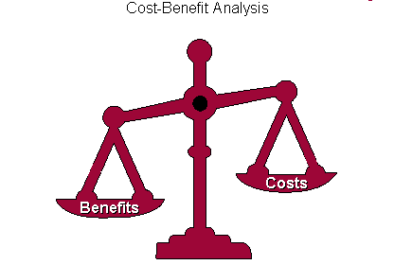
Factors influenced decision making
Benefits
Cost
Timeliness
Acceptability
Ethical soundness

Slide 10
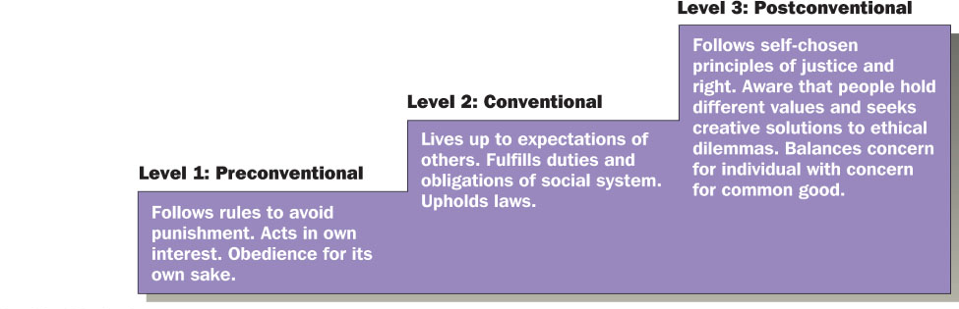
Levels of personal moral development

Slide 11
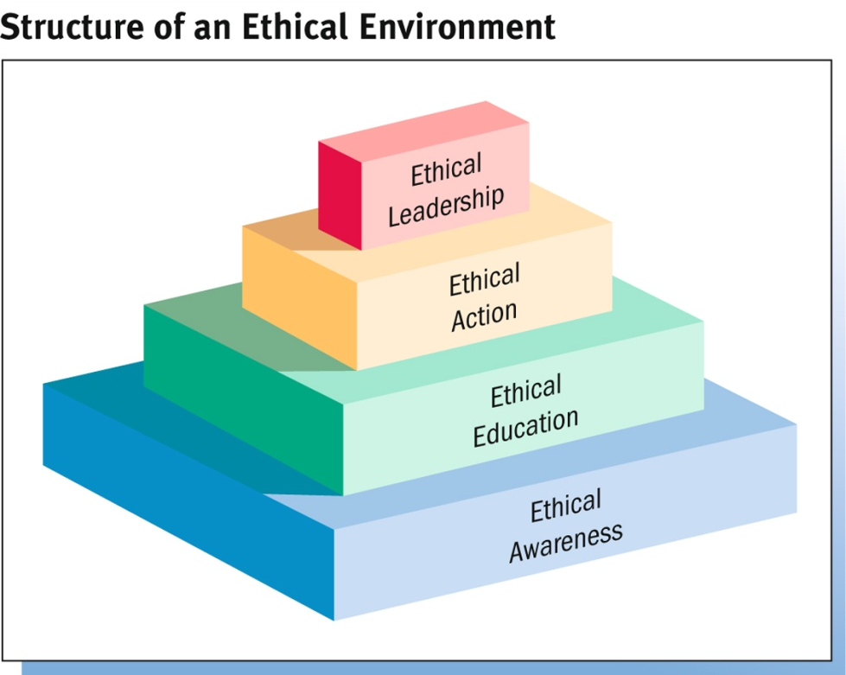
Building ethical environment
Ethical Awareness
Code of Conduct : Formal statement that defines how the organization expects and requires employees to resolve ethical questions
Ethical Education
Codes of conduct cannot detail a solution for every ethical situation, so corporations provide training in ethical reasoning.
Ethical Action
Helping employees recognize and reason through ethical problems and turning them into ethical actions.
Ethical Leadership
Executives must demonstrate ethical behavior in their actions.
Notes:
http://en.wikipedia.org/wiki/Corporate_social_responsibility

Slide 12
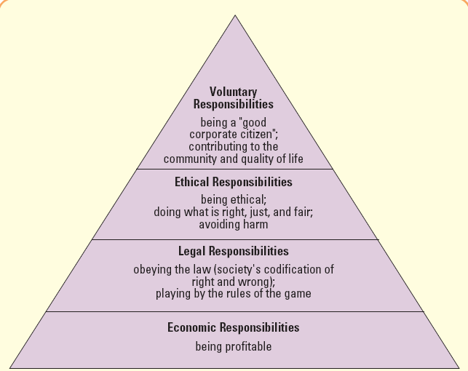
Social Responsibility
Social responsibility– business’s obligation to maximize its positive impact and minimize its negative impact on society
Notes:
Management’s consideration of profit, consumer satisfaction, and societal well-being of equal value in evaluating the firm’s performance.

Slide 13
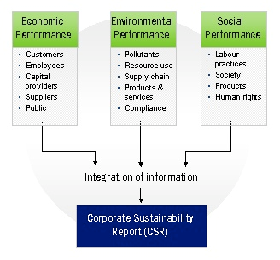
Corporate Social Responsibility
CSR – A concept whereby companies integrate social and environment concern in their business operations and in their interaction with their stakeholders on a voluntary basis.

Slide 14
Benefits from CSR
Win new business
Increase customer retention
Develop and enhance relationships with customers, suppliers and networks
Attract, retain and maintain a happy workforce and be an Employer of Choice
Save money on energy and operating costs and manage risk
Differentiate yourself from your competitors
Generate innovation and learning and enhance your influence
Improve your business reputation and standing
Provide access to investment and funding opportunities
Generate positive publicity and media opportunities due to media interest in ethical business activities

Slide 15
Benefits from CSR
“88% of consumers said they were more likely to buy from a company that supports and engages in activities to improve society”
(UK Small Business Consortium)
“2,215 workers around the globe, found that employees are more likely to be “proud” of their company if it’s engaged in good corporate behavior”
“Employees are more likely to decide to work for companies that are environmentally responsible”
“Employees are more likely to accept lower pay or a small role in an organization with sound corporate reputation”
(Kelleyservices, 2010)
Notes:
http://www.kellyservices.com.sg/web/sg/services/en/pages/sociallyresponsible.html

Slide 16
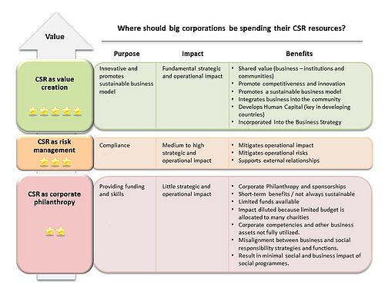
CSR approach
Strategic CSR
Responsive CSR
Philanthropy
Notes:
http://en.wikipedia.org/wiki/Corporate_social_responsibility

