Slide 1




Marketing Planning 312
Chapter 5 Part 1
Customer BEhavior
By Ajarn Suwalya K.

Slide 2
Chapter 5
Customers, Segmentation, and Target Marketing

Slide 3
Chapter Outline
Introduction
Buyer behavior in consumer markets
Market segmentation
Identifying market segments
Target marking strategies

Slide 4
Segmentation and Target Marketing
Consider markets as individuals, institutions, or a group of people
  Have similar needs that can be met by a specific offering
Aim
  To identify specific customer needs and design marketing programs to satisfy those needs

Slide 5

Segmentation and Target Marketing (Continued)
Firms must comprehensively:
  Understand current and potential customers
  Know customer motivations, behaviors, needs, and wants
Marketers must comprehend and define consumer needs better to help attain success

Slide 6
Buyer Behavior in Consumer Markets
Often irrational and unpredictable
Progresses through five stages
Issues in the buying process
  Consumers do not always follow stages in the sequence and can be swayed by brand loyalty
  Involves making parallel decisions
    What to buy
    Where to buy
  Bias towards a merchant limits purchasing powers

Slide 7
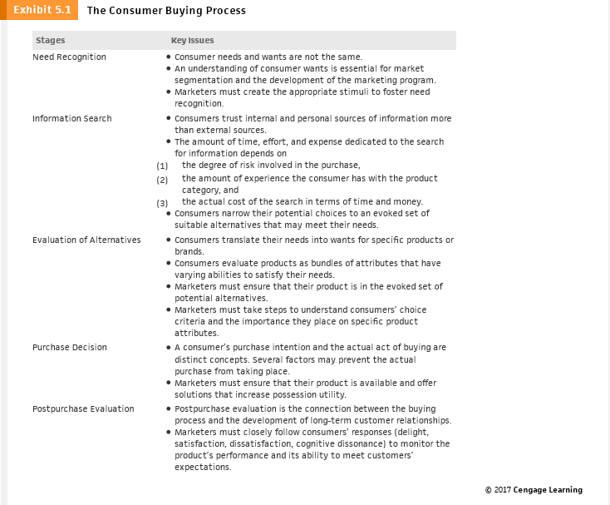
Exhibit 5.1- The Consumer Buying Process

Slide 8
Exhibit 5.1 - The Consumer Buying Process (Continued)

Slide 9
The Consumer Buying Process:
Need Recognition
Need
  Occurs when the consumer’s existing level of satisfaction and desired level of satisfaction are not the same
  Based on internal or external stimuli
Want
  Consumer’s desire for a specific product that will satisfy the need
Demand
  Occurs when a consumer’s ability and willingness to purchase a specific product backs up the want for that product

Slide 10
Discussion Question 1
Discussion Questions
Many people criticize marketing as being manipulative based on the argument that marketing activities create needs where none previously existed. Marketers of SUVs, tobacco products, diet programs, exercise equipment, and luxury products are typically the most criticized. Given what you now know about the differences between needs and wants, do you agree with these critics? Explain.

Slide 11
The Consumer Buying Process:
Information Search
Marketing activities can stimulate a desire for information
  Passive information search
  Active information search
Sources of information
  Internal sources - Personal experiences and memories
  External sources - Advertising, websites, packaging, display, and salespeople

Slide 12
The Consumer Buying Process:
Information Search (Continued)
Amount of time, effort, and expense dedicated to information search depends on:
  Degree of risk involved in the purchase
  Amount of expertise with the product category
  Actual cost of the search (time and money)
Evoked set
  Narrowing down potential product choices to a few products that can meet consumer needs
  Represents the outcome of information search

Slide 13
The Consumer Buying Process:
Evaluation of Alternatives
Consumers evaluate products as bundles of attributes
  Each attribute has a different level of importance
  Priority of choice criteria can change during the process
Important considerations
  Products must be in the evoked set
  Consumers’ choice criteria must be understood

Slide 14
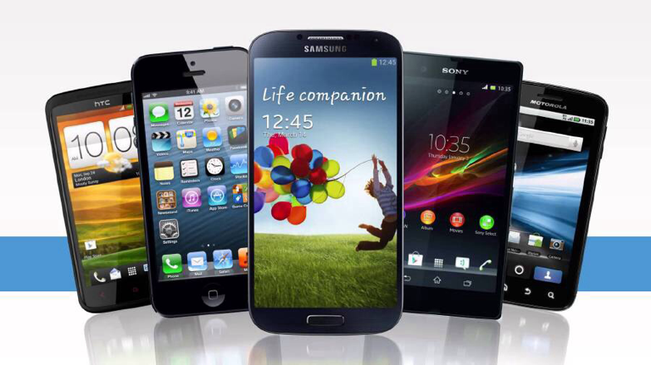
The Consumer Buying Process:
Evaluation of Alternatives

Slide 15
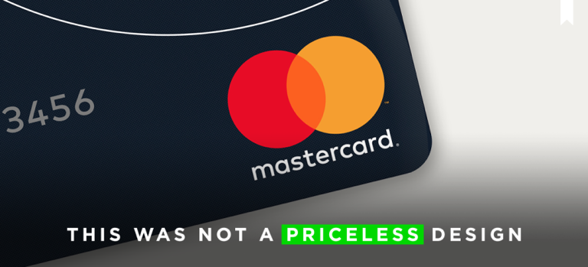
The Consumer Buying Process:
Evaluation of Alternatives (Continued)
  Marketing programs must be designed to:
    Change priority of choice criteria
    Change consumers’ opinions about product or brand image

Slide 16
The Consumer Buying Process:
Purchase Decision
Unforeseen circumstances can interfere with consumer’s decision to buy a product
Marketers overcome these factors by:
  Reducing the risk of purchase
  Making purchase easy
  Finding creative solutions to unexpected problems.
Key issues in the purchase decision stage:
  Product availability
  Possession utility

Slide 17
The Consumer Buying Process:
Postpurchase Evaluation
Connection between buying process and developing long-term customer relationships
Four possible outcomes
  Delight
  Satisfaction
  Dissatisfaction
  Cognitive dissonance (post-purchase doubt)

Slide 18

The Consumer Buying Process:
Postpurchase Evaluation (Continued)
High likelihood of experiencing dissatisfaction or cognitive dissonance when:
  Dollar value of the purchase increases
  Opportunity costs of rejected alternatives are high
  Purchase decision is emotionally involving

Slide 19
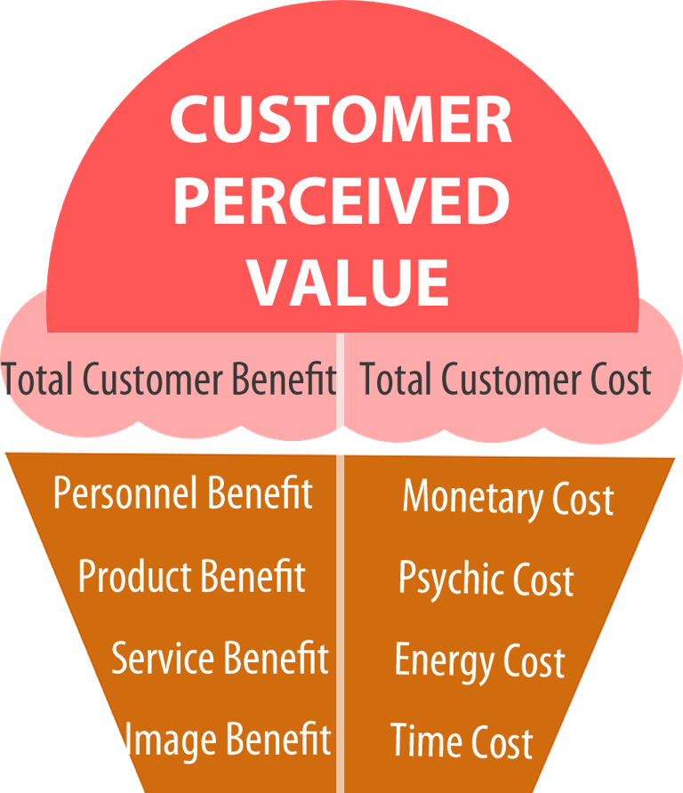
The Consumer Buying Process:
Postpurchase Evaluation (Continued)

Slide 20
Factors Affecting the Consumer Buying Process
Decision-making complexity
  Primary reason for variations in the buying process
Individual influences
  Demographics, perceptions, motives, interests, attitudes, opinions, or lifestyles
Social influences
  Culture, subculture, social class, reference groups, and opinion leaders
Situational influences
  Affect amount of time and effort devoted to the purchase task

Slide 21

Common Situational Influences
Physical and spatial influences
  Example - Retail atmospherics
Social and interpersonal influences
  Example - Salespeople
Temporal influences
  Example - Lack of time

Slide 22

Common Situational Influences (Continued)
Purchase task or product usage influences
  Example - Special occasions
Consumer dispositional influences
  Example - Stress

Slide 23
Factors Influencing the Buying Process
Environmental conditions
  Increase uncertainty, risk, and complexity associated with purchase
Organizational factors
  Include internal and external environmental conditions
Individual factors
  Importance depends on specific buying situations and the importance of the firm’s goals and objectives

Slide 24


