Slide 1

D
BI201/ BA291
The Environment of Business
by Parichat Jantori

Slide 2
Business Models are designed and executed in specific environments.
Developing a good understanding of your organization’s environment helps you conceive stronger, more competitive business models.

Slide 3
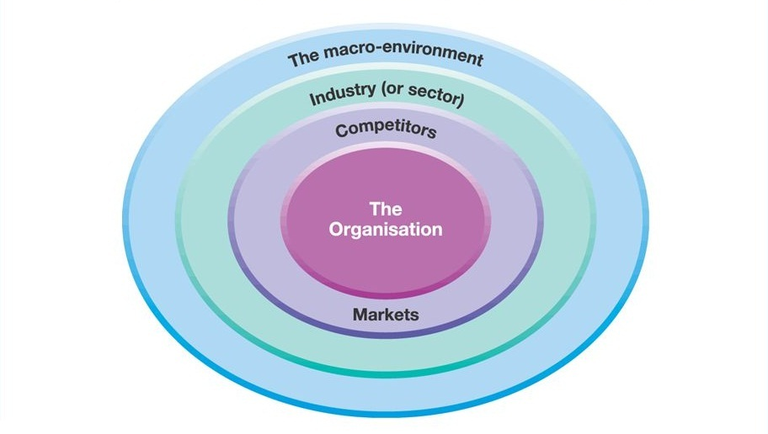
The combination of internal and external factors that influence a company's operating situation.

Slide 4
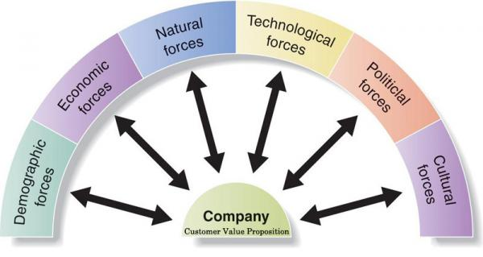

Slide 5
Economic Forces
Macroeconomic influences are broad economic factors that either directly or indirectly affect the entire economy and all of its participants, including your business.
These factors include such things as:
Interest rates
Taxes
Inflation
Currency exchange rates
Consumer discretionary income
Savings rates
Consumer confidence levels
Unemployment rate
Economic Cycle

Slide 6
Political Forces
The government plays a major role in determining how businesses operate. Changes in the government policy make up the political factors. The change can be economic, legal or social. It could also be a mix of these factors.
Political factors affecting business includes:
Bureaucracy
Corruption level
Freedom of the press
Legal framework
Government initiatives
The political situation of a country affects its economic setting. The economic environment affects the business performance.
Lack of political stability in a country effects business operations.

Slide 7
Political Forces
Firms should track their political environment. Change in the political factors can affect business strategy because of the following reasons:
The stability of a political system can affect the appeal of a particular local market.
Governments view business organizations as a critical vehicle for social reform.
Governments pass legislation, which impacts the relationship between the firm and its customers, suppliers, and other companies.
The government is liable for protecting the public interest.
Government actions influence the economic environment.
Government is a major consumer of goods and services.
The political environment is perhaps among the least predictable elements in the business environment

Slide 8
Technological Forces
- Technological forces impact everything from how a product is produced to how a customer uses it and may affect every function in an organization, including what products are developed, how marketing reaches consumers, and how sales are tracked and managed.
- Technological innovations in processes can improve productivity and efficiencies that will reduce costs and improve profit margins. It can make a business more competitive.
- Innovation in technological processes can also make products possible that were otherwise impossible with older technology.

Slide 9
Social-Cultural Forces
The social factors shape who we are as people. Social factors include attitudes, values and lifestyles of people. Social factors influence the products people buy, the prices they are willing to pay for the products, the effectiveness of specific promotions, and how, where, and when people expect to purchase products.

Slide 10
Demographic Forces
Demographics are various traits that can be used to determine product preferences or buying behaviors of consumers.
Gender (Sex Distribution)
Level of education
Geographic location, Immigration
Income
Family composition
Age
Notes:
Population changes are also directly affecting organizations. The supply and demand of goods and services in an economy can change with the structure of the population. Decline in birth rates mean demand will decrease. It also indicates greater competition as the total consumers fall.

Slide 11
Nature/ Environmental Forces
Environmental issues relate to weather, natural disasters, climate change, pollution, availability of natural resources and anything else that could impact business.

Slide 12
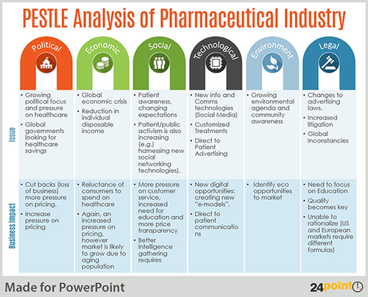
PESTEL Analysis

Slide 13
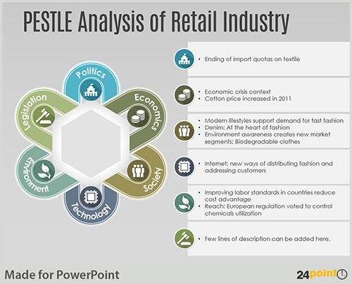
PESTEL Analysis

Slide 14
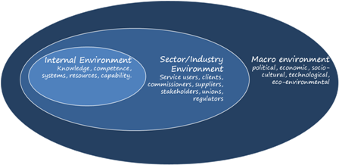
Industry Environment
The industry environment is composed of the following stakeholders, around which analysis is done. Namely: Competitors, Suppliers and Buyers. It defines the battle ground of business setting.

Slide 15
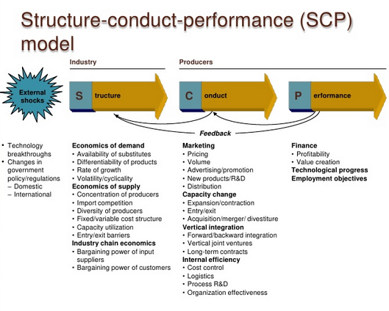
Analyzing Industry Environment

Slide 16
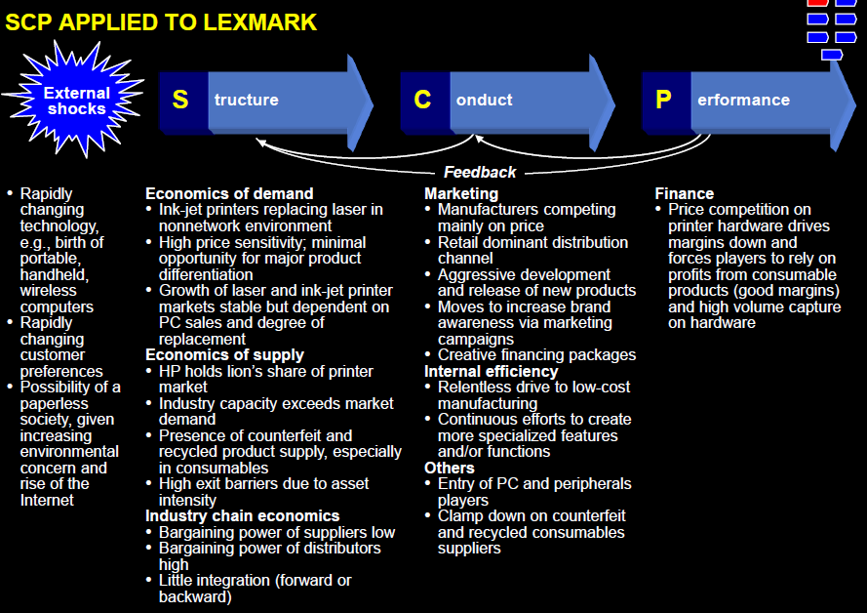

Slide 17
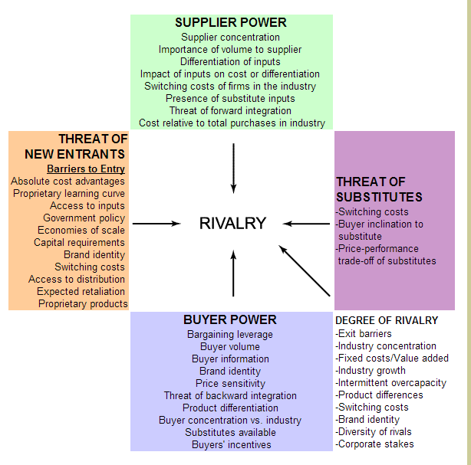
Analyzing Industry Environment

Slide 18
Internal Environment
The internal business environment comprises of factors within the company which impact the success and approach of operations.
Some examples of areas which are typically considered in internal factors are:
Financial resources like funding, investment opportunities and sources of income.
Physical resources like company’s location, equipment, and facilities
Human resources like employees, target audiences, and volunteers
Access to natural resources, patents, copyrights, and trademarks
Current processes like employee programs, software systems, and department hierarchies

Slide 19
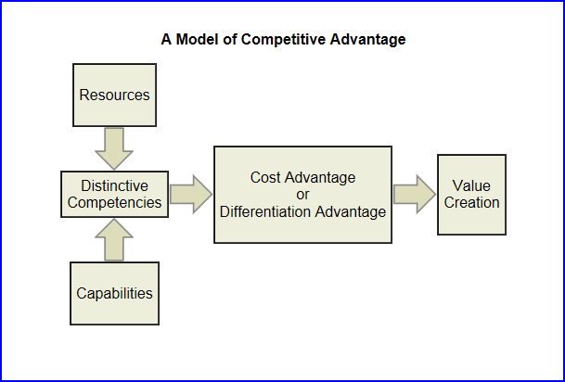
A model of competitive advantage

Slide 20
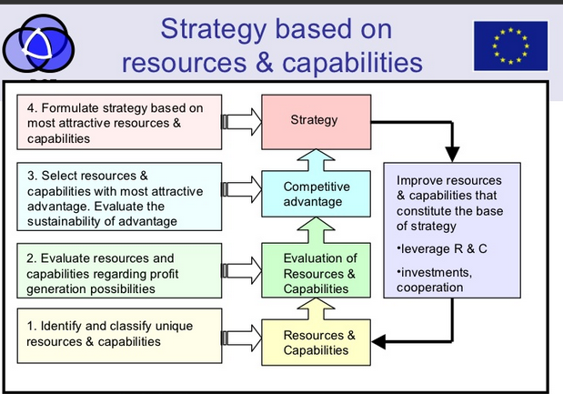

Slide 21
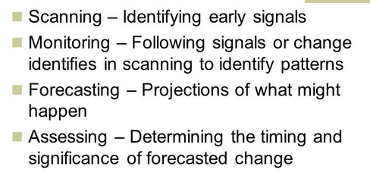
Method of External Environment Analysis

Slide 22
Method of External Environment Analysis
As a strategic leader you will need to maintain your knowledge of the industry environment, this can be achieved through:
Reading trade journals
Attending trade shows
Attending industry networking functions
Open conversations with your
Customers and their competitors
Suppliers and their competitors
Participation on industry boards
Research on the internet

Slide 23
“ It’s not the strongest of the species that survives, nor the most intelligent, that survives. It is the one that is the most adaptable to change”

Slide 24
Responses to the environment
Adapting to the environment
Decentralize decision making (empowerment)
buffering, smoothing, rationing, flexible process (mass customization)
Changing the environment
Domain selection: entering the new market using existing expertise
Diversification: entering the new or existing market with new products
Influencing
- public relation, advertising, building alliances, co-opting, contracting, trade association, legal action, political action

Slide 25
8 Mega Trends
1. Connectivity: Everything. All the time. Anywhere.
2. Digital Age: Power of ONLINE
3. Aging Society: The median age rises due to rising life expectancy and/or declining fertility rates
4. Urbanization: Population shift from rural to urban areas
5. New Generation: Digital Teens (BORN BETWEEN 1995 – 2002)
6. Global Knowledge Society: Borderless learning
7. Womenomics (Sheconomy): Women’s pay will overtake men’s
8. World friendly
Notes:
http://www.trendsactive.com/#!/our-trends/generation-trends/

Slide 26
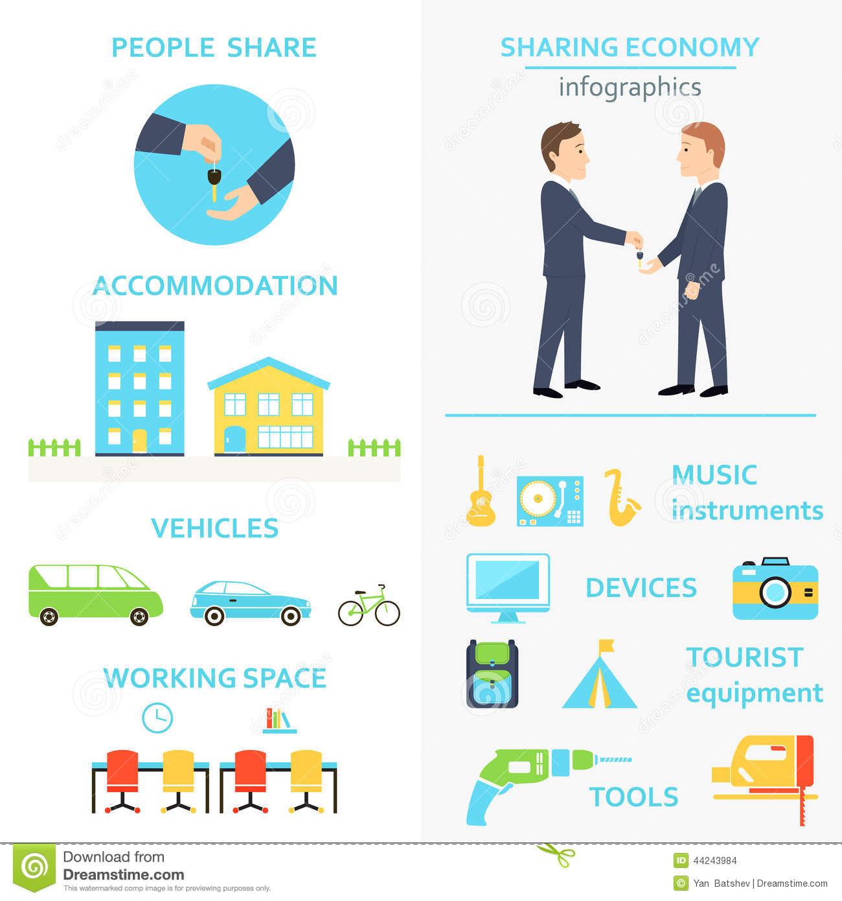

Sharing Economy
(Shareconomy or collaborative consumption)
refers to peer-to-peer-based sharing of access to goods and services

Slide 27
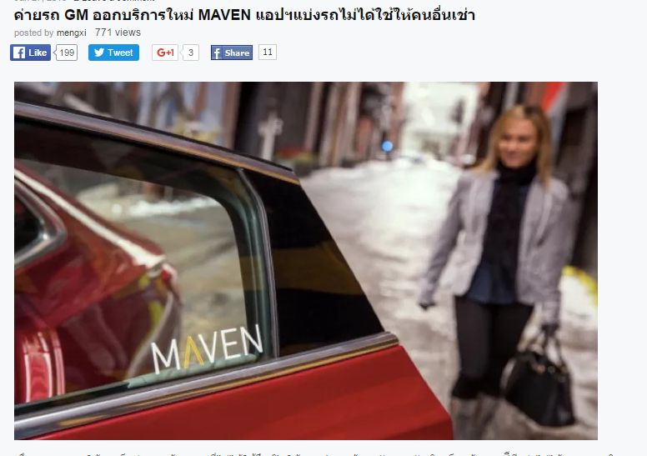
Sharing Economy
Notes:
http://www.marketingoops.com/news/biz-news/gm-maven/

Slide 28
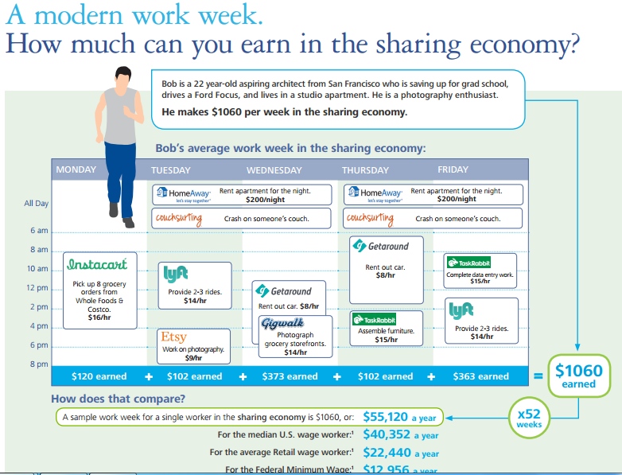
Notes:
http://www2.deloitte.com/content/dam/Deloitte/us/Documents/strategy/us-consulting-sharing-economy-infographic-060914.pdf

Slide 29
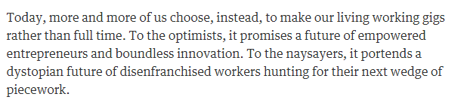
Gig Economy
A gig economy is an environment in which temporary positions are common and organizations contract with independent workers for short-term engagements.
Notes:
http://www.theguardian.com/commentisfree/2015/jul/26/will-we-get-by-gig-economy
http://www.bangkokbiznews.com/blog/detail/635508

Slide 30

Gig Economy
Notes:
http://www.marketingoops.com/news/biz-news/gm-maven/

Slide 31



Gig Economy
Notes:
http://www.marketingoops.com/news/biz-news/gm-maven/

Slide 32
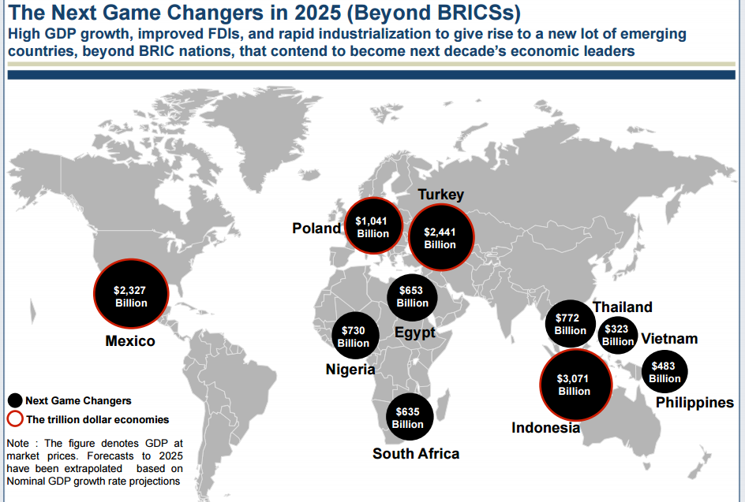
BRICS to MINTs

Slide 33
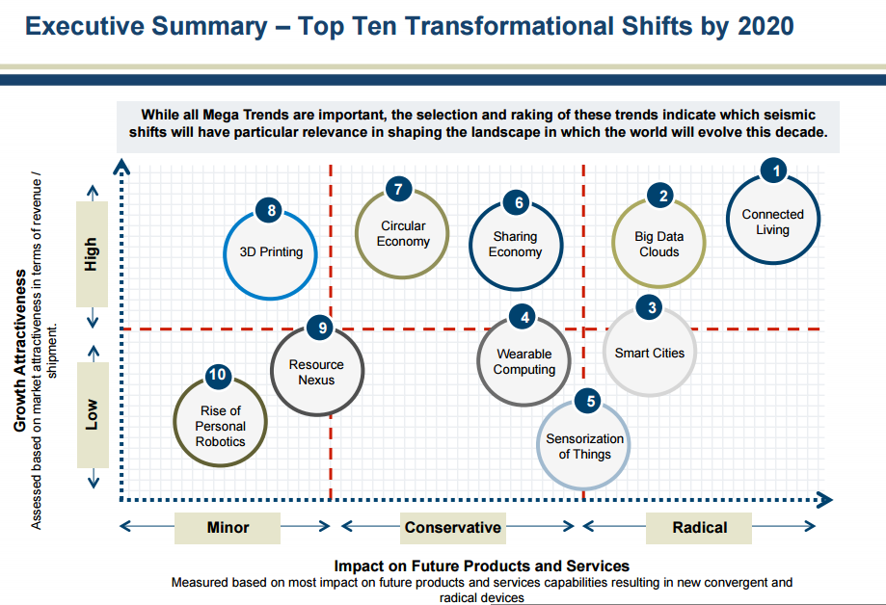
Notes:
http://www.investinbsr.com/ipaforum/wp-content/uploads/Iain-Jawad-IPA-Forum-2014-Presentation.pdf

Slide 34
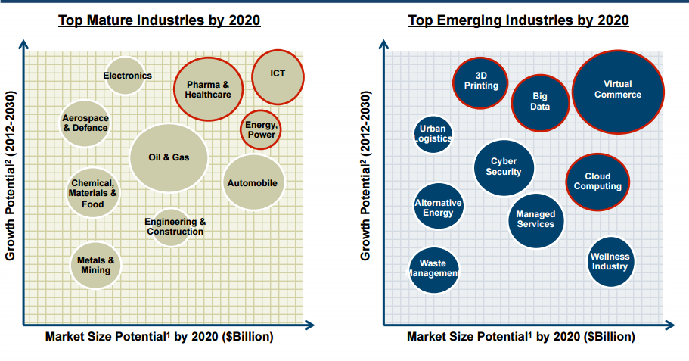
Notes:
http://www.investinbsr.com/ipaforum/wp-content/uploads/Iain-Jawad-IPA-Forum-2014-Presentation.pdf

Slide 35
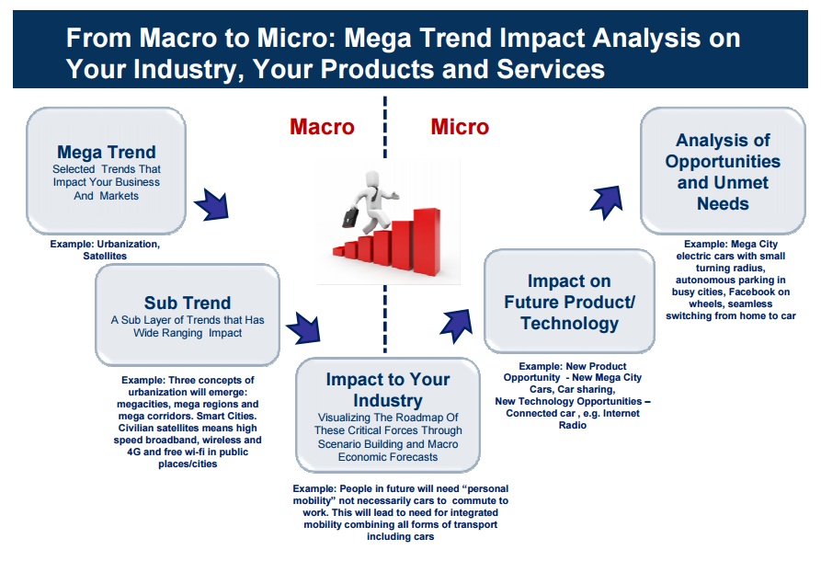
Notes:
http://www.investinbsr.com/ipaforum/wp-content/uploads/Iain-Jawad-IPA-Forum-2014-Presentation.pdf

