Slide 1

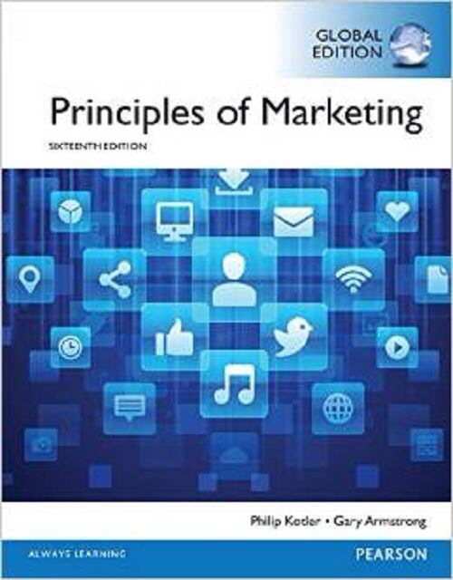
Products & Service Strategy I
CHAPTER 8
MK 202 Fundamentals of Marketing
By Aj.Suwalya Khemvaraporn

Slide 2
Objective Outline
Objective 1: Define product and major classifications of products and services.
Objective 2: Describe the decisions companies make regarding their individual products and services, product lines and product mixes.
Objective 3: Identify the four characteristics that affect the marketing of services and additional marketing considerations that services require.

Slide 3
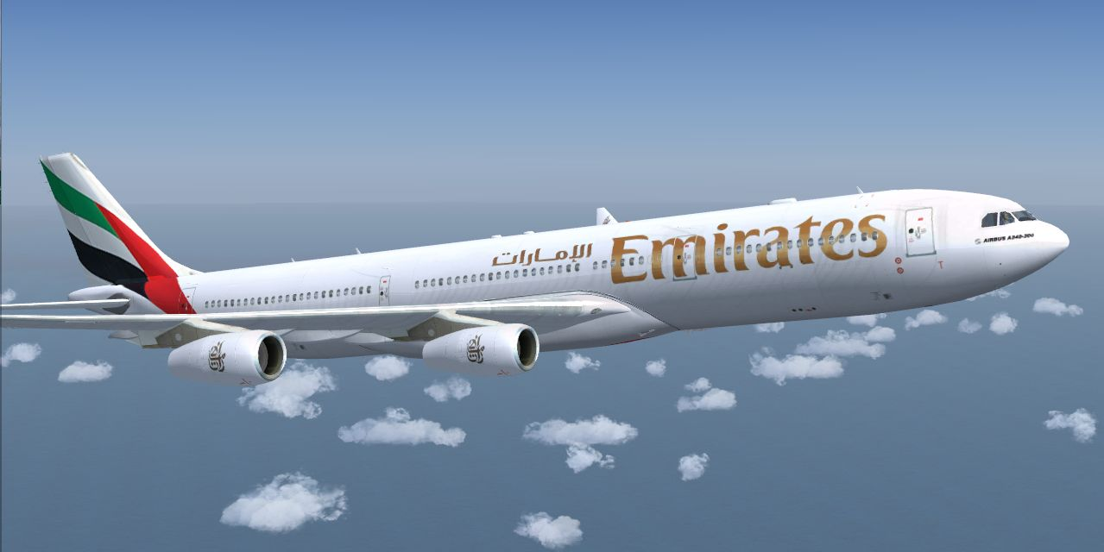
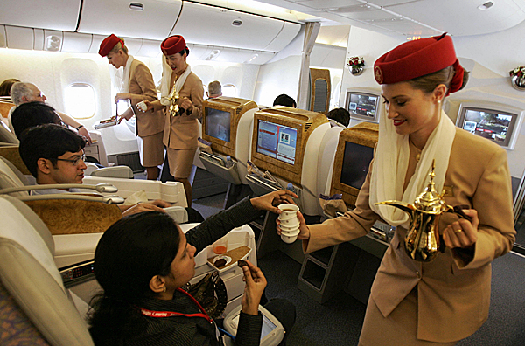
First Stop: Emirates Airlines
Emirates Airlines’ outstanding success results from much more than just good services. It’s based on a deep-down connection between iconic Emirates brand and its customers.

Slide 4
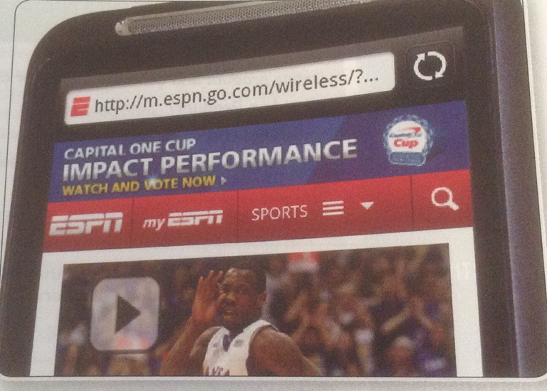
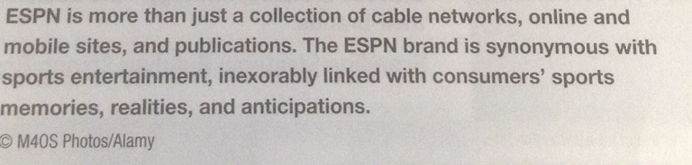
ESPN

Slide 5
What is a product?
Product: Anything that can be offered to a market for attention, acquisition, use or consumption that might satisfy a want or need.
Service: An activity benefit, or satisfaction offered for sale that is essentially intangible and does not result in ownership or anything.

Slide 6
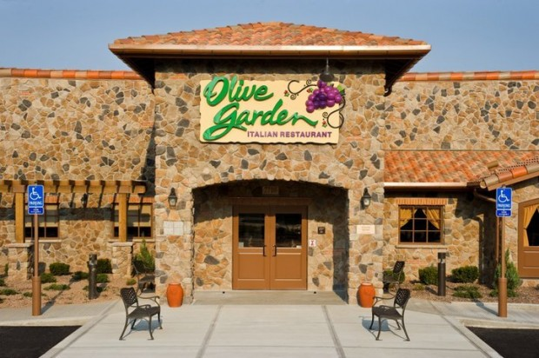
Experiences
Creating Customer Experiences: Olive Garden sells more than just Italian food. It serves up an idealized Italian family meal experience. “When you’re here, you’re family.”

Slide 7
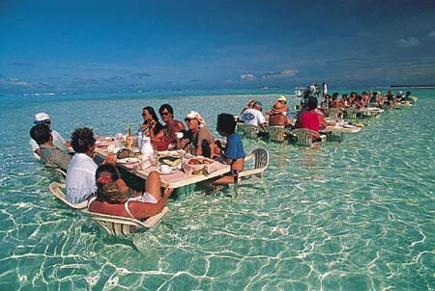

Experiences

Slide 8
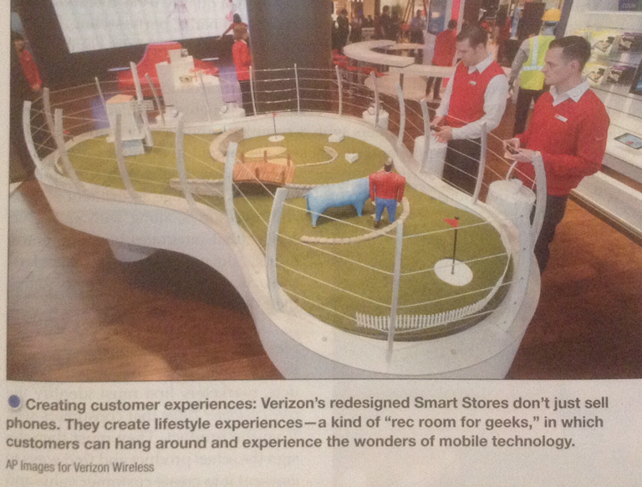
Experiences

Slide 9
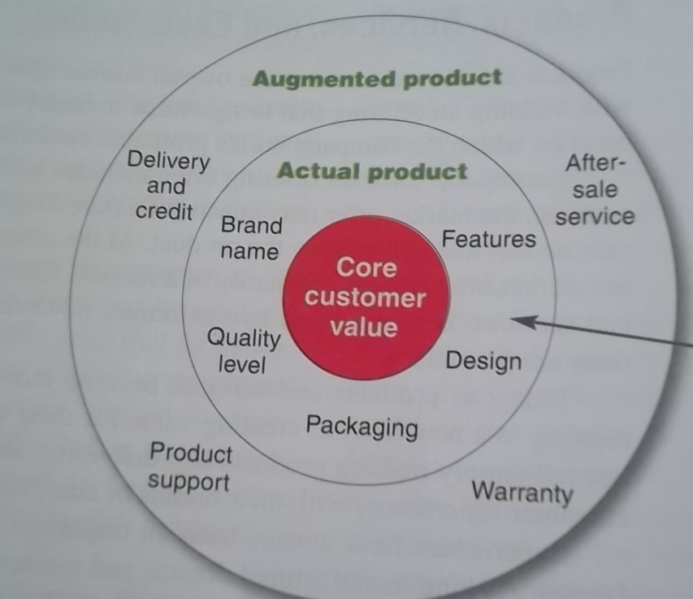
Level of Products and Services
Figure 8.1

Slide 10

Levels of Product and Services
Core, actual, and augmented product: People who buy an iPad are buying much more than a tablet computer. They are buying entertainment, self-expression, productivity and connectivity- a mobile and personal window to the world.

Slide 11
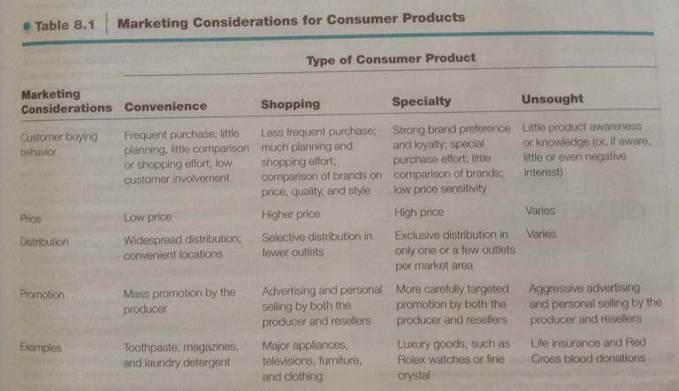
Product and Service Classifications

Slide 12

Organizations, Persons, Places and Ideas
Organization marketing: consists of activities undertaken to create, maintain and change the attitudes and behavior of target consumers toward and organization.
Organizational Marketing: IBM’s Smarter Planet campaign markets IBM as a company that helps improve the world’s IQ. This ad tells how IBM technologies are helping to create safer food supply chains.

Slide 13
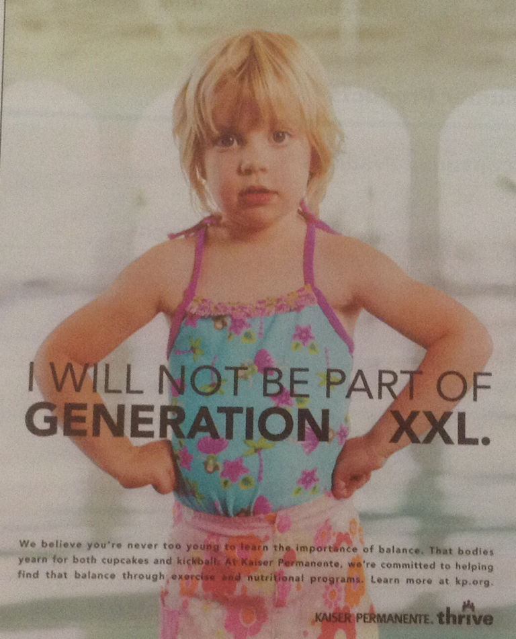
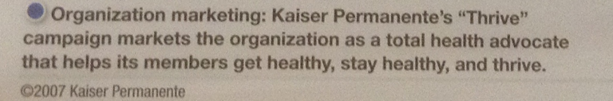
Organizations, Persons, Places and Ideas

Slide 14
Product and Service Decisions
Individual Product and Service Decisions
Product Attributes
Branding
Packaging
Labeling
Product Support Services
Figure 8.2 Individual Product Decisions
The focus of all theses decisions is to create core customer value!

Slide 15

Product and Service Decisions
Product Quality: The characteristics of a product or service that bear on its ability to satisfy stated or implied customer needs.
Total Quality management (TQM) is an approach in which all of the company’s people are involved in constantly improving the quality of products, service and business processes.

Slide 16

Product and Service Decisions
Total Quality management (TQM):
1. Performance quality
  Example: Rolls-Royce provides higher performance quality than Chevrolet->It has smoother rides, provides more luxury and “creature comforts” and lasts longer.
2. Conformance quality
  Beyond quality level, high quality also can mean high levels of quality consistency.

Slide 17
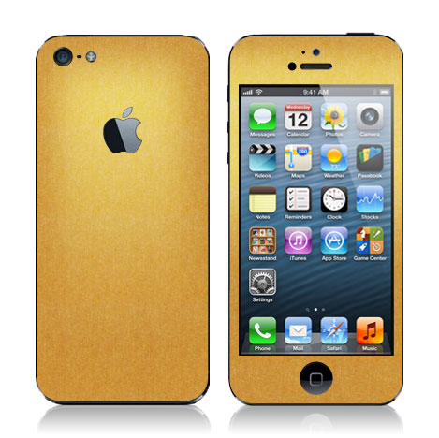
Product and Service Decisions
Product Features: Differentiating?

Slide 18
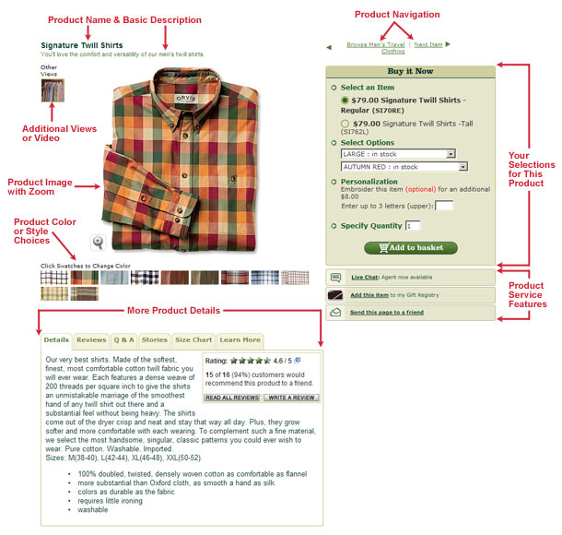

Slide 19

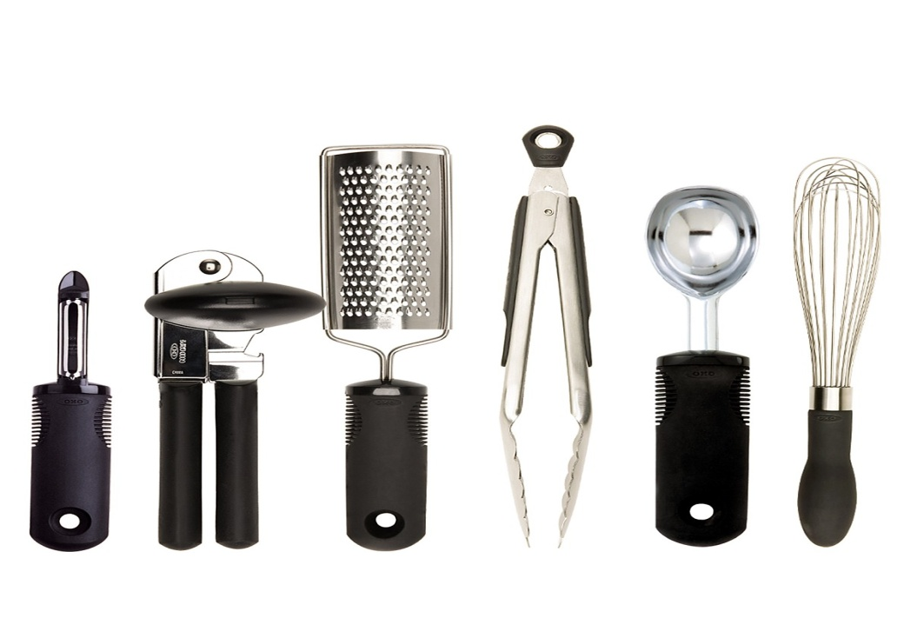
Product and Service Decisions
Product Style and Design: sensational style, pleasing Aesthetics
Product design: OXO focuses on the desired end-user experience, and then translates its pie-cutter-in the sky notions into eminently usable gadgets

Slide 20
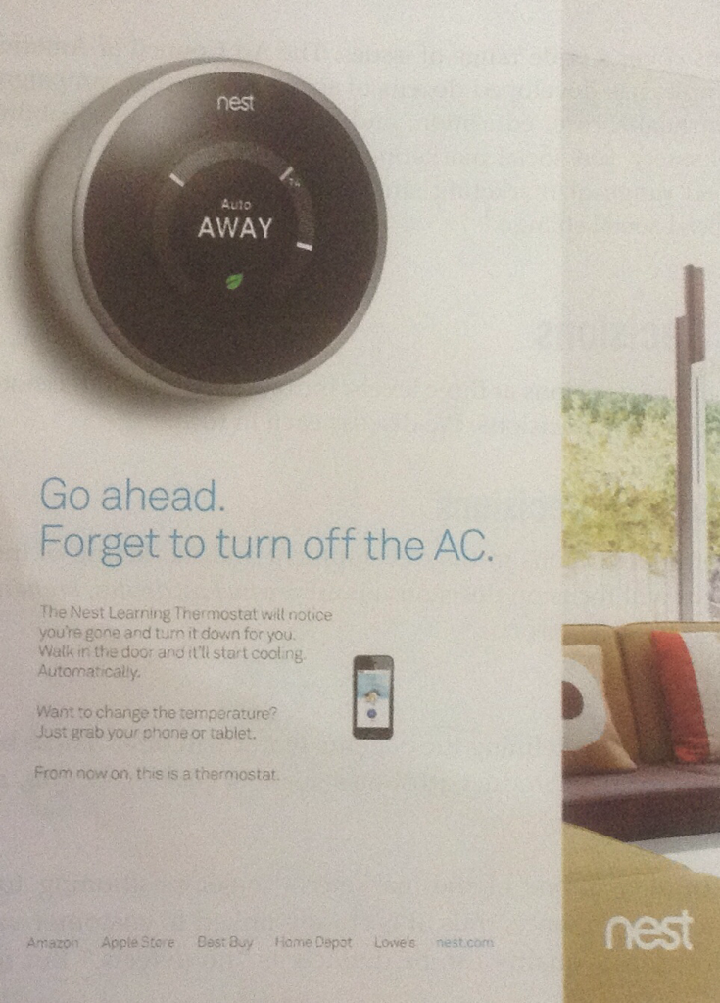
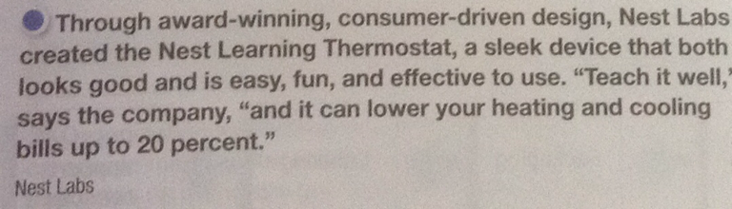
Product and Service Decisions
Product Style and Design:

Slide 21
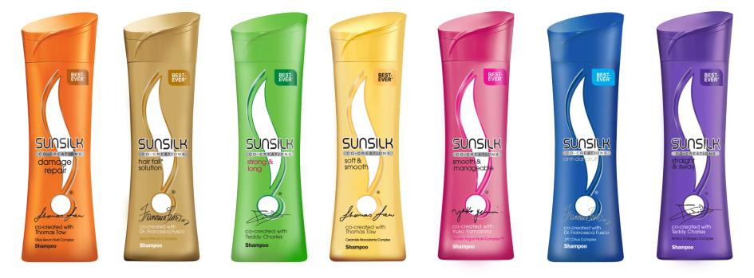
Product and Service Decisions
Branding
Brand: A name, term, sign, symbol, or design, or a combination of these, that identifies the products or services of one seller or group of sellers and differentiates them from those of competitors

Slide 22
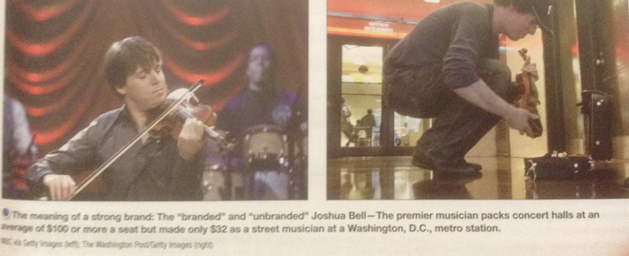
Product and Service Decisions
Branding

Slide 23
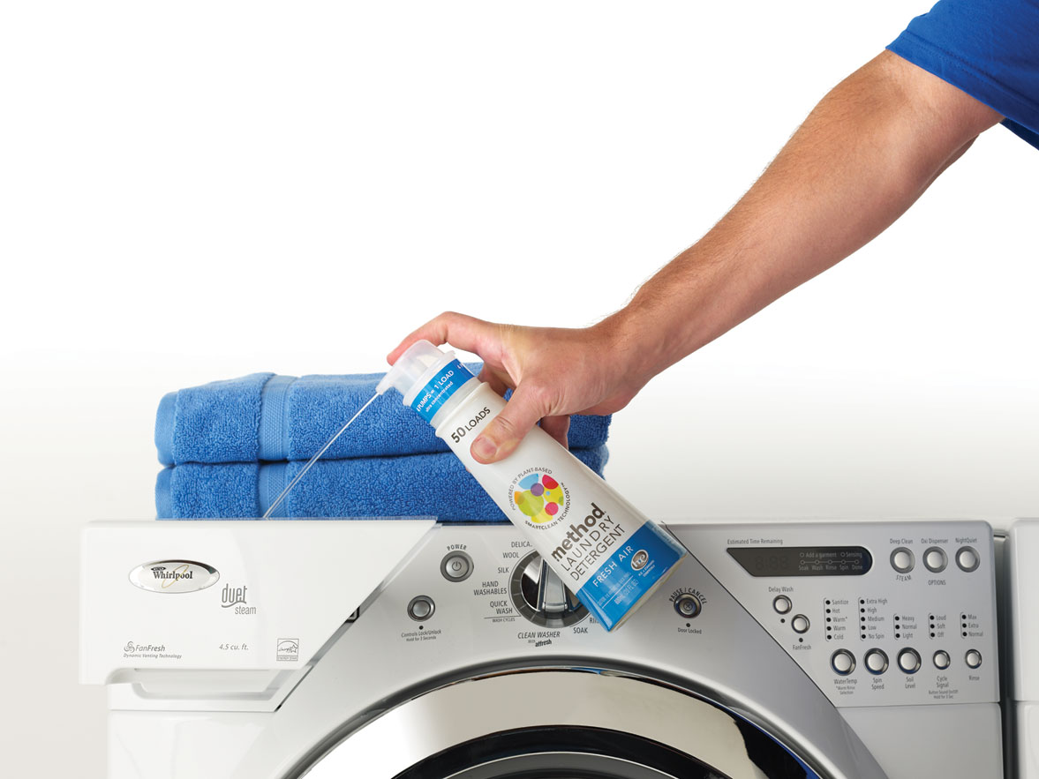
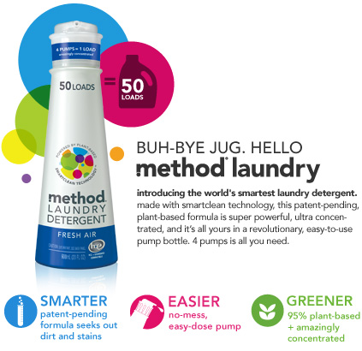
Product and Service Decisions
Packaging: The activities of designing and producing the container and wrapper for a product.

Slide 24
Packaging
From the perspective of both the firm and consumers, packaging must achieve a number of objectives:
Identify the brand
Convey descriptive and persuasive information
Facilitate product transportation and protection
Assist at-home storage
Aid product consumption
  Susan B. Bassin, “Value-Added Packaging Cuts through Store Clutter,”
  Marketing News, 26 September 1988, 21.

Slide 25
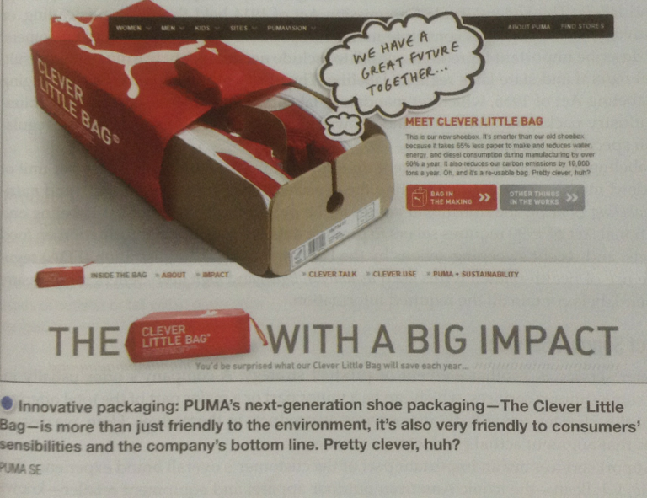
Packaging

Slide 26
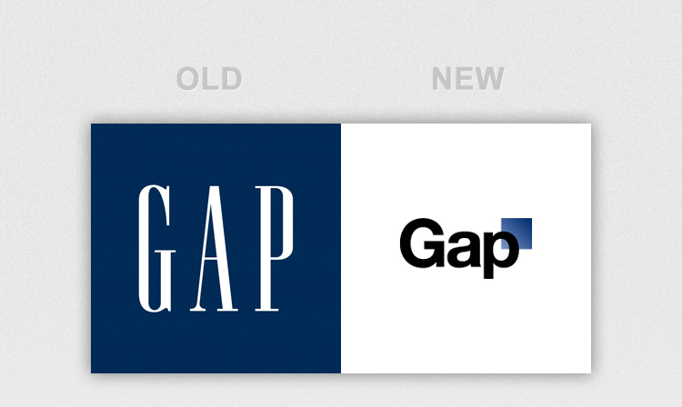
Product and Service Decisions
Labeling
Brand label and logos: When Gap tried to modernize its familiar old logo, customer went ballistic highlighting the powerful connection people have to the visual representations of their beloved brands.

Slide 27
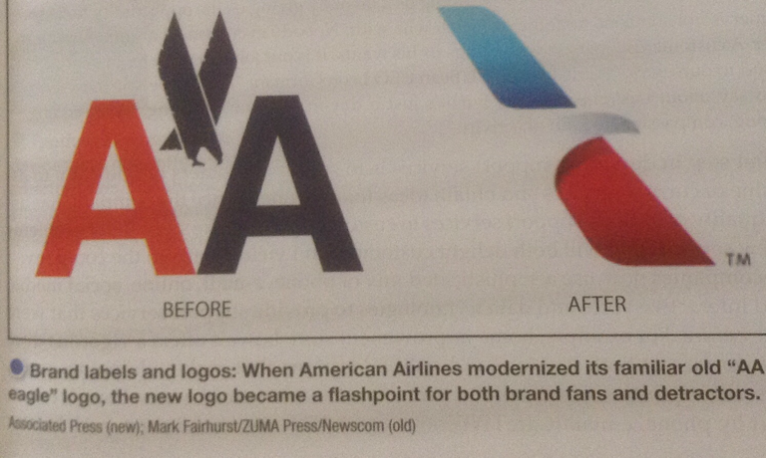
Product and Service Decisions
Labeling

Slide 28
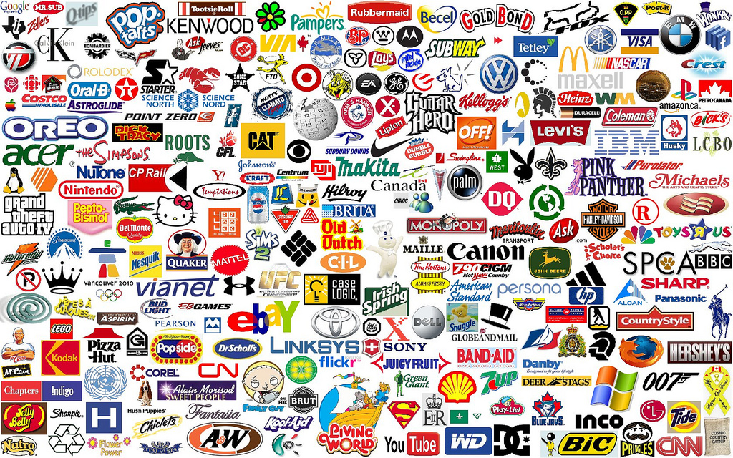

Slide 29
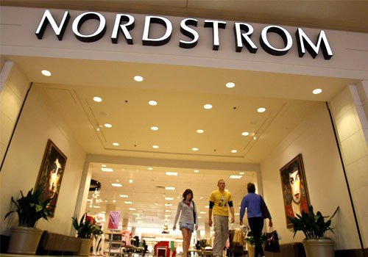
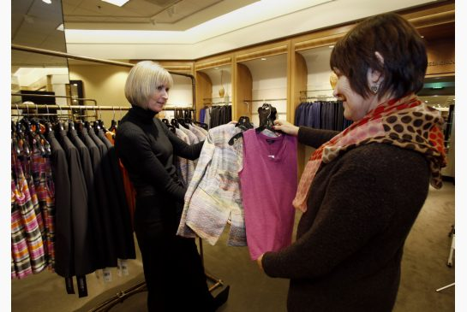
Product and Service Decisions
Product & Support Services
Nordstorm thrives on stories about its after-sale service. It wants to “Take care of customers, not matter what it takes,” before, during and after the sale.

Slide 30
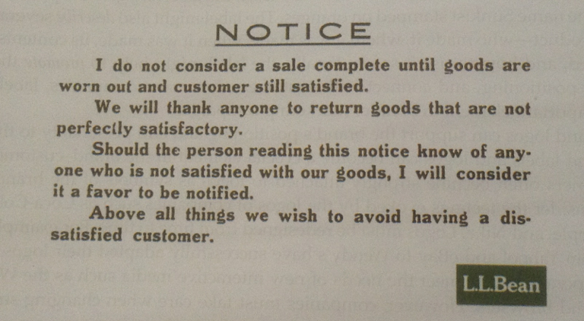
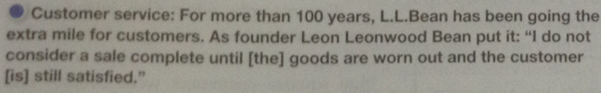
Product and Service Decisions
Product & Support Services

Slide 31
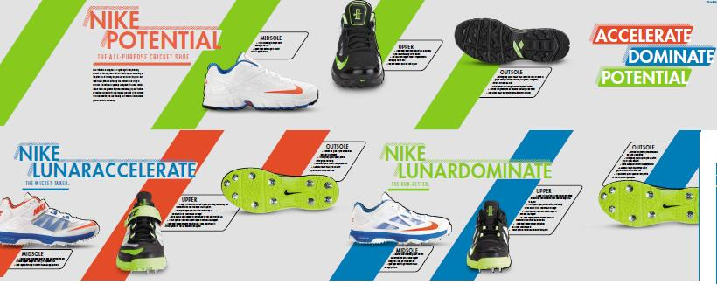
Product Line Decisions
Product Line: A group of products that are closely related because they function in a similar manner, are sold to the same customer groups, are marketed through the same types of outlets, or fall within given price ranges.

Slide 32
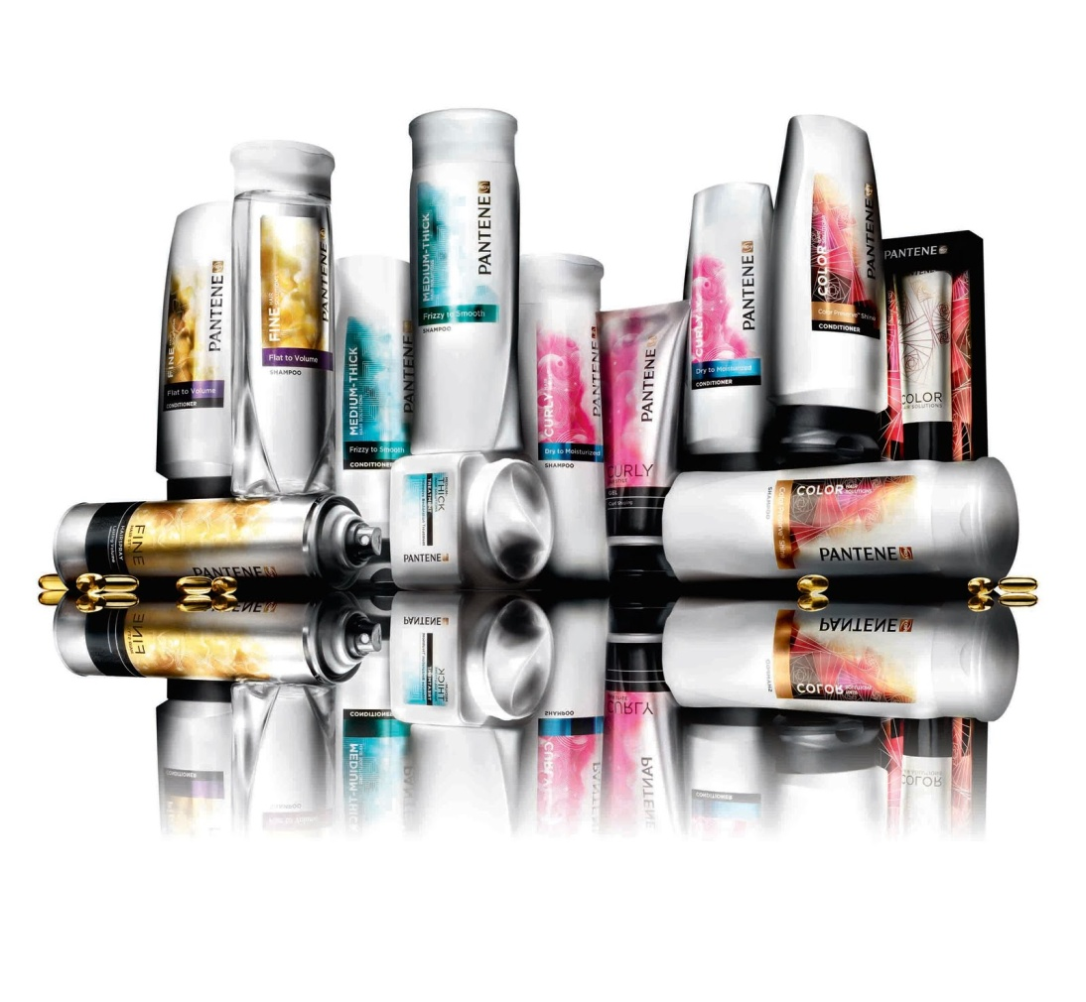
Product Line Decisions
Product line length: the number of items in a product line
Two ways a company can expand product line:
  1. Line filling: involves adding more items within present range of the line
  2. Line stretching: company lengthens its product line beyond its current range

Slide 33

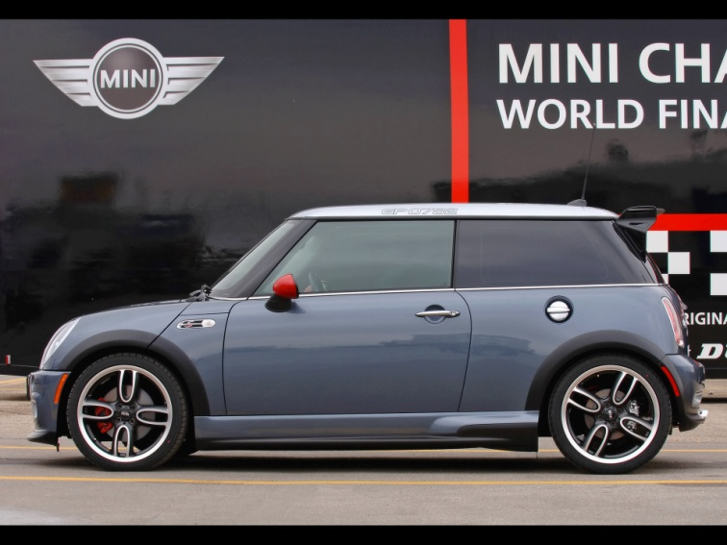
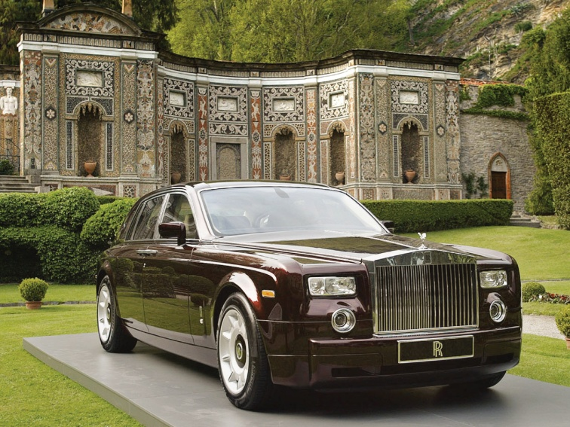
Product Line Decisions
  Line stretching:
  Example: BMW->one brand, 5 model maker, power house of 3 brands, 14 series and more than 30 distinct models
Downward
Upward

Slide 34
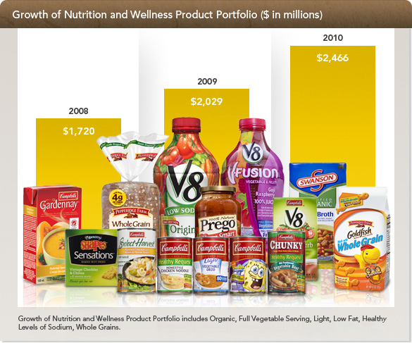
Product Mix Decisions
Product mix(or product portfolio): The set of all product lines and items that a particular seller offers for sale.
The product mix: Campbell Soup Company has nicely contained product line consistent with its mission of “nourishing people’s lives everywhere, every day.”

Slide 35
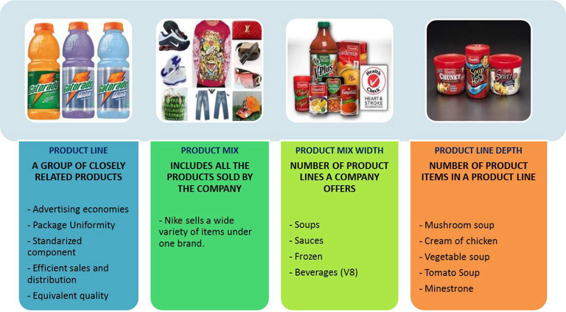
Product Mix Decisions

Slide 36
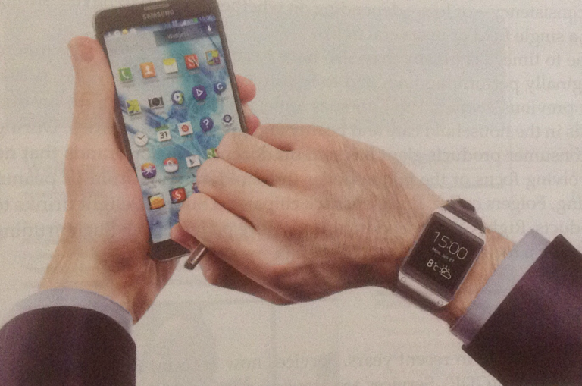
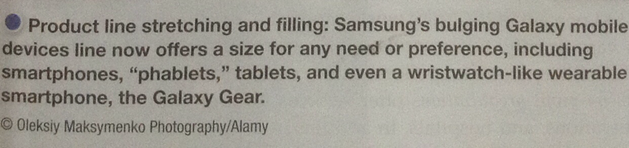
Product Mix Decisions

Slide 37
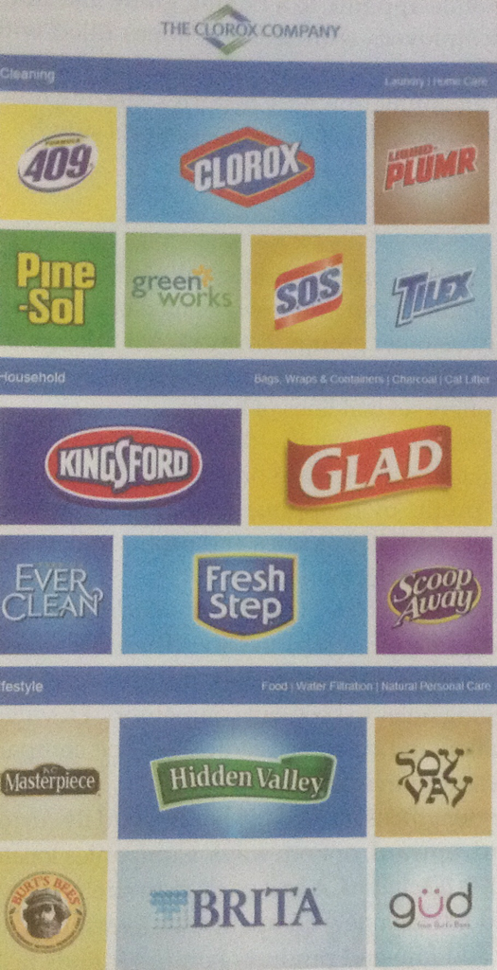
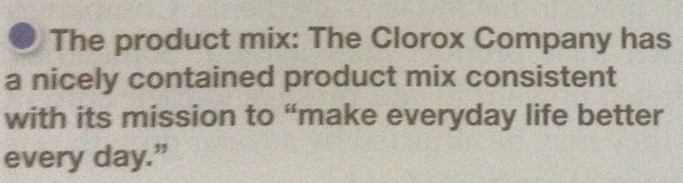
Product Mix Decisions

Slide 38


Services Marketing

Slide 39
Tangibility Spectrum
Salt
●
Soft Drinks
●
Detergents
●
Automobiles
●
Cosmetics
●
Fast-food
Outlets
●
Intangible
Dominant
Tangible
Dominant
●
Fast-food
Outlets
●
●
Advertising
Agencies
●
Airlines
Investment
Management
●
●
Consulting
Teaching

Slide 40
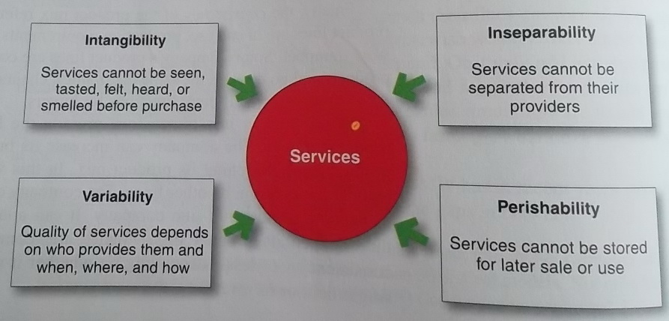
Services Marketing
Figure 8.3 Four Service Characteristics

Slide 41
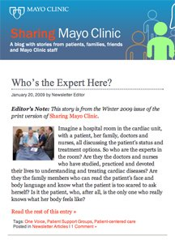
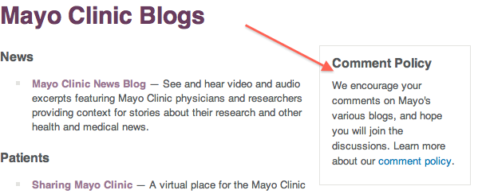
Services Marketing
By providing customers with organized honest evidence of its capabilities, the Mayo Clinic has built one of the most powerful brands in health care. Its Sharing Mayo Clinic blog lets you hear directly from those who have been to the clinic or who work there.

Slide 42
Services Marketing
The Service Profit Chain: The Chain that links service from profits with employee and customer satisfaction.
Internal Service quality: superior employee selection and training, a quality work environment, and strong support for those dealing with customers, which results in…
Satisfied and productive service employees: more satisfied, loyal, and hard working employees, which results in…
Greater service value: more effective and efficient customers who remain loyal, make repeat purchases, and refer other customers which results in…
Satisfied and loyal customers: satisfied customers who remain loyal, make repeat purchases and refer other customers, which results in…
Healthy service profits and growth: superior service firm performance.

Slide 43

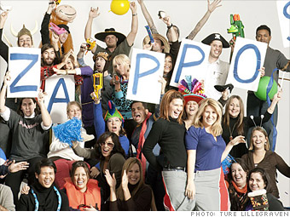
Services Marketing
Zappos.com Taking Care of Those Who Take Care of Customers
Zappos knows that happy customers begin with happy, dedicated, and energetic employees. Zappos is ”happy to help 24/7”

Slide 44
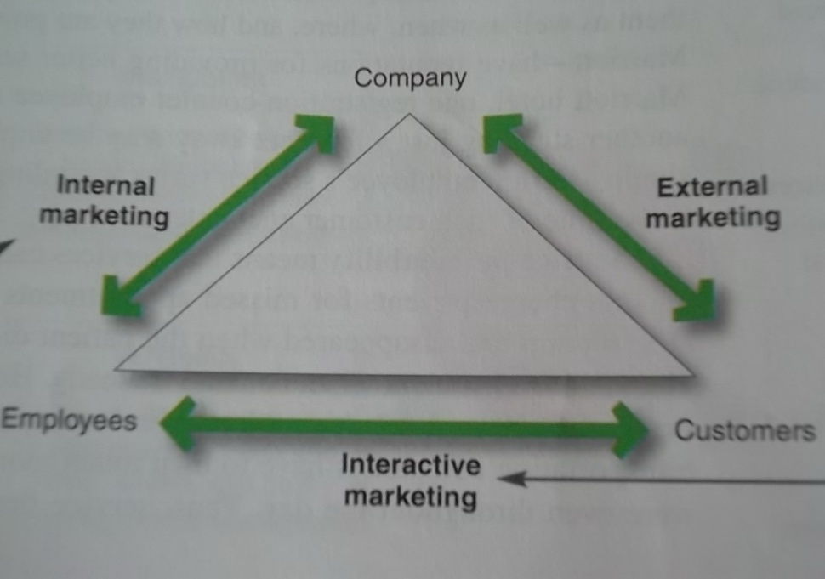
Services Marketing
Figure 8.4 Three types of Service Marketing
Then service firms must help employees master the art of interacting with customers. Every employee at Zappos from CEO down, goes through 4 weeks of customer-loyalty training.
Service firm must sell the importance of delighting customers to consumer-contact employees. At Zappos.com, the No 1 core value is “Deliver WOW through service.”

Slide 45

Services Marketing
Internal Marketing: Orienting and motivating customer contact employees and service support people to work as a team to product customer satisfaction.
Interactive Marketing: Training service employees in the fine art of interacting with customers to satisfy their needs.

Slide 46
Services Marketing
How to Manage…
Service Differentiation
Service Quality
Service productivity

Slide 47
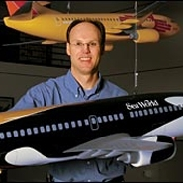
Service Marketing
Service Quality
Service recovery: Southwest created a high-level group- headed by Fred Taylor,” senior manager of proactive customer service communications”- that carefully coordinates responses to major flight disruptions, turning wronged customers into more loyal ones.

Slide 48
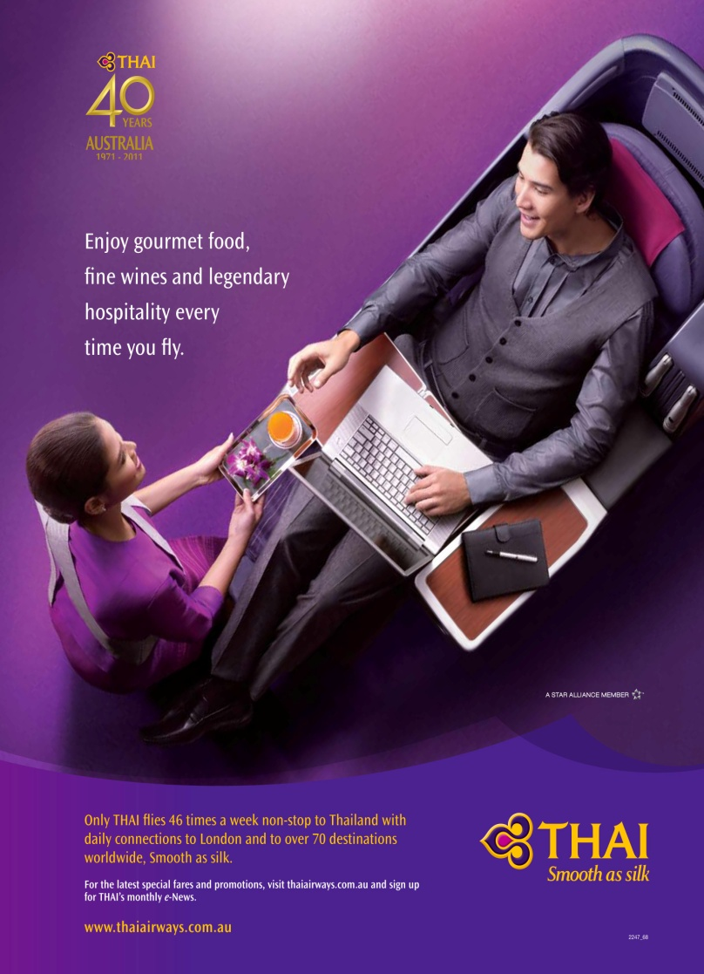
Should a Company Try to Delight the Customer?
Some management consultants urge service companies to “delight” customers to gain a competitive advantage.
The delight they refer to is a profoundly positive emotional state that results from having one’s expectations exceeded to a surprising degree.
One Author describes the type of service that results in delight as “positively outrageous service” which is unexpected, random, extraordinary, and disproportionately positive.

Slide 49
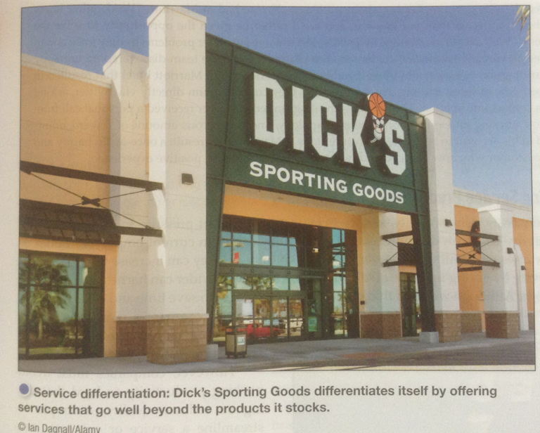
Services

Slide 50

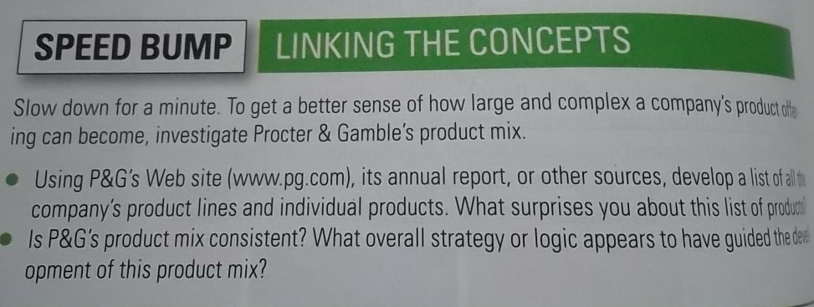
Homework:
Individual

Slide 51
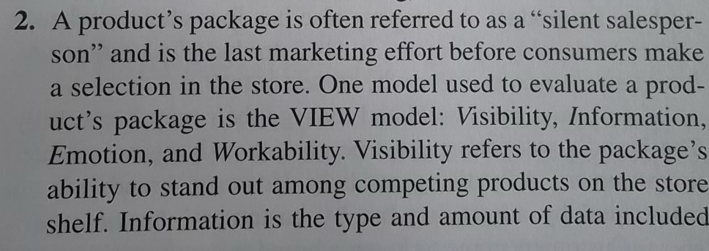
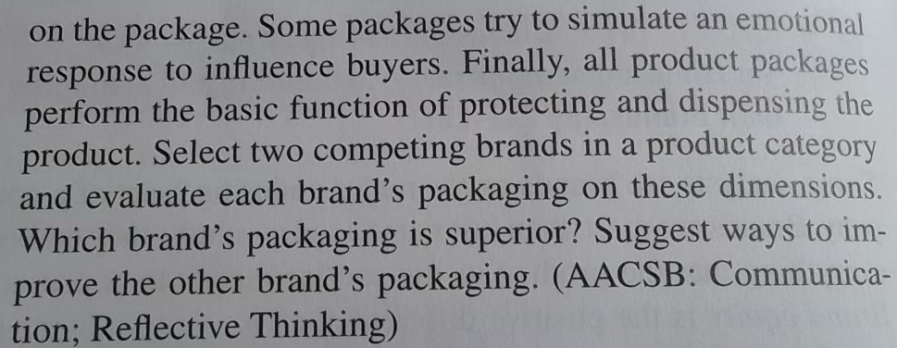
Homework:
Group: Do the Critical Thinking Exercise
  Presentation in next class: 7 mins /group

