Slide 1
Today’s Happenings
Chapter 9 on Distribution
Chapter 12 on Marketing Plan
New Product Concepts

Slide 2

Chapter 1
Chapter 9
Marketing Mix Decisions III: Distribution
Introduction
MK 312 Marketing Management
By
Ajarn Suwalya Khemvaraporn

Slide 3
Ch. 9 - Learning objectives
After studying this chapter you should be able to:
■ explain how distribution patterns affect the various aspects of international marketing
■ understand the variety of distribution channels and how they affect cost and efficiency in marketing
■ list the functions, advantages and disadvantages of various kinds of middlemen
■ explain the different stages in the design of channel structure
■ understand how distribution channels can be managed internationally.

Slide 4
Introduction
A product must be made accessible to the target market at an affordable price. Distribution decisions deal with the problem of moving products from point or origin to points of consumption.
Often referred to as the place variable, distribution decisions are directed at ensuring the right product is in the right place at the right time and in the right quantities.

Slide 5
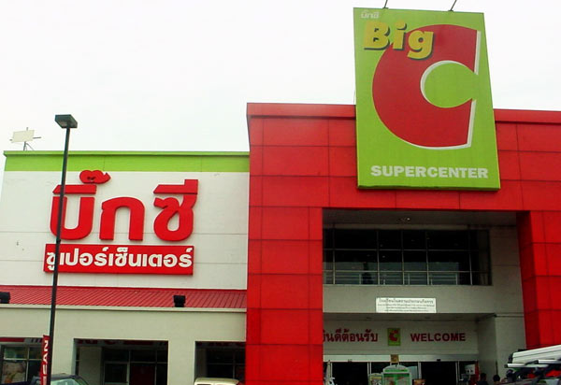
Channel Strategy
The manner by which a product is sold or distributed can have a profound impact on the resulting equity and ultimate sales success of a brand.
Channel strategy includes the design and management of intermediaries such as wholesalers, distributors, brokers, and retailers.
Notes:
22

Slide 6
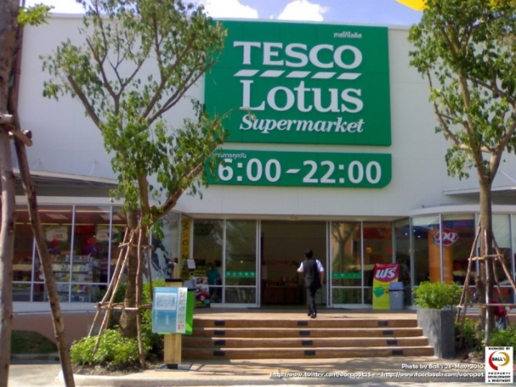
Channel Design
Direct channels
  Selling through personal contacts from the company to prospective customers by mail, phone, electronic means, in-person visits, and so forth
Indirect channels
  Selling through third-party intermediaries such as agents or broker representatives, wholesalers or distributors, and retailers or dealers
  Push and pull strategies
Web strategies

Slide 7
Role of the intermediary
Channel intermediaries (eg. Wholesalers and agents) essentially solve the problem of discrepancy between various assortments of goods and services required by industrial household consumers and assortments available directly from individual producers.
In other words, manufacturers usually produce a large quantity of a limited number of products, whereas consumers purchase only a few items of a large number of diverse products.
Middlemen reduce this discrepancy of assortments, thereby enabling consumers to avoid dealing directly with individual manufacturers in order to satisfy their needs.

Slide 8
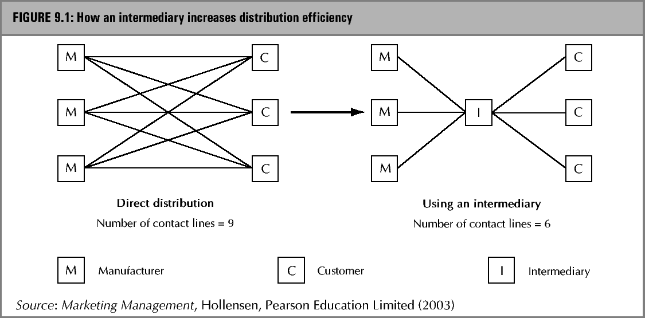
Efficiency through an intermediary

Slide 9
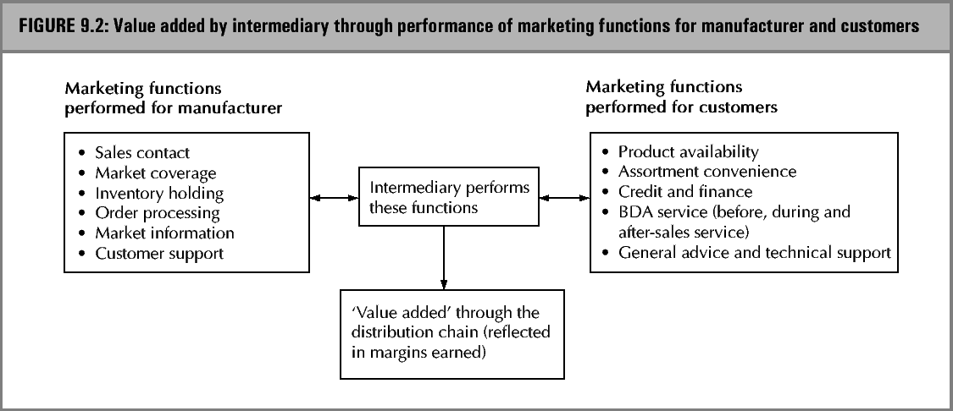
Value added through an intermediary

Slide 10
Market Entry Modes
Once the firm has chosen its target markets abroad, the question arises as to the best way to enter those markets
1. Export modes – here the distributor is shown as an example
2. Intermediate modes – here the joint venture is shown as an example
3. Hierarchical modes – here a sales subsidiary is shown as an example.
(See next slide)

Slide 11
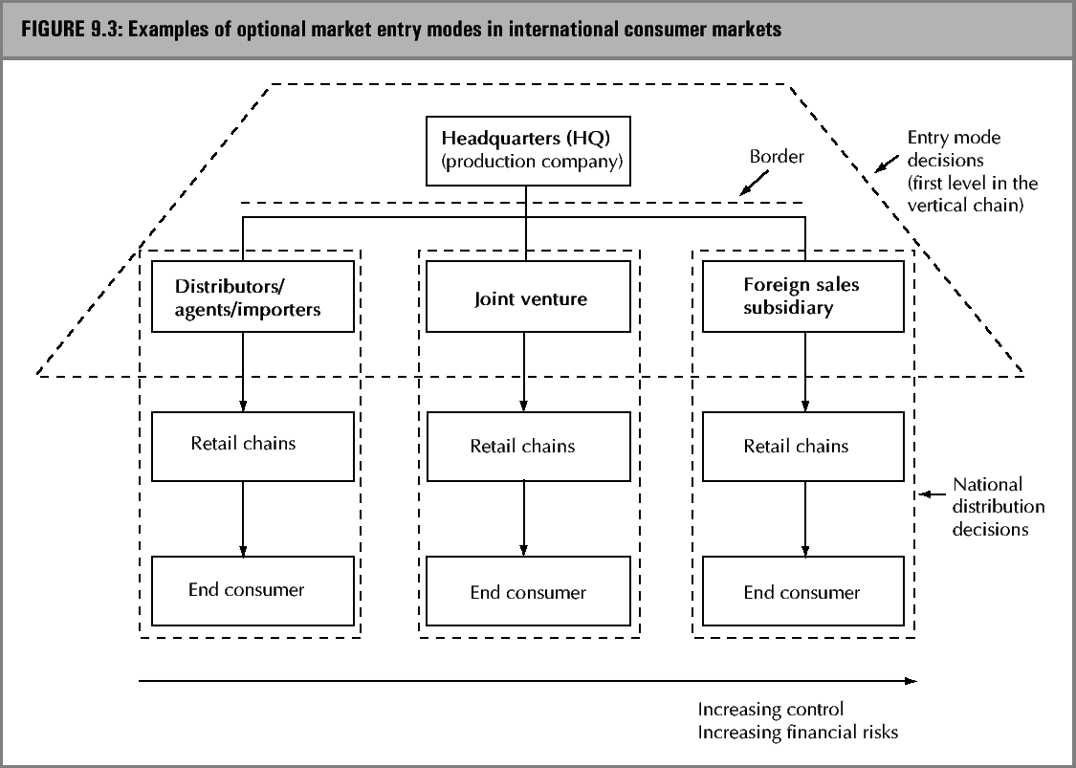
Market Entry Modes

Slide 12
The stages of Channel Design
Once having considered and chosen the overall market entry strategy for a given foreign market, the management then needs to turn its attention to the task of designing the firm’s channels and distribution within a given country.The process of channel design and the management of it can be broken down into seven basic stages or phases:
1 setting distribution objectives
2 specifying the functions that need to be performed by the channel
3 considering alternative channel structures
4 choosing an ‘optimal’ channel structure
5 selecting the intermediaries
6 motivating the channel members
7 evaluating channel member performance.

Slide 13

Setting distribution objectives
Distribution objectives refer to what the firm would like its channel strategy to accomplish in terms of how, when and where its products and services are provided to its target markets.

Slide 14
Specifying the functions that need to be performed by the channel
The following factors should be considered as detailed distribution functions, which should be performed by the distribution channel.
1. Product and services flow (from manufacturer to final customer). Inventory management, product transportation, product modification and after-sales service, customizing a product for the specific needs of clients/distributors, providing technical service, product maintenance and repair, procedure and handling of returned products, promoting product availability, packaging, specific packaging requirements, evaluating new products and so on.

Slide 15

Specifying the functions that need to be performed by the channel
2. Communication flow (from manufacturer to final customers). Sales promotion to final consumers, information about product features, advertising, providing sales force, packaging information, loyalty programmes, website participation, traceability, information and so on.

Slide 16
Push and Pull Strategies
By devoting marketing efforts to the end consumer, a manufacturer is said to employ a pull strategy.
Alternatively, marketers can devote their selling efforts to the channel members themselves, providing direct incentives for them to stock and sell products to the end consumer. This approach is called a push strategy.

Slide 17
Channel Support
Two such partnership strategies are retail segmentation activities and cooperative advertising programs.
Retail segmentation
  Retailers are “customers” too
Cooperative advertising
  A manufacturer pays for a portion of the advertising that a retailer runs to promote the manufacturer’s product and its availability in the retailer’s place of business.

Slide 18
Specifying the functions that need to be performed by the channel
3. Information flow( from customers to manufacturer) Sharing knowledge of local market, scanning data (assess to computer data), complaints via website/service line, order frequency, order formats consideration, arrange information about consumption and so on.

Slide 19
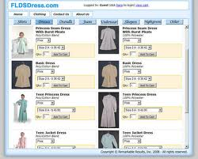
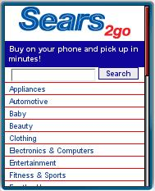
Web Strategies
Advantage of having both a physical “brick and mortar” channel and a virtual, online retail channel
The Boston Consulting Group concluded that multichannel retailers were able to acquire customers at half the cost of Internet-only retailers, citing a number of advantages for the multichannel retailers.

Slide 20

Specifying the functions that need to be performed by the channel
4. Payments and financial flows-Conducting credit checks on final consumers, billing customers, caring for specific customer orders, arranging for credit provisions, price guarantees, financing and so on.

Slide 21
Considering alternative channel structures
Management needs to be concerned with three dimensions of channel structure.
  1. the length of the channels
  2. the intensity of the various levels
  3. the types of intermediary involved.

Slide 22

Considering alternative channel structures
The intensity dimension, which refers to the number of intermediaries to be used at each level of the channel, is usually characterized as.
  1. intensive distribution – where as many intermediaries as possible are used.
  2. selective distribution- where the number of intermediaries to be used is limited through more careful selection.
  3. exclusive distribution – where only one intermediary is used in a given geographical territory

Slide 23
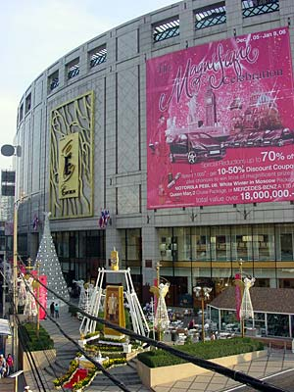
Choosing an ‘optimal’ channel structure
In the process of applying its best judgment, management also needs to take into consideration a number of key variables that are usually relevant when choosing channel structure: The most basic are

Slide 24
Key variables to consider
The location of final customers, and number of customers and their density, together with their patterns of buying behavior, would all be the key market variables.
Factors such as bulk and weight, unit value, newness, technical versus non-technical, and perishability are product variables that are frequently important.
The financial capacity of the firm, its size, expertise, and desire for managerial control are some of the most important firm variables.
Cost, availability and services provided are indicative of significant intermediary variables that management needs to consider.
Factors such as the potential of particular channel structures to reduce conflict while maximizing power and communications effectiveness are critical behavioral variables for management to consider.
Finally variables such as economic conditions, socio-cultural changes, competitive structure, technology and government regulations can all be important environmental variables to consider when choosing channel structure.

Slide 25

Selecting the intermediaries
The selection of channel members consists of four steps:
  1. Developing selection criteria
  2. Finding prospective channel members
  3. assessment of the prospective channel members against the criteria
  4. converting prospective channel members to become actual channel members.

Slide 26
Motivating channel members
Motivation Management in the marketing channel can be viewed as sequence of three steps.
  1. learning about the needs and problems of channel members.
  2. offering support to channel members to help meet their needs and solve their problems.
  3. providing ongoing leadership.

Slide 27

Evaluating channel member performance
Evaluations require the manufacturer to gather information on channel member. The manufacturer’s ability to do this will be affected by:
  The degree of control of channel members
  The importance of the channel members
  The number of channel members

Slide 28
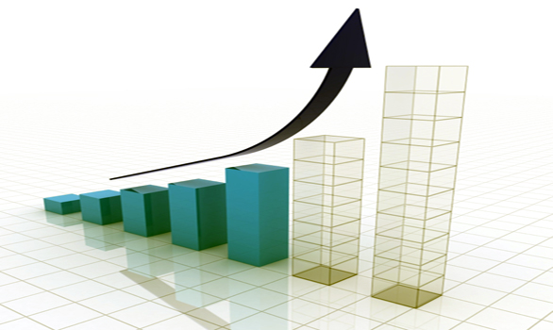
Developing performance criteria
Although a wide variety of performance criteria can be sued to evaluate channel members, by far the most commonly used are:
  Sales performance
  Inventory maintenance
  Selling capabilities
  Attitudes
  Competitive Products Handled
  Growth prospects

Slide 29
Multiple channel strategy
Distribution channels can be seen as sets of interdependent organizations involved in the process of making a product or service available for consumption or use. Then making channel choices, firms can choose from a wide variety of alternatives. It should be noted, however that companies are increasingly using a multiple channel strategy for most or all of their products.

Slide 30
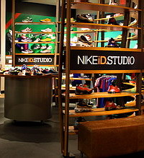
A trend towards hybrid multiple channels
In a hybrid multiple distribution channel, the marketing functions are shared by the producer and the channel intermediary. The former handles promotion and customer-generation activities , whereas the intermediary is in charge of sales and distribution (Gabrielsson et al., 2002).

Slide 31
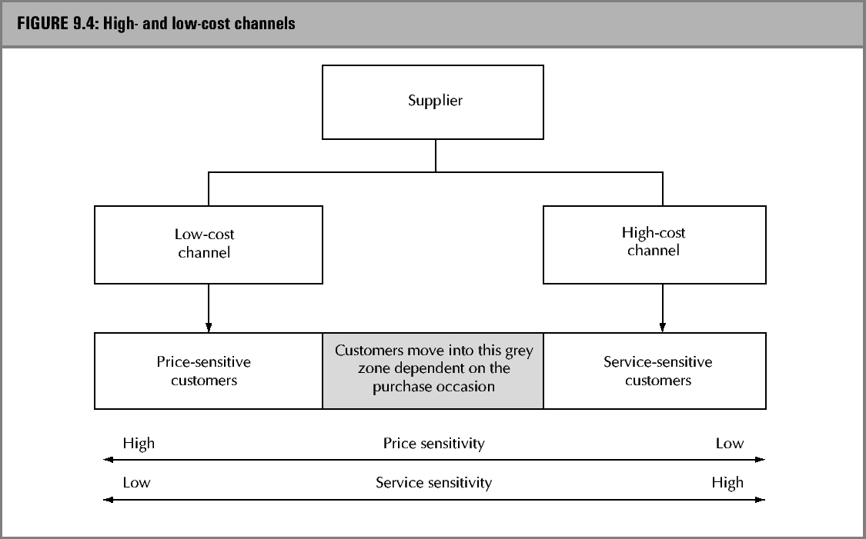
High- and low-cost channels

Slide 32
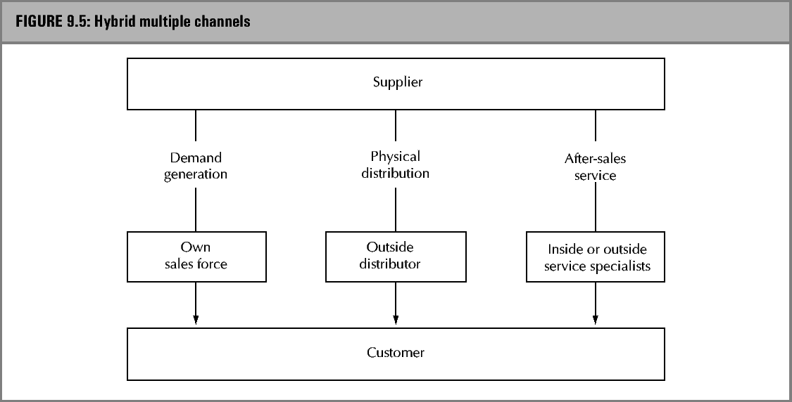
Multiple channels

Slide 33

The Internet and the growth of multiple channel strategies
The internet has turbocharged the growth of multi-channel companies, enabling them to leverage their existing assets, brands, and customer bases for revenue and profit growth. Key to this leverage is correctly determining the strategic role of the online channel in combination with all other channels.

Slide 34
The Internet and the growth of multiple channel strategies
Here are few important ideas on how multi-channels can build competitive advantage (Vishwanath and Mulvin, 2001)
  Define the Internet’s role in your channel and operational portfolios.
  Identify and cater to your most profitable customer segments.
  Invest in execution
  Take risks, but remain flexible.

Slide 35
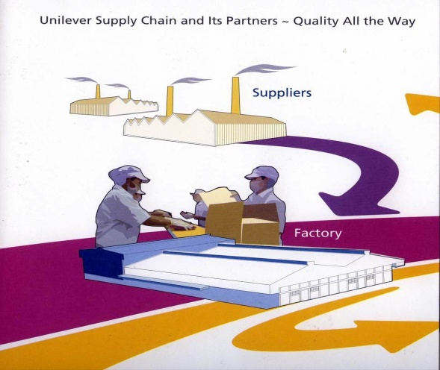
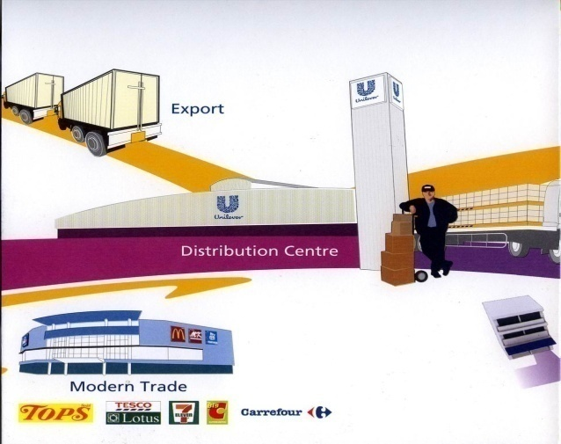

Logistics
Logistics involve all activities required to plan and move items from a material or manufacturing source to the point of consumption.
While logistics has been defined as a discipline of its own, it is important to note that it is a critical component of a firm’s marketing capability.

Slide 36


Logistics
Simply stated, customers expect nine ‘rights’ in any transaction:
  1. right product
  2. right quantity
  3. right quality
  4. right location
  5. right time
  6. right form
  7. right price
  8. right packaging
  9. right information

Slide 37

Logistics activities
Traditional organizations incorporate four areas of logistics functionality:
  Customer service
  Transportation
  Inventory management and
  Distribution operations

Slide 38
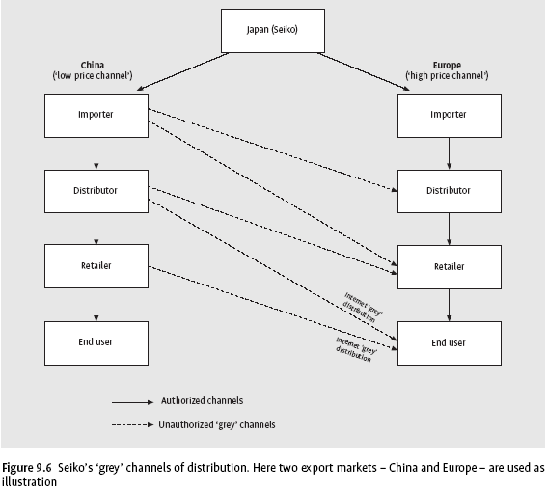
’Grey’ channels

Slide 39
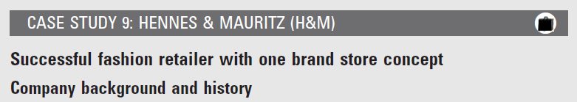


Slide 40
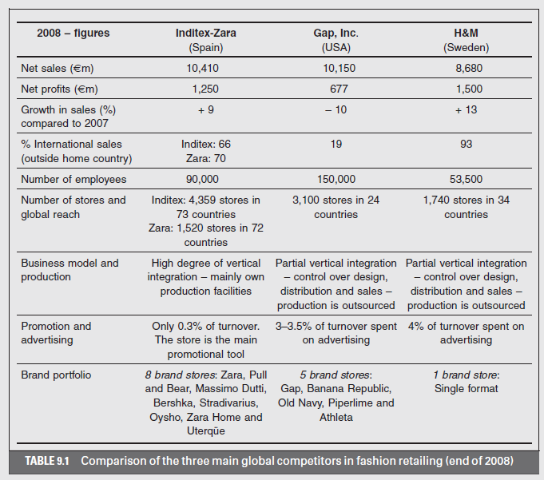

Slide 41



