Slide 1
FN 221: Personal Finance
Thanachote Rungsitivat, CFA, FRM

Slide 2
Stages of Career Planning and Advancement
Assess and Research Personal Goals, Abilities, and Career Fields
Evaluate Employment Market and Identify Specific Employment Opportunities
Develop Resume and Cover Letter and Apply for Available Positions
Interview for Available Positions and Assess Your Interview Performance
Evaluate Financial and Other Factors of Positions You are Offered
Plan and Implement a Program for Career Development

Slide 3
The Situation
Akradej is in his third year of bachelor degree. After taking several business courses, he thinks that the sales and marketing field would be an interesting career. He wonders whether his personality would be suited for this career, what a sales and marketing person would do and what skills he would need to be successful in this career.

Slide 4
Career Choice Factors
Trade-offs of Career Decisions
Career Training and Skill Development
Personal Factors
Career Decision Making

Slide 5
Career Opportunities: Now and in the Future
Social Influences
  Demographic trends
  Geographic trends
Economic Conditions
  Interest rates
  Inflation
  Consumer demand
Industry Trends
  Foreign competition
  Changing uses of technology

Slide 6
Identifying Job Opportunities
Job Advertisements
Career Fairs
Employment Agencies
Other Job Search Methods

Slide 7
Career Strategies in a Weak Job Market
Acknowledge stress, anxiety and fear
Assess your financial situation
Evaluate your current and future employment potential
Maintain focus and keep a positive outlook
Connect with others in professional and social settings
Consider part-time work, consulting and volunteering

Slide 8
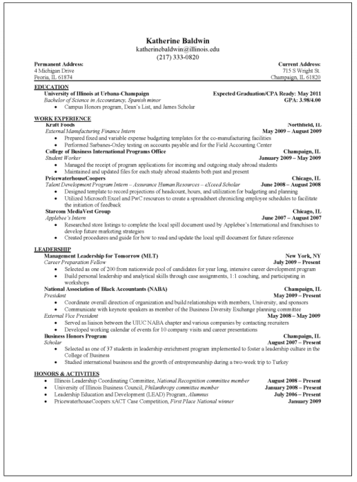
Resume

Slide 9
Financial and Legal Aspects of Employment
Accepting an Employment Position
  The Work Environment
  Factors Affecting Salary
Evaluating Employee Benefits
  Meeting employee needs
  Comparing benefits
Your Employment Rights

Slide 10
Employee’s Benefit Comparison Sheet
Corporate Culture
Health Insurance
Life Insurance
Retirement
Holidays
Training Opportunities
Child Care
Vacation Time (period)
Sick Leave
Tuition Reimbursement
Provident Funds
Other Benefits

Slide 11
Successful Money Management
Spending money now reduces saving and investing for long term goals
Buying on credit results in payments later and reduces the amount of future income available for spending.
Using savings for purchases results in lost interest earnings and inability to use savings for other purposes
Comparison shopping can save you money and improve the quality of your purchases but uses up something of value you cannot replace: your time

Slide 12
Money Management Activities
Storing and Maintaining Personal Financial Records and Documents
Creating Personal Financial Statements
Creating and Implementing a Plan for Spending and Saving

Slide 13
The Situation
Jane wants to follow the three money management activities to begin the process of long-term financial planning. Jane has just graduated from university and has found a job working in an accounts receivables department of a small company. Jane wants to be able to save for a home and other goals but does not know where she stands today.

Slide 14
Storing and Maintaining Personal Financial Records and Documents
Jane has never been very systematic about maintaining her financial records. She keeps her bank and credit card statements but throws everything else into a bag in the corner of her apartment along with other important financial documents. She realizes the she will never understand what her current financial position is until she organizes her records.

Slide 15
Jane’s Home File
Personal and Employment Records
Tax Records
Credit Records
Housing Records
Investment Records
Estate and Retirement Planning Records
Money Management Records
Financial Services Records
Consumer Purchases and Automobile Records
Insurance Records

Slide 16
Jane’s Safe Deposit Box
Birth, marriage, and death certificates
List of bank account numbers
Automobile title, copies of insurance policies
Serial numbers of expensive equipment (TVs, stereo, etc.)
List of credit card numbers and contacts
Investment accounts and contacts
Tax form (LTF, RMF, etc) to be used for filing tax refund
Copy of her Will

Slide 17
Jane’s Electronic System
Computer or Smartphone
List of all checks written and other banking transactions
List of all credit card transactions (keep hard copy as well!!!)
List of all investment accounts and performance results of investments
Electronic versions of Will and other Financial Documents

Slide 18
Jane’s Balance Sheet
Assets
Liquid Assets
Real Estate
Personal Possessions
Investments and Retirement Assets
Liabilities
Current Liabilities
Long-Term Liabilities
Net Worth
Assets - Liabilities

Slide 19
Jane’s Liquid Assets
Jane has a current account that currently has THB 6,750 in it.
Jane has a savings account with a THB 15,000 balance
Total Liquid Assets = THB 21,750 (6,750 + 15,000)

Slide 20
Jane’s Personal Possessions
Toyota year 2000 valued at THB 98,000
Laptop at THB 35,000
iPad at THB 22,000
Jewelry worth THB 88,000
Total Value of Personal Possessions THB 243,000

Slide 21
Jane’s Investment Assets
Mutual Fund Account THB 55,000
Retirement Account at Work THB 21,000
Equity Account THB 30,000
Total Value THB 106,000

Slide 22
Value of Jane’s Assets
Liquid Assets THB 21,750
Personal Possessions THB 243,000
Investments THB 106,000
Total Assets THB 370,750

Slide 23
Jane’s Current Liabilities
Credit Card Balance THB 41,000
Balance on Automobile loan THB 75,000
Installment Loans on Computer and iPad THB 35,000
Total Current Liabilities THB 151,000

Slide 24
Jane’s Long-Term Liabilities
Student Loan Balance THB 85,000
Total Long-Term Liabilities THB 85,000

Slide 25
Jane’s Total Liabilities
Jane’s Current Liabilities THB 151,000
Jane’s Long-Term Liabilities THB 85,000
Total Liabilities THB 236,000

Slide 26
Jane’s Net Worth
Net Worth = Assets – Liabilities
Jane’s Net Worth = THB 370,750 – THB 236,000
= THB 134,750

Slide 27
Jane’s Personal Cash Flow
Jane has a pretty good understanding of what income she can expect for a month. However, she realizes that she does not understand completely where her money is going.
She knows she stops by the ATM about once a week but does not know where her cash goes. She knows it will not be easy, but she decides to track her cash expenditures for at least one month to determine what she spends.

Slide 28
Jane’s Monthly Income
Salary Gross THB 21,000
Less Deductions
  Personal Income Tax THB 1,760
  Social Security THB 750
Salary Net THB 18,490
Interest Income THB 60
Income on Investments THB 420
Total Income THB 18,970

Slide 29
Fixed Monthly Expenses
Rent THB 5,500
Automobile Loan Payment THB 3,320
Student Loan Payment THB 860
Internet THB 520
Automobile Insurance THB 230
Credit Card Payment THB 400
Total Fixed Expenses THB 10,830

Slide 30
Variable Monthly Expenses
Food at Home THB 1,100
Food away from Home THB 3,680
Clothing THB 1,250
Cell Phone THB 460
Utilities THB 790
Personal Care THB 1,200
Gas THB 590
Total Variable Expenses THB 9,070

Slide 31
Jane’s Monthly Cash Surplus or Deficit
Cash Surplus (Deficit) = + Monthly Net Income
– Monthly Fixed Expenses
– Monthly Variable Expenses
Jane’s (Deficit) = + THB 18,970 – THB 10,830 – THB 9,070
= (THB 930)

Slide 32
Creating and Implementing a Budget
Assessing Jane’s Current Situation
Planning her Financial Direction
Implementing Her Budget
Evaluating Her Budget Program

Slide 33
Jane’s Budget Strategies
Jane realizes she needs to cut back on her spending if she wants to reach her financial goals. She looks at what she spent this last month and realizes there are several places she can save. One of her biggest expenses for the month is eating out She decides to eat at home more. However, she wants to make sure she can stick to her budget, so she wants to build in some fun activities.

Slide 34
Jane’s Budgeted Fixed Expenses
Rent THB 5,500
Automobile Loan Payment THB 3,320
Student Loan Payment THB 860
Internet THB 280
Automobile Insurance THB 230
Credit Card Payment THB 800
Total Fixed Expenses THB 10,990

Slide 35
Jane’s Budgeted Variable Expenses
Food at Home THB 3,000
Food away from Home THB 500
Clothing THB 750
Cell Phone THB 400
Utilities THB 800
Personal Care THB 1,000
Gas THB 600
Entertainment THB 400
Total Variable Expenses THB 7,450

Slide 36
Jane’s Budgeted Surplus
Cash Surplus (Deficit) = + Net Income
– Fixed Expenses
– Variable Expenses
Jane’s (Deficit) = + THB 18,970 – THB 10,990 – THB 7,450
= THB 530

Slide 37
Jane’s Conclusions Regarding Money Management
Jane realizes that the following will help her achieve her financial goals:
Balance Sheet
Cash Flow Statement
Budget
Identify savings goals

Slide 38
Thank you

