Slide 1


Chapter 6
The Segmentation Process
MK 312 Marketing Planning
By
Aj. Suwalya K.

Slide 2
Ch. 6 - Learning objectives
After studying this chapter you should be able to:
■ understand the advantages of segmentation
■ describe the steps involved in segmentation
■ explain the STP process
■ discuss criteria for successful segmentation in B2C and B2B markets
■ discuss ways of segmenting global markets
■ discuss possible barriers to implementing segmentation in the organization.

Slide 3

Purpose and definition of segmentation
Segmentation is really a process of aggregation. The idea is to pull together groups of customers who resemble each other on some meaningful dimensions.
Segmentation is the strategy of developing different marketing programmes for different customer groups or segments. It recognizes heterogeneity in the market.

Slide 4

Segmentation process
In segmentation, you need to identify the best ways to segment a market and then pin down the characteristics of each group -this second step is called profiling.
Next, you must evaluate the attractiveness of the segments and select the most appropriate target markets.
Finally, you need to position your product or service relative to competitive offerings within the chosen market segments.

Slide 5

Benefits of Segmentation
Segmentation is a particularly useful approach to marketing for smaller company. It allows target markets to be matched to the company competencies and makes it more likely that the smaller company can create a defensible niche in the market.
It helps to identify gaps in the market ie. unserved or underserved segments. These can act as targets for new product development or the extension of the existing product or service range.

Slide 6

Benefits of Segmentation
In mature or declining markets it may be possible to identify specific segments that are still in growth. Concentrating on growth segments when the overall market is declining is a major strategy in the later stages of the product life cycle.
Segmentation enables the marketer to match the product or service more closely to the needs of the target market. In this way a stronger competitive position can be built.

Slide 7
Benefits of Segmentation
The dangers of not segmenting the market when competitors do so should also be emphasized. The competitive advantage noted above can be lost to competitors if the company fails to take advantage of them.
A company practicing a mass marketing strategy in a clearly segmented market against competitors operating a focused strategy can find itself falling between many stools.

Slide 8
Components of useful segmentation
For segmentation to be useful customers must differ from one another in some important respect, and this can be used to divide the total market. If they were not different in some significant way, if they were totally homogeneous, then there would be no need or basis on which to segment the market.
The operational use of segmentation usually requires that segment targets can be identified by measurable characteristics to enable their potential value as a target market to be estimated and for the segment to be identified.

Slide 9

Components of useful segmentation
The effective application of segmentation strategy also requires that selected segment be isolated from the remainder of the market, enabling them to be targeted with a distinct market offering. Where segments are not distinct they do not form a clear target for the company’s marketing efforts.

Slide 10
Bases of segmentation should fulfill the following criteria
Measurability/identifiability: the base(s) used to segment a market should ideally lead to ease of identification(who is in each segment) and measurability (how large is each segment)
Accessibility: the base(s) used to segment a market should ideally lead to marketers being able to reach selected market targets with their marketing effort.
Substantiality: the base(s) used to segment markets should ideally lead to segments that are sufficiently large for it to be worthwhile serving them as distinct market targets.
Meaningfulness: the base(s) used to segment markets must lead to segments that have different preferences/needs and show clear variations in market behavior/response to marketing efforts

Slide 11
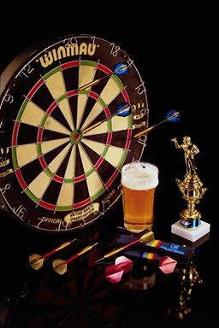
STP Process
Segmentation is the firs part of the STP Process which consists of:
  Segmentation: identifying the most productive bases for dividing a market, identifying the customers in different segments and developing segment descriptions.
  Targeting markets: evaluating the attractiveness of different market segments, parts of segments(niches) or groups of segments, and choosing which should be targets for marketing.
  Positioning: identifying the positioning of competitors( in the market and the target segments or niches), to develop the firm’s won positioning strategy.

Slide 12
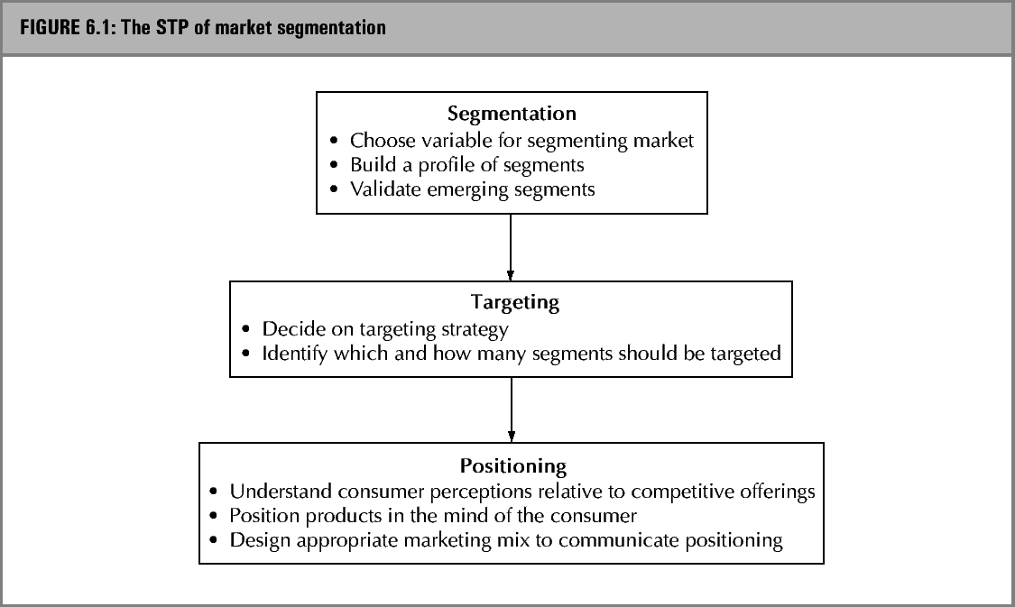
The STP approach to segmentation

Slide 13

Segmenting B2C markets
Bases for segmentation:
Socio-demographic segmentation
  Geographic segmentation
  Gender
  Age
  FLC (Family Life Cycle)
  Occupation / social class
  Subculture

Slide 14
Segmenting B2C markets

Slide 15
Segmenting B2C markets

Slide 16
Segmenting B2C markets
Bases for segmentation (cont.):
Personality characteristics
  Lifestyle characteristics
Occasions for purchase
  Usage segmentation (heavy-, light-, non-users)
  Benefit segmentation
  Behavioural segmentation
  Innovators / opinion leaders

Slide 17

Exhibit 6.1 The use of occasion-based segmentation at Coca-Cola

Slide 18
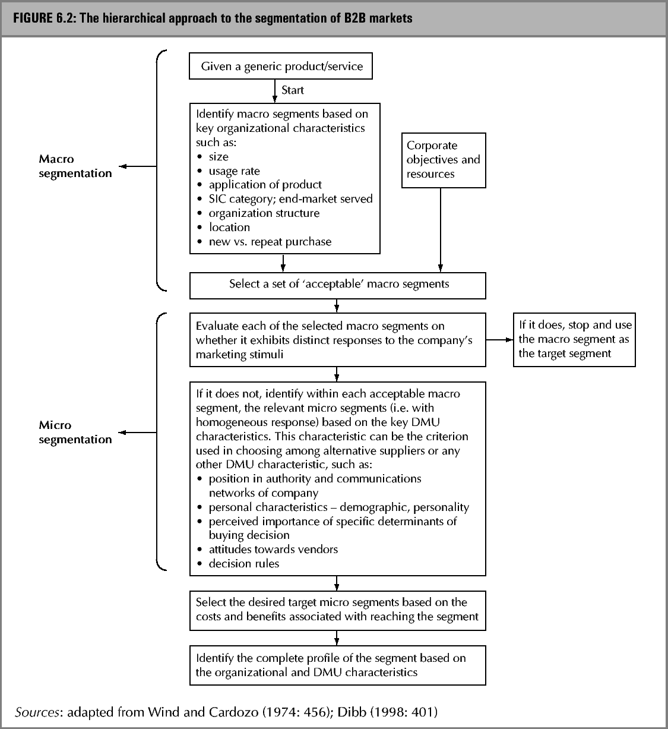
Segmenting B2B markets

Slide 19
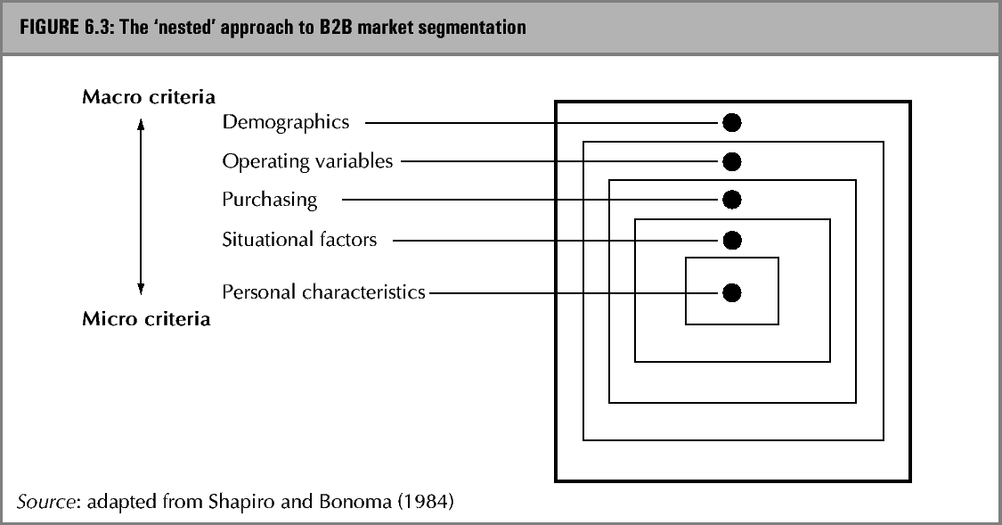
Segmenting B2B markets

Slide 20
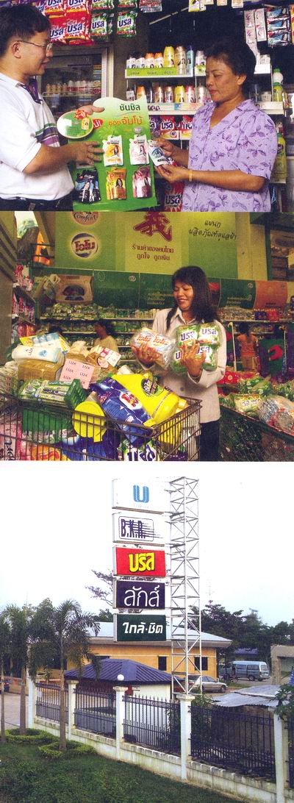
Segmenting B2B markets
Marketers of industrial goods, like those for consumer products, can segment markets according to the individuals involved in a purchase in terms of buyer/seller similarity, buyer motivation, individual perceptions and risk-management strategies.

Slide 21

Segmenting B2B markets
For example, purchasing officers may differ in the degree to which they shop around and look at numerous alternative suppliers, and dual-source important products and services, as opposed to relying on informal contacts for information and remaining loyal to existing personal contracts

Slide 22
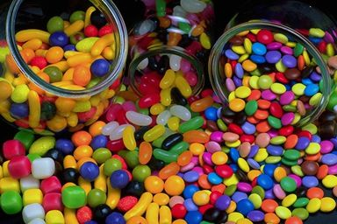
Exhibti 6.2 Cadbury’s segmentation strategy in chocolate confectionery

Slide 23

Segmenting international markets
The assessment of international marketing opportunities usually begins with a screening process that involves gathering relevant information on each country and filtering out the less desirable countries. A ‘top-down’ model for selecting foreign markets is shown in Hollensen (2004), p. 232 (ISBN 0-273-67839-6).

Slide 24

Segmenting international markets
The Hollensen (2004) model includes a series of four filters to screen out countries.
The overwhelming number of market opportunities makes it necessary to break the process down into a series of steps.
Although a firm does not want to miss a potential opportunity, it cannot conduct extensive market research studies in every country of the world.

Slide 25

Segmentation, targeting, positioning
In segmentation, targeting and positioning, we are seeking we are seeking to identify distinct subsets of customers in the total market for a product. Any subset might eventually be selected as a market target, and on that basis a distinctive marketing mix will be developed:

Slide 26
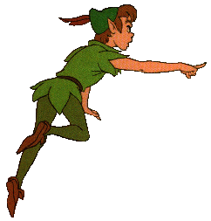
Segmentation, targeting, positioning
A better understanding of customers, their needs and wants.
A better understanding of competition and the kind of competitive advantage to pursue.
A more effective use of company resources.
The development of more effective marketing plans.

Slide 27
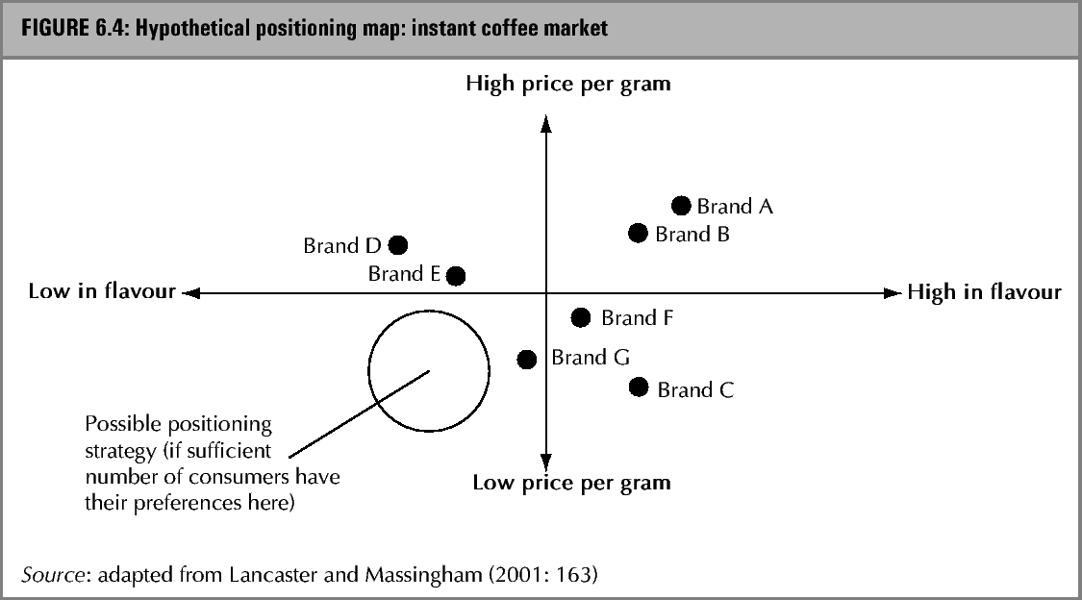
Positioning

Slide 28
Positioning & differentiation
Positioning Statement:
We are (name of brand).
We produce (type of offering) for (target consumer)
This market offering provides benefits that
satisfy(consumer needs)
Our offering uniquely attracts our target consumer
Because (source of competitive uniqueness).
Our benefits differ from competitors’ benefits in the
Following way(s): (points of differentiation).

Slide 29
Positioning & differentiation
Gatorade
We are Gatorade. We produce sports drinks for physical
activity enthusiasts who consider themselves to be
accomplished, but not necessarily competitive, athletes.
This market offering provides benefits that satisfy our
Consumer’s need to quench thirst in a healthy and fun
(but not frivolous)way. Our offering uniquely attracts
Our target consumer because it is absorbed in the body
12 times faster than water and because it is heavily promoted
Using imagery of everyday athletes working up a sweat.
Our benefits differ from competitors’ benefits in the following
ways: fun, scientifically-backed quenching.

