Slide 1
An Outlook of Economic Prosperity in the GMS: Building Upon Connectivity, Competitiveness and Community

Slide 2
Presentation Outline
Overview of the Greater Mekong Subregion
Increasing Connectivity in the GMS
Improving Competitiveness of the GMS
Achieving a Greater Sense of Community
Expanding Investment Opportunities in the GMS
Capital Market Development in the GMS

Slide 3
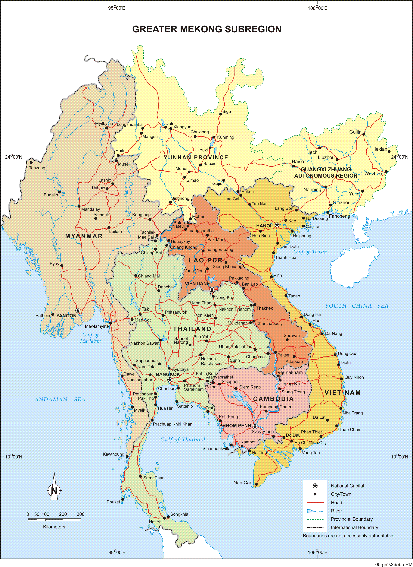
What is the GMS?
The Greater Mekong Subregion (GMS) is a natural economic area bound together by the Mekong River, covering 2.6 million square kilometers.
The GMS countries are Cambodia, the People's Republic of China (PRC, specifically Yunnan Province and Guangxi Zhuang Autonomous Region), Lao People's Democratic Republic (Lao PDR), Myanmar, Thailand, and Viet Nam.

Slide 4
Quick Facts about the GMS
Total population of 334 million in 2013
Total GDP of about $2.5 trillion in 2013 (PPP, current US$)
Total exports of $411 billion in 2013
Total imports of $432 billion in 2013
Inward FDI flows near $150 billion in 2013
More than $17 billion in investment projects under the GMS Program since 1992.

Slide 5
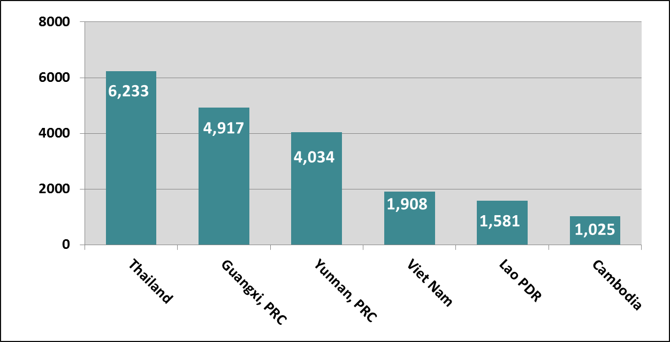
2013 GDP per capita (PPP,current $)
Sources: ADB Key Indicators and China Statistical Yearbook, various issues and ADB Staff estimates.
Data for Myanmar not available at cutoff date.
GDP per capita converted at official exchange rate, average of period.

Slide 6
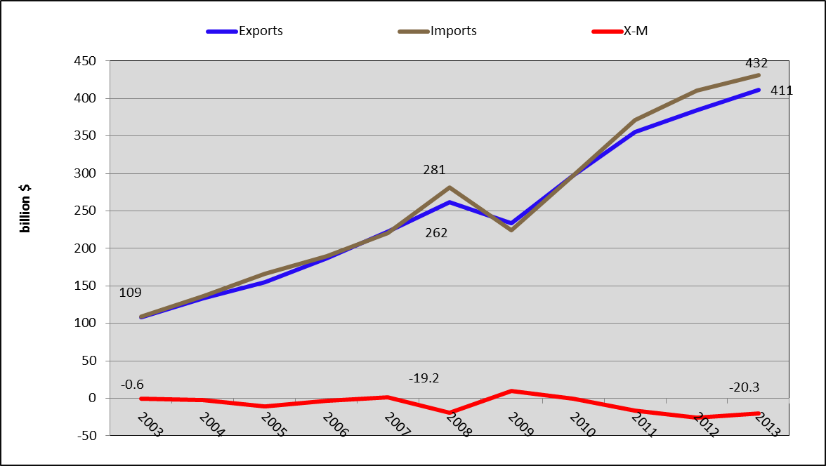
GMS Exports, Imports and Trade Balance
Sources: ADB Key Indicators and China Statistical Yearbook, various issues and ADB Staff estimates. GMS members: Cambodia, Guangxi PRC, Yunnan PRC, Lao PDR, Myanmar, Thailand , Viet Nam

Slide 7
The GMS Program
Started in 1992
Pragmatic and Informal
Promote mutual trust and goodwill
Multifaceted role of ADB : Financier, Honest broker, Coordinator/Secretariat
GMS Sectors : Transport, Telecoms, Energy, Environment, Tourism, HRD, Trade Facilitation, Investment, Agriculture

Slide 8
The GMS Program’s 3 Cs:
Increased Connectivity
Greater Sense of Community
Improved Competitiveness
The 3 Cs also open the door to the 4th C:
Developing Capital Markets in the GMS

Slide 9
The 3 C’s are integral for the GMS to realize its vision of a prosperous, integrated and harmonious subregion
Increased Connectivity through sustainable development of physical infrastructure and transformation of transport corridors into transnational economic corridors.
Improved Competitiveness through efficient facilitation of cross-border movement of people and goods and the integration of markets, production processes, and value chains.
Greater sense of Community through projects and programs that address shared social and environmental concerns.
How can capital markets in the GMS help advance this vision?

Slide 10

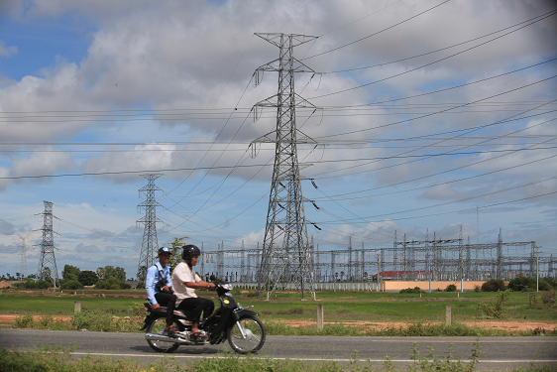
Physical Connectivity in the GMS is Increasing:
Countries are increasingly linked via roads, railways, telecoms, and power lines.
Nearly 7,000 kilometers of roads constructed, upgraded, or improved under the GMS Program.
Nearly 20GWh of electricity traded within the GMS in 2013

Slide 11
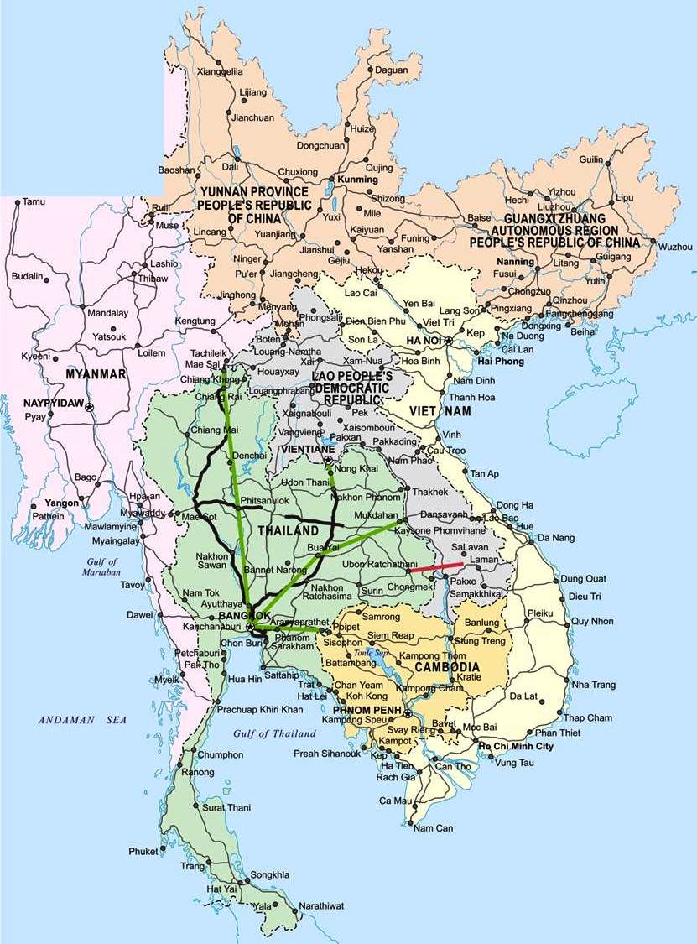
GMS Connectivity Infrastructure in 1992
Roads
Telecommunications
Power Transmission Line

Slide 12
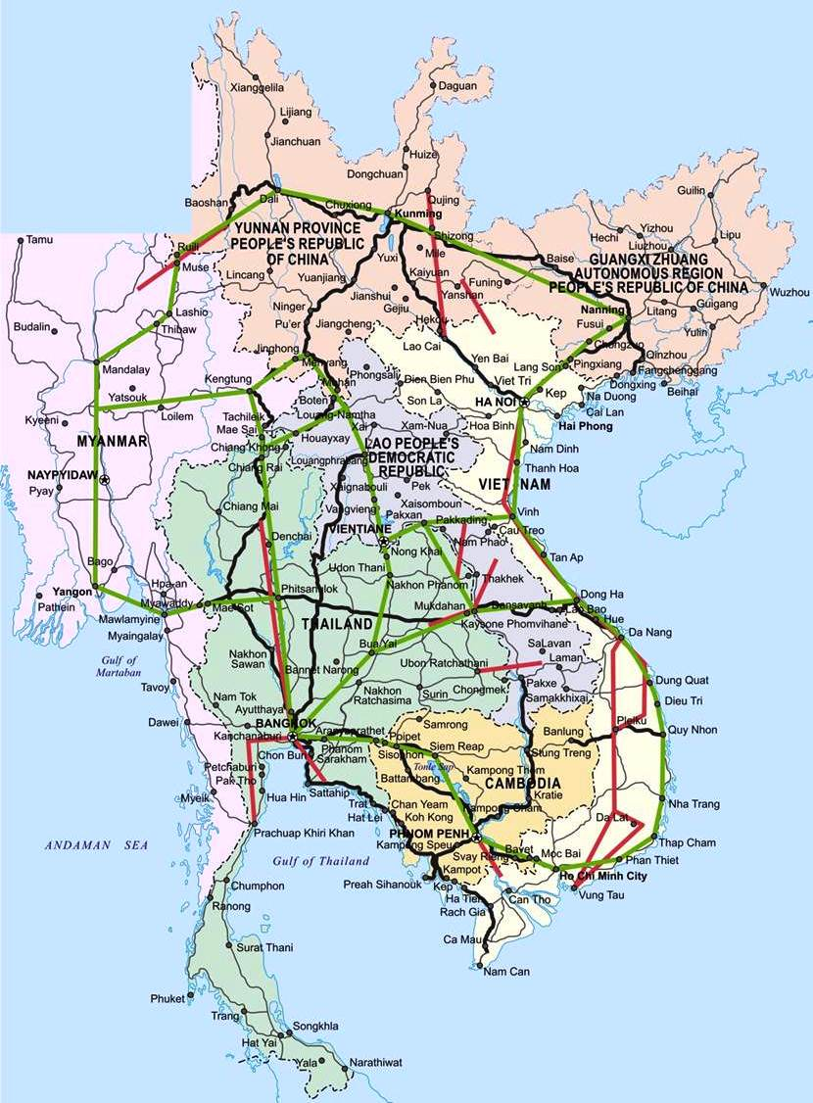
GMS Connectivity Infrastructure in 2010
Roads
Telecommunications
Power Transmission Line

Slide 13
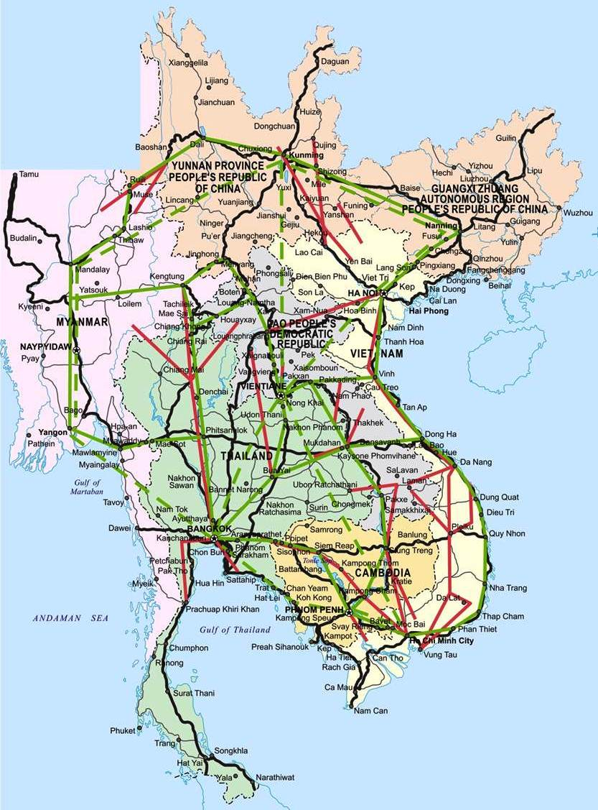
Future GMS Connectivity Infrastructure 2015-2020
Roads
Telecommunications
Power Transmission Line

Slide 14
THE GMS IS ALSO COMMITTED TO IMPROVING CONNECTIVITY “SOFTWARE” TO FACILITATE CROSS-BORDER TRANSPORT & TRADE
The GMS Cross Border Transport Facilitation Agreement (CBTA) provides a subregional framework for making cross-border transport faster, easier and cheaper.
GMS countries have successfully implemented a number of bilateral and/or trilateral traffic rights agreements at key border crossings.
The second phase of the GMS Transport and Trade Facilitation Action Plan and other technical assistance projects will further support efforts to facilitate cross-border transport and trade in the GMS.

Slide 15
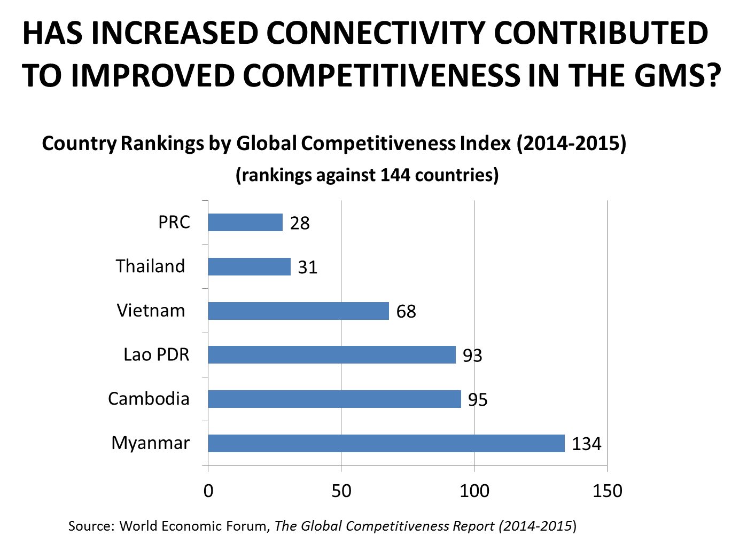

Slide 16
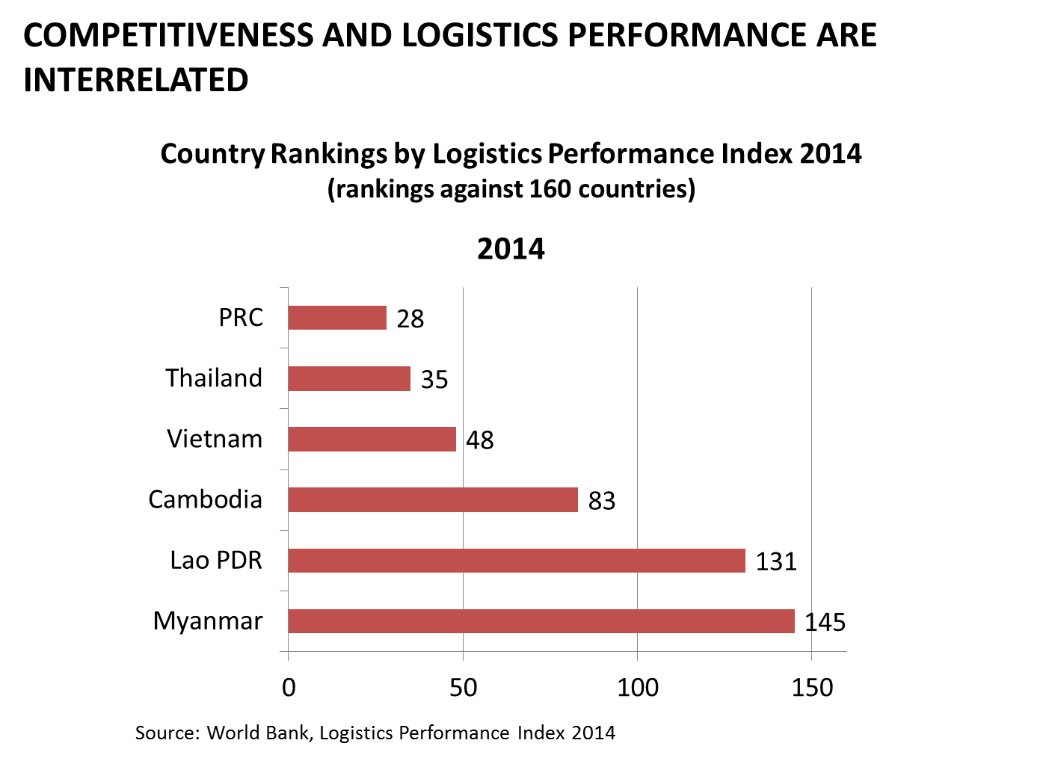

Slide 17
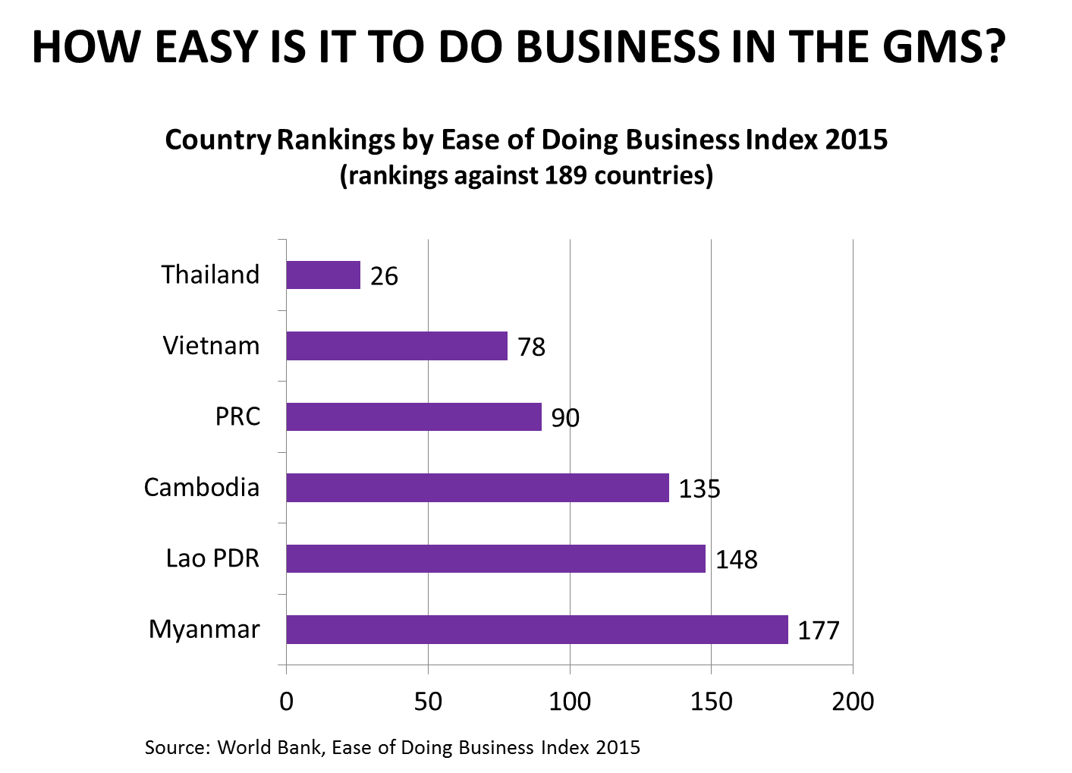

Slide 18
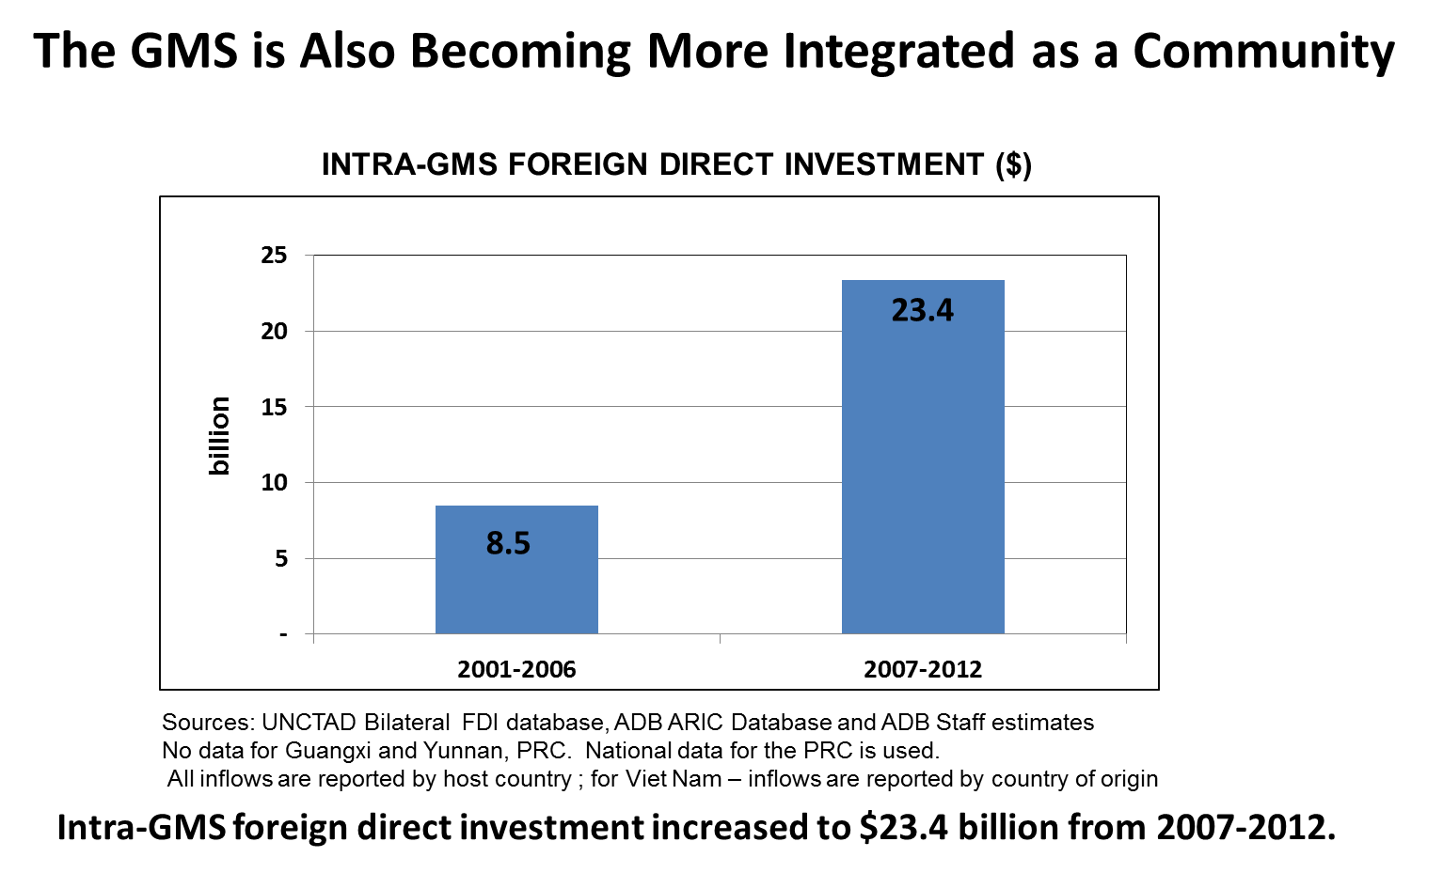

Slide 19
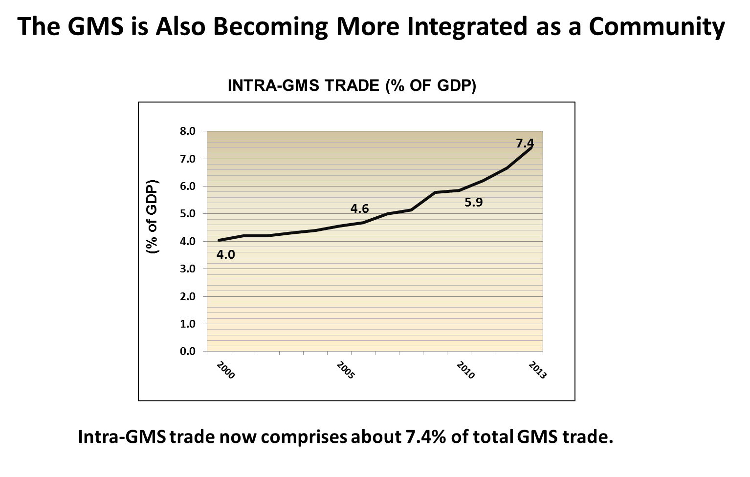

Slide 20
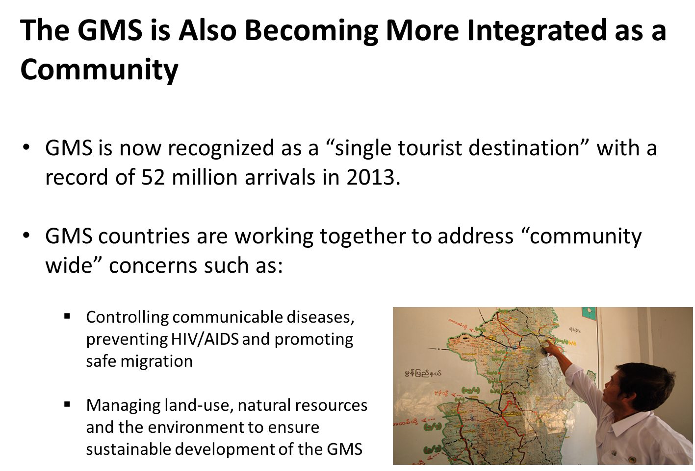

Slide 21
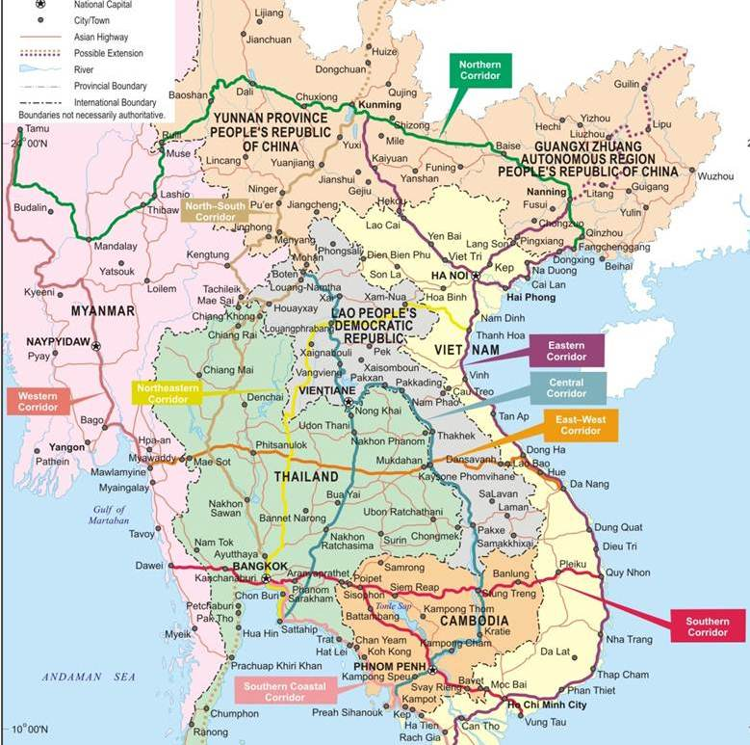
Developing Economic Corridors is a Strategic Priority for the GMS
Transform 9 priority transport corridors…
…into economic corridors to boost cross-border trade and investment and to stimulate jobs and growth.

Slide 22
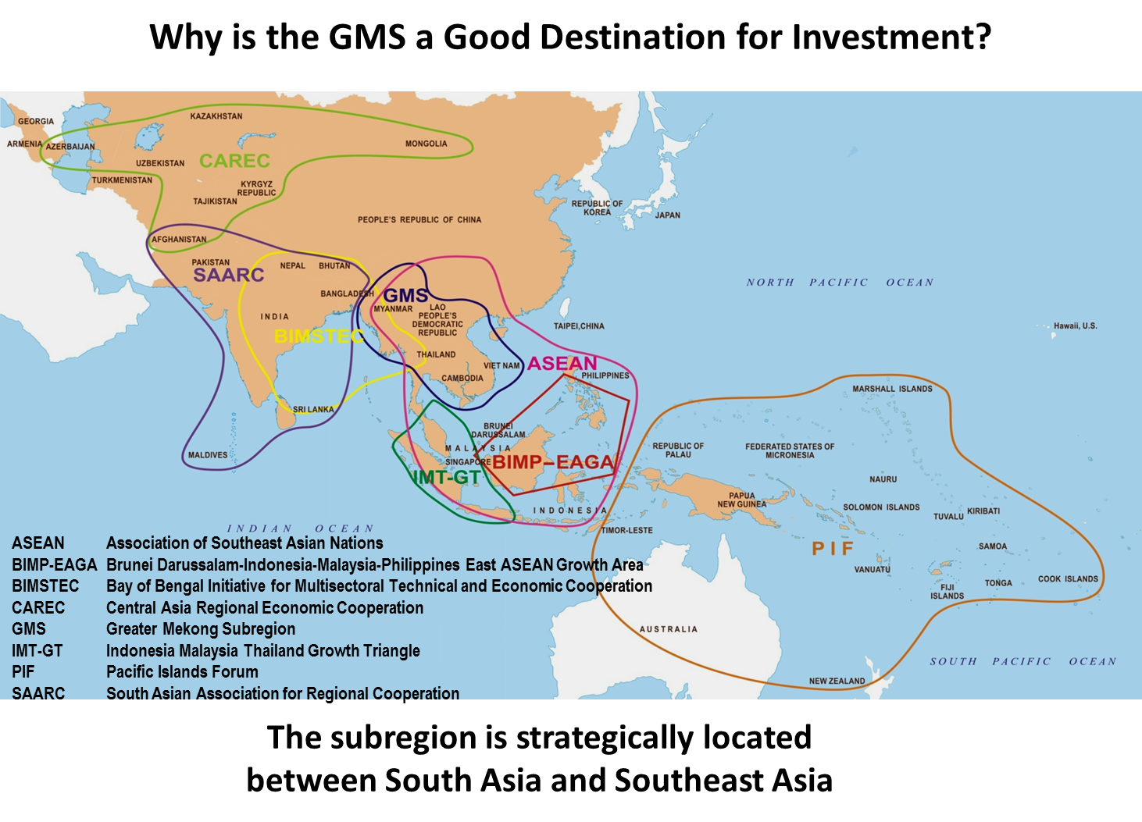

Slide 23
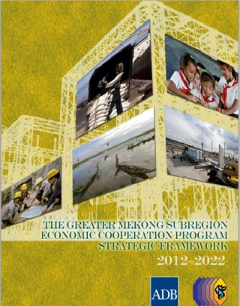
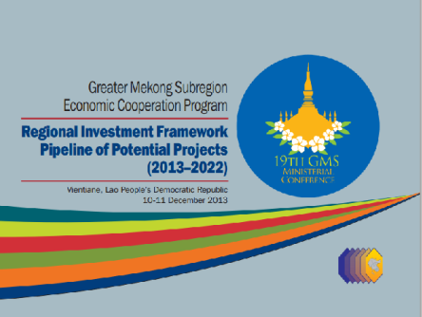
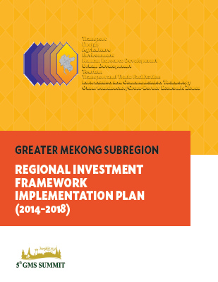
Why is the GMS a Good Destination for Investment?
The subregion has a:
Strategic Framework
Regional Investment Framework
Implementation Plan

Slide 24
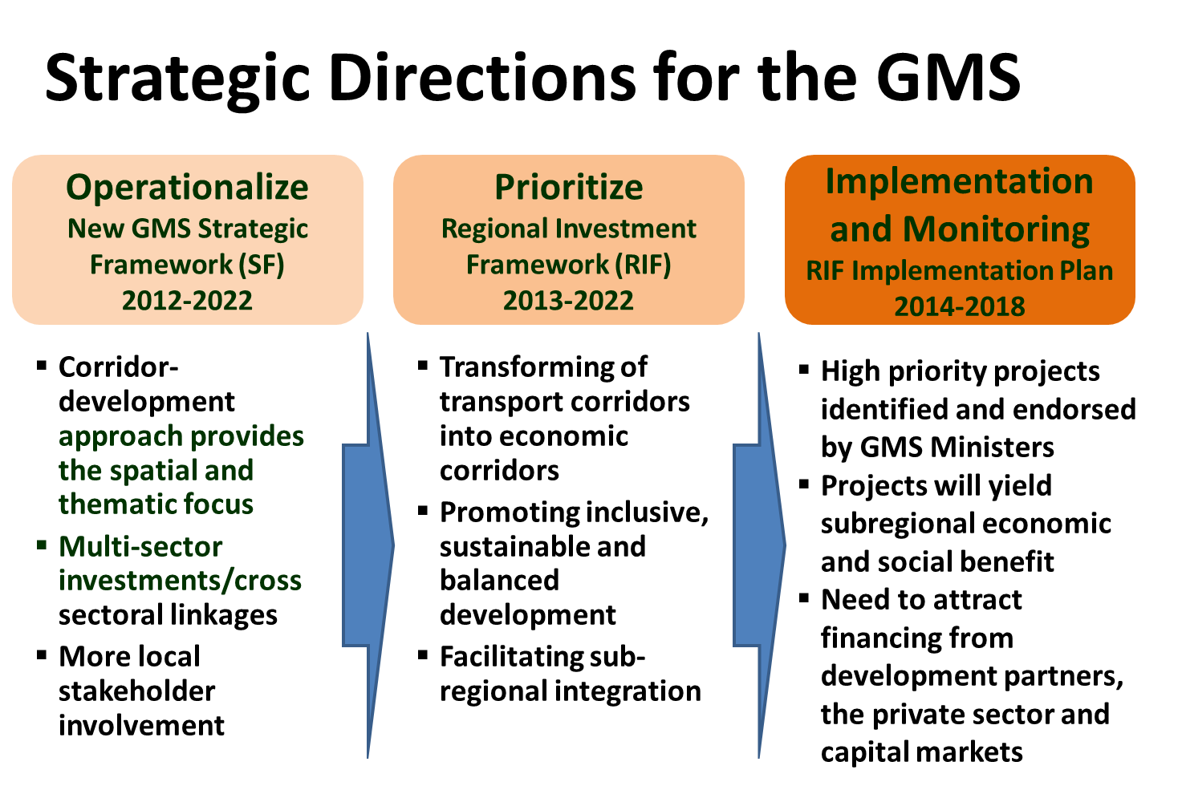

Slide 25
Regional Investment Framework
Pipeline of GMS Projects (2013-2022)
Over 200 GMS projects covering multiple sectors, including transport, energy, environment, agriculture, human resource development, ICT, tourism, transport and trade facilitation, and urban development.
Estimated cost of $51.3 billion

Slide 26
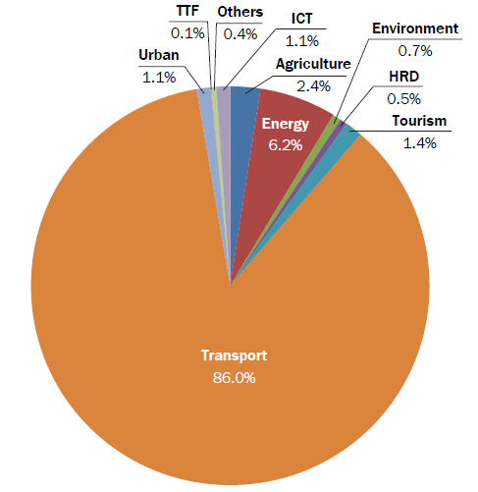
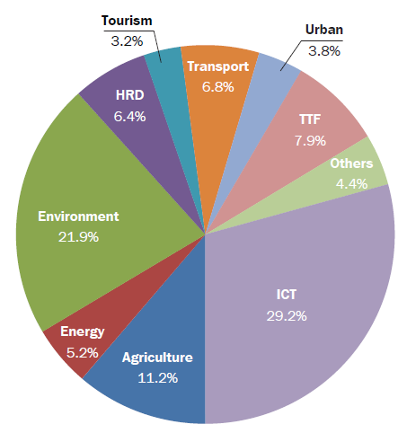
RIF Project Pipeline (Long List)
RIF Investment Projects
RIF TA Projects

Slide 27
Project Prioritization to Prepare RIF Implementation Plan
RIF projects further prioritized by GMS sector working groups, task forces, and forums throughout 2014.
Criteria for prioritizing projects:
  Subregional development benefits and impact
  Economic and social viability
  Implementation time frame of 2014 to 2018
  Likelihood of financing
  Other criteria as agreed upon by sector working groups, task forces and forums

Slide 28
GMS RIF Implementation Plan (2014-2018)
Identifies 92 priority projects across multiple sectors.
Estimated investment cost exceeds $30 billion.
90% of all investment projects are in the transport sector.
Download RIF-IP at: http://www.adb.org/countries/gms/strategy

Slide 29
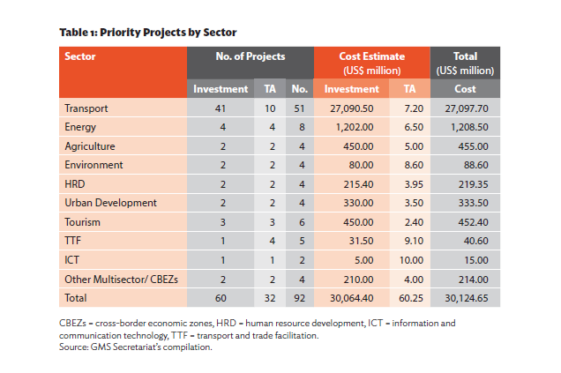
GMS RIF Implementation Plan for 2014-2018
Identifies 92 priority projects across multiple sectors
Estimated investment cost exceeds $30 billion
90% of all investment projects are in the transport sector
All projects will contribute to increased connectivity, improved competitiveness and a greater sense of community.

Slide 30
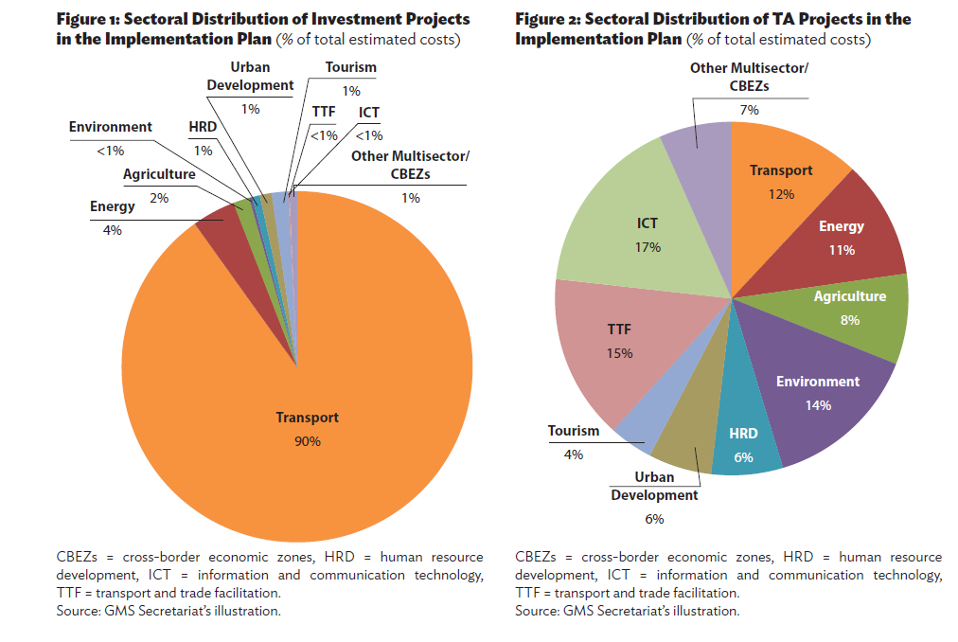

Slide 31
Securing the Financing Required for Priority GMS Projects is a Challenge
Traditional sources include multilateral development banks, bilateral funding and governments’ own resources.
There is a need to tap new sources such as financing from the private sector and GMS capital markets.
Thailand is looking at its capital markets as a source of long term debt to finance priority railway projects in the GMS.
Thailand is also exploring the issuance of “infrastructure funds” (a blend of fixed income and equities) to mobilize financing for domestic and regional infrastructure projects.

Slide 32
Developing GMS Economic Corridors
Requires a multi-sector approach to maximize the economic and social benefits of physical infrastructure:
    Cross-border and Special Economic Zones
    Corridor Town Development
    Logistics Centers and Dry Port Facilities
    Agro-processing Zones and Market Centers
Requires private sector participation to:
    Identify investment opportunities
    Contribute to project financing
    Create viable public-private partnerships

Slide 33
Institutional Connectivity is also progressing
GMS Business Forum established in 2000.
Mekong Tourism Coordinating Office established in 2006.
GMS Freight Transport Association established in 2012.
Greater Mekong Railways Association established in 2014.
GMS Regional Power Trade Coordination Committee is working to establish the GMS Regional Power Coordination Center in 2015.

Slide 34
But How “Developed” are Capital Markets in the GMS?
…and Can GMS Capital Markets be a Source of Financing for priority GMS Projects?
Let’s Look at the Capital Markets in the GMS Countries…
…except the PRC

Slide 35
GMS EQUITY MARKETS 2013
Different Stages of Development
Among GMS countries, big differences exist in terms of market cap, market cap as % of GDP and number of listed companies
 | Domestic Market Cap | Market Cap % of GDP | Number of Listed Companies
Cambodia | $135.6 Million | 1 | 2
Lao PDR | $1.1 Billion | 11.3% | 4
Myanmar | N/A | N/A | N/A
Thailand | $389.8 Billion | 106.6% | 558
Viet Nam | $37.3 Billion | 26.3% | 704
Source: World Federation of Exchanges, and KPMG Report 2013

Slide 36
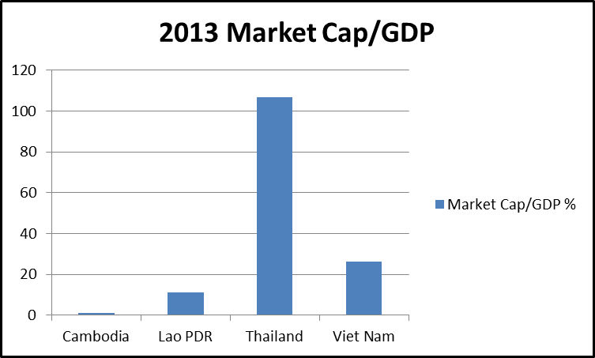
GMS EQUITY MARKETS 2013
Different Stages of Development
Source: World Federation of Exchanges, and KPMG Report 2013

Slide 37
Status and challenges for Cambodian equity market (CSX)
Cambodia Securities Exchange (“CSX”) in July 2011, as a joint venture between the Cambodian Ministry of Economy, which controls 55%, and the Korea Exchange (“KRX”).
The CSX started trading in April 2012, though there remains only two listings on the exchange – the state-owned Phnom Penh Water Supply Authority and Grand Twins International PLC
Unclear listing rules and companies don’t understand the process of raising funds through the market.
Lack of understanding and financial literacy on investment in the stock market
Source: KPMG Report 2013

Slide 38
Status and challenges for Lao equity market (LSX)
Lao Securities Exchange (“LSX”), was established in October 2010, as a joint venture between the Bank of the Lao PDR (51% ownership) and the Korean Exchange, KRX.
Trading began in early 2011, currently there are 4 listed companies on LSX
Foreign investors tend to trade these stocks more actively than their domestic counterparts; more than half of all transactions on the LSX were carried out by foreign investors in 2012.
Despite foreign interest, limitation of foreign equity reduces interest for more foreign listings. Unlikely to have more local listings unless from government push on state owned enterprises
Local investors invest without necessarily understanding fundamentals of market
Source: KPMG Report 2013

Slide 39
Status and challenges for Myanmar equity market (YSE)
Securities Exchange Law enacted July 2013
Myanmar Securities and Exchange Commission (MSEC) established in August 2014. Yangon Stock Exchange (YSE) targeted to begin operation by end-2015
Need to have sufficient resources to have adequate staff and strengthen capacity of the regulator (MSEC)
Framework and guidelines need to be developed for listing requirements including prospectus disclosure
Need to identify companies that are: (i) interested in listing, and (ii) meet the requirements to list
Need to develop pool of intermediaries including brokers, securities companies and supporting services such as law and accounting firms

Slide 40
Possible GMS Collaboration
Capacity Building: Cambodia and Lao securities market and regulator need support for capacity building in a variety of areas including:
i) intermediaries licensing & supervision;
ii) product development;
iii) investigation and enforcement; and
iv) clearing and settlement
Investor Outreach: Financial literacy for investors need to be strengthened to increase demand and provide understanding of fundamentals of market.

Slide 41
Possible GMS Collaboration
Knowledge Sharing: Thailand (SEC and SET) and Viet Nam (SSC, HNX and HOSE) can support GMS neighboring countries through sharing of information, capacity building, training, staff exchanges and other programs.
Leverage Expertise in the Broader ASEAN Economic Community: There is also potential to have wider collaboration and obtain capacity building support through the ASEAN Capital Market Forum (ACMF) from other ASEAN Member Countries such as Indonesia, Malaysia, Philippines and Singapore.

Slide 42
KEY POINTS
  Increasing Connectivity in the GMS still requires massive investments in physical infrastructure, “software” and capacity building.
  Improving GMS Competitiveness requires greater focus on addressing the challenges and constraints faced by the CLMV countries.
  Sustaining the GMS Community requires collective efforts to protect the environment and manage public goods and “bads.”
  The GMS Strategic Framework, Regional Investment Framework and Implementation Plan define Strategic Directions and Priority Investments for the GMS in the coming years.
  Capital Market Development can help fill the financing gap of priority GMS projects and further strengthen GMS Connectivity, Competitiveness, and Community.

Slide 43
Thank you

