Slide 1
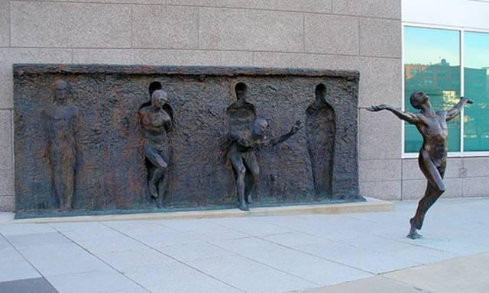

Slide 2

INTEGRATED BRAND COMMUNICATION
Massimiliano La Franca
Part 7

Slide 3
Last session recap
What is the brief; is the brief important?
What’s in it
Jobs to be done
Marketing/Communication Objectives
SMART objectives

Slide 4
Into the details of the standard brief

Slide 5
Today we will focus on:
A. What is the Job-to-be-Done (Brand Task) and resulting marketing objective? ▲ B. What is the measurable communication objective for this Job to be Done? ▲
What insight drives this brief? ▲
Who is our target audience? ▲
A. If Briefing for a Campaign Idea: Initial recommendation on required channels to reach and engage our target and why: ▲ B. If Briefing for an Execution: What is the role of this execution within the Channel Strategy?
What do they think and do now? (in relation to our brand and its product category) ▲
What would we like them to think and do in response to the communication? ▲
What is the single most important point to communicate? ▲ Why should they believe it? ▲
Section 1: Objectives
Section 2: Insight
Section 3: Target
Section 4: Channels
Section 5: Key point

Slide 6
The insight

Slide 7
Insight
“
A penetrating understanding of a complex situation or problem.
”
“
The ability to perceive clearly or deeply the inner nature of things.
”

Slide 8
Insight
Insight: deep understanding of consumers’ on which the brand builds a unique proposition.
A Deeply Felt Human Truth That Bonds Our Consumer To Our Brand
Foundation on which a communication strategy is built
Can come from observation of a behavior but must answer the question WHY?
  Observation = How do people behave?
  Insight = Why do people behave this way?
Can come in the form of an unmet need (ex. I wish I could eat chocolate without getting fat)

Slide 9
An abused word…
Consumer insight: a profound understanding of the consumer
Communication insight: the element upon which the communication is built on
Shopper insight: a profound understanding of the shopper (as person who shops in the point of sale)
Product insight: that key element of the product that makes it unique and different
Media insight: that specific element of that media channel that makes it unique and different

Slide 10
Our focus
Consumer insight: that deep understanding of the underlying reasons of people’s behaviors
  Used as a leverage to try and change behaviors
  Related to how people relate to the brand
Executional insight: directly related to a specific execution (example: something related to local culture or usage of a specific media)
  The insight that is at the core of the creative idea

Slide 11
Communication Development process
BUSINESS
CHALLENGE
Consumer
Insight
COMMUNICATION
CHALLENGE
COMMUNICATION
STRATEGY
Executional
Insight
ADVERTISING IDEA

Slide 12
Clarity on terms
Let’s be clear what are we talking about ate each stage of the communication development
Clients brief usually contains Consumer insight (regardless the quality of it)
Creative brief contains Consumer insight and execution insight (shopper, media, cultural). Planners to make clear the differences
Presentation of execution ideas stem from execution insight

Slide 13
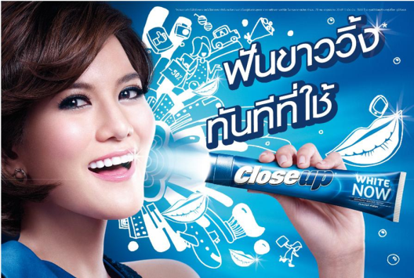
White teeth are as important as my make-up or hair - its part of looking fantastic and turning heads.

Slide 14
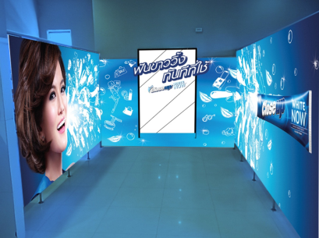

Ladies room is where girls transform, check their look and adjust make up…
Bright smile is a seduction weapon.

Slide 15
Insight
Insight is different from observation or fact
Observation
Insight
WHY?
Driving a high performance
car is a clear signal to others
that I am on the road to
success
I enjoy driving
high performance
cars

Slide 16
Fact
Milk Goes With Many Things

Slide 17
Insight
You Only Notice Milk When It Isn’t There

Slide 18
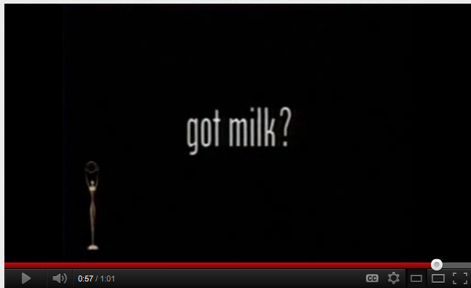
A famous case

Slide 19
Fact
Men think about sex every 3 seconds

Slide 20
Insight
when it comes to girls, I whish they would make the first move
Notes:
Separate into text boxes and hav them come in together

Slide 21
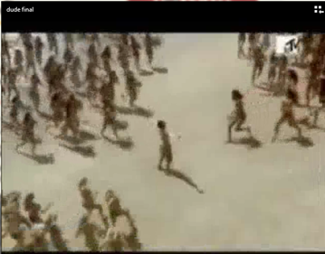

Slide 22
Fact
Candy Is For Sharing

Slide 23
Insight
When you have some delicious candy, the last piece is the most precious.
Notes:
Separate into text boxes and hav them come in together

Slide 24
Fact
Kids get dirty every time they go out and play

Slide 25
Insight
Dirt is good
If you don’t get dirty, you don’t grow…
Notes:
Separate into text boxes and hav them come in together

Slide 26
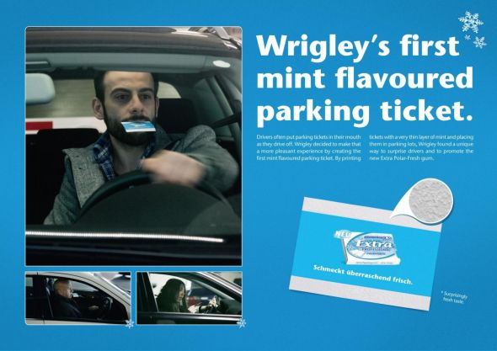
Channel Insight

Slide 27
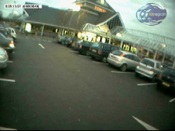
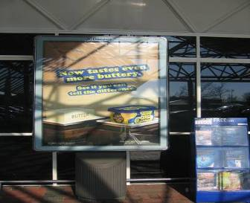
Channel insight
When shoppers are approaching the store, they are observed to be looking for parking, fixing their things.
Thus, communication approaching the store is generally ignored.
At most, 1% of shoppers look at them.
IMPLICATION: Do NOT invest in communication outside the store.
*source: tesco shopper study

Slide 28
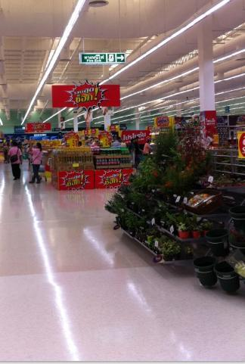
Shopper Insight
Shopper Insight:
People do not usually start shopping until they are a few meters in the store
Implication:
Leverage the landing strip to disrupt shopper and make them adjust to shopping mode quickly
Examples:
Exclusive/innovative items (imagine use iPhone5!) to surprise shopper
Create shocking savings “check price carts” and place them in the landing strip
Landing strip

Slide 29
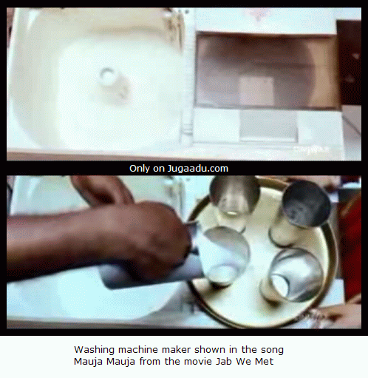
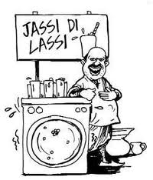
Product Insight

Slide 30
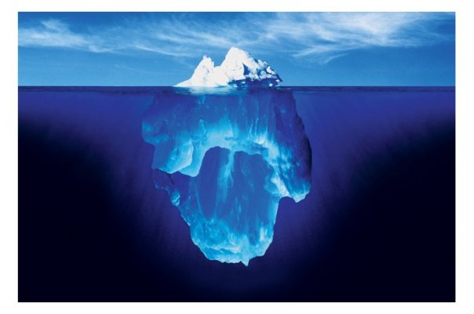
Facts are Cold!
Insights are electrifying!

Slide 31
How do we know we have a good consumer insight?
RIGOUR: Is it based on a deep understanding of consumer behavior, emotion or attitudes?
RELEVANCE: Is it relevant to the brand and communication challenge?
HUMAN TRUTH: Will it “Ring True” in the minds of our target consumer?
  Will it feel personally relevant?
  Will it move them closer to the brand?
  Is it simple and single minded, so that it can be easily understood and assimilated?
SPRINGBOARD POTENTIAL: Will it challenge the agency to come up with breakthrough creative ideas?

Slide 32
Some practical questions
Does our Insight describe a relevant human truth and how it opens the door to the brand?
Is it fresh and is it inspiring for us?
Is this just an observation or a deeper Insight?
Does it create some sort of tension?
Does it hook back into the brand?
Is it enduring?
Keep asking why people use the brand / category and ‘so what?’ until we get to a deep level of understanding of why the brand is important to consumers.

Slide 33
Dig deeper to get to a real insight. Probe for meaning
WHY BECAUSE TOOL
Keep probing: why why why
So…….?
Well, I work really
hard
Why?
I feel the need to
reward myself!!
The longer the day goes on, the more tempted I am to snack
And?
I often reward myself
with ‘bad’ snacks
…..but they are
usually bad for
the figure
So what?
Well, they are usually
tasty and fulfilling
What else?
The longer the day goes on, the more tempted I am to reward myself with something
nice to eat, often something naughty, and my figure suffers!
Notes:
Learning to see behind an event- to its fundamental drivers
DRIVERS
TRENDS
MANIFESTATIONS

Slide 34


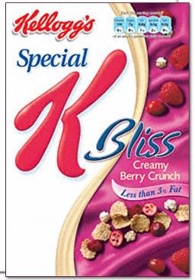
Pleasure that can enjoy anytime
The longer the day goes on, the more tempted I am to reward myself with something nice to eat.
Unfortunately, nice is often naughty and my figure often suffers!
Kellogg’s Special K Bliss are crunchy rice and wheat flakes with strawberries and smooth dark chocolate flakes.
A delicious treat served with ice cold milk, but low in calories and fat at the same time.
Spoil yourself and not your figure.

Slide 35
Target: the starting point of any promotional activity
?
why

Slide 36
Why?
Remember communication process? Encoding and decoding the message
Talk to relevant people that are interested in what the brand wants to say
Talk differently and in different channels to different people

Slide 37
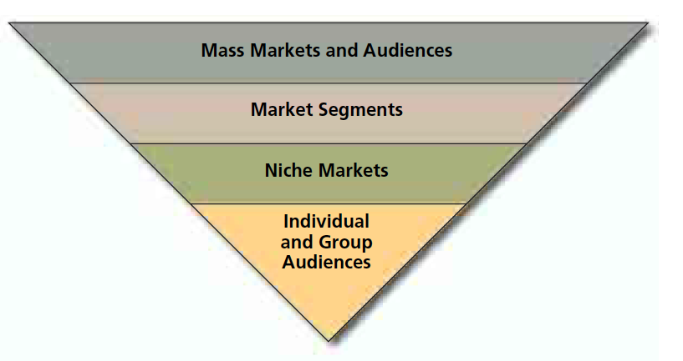
The big picture
General Audience
Segments with similar needs
Narrowly defined groups
One to one

Slide 38
How are they defined?
Geography: we might need to address the specific needs of a specific area (for example: think sim-cards in BKK and upcountry)
Demographic: gender, age, lifestages, Birth Era (Gen Y, Z),
Socioeconomic: income, education, occupation
Psycographic: personality (extroverted, ambitious), values (achievers, gregarious), attitudes (rejectors, lovers)
Behaviour: heavy or light users of a product, loyal, non-users
Lifestyle

Slide 39
Define the Key Target
Target describes the chooser of the brand, who may be the buyer or the user. This is the person for whom the brand is – or wants to be – the first choice.
The ‘chooser’ should be defined in terms of attitudes, behaviour and values as well as in socio-economics. Sometimes it can also be helpful to specify the situation in which the brand will be the first choice

Slide 40
An abused term
There’s a lot of confusion with the word target: be clear what you mean.
The most important:
Target users/buyers
Communication target (bulls eye)
Media target
Watch out: The 3 above might not be the same for the same category

Slide 41
Users - Buyers
Those people who actually buy and use the product/service
Information coming from market data and analysis (scan, loyalty cards, researches)
The ones who use the product are not always the same than the one who buy it
Can be quantified

Slide 42
Communication target
Those people which we want to communicate to
They’re not always the same than those who use the product
  Influencers - Bull’s eye target: a very narrowly defined group of people who are the key influencers or motivators for the decision of the mass
  Aspirational
  Rejuvenating / refreshing activities
Mainly used in the communication brief, they tend to be defined more in terms of psychographic values and attitudes more than figures

Slide 43
Media target
The group of people that use a specific media that a brand want to target
  men 18-24 at futsal
Media agencies provide data and detailed description of who use a specific media, how much and when
It becomes relevant to decide what channels are more relevant to reach a specific group of people with a specific message

Slide 44
So, where to start?
Start from the key users: who are them?
Once defined them, ask yourself:
  are they the key people to focus our communication on?
  Are they the main source of business? Who else could you get? Who would you most like to get?
Once defined the target group you want to talk to, describe them in an inspiring way for the agency to develop communication to influence them
Media target gets relevant at the end of the process when you want to define what media to buy

Slide 45
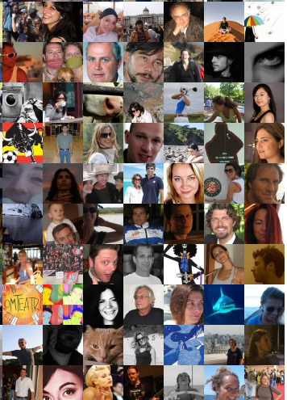
Remember…
How could you describe them in a meaningful way?
  Demographics are important but not enough
  What’s their behavior: current users, non users, rejectors, loyal, light or heavy users?
  No marketing jargons, we’re talking about people…
What insight do we know about them?
  What does explain their behavior?
  Remember insight answer the question, why do they behave this way?
Focus
  The more precise is the target the biggest the chances of success
  You can’t please everyone all the time but you must please your key target

Slide 46
Some useful exercises
What is our Target ‘For’ and ‘Against’?
  Draw up a list what our core target consumers are ‘For’ and ‘Against’ so that we understand them in the wider context of their lives.
24-hour clock – a day in the life to understand them holistically, tracking:
  Time of day?
  Doing what?
  Where?
  Brand messages exposed?
  Impact?
  Receptiveness to message?

Slide 47


Some example
Successful business men who spend about 1/8th of their waking life in their car
14-25 year-old men, fairly cool but still limited in experience of women. Chasing girls, getting chased by girls, getting girls is a way of defining themselves as individuals and men. Peer group approval is critical
14-65 years old who like drinking beer (too broad, who are them? when do they drink? Why do they drink?)
Shoppers who have the member card and shoppers who don’t (need to choose, we can’t talk to both with the same message)

Slide 48


