Slide 1
Economy of myanmar
EE361 ECONOMIES of CLMV
Faculty of economics
Thammasat university

Slide 2
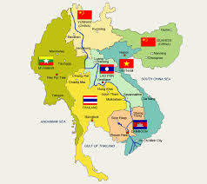
Myanmar within the Greater Mekong Subregion
 | 2000 | 2018
Population | 46.7 million | 54.0 million
GDP per capita | $190 | $1,418
Life expectancy | 60 | 66
Infant mortality (per 100,000 births) | 88.9 | 42.2
Primary education attainment | 85% | 99%
Poverty rate | 48.2% | 24.8%

Slide 3
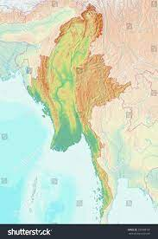
geography
Land area: 677,000 square km
Myanmar is the largest country in mainland Southeast Asia, and is strategically links GMS with South Asia, bordering with Bangladesh, PR China, India, the Lao PDR, and Thailand
The central, fertile lowlands running the central part of Myanmar where most of the key cities are located. The western and eastern regions are mountainous and relatively isolated
Only of the land area is arable, mostly in the central part of Myanmar
Mandalay
Taunggyi
Nay Pyi Taw
Yangon
Mawlamyine

Slide 4
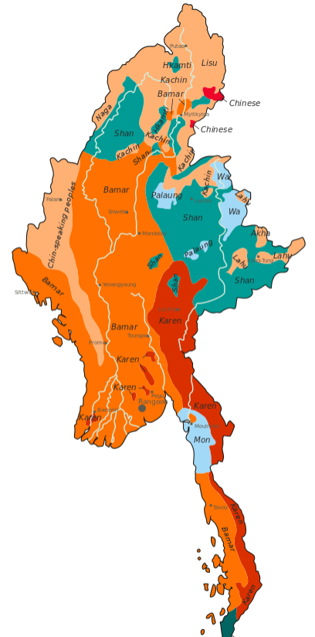
ethnicity
The main ethnic group in Myanmar are the Bamars, living in the flat, central lowlands along the Irrawady watershed.
Other ethnic groups are the living in the seven ethnic minority states of Burma are the Karen, Shan, Mon, Chin, Kachin, Rakhine and Karenni, which live in the mountainous areas of Myanmar
The locations of various ethnic groups correspond more or less with Myanmar’s general topography

Slide 5

Economic Milestones
Myanmar is a nation in transition, seeking to break with past authoritarian rule, economic mismanagement, and multiple conflicts that persist today, driven by social exclusion and predatory natural resource extraction
The country’s opening, in 2011, and the first democratic elections, in 2015, marked critical turning points for Myanmar
Poverty almost halved, falling from 45% to 25% between 2000 and 2018

Slide 6
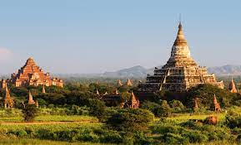
Economic Milestones
Adjustment of exchange rates, liberalization of product and factor markets, integration into regional markets, and modernization of financial institutions resulted in rapid economic growth (above 7% per year)
Reform momentum slowed after 2016 as the new civilian government struggled to realize its economic vision, policies and programs
Government adopted an ambitious Myanmar Sustainable Development Plan, economic reform agenda, and new reforms to sustain the economic transition

Slide 7
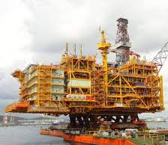
The Myanmar Economy
The economy is narrowly based, with growth driven by natural resource exports (mostly gas), construction, and tourism
Agriculture dominates the economy, accounting for about 29% of GDP, 52% of employment, and 20% of exports; manufacturing contributes 20% of GDP, with garments and wood products as the major exports
Reflecting the its economic transformation and reform efforts, GDP growth has increased from 5.6% in 2011 to an average of over 8.0% during FY2013–2015

Slide 8
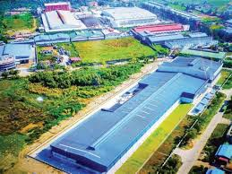
The Myanmar Economy
Liberalization of the economy and opening up to foreign direct investment has prompted rapid growth of the industry sector, notably exports of natural gas
A parallel increase in employment generation in the industry sector is unlikely, as the mining and energy sectors are capital-intensive rather than labor-intensive

Slide 9
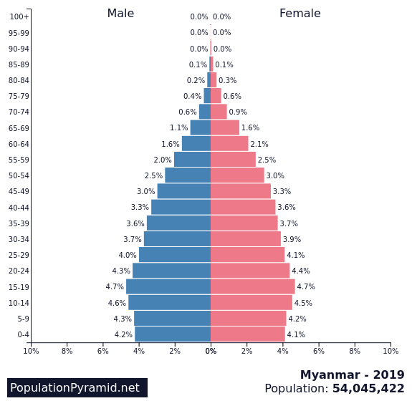
Population and demographics
The Republic of the Union of Myanmar conducted its most recent census in 2014 following the last census in 1983; current population is 54.0 million
Myanmar is at shifting from stage 2 to stage 3 of the demographic transition whereby death rates are declining and fertility rates are gradually declining as well
Steady increase in population size up to 2017 has policy implications for all sectors of the economy particularly those of education, health, employment and housing

Slide 10
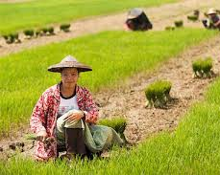
agriculture
The agriculture sector accounts for 60%–70% of total employment and 38% of GDP, down from 57% in 2001. In contrast, the share of GDP accounted for by the industry sector more than doubled during this period, to 25%.
Almost 70% of the population reside in rural areas; about half of the rural population is landless, with limited sources of income, while some 40% of rural households have landholdings of less than 2 hectares

Slide 11
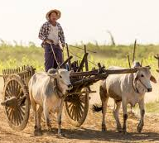
agriculture
Myanmar’s agricultural industry can be divided into three sectors: crop production, livestock, and fishing; rice is the leading crop product in Myanmar's agriculture with a production value of 25.1 million tons in 2018, followed by sugar cane and dry beans
Opportunities for broader integration into agricultural supply chains remain largely untapped due to low returns to land, rural infrastructure gaps, and limited market access
There is a need to further diversify farming systems and provide access to financial products suitable for agriculture activities

Slide 12

education
There are significant disparities by gender, location, and socioeconomic status in terms of access to education and workforce outcomes.
Businesses consistently rate human resource inadequacies as main constraints to doing business in Myanmar
In addition to access challenges, the shortage of workers with skills needed in a modern economy reflects weak educational quality and relevance

Slide 13
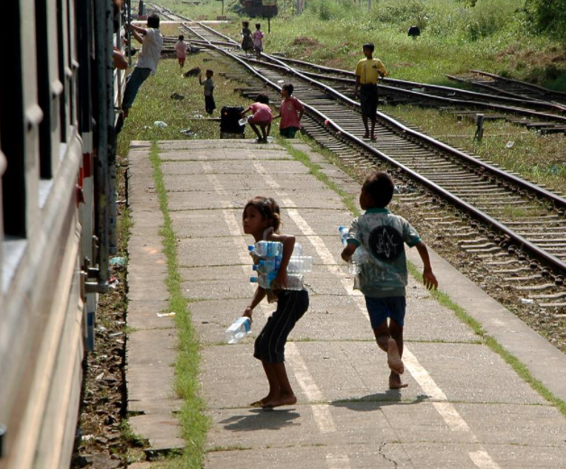
education
81 per cent of children complete primary education while only 40% complete secondary education; therefore at the primary school level, 1 in 5 children are not attending school either because they never entered school or dropped out
Main reasons for school non-attendance are: fees related to education, limited quality and relevance of the education that is offered, and economic hardships force many young children to give up education in order to work

Slide 14
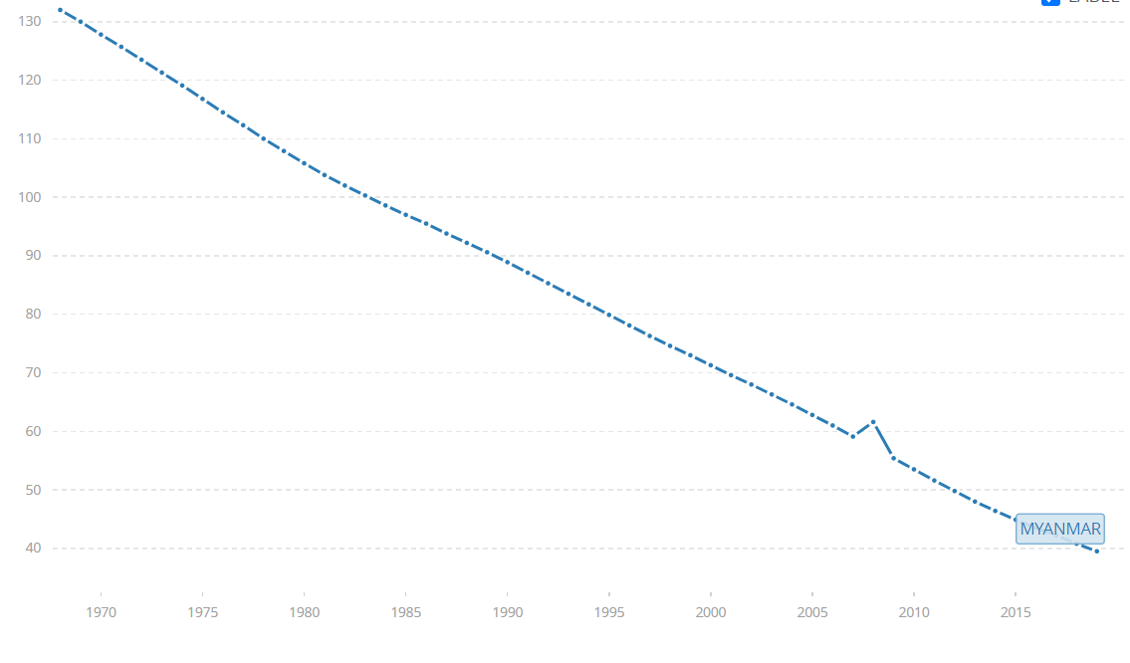
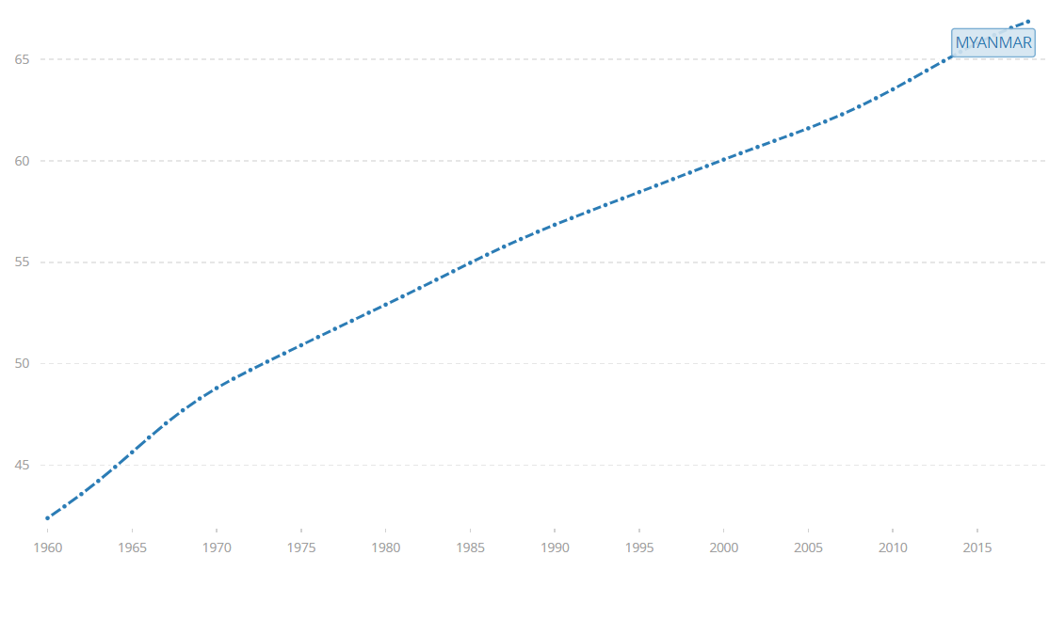
health
Infant mortality rate has steadily decreased from 71.3 per thousand births in 2000 to 44.2 in 2017; during the same period, life expectancy has increased from 60 years to 66 years
Myanmar is short of human resources for health, mainly due to a mismatch between supply and demand for health professionals. Unequal distribution of health professionals, and increasing need for health professionals due to population growth and increasing life expectancy remain challenging for Myanmar
Infant mortality rate, 1970-2018
Life expectancy 1970-2018

Slide 15
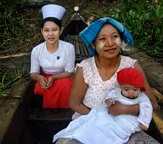
health
Prior to the COVID-19 pandemic, economic growth in Myanmar was projected to pick up to 6.3 percent in 2020 and 6.4 percent in 2021; however, Myanmar’s economy is expected to decline sharply due to direct and indirect impacts of the pandemic.
The global shock and domestic efforts to contain the spread of the virus have had a substantial economic cost

Slide 16
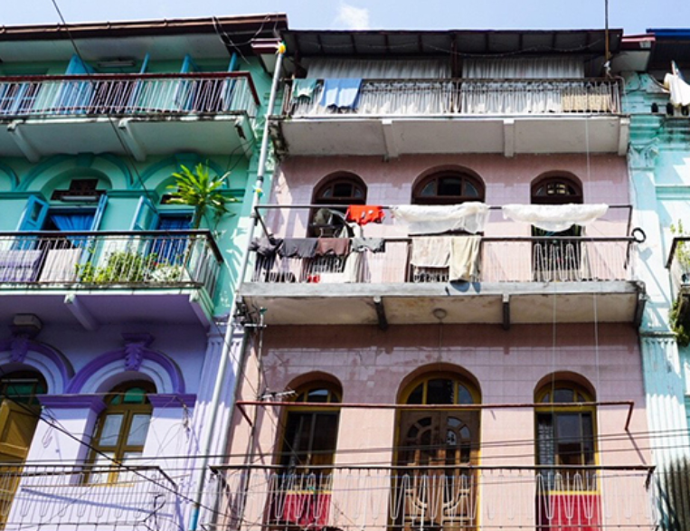
Urban development
Myanmar is in an early phase of urbanization; opportunities exist to shape cities for sustainable growth and poverty reduction.
While urbanization brings opportunities for urban dwellers, keeping pace with the their growing needs presents a challenge
Inadequate planning and lack of investments in infrastructure and basic services can lead to sprawl, congestion environmental pollution, and inequality

Slide 17
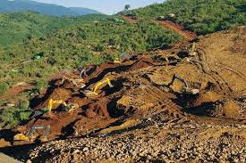
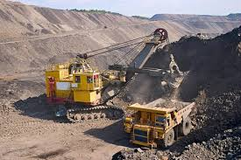
environment
Many livelihoods in Myanmar, especially in rural areas, depend on natural resources and the environment; however, the environment and the natural resource base are under stress from increased population, commercial exploitation, climate change, and natural disasters.
Unsustainable land and water management practices have led to decreasing forest cover, declining agriculture productivity, and poor water quality. In urban areas, people suffer from inadequate water supply, drainage and sewerage, and solid waste disposal

Slide 18
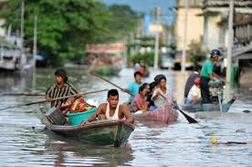
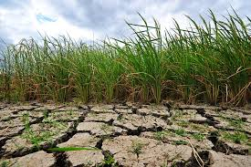
environment
Climate change is another major challenge for the development of Myanmar
It is one of the world’s most disaster-prone countries, exposed to multiple hazards, including floods, cyclones, earthquakes, landslides and droughts, sea-level rise, warming sea surface temperatures, salt water intrusion in its river deltas, as well as shifting weather patterns, and is one of three countries most affected by climate change

Slide 19
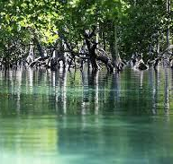
DEVelopment challenges
While Myanmar has enormous potential for growth, there are significant development challenges that require attention:
meeting deficits in infrastructure and human capital to boost social and economic development
maintaining macroeconomic and fiscal stability in a challenging global economic environment
accelerating the reform process to achieve structural and institutional change
enhancing the business environment
improving capacities and governance standards
addressing environmental issues and climate change

