Slide 1

Technical Barriers to Trade, Environmental Concerns and the ppm
By
Assistant Professor Dr. Jaurprapa Rakpong

Slide 2

Topics
Definition of TBT and When to Apply
Substantive Right: Members’ autonomy
Substantive Obligations
Procedural Obligations
Legal Text and Case Law
Further Issues

Slide 3
Why does WTO need a separate TBT Agreement?
TBT and GATT
GATT has already respected non-discrimination principles (MFN, NT), which is balanced by Article XX general exceptions (in order to respect the Member States’ autonomy).
However, border measures which perfectly comply with GATT, esp. Art. XX can still be unnecessarily applied in a discriminatory manner to restrict, or even exclude imports. E.g. measures requiring imports to be repackaged or to change their common trade names,
SPS and TBT:
SPS Agreement typically deals with food, animal and plant-borne risks, pests. But what about measures relating to product quality e.g. nutrition labelling? Or those concerning non-food imports, such as measures prescribing/restricting chemical usage in electrical appliances/toys?
Similar to the SPS Agreement, in TBT Agreement, the WTO seeks to balance the Members’ autonomy and the need to promote trade liberlisation through international standards. But unlike SPS Agreement, there is no need to establish RA.

Slide 4
Why does WTO need a separate TBT Agreement?
TBT and GATT
GATT has already respected non-discrimination principles (MFN, NT), which is balanced by Article XX general exceptions (in order to respect the Member States’ autonomy).
However, border measures which perfectly comply with GATT, esp. Art. XX can still be unnecessarily applied in a discriminatory manner to restrict, or even exclude imports. E.g. measures requiring imports to be repackaged or to change their common trade names,
SPS and TBT:
SPS Agreement typically deals with food, animal and plant-borne risks, pests. But what about measures relating to product quality e.g. nutrition labelling? Or those concerning non-food imports, such as measures prescribing/restricting chemical usage in electrical appliances/toys?
Similar to the SPS Agreement, in TBT Agreement, the WTO seeks to balance the Members’ autonomy and the need to promote trade liberlisation through international standards. But unlike SPS Agreement, there is no need to establish RA.
SPS and TBT Agreements have strong “conceptual similarities” so analogies betw. these two Agreements can usually be drawn (Sardines, para 275).

Slide 5



Slide 6
What kinds of trade measures are covered by the Agreement? = (Annex 1)
1.Techncial Regulations = กฎระเบียบทางเทคนิค
2. Standards = มาตรฐาน
3. Conformity Assessment Procedures = กระบวนการตรวจสอบ
Document which lays down product characteristics or their related processes and production methods, including the applicable administrative provisions with which compliance is mandatory. It may also include or deal exclusively with terminology, symbols, packaging, marking or labeling requirements as they apply to a product, process or production method.
Document approved by a recognized body, that provides, for common and repeated use, rules, guidelines or characteristics for products or related processes and production methods, with which compliance is not mandatory. It may also include or deal exclusively with terminology, symbols, packaging, marking or labelling requirements as they apply to a product, process or production method.
Any procedure used, directly or indirectly, to determine that relevant requirements in technical regulations or standards are fulfilled.

Slide 7
What kinds of trade measures are covered by the Agreement? = (Annex 1)
1.Techncial Regulations = กฎระเบียบทางเทคนิค
2. Standards = มาตรฐาน
3. Conformity Assessment Procedures = กระบวนการตรวจสอบ
E.g. technical regulations on bottle packaging
Document which lays down product characteristics or their related processes and production methods, including the applicable administrative provisions with which compliance is mandatory. It may also include or deal exclusively with terminology, symbols, packaging, marking or labeling requirements as they apply to a product, process or production method.
E.g. ISO, GlobalGAP, Organic, Q standard
Document approved by a recognized body, that provides, for common and repeated use, rules, guidelines or characteristics for products or related processes and production methods, with which compliance is not mandatory. It may also include or deal exclusively with terminology, symbols, packaging, marking or labelling requirements as they apply to a product, process or production method.
E.g. exporters’ certificates
Any procedure used, directly or indirectly, to determine that relevant requirements in technical regulations or standards are fulfilled.

Slide 8
Substantive Obligations
Technical regulations are mandatory, therefore, their impacts are “usually” felt more greatly by other members.
Consequently, TBT rules regarding technical regulations are stricter and more detailed than those applying to standards.
Amongst technical regulations, those belong to central governmental bodies are the strictest.
Article 2: Preparation, Adoption and Application of Technical Regulations by Central Government Bodies
With respect to their central government bodies…. Member Shall ensure….
Article 3: Preparation, Adoption and Application of Technical Regulations by Local Government Bodies and Non-Governmental Bodies
With respect to their local government and non-governmental bodies within their territories…
3.1 Members shall take such reasonable measures as may be available to them to ensure compliance by such bodies with the provisions of Article 2, with the exception of the obligation to notify as referred to in paragraphs 9.2 and 10.1 of Article 2.

Slide 9
Requirement for Technical Regulation
Article 2.1 remarks on the non-discriminatory treatments.
Article 2.2 tries to inject the “necessity” and “means-end rationality” tests whist trying to respect Members’ autonomy.
2.1 Members shall ensure that in respect of technical regulations, products imported from the territory of any Member shall be accorded treatment no less favourable than that accorded to like products of national origin and to like products originating in any other country.
2.2 Members shall ensure that technical regulations are not prepared, adopted or applied with a view to or with the effect of creating unnecessary obstacles to international trade. For this purpose, technical regulations shall not be more trade-restrictive than necessary to fulfil a legitimate objective, taking account of the risks non-fulfilment would create. Such legitimate objectives are, inter alia: national security requirements; the prevention of deceptive practices; protection of human health or safety, animal or plant life or health, or the environment. In assessing such risks, relevant elements of consideration are, inter alia: available scientific and technical information, related processing technology or intended end-uses of products.

Slide 10
Requirement for Technical Regulation
Article 2.1 remarks on the non-discriminatory treatments.
Article 2.2 tries to inject the “necessity” and “means-end rationality” tests whist trying to respect Members’ autonomy.
2.1 Members shall ensure that in respect of technical regulations, products imported from the territory of any Member shall be accorded treatment no less favourable than that accorded to like products of national origin and to like products originating in any other country.
NT
MFN
No-disguised trade discrimination
2.2 Members shall ensure that technical regulations are not prepared, adopted or applied with a view to or with the effect of creating unnecessary obstacles to international trade. For this purpose, technical regulations shall not be more trade-restrictive than necessary to fulfil a legitimate objective, taking account of the risks non-fulfilment would create. Such legitimate objectives are, inter alia: national security requirements; the prevention of deceptive practices; protection of human health or safety, animal or plant life or health, or the environment. In assessing such risks, relevant elements of consideration are, inter alia: available scientific and technical information, related processing technology or intended end-uses of products.
Non-exhaustive exceptions vs. Art. XX GATT for MS’ autonomy
Necessity Test
Means-end rationality (non-exhaustive)

Slide 11
Requirements on Technical Regulation (con’t)
Article 2.4 addresses the importance of international standards in the establishment of MS’ technical regulations.
2.4 Where technical regulations are required and relevant international standards exist or their completion is imminent, Members shall use them, or the relevant parts of them, as a basis for their technical regulations except when such international standards or relevant parts would be an ineffective or inappropriate means for the fulfilment of the legitimate objectives pursued, for instance because of fundamental climatic or geographical factors or fundamental technological problems.

Slide 12
Requirements on Technical Regulation (con’t)
Article 2.4 addresses the importance of international standards in the establishment of MS’ technical regulations.
Alignment to International Standards
2.4 Where technical regulations are required and relevant international standards exist or their completion is imminent, Members shall use them, or the relevant parts of them, as a basis for their technical regulations except when such international standards or relevant parts would be an ineffective or inappropriate means for the fulfilment of the legitimate objectives pursued, for instance because of fundamental climatic or geographical factors or fundamental technological problems.
Means-end Rationality
MS Autonomy

Slide 13
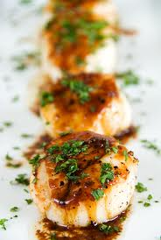
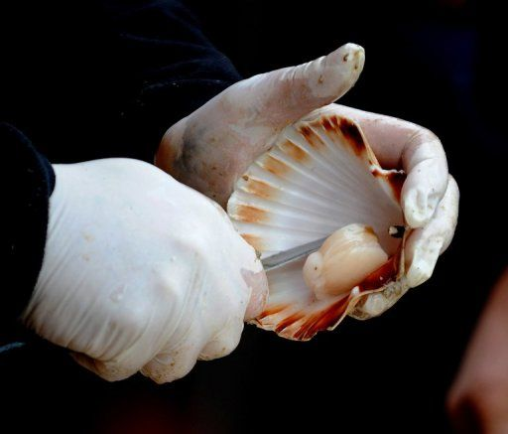
Case Law : Trade Description Cases
EC- Trade Descriptions of Scallops
(CAN, PERU and CHILE)
The First TBT dispute.
French Order laying down the official name & description for scallops. Only certain species were allowed to be called “Coquille Saint-Jacques”,
a common trade name for scallops in France.
Scallops from these three countries, were not allowed to use the common trade name but had to be labelled as "pétoncle" in the market.
The term pétoncle would be associated with an inferior product type. The three countries claimed that their “scallops” were similar to French Coquille Saint-Jacques in size, texture, colour, appearance and use, and that these were “like products”. Consequently, they claimed that the EC breached Art. 2 TBT (also Art. I & III GATT).

Slide 14
Case Law : Trade Description Cases
EC- Trade Descriptions of Scallops
(CAN, PERU and CHILE)
The EC realised that it could loose the dispute and that the case would set a precedent for other EC law relating to product descriptions.
The EC then mutually agreed with these three WTO members. That their products could also be called Coquille Saint Jacques but the term had to be followed by their origins.

Slide 15
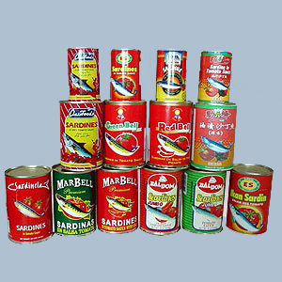
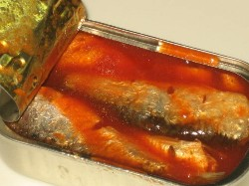

Case Law : Trade Description Cases (cont’)
EC- Trade Descriptions of
Sardines (Peru)
The First ‘real' TBT dispute.
Concerning “trade name” under which certain species of fish might be marketed as “Sardines” in the EC.
Two species of fish marketed in the EC as “Sardines”.
  1. Sardina pilchadus found along North Atlantic, 1. Mediterranean Sea and Black Sea i.e. European Sardines.
  2. 2. Sardinops sagus found in Eastern Pacific along Peruvian and Chilean coasts, i.e. Peruvian Sardines.

Slide 16
Case Law: Trade Description : EC- Sardines (cont’)
Council Regulation (EEC) 2136/89→ Only products prepared exclusively from fish of the species "Sardina pilchardus walbaum” (i.e. European Sardines) might be marketed as preserved sardines in the EC.
As a result, only “European Sardines” could still be marketed as “Sardines”, the “Peruvian Sardines” had to use the scientific name “Sardinops sagax” to describe the products.
This made selling them more difficult since the European consumers were not familiar with the scientific name.
Relevant international standards contained in “Codex Stan 94” would allow both types of species to be marketed as “Sardines” (along with other 21 species).
For Sardina pilcharrdus, this could be marketed as Sardines straight away,
For other 21 species, these could be marketed as “X sardines”, where
X = country, geographic area, species or common name.

Slide 17
Case Law: Trade Description : EC- Sardines (cont’)
The claim was on Art. 2.4, 2.2 and 2.1 of the TBT Agreement and Art. III: 4 GATT
The main legal provision which was considered by the Panel concerns Art. 2.4 TBT.
2.4 Where technical regulations are required and relevant international standards exist or their completion is imminent, Members shall use them, or the relevant parts of them, as a basis for their technical regulations except when such international standards or relevant parts would be an ineffective or inappropriate means for the fulfilment of the legitimate objectives pursued, for instance because of fundamental climatic or geographical factors or fundamental technological problems.

Slide 18
Case Law: Trade Description : EC- Sardines (cont’)
The claim was on Art. 2.4, 2.2 and 2.1 of the TBT Agreement and Art. III: 4 GATT
The main legal provision which was considered by the Panel concerns Art. 2.4 TBT.
        1. Does the relevant international standard exist?
2. If so has it been used as a basis for the measure at issue?
2.4 Where technical regulations are required and relevant international standards exist or their completion is imminent, Members shall use them, or the relevant parts of them, as a basis for their technical regulations except when such international standards or relevant parts would be an ineffective or inappropriate means for the fulfilment of the legitimate objectives pursued, for instance because of fundamental climatic or geographical factors or fundamental technological problems.
3. Is it a situation where international standard would be ineffective or
inappropriate?
4. What is the legitimate objective pursued?

Slide 19
Case Law: Trade Description : EC- Sardines (cont’)
1. Does the relevant international standard exist? I.e. Is Codex Stan 94 = the relevant international standard.
EC: Codex Stan 94 was not adopted by consensus.
AB: The scope of Article 2.4 does not limited to international agreements that are adopted by consensus. Annex 1 points out that it can be document approved by a recognised body.
EC: Our EC Regulation only deals with one type of fish, i.e., Sardina pilchadus but Codex Stan 94 also deals with the other types of fish that can be called Sardines.
AB: relevant international standard is only required to “bear upon or relate to the matter” (at issue), being pertinent is enough (para 229-30).
So Codex Stan 94 was a relevant international standard.

Slide 20
Case Law: Trade Description : EC- Sardines (cont’)
2. Was the relevant international standard used as a basis for the measure at issue?
The AB agreed with the Panel that the dictionary meaning should be used.
Based on = “as a basis for” or in other words = “principal constituent” = “fundamental” = “determining principle” (para 240- 249).
In other words, the similarities betw. the measure and international standard must be strong although they don’t have to be identical.
The AB refused to lay down the level of similarities but held that something cannot be said to be a basis for something if the two are contradictory.
So, in this case, international standard was not used as a basis for the EC measure.

Slide 21
Case Law: Trade Description : EC- Sardines (cont’)
3. + 4. Is it the situation where relevant international standard would be ineffective or inappropriate for the fulfilment of legitimate objective?
I.e. If this was the case, the EC would be exempted from complying with Art. 2.4.
The burden of proof was on Peru (complainant)
to prove why the relevant international standard would be effective and appropriate to bring about the fulfilment of objective
that the EU had pursued.

Slide 22
Case Law: Trade Description : EC- Sardines (cont’)
4. What was the legitimate objective?
Peru: We couldn’t know what the legitimate objective was.
AB: Leading to the dispute, many transparency procedures existed and Peru could have used them to discover the claimed legitimate objectives of the EC. (para 277)
Here, the objectives were market transparency, consumer protection & fair competition.

Slide 23
Case Law: Trade Description : EC- Sardines (cont’)
3. Is it the situation where the relevant international standard would be ineffective or inappropriate for the fulfilment of legitimate objectives?
3.1 Effective = the means has the capability to achieve all the result (objectives) pursued.
3.2 Appropriate = the nature of the means employed is suitable for the fulfillment of all the objective pursued. (para 7.116).
The Result
The AB → Peru had sufficiently demonstrated that the EC consumers did not associate Sardines only to one species (i.e. Sardina Pilcardus or European Sardines). Therefore, labelling in accordance with Codex Stan 94 could actually ensure market transparency. (para 7.125-138)
Evidence = the length of the previous trade name usage, consumer survey.
Therefore, Codex Stan 94 was not ineffective or inappropriate to fulfil the legitimate objectives that the EU pursued (market transparency, consumer protection and fair competition).
Thus, EC breached Art. 2.4 TBT
Therefore, Members must follow international standards unless that Member has a valid justification for not doing so.
If the intended result could proved to also be achieved by the international standards, this would be a breach of Art. 2.4.

Slide 24
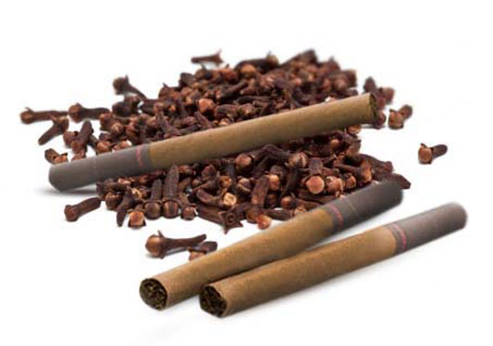
Case Law: Different Labelling Treatment for
“Like Products”
Clove Cigarettes
S. 907 of the U.S. Federal Food Drug and Cosmetic Act prohibited the production and sale of flavoured cigarettes (such as clove, strawberry, cinnamon, chocolate) but still allowed menthol cigarettes to be sold.
Indonesia exported a lot of clove cigarettes to the U.S.
Potential breaches to many TBT provisions and GATT
Art. III:4, XX but only TBT was at issue.

Slide 25
Case Law: Different LabellingTreatment for
“Like Products”
2.1 Members shall ensure that in respect of technical regulations, products imported from the territory of any Member shall be accorded treatment no less favourable than that accorded to like products of national origin and to like products originating in any other country.
Art. 2.1 = technical regulation must treat like products no less favourably.
The AB went back to basic on the interpretation of “like products” and “no-less favorable treatment”.

Slide 26
Case Law: Different Labelling Treatment for
“Like Products”
Like product => 4 criteria used in Asbestos (para 101)
i) Physical characteristics
ii) End-uses
iii) Consumer tastes and habits
Iv) Tariff classification
Accord “treatment no less favourable” = looking at the “design, architecture, revealing structure, operation and application of the technical regulation at issue” to see if the technical regulation is even handed → Objective Approach.
In this case, there was a clear detrimental impact on the competitive opportunities of clove cigarettes from Indonesia, compared to the ‘like products’ which were menthol cigarettes from the U.S. and other countries.
Inconsistent with Article 2.1 TBT.
Like Product
Chile Alcohol (para 61-62)

Slide 27
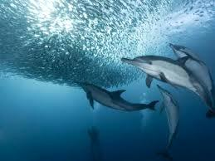
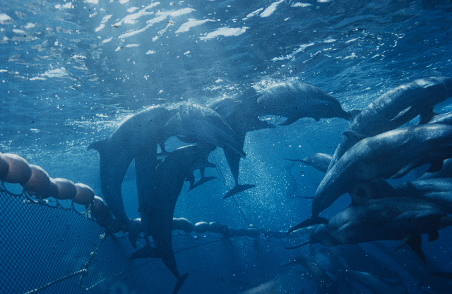
Case Law : Environmental Labelling
Tuna-Dolphin
Mexico challenged the US rules on labelling requirements for “dolphin-safe” tuna products.
The Dispute began in 1989 (Tuna I), then went on to the Panel’s hearing in 2011 (Tuna II). Both parties appealed on the points of law and in May 2012, the AB’s report was circulated (Tuna III).
Set the implications regarding the WTO’s control over environmental and other “feel-good” labelling (E.g. labour welfare) and in balancing trade and other legitimate concerns.

Slide 28
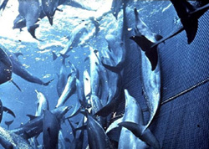

Case Law : Environmental Labelling (Tuna/Dolphin)
Background
In the Eastern Tropical Pacific, yellowfin tuna swim beneath schools of dolphins. Fishermen began to take advantage of this and associated schools of dolphins with schools of tuna.
Purse-seine net method (“setting on dolphin”), used by fishermen in the Eastern Pacific would catch both dolphins and tuna together → high mortality rate of dolphins.
In 1972, U.S. Congress enacted the Marine Mammal Protection Act requiring fishermen to use dolphin-safe techniques and abolished the setting on dolphin method. There was also a fixed ceiling on dolphin mortalities. The situation did not improve because Mexico fishermen were still using dolphin-unfriendly techniques including setting on dolphin method .
The U.S. then added a direct embargo clause to the Act. → Import bans of tuna products from countries that could not prove to have met the US dolphin protection standards, (i.e. did not have dolphin mortality rates and regulatory programmes comparable to those of the US), including Mexico.
More importantly, US enacted the Dolphin Protection Consumer Information Act which prohibited the use of labels or related claims that tuna products were “dolphin-safe”, if the tuna had been caught by “setting on dolphins” in the Eastern Tropical Pacific.

Slide 29
Case Law : Environmental Labelling (Tuna/Dolphin)
Tuna I
During 1989-91 Mexico brought a claim under GATT and won (the US import ban on Mexican Tuna breached Article III, XI GATT and did not meet Art XX exceptions as the interest protected were outside the US’s jurisdiction (“no-extra-territoriality”, but please note the Shrimp/Turtle case).
However, Tuna I report was not adopted → pending NAFTA negotiation.
In 1999, US and Mexico established the Agreement on International Dolphin Conservation Programme (AIDCP).
AIDCP concerns the use of dolphin friendly labels. It focuses on the techniques that do not create “significant adverse impacts” on dolphins rather than an outright prohibition of the “setting-on dolphins” technique. The indicators are dolphin mortality and injury rates.
AIDCP was less strict than the US’s standard provided in the DPCIA.
However, the AIDCP were not in use in the US. DPCIA remained in place.

Slide 30
Case Law : Environmental Labelling (Tuna/Dolphin)
Tuna II : No longer about the import bans but the optional dolphin-friendly -labelling
Concerns several TBT provisions.
Art. 2.1- Whether the “DPCIA” = a technical regulation that is discriminatory.
Art. 2.2 - Whether the “DPCIA” was more trade-restrictive than necessary to achieve the objective pursued.
Art. 2.4 - Whether “DPCIA” fails to use existing international standard (AIDCP) as a basis
(unless it is ineffective or inappropriate).

Slide 31
Case Law : Environmental Labelling (Tuna/Dolphin)
Tuna II
Concerns over Art. 2.1 = whether the “DPCIA” a technical regulation that is discriminatory
i) Whether the “DPCIA” = a technical regulation = Yes!
DPCIA was a technical regulation because it has “the effect of regulating in a legally binding or compulsory fashion the characteristics at issue” (Tuna II para 7.111) I.e. prescribe and impose the condition under which a product may be labelled “dolphin-safe” (ibid, para 7.131).
Non-product related could also be technical regulation ( NB: contrary to the Secretariat’s note on TBT in 1995 that non-product related PPM shouldn’t be caught under TBT Agreement).
ii) Whether the “DPCIA” scheme is applied in a discriminatory manner = No!
Mexico → DICIA discriminate de facto against Mexican tuna as they were mostly caught in the Eastern Tropical Pacific by setting on dolphins (subject to requirements for releasing the caught dolphins). The DPICIA, however, favoured other fishing methods which were more dangerous to dolphins.
The Panel → DPCIA was not discriminatory because it applied equally to all fleets regardless of their flags. The fact that Mexican fishermen still chose the “setting on dolphins” technique was their business choices rather than the discriminatory nature of the U.S. scheme, per se (para 7.3340).

Slide 32
Case Law : Environmental Labelling (Tuna/Dolphin)
Concerns over Art. 2.2 = Whether it was more trade-restrictive than necessary to achieve the objectives pursued
I) What are the objectives pursued?
- The U.S claimed that the measures were to i) ensure that US consumers were not misled about whether the tuna products were caught in a manner that adversely affected dolphins (ii) contributed to the dolphin protection.
- The Panel accepted this and ruled that the US objectives fit with the non-exhaustive list of legitimate objectives contained in Article 2.2 (the prevention of deceptive practices and protection of animal life or health or the environment) (para 7.440-3).
ii) Was the measure more trade restrictive than necessary? = Yes!
It virtually allowed the use of dolphin-safe label on any tuna caught outside the Eastern Tropical pacific. No specifications regarding the risk of dolphin mortality or injury rates from non “setting on dolphin” techniques used outside the zone. (para 7.529).
The AIDCP would at least “contribute to the objective” of preventing consumers being misled (para 7.577).
The DPCIA allowed non- Eastern Pacific fishing fleets to use non-setting on dolphin technique without furthering their incentive to use safer fishing techniques in order to protect dolphins. Consequently, the US DPCIA were not able to contribute to the protection of dolphins ( para 5.999).

Slide 33
Case Law : Environmental Labelling (Tuna/Dolphin)
Concerns over Art. 2.4 =Whether “DPCIA” fails to use existing international standard (AIDCP) as a basis for DPCIA. Exception = where international standards would be ineffective or inappropriate to fulfill the legitimate objectives pursued.
The Panel→ referred to a TBT Committee Decision adopted in 2000 and took the definition from ISO/IEC Guide 2.
The Panel → AIDCP = an international standardizing organisation and the AIDCP dolphin safe certification was a relevant international standard (para 7.678-7.692).
→ The US DPCIA did not base on international standard as it was clearly contrary to the AIDCP standards (similar interpretation with the AB in Sardines).
But Mexico failed to satisfy its burden of proof on the second part of Art. 2.4 in demonstrating that the AIDCP labellling alone would be an effective and appropriate means of achieving the US legitimate objectives (para 7.721-40).
International organization = 1) a body that has specific tasks and activities, 2) the membership is opened to all WTO members.

Slide 34
Case Law : Environmental Labelling (Tuna/Dolphin)
The Results of Tuna II
Art. 2.1- Whether the “DPCIA” a technical regulation that is discriminatory.
Art. 2.2 - Whether it was more trade-restrictive than necessary to achieve the objective pursued.
Art. 2.4 - Whether “DPCIA” fails to use existing international standard (AIDCP) as a basis (unless it is ineffective or inappropriate).
Yes!
No!
Yes!
APPEAL!!
No!

Slide 35
Case Law : Environmental Labelling (Tuna/Dolphin) con’t
Tuna/Dolphin III
The AB’s Report 16 May 2012
APPEAL!!

Slide 36

In Tuna/Dolphin II
Art. 2.1- Whether the “DPCIA” a technical regulation that is discriminatory.
Art. 2.2 - Whether it was more trade-restrictive than necessary to achieve the objective pursued.
Art. 2.4 - Whether “DPCIA” fails to use existing international standard (AIDCP) as a basis
(unless it is ineffective or inappropriate).
Yes!
No!
Yes!
No!

Slide 37
Tuna/Dolphin III
I) The AB on Art: 2.1→ Whether the “DPCIA” a technical regulation that is discriminatory.
Confirmed the Panel’s decision that the DPCIA = technical regulation as it set out a legal mandate of how the term “dolphin-safe” could be used for tuna products. = similar reason to the Panel.
But Reversed the Panel’s finding that DPCIA was not inconsistent (i.e. complied with) Art. 2.1. Instead, it breached Art. 2.1 because:
Most Mexican tuna was denied an access to the “dolphin-safe” label whereas like products from other countries and from the US were not.
The measure was not managed in an even handed manner as it failed to “calibrate” the risks to dolphin which had been arisen from other different fishing techniques in different area of the ocean.
Means-end rationality?
WTO approves extra-territoriality??

Slide 38
Tuna/Dolphin III
II) The AB on Art: 2.2 → Whether the “DPCIA” was more trade restrictive than necessary to achieve the objective pursued.
- It reversed the Panel’s finding that the DPCIA was more trade restrictive than necessary to fulfil the US’s legitimate objectives as…
- The alternative purposed by Mexico (the use of AIDCP) would be inadequate to meet the US’s objectives in protecting dolphins in all ocean areas. This was because AIDCP would only applied to the Eastern Tropical Pacific area.
WTO approves extra-territoriality??

Slide 39
Tuna Dolphin III
III) The AB on Art 2.4 → whether “DPCIA” failed to use existing international standard (AIDCP) as a basis for its “dolphin-safe” labelling programme.
On the outcome, the AB agreed with the Panel that the US did not breach Art. 2.4 provision.
However, this was not because Mexico failed on the burden of proof but because the AIDCP was not relevant international standard.
The AB stated that the AIDCP were not opened to all WTO members as membership was by invitation only.

Slide 40
Post-Tuna/Dolphin
No doubt that non-product related process and production methods (NPR-PPMs) are caught under the TBT Agreement.
The term “technical regulation” is defined broadly. The key point is whether it applies in a compulsory fashion to prescribe the condition of the product or PPM.
Whether the measure is discriminatory (in Art. 2.1), WTO tends to look at the de facto results.
Arguably, there was an element of means-end rationality in deciding whether the measure was discriminatory.
Arguably, the AB gave the extra-territoriality application of law in environmental disputes (Art. 2.2 and 2.4) a green light? The US was allowed and urged to use a scheme to protect dolphins in all ocean areas.
Arguably, the ruling can be expanded to permit various labelling schemes for other legitimate concerns (e.g. labour welfare), providing that these were not discriminatory.

Slide 41
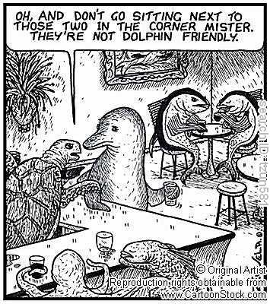
Source: www.CartoonStock.com.

Slide 42
Summary on Substantive Obligations
N.
Procedural Obligations
A Measure Is it a Technical Regulation
Annex 1 + (Tuna/Dolphin)
Central govt = must ensure… Local and non-govt body = take reas. measures as may be available. (Art.3)
Y
Art. 2
Art. 2.4 Using relevant (Sardines) International Standards (Tuna/Dolphin) as a basis for technical regulation (Sardines) unless it is ineffective or inappropriate
(Sardines)
Art. 2.1:
Technical regulation (as above) shall treat Like Products (Clove Cigarettes), not less favourably
(Clove Cigarettes + Tuna/Dolphin)
Art.2.2 Not more trade restrictive than necessary to achieve the objective pursued (Tuna/Dolphin)

Slide 43
Procedural Obligations
For technical regulation issued by a central govt bodies, Members must ensure that they comply with procedural obligations laid down in Art: 2.
For those issued by local govt bodies or by non-govt bodies, members must take reasonable steps to ensure that they have done so.
- To provide justifications upon request (Art. 2.5)
To accept equivalent TBT measures of other countries if they can also achieve the same level of objectives pursued (Art.2.7)
Notification duty before the new measure is implemented→ to notify via the Secretariat (Art 2.9.2), to publish and give a notice of the new measure at an early stage (Art.2.9.1), to provide copies upon other members’ request (Art. 2.9.3) and to allow other members to give comments (Art. 2.9.4). Unless, urgency required. To publish the new TBT measure promptly and to allow other members to be acquainted with it (Art. 2.11)
To allow a reasonable period of time to lapse between the publication and implementation dates (Art. 2.12), unless urgency required.
After Clove-Cigarettes. These procedural duties become very important!

Slide 44
Clove Cigarettes
In Clove Cigarettes, the U.S. measure was held to have breached Article 2.12 TBT by allowing only 3 months betw. the publication date and the date that the measure came into force.
The AB stated that a reasonable period of time should be 6 months instead of 3 months.
6 months = in accordance with para 5.2 of the Doha Ministerial Decision on Implementation-Related issues and Concern.
The Doha Ministerial Decision constituted a subsequent agreement between parties regarding the interpretation of the treaty (TBT Agreement) within the meaning of Art. 31(3) VCLT.

Slide 45
Procedural Obligations
For standards issued by central govt bodies, Members must ensure that they comply with Art. 4 which refers to procedural duties laid down under the Code of Good Practice for the Preparation, Adoption and Application of Standards (contained in Annex III).
For standards issued by local govt bodies or by non-govt bodies, Members must take reasonable steps to ensure that they accept and comply with the Code of Good Practice.
Same interpretation problem as SPS Art. 13 in taking reasonable steps
E.g.
Point E: Standards shall not be prepared, adopted or applied so as to create unnecessary obstacles to international trade.
Point F: Preference should be given to existing international standards.
Point H: Duplications and overlaps between standards should be avoided.
Point L: Submission of comments by interested parties should be allowed during a 60 day period prior to the adoption of standards.

Slide 46
Summary of Procedural Obligations
Is it a technical regulation
It is a standard
Members must ensure… Members must (Art. 4.1) take reasonable steps to ensure….
(Art. 4.1)
Central govt body…must ensure
Y.
Article 2Clove Cigarettes.
N
Local and non-govl bodies .. Members must take reas steps… (Art. 3.1)
It is a standard, issued by a local governmental body, non-governmental (private), regional standardising body
It is a standard, issued by a central governmental body
The Code of Good Practice (Annex III)

Slide 47




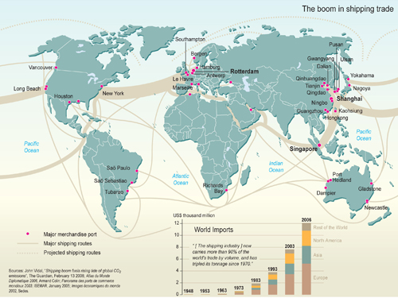
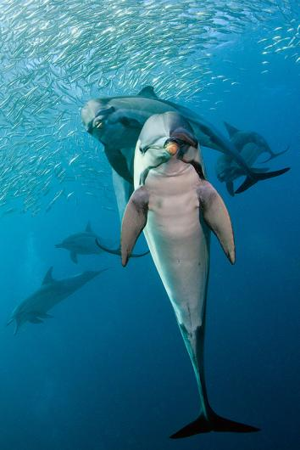
Balancing Trade and…
Here’s some food for thought!!
Thank you for Attending this Class!
WTO

