Slide 1
Practice I
Goofy Wintersports Inc. can produce snowboards according to the following schedule. Complete the table by calculating the marginal and average products.

Slide 2
Input of Labor (per week) | Number of snowboards (per week) | Average product | Marginal product
0 | 0
1 | 2
2 | 5
3 | 9
4 | 14
5 | 18
6 | 21
7 | 23
8 | 24

Slide 3
Input of Labor (per week) | Number of snowboards (per week) | Average product | Marginal product
0 | 0 | - | -
1 | 2 | 2 | 2
2 | 5 | 2.5 | 3
3 | 9 | 3 | 4
4 | 14 | 3.5 | 5
5 | 18 | 3.6 | 3
6 | 21 | 3.5 | 3
7 | 23 | 3.3 | 2
8 | 24 | 3 | 1

Slide 4
Practice II
The following table shows how the total output of ice skates (per month) changes when the quantity of the variable input (labor) changes. The firm’s amount of capital is fixed.
Compute the average product of labor for each level of output and the marginal product of labor for each interval. Plot the AP and MP curve on the same diagram
Is the “law of diminishing marginal returns” satisfied?
Explain the relationship between the marginal product of labor and the average product of labor

Slide 5
Hours of labor (per month) | Pairs of skates (per month) | Average product | Marginal product
100 | 200
120 | 260
140 | 350
160 | 580
180 | 720
200 | 780
220 | 800
240 | 810

Slide 6
Hours of labor (per month) | Pairs of skates (per month) | Average product | Marginal product
100 | 200 | 2 | -
120 | 260 | 2.17 | 3
140 | 350 | 2.5 | 4.5
160 | 580 | 3.63 | 11.5
180 | 720 | 4 | 7
200 | 780 | 3.9 | 3
220 | 800 | 3.64 | 1
240 | 810 | 3.38 | 0.5

Slide 7
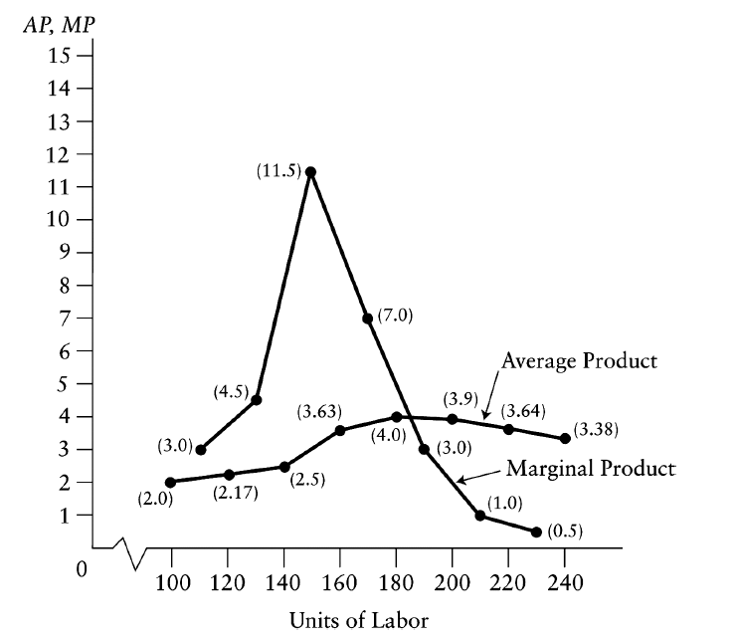

Slide 8
The “law of diminishing marginal returns” is satisfied for labor because the marginal product of labor falls as more and more labor is used.

Slide 9
The average product of labor can only rise if the marginal product exceeds the average product. This relationship is seen clearly in the figure for levels of labor input below 180. Similarly, the average product of labor only falls when the marginal product is less than the average product, as seen in the figure for values of labor above 180. It follows that the MP curve must intersect the AP curve at its maximum.

Slide 10
Practice III
Consider the table below, which shows the total fixed costs (TFC) and total variable costs (TVC) for producing specialty bicycles in a small factory with a fixed amount of capital

Slide 11
Output per year (thousands of bicycles | TFC | TVC | AFC | AVC | ATC
1 | 200 | 40 | 200 | 40 | 240
2 | 200 | 70 | 100 | 35 | 135
3 | 200 | 105 | 66.7 | 35 | 101.7
4 | 200 | 120 | 50 | 30 | 80
5 | 200 | 135 | 40 | 27 | 67
6 | 200 | 155 | 33.3 | 25.8 | 59.1
7 | 200 | 185 | 28.6 | 26.4 | 55
8 | 200 | 230 | 25 | 28.8 | 53.8
9 | 200 | 290 | 22.2 | 32.2 | 54.4
10 | 200 | 350 | 2 | 35 | 55
11 | 200 | 425 | 18.2 | 38.6 | 56.8

Slide 12
Compute average fixed costs (AFC) for each level of output.
Compute average variable costs (AVC) for each level of output.
Compute average total cost (ATC) for each level of output. What level of output (per year) is the firm’s “capacity”?
Plot the AFC, AVC, ATC curves on a scale diagram with dollars on the vertical axis and the level of output on the horizontal axis.

Slide 13
The firm’s “capacity” is the level of output at which ATC is minimized, which in this case 8 (thousands) bicycles per year.

Slide 14


