Slide 1
Market Governance and
Contract Farming

Slide 2
Trends in agri-food systems
  Increasing coordination and consolidation in the supply-chain both upstream and downstream
  How can we explain this new market arrangement?
  Price theory/ equilibrium/ quantitative analysis → Qualitative institutional analysis

Slide 3
“Transaction Cost Economics” (TCEs)
  Broad definition:
    Transaction cost: “costs of running the economic system”
  Institutional Economics: two focuses
  1. Institutional rules of the game: customs, laws, politics
  2. Modes of Governance: microanalytic structure of transaction: (Williamson, 1991)
  - Market/ Hierarchy/ Hybrids

Slide 4
Two polar forms
Market
Hierarchy
Hybrid

Slide 5
Many economic activities take place within firms
“economies of scales”/ “comparative advantage”: ‘to make’ instead of ‘to buy’
Employers & Employees contract
Hierarchy

Slide 6
Pooling Resources
Reciprocal Returns
Contracting (to regulate the relationship among partners)
Cooperatives/ Franchising/ Sub-contracting/ Contract farming/ Sharecropping
Hybrid

Slide 7
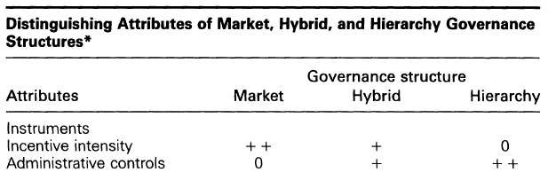

Slide 8
Asset
Specificity
Transaction
Costs
Uncertainty
Governance
Choice
Frequency of
Transactions

Slide 9
Asset-specificity
Site specificity
Physical asset specificity
Human-asset specificity that arises in learning by doing
Brand name capital;
Temporal specificity, which is akin to technological
Ex. HVFs, Products requiring post-harvest technology, Specificity in farm capitals, Standardization/labelling (HACCP, GAP, IFOAM, etc.)

Slide 10
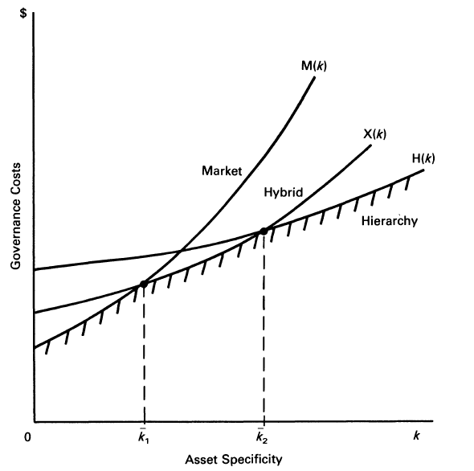

Slide 11
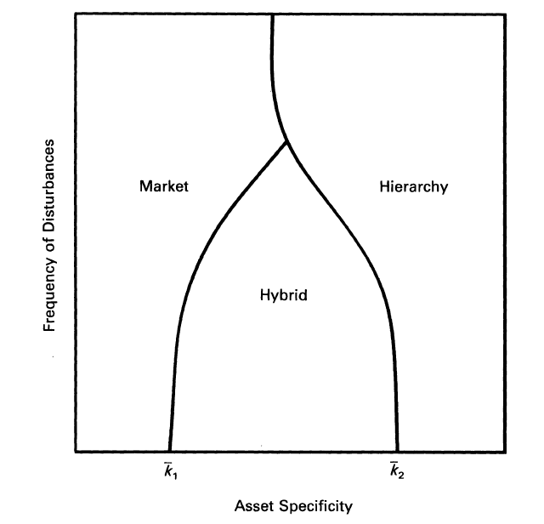
Uncertainty: → Choice of ‘governance structure’
Higher uncertainty ↑
costs for carrying out
and secure transactions go up (for overcoming information deficiency, safeguarding against risk).
for low asset specificity:
hybrid → market
for high asset specificity:
hybrid → hierarchy
Market
Hierarchy
Frequency of Disturbances
Hybrid
Asset specificity

Slide 12
Mode of governance | Asset Specificity |  | Uncertainty |  | Frequency |  | Examples
 | Low | High | Low | High | Low | High
Market |  |  |  |  |  |  | Meat cows, fishery products, Fruits and vegetables, Rubber, Rice
Contract |  |  |  |  |  |  | Chicken, Pig, Potato, Sugarcane, Cage fish, Fruits and vegetables for export
 |  |  |  |  |  | 
Plantation/ Factory Farm |  |  |  |  |  |  | Chicken, Shrimp, Wine grapes

Slide 13
Hybrid governance
more efficient than pure public forms given coordination, incentives, and control advantages.
Involvement of farmers, beneficiaries and interest groups
  increases efficiency
  decreases asymmetry of information
  restricts opportunisms
  increases incentives

Slide 14
Hybrid governance
for private
  costs-sharing
  reduces management costs
  quality controls
  possibilities in enforcement of most labor, animal welfare, environmental standards

Slide 15
Hybrid governance
for farmers
  certain markets
  advanced inputs and/or credits
  technology transfer

Slide 16
Two major types of contractual arrangement in Thailand
 | Outsourcing contract | Price assuring contract
Inputs | Property rights of inputs belong to the firms | Farmers purchase inputs by themselves (could be deducted after the production cycle)
Outputs | Firms’ property | Farmers’ property
Returns | “Wage” depends on the agreed price or at the spot price Formula: e.g. Meat conversion ratio or survival rate | Ex ante assured price which could be higher or lower than the spot price In some commodities, no assured price

Slide 17
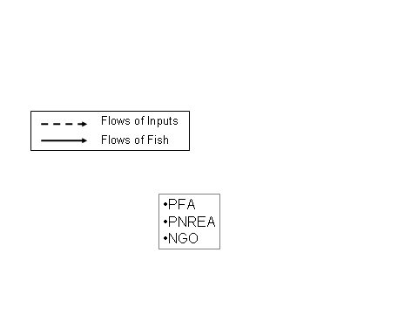
Compositions of Contract Governance
3
Formal Institutions
2
Feed
Companies
Feed
Retailers
2
Breeding Farms
1
1
Dealers
Contractual
Commitment
Farmers
2
2
Fish Traders
2
3
1
Fish
Retailers
2
Institutional
Environment
Indirect actors
Direct actors
Consumers
3
Informal Institutions

Slide 18
3.3 Contractual Arrangement
Forms of contract: both “unwritten” (5 dealers) and “written” (1 dealer)
Duration: Short-term contract (cycle-to-cycle)
Obliged sell
Shared
Investment
Farmer
Sell fish only
to dealer
Dealer
-Provide market
(Catch service)
Dealer
Technology
Inputs (feeds and fries) (*obliged)
Dealers’ authority in monitoring
Sell Price
no
Farmer
All fixed costs (cage, machines)
Labors
- Other variable costs (electricity, medicine, vitamin)
1 | 2 | 3 | 4
Fish quality
800g
/fish
Production Cycle
(4 months)
Payment
Farmer
Repay the advanced feed costs
Dealer’s irresponsibility
for any losses from risks!!
20

Slide 19
Risks
External Factors
Partner A
Partner B
1. ‘Contractual Risks’
Endogenous risks
opportunistic behaviors
e.g. Free-riding behavior, hidden information/action, contract breaching
2. ‘External Risk’
Exogenous risks
- market, institutional, or natural uncertainties

Slide 20
Contractual risk
Breaching
Actors’ decision functions within hybrid governance
→ Contractual risks (debtors’ breach of contracts)
Benefits of breaching > Costs of breaching

Slide 21
Incomplete contracts
Some contracts are silent on a number of important contingencies and/or have components that are not enforceable by a third party
  For example, the timing of delivery of a crop from a grower to a processor may be important to both parties, but many agricultural contracts do not include detailed descriptions of how on-time deliveries are to be rewarded or how delays are to be punished
‘Signing-without-reading’ problems
Risk-pooling problems

Slide 22
Monopsony/bargaining power
  an imbalance of bargaining power between processors and growers
  may make it ‘necessary’ for growers to accept take-it-or-leave-it, standard form contracts that leave little room for negotiation

Slide 23
it threatens to destroy the value of the relationship-specific investment in order to force the grower to make decisions that she would otherwise not make.
Exchanges made under duress resemble zero-sum games rather than surplus-creating cooperative games

Slide 24
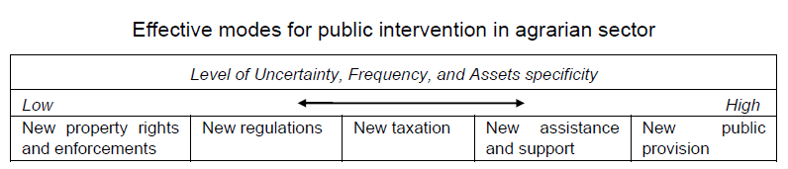
Public intervention

