Slide 1
ASEAN Financial Integration:
Freer flows of capital—
Theory and Practice
Pariwat Kanithasen
pariwatk@bot.or.th
BE Summer School—International Economics EE561
Faculty of Economics, Thammasat University, Thaprachan
16 July 2018
Disclaimer: Views expressed in this presentation are those of the speaker

Slide 2
Outline
Freer Flows of Capital in ASEAN:
(1) Capital Flows: Concepts and Trends
(2) Capital Account Liberalization
(3) Capital Account Measures
Freer Flows of Capital in International Investment Agreements
Fun Part: Mock Negotiations

Slide 3
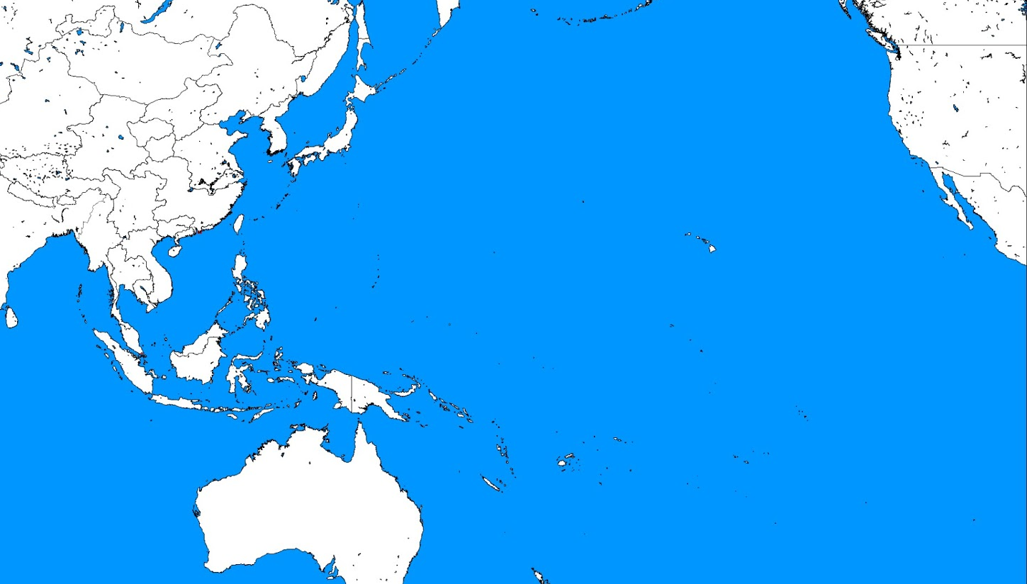
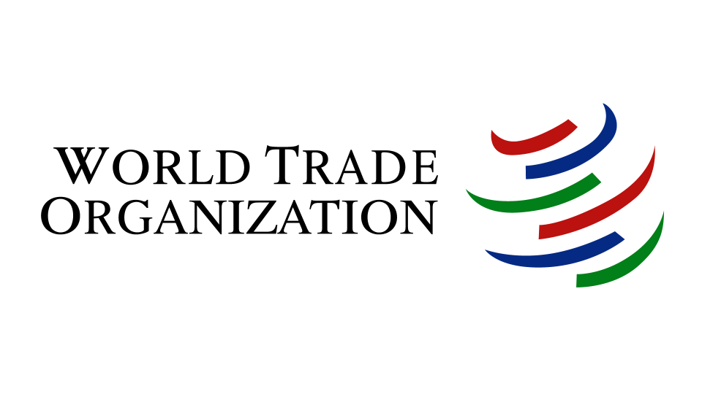

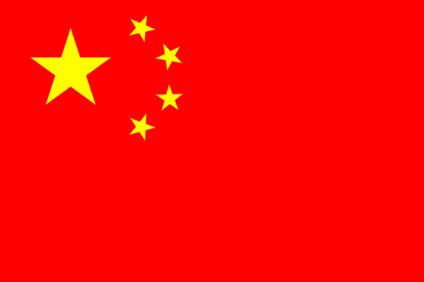

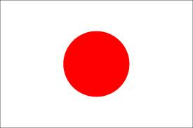
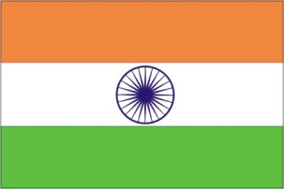
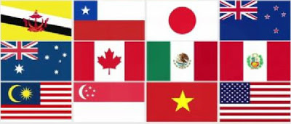

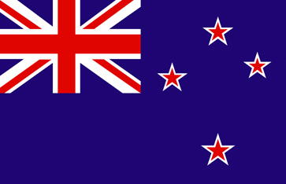
1. Selected Trade Agreements in the Pacific Rim
NAFTA
164 members
ASEAN-China
ACFTA
ASEAN-Korea
AKFTA
ASEAN-Japan
AJCEP
Japan-Thailand
JTEPA
TPP
ASEAN-India
AIFTA
Thailand-India
TIFTA
ASEAN
Th-ChileFTA
Th-PeruFTA
ASEAN-AUS-NZ
AANZFTA
Thailand-Aus
TAFTA
TNZFTA

Slide 4
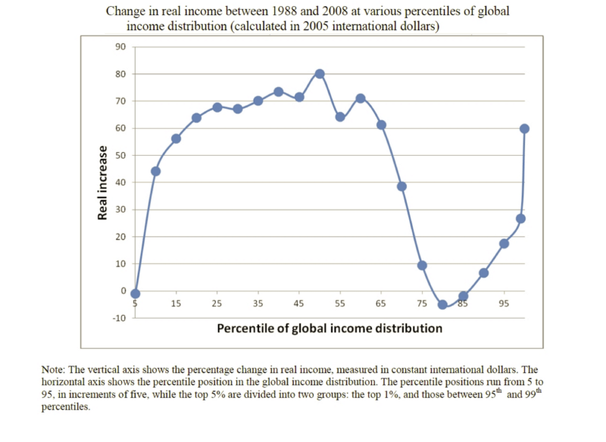
1. One graph that explains all
The new middle class in Asia
The global elite
Those in the poverty trap
Worse of Middle class in the West
Source: Branco Milanovic (2012): Global Inequality by the Numbers, World Bank

Slide 5
AEC Blueprint: Freer Flow of Capital
1. Freer Flows of Capital in ASEAN
1. Free flows of Goods
2. Free flows of Services
3. Free flows of Investment
4. Free flows of Skilled Labor
5. Freer flows of Capital
Orderly capital account liberalisation
Allowing adequate safeguard against potential economic instability

Slide 6
1. Capital Flows: Concepts
Capital Account Liberalization: Aiming for freer flows of capital
Balance of Payments
Current Account
Goods
Service / Income / Transfers
Capital Account
Foreign Direct Investment
Portfolio Investment
Other Investments: Loans, Deposits, Cash etc.

Slide 7
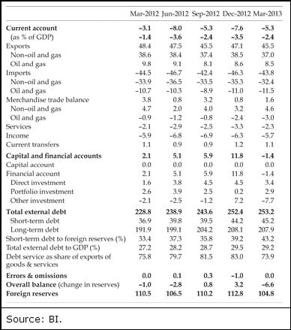
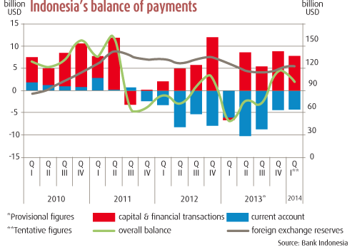
Balance of Payments Account

Slide 8
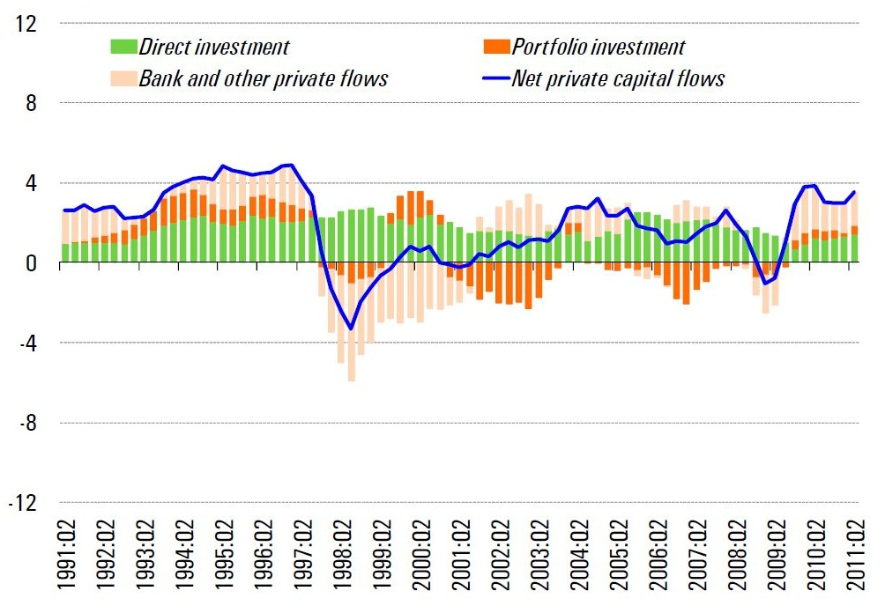
Capital flows in Asia
Source: IMF

Slide 9
3. Freer Flows of Capital: Capital Account Liberalization (2)
ASEAN
Capital Account Liberalization Framework
Stage 5
DEGREE OF RISK
Stage 4
Other flows
Substantial liberalisation to allow residents to undertake external borrowing and lending
Stage 3
Portfolio outflows
Progressively allow resident institutional investors AND resident retail investors to purchase equity and debt securities abroad
Progressive liberalisation to allow non-residents to issue securities in the domestic market
Stage 2
Stage 1
Portfolio Inflows
Progressively allow residents to issue securities abroad and repatriate proceeds back to home country
Progressively allow non-residents to purchase domestic debt securities
Current Account
No restrictions on trade related payments
Progressive liberalisation of repatriation/surrender requirement on export proceeds
Direct
Investment
Free direct investments
(inflow or
Outflow)
Source: ASEAN Working Committee on Capital Account Liberalization 2010

Slide 10
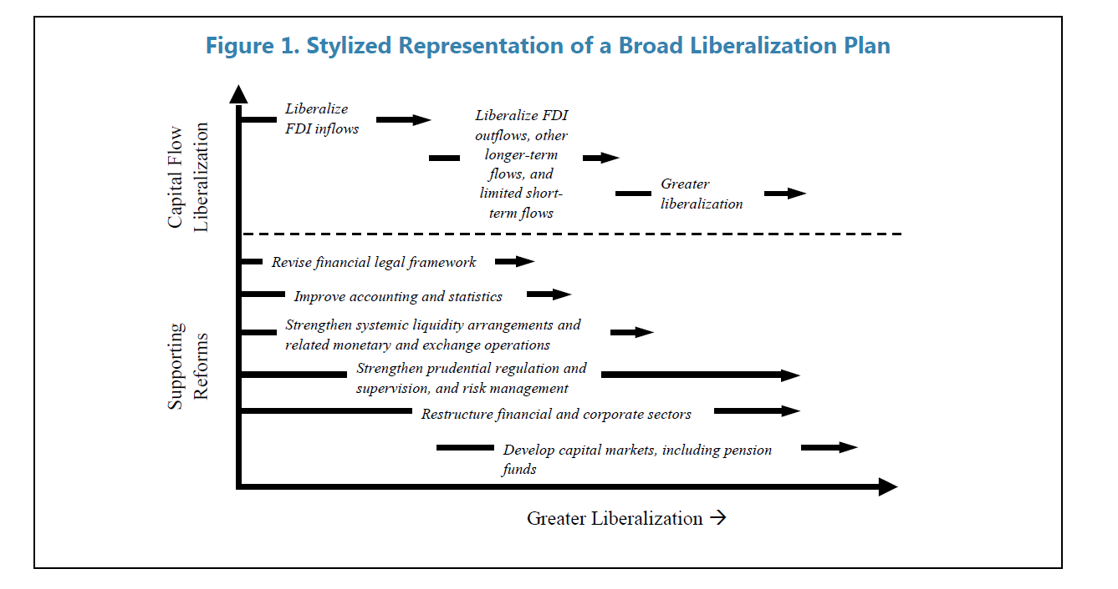
3. Freer Flows of Capital: Capital Account Liberalization (2)
IMF Capital Account Liberalization Framework
Source: ASEAN Working Committee on Capital Account Liberalization 2010

Slide 11
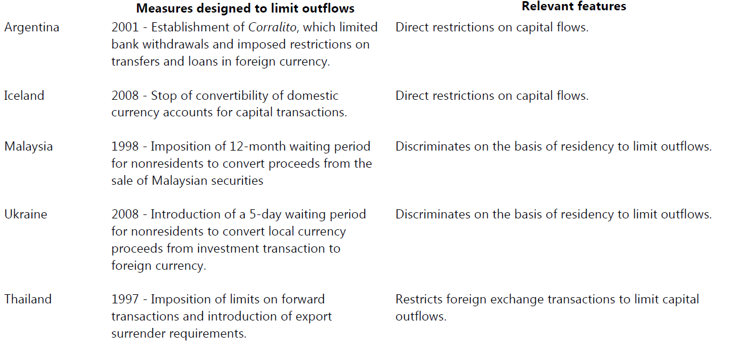
Selected Capital Outflow Measures

Slide 12
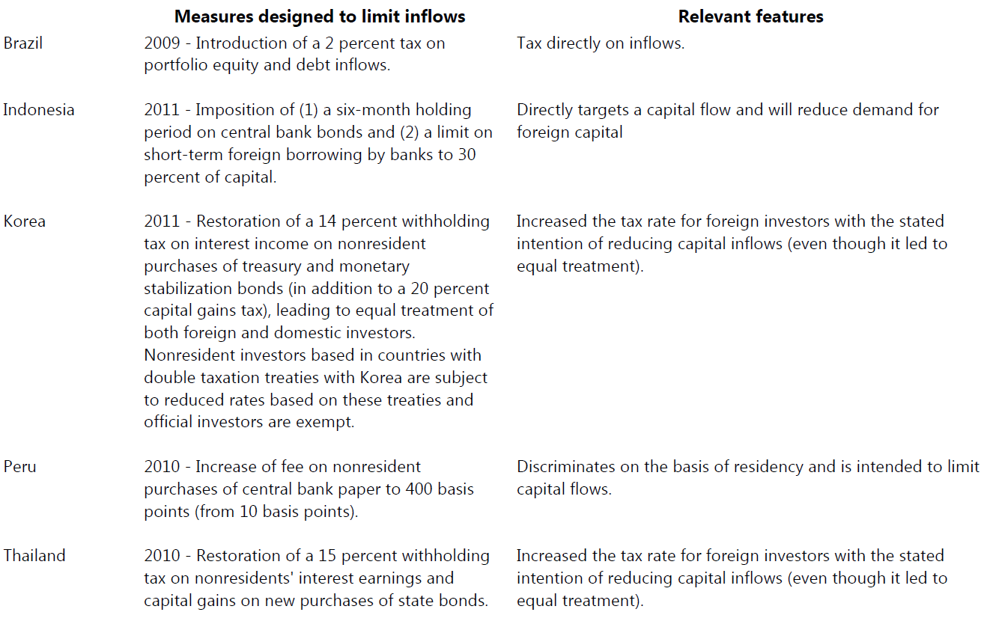
Selected Capital Inflow Measures

Slide 13
3. Freer Flow of Capital: Capital Account Liberalization (4)
Thailand Capital Account Master Plan: Phase I (2012-2013)
Direct Investment
Remove amount limit for direct investments by Thai individuals
Remove amount limit per investor
  Institutional investor: Invest abroad directly without intermediary
  Retail investor*: Invest abroad via intermediary
Portfolio Investment
FCD Onshore Bank
Remove limit on Foreign Currency Deposit where there are future obligations of payment
FX Risk Management
Thai residents hedging overseas investment to be able to unwind freely their hedging transactions
Money Changer/
Money Transfer Agent
Relax qualifications and increase flexibility of money changer and money transfer agent in providing services to their customers
* Investment amount limit is to be allocated to retail investors under Securities and Exchange Commission (SEC) supervision
13
Notes:
Relaxations under the master plan, which has already been consented by the Ministry of Finance, have been set during year 2012-2013. The BOT plans to relax foreign exchange regulations to increase flexibility for Thai residents in overseas investment and in foreign exchange risk management, which consists of five main issues;
(1) Outward direct investment
Relaxation in Q2/2013: remove amount limit for direct investment by Thai individuals to facilitate expansion of their markets and operation bases, as well as strengthen their competitiveness. In the case of Thai companies, there has been no amount limit for outward direct investment since year 2010.
(2) Outward portfolio investment
Relaxation that has been implemented:
- 19 Oct 2012: (1) widen institutional investor base which includes companies listed at the SET and (2) expand list of permitted type of securities including FX bond.
- 16 Jan 2013: Increase amount limit of each retail investor from USD 20 mil to USD 50 mil to be equal to institutional investors
Relaxation in Q2/2013:
- remove amount limit per investor; however subject to the regulators which supervise certain investors
(3) Foreign currency deposit (FCD)
Relaxation in Q2/2013: remove the amount limit of FCD (opened with domestic financial institutions) where there are future obligations of payment in order to provide more flexibility for importers or residents with obligations in their foreign exchange risk management.
(4) Foreign exchange risk management
Relaxation: allow Thai residents hedging overseas investment to be able to unwind freely their foreign currency hedging transactions (currently able to unwind freely only for goods and services transactions)
(5) Money changer (MC) and Money transfer agent (MT)
Relaxation in Q2/2013: Relax qualifications and increase flexibility of money changer and money transfer agent in providing services to their customers, including increase limit for sale or transfer per to customers.

Slide 14
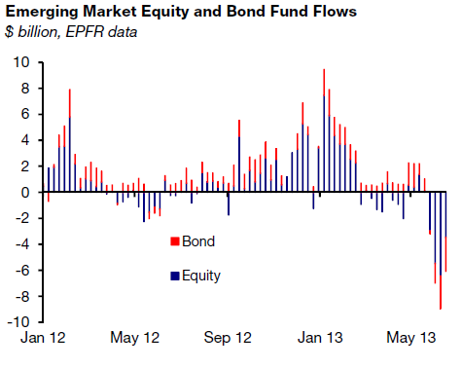
4. Freer Flows of Capital in
International Investment Agreements (1)
Safeguards: Banking and Capital Account Liberalisation
Capital Flows are often volatile.
The authorities need to preserve the government’s legitimate regulatory prerogatives
to adopt necessary measures relating to:
    Balance of Payments difficulties
    Difficulties caused by capital movement
    Macroeconomic or exchange rate instability
    Minimising the government’s exposure to inappropriate expropriation claims

Slide 15
What are International Investment Agreements?
4. Freer Flows of Capital in
International Investment Agreements (2)
  International Investment Agreements (IIAs) are legally binding treaties between countries to provide foreign investors from the “home state” with rights and remedies to protect the investment into the “host state”.
  Main forms of investment agreements:
      Bilateral Investment Treaties (BITs)—investment protection (as well as promotion and facilitation)
      Investment Chapters of FTAs and Separate Investment Agreements—investment liberalization and protection

Slide 16
Investment Agreements in Context of FTAs
4. Freer Flows of Capital in
International Investment Agreements (3)
FTA
Goods
Goal: Lower or eliminate tariffs
Multilateral Agreements:
GATT (1947,1994)
Services
Goal: Reduce or eliminate restrictions (=liberalize) cross-border services
Multilateral Agreements:
GATS (1994)
Investment
Goal: Liberalize (FTA) and protect foreign investments (FTA+BIT)
No multilateral agreement existing given the lack of consensus

Slide 17
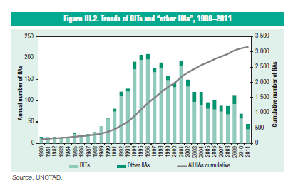
Proliferation of IIAs
4. Freer Flows of Capital in International Investment Agreements (3)
Global
Over 3000 BITs and around 300 FTAs Investment Chapters exist globally, partly due to the failure to agree on a multilateral investment agreement.
The majority are between developed and developing countries.
Thailand
Thailand has signed 42 BITs since the 1960s, with a handful currently under negotiation.
Thailand has signed several FTAs with Investment Chapters and is currently negotiating* several others—
  Bilaterals:
    TAFTA (Aus), TNZCEP (NZ),
    JTEPA (Japan), TIFTA* (India),
    Thai-Peru*, Thai-Chile*, Thai-EU*, Thai-EFTA*, Thai-Canada*
  Regionals:
    ACIA (ASEAN), ACFTA (A-China), AKFTA (A-Korea), AJCEP (A-Japan), AANZFTA (A-Aus-NZ), AIFTA* (A-India), BIMSTEC* (Bay of Bengal)

Slide 18
Basic Framework of IIAs
4. Freer Flows of Capital in
International Investment Agreements (4)
Scope
1. Scope
defines what is in
the agreement
Obligations
National Treatment
Most-Favored-Nation Treatment
Transfers
Expropriation
etc.
2. Obligations
tells what the host country needs to do
Exceptions
Reservations: Which sectors or measures are excluded
Safeguards: Security, public health BOP, Prudential, capital flows, etc.
Denial of Benefits
Dispute Settlement
State-to-State
Investor-to-State
3. Dispute Settlement
specifies recourse to remedies if obligations are breached
4. Exceptions/Safeguards
carves out what is excluded from the obligations

Slide 19
Obligations: Transfers
4. Freer Flows of Capital in
International Investment Agreements (6)
Key: Transfers have to be free and without delay
AANZFTA Article 8
Transfers
1. Each Party shall allow all transfers relating to a covered investment to be made freely and without delay into and out of its territory. Such transfers include:
(a) contributions to capital, including the initial contribution;
(b) profits,…
(c) …
2. Each Party shall allow such transfers relating to a covered investment to be made in a freely usable currency at the market rate of exchange prevailing at the time of transfer.
Only for “covered” investments
Both inwards and outwards
4
“Open list” of items
FUC as defined by the IMF
=USD, EUR, GBP, JPY
Use market exchange rate
Concerns: Ability to prevent transfers when needed, such as to prevent crises or to ensure stability

Slide 20
Safeguards: Capital flows
4. Freer Flows of Capital in
International Investment Agreements (8)
ACIA: Art. 13 Transfers
4. Nothing in this Agreement shall affect the rights and obligations of the Member States as members of the IMF, under the Articles of Agreement of the IMF, including the use of exchange actions which are in conformity with the Articles of Agreement of the IMF, provided that a Member State shall not impose restrictions on any capital transactions inconsistently with its specific commitments under this Agreement regarding such transactions, except:
…. (c) where, in exceptional circumstances, movements of capital cause, or threaten to cause, serious economic or financial disturbance in the Member State concerned.
5. The measures taken in accordance with paragraph 4(c):
(c) shall be temporary and shall be eliminated as soon as conditions no longer justify their institution or maintenance; ....
(e) shall be applied such that any one of the other Member States is treated no less favourably than any other Member State or non-Member State;
(f) shall be applied on a national treatment basis; ....
IMF allows exchange controls
(AA Art VI, VIII)
Usage restricted by situation of exceptional capital movements –in and out flows but is far narrower than macro/fx stability articles
Several conditions such as:
temporary use, NT, MFN
Concerns: Limitations of measures

Slide 21
Fun Part ☺: Mock Negotiations
Korea-ASEAN FTA Investment Chapter on capital flows safeguards
Two teams: Korea and ASEAN
Negotiation Steps:
  Read the given text
  Anything not agreed is put in square brackets KR=Korea, AS=ASEAN
    Before: [Each Party shall eliminate all tariffs…]
    After: Each Party [KR: shall] [AS:aims to] eliminate all tariffs
    Final: : Each Party shall, as much as possible, eliminate all tariffs

Slide 22
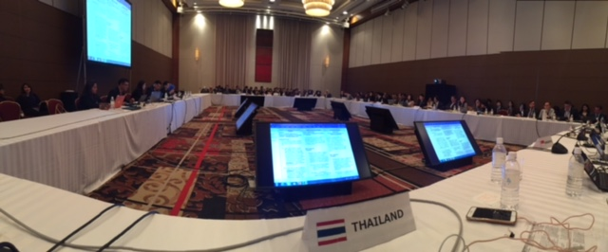
FTA Negotiations: RCEP, Kobe, February 2017

Slide 23
Principles of Negotiations: Finding the Sweet Spot
Country A:
Doesn’t want commitment,
Can’t go beyond Y
Country B
Wants commitment
Can’t go below X
No
commitment
X
=B’s minimum
Y
=A’s maximum
Full
commitment
May…. Hopes to… Endeavors to.. Shall …
Sweet Spot:
Zone of Possible Agreement

Slide 24
ASEAN-Korea Free Trade Agreement
Investment Chapter
[Article 11 Temporary Safeguard Measures
1. A Party may adopt or maintain measures not conforming with its obligations under Article 10 (Transfers) in cases where movements of capital cause or threaten to cause economic or financial disturbance.
2. The measures referred to in paragraph 1 shall be phased out within six months or when conditions no longer justify their institution or maintenance. ]

Slide 25
AKFTA http://akfta.asean.org/uploads/docs/agreements/Investment-Article-11.pdf

