Slide 1

BA 291 – Business Environment
By Aj. Parichat Jantori

Slide 2
“ It’s not the strongest of the species that survives, nor the most intelligent, that survives. It is the one that is the most adaptable to change”

Slide 3
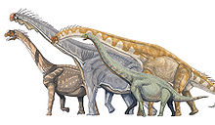

Which one do you prefer?

Slide 4

“Geologists at Ohio State University have found the largest-ever complete fossil of a cockroach, one that lived 55 million years before the first dinosaurs.”

Slide 5

Facts about cockroaches
can eat almost anything, including paper, wood, glue and rubbish.
quite intelligent and can learn and adapt to situations amazingly fast.
move fast from place to place. They can fly or walk. run in mazes and remember the route of the maze from day to day
know how to become resistant to pesticides quickly and are therefore very difficult to poison
each female cockroach can produce hundreds of eggs during her short life span. Within a year, you can have over 100,000 cockroaches from that original female.
Cockroaches are infamous for their tenacity, they survive a nuclear war, can live without head for weeks.

Slide 6

Facts about dinosaur
A large collision would throw so much dust into the air that sunlight would not be able to shine and plants and animals would die. The dramatic changes in climate that resulted from this huge collision were too much for the dinosaurs. They were not able to survive.
Dinosaurs became extinct is volcanic activity.
Disease killed off the dinosaurs
Size, slow, food, number offspring, slow breeding ….

Slide 7


Business Environment
The environment in which companies operate is continually changing, sometimes quite rapidly. Companies have to learn how to adjust and adapt their business to change.

Slide 8
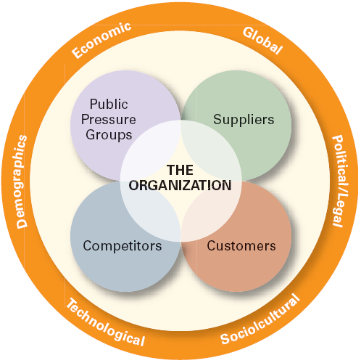
Business Environment

Slide 9
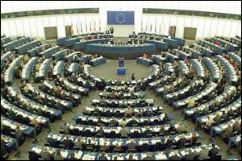


General Environment
The general environment affects organizations indirectly. Change in general environment does not directly change day-to day operations, however, they do effect all organizations eventually.
Notes:
http://www.youtube.com/watch?v=6_WAmt3cMdk

Slide 10
Political Environment
Political Risk
Political instability
Expropriation of corporate assets without prompt and adequate compensation
Forced sale of equity to host-country nationals, usually at or below depreciated book value
Discriminatory treatment against foreign firms in the application of regulations or laws
Barriers to repatriation of funds (profits or equity)
Loss of technology or other intellectual property (such as patents, trademarks, or trade names)
Interference in managerial decision making
Dishonesty by government officials, including cancelling or altering contractual agreements, extortion demands, and so forth
Notes:
http://www.youtube.com/watch?v=6_WAmt3cMdk

Slide 11
Legal Environment
Business related law
Company law
Product safety and liability, labeling requirement, consumer protection
Tax law
Competition law, anti-trust law, cartel law
Regulations on accounting – US GAAP, IFAS, IAS, Thai GAAP
Labor law, employee right
Environment law

Slide 12

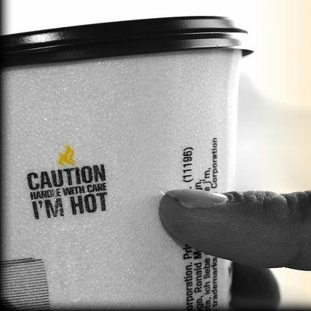
Legal Environment
Liebeck v. McDonald's Restaurants (McDonald's coffee case and the hot coffee lawsuit)
a woman who was heavily burned by hot coffee purchased from fast food restaurant McDonald's was rewarded $2.86 million.
Her attorneys argued that McDonald's coffee was "defective," claiming it was too hot and more likely to cause serious injury than coffee served at any other establishment

Slide 13
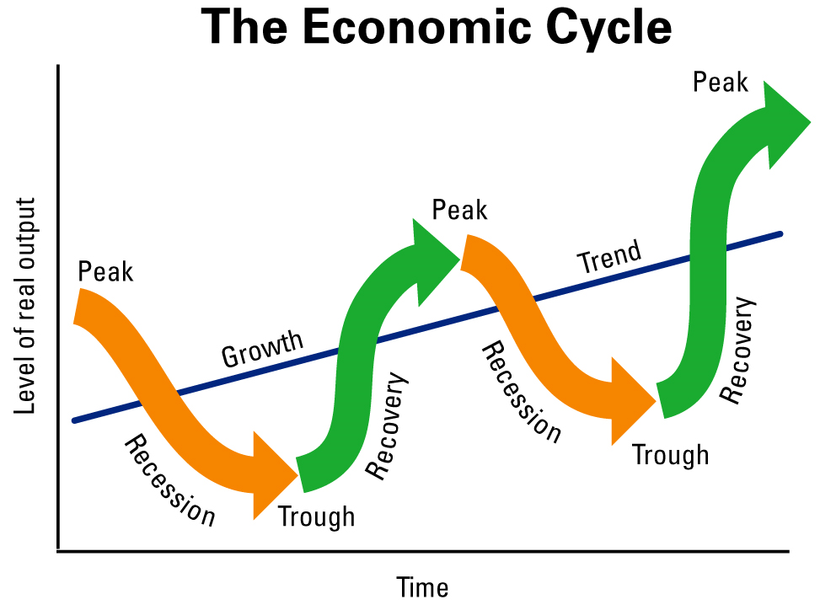
Economic Environment

Slide 14
Exchange Rate
„The euro briefly traded as low as Y108 on Monday, its weakest level since November 2001. The resulting loss of buying power among European consumers is a serious problem for Japanese exporters such as Sony, whose profit forecast for the year to March 2011 assumes an average exchange rate of Y125 to the euro. The divergence could cost the electronics group Y100bn this year.” […]
The financial turmoil in Europe, which is hitting the euro, is creating additional problems for Japanese companies. Hitachi, for example, has said some of its projects are being delayed by financing issues. The weaker euro, which has lost 5.9 per cent against the yen over the past month, also makes European manufacturers more competitive. […]” (Financial Times, 8.06.2010)

Slide 15
Exchange Rate
Currency Exposure
Transaction exposure: the extent to which the income from individual transactions is affected by fluctuations in foreign exchange values
Translation exposure: the impact of currency exchange rate changes on the reported financial statements of a company
Economic exposure: the extent to which a firm’s future international earning power is affected by changes in exchange rates

Slide 16
Inflation
Inflation: The rate at which the general level of prices for goods and services is rising, and, subsequently, purchasing power is falling (Consumer price index)
Core inflation: a measure of inflation which excludes certain items that face volatile price movements
Headline inflation: measure of the total
inflation within an economy

Slide 17
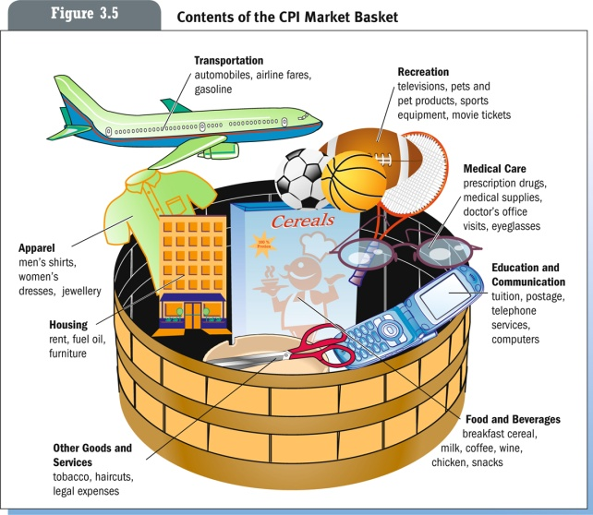
Inflation

Slide 18
Cause of inflation
Demand-pull inflation caused by increases in aggregate demand due to increased private and government spending
Cost-push inflation, also called "supply shock inflation," is caused by a drop in aggregate supply (potential output). This may be due to natural disasters, or increased prices of inputs.
Built-In inflation is often linked to the "price/wage spiral".

Slide 19
Unemployment rate
Frictional unemployment: is the time period between jobs when a worker moves from one job to another.
Seasonal unemployment: Unemployment expected at a given time of year
Cyclical unemployment: occurs when there is not enough aggregate demand in the economy.
Structural unemployment: occurs when a labor market is unable to provide jobs for everyone who wants one because there is a mismatch between the skills of the unemployed workers and the skills needed for the available jobs

Slide 20
Demographic
Physical characteristics of a population such as:
Gender
Level of education
Geographic location, Immigration
Income
Family composition
Age
Notes:
http://sawangkanives.com/

Slide 21


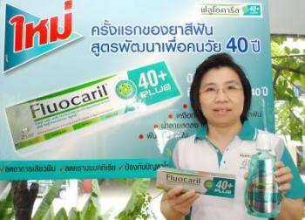

Product for aging society
Notes:
http://sawangkanives.com/

Slide 22
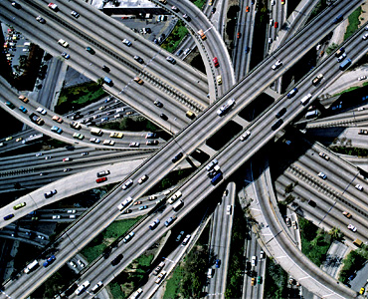
Infrastructure
The physical facilities that support economic activities, including railroads, highways, ports, airfields, utilities, power plants, schools, hospitals, and commercial distribution systems.

Slide 23
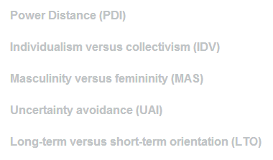
Socialcultural
The sum total of beliefs, rules, techniques, institutions, and artifacts that characterize human populations.
Consists of learned patterns of behavior common to the members of a given society.
The unique lifestyle of a particular group of people.
Hofstede’s Cultural Dimensions
Notes:
http://www.youtube.com/watch?v=sSLPEwvVvN0&feature=related

Slide 24
Technology
method or technique for converting inputs to outputs in accomplishing a specific task.
Changes in the technological environment have had some of the most dramatic effects on business. A company may be thoroughly committed to a particular type of technology, and may have made major investments in equipment and training only to see a new, more innovative and cost-effective technology emerge.

Slide 25
Globalization/ Internationalization
International integration arising from increasing human connectivity and interchange of worldviews, products, ideas, and other aspects of culture.
In particular, advances in transportation and telecommunications infrastructure, including the rise of the Internet, represent major driving factors in globalization and precipitate further interdependence of economic and cultural activities.

Slide 26

Task Environment
The task environment include all the sectors that conduct day-to-day transactions with the organization and directly influence its basic operations and performance.
Task environment includes customers, competitor, suppliers, labor market and pressure groups.

Slide 27
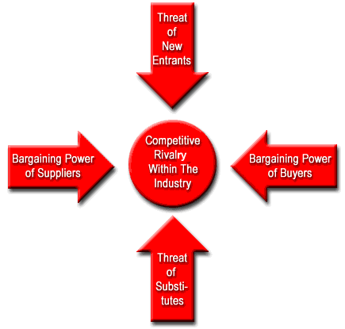
Task Environment

Slide 28
Internal Environment
The internal environment of an organization contains the internal resources (funding, employee, skills, know-how)and possesses internal capabilities (process, management system) and core competencies. The organization needs to conduct the internal analysis figure out loopholes in resources, capabilities, and core competencies.
This enables the firm to devise suitable strategies for closing the gaps in the aforesaid internal components

Slide 29
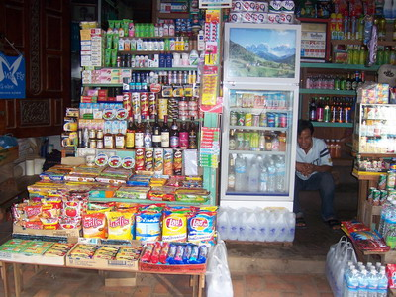
Getting involve in international business
Business, just like a crime has become a unified, global field.
If you are not thinking international,
you are not thinking business management

Slide 30

Why doing international business?
increase profit
expand market
reduce cost by exploiting economies of scale

Slide 31

Basic foreign entry decision
Which markets to enter
When to enter these markets
What is the scale of entry

Slide 32
Which foreign market
Favorable
  Politically stable developed and developing nations
  Free market systems
  No dramatic upsurge in inflation or private-sector debt
Unfavorable
  Politically unstable developing nations with a mixed or command economy or where speculative financial bubbles have led to excess borrowing
Cost
Benefits
Risk

Slide 33
Timing of entry
Advantages in early market entry:
  First-mover advantage.
  Build sales volume.
  Move down experience curve and achieve cost advantage.
  Create switching costs.
    Tie customers to your product.
    Establishment of entry barriers for late entrants
Disadvantages:
  First mover disadvantage - pioneering costs.
  Changes in government policy
  Opportunity to free ride on first mover investment

Slide 34

Scale of entry
Large scale entry
  Strategic Commitments - a decision that has a long-term impact and is difficult to reverse.
  May cause rivals to rethink market entry.
  May lead to indigenous competitive response
Small scale entry
  Time to learn about market.
  Reduces exposure risk.

Slide 35
Strategies for entering the international business
High
Greenfield
Venture
Acquisition
Ownership of
Foreign Operations
Joint Venture
Franchising
Licensing
Exporting
Low
Cost to Enter Foreign Operations
High

Slide 36
Entry mode
Exporting and Importing - The act of selling and buying goods across the countries
Global sourcing (offshoring) – Purchasing materials or labor from around the world wherever it is cheapest
Licensing - A trade agreement in which one company (licensor) allows another company (licensee) to use its company name, products, patents, brands, trademarks, etc. in exchange for a fee or royalty.

Slide 37
Entry mode
Franchising - a form of licensing where a company (franchiser) agrees to provide a franchisee a name, logo, operational guidelines, products, etc, in return for a financial commitment and the agreement to conduct business in accord with the franchiser’s standard of operations.
Joint venture – A specific type of strategic alliance in which the partners agree to form a separate, independent organization for some business purpose.
Direct investment (Greenfield venture)– Directly investing in a foreign country by setting up a separate and independent production facility or office.

Slide 38
Example of global sourcing
Labor-intensive manufactured products produced using low-cost Chinese labor
Call centers staffed with low-cost English speaking workers in the Philippines and India
IT work performed by low-cost programmers in India and Eastern Europe

Slide 39
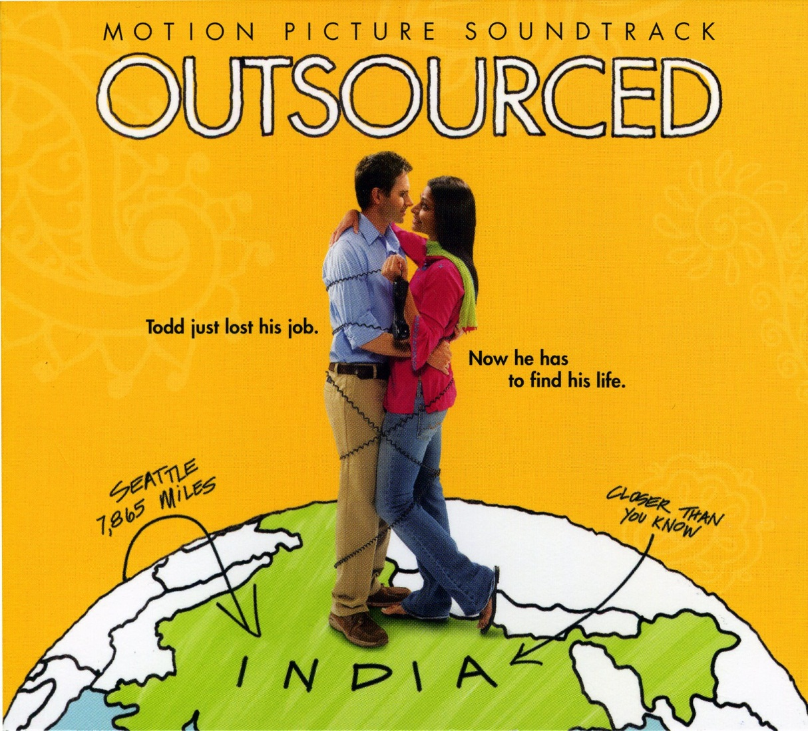

Slide 40
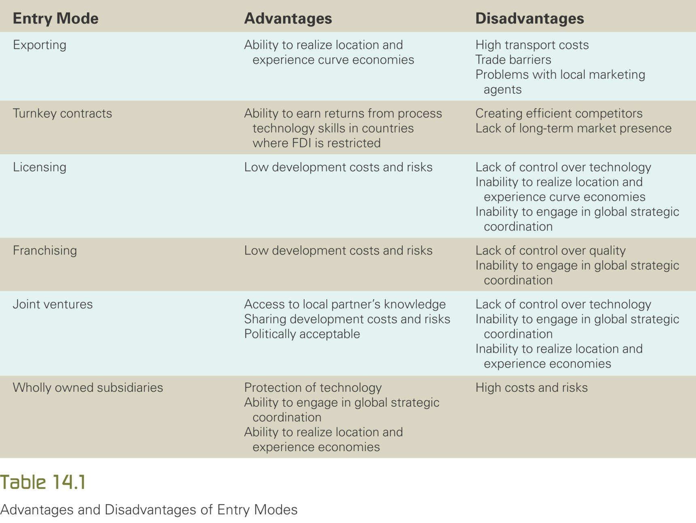
Advantages and disadvantages of entry modes

